Slide 1
Derek Grove Senior Research

Slide 2
Topic Description
My senior research project will be based around the area in computer science called Machine Learning. Specifically, I will be exploring Neural Networks and Genetic Algorithms and applying them to a Minecraft bot. The bot is essentially a shell that has basic functionality in terms of the Minecraft world. I will add a layer of intelligence to this base with the goal of achieving a bot capable of learning and having a basic memory.

Slide 3
Primary Objective
To measure the performance of a Minecraft bot’s(Torchbot) ability to collect supplies and craft basic tools that implements different configurations of the NeuroEvolution of Augmenting Topologies (NEAT) algorithm. (1.5 person-weeks over one semester)

Slide 4
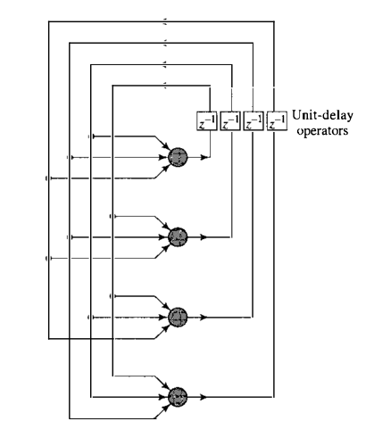
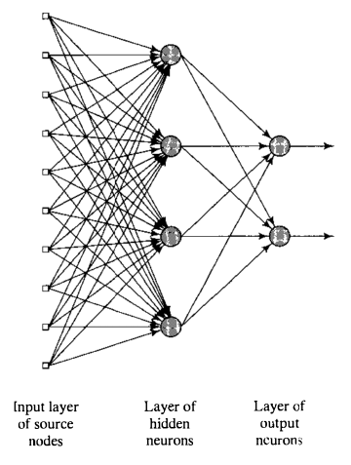
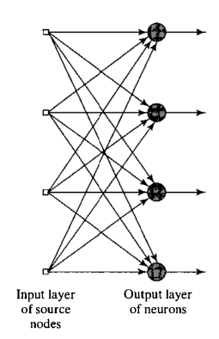
Neural Network Diagrams
Single Layer Feed Forward Multi Layer Feed Forward Recurrent

Slide 5
Specific Neural net Quotes
“the neural networks were intended to mimic a task-specific subsystem of a mammalian or human brain” [1]
“(1) net topology; (2) node characteristics; and (3) training or learning rules” [1]
“takes in information, perceives it, and makes appropriate decisions” [2]
“modify the synaptic weights of the network in an orderly fashion to attain a desired design objective” [2].

Slide 6
Basic Genetic Algorithm
A genetic algorithm is a heuristic search method used in artificial intelligence and computing. It is used for finding optimized solutions to search problems based on the theory of natural selection and evolutionary biology. Genetic algorithms are excellent for searching through large and complex data sets.

Slide 7
Genetic Alg Quotes
“Evolution is, in effect, a method of searching among an enormous number of possibilities for ‘solutions’ [4]”
“investigate the space of feasible solutions of some quantitative problem and … finds the best among the selected ones [4]”
“F maps the search space to the set of real (rational) or integer nonnegative values, i.e. it assigns the nonnegative goodness or fitness value F(x) to each individual solution, or chromosome x [4]”.
“Every chromosome represents a NN and every gene the weight of a synapse connection [12]”

Slide 8
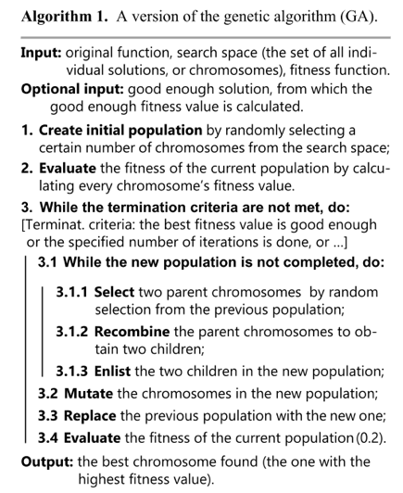
BASIC ALG Diagram

Slide 9
NEAT
NEAT
5 Elements
NeuroEvolution of Augmenting Topologies (NEAT) is a genetic algorithm (GA) for the generation of evolving artificial neural networks (a neuroevolution technique) developed by Ken Stanley in 2002 while at The University of Texas at Austin. It alters both the weighting parameters and structures of networks, attempting to find a balance between the fitness of evolved solutions and their diversity. It is based on applying three key techniques: tracking genes with history markers to allow crossover among topologies, applying speciation (the evolution of species) to preserve innovations, and developing topologies incrementally from simple initial structures ("complexifying"). -Wiki
“evolves both the connection weights and connection topologies of ANNs simultaneously” [11]
“A NEAT individual consists of a series of connection status genes. Each gene represents the connection status of two neurons.” [11]

Slide 10
Algorithms: supports neat section
NE – bases of the other algorithms
Neuroevolution, or neuro-evolution, is a form of artificial intelligence that uses evolutionary algorithms to generate artificial neural networks (ANN), parameters, topology and rules.^{[1]} It is most commonly applied in artificial life, general game playing^{[2]} and evolutionary robotics. A main benefit is that neuroevolution can be applied more widely than supervised learning algorithms, which require a syllabus of correct input-output pairs. In contrast, neuroevolution requires only a measure of a network's performance at a task. For example, the outcome of a game (i.e. whether one player won or lost) can be easily measured without providing labeled examples of desired strategies. Neuroevolution can be contrasted with conventional deep learning techniques that use gradient descent on a neural network with a fixed topology. -Wiki
“The core concept of neuro-evolution is having a pool of neural networks as the population of a genetic algorithm and searching through that pool of behaviors for a network that performs well for a given task.” [1]
Traditionally, neuroevolution techniques started out with a fixed topology and evolved only the weights of the networks which contained fully connected neurons. [1]
“evolves connection weights of
complete neural networks, where each individual in the
population represents a vector with all connection weights of a
network, and each gene of an individual specifies a weight value between two neurons.”[11]

Slide 11
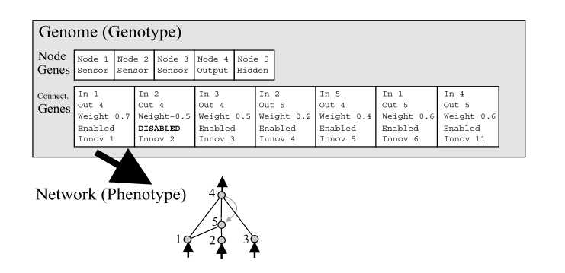


NEAT

Slide 12
Experiment Design/Time
Fitness Function parameters:
1. w = each second survived
2. x = player hit a zombie
3. y = player killed zombie
4. z = zombie hits the player
F = 1w + 20x + 50y - 100z
*likely will need tweaked
Malmo- Microsoft Bot Mod
Enclosed Area of blocks
Alternate between one two and three zombies placed In the world
FIGHT

Slide 13
Specific Neural net Ref’s
[1] E. Micheli-Tzanakou, “Artificial neural networks: An overview,” Netw. Comput. Neural Syst., vol. 22, no. 1–4, pp. 208–230, 2011.
[2] (NEEDS ADDTL INFO) M. Titterington, Neural networks, vol. 2, no. 1. 2010.
[3] A. Sharma, “Understanding Activation Functions in Neural Networks,” The Theory of Everything, 2017. [Online]. Available: https://medium.com/the-theory-of-everything/understanding-activation-functions-in-neural-networks-9491262884e0. [Accessed: 28-Mar-2018].

Slide 14
References(Using):
[6] A. C. Cosma and R. Potolea, “Meta-NEAT, meta-analysis of neuroevolving topologies,” Proc. 18th Int. Conf. Inf. Integr. Web-based Appl. Serv. - iiWAS ’16, pp. 133–140, 2016.
(Scholarly Journal) This paper builds on the NEAT approach to neuro-evolution. Meta-NEAT utilizes an additional genetic algorithm on top of the usual NEAT which learns additional hyper-parameters. This boosts the convergence rate by revealing the most imporatant aspects of the evolution and helps speed things up. Using the complex fitness function described seems to have been successful and may help speed up the learning.

Slide 15
References(using)
[4] J. Hižak and R. Logožar, “AN OVERVIEW OF THE GENETIC ALGORITHM AND ITS USE FOR FINDING EXTREMA ─ WITH IMPLEMENTATIONS IN MATLAB PRIKAZ GENETIČKOG ALGORITMA I NJEGOVA UPORABA ZA NALAŽENJE EKSTREMA — S IMPLEMENTACIJAMA U MATLABU,” vol. 6168, 1848.

Slide 16
References(Using) Continued:
[7] M. Shi, “An empirical comparison of evolution and coevolution for designing artificial neural network game players,” Proc. 10th Annu. Conf. Genet. Evol. Comput., pp. 379–386, 2008.
(Scholarly Journal) In this paper, 2 neuroevolutionary techniques are explored, NE and NEAT and compared with 3 neurocoevolutionary techniques: SANE, ESP, and EEC. They find that the neurocoevolutionary methods seem to work more efficiently and find that fully connected networks sometimes generate white noise. This paper may help in the decision-making of which neural framework to use.

Slide 17
References(Using) Continued:
[5] S. Zanetti and A. El Rhalibi, “Machine learning techniques for FPS in Q3,” Proc. 2004 ACM SIGCHI Int. Conf. Adv. Comput. Entertain. Technol. - ACE ’04, pp. 239–244, 2004.
(Scholarly Journal) This paper discusses the use of Genetic Algorithms stacked with a Feed Forward Multi-layer Neural Network to teach an AI to play Quake 3. What is unique about this paper is that they used examples of humans playing the game to teach the AI the basics of how to play in attempt to speed up the learning curve. Although the bot in this experiment did not reach an acceptale playing level, aspects of the experiment may be reproducable for my research.

Slide 18
References(Using)
[8] K. O. Stanley and R. Miikkulainen, “Evolving Neural Networks through Augmenting Topologies,” Evol. Comput., vol. 10, no. 2, pp. 99–127, 2002.

Slide 19
Deprecated Items(This point forward)

Slide 20
References(OLD) CoNTINUED:
[2] A. I. Esparcia-Alcazár, A. Martínez-García, A. M. Mora, J. J. Merelo, and P. García-Sánchez, “Genetic evolution of fuzzy finite state machines to control bots in a first-person shooter game,” Proc. 12th Annu. Conf. Genet. Evol. Comput. - GECCO ’10, p. 829, 2010.
(Scholarly Journal) This work uses steady state algorithms to evolve bot behaviors. They employ four fitness functions which may become relevant to stack upon a neural network. The basis is on kills, lifespan, items collected, and a combination of the 3. Results are positive with the bots employing these algorithms coming out on top of the standard provided ones.

Slide 21
References(NOT Using) Continued:
[5] M. Hausknecht, P. Khandelwal, R. Miikkulainen, and P. Stone, “HyperNEAT-GGP: A HyperNEAT-based Atari General Game Player,” Proc. fourteenth Int. Conf. Genet. Evol. Comput. Conf., pp. 217--224, 2012.
(Scholarly Journal) Uses the hyperNEAT approach to evolve policies for gameplay based on little to no domain knowledge. The goal was to create an agent capable of transitioning between different tasks which may be helpful in the Minecraft scenario. Results showed that they greatly improved learning benchmark scores. If nothing else, another implementation of hyperNeat is useful.

Slide 22
References(NOT Using) ContinueD:
[3] I. Gabriel, V. Negru, and D. Zaharie, “Neuroevolution based multi-agent system for micromanagement in real-time strategy games,” Proc. Fifth Balk. Conf. Informatics - BCI ’12, p. 32, 2012.
(Scholarly Journal) This paper discusses the rtNEAT to create customized neural nets. The goal was to create a multi-agent system that learn and adapt to gameplay. The MAS was successful in micromanagement but may be built upon to use for things such as terrain analysis and economic planning which could be adapted to my project.

Slide 23
References(Not USing) Continued:
[4] J. Gauci and K. O. Stanley, “Evolving neural networks for geometric game-tree pruning,” Proc. 13th Annu. Conf. Genet. Evol. Comput. - GECCO ’11, p. 379, 2011.
(Scholarly Journal) This paper discusses the engine behind many computer opponents called game tree search which essentially is a tree of possible future states and options that can be made. They dive into the idea that "pruning" the search tree to keep things optimized is perhaps one of the most important things.Using an algorithm called hyper-NEAT Cake which includes a GGTP algorithm can be highly effective. This may help my bot make decisions based on future states. If not, it may help in further understanding of NEAT usage.

Slide 24
References(NOT Using) Continued:
[6] N. Justesen and S. Risi, “Continual online evolutionary planning for in-game build order adaptation in starcraft,” GECCO 2017 - Proc. 2017 Genet. Evol. Comput. Conf., pp. 187–194, 2017.
(Scholarly Journal) This focus evolves around the idea of building: what units to build and what units to use. An idea is introduced called Continual Online Evolutionary Planning which aims at adapting to an evolving environment and deciding what things should be build in the right scenarios. Adapting to new scenarios and building are two of the most fundamental parts of minecraft so this may be of some use.

Slide 25
References(NOT Using) Continued:
[8] V. Makris and D. Kalles, “Evolving Multi-Layer Neural Networks for Othello,” Proc. 9th Hell. Conf. Artif. Intell. - SETN ’16, pp. 1–6, 2016.
(Scholarly Article) This paper discusses the use of neural networks to teach an agent to learn how to play othello. Four different architectures are used: two weighted, one fully connected, and one spatial. Using coevolution, a few evolved to play at the master level. The different network architectures will be useful as well as the strategies used to construct and compare them.

Slide 26
References(NOT Using) Continued:
[9] R. G. Price and S. D. Goodwin, “Synthesizing neural networks for learning in games,” Proc. 2008 Conf. Futur. Play Res. Play. Share - Futur. Play ’08, p. 189, 2008.
(Scholarly Journal) This paper is based on agents navigating through a random “board” to accomplish their goals in different environments. RtNEAT was the neuro network ideology used while NERO is the base for the virtual bots. The major takeaway from this is the navigation through different environments part. Using their experience and methodology may assist in better navigation in my project.

Slide 27
References(NOT Using) Continued:
[10] J. Schrum and R. Miikkulainen, “Solving Interleaved and Blended Sequential Decision-Making Problems through Modular Neuroevolution,” Proc. 2015 Genet. Evol. Comput. Conf. - GECCO ’15, pp. 345–352, 2015.
(Scholarly Journal) This paper discusses the issue of blended tasks that mix different policy areas (ex offense and deffense). To address this multitasking problem, they present the MM-NEAT neuroevolution framework. Using the modular evolution method, the highest scores ever in this game were produced. Addressing multitasking could be useful in the Minecraft world.

Slide 28
References(NOT Using) Continued:
[7] J. E. Laird, “It Knows What You’re Going To Do: Adding Anticipation to a Quakebot,” Proc. fifth Int. Conf. Auton. agents - AGENTS ’01, pp. 385–392, 2001.
(Scholarly Journal) The bot in this paper uses hierarchical task decomposition to organize knowledge and action possibilities. It analyzes its own tactics to predict others. It becomes aware of the world and is able to build an internal map of its surroundings. That is the major piece of this article that I intend to take away. It also provides a general analysis on how a bot can analyze and predict.

Slide 29
ALGORITHMS (Deprecated)
rtNEAT
n 2003 Stanley devised an extension to NEAT that allows evolution to occur in real time rather than through the iteration of generations as used by most genetic algorithms. The basic idea is to put the population under constant evaluation with a "lifetime" timer on each individual in the population. When a network's timer expires its current fitness measure is examined to see whether it falls near the bottom of the population, and if so it is discarded and replaced by a new network bred from two high-fitness parents. A timer is set for the new network and it is placed in the population to participate in the ongoing evaluations. -Wiki
“Members of the population are constantly evaluated and are replaced in the population by creating a new individual after a certain number of game ticks or if the unit that is represented by a member of the population dies” [3]
“A problem of NN is that as we start to add more neurons to their topology the amount of neural computation also increases. By using rtNEAT to evolve the NN topology we eliminate this problem and are able to use NN topologies tailor made to the given task of unit micromanagement.” [3]

Slide 30
Algorithms (Deprecated)
hyperNEAT
HyperNEAT is specialized to evolve large scale structures. It was originally based on the CPPN theory and is an active field of research. -Wiki
“Hyper- NEAT’s encoding allows it to take advantage of geometric regularities present in many board and 2D games” [5]
“because the CPPN is aware of domain geometry, the ANN it encodes implicitly contains knowledge about geometric relationships present in a given domain.” [5]
“The advantage of this approach is that it can
exploit the geometry of the task by mapping its regularities onto the topology of the network, thereby shifting problem difficulty away from dimensionality to underlying problem structure.”[1]

Slide 31
References (DEPRECATED):
[0] K.-T. Förster, M. König, and R. Wattenhofer, “A Concept for an Introduction to Parallelization in Java,” Proc. 17th Annu. Conf. Inf. Technol. Educ. - SIGITE ’16, vol. 34, no. 3, pp. 169–169, 2016.
[0] J. Hagelbäck and S. Johansson, “Using multi-agent potential fields in real-time strategy games,” Proc. 7th Int. Jt. Conf. Auton. agents multiagent Syst., vol. 2, no. Aamas, pp. 631–638, 2008.
[0] R. Kadlec, O. Burkert, and C. Brom, “Creating game bots in a few easy steps,” Proc. 13th Int. MindTrek Conf. Everyday Life Ubiquitous Era - MindTrek ’09, p. 222, 2009.
[0] R. Miikkulainen and Risto, “Evolving neural networks,” Proc. 12th Annu. Conf. comp Genet. Evol. Comput. - GECCO ’10, p. 2441, 2010.
[0] R. Morosan, Mihail; Poli, “Speeding up Genetic Algorithm-based Game Balancing using,” Gecco 2017, vol. 5, pp. 91–92, 2017.
[0] C. Salge, C. Lipski, T. Mahlmann, and B. Mathiak, “Using genetically optimized artificial intelligence to improve gameplaying fun for strategical games,” Proc. 2008 ACM SIGGRAPH Symp. Video games - Sandbox ’08, vol. 1, no. 212, p. 7, 2008.
[0] J. Schrum and R. Miikkulainen, “Evolving multimodal behavior with modular neural networks in Ms. Pac-Man,” Proc. 2014 Conf. Genet. Evol. Comput. - GECCO ’14, pp. 325–332, 2014.
[0] P. D. Sørensen, J. M. Olsen, and S. Risi, “Interactive Super Mario Bros Evolution,” Proc. 2016 Genet. Evol. Comput. Conf. Companion - GECCO ’16 Companion, no. Figure 1, pp. 41–42, 2016.

