Slide 1
Measuring the performance of the NEAT algorithm in Minecraft
Derek Grove

Slide 2
Problem Description
Will the NEAT algorithm produce an acceptable result when applied to a Minecraft bot?

Slide 3
Background Areas:
Neural Network Basics
Genetic Algorithm Basics
The NEAT Algorithm
Minecraft

Slide 4
Neural Networks
Network Topology
Nodes
Activation Function/Learning Rules

Slide 5
Topology
-Describes the number of layers, the number of nodes in each layer, and the connections of the nodes of each layer
Input Layers – take in the raw data
Hidden layers- Each transform the data and pass it on
Output layers- provide the determined output
Notes:
Example could be a machine that recognizes hand written numbers
Input: pixels with each value set as the gray scale value
Hidden layers: layer that would recognize/separate different parts of the numbers out such as the loops in an 8
Output Layer: the number 0 - 9

Slide 6
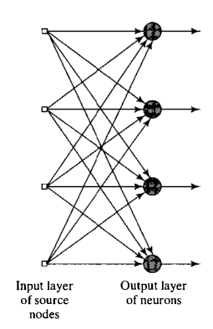
Single
[2]
Feed Forward
No hidden layers
Inputs are mapped to Outputs
Notes:
Simplest Network type
-not really used that much

Slide 7
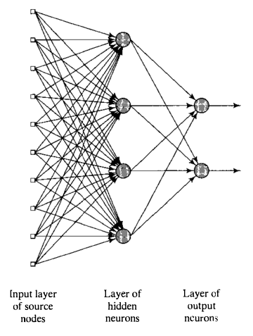
Multi
[2]
Feed Forward
One to many hidden layers of neurons

Slide 8
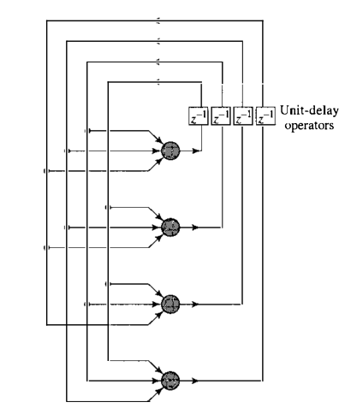
Recurrent
[2]
Output of layers can also function as input to itself

Slide 9
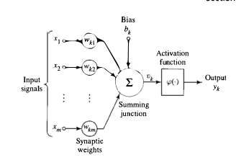
Node/Neuron
Simple elements that receive a series of inputs, process the inputs by calculating a weighted sum, and provide a calculated output
Can be thought of as a function transforming data
[2]
Notes:
Weighted sum many times with the sigmoid activation function which maps to values of 0 to 1
Takes values of previous nodes(activations) and values of the connection weights plus a bias
a1 = W x a0 + b
Back to handwritten numbers example:
Receive the grayscale weights and
Activation Function on next slide...

Slide 10
Functions/Rules/Training
Activation Function- converts the input signals from previous neurons to an output signal for the next layer
Training – teaching the network to output the correct values
Cost- used to measure the “correctness” of the network
Learning Rules- way to modify the weights of the network to attain a desired output (minimizing a cost function)
-Backpropagation
Notes:
COST function: add up the squares of differences between trash outputs and what you want them to have
sum is small when the network is confident in its classification, large if not
Average of all training examples is measure of the network
Backpropagation- algorithm to determine how to nudge weights and bias’s of the network to create the most rapid decrease in the cost for one training example
-gradient decent is doing this over all of the training examples, mini batches is more efficient

Slide 11
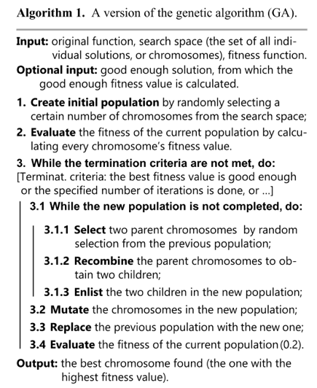
Genetic Algorithms
Genes/Chromosomes
Population/Generation
Fitness Function/Selection
Crossover/Mutation
[4]

Slide 12
Genes/Chromosomes
Genes are a group of parameters or variables
Chromosomes are a sequence of genes that create a solution
-often thought of as an individual
Notes:
Many times in computer science, we represent the genes as binary so 0 and 1
-our robotics example we used basic movements
Chromosome using binary would be a string such as 010101101
- robotics an individual or solution or chromosome, was a sequence of basic movements

Slide 13
Population/Generation
The set of all solutions/individuals
Initial population many times randomly generated
Generations refer to the iterative sets of newly created offspring
Notes:
Binary- randomized strings
Robotics- randomized sets of directions/movements

Slide 14
Fitness Function/Selection
Function to score individuals based on how close their solution is to solving the given problem
Select individuals with higher fitness values to pass on their genes
-referred to as the parents
Notes:
Binary- say you’re looking for all 1’s in a string
an individual of 110111 would have a higher fitness score than 000000
Robotics- we generally used how much distance it moved towards the exit of the maze
Once initial population is scored…
If you select two strings with all zeros to proceed with and be the basis for the next population, you will only get more strings of zeros when bred

Slide 15
Crossover/Mutation
Crossover/Breeding involves taking genes from each of the parents and combining/exchanging to create a new individual/solution
Mutation involves modifying 1 to N genes of an individual
These are used to create the next generation of offspring
Run loop until convergence
Notes:
Few ways of changing the population
Crossover:
Binary: You could pick a spot in the string, say the fourth digit, and swap everything that follows between parent 1 and parent 2
Robotics: Swapping out
Mutation:
Binary: pick a digit or two and flip the bits so zero to one and one to zeros
Robotics: just picked a movement direction and randomly replaced it
May bring some of old population through to the next generation
Convergence: does not produce offspring which are significantly different from the previous generation

Slide 16
NEAT
Neuro-Evolution of Augmenting Topologies
“A pool of neural networks as the population of a genetic algorithm and searching through that pool of behaviors for a network that performs well for a given task”[6]
Essentially a GA where each network is an individual
Notes:
Did not want to use a quote here but it summed everything up pretty well

Slide 17
NEAT
Genomes
Mutations
Crossover
Speciation

Slide 18
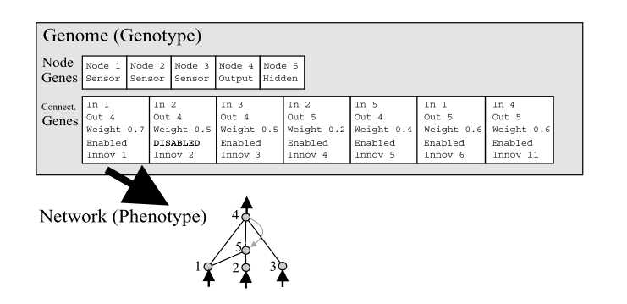
Genomes
Two types:
Node Genes
Connection Genes
[8]
Notes:
These are the basic building blocks as the genes are in the genetic algorithm
Node genes are genes that represent nodes in the network
Made up of:
1. Node Number
2. Type: Sensor/Input, Hidden, Output
Connection genes are genes that represent the connections paths in the network
Made up of:
1. Node in
2. Node out
3. The weight of the connection
4. enabled or disabled - disabled if there is no direct path/ other nodes make up for it
5. Innovation number - used for cross-over
The genes all combined represent what we considered a chromosome or individual in the base genetic algorithm

Slide 19
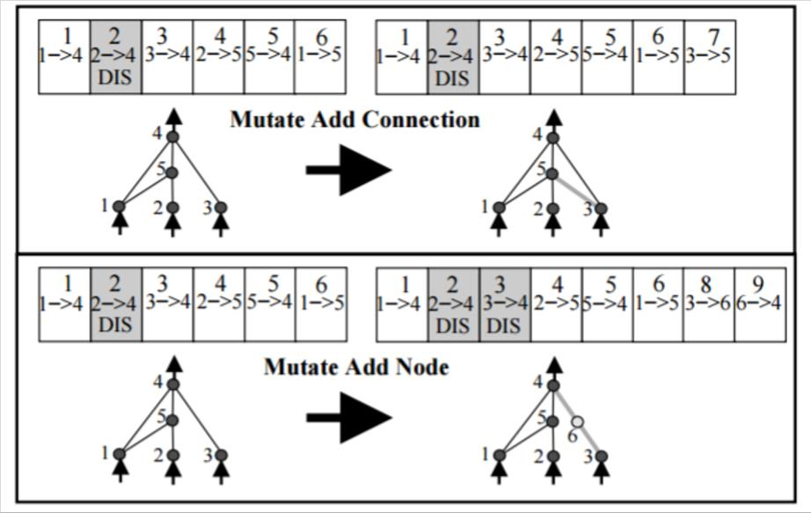
Mutations
Three options:
Add Connection
Add Node
Change Connection Weight
[8]
Notes:
Backpropagation is not used in NEAT***
It instead relies on the evolution of these networks via the mutations
More complicated than vanilla GA but the basis for change in NEAT
Add connection randomly creates a new connection gene between two previously unconnected nodes and adds it to the network
Add node randomly splits an existing connection and creates a node gene.
-the old connection is disabled and two new connections/connection genes are added to the genome
-the connection between the first node and the new node is given a weight of one and the new node to the second is
given the deleted connection’s original weight
Change connection weight- weights of a connection randomly change

Slide 20
Connection Weight Change Options
1. completely replace it with a new random value
2. change the weight by some percentage
3. add or subtract a random number between 0 and 1 to/from the weight.
4. Change the sign of a weight.
5. swap weights on a single neuron
Notes:
Same as used in basic neuro evolution
Most like will use the first option

Slide 21
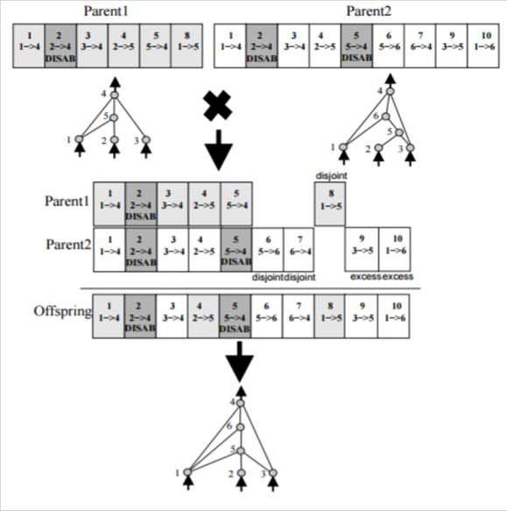
Crossover
Global Innovation Variable
Fitness Score
Cross breeding Networks
[8]
Notes:
Each time a new gene appears via a mutation, it is marked with an innovation number which is then incremented
-represents the chronology of the network
Just as in plain GA, each network is given a fitness scoring based on its performance
Crossover of two parents line up the innovation numbers
- genes that match are randomly chosen to move to the child network
- if they do not match, the genes are inherited from the more fit parent
- if they are of equal fitness, the genes are randomly selected to be inherited
disjoint: inside other parents innovation range
excess: outside other parents innovation range
Disabled genes may become active again
Reproduce by eliminating lowest members of species
Entire population is then replaced by the remaining members

Slide 22
Speciation
Similar networks are clustered so that they compete with their own niche instead of whole population
Competition/mating restricted to networks within the same species
Allows new ideas to be given time to reach potential
Notes:
REASONS FOR SPECIATION:
smaller structures optimize faster than larger structures
adding nodes and connections usually initially decreases the fitness of the network
recently modified structures have smaller change of survival even thought they might have key solutions in them

Slide 23

Speciation continued
Topological similarity
[8]
Notes:
Can divide the population into species based on topological similarity which is based on the innovation numbers
Compatibility distance:
Lowercase delta means distance
E is number of excess genes
D is number of disjoint genes
W is the average weight differences of the matching genes
c123 adjust the importance of the different factors
N is the number of genes in the larger network but can be 1 if both are small
If a network’s distance to a randomly chosen member of the species is less than delta, it is placed in that species.
Each individual is placed into first species where this is satisfied so no individual is in more than one
If an individual is not compatible with any, a new species is created
“A given genome g in the current generation is placed in the first species in which g is compatible with the representative genome of that species…if g is not compatible with any existing species, a new species is created with g as its representative [8]”

Slide 24

Speciation continued
Reproduction Mech.
Explicit fitness sharing
[8]
Notes:
Organisms must share fitness with their niche so that one species doesn’t grow too large and take over
Adjusted fitness is calculated according to an individuals distance from every other individual in the population
f prime i = adjusted fitness of individual I
j = is some other individual
sh(distance(I, j)) is set to zero when distance is above threshold and 1 elsewise
So naturally the summation reduces to the number of individuals in the same species as I
Species are assigned a different number of offspring based on the proportion of the sum of adjusted fitness of its members

Slide 25
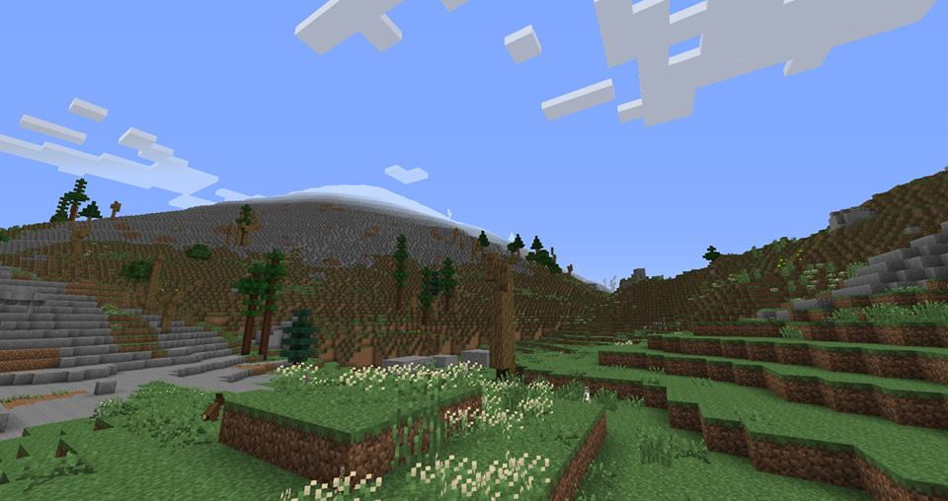
Minecraft
Game basics
Why it is a good choice for experimentation purposes?
[15]
Notes:
Game Basics:
World built of many different types of blocks
Can be broken down to gather resources or built up to create structures
Resources can be used to craft items that further enhance the game experience
Experimentation Purposes:
Customizable world
- environment size
- resource amounts/locations
- lots of basic open source bots to work off of

Slide 26
Malmo
(Built by Microsoft)
Allows basic functionality such as moving, turning, attacking, block placement
Allows custom environment creation
-can create a small flat world
-can draw primitive shapes out of blocks
Allows inventory manipulation and item equip/use

Slide 27
Solution Description
Tools: Java Plugin with Eclipse
Project Malmo
Implement: NEAT algorithm
Place the bot equipped with a sword into environments with varying levels of zombies
Measure the survival time that the bot achieves
Measure the amount of damage inflicted to enemies

Slide 28
Objective Description
To measure the performance of a Minecraft bot’s(Malmo) ability to survive environments with varying levels of zombies using the NeuroEvolution of Augmenting Topologies (NEAT) algorithm. (1.5 person-weeks over one semester)

Slide 29
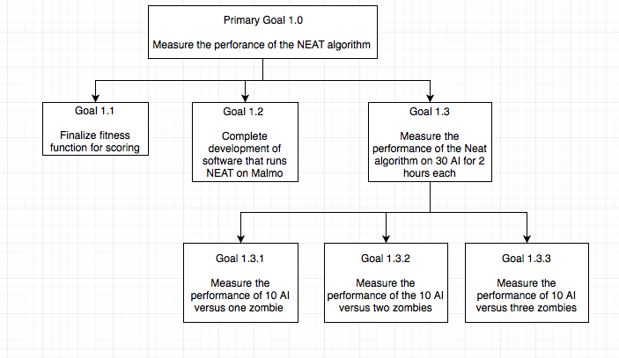
Goal Tree

Slide 30
Hypothesis
The AI will obtain the highest score in the smallest period of time in the environment with one zombie.

Slide 31
Experiment Design: Measurements
Points of Measurement:
1. Time survived
2. Damage inflicted on enemy zombies

Slide 32
Experiment Design: Fitness Function
Fitness Function parameters:
1. w = each second survived
2. x = player hit a zombie
3. y = player killed zombie
4. z = zombie hits the player
F = 1w + 20x + 50y - 100z
*likely will need tweaked

Slide 33
Experiment Design: Baselines
To measure how effective the NEAT algorithm actually is, create comparison players to score:
1. Random player: Button Mashing
2. Rule Based: (examples)
-Attack if zombie within x space
-If zombie seen to side, turn 90 toward zombie
-If damage taken, turn away from zombie and run
To create an overall timeline of the AI evolution, record the score of the first individual of each generation

Slide 34
Experiment Design: Block Design
Factors | Values
Environment Size | {Small, Medium, Large}
Zombie Count -Randomly Placed In Environment | {One, Two, Three}
 |  | Zombie Count
 |  | One | Two | Three
Environment Size | Standard | X | X | X
Notes:
May change environment size to be just two sizes

Slide 35
Experiment Design: Time Estimation
Run 30 (10 for each zombie count scenario) AI in a predefined Minecraft setting for 2 hours each:
-10 at a time: 3 testing periods * 2 hours = 6 hours
-15 at a time: 2 testing periods * 2 hours = 4 hours
Training time caps:
-Each AI will be stopped at 2 hours into a session
-If an AI’s generation score does not improve for a 30 minute period, the training for that particular AI will be halted
Notes:
5 per environment/zombie pairing

Slide 36
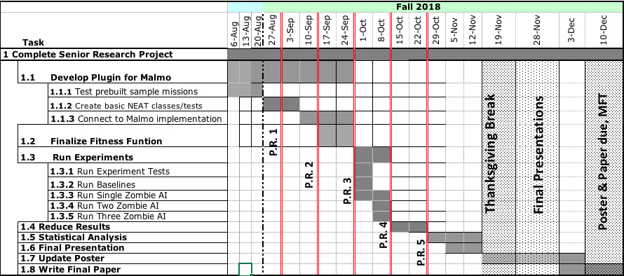
Schedule

Slide 37
References
[2] M. Titterington, Neural networks, vol. 2, no. 1. 2010.
[4] J. Hižak and R. Logožar, “AN OVERVIEW OF THE GENETIC ALGORITHM AND ITS USE FOR FINDING EXTREMA ─ WITH IMPLEMENTATIONS IN MATLAB PRIKAZ GENETIČKOG ALGORITMA I NJEGOVA UPORABA ZA NALAŽENJE EKSTREMA — S IMPLEMENTACIJAMA U MATLABU,” vol. 6168, 1848.
[6] A. C. Cosma and R. Potolea, “Meta-NEAT, meta-analysis of neuroevolving topologies,” Proc. 18th Int. Conf. Inf. Integr. Web-based Appl. Serv. - iiWAS ’16, pp. 133–140, 2016.
[8] K. O. Stanley and R. Miikkulainen, “Evolving Neural Networks through Augmenting Topologies,” Evol. Comput., vol. 10, no. 2, pp. 99–127, 2002.
[15] https://www.google.com/url?sa=i&rct=j&q=&esrc=s&source=images&cd=&cad=rja&uact=8&ved=2ahUKEwj95LeGpczaAhVSMd8KHVT6CJwQjB16BAgAEAQ&url=http%3A%2F%2Flotrminecraftmod.wikia.com%2Fwiki%2FThe_Lonely_Mountain&psig=AOvVaw0Nz_ffMQIqtAvbzlvLiivk&ust=1524431739244650

