Slide 1
Using SVG in Web Pages
Intent Scale with zoom, Simple image updates
Alternatives Fonts, Raster images of different sizes
Motivation Raster images often do not scale well, Updating raster images often takes more bandwidth
Applicability Icons, Buttons, Backgrounds, GIS overlays, Trees, Graphs

Slide 2
We'll focus on three use cases
As an HTML Image Source
<img src=”images/simple-box.svg”/>
As a background image
<div class=”interesting”/>
.interesting: url(images/simple-box.svg);
Directly in the markup
<svg><rect width="18" height="12" x="0" y="0" style="fill:#800000;fill-opacity:1;stroke:none" /></svg>

Slide 3
But First, What About Browser Support
Support in modern browsers after IE8
As image http://caniuse.com/#feat=svg-img
As background http://caniuse.com/#feat=svg-css
Inline http://caniuse.com/#feat=svg-html5
SVG Fonts http://caniuse.com/#feat=svg-fonts

Slide 4
But Sometimes...
Firefox (< 24) rendering does not scale in the same way as other browsers, when used in CSS.
It creates a raster image from the SVG based on it's size and then places the image on the page
This can cause fuzzy edges in many cases
Workaround is available... May use lots of CPU cycles, careful...
Fixed in FF24 https://bugzilla.mozilla.org/show_bug.cgi?id=600207

Slide 5
As an Image Source
Simple for cases where the same SVG is rendered for all resolutions, e.g. responsive design
Potential Drawbacks in some usage cases
  Duplicate image src
    Can be handled with LESS, SASS
  Responsive Sites may download multiple images
    But only in cases where SVG is different

Slide 6
Examples Using as an Image Source
<img src="yourfallback.jpg" />
IE9 or above
Or as an object, html5
<object data="your.svg" type="image/svg+xml">
<img src="yourfallback.jpg" />
</object>
Example:
http://jsfiddle.net/derekjwilliams/ebTN9/11/show
W3C Link:
http://www.w3.org/Graphics/SVG/IG/resources/svgprimer.html#SVG_in_HTML

Slide 7
SVG as a background image
Pretty simple to place an object
http://jsfiddle.net/derekjwilliams/7DYdT/4/
Note the background repeat and height.
Can also combine images simple back drop
http://jsfiddle.net/derekjwilliams/7DYdT/5/

Slide 8
SVG in line
Very simple example
http://jsfiddle.net/derekjwilliams/euVvb/1/

Slide 9
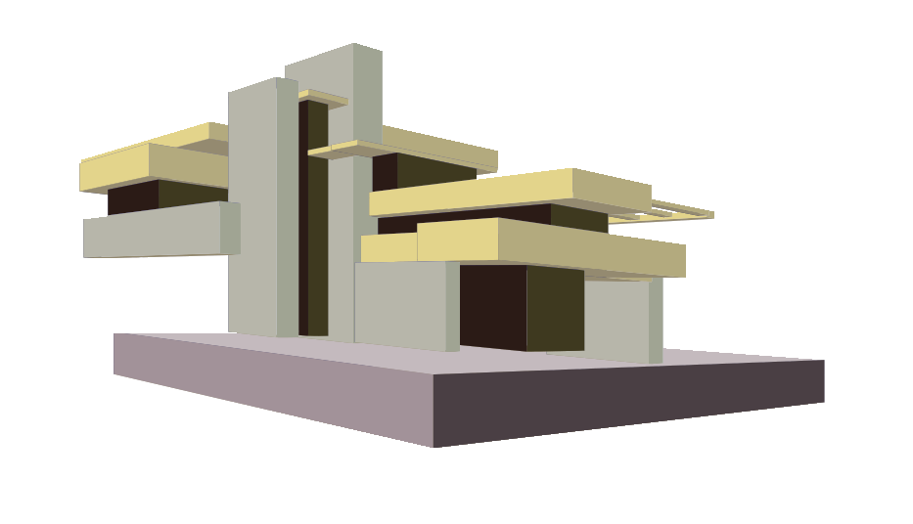
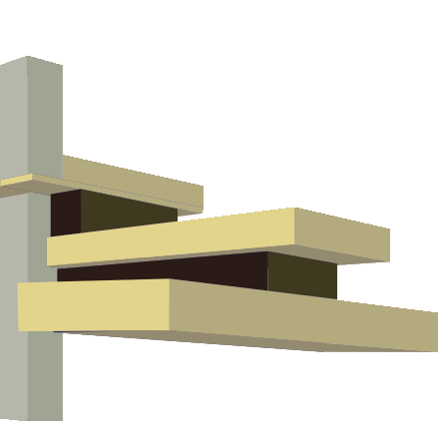
Why use different SVG images
Similar issues as fonts
  Shape of letters with small font size are not simply scaled down versions of larger sizes
In the same way a small SVG image may not be the same as a larger version, e.g. icon, tile, larger abstraction.

Slide 10
Smaller Icons may have different needs
For a simple small icon a scaled down version of Falling Waters is not legible, so something simpler may be appropriate

Slide 11
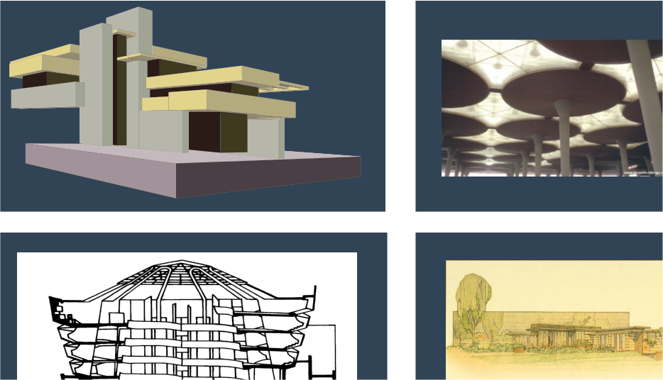
Larger Version may have more details

Slide 12
One more thing...
D3 JS Data Driven Documents
https://github.com/mbostock/d3/wiki/Gallery
Cubism (based on d3)
http://square.github.io/cubism/
Xcharts (based on d3)
http://tenxer.github.io/xcharts/

