Slide 1

PHENOLOGICAL CHARACTERIZATION AND MODELING OF DIVERSE LENTIL (Lens culinaris Medik.) GERMPLASM GROWN IN MULTIPLE ENVIRONMENTS
Derek M. Wright, Sandesh Neupane, Taryn Heidecker, Teketel Haile, Clarice Coyne, Sripada Udupa, Eleonora Barilli, Diego Rubiales, Tania Gioia, Reena Mehra, Ashutosh Sarker, Rajeev Dhakal, Babul Anwar, Debashish Sarker, Albert Vandenberg, and Kirstin E. Bett
November 7, 2019

Slide 2
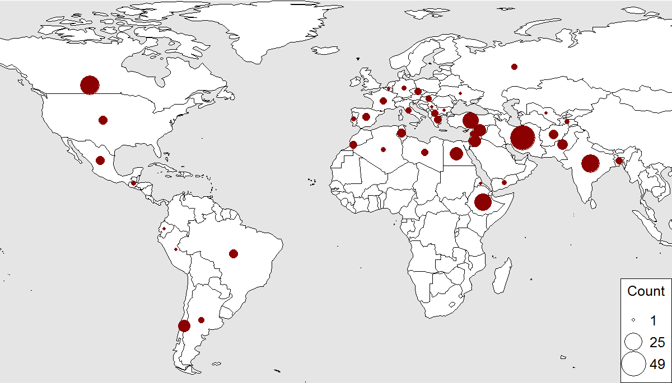
Lentil Diversity Panel
LDP: 324 accessions representing global genetic diversity

Slide 3
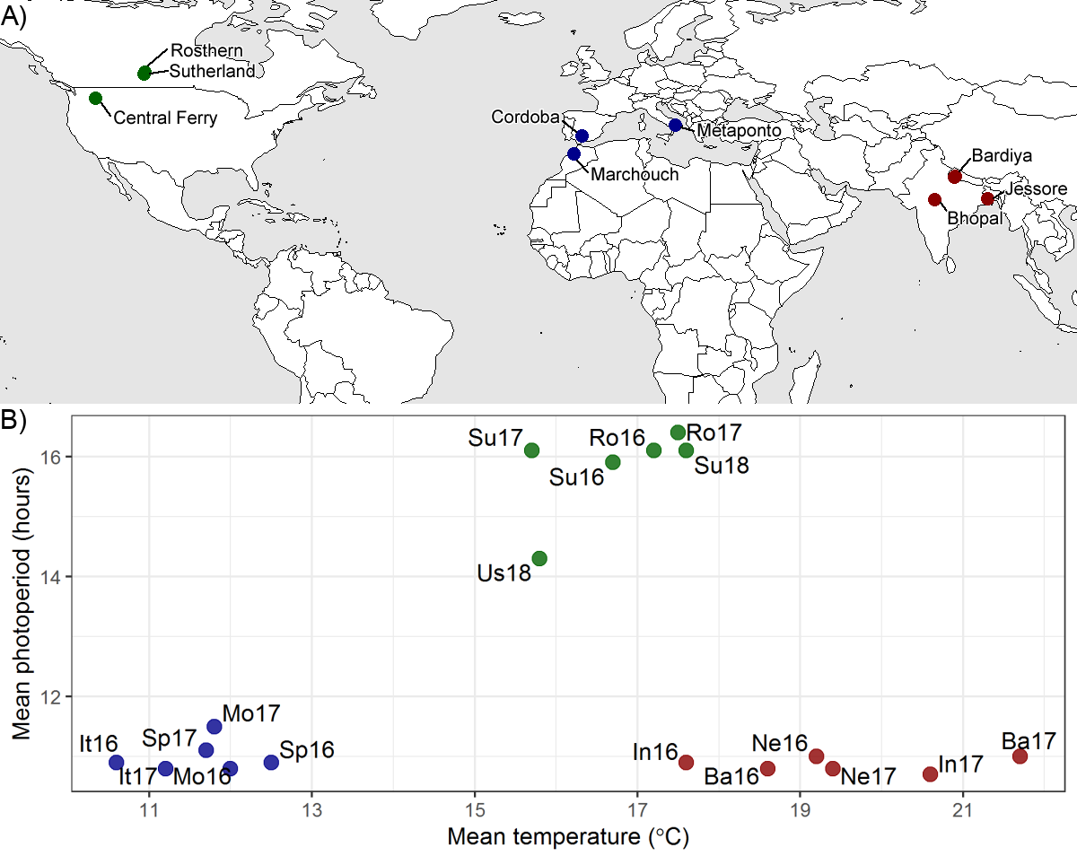
Field Trials

Slide 4
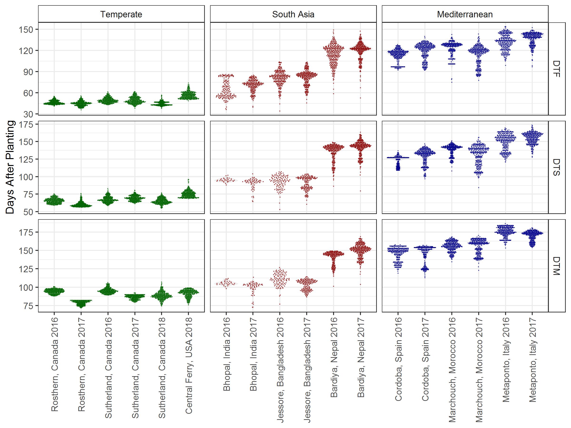
Phenology

Slide 5
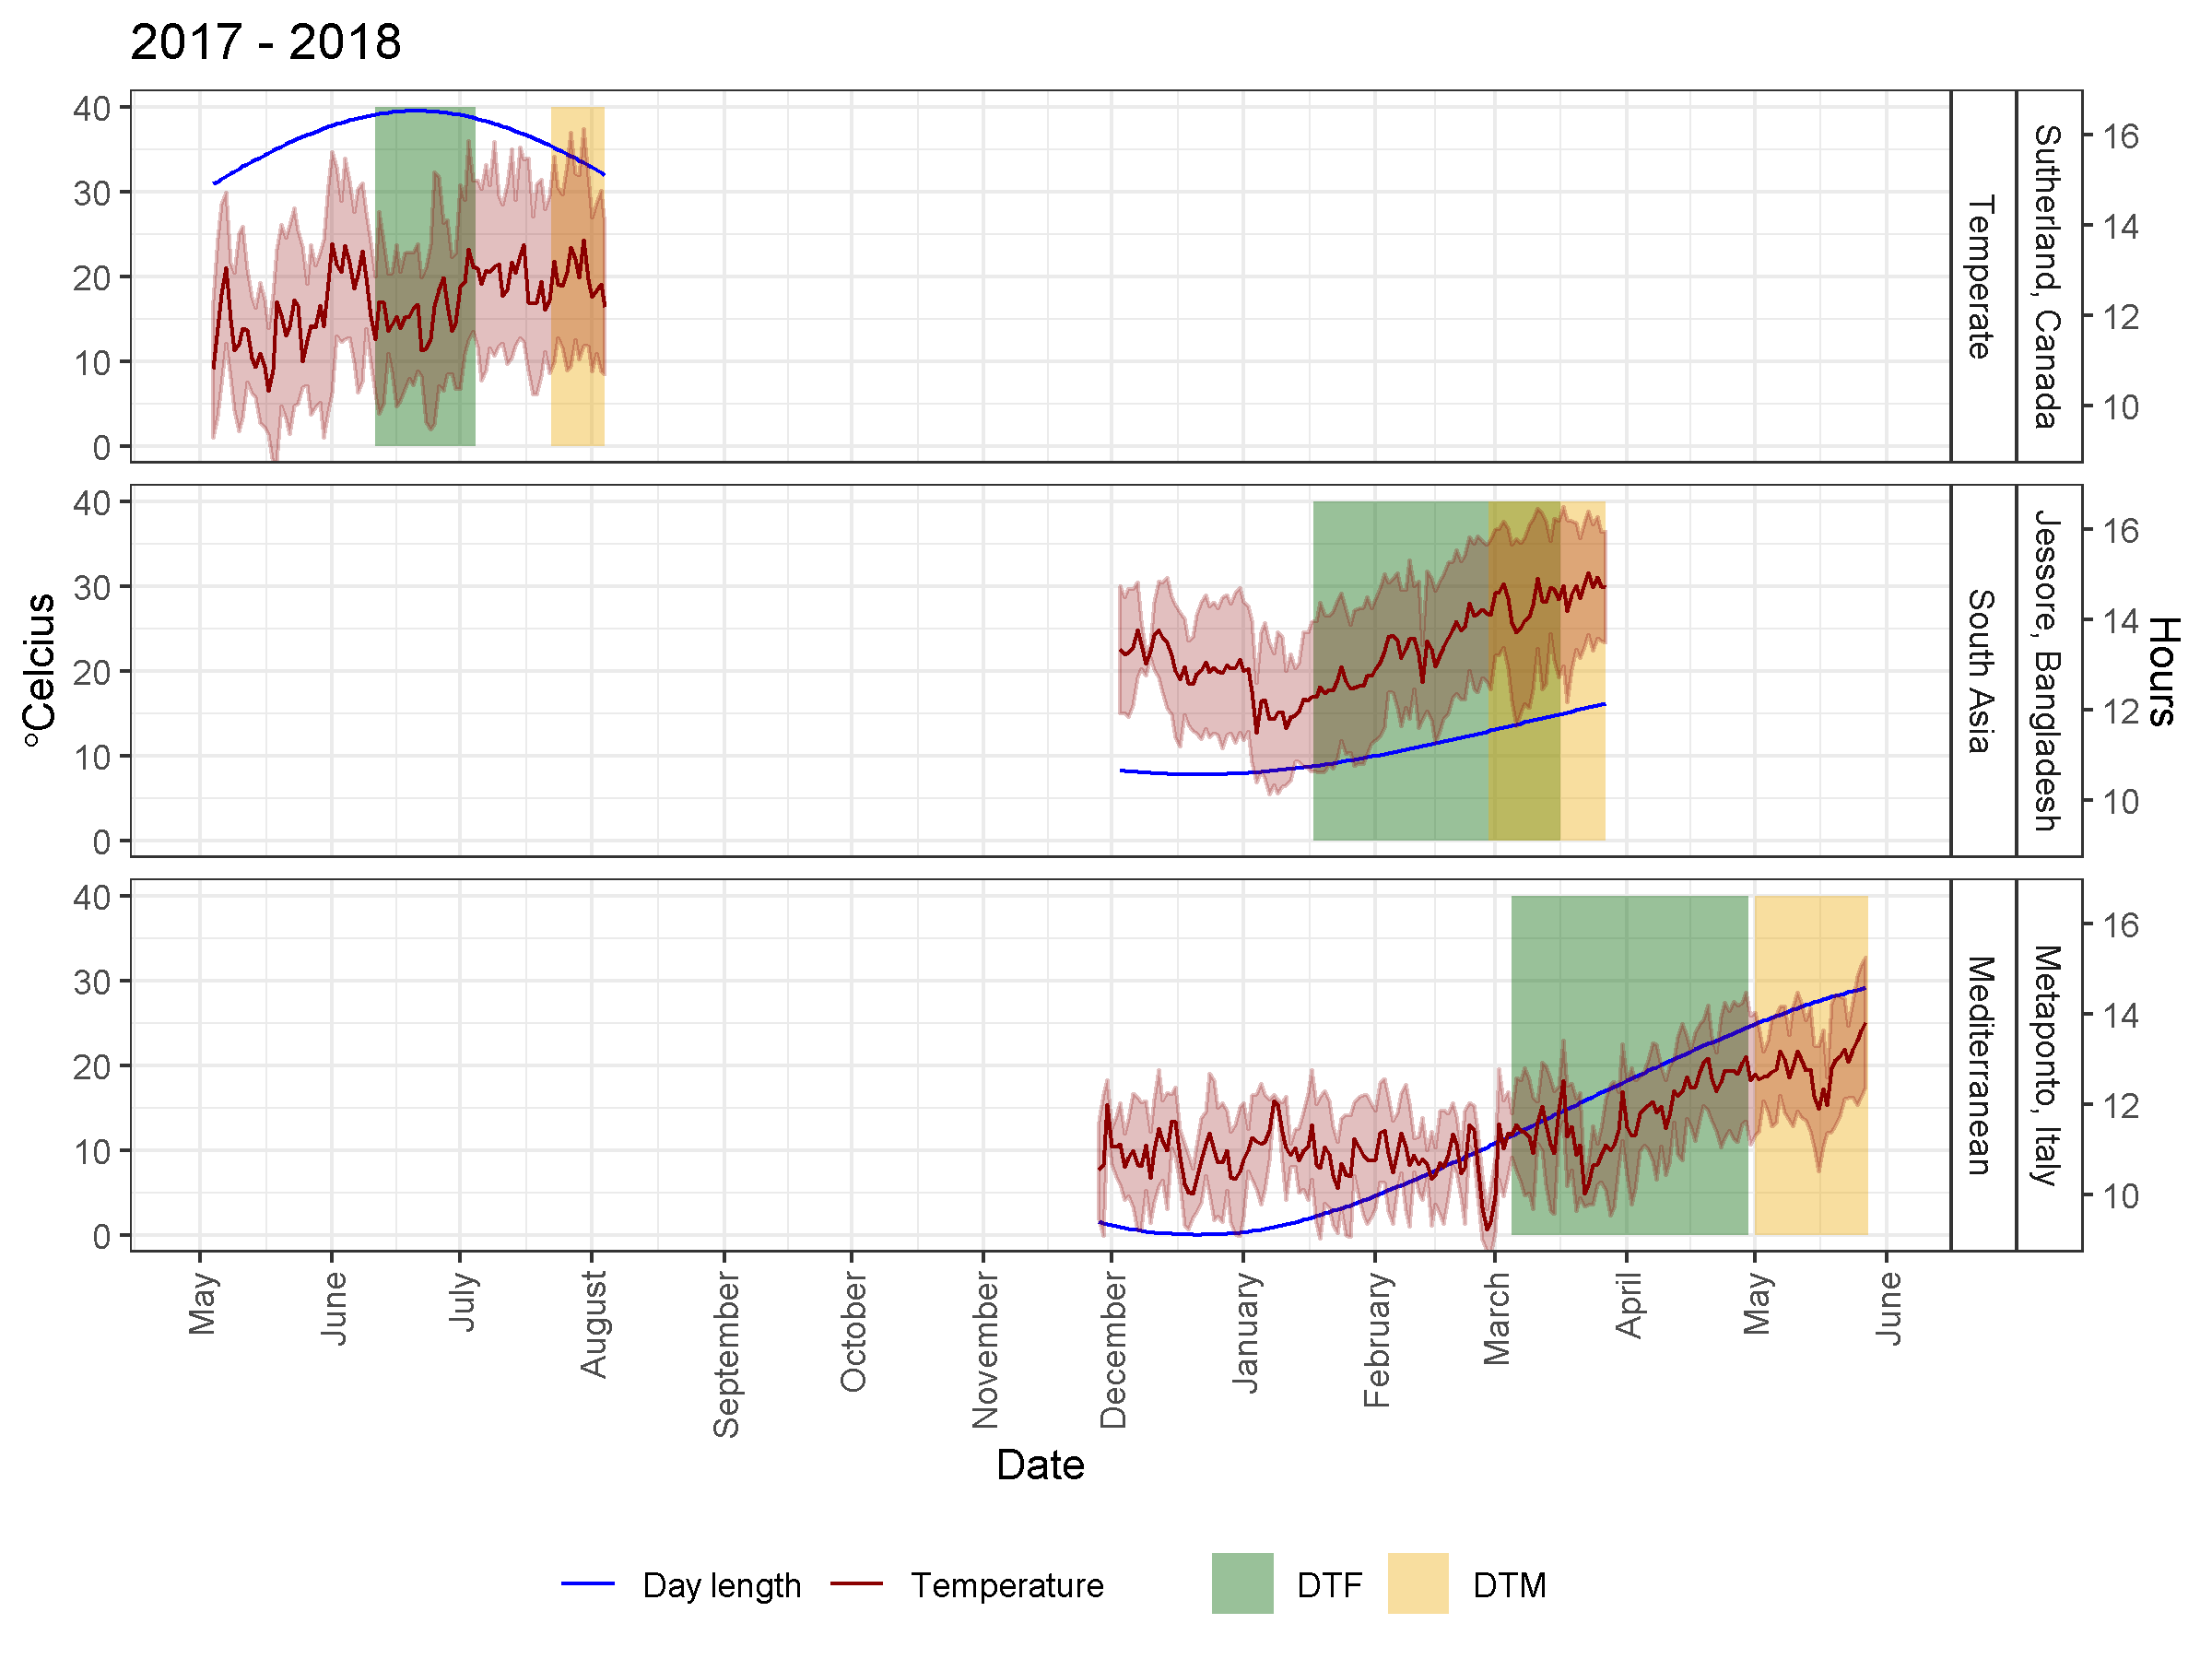
Macro-Environments

Slide 6
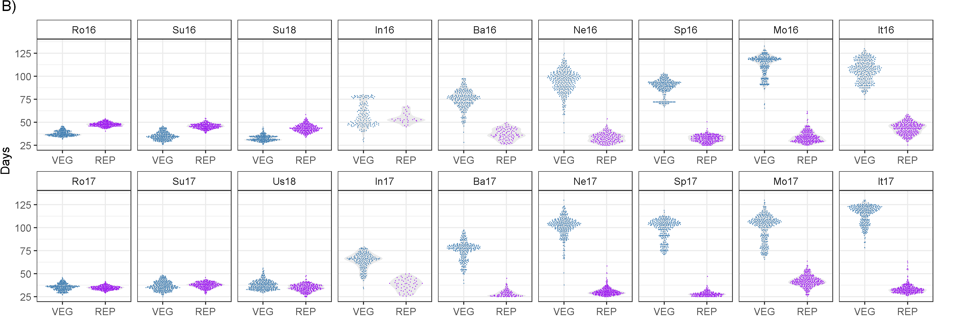
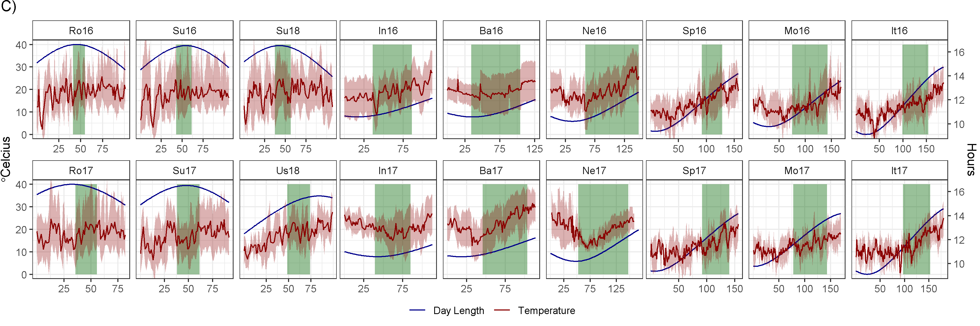
Phenology

Slide 7
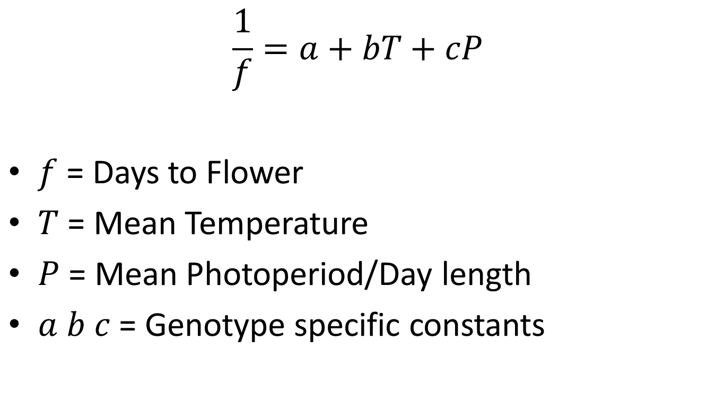
Photothermal Model¹
$$\frac{1}{f}=a+bT+cP$$
$f$ = Days to Flower
$T$ = Mean Temperature
$P$ = Mean Photoperiod/Day length
$a b c$ = Genotype specific constants
¹Summerfield et al. (1985) Effects of Temperature and Photoperiod on Flowering in Lentils (Lens culinaris Medic.). Annals of Botany. 56: 659-671.

Slide 8
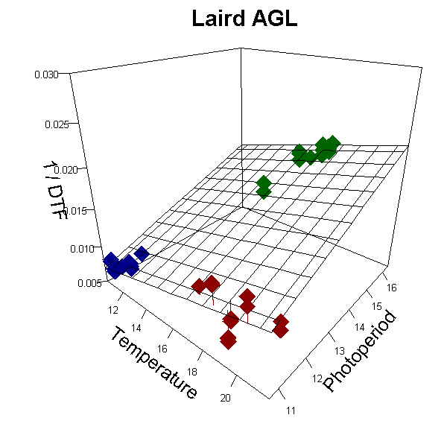

Slide 9
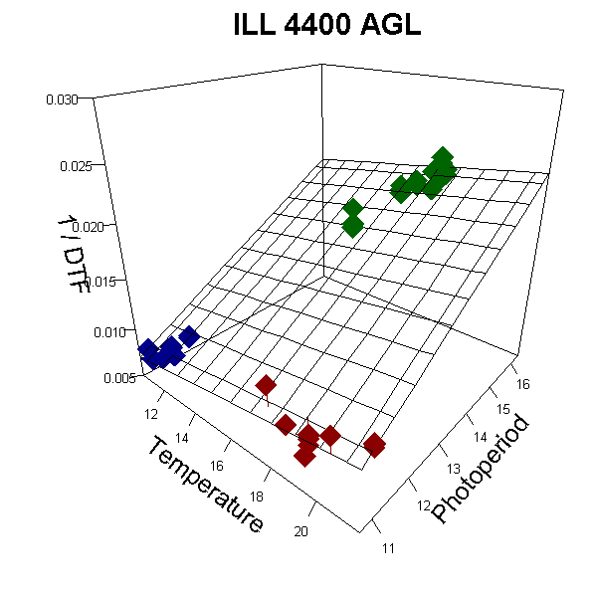

Slide 10
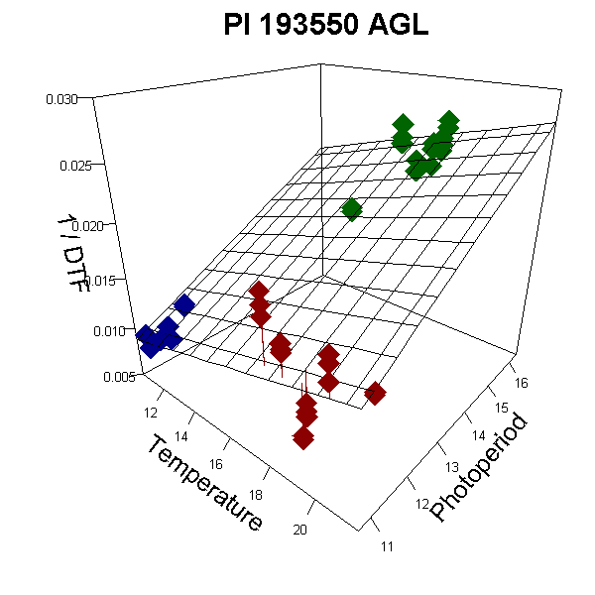

Slide 11
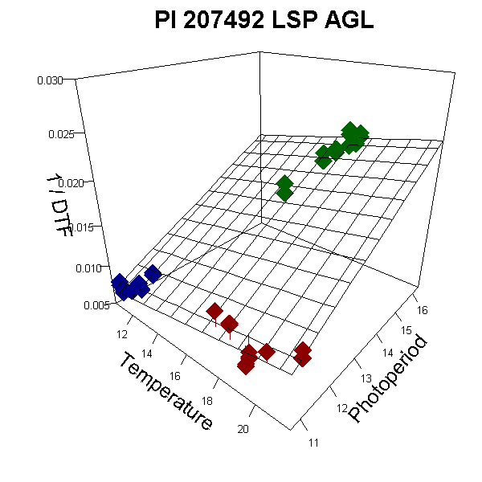

Slide 12
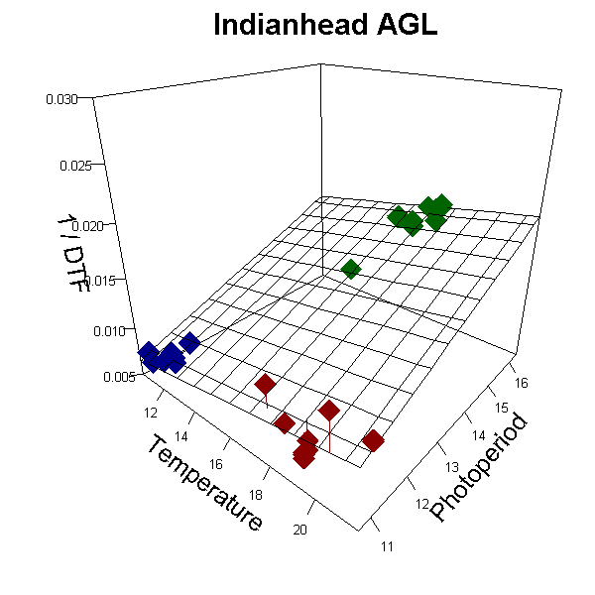

Slide 13
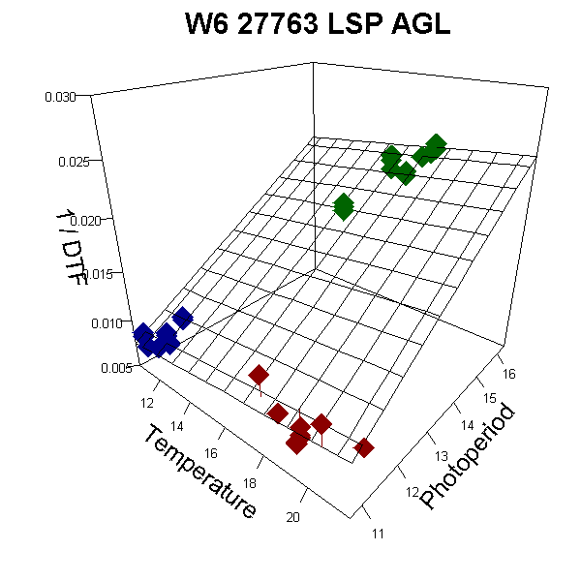

Slide 14
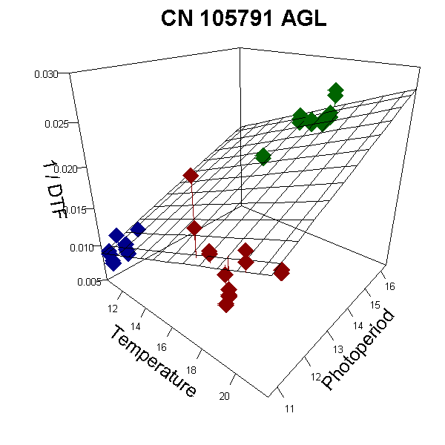

Slide 15
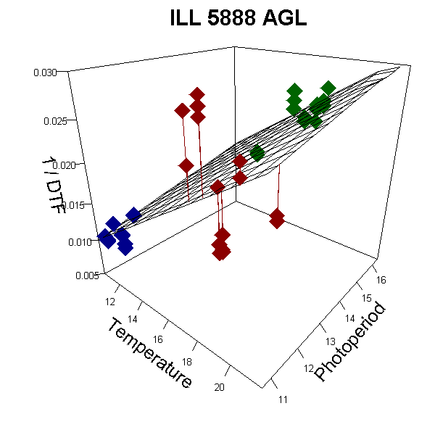

Slide 16
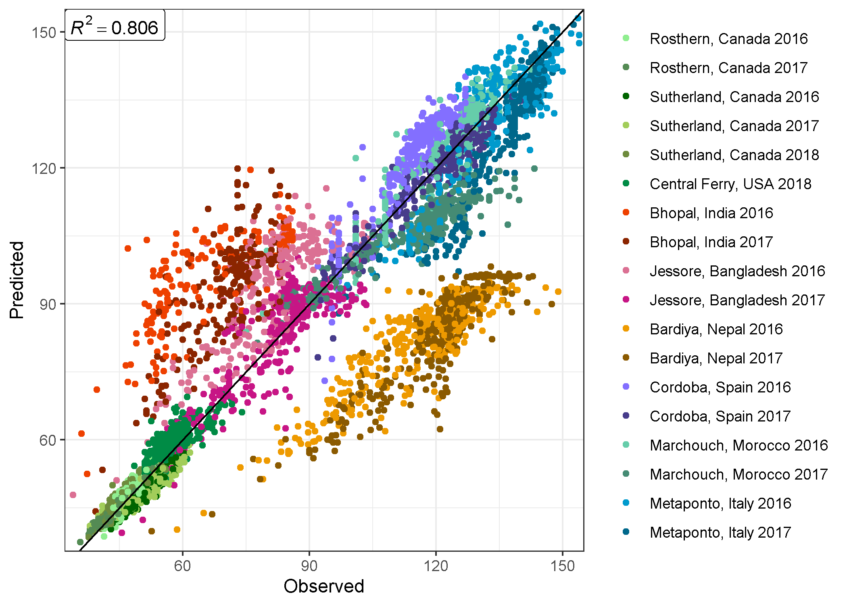

Photothermal Model: $\frac{1}{f}=a+bT+cP$

Slide 17
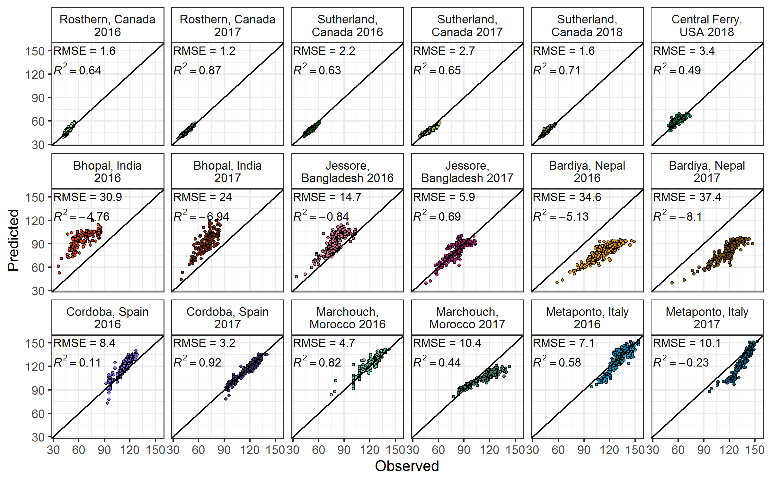
Photothermal Model: $\frac{1}{f}=a+bT+cP$

Slide 18
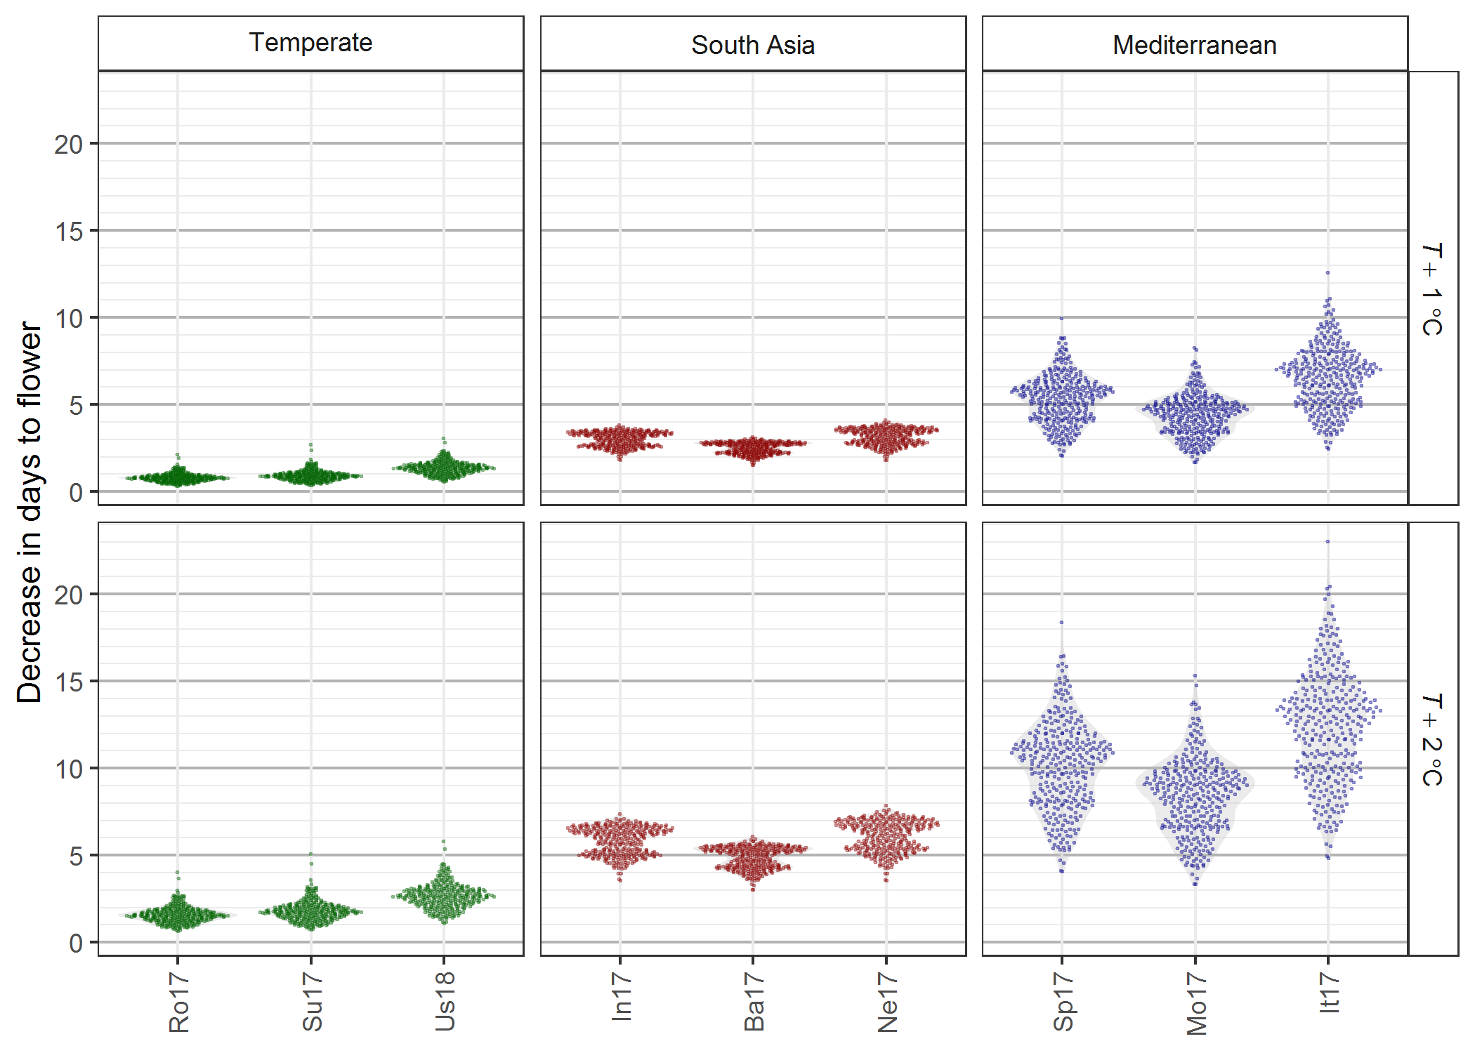
Increased Temperatures

Slide 19
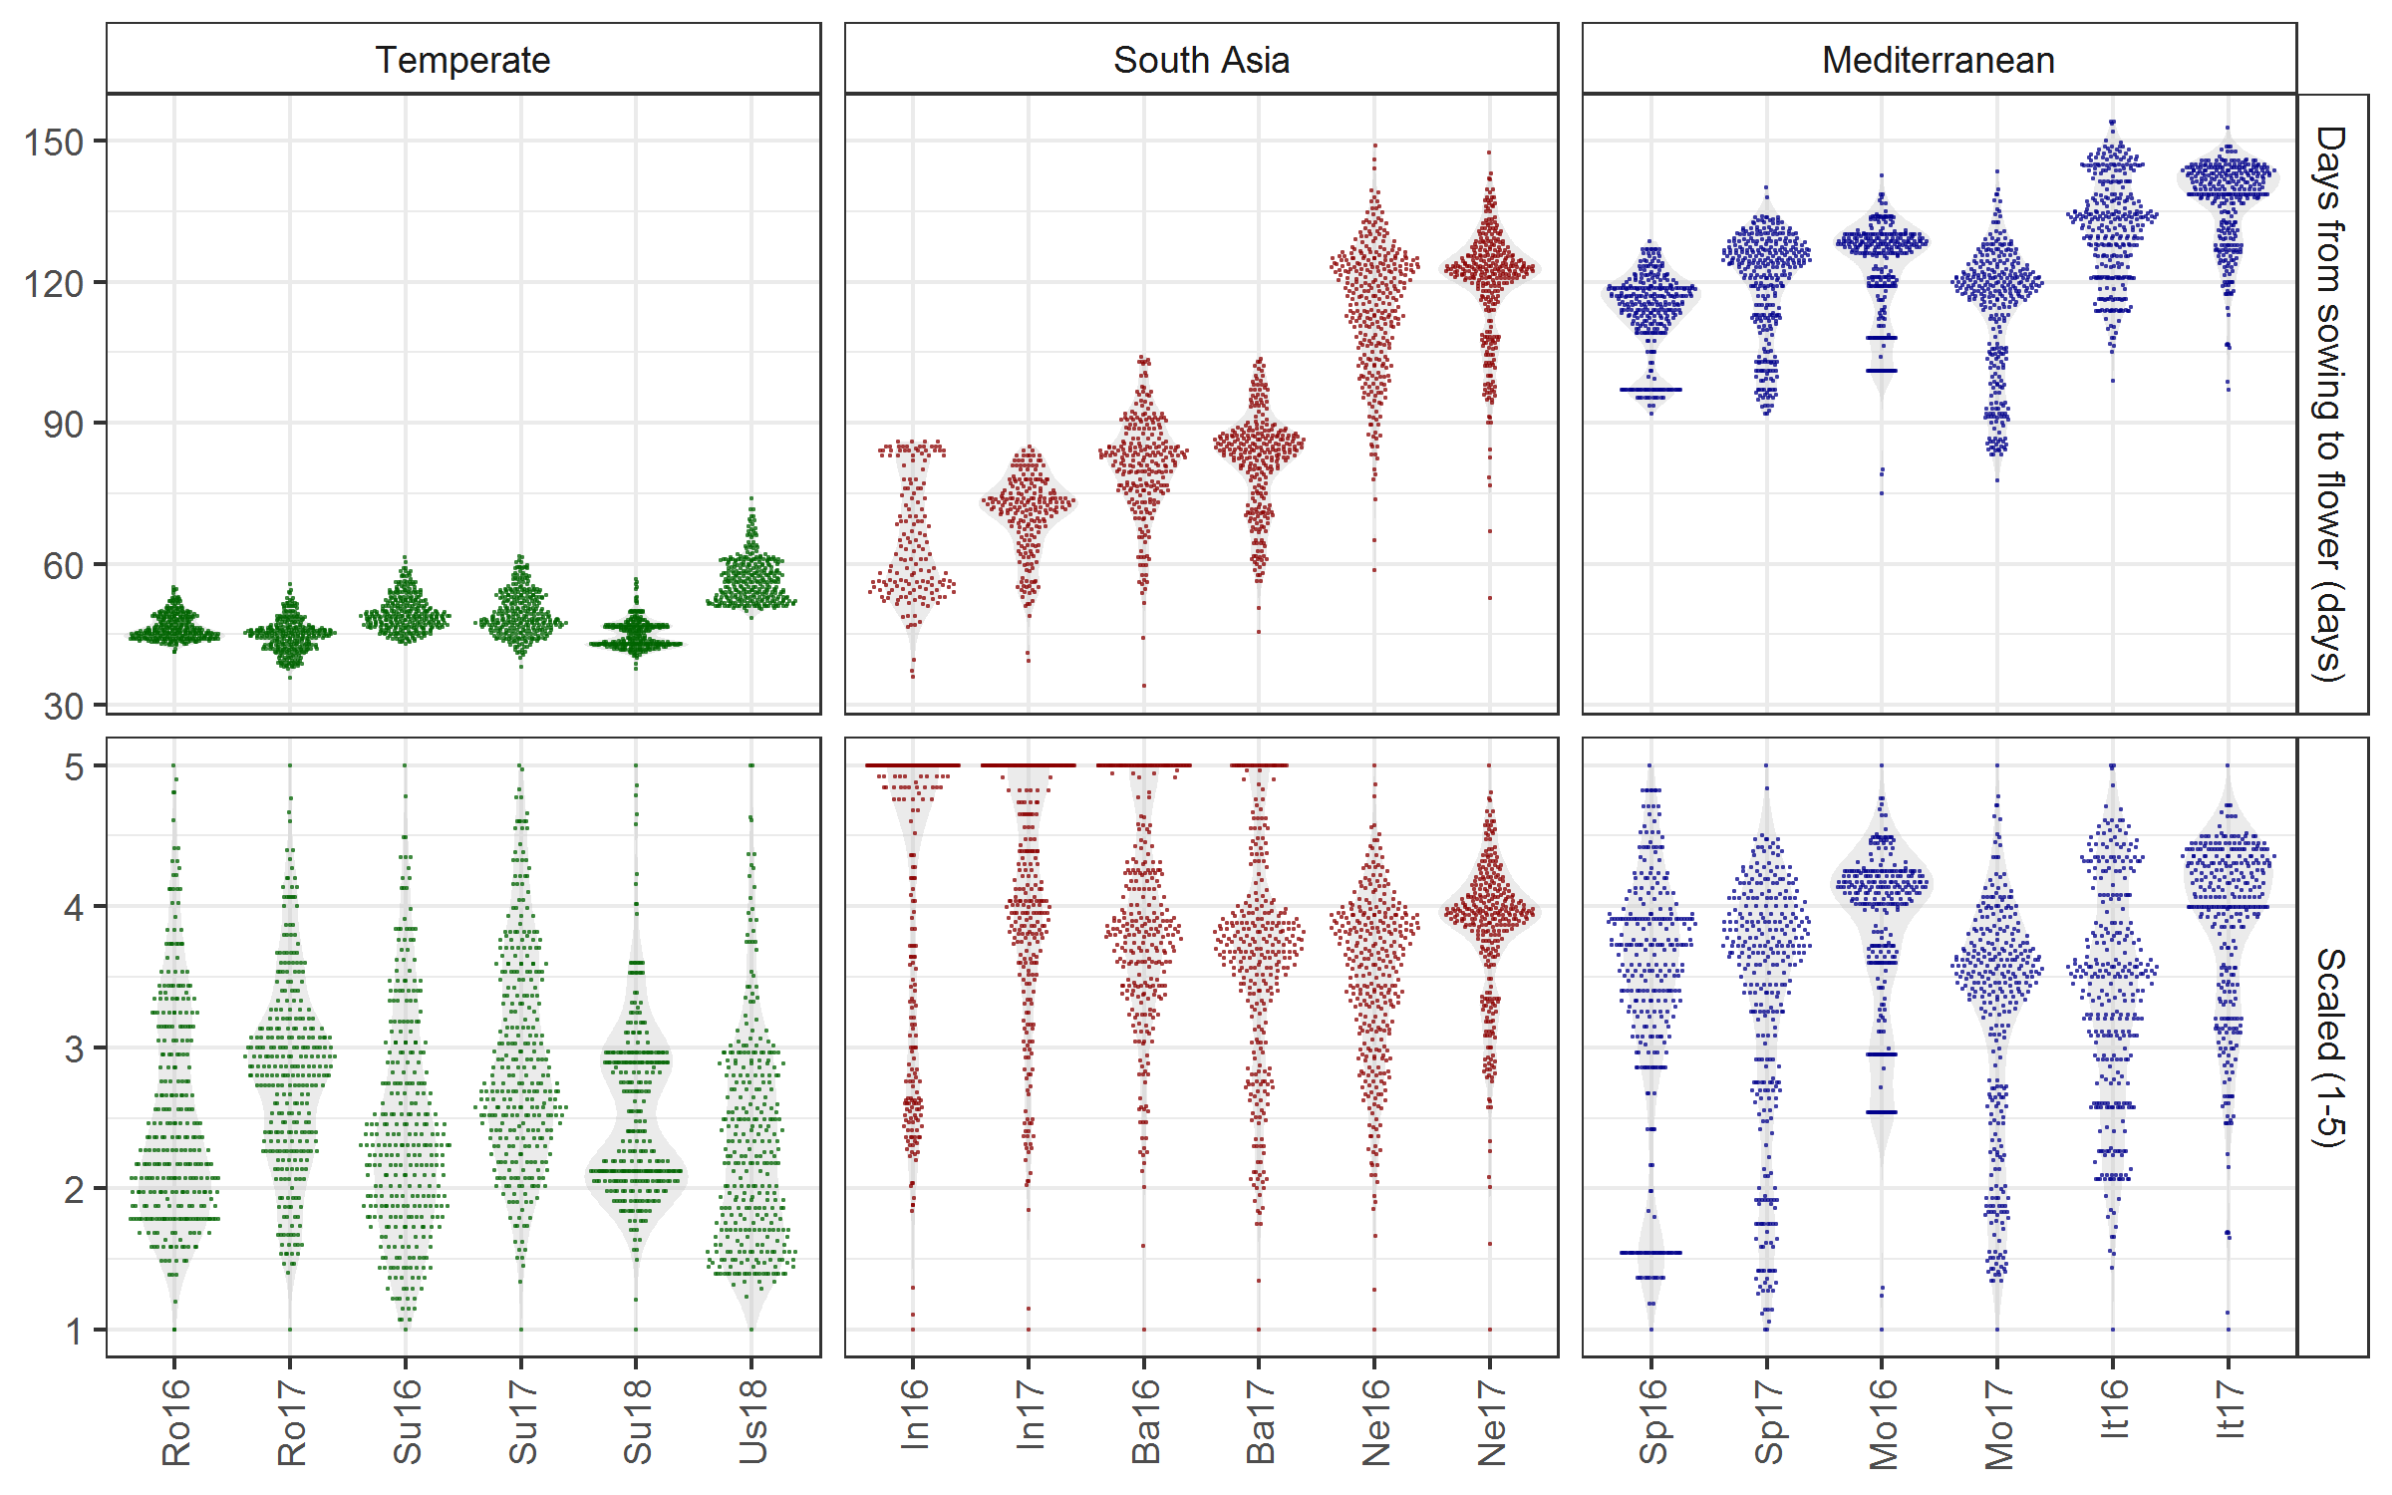
Principle Component Analysis & Hierarchical k-Means Clustering

Slide 20
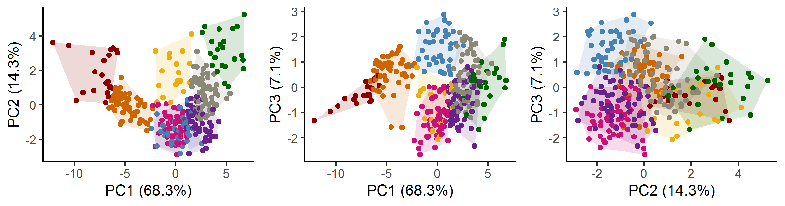
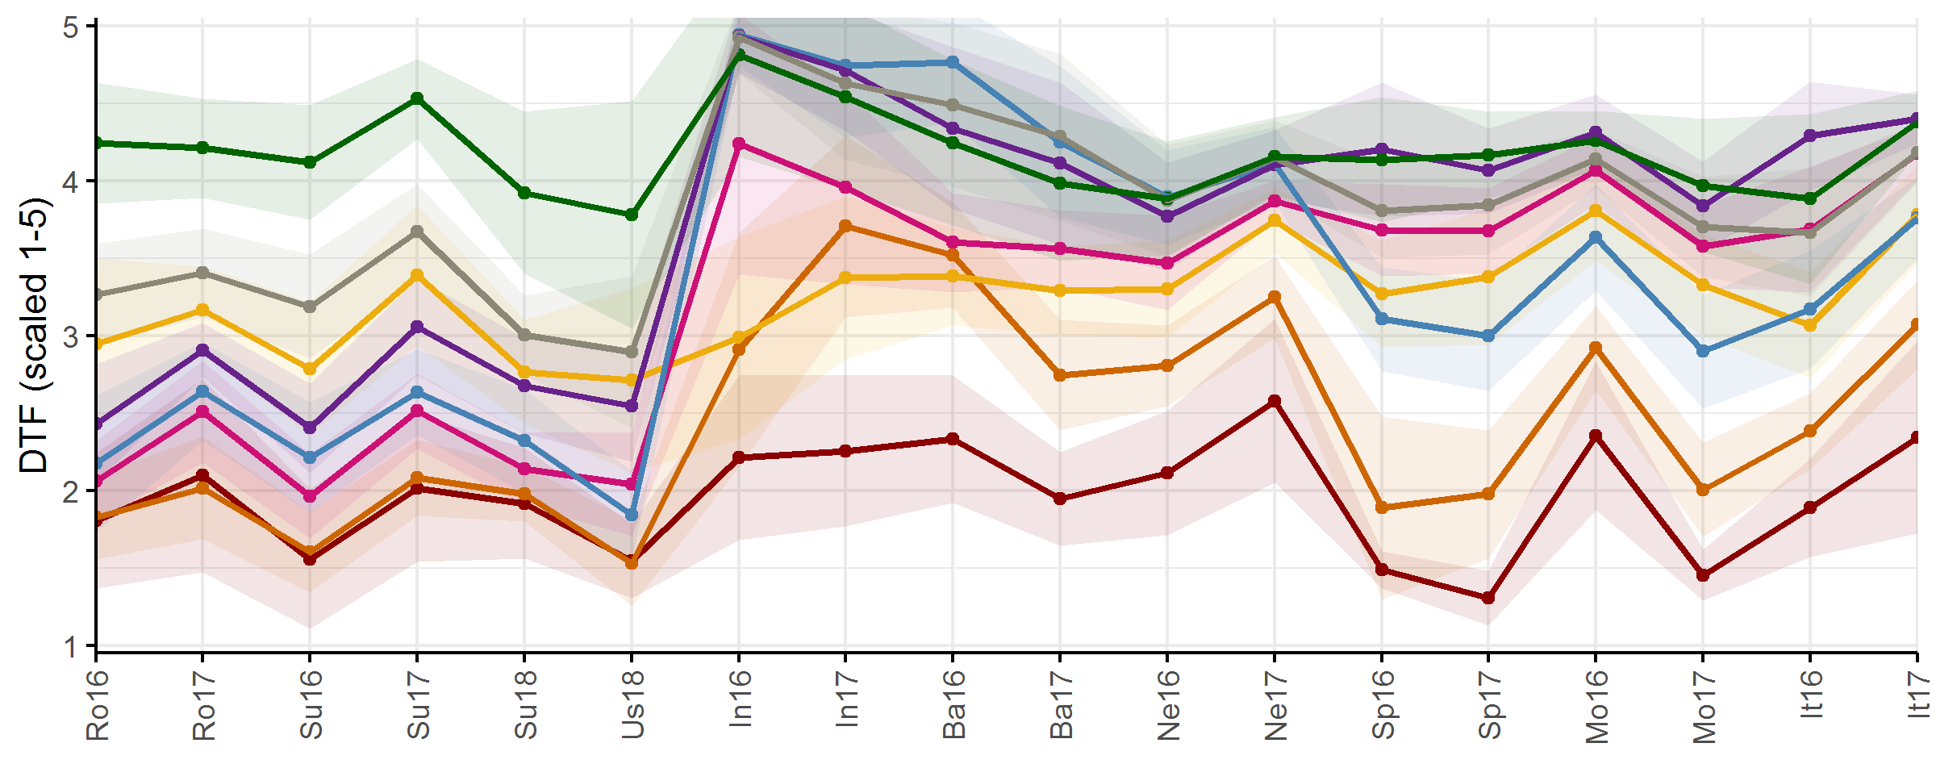
Principle Component Analysis & Hierarchical k-Means Clustering

Slide 21
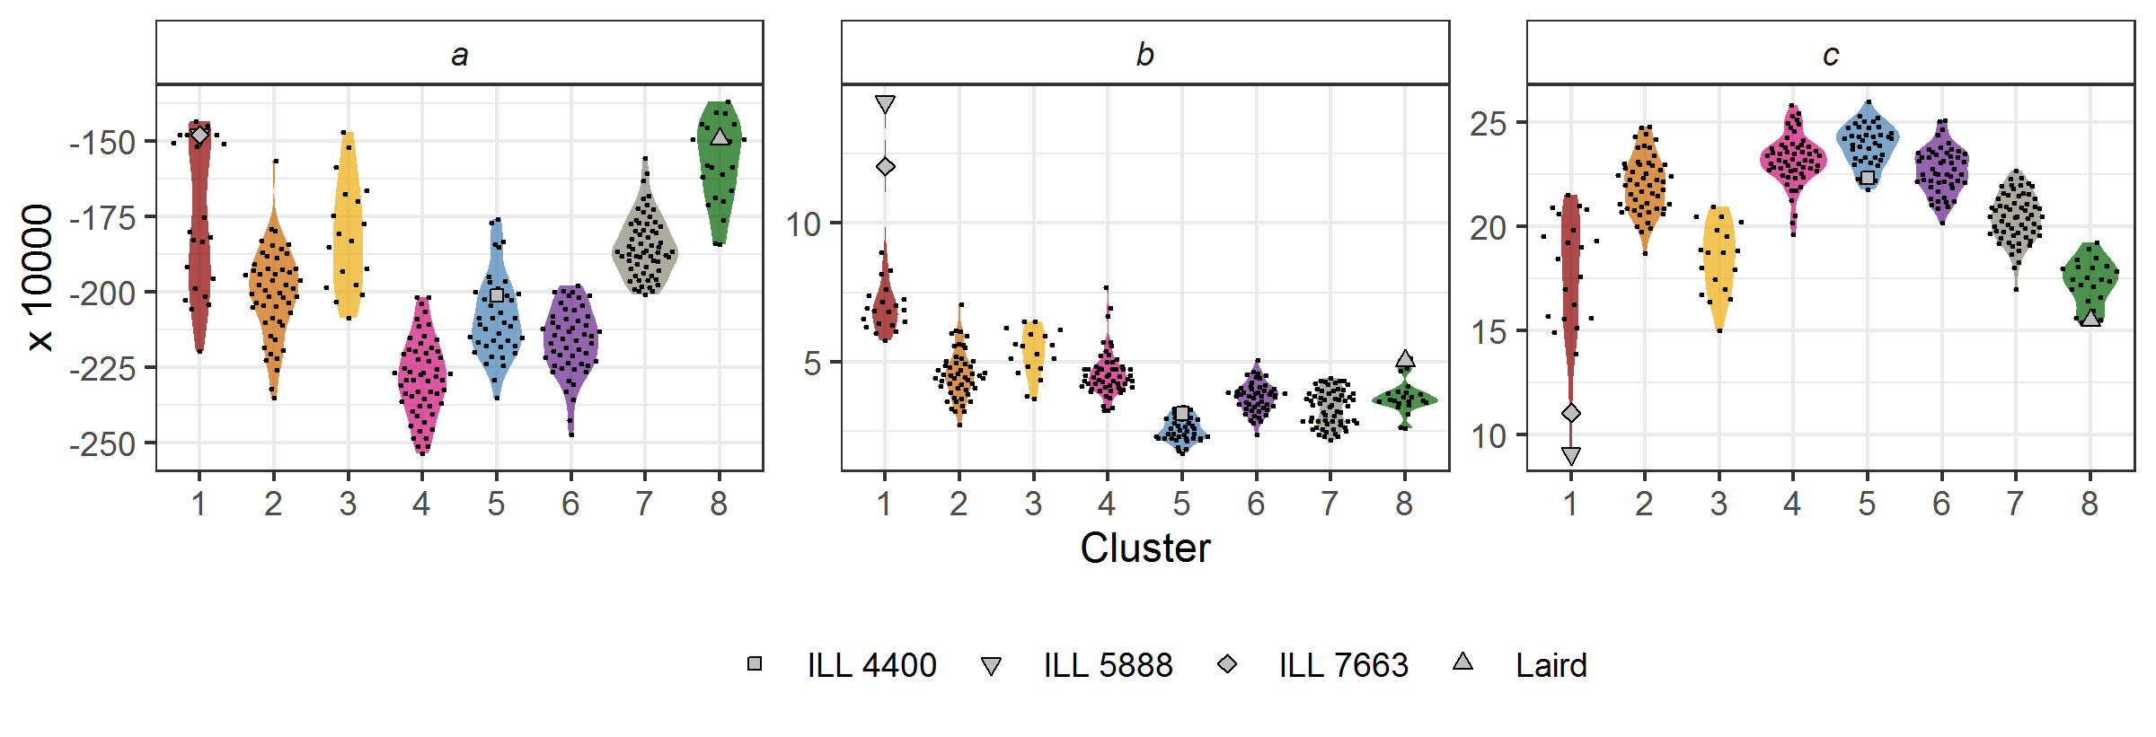
Principle Component Analysis & Hierarchical k-Means Clustering

Slide 22
