Slide 1
Indexing Tips and Tricks with FrameMaker
Presented by
Susan Self

Slide 2
Overview of Topics
Making Index Entries
Reviewing and Fixing Entries
Formatting Index Pages
Generating Thumbtabs for Navigation
Producing a Global Index with FM 6.0

Slide 3
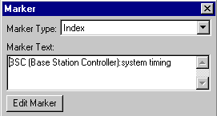
Making Index Entries (1)‏
Use a colon to define a subentry below a primary entry:
This entry produces in the index:
BSC (Base Station Controller)
system timing 1‑ 3
You can use three or four levels of entries in an index hierarchy, where each level is separated by a colon.
Use character tags to make font changes for special words:
<code>TMPDIR<Default Para Font> environment variable
produces:
TMPDIR environment variable 2-29

Slide 4
Making Index Entries (2)‏
For see and see also entries, omit the page number and use an Italic font:
<$nopage>relay devices <italic>see<Default Para Font> output relays
relay devices see output relays
Separate multiple see also topics with semicolons and sort the entry as a subentry at the end of the primary entry list:
<$nopage>sector:<italic>see also<Default Para Font> analysis radius\;
RF model[sector:zzz]
sector
…
wilting 1-17
see also analysis radius; RF model

Slide 5
Making Index Entries (3)‏
Use semicolons to separate multiple entries at a single marker:
pilots:number in neighbor list;neighbor list:number of pilots
Use the <$singlepage> building block to restore page numbers in a marker with a <$nopage> block:
<$nopage>signal strength <italic>see<Default Para Font> Pilot
E<subscript>c<Default Para Font>/I<subscript>o<Default Para
Font>;<$singlepage>Temporal Analyzer
produces:
signal strength see Pilot E_{c}/I_{o}
Temporal Analyzer 3-24

Slide 6
Making Index Entries (4)‏
Use IXGen™ to generate index entries from:
  paragraph tags: such as glossary terms, headings
  character tags: such as <menu> or <command> tags
  keywords: such as a custom list of keywords and alternative text to use for index entries every time the keyword is found, or else use the keyword itself
Use IXGen to permute marker text to create more entries,
such as for “reference pages” generate “pages, reference”
(See IXGen documentation for details on these features.)‏

Slide 7
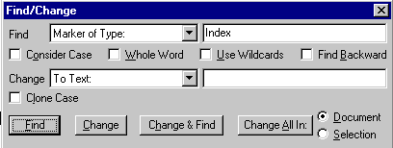
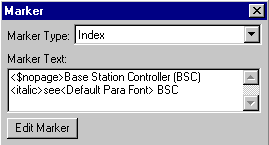
Reviewing and Fixing Entries (1)‏
Scanning all index entries within a file in sequence
1. In the Find/Change window, search for Marker of Type “Index”
2. Open the Marker window.
3. Every time you press the Find button, the next index entry text appears in the Marker window.

Slide 8
Reviewing and Fixing Entries (2)‏
Finding index entries through the index file
1. Make sure to set up your index to create hypertext links.
2. Put the index file into navigation mode by entering:
Esc+Shift-f+l+k (Exit the mode in the same way.)‏
3. When you put the cursor over the hypertext link of a page number, the cursor changes to a pointing finger.
4. Click on a page number to navigate to the page containing the index entry.
5. Open the Marker window to see the index entry text and change it.

Slide 9
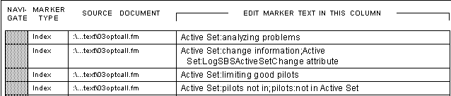
Reviewing and Fixing Entries (3)‏
Making global replacements and corrections
1. Use IXGen to generate an Editable Marker List for an entire book.
2. Do global search and replace for terms that have changed or individually correct inconsistent entries.
3. Apply the edited markers back to the source text.
4. Regenerate the document to reflect updated marker text.
Editable Marker List

Slide 10
Formatting Index Pages (1)‏
To minimize the search context and the index length:
  Use two or three text columns per page
  Use a font one point size smaller than the normal document text, such as 11 pt. instead of 12 pt., for the index entry paragraph tags (Level1IX, Level2IX, Level3IX, Level4IX).
To display in the header the first effective group title on the page, such as A, B, or C, on the Right and Left master pages, on the outer edge of the header, insert a Running H/F 3 variable defined as <$paratext[GroupTitlesIX]>.

Slide 11
Formatting Index Pages (2)‏
Controlling line breaks in index entries
To keep a [chapter-page] page number from breaking at the hyphen, in the chapter file set-up window, enter a non-breaking hyphen after the chapter number, such as: 1\+
To keep the page number on the same line with index entry text, in the index Reference page where “1, 2-3” appear, change the space before the 1 to two non-breaking spaces (Ctrl+Space Ctrl+Space)‏
To prevent line breaks after an en dash, in the index file choose Format  Document  Text Options and make sure that the en dash is not listed in the Allow Line Breaks After: box.

Slide 12
Formatting Index Pages (3)‏
To compress identical index entries on multiple consecutive pages into a page range (1-5, 1-6, 1-7 into
1-5–1-7), edit the paragraph tagged IndexIX in the index Reference page so that the <$autorange> block appears before the <$pagenum> block:
<$autorange><$pagenum>
To make page numbers appear blue to indicate that they are hypertext links in a PDF file, add a <hypertext> character tag with a blue font before the <$pagenum> block:
<$autorange><hypertext><$pagenum><Default Para Font>

Slide 13
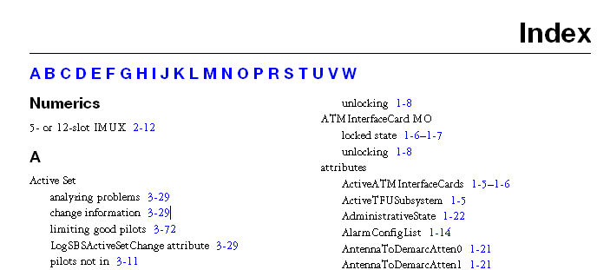
Generating Thumbtabs (1)‏
Thumbtabs are hypertext-linked group titles that help the user of an index in a PDF file to navigate quickly to an alphabetic group of index entries. The thumbtabs are put in master pages to appear at the top of every index page.
thumbtabs

Slide 14
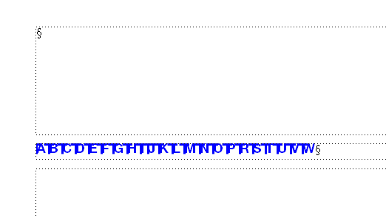
Generating Thumbtabs (2)‏
Make a background text frame on the First, Right, and Left master pages for the thumbtabs.
  For the First master page, you can put the background frame between two connected body text frames:
body text frame
Connect frames
background text frame
body text frame

Slide 15
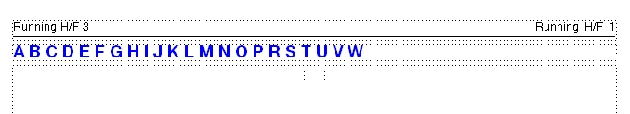
Generating Thumbtabs (3)‏
  For the Right and Left master pages, you can put the background frame between the header frame and the body text frame:
header
background text frame
Two-column body text frame

Slide 16
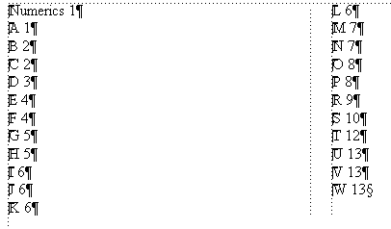

Generating Thumbtabs (4)‏
This method for generating thumbtabs is much easier than that described in the FrameMaker documentation.
1. In the index file, generate a table of contents that includes only the paragraphs tagged GroupTitlesIX.
2. Edit the text in the resulting file so that the letters are on one line without page numbers:
Make sure you don’t delete the hypertext markers!

Slide 17

Generating Thumbtabs (5)‏
3. Change the font to a bold, blue, Sans Serif font:
4. Copy and paste the text from the generated TOC file
into the background text frames prepared on the master
pages.

Slide 18
Generating Thumbtabs (6)‏
To test that the thumbtabs works, put the index into navigation mode (Esc+Shift-f+l+k) and click on each of the thumbtabs to confirm that they take you to the correct group title.
Make sure not to leave an index file in navigation mode, as it is read-only then and cannot be regenerated and saved.
Every time you regenerate an index, the hypertext object Ids become invalid, so you need to regenerate the thumbtabs. Therefore, do not bother to save the generated TOC file for the index.

Slide 19
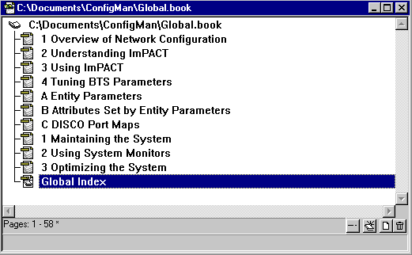
Producing a Global Index with FM 6.0 (1)‏
1. Put the folders for all the manuals into a folder so they are siblings of each other in the hierarchy.
2. Create a new book file, add the chapter and appendix files from each of the manuals into the book file, and add a global index:
Configuration manual
Advanced operations manual
global index file

Slide 20
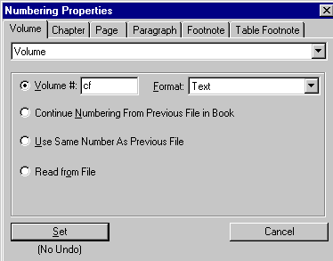
Producing a Global Index with FM 6.0 (2)‏
3. Select the first chapter and choose Format  Document  Numbering to open the Numbering Properties window. In the Chapter tab, set the chapter number to 1. In the Volume tab, set the Volume to a Text format with a mnemonic tag, such as “cf” for the Configuration manual.
mnemonic volume tag

Slide 21
Producing a Global Index with FM 6.0 (3)‏
4. For each succeeding chapter in the first manual, set the Chapter and Volume tab values to Continue Numbering From Previous File in Book.
5. For the first appendix, reset the chapter number to 1 and change the format to Alphabetic. Set the Volume # to the same mnemonic tag as for the chapters.
6. For each succeeding appendix in the first manual, set the Chapter and Volume tab values to Continue Numbering From Previous File in Book.

Slide 22
Producing a Global Index with FM 6.0 (4)‏
7. For a second manual in the global index, reset the first chapter number to 1 and provide a different volume mnemonic tag, such as “ao” for the Advanced Operations manual.
8. Set up the subsequent chapters and appendices as described in the steps 3-6.
9. Generate the global index and set up the page layout as desired.

Slide 23
Producing a Global Index with FM 6.0 (5)‏
10. Edit the index Reference page to add the volume tag to the page number sequence in the IndexIX line:
<$autorange><hypertext><$volnum>_<Default Para Font> <hypertext><$chapnum>-<Default Para Font> <hypertext><$pagenum><Default Para Font>
(For some reason, in FM 6.0, each variable needs the <hypertext> font change applied individually.)‏
11. Regenerate the index so that the new volume block can take effect. The page numbers show as: cf_1-7 or ao_4-2
12. Add a key to the volume tags at the top of the index entries.

Slide 24
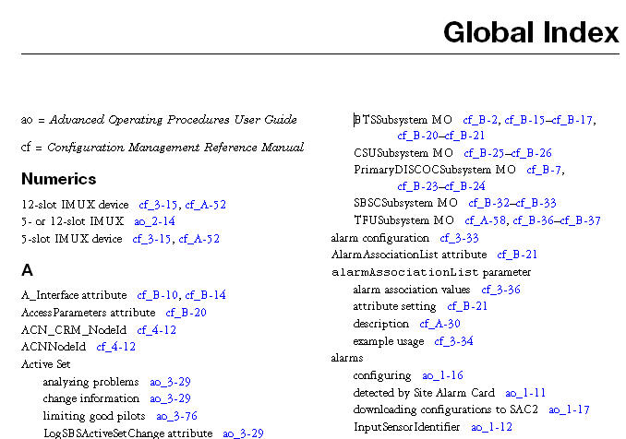
Producing a Global Index with FM 6.0 (6)‏
Example of a Global Index and Key to the Notation
key

Slide 25
For More Information
IXGen™ Indexing and Marker Management Tool for Adobe FrameMaker:
http://home.pacifier.com/~franks/ixmid.html
American Society of Indexers:
http://www.asindexing.org/
FrameUsers.com, website and internet list:
http://www.frameusers.com/
Society for Technical Communication:
http://stc.org/

