Slide 1
Managing Relationships between Code and Documentation
Dejun Qian

Slide 2
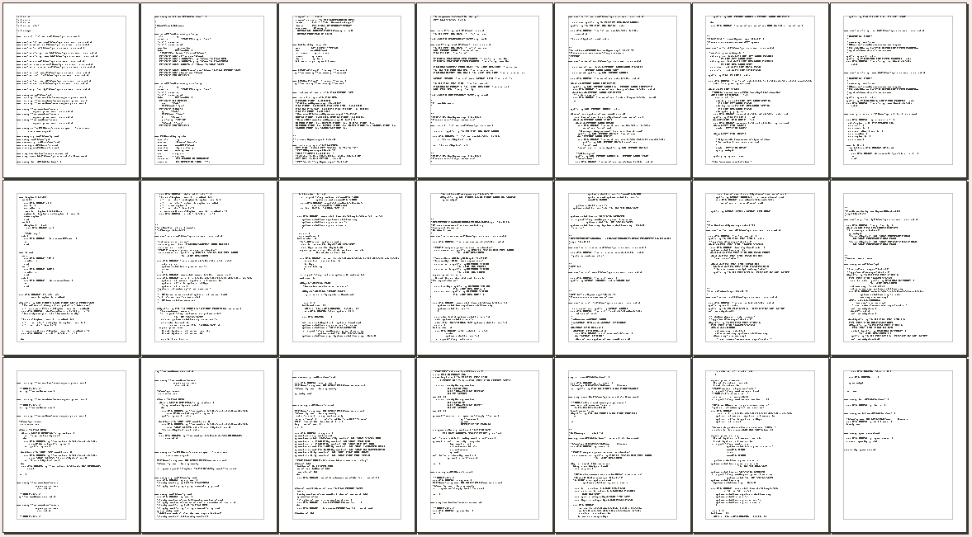
Problem
TG3 virtual device for QEMU (4520 lines)

Slide 3
Problem
TG3 virtual device for QEMU (4520 lines)

Slide 4
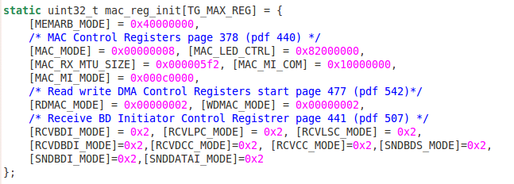
Problem
13 lines of code from TG3 virtual module
Define and initialize a structure
Why these constants at certain offsets

Slide 5
Problem
13 lines of code from TG3 virtual module
Define and initialize a structure
Why these constants at certain offsets

Slide 6
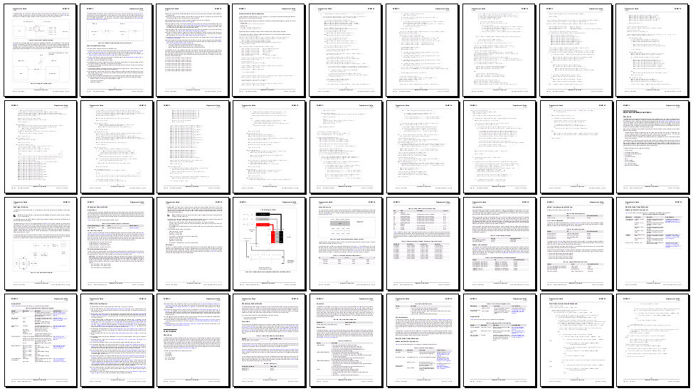
Problem
TG3 Host Programmer Interface Document (791 pages)

Slide 7
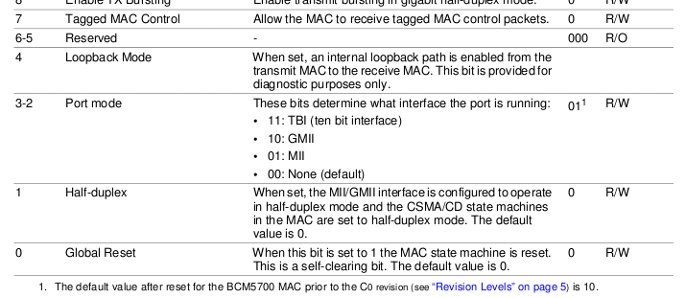
Problem
Part of the content on page 378

Slide 8
Problem
Manage relationships between code and documentation
1
2
3
4
1
2
3
4
5
6
7
8
5
6
7
8
9
10
11
12
9
10
11
12
13
...
13
...
code
documentation

Slide 9
Previous Solution
Comment and annotation
Tightly related with the code and documentation

Slide 10
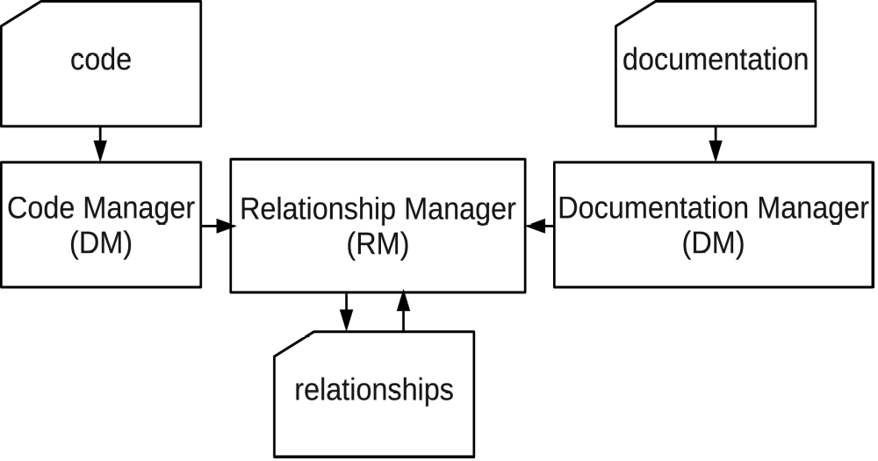
coDoc Architecture

Slide 11
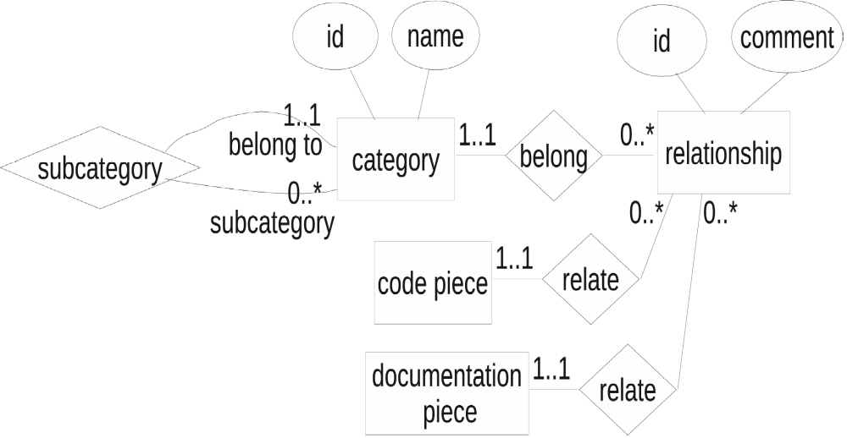
Solution

Slide 12
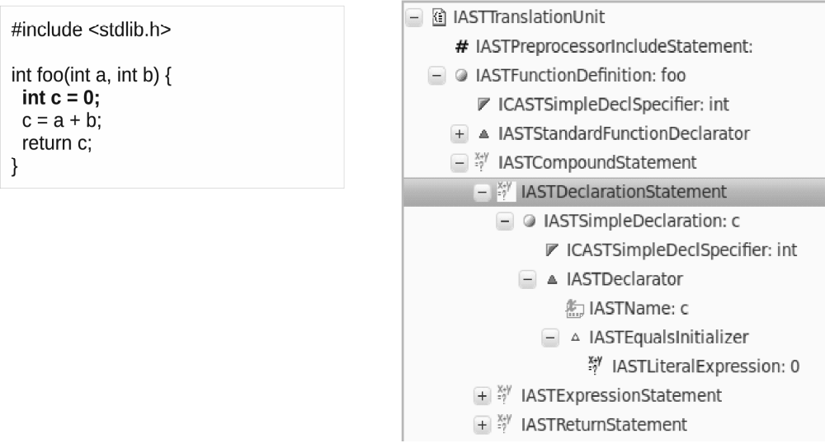
Solution

Slide 13
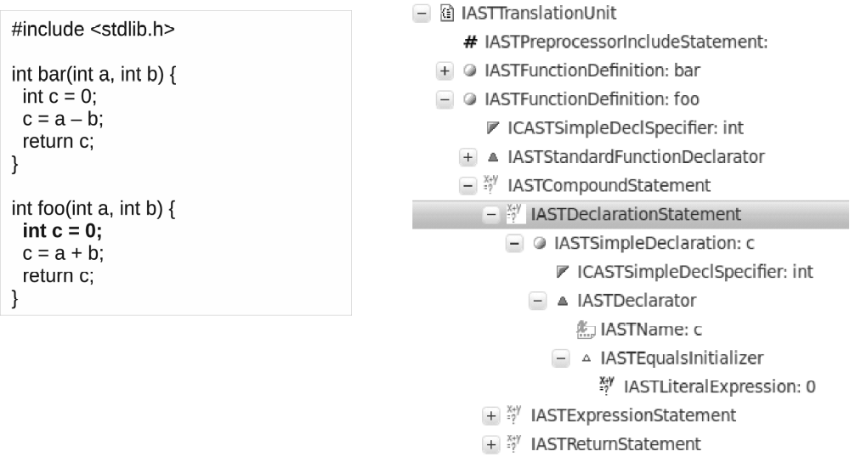
Solution

Slide 14
Solution

Slide 15
Conclusion
Effective
useful

Slide 16
Questions!

