Slide 1
Midterm Competition
ICP Localization 1

Slide 2
ICP Localization 1
1. Read the map
2. Subscribe topic (lidar scan, GPS…)
3. Use ICP
4. Transform map and matched lidar scan and result odometry to world frame.
5. Publish results and pointclouds

Slide 3
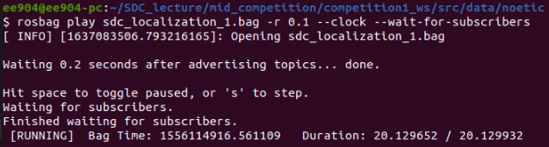
ICP Localization 1
Prevent the data loss with “--wait-for-subscribers”.

Slide 4
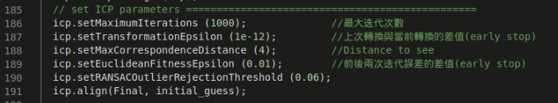
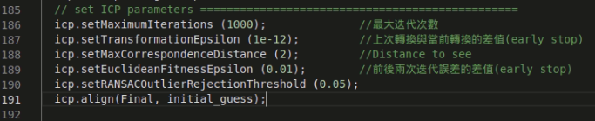
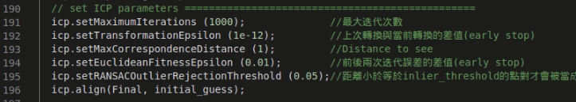
ICP Localization 1 --- correspond distance ---
Performance(RMSE): 0.21928
Performance(RMSE): 0.20959
After correcting the result id: 0.01775

Slide 5
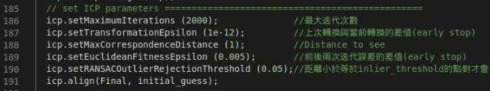
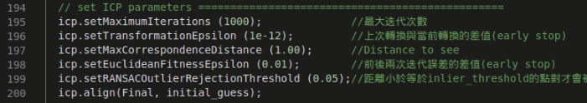
ICP Localization 1 --- Fitness Epsilon ---
Performance(RMSE): 0.20863 (no better)
Best parameter’s RMSE: 0.01775

Slide 6
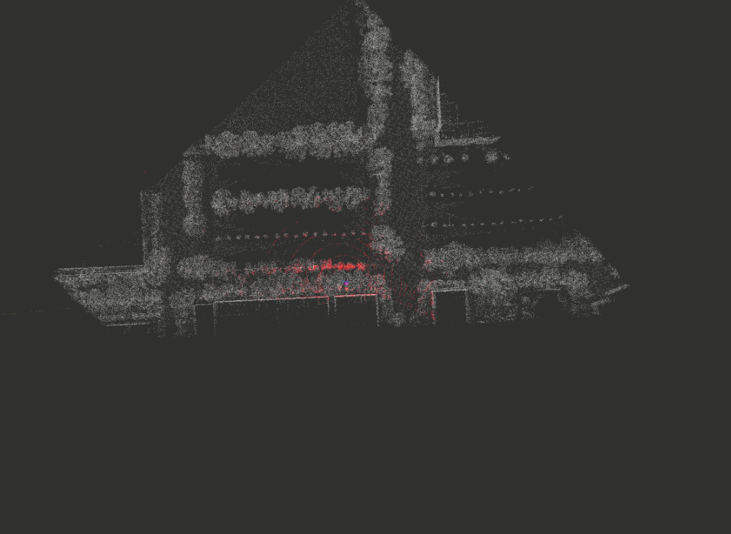
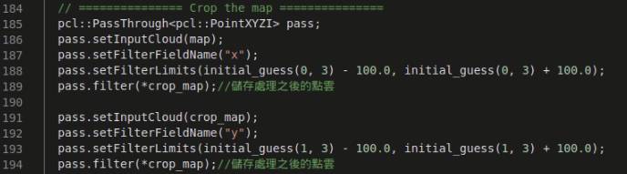
ICP Localization 1 --- pass the unused map region ---
To reduce the computational resource consumption.

Slide 7
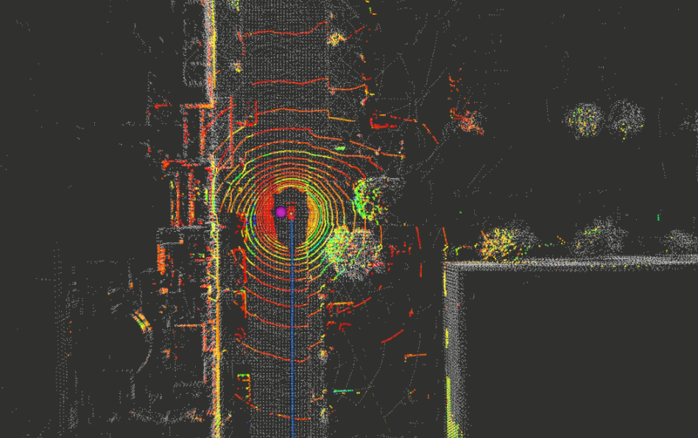
ICP Localization 2 --- Try to add initial x y z by wheel odometry diff ---
To ensure this can work, I add 0.37 on initial guess x every scan to test. And yes, it worked. RMSE = 0.27947

Slide 8
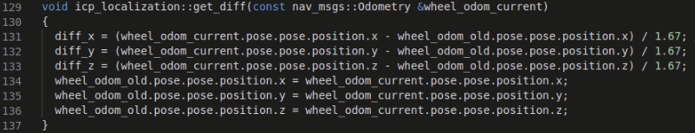

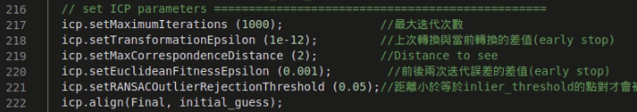
ICP Localization 2 --- Try to add initial x y z by wheel odometry diff ---
By adding initial guess and diff odometry from wheel encoder, we can get better initial guess and better performance.

Slide 9
ICP Localization 2 --- Try to add initial x y z by wheel odometry diff ---
By adding initial guess and diff odometry from wheel encoder, we can get better initial guess and better performance.
RMSE = 0.17760

Slide 10
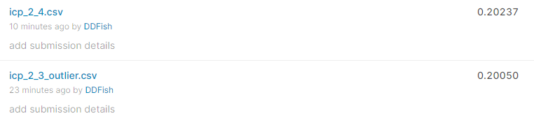
ICP Localization 2 --- Try to use outlier ---
Only used on map (2_3), or used on map and scan (2_4) did not get better performance
RMSE = 0. 20050

Slide 11
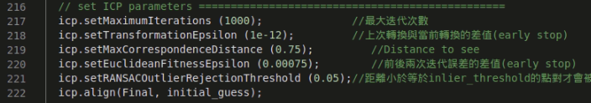
ICP Localization 2 --- Try to add initial x y z by wheel odometry diff ---
Adjust the parameters to be better.
RMSE = 0.12912

Slide 12
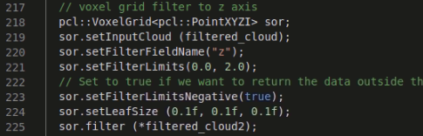
ICP Localization 2 --- Try to remove car using voxel filter ---
RMSE = 0.07595

Slide 13
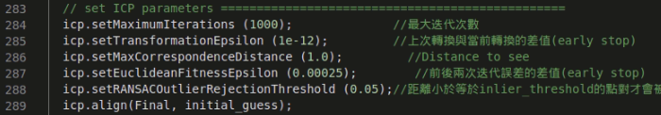
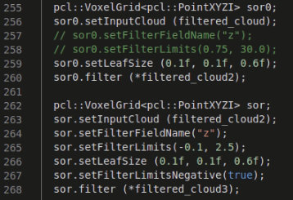
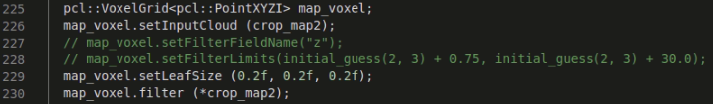
ICP Localization 3 --- Try to remove car using voxel filter ---
RMSE = 0.21848

Slide 14
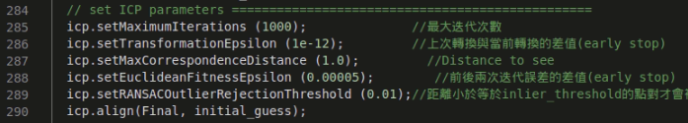
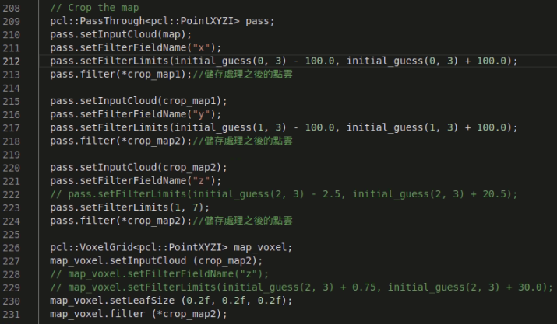
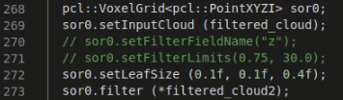
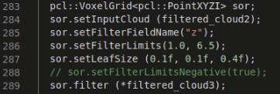
ICP Localization 3 --- Remove points that is too far (z) ---
RMSE = 0.11519

Slide 15
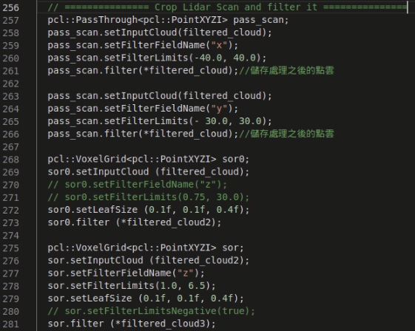
ICP Localization 3 --- Try to Remove points that is too far (xyz) ---
Reduce the computation time
RMSE = 0.13193 no better

Slide 16
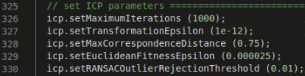
ICP Localization 3 --- Best case by adjusting parameters ---
RMSE = 0.06787

