Slide 1
Exploring the Attack Surface of Domain Control Validation in TLS Certificate Issuance
THESIS DEFENSE 3/3/25 | DEREK R. GREENE | OREGON STATE UNIVERSITY

Slide 2
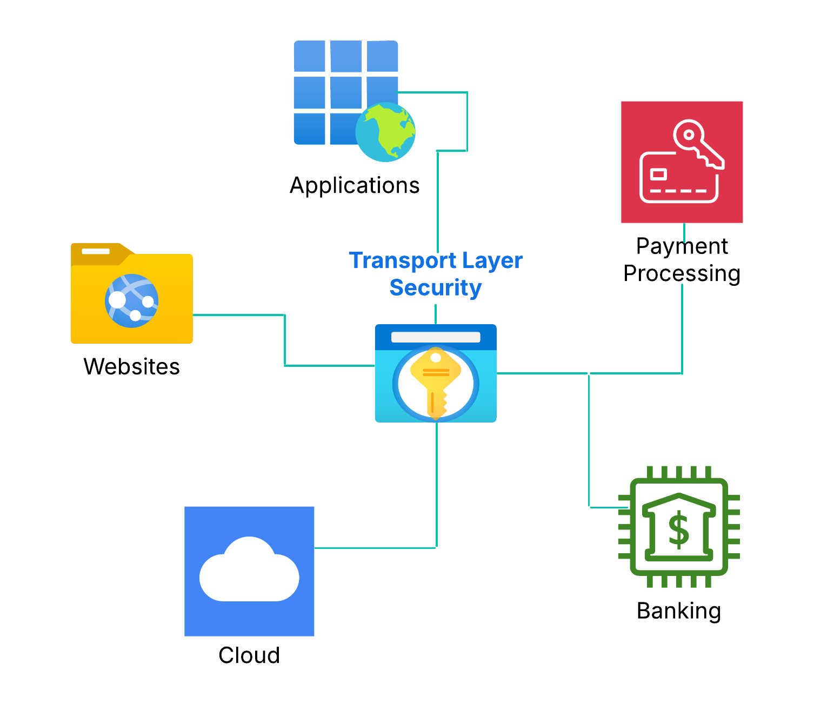


TLS is critical to security on the web!
TLS provides encryption for millions of websites, applications, and services on the internet.

Slide 3
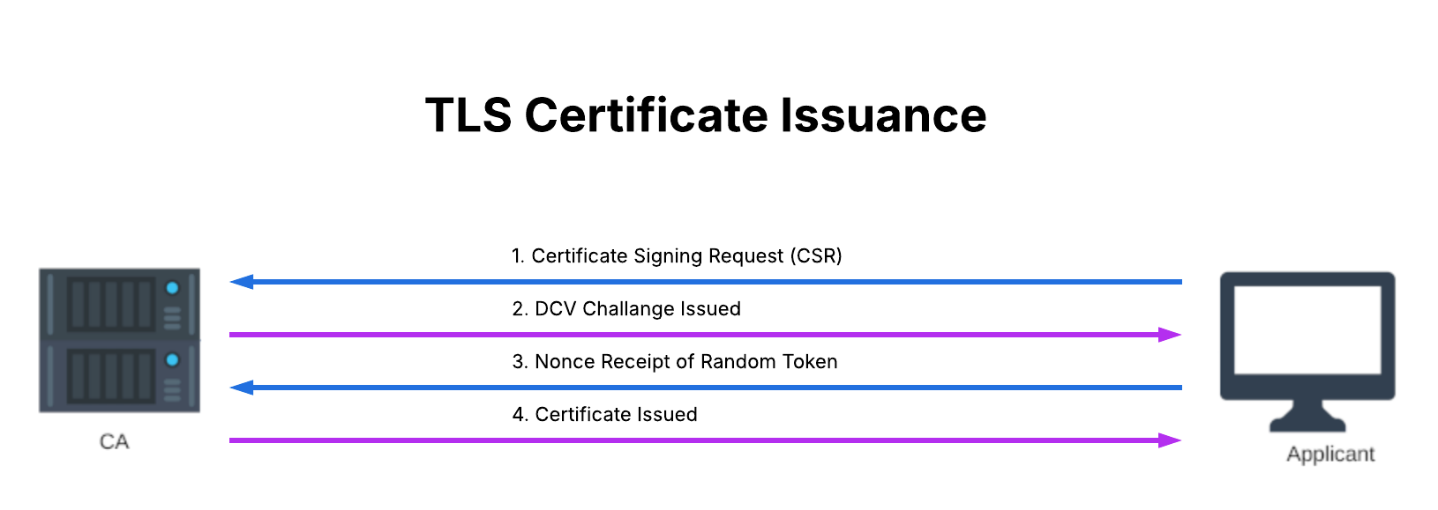
How TLS certificates are issued
Generate cryptographic key pair which is linked to a Fully Qualified Domain Name (FQDN).
Send Certificate Signing Request (CSR) with public key to a Certificate Authority (CA).
Complete the challenge provided by the CA.

Slide 4

If certificate issuance is compromised...
Attackers can obtain certificates for FQDNs they do not control to:
Impersonate domains & harvest sensitive information
Disrupt critical services on the web
https://miro.medium.com/v2/resize:fit:1024/1*Q_-MFLNcirIjOi1rm2mHuQ.png

Slide 5
Instances of Improper DCV
These examples represent cases when CAs failed to adhere to the BRs
Our research focuses on DCV methods with respect to their proper implementation as outlined in the BRs
August 24th 2016, WoSign’s certificate issuance system allowed applicants to specify port number for DCV.
GitHub.com: June 11th 2015, schrauger.github.io
https://www.wosign.com/report/WoSign_Incidents_Report_09042016.pdf

Slide 6
Domain Control Validation (DCV)
Challenges
The ecosystem is quite broad (millions of FDNs, fax, sms, postal mail, etc.)
DCV utilization is not reported in certificates nor transparency logs or any other unified source.
The DCV attack surface has not been well studied
Outdated methods such as fax, SMS, and postal mail are still in use.

Slide 7
Work to Address Issues
In order to identify weak and redundant DCV methods, we performed a comprehensive enumeration and mapping of the DCV attack surface.
This led us to create a novel approach to approximate DCV method frequency across CAs which we utilized to perform a de-bloating analysis outlining potential DCV methods for removal.
From our analysis we provide recommendations aimed at enhancing the overall security of the web PKI.

Slide 8
Presentation Outline
Overview of Domain Control Validation (DCV)
Research Objectives & Methodology
Dependency Concentration and Redundancy
Vulnerabilities
DCV Method Popularity
Broader Takeaways & Future Work

Slide 9
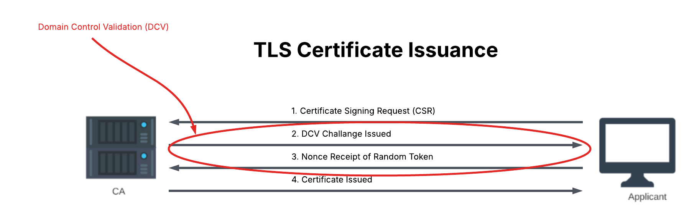
Role of DCV
DCV is the process that verifies an applicant has control over a domain before certificate issuance.
Consists of successful completion of 1 of 13 challenges outlined in the Baseline Requirements for Certificate Issuance.

Slide 10
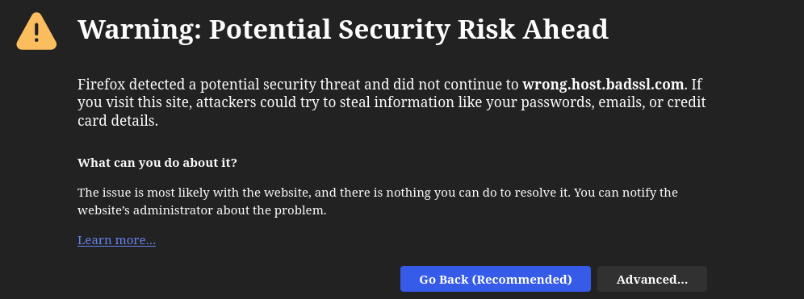
Why DCV is so Important
DCV is the initial authentication method for obtaining a certificate
Starting point for trust on the web

Slide 11
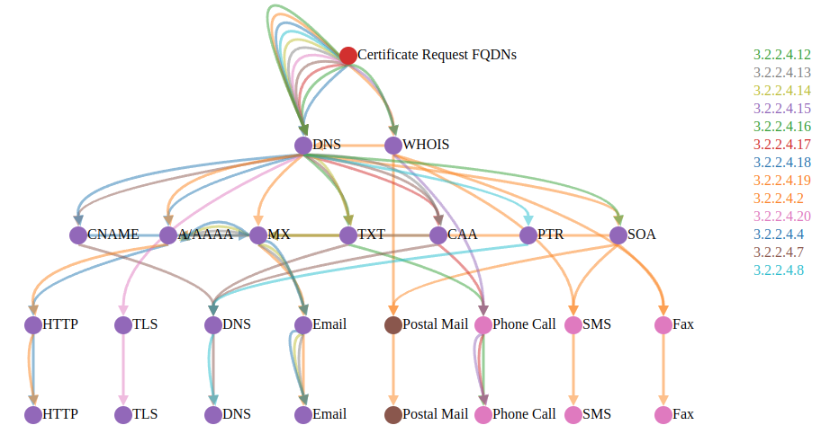
DCV Methods
13 DCV Methods
Communication Channels: SMS, FAX, Phone, Email, Postal Mail, DNS, TLS, and HTTP

Slide 12
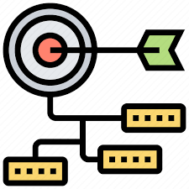
Research Objectives
Map DCV Attack Surface
Determine any weak or insecure methods
Enumerate potential methods for de-bloating to reduce attack surface and remove redundancy
https://cdn3.iconfinder.com/data/icons/talent-management-9/64/cascading-goals-organization-process-management-512.png

Slide 13
Methodology
Goal was to measure diversity and frequency across CAs
Diversity is measured in two ways
      Number of CAs that support each BR method
      Numbers of CAs that support each DCV node
Data Sources
Certificate Logs streamed from Certstream Server Go
CAA and TXT DNS records obtained through ZDNS scans
WHOIS
Common CA Database
Chrome Root Store CA data provided by Google

Slide 14
Methodology Continued...
13 DCV Methods
4 root stores
  Chrome
  NSS (Mozilla)
  Microsoft
  Apple
Semi-automated Approach
Developed script to download all Certificate Practice and Policy statements.
Fed PDFs to chatgpt-4o llm model (manual verification of results on a subset of the sample)

Slide 15
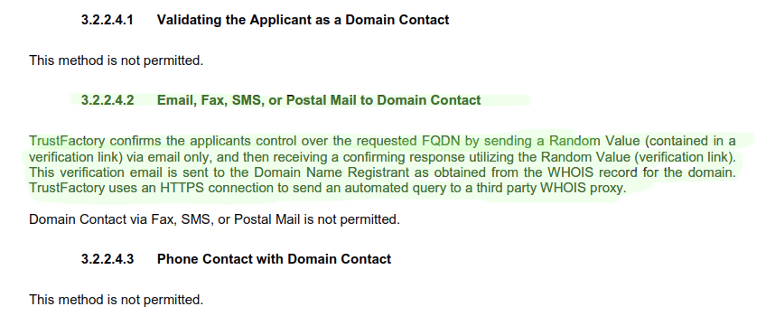
Methodology Continued...
"www.trustfactory.net_repository_trustfactory_ssl_issuing_ca_cps_v1.7.pdf":
“Based on the document analysis, the following methods for domain control validation are used:\n\n- **3.2.2.4.2** Email, Fax, SMS, or Postal Mail to Domain Contact\n- **3.2.2.4.4** Constructed Email to Domain Contact\n- **3.2.2.4.18** Agreed-Upon Change to Website v2\u30104:0\u2020www.trustfactory.net_repository_trustfactory_ssl_issuing_ca_cps_v1.7.pdf\u3011."

Slide 16
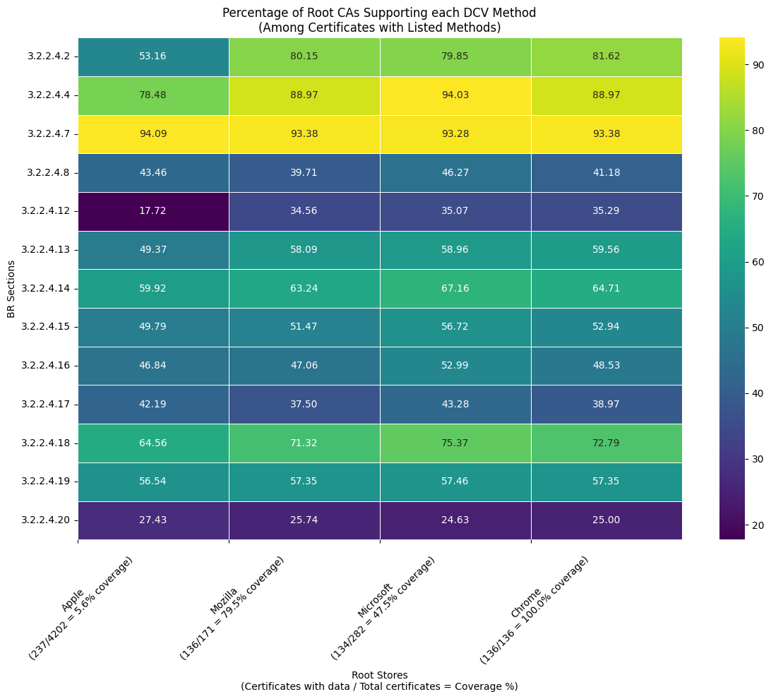

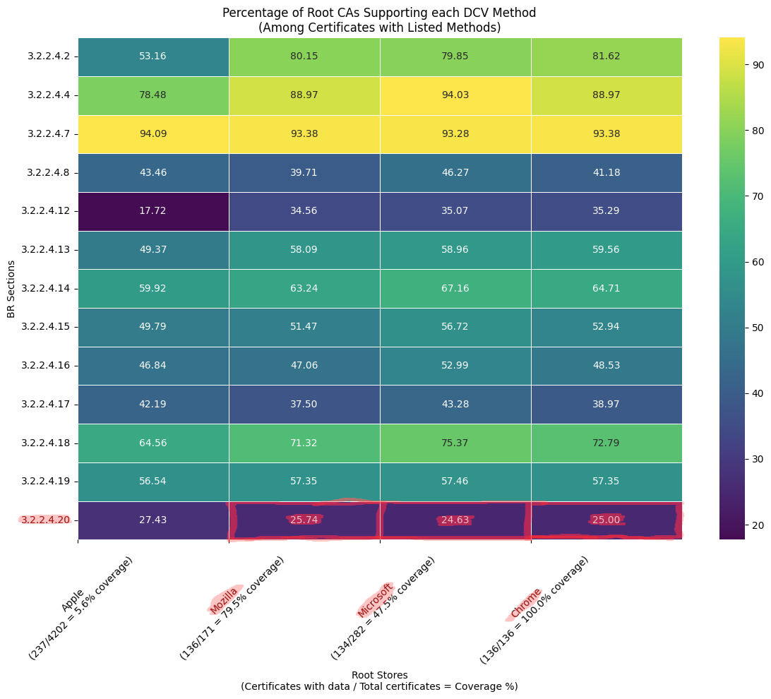
Methodology Continued...
To create an estimate of popularity, we totaled the number of CAs and Parent CAs that support each method across each root store

Slide 17
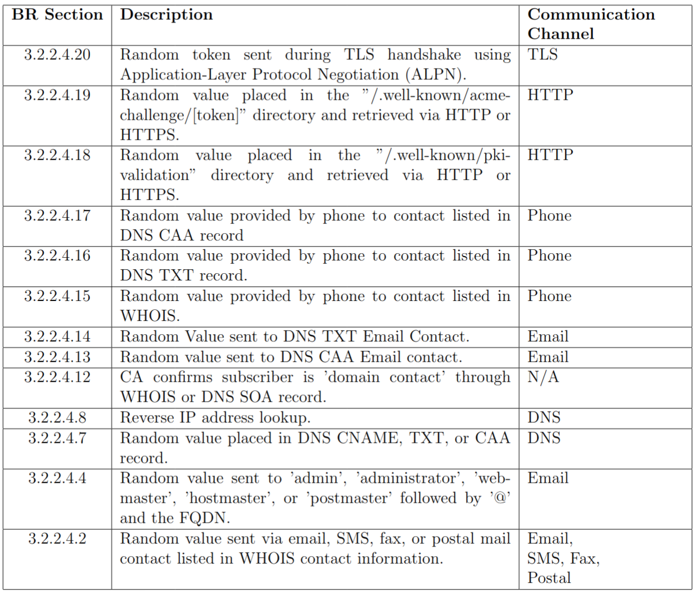
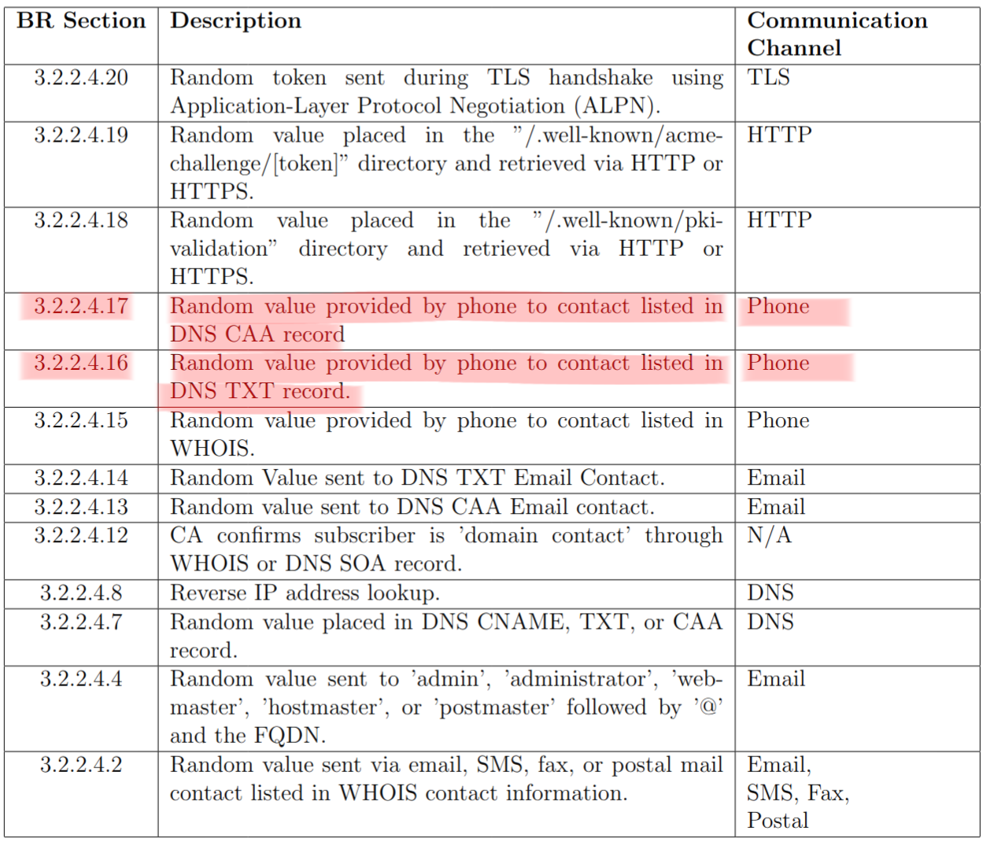
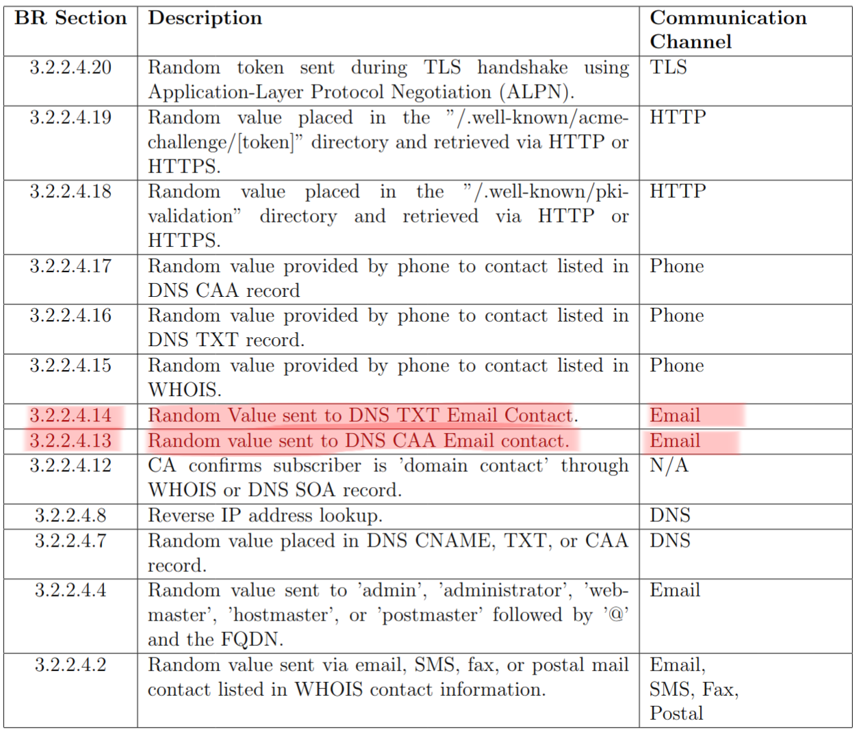
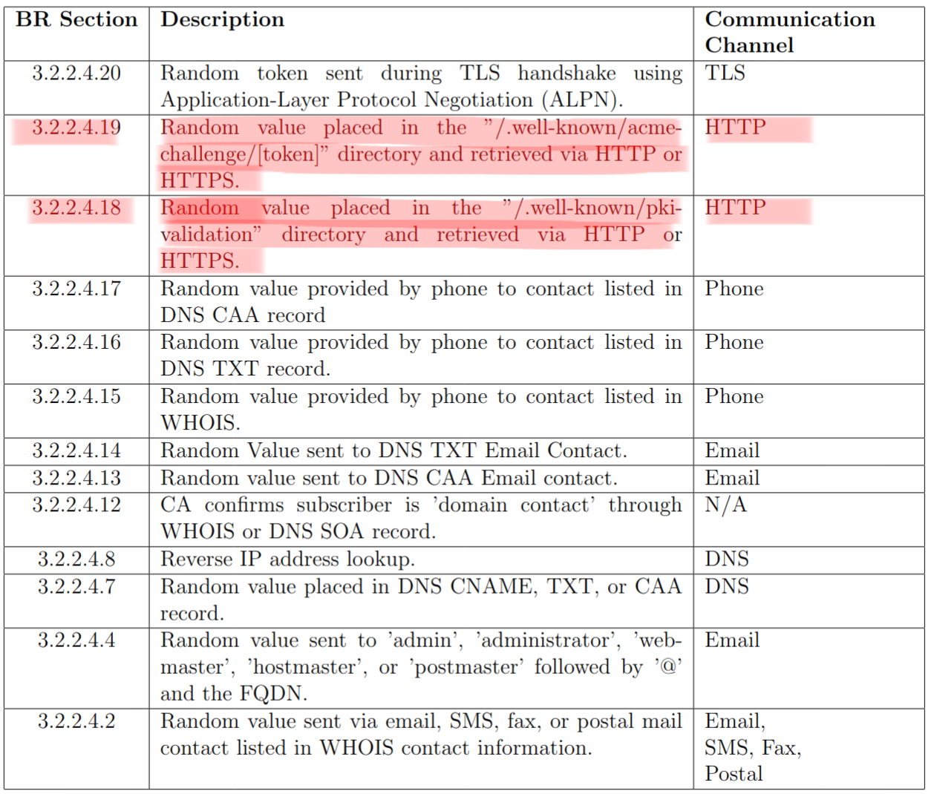
Dependency Concentration & Redundancy
Dependency concentration in DCV methods increases the potential attack surface.
Most CAs only require a single successful DCV method
Every node results in a single point of failure

Slide 18
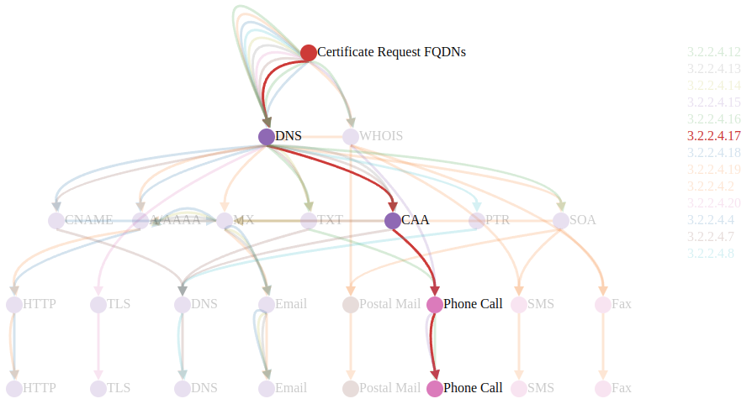
Dependency Concentration & Redundancy Continued…
1. Certificate Signing Request (CSR)
2. CA queries DNS
3. DNS CAA record lists contact phone
4. CA calls contact phone
5. Subscriber confirms

Slide 19
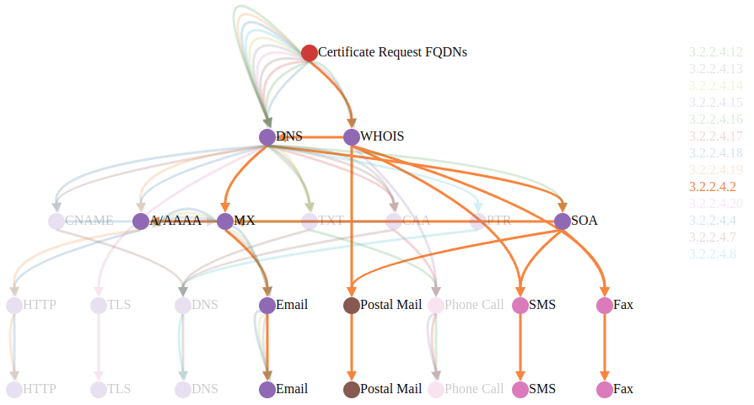
Dependency Concentration & Redundancy Continued…
1. Certificate Signing Request (CSR)
2. CA queries DNS or WHOIS
3. DNS SOA, or A/AAAA and MX
4. CA emails, mails, faxes, SMS token
5. Subscriber confirms random token

Slide 20
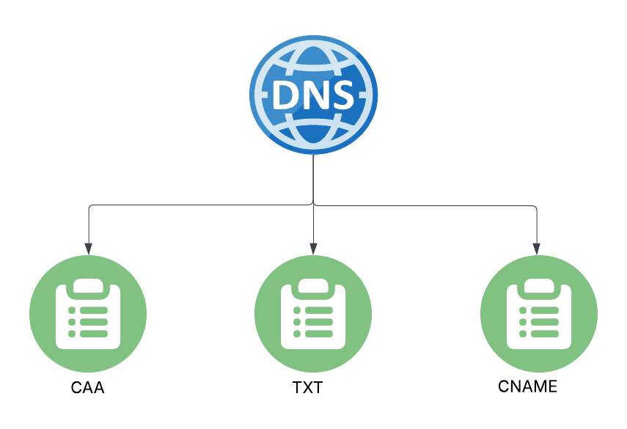
Overlapping DCV Methods
3.2.2.4.7 DNS Change
3.2.2.4.13 Email to DNS CAA Contact
3.2.2.4.14 Email to DNS TXT Contact
3.2.2.4.16 Phone Contact with DNS TXT
3.2.2.4.17 Phone Contact with DNS CAA
Same level of control required required to place contact info in each DNS record

Slide 21
Impact of Compromise at Each Node
Individual contact information
Emails
Phone/Fax numbers
Postal address
Contact infrastructure provider
DNS
WHOIS
HTTP
EMAIL
Phone

Slide 22
Vulnerabilities
Web Infrastructure Security
CA issuance security
Network-level attackers can exploit BGP prefix hijacking to reroute traffic
Attackers can obtain cloud IP addresses with stale DNS records
Prior work has shown multiple DNS hijacking/spoofing attacks exist
Certificate invalidation events lead to stale TLS certificates
Miscellaneous
Attacks can exploit disposable email used in DNS or WHOIS records to obtain TLS server certificates for domains they do not control.

Slide 23
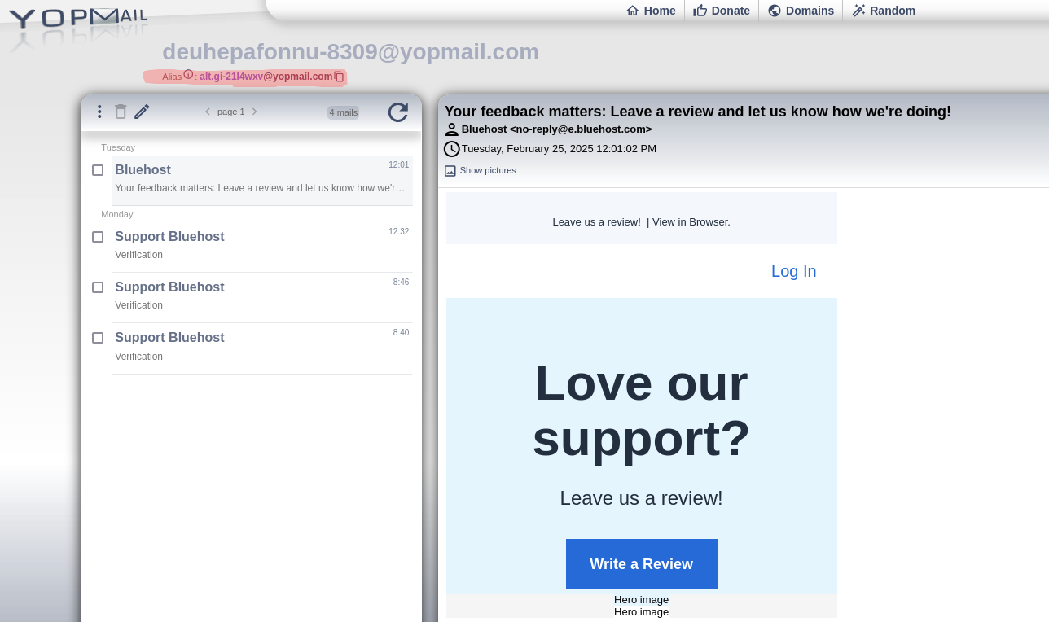
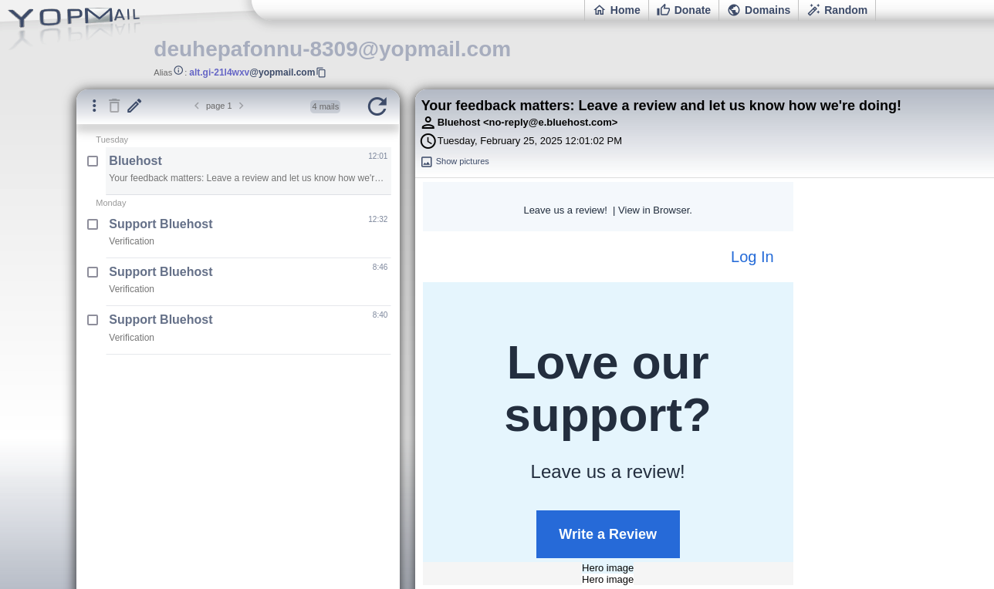
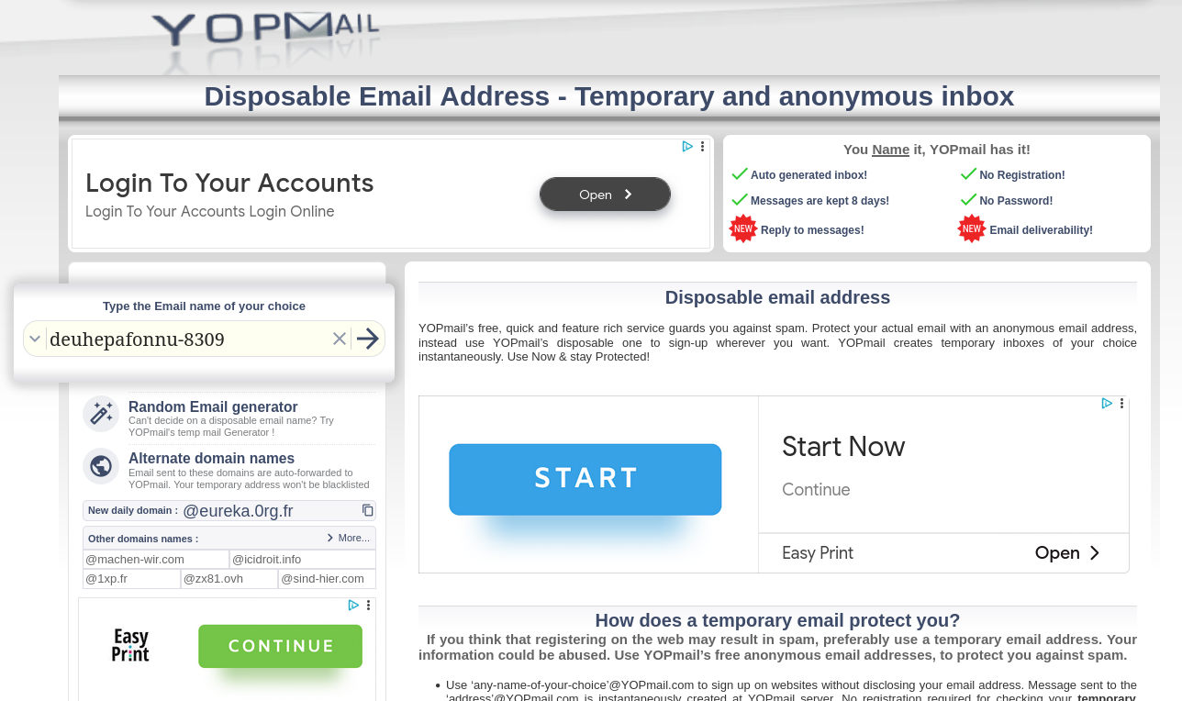
What is a Disposable Email?
Temporary email address that can be used and then discarded.
In many cases there is no password associated with an inbox
YOPmail – only need to know email address to access inbox

Slide 24
Disposable Email in DCV
Scripts developed to parse WHOIS, CAA, and TXT records for surveilled domains
Compiled 15k+ known disposable email domains
Developed DomainScout application to identify and log domains using known disposable email.
13,153 domains @yopmail.com

Slide 25

DCV Popularity
contact@privacyprotect.org listed in WHOIS for (2.2%)
Gmail most popular email provider with (3.2%)
Outlook (0.6%)
AOL (0.39%)
Yahoo (0.34%)
https://media.licdn.com/dms/image/C4D12AQEBD2TPyqD7Uw/article-cover_image-shrink_720_1280/0/1531512583383?e=2147483647&v=beta&t=5jksQFDTkNTXrPqvyJVSAnLV9_TaNZSj7W4yGIcqXqc

Slide 26
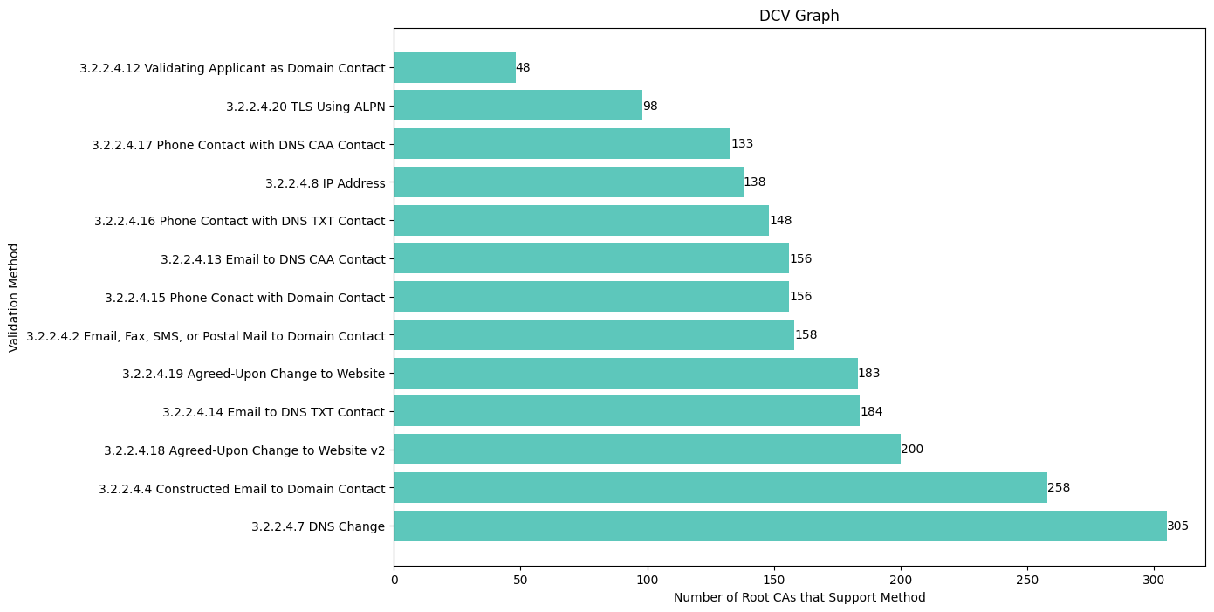
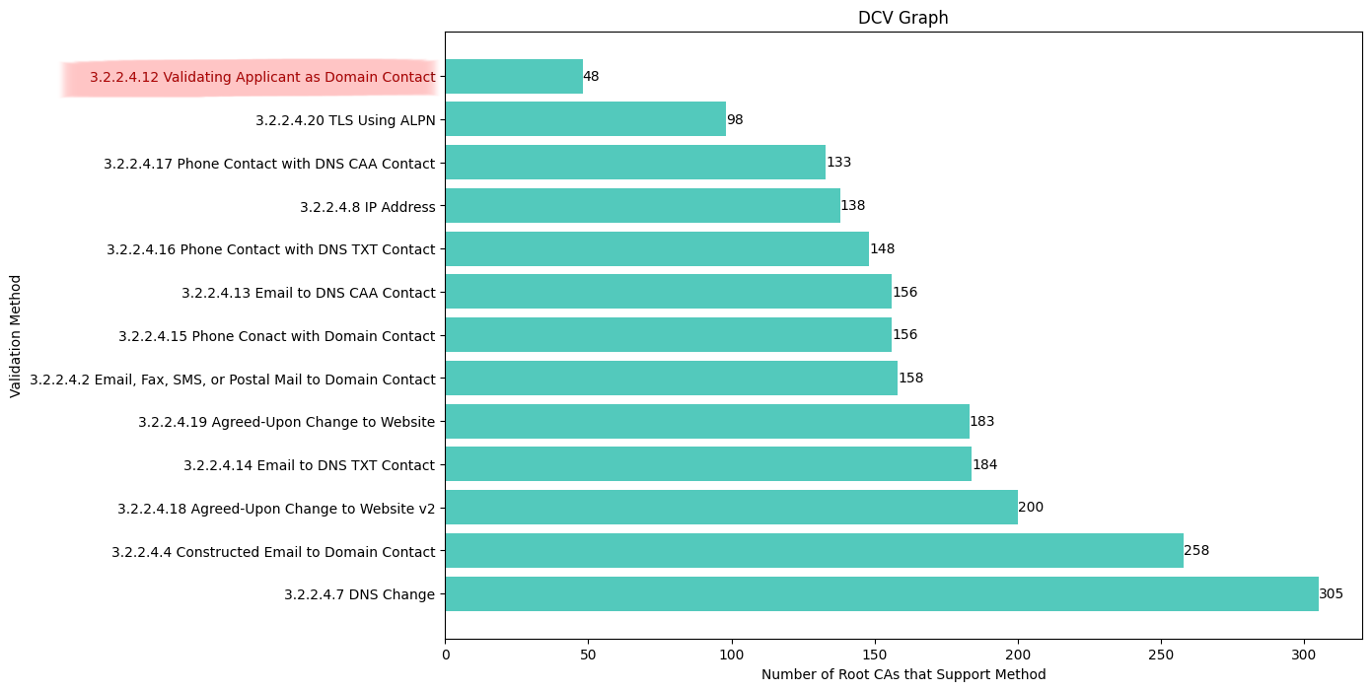
DCV Frequency
Data recording which DCV method used is not publicly available.
CAs and Parent CAs were compared against each DCV method that they support.

Slide 27

Broader Takeaways
Current set of DCV methods include less-secure, legacy communication channels
Wide attack surface with overlapping dependencies
TLS Certificates are keystone of server identity on the web
DCV is the initial starting point for authentication in the web PKI
Ultimately, reducing the attack surface by eliminating redundant and less secure DCV methods will improve the security of the web PKI
https://media.istockphoto.com/id/1350655687/vector/key-takeaway-speech-bubble-icon.jpg?s=612x612&w=0&k=20&c=x6hvHhSfprt0Lp3DVmZOAmLv1bgFA_l0ZAcTBK9Ff0M

Slide 28
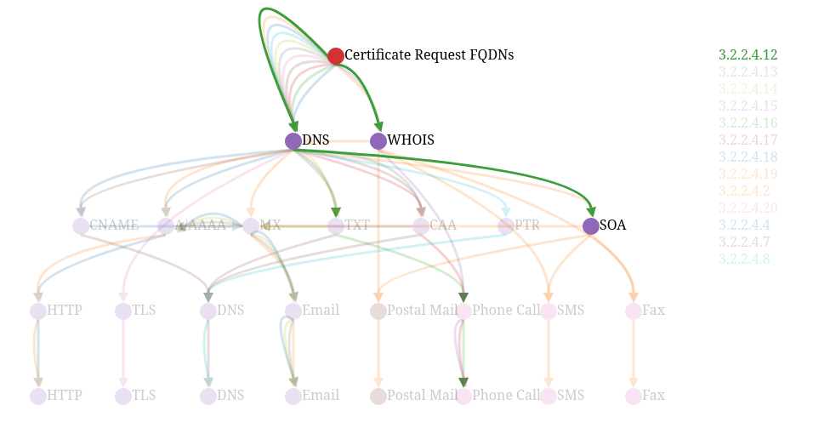
Recommendations
Low utilization/support across CAs
Method is unclear/under specified
Retirement of BR section 3.2.2.4.12

Slide 29
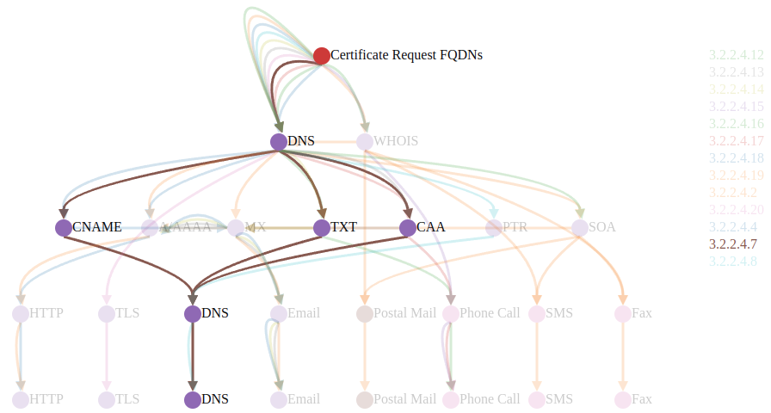
Recommendations Continued...
De-bloating BR sections
3.2.2.4.13
3.2.2.4.14
3.2.2.4.16
3.2.2.4.17
3.2.2.4.7
Wide Attack Surface
Reliant upon redundant infrastructure (multiple DNS records)

Slide 30
Future Work
Future work can be performed in collaboration with CAs to obtain and analyze DCV utilization data
Better quantification of risks (sms, fax, etc)
A deeper quantification of the impact of disposable email services used in DCV
We plan to submit our research to the Internet Measurement Conference in May.

Slide 31

Dr. Ma: For your guidance, mentorship, and continuous support throughout this journey.
Landon Greene: For your love, patience, and being my constant source of motivation
Acknowledgments
Dr. Ma: For your guidance, mentorship, and continuous support throughout this journey.
Landon Greene: For your love, patience, and being my constant source of motivation.

