Slide 1


Measuring Hospital Acquired Infection (HAI) Rates under Incomplete Sampling
Derek Sonderegger¹, Jason Sahl², Paul Keim²
¹ Dept. of Mathematics, Northern Arizona University
² Pathogen & Microbiome Institute, Northern Arizona University

Slide 2
Background
C. diff bacteria often infects hospital patients.
Federal funding requires identifying hospital acquired infection (HAI) vs already present.
Genotype bacteria from all N patients.
Group similar bacteria genotypes into clusters of patients.
Assume first patient brought it to the facility, rest are HAIs.
JSM 2019
of 7

Slide 3
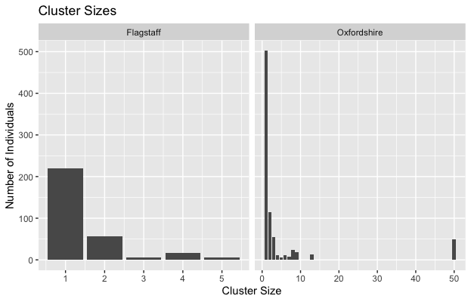
Data Sources
Two regional healthcare providers.
Oxfordshire has a large cluster.
JSM 2019
of 7

Slide 4

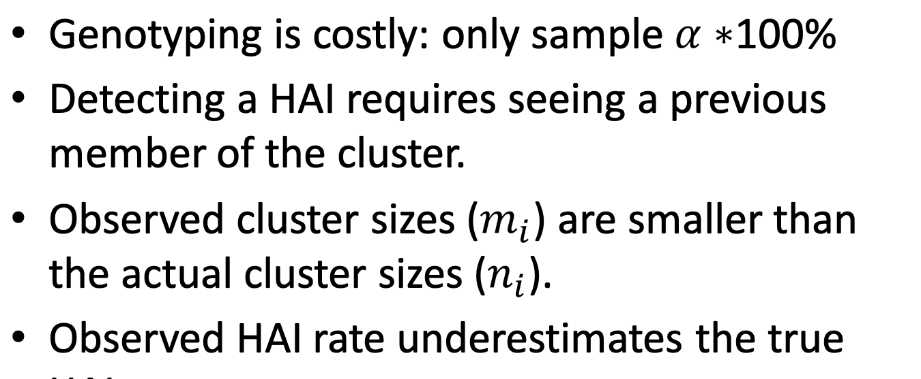
JSM 2019
of 7

Slide 5
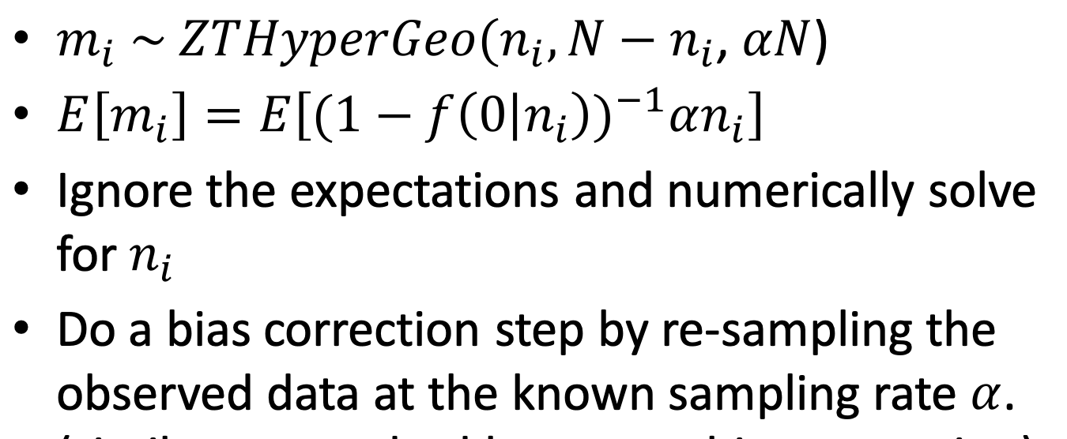
Zero Truncated Hypergeometric
JSM 2019
of 7

Slide 6
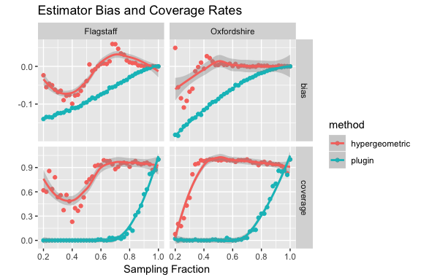
Results
While better, we still need 50% sampling effort or greater for satisfactory bias/coverage, particularly with many small clusters.
JSM 2019
of 7

Slide 7
References etc.
More Information
References
R package at:
github.com/dereksonderegger/HAI
Eyre, D. W., Cule, M. L., Wilson, D. J., Griffiths, D., Vaughan, A., O’Connor, L., … Walker, A. S. (2013). Diverse Sources of C. difficile Infection Identified on Whole-Genome Sequencing. New England Journal of Medicine, 369(13), 1195–1205. https://doi.org/10.1056/NEJMoa1216064
JSM 2019
of 7

