Slide 1
Index
Slide 2: First order BC, First order interior nodes with averaging (STABLE, Rounding)
Slide 3: First order BC, First order interior nodes without averaging (UNSTABLE)
Slide 4: First order BC, Centered Diff interior nodes without averaging (SEMI-STABLE, alternating jitter after first bounce)

Slide 2
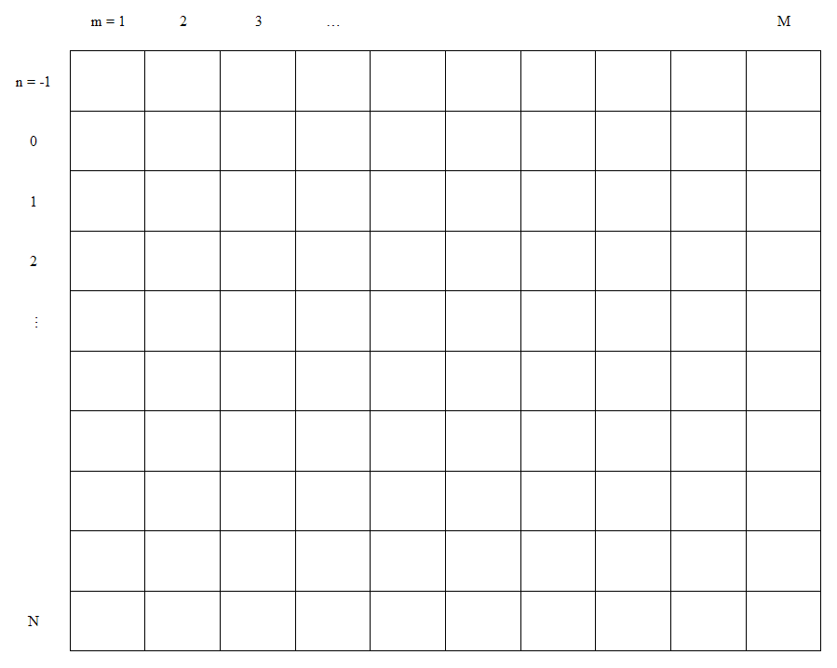
STABLE

Slide 3
UNSTABLE

Slide 4

SEMI STABLE

