Slide 1
Chapter 8

Slide 2
MEMORY MANAGEMENT
ADDRESS SPACE:
We have 2 types of address spaces:
Physical address – Memory address seen by the memory management unit (MMU). I.e. the actual hardware address.
Logical address – Address location generated by CPU.

Slide 3
MEMORY MANAGEMENT
ADDRESS BINDING:
When a program is loaded into memory the addresses of data and instructions must be mapped into memory locations. This is called address binding. The 3 methods of address binding are:
  Compile-time – The compiler generates absolute memory addresses (i.e. DOS .COM files). These programs can only reside at a specific location in memory and if that location is already occupied, the program cannot load.
  Load-time – The compiler generates relocatable code. With relocatable code each memory address is relative to a base address. So, when the program is loaded, it can load into any memory location.
  Execution-time – The compiler generates relocatable code. However, since it is possible that the program will be moved to different memory locations during its execution phase, the base address may change. Requires special hardware (an MMU).

Slide 4
MEMORY MANAGEMENT
ADDRESS SPACE and BINDING:
  Compile-time binding - logical addresses (generated by the CPU) and the physical addresses are the same.
  Load-time binding - logical addresses and the physical addresses being the same (once the program is loaded).
  Execution-time binding - logical addresses being different than the physical addresses. While the program runs the MMU re-maps the logical addresses to the correct physical address.

Slide 5
MEMORY MANAGEMENT
DYNAMIC MEMORY MANAGEMENT:
Up until the 1960’s (batch OS’s) it was common for one program to reside in memory. As programs outgrew the available memory methods were developed to conserve memory usage. These include:
  Dynamic loading – Only the main program loads at startup. Routines are not loaded until needed.
  Dynamic linking – Similar to dynamic loading. The compiler includes a stub for each routine used from the dynamic linked library (.DLL) in the user’s program. The stub has information as how to load the routine. When a routine from the DLL is needed, it is loaded into memory and the stub is replaced with the memory address of the routine.
  Overlays – Only a portion of the program is kept in memory. When another part of the program is required, it is loaded and overwrites the existing portion of the program that was in memory.
  Virtual memory – Similar to overlays, except the OS manages the process.

Slide 6
MEMORY MANAGEMENT
MEMORY VS CPU USAGE:
With multiprogramming we can make better use of the CPU. However, the assumption is not always valid. On average, programs are 80% I/O dependent. Therefore, it is very likely that at any given time, all of the processes will be waiting for I/O and the CPU will have nothing to do. The probability that the CPU will be idle at any given time is:
P^{n}
and CPU utilization is:
1 – P^{n}
We have assumed that the processes are independent. This is not completely accurate. But, the model does give us a good idea as to what is going on.
P = I/O dependence
n = # of processes

Slide 7
MEMORY MANAGEMENT
MEMORY VS CPU USAGE:
Even though the model is simple it can still be used to make approximate predictions about CPU usage. For example:
  Assume we have 1Meg RAM and the OS requires 200K and each of the 4 users requires about 200K. With an average I/O dependency of 80%, we get a CPU utilization of about 68%.
  If we add another 1Meg RAM, we can increase our degree of multiprogramming to 9 and we can raise our CPU utilization to about 87%. We’ve increased CPU utilization by about 28%.
  If we add another 1Meg RAM, we can increase our degree of multiprogramming to 14 and we can raise our CPU utilization to about 96%. We’ve further increased CPU utilization by about 10%.

Slide 8
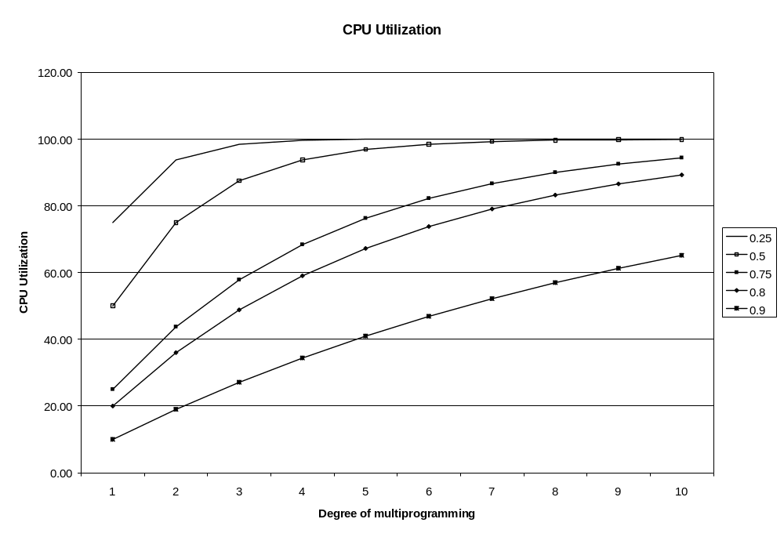
MEMORY MANAGEMENT
MEMORY VS CPU USAGE:
Case #2
Case #3
Case #1

Slide 9
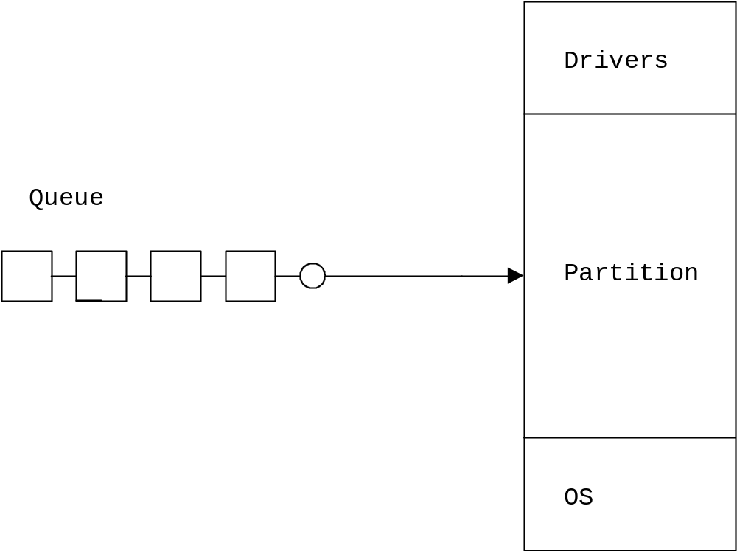
MEMORY MANAGEMENT
CONTIGUOUS MEMORY ALLOCATION:
With contiguous memory allocation, a program is allocated a chunk of memory large enough to hold the entire program. We can have a single memory partition or multiple memory partitions.
  Single memory partition – The OS and programs share the same memory partition. Used in DOS.

Slide 10
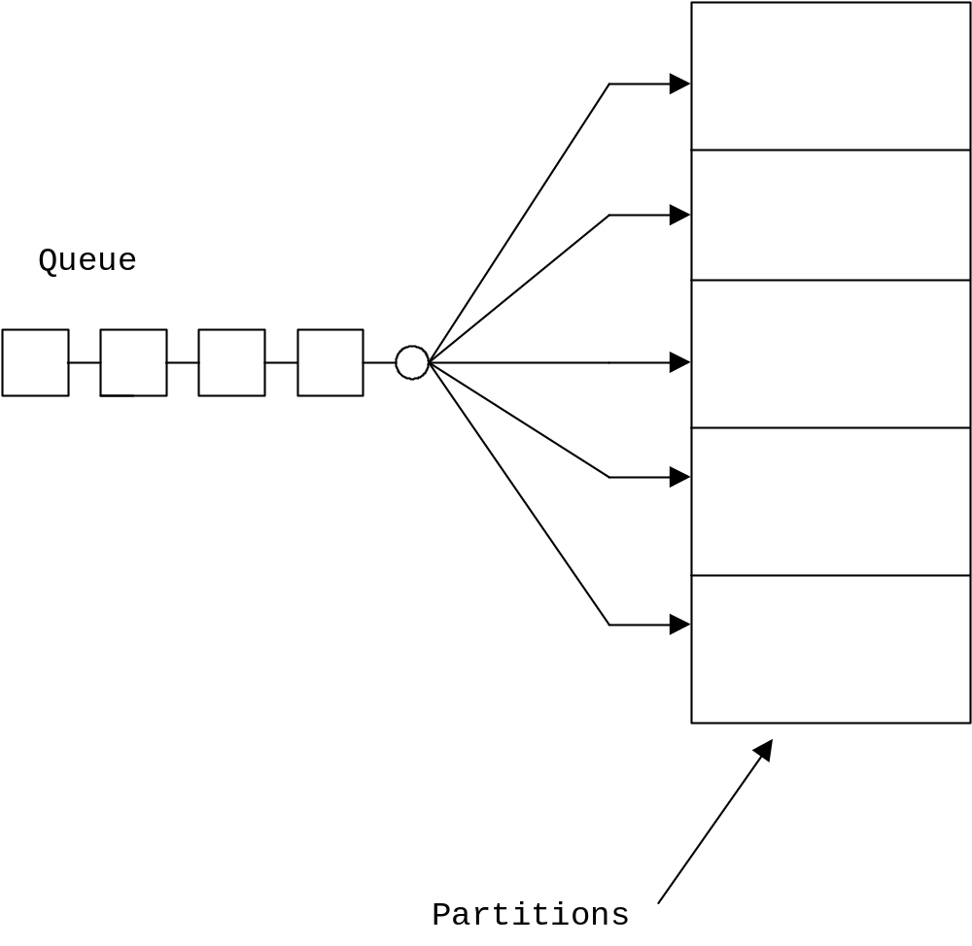
MEMORY ALLOCATION
  CONTIGUOUS MEMORY ALLOCATION:
  Fixed partition #1 – To allow more than one user program in memory, we need to allocate multiple partitions. The simplest method is to divide the memory into N fixed sized partitions. Where each partition can only contain 1 process.

Slide 11
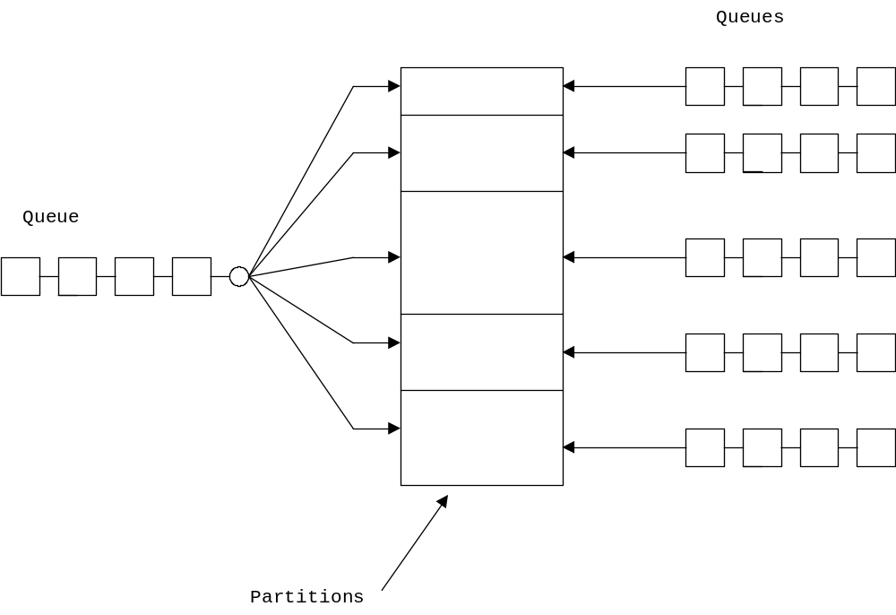
MEMORY ALLOCATION
  CONTIGUOUS MEMORY ALLOCATION:
  Fixed partition #2 – The method used in the IBM 360 was to allow the sys-admin to define multiple partitions, each of different size. Therefore, the system could be custom configured on a day-to-day basis (memory protection was by a 4-bit code assigned to each partition).

Slide 12
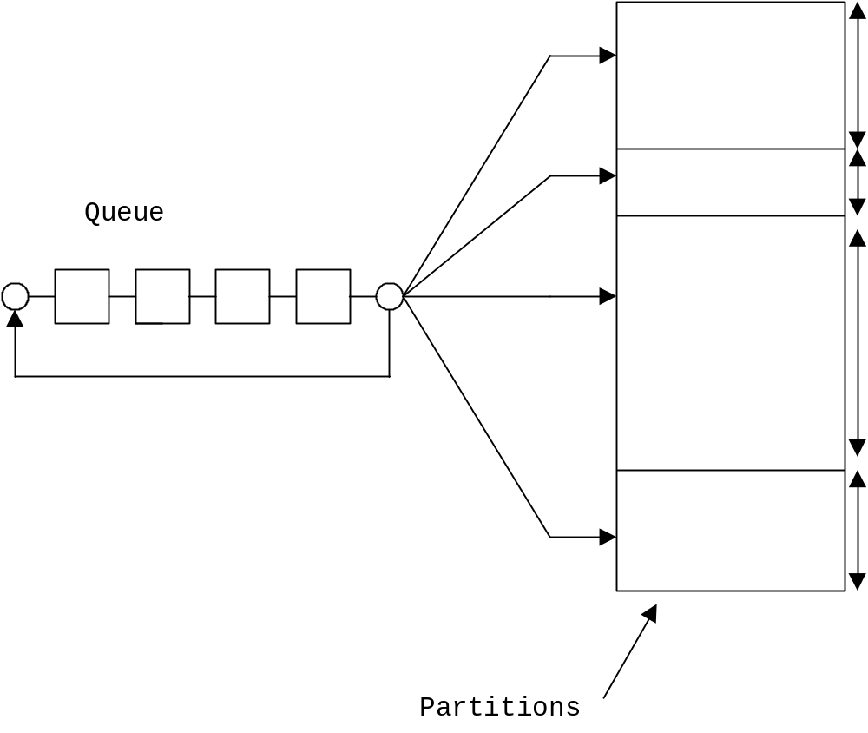
MEMORY ALLOCATION
  CONTIGUOUS MEMORY ALLOCATION:
  Dynamic partition – This scheme assumes that the partition sizes are dynamic (from process to process). This method requires some type of data structure (bit map, linked list, or table) to maintain a list of occupied memory locations and holes.

Slide 13
MEMORY ALLOCATION
  CONTIGUOUS MEMORY ALLOCATION:
  Segmented – Supports the user’s view of the memory. Where the memory is not broken down into fixed sized meaningless chunks, but into chunks (segments) of related material. Segments might include global variables, stack space, local variables for each routine, the code for each routine, etc.
  Segmentation makes protection and sharing easier.
  Segmentation memory management is very similar to contiguous multiple memory partition scheme #3 (variable sized partitions) and suffers from the same problem of external fragmentation and occasionally, internal fragmentation.
  Segmentation could be used in combination with paging.

Slide 14
MEMORY ALLOCATION
CONTIGUOUS MEMORY ALLOCATION:
When using the dynamic partition memory partitioning scheme, when a process terminates its memory partition is returned to the system (creating a hole in the memory – we also assume that adjacent holes are combined to form 1 larger hole). When another process becomes ready, the OS searches for a hole big enough to hold the process. If none are found, the process must wait until a large enough hole is available. If one is found, the process is allowed to start and to acquire the memory it needs (the left over memory is now marked/recorded as a hole).
Since we have random sized holes and processes requiring random sized holes, we need a method to manage this*. Assumptions:
  That there are holes scattered throughout the memory.
  That adjacent holes are combined into a single larger hole.
  That memory compaction (i.e. disk defragging) is not done because it is too expensive (except on the CDC Cyber mainframes which had special hardware to do this).
* This same problem occurs with many disk file systems.

Slide 15
MEMORY ALLOCATION
CONTIGUOUS MEMORY ALLOCATION:
External fragmentation – As processes are loaded and terminated, the memory holes get broken down into smaller and smaller holes.
  50% rule - With the BEST-FIT allocation method, averaged over time, there will be half as many holes as processes. Therefore, 1/3 of the total memory will be wasted. This rule also applies to swap systems.
  Unused memory rule – Used to determine percentage of wasted memory (%W). Let:
K = average hole size / average process size
%W = K / (K + 2)
Internal fragmentation – A process may require all but a few bytes of an available hole. Since it is probably not worth the effort to allocate only the required memory and have to record a small hole, we would allocate the entire hole to the process. The leftover unused section is called the internal fragmentation.

Slide 16
MEMORY ALLOCATION
CONTIGUOUS MEMORY ALLOCATION:
We know that fragmentation is a concern and that compaction is not feasible, so several allocation methods have been proposed to reduce the fragmentation problem:
First fit – Allocate the first hole that is big enough (a greedy method). Fast, but the problem here is that we may allocate a hole that is much larger than required.
Best fit – Allocate the smallest hole that is big enough. Since we must search the entire list of holes, this method is slow, but does the best job (simulations suggest it is about equal to FIRST-FIT) of allocating memory.
Worst fit - Allocate the largest hole. Since we must search the entire list of holes, this method is slow, and does the worst job of allocating memory.
Quick fit – Maintains a list of commonly requested partition sizes. Fast, but only for holes of exactly the commonly requested size.
Buddy system – Maintains a dynamic binary tree of holes (leaf nodes are called buddies). Fast, but is inefficient as all memory partitions must be a power of 2.

Slide 17
MEMORY ALLOCATION
CONTIGUOUS MEMORY ALLOCATION:
If a program, using dynamic memory techniques, tries to acquire additional memory after it has begun execution, we have 3 choices:
  If there is an adjacent hole, allocate the required additional memory from it.
  Rearrange the processes in memory such that an adjacent hole is formed.
  Kill the process.

Slide 18


