Slide 1
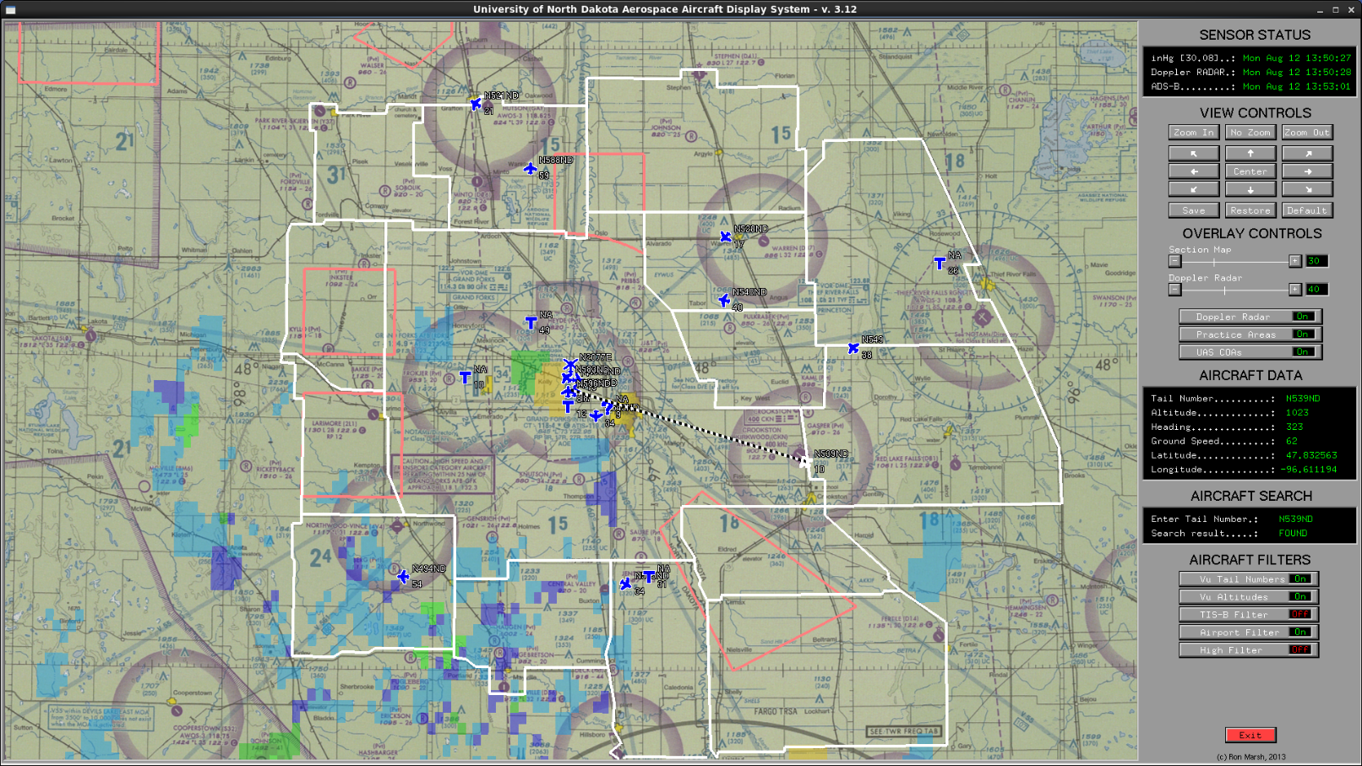
MUTEX CASE STUDY:
The Aerospace Airport Display System (AADS) would acquire ADS-B position data for all ADS-B equipped aircraft and display that information on the screen (as an Information Display System – IDS). The display background was an aviation sectional chart.
The user could zoom, pan, scroll, and adjust the opacity of the display. The user could also search for specific aircraft.
The user could also toggle the display to show UND practice and UAS areas, the Doppler RADAR, and aircraft text data (tail number and altitude)

Slide 2
MUTEX CASE STUDY:
The AADS relied on 3 data sources to keep the display up to date.
The AADS would acquire ADS-B data from a Garmin ADS-B receiver (via a socket connection) once per second.
The AADS would acquire weather data from a webpage (via wget) and was downloaded every 7 minutes (twice the data rate – Nyquist sampling criteria).
The AADS would acquire Doppler RADAR from another webpage (via wget) and was downloaded every 7 minutes (twice the data rate – Nyquist sampling criteria).
As the display was an IDS, we expect that the user would make changes to the display (zoom, pan, scroll, etc) as the system was running. As such, one could argue that we have 4 concurrent (possibly simultaneous) processes running.
We also had to consider that the system was part of the Aerospace Safety Management system and had to be reliable (could not fail).
The solution was to use threads as they would provide a more robust system (if a thread failed we would restart it without restarting the entire system – in fact, we spawned threads when needed and killed them immediately after) and would provide for good interactivity (e.g. the user could zoom while the system was downloading a new Doppler RADAR map).

Slide 3
Main/Parent
MUTEX CASE STUDY:
Section Map
Black text indicates static GUI items (widgets or data).
Aircraft Icons
Lambert
Conversion
Text
Practice Areas
Buttons
Aircraft Data
GUI
Lambert
Conversion
Sliders
Doppler Map
Windows
Doppler RADAR
Lambert
Conversion
Weather data
ADS-B
Red text indicates a thread started by GUI.
Each thread has an associated mutex.

Slide 4
MUTEX CASE STUDY:
The most complex component was the Doppler RADAR system:
For each new radar image we have to download it from a webpage, then crop it to fit our display, then convert the color scale, and then convert the image from Cartesian coordinates to inverse Lambert Conformal coordinates (reduced aliasing). This took several minutes, but we then had a new Doppler RADAR image layer to replace the old Doppler RADAR image layer on the display.
So, the algorithm could be:
IDS:
mutex(lock)
write RADAR image to screen
mutex(unlock)
The drawback is that if the user was doing a lot of GUI activity the RADAR image would have to constantly be written to the screen, and:
The Doppler thread could be repeatedly blocked.
The GUI (Main/parent) would be blocked (e.i. entire GUI would freeze).
Doppler thread:
mutex(lock)
wget RADAR image
crop RADAR image
inverse Lambert Conformal coordinates conversion
mutex(unlock)
Critical section

Slide 5

MUTEX CASE STUDY:
The moral of the story is that while a mutex can
solve the critical section problem. Lengthy delays are still possible.

Slide 6
MUTEX CASE STUDY:
So, the revised algorithm was:
We start be defining two pointers to the image data type and allocate memory to them:
unsigned char **radar1, **radar2;
radar1 = (unsigned char **)calloc(RADAR_image_height, sizeof(*unsigned char));
radar2 = (unsigned char **)calloc(RADAR_image_height, sizeof(*unsigned char));
for (y = 0; y < RADAR_image_height; y++) {
radar1[y] = (unsigned char *)calloc(RADAR_image_width, unsigned char);
radar2[y] = (unsigned char *)calloc(RADAR_image_width, unsigned char);
}
We now use the radar1 array to display the RADAR image.
IDS:
mutex(lock)
write RADAR image (radar1) to screen
mutex(unlock)
Critical section

Slide 7
MUTEX CASE STUDY:
The revised algorithm (cont):
We now use radar2 array for the initial RADAR processing.
Doppler thread:
wget RADAR image
crop RADAR image
inverse Lambert Conformal coordinates conversion
mutex(lock)
swap what pointers radar1 and radar2 point to
mutex(unlock)
Since, we now have 2 separate arrays, this version can move the previous long running critical section to the remainder section.
The new critical section is MUCH faster and resulted in no perceivable delay in the system.
All on radar2
Critical section

Slide 8

MUTEX CASE STUDY:
The method we used to improve system performance is called “double buffering” and while not quite as good pulling a Rocky out of a hat. Double buffering definitely is a technique used to move long running code out of a critical section.

Slide 9
