Slide 1
Chapter 6

Slide 2
UNI-CPU SCHEDULING:
CRITERIA:
Many different scheduling criteria have been proposed. A few include:
  CPU utilization – We want to keep the CPU as busy as possible.
  Throughput – We want to maximize the number of processes being completed per unit time.
  Turnaround time – We want to minimize the time it takes for a job to be completed.
  Wait-time – We want to minimize the time the process spends in the ready queue.
  Response time – We want to minimize the time between input of a command and the response.
  Variance – We want to minimize the variance in the response time.
We would like to achieve all of the above; that is seldom possible. So we settle for some average value. Furthermore, some of these may be obsolete. For example, does it make any sense to use CPU utilization as a scheduling criteria?

Slide 3
UNI-CPU SCHEDULING:
OBJECTIVES:
Scheduling objectives include:
  Should be fair to all processes.
  Should attempt to service the maximum number of processes per unit time.
  Maximize number of interactive users receiving acceptable response times.
  Predictable.
  Minimize overhead.
  Balance resource use.
  Enforce priorities.
  Give preference to any process holding key resources.
  Avoid indefinite postponement - Indefinite postponement can be as bad as deadlock.
  Give priority to well behaved processes.
  Graceful degradation.
  Again, we would like to achieve all of the above. However, that is seldom possible.

Slide 4
UNI-CPU SCHEDULING:
TYPES:
  Non-preemptive – Once a process has been given the CPU the CPU cannot be taken away from that process. However, the process can, but doesn’t have to, release the CPU while performing I/O.
  Preemptive – The CPU can be taken away by the OS. Characteristics of preemptive scheduling include:
      Useful in systems where high-priority processes require rapid attention.
      Required in interactive systems.
      Preemption incurs overhead (context switching, memory required to hold jobs waiting in ready queue, mechanisms to protect resources held by a waiting process, and CPU cycles lost to the scheduler).

Slide 5
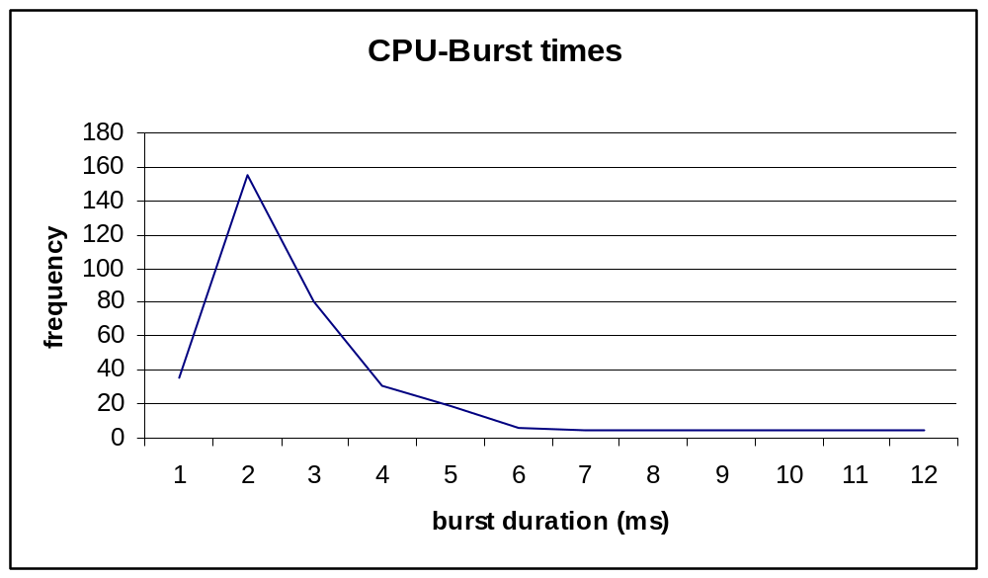
UNI-CPU SCHEDULING:
CPU I/O BURST TIMES:
CPU-burst times can be of use to determine a “good” time slice criteria. Some statistical methods include using the peak height, half peak height, and the peak base height.
I/O-burst times may also be of use.

Slide 6
UNI-CPU SCHEDULING:
METHODS:
First-Come First-Served (FCFS). Characteristics include:
  Simplest (simply a FIFO queue).
  Wide variation in waiting times.
  Non-preemptive – which can cause a convoy effect.
  Not applicable to time-shared or interactive systems.
Shortest-Job-First (SJF) - The job with the shortest next CPU-burst cycle is run first. Characteristics include:
  Optimal in reducing the waiting time.
  Difficult to determine shortest next CPU-burst cycle – the next CPU-burst cycle can be estimated using a moving average (exponential or linear).
  Non-preemptive – the current job is allowed to finish, even if a (new) job with a shorter next CPU-burst cycle arrives at the ready queue.
Shortest-Remaining time – Almost identical to the Shortest-Job-First method. Characteristics include:
  Preemptive – the current job is preempted if a (new) job with a shorter next CPU-burst cycle arrives at the ready queue.

Slide 7
UNI-CPU SCHEDULING:
METHODS:
Priority – Jobs are run based on priority. Characteristics include:
  Job priority may be static or dynamic.
  Job priority may be determined internally (resource requirements) or externally (company policies).
  Can be preemptive or non-preemptive.
  Can result in low-priority jobs being starved.
Deadline – Jobs that are required to complete by a specific time are given priority. Characteristics include:
  Complex – Resource requirements need to be accurately specified by the programmer.
  Multiple deadline jobs can create problems/resource conflicts.
Round-Robin (RR) – Processes are run for a maximum of 1 time-quantum. They are then preempted and place on the tail of the ready queue. Characteristics include:
  Designed for time-shared systems.
  Similar to FCFS, but preemption is added to switch between processes.
  A process may use less than the time-quantum if I/O is required.
  Average wait time is long, but average response time is short.

Slide 8
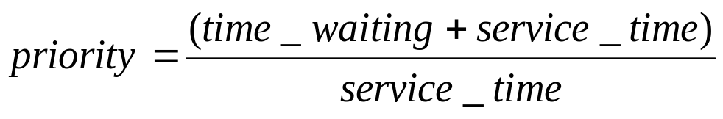
UNI-CPU SCHEDULING:
METHODS:
Multi-level – A method that provides different levels of priority for different groups of users / job types. Characteristics include:
  Each level may have a separate queue and may use a different scheduling method.
  A “master” scheduler allocates system resources to each queue. It is common to use a priority method between the queues (no lower priority queued job runs until all higher priority queued jobs are completed) or a Round-Robin method between the queues (the higher priority queued jobs get more or longer time quantum than the lower priority queued jobs).
Multi-level feedback – Similar to the Multi-level, except:
  Jobs can migrate up to a higher priority queue as they age. Or can migrate down to a lower queue if they require too much CPU time.
Highest-Response-Ratio-Next (HRN) – Corrects some of the weaknesses of the Shortest-Job-First methods:
  Non-preemptive.
  Priority determined by:

Slide 9
UNI-CPU SCHEDULING:
METHODS:
Linux - This algorithm is a credit based algorithm. Each process is given a certain number of credits. When a new task is to be run, the process with the most credits runs. As a process runs, every time a timer interrupt occurs, the process losses one credit. When its credit count reaches 0, it is suspended and another process is chosen to run.
If no runnable processes have any credits, Linux re-credits all (even the non-runnable ones) of the processes according to:
credits = (held_credits / 2) + priority
This method favors processes with high priority and processes that have not run in a long time, but are I/O bound (non I/O bound processes are not favored).

Slide 10
UNI-CPU SCHEDULING:
SCHEDULING EVALUATION:
Deterministic modeling – Uses a predetermined workload to determine system characteristics. The method is simple and fast and gives exact numbers for the cases tried, but is only useful for demonstrative purposes (unless you run 100’s of cases, but, then you have a simulation).
Queueing models – Use queuing statistical models. The method is useful in comparing scheduling methods. However, the classes of models that can be handled are limited and the math is too complicated to develop a new model. So assumptions are made to simplify the math.
Implementation – Implementation of the scheduling method on a real system. The method is probably the worst evaluation method possible as it requires a working version of the scheduler in code. Is dangerous, as it may have bugs in it. Is frustrating to the users and the testers as the system will probably behave differently.
If the system behaves differently, the users will (a known fact) adjust the ways in which they use the system.

Slide 11
UNI-CPU SCHEDULING:
SCHEDULING EVALUATION:
Simulations – Simulation of the scheduler in software is, perhaps, the best approach. The method is fairly easy to implement (software packages exist for this purpose) and provides statistics. All of the pertinent events (process arrival, size, type - CPU driven, I/O driven, etc) can all be randomly generated (using different distributions) and measurements taken from the actual system may be used to tailor the distribution of events.
The quality of the simulation is affected by the quality of the random number generator.
Simulations can be expensive to run (CPU time) as a good simulation will require many different distributions of data.

Slide 12
Multi-CPU SCHEDULING:
When multiprocessing (or parallel processing) is employed several additional issues become apparent…
TYPES:
Types of multiprocessor systems:
  Clusters – Just a bunch of computers connected by a network.
  Multiprocessor systems – Machines that have multiple processors and/or mulit-core.
  Specialized processors – Like a common computer. Many task-specific processors working towards a common goal.

Slide 13
Multi-CPU SCHEDULING:
DESIGN ISSUES:
  Granularity – the frequency by which the individual processes must communicate between themselves:
    Independent processes - do not need to communicate with each other.
    Dependent processes - do need to communicate with each other and the frequency of required communication drives the hardware/software design. Tightly coupled (fine grained) processes raise many problems.
  Process / Processor assignment – two major classes of parallel design:
    Master/slave - environments have a master program run on 1 of the processors with the slave processes run on the other processors.
    Peer - environments do not have a “master” and any process can run on any processor.

Slide 14
Multi-CPU SCHEDULING:
  METHODS:
  Process / Processor scheduling has four major scheduling methods:
    Load sharing – Processes are sent to the current idle processor (aka load balancing). With large numbers of processors accessing the ready-queue (a not shared resource) a bottleneck can result and processes that were pre-empted may not get to run on the processor that they started with, hence, their cached data may have to be “moved.”
    Gang scheduling – tightly coupled processes are run in parallel to make it efficient for them to exchange data or to synchronize.
    Dedicated assignment – dedicates of a set of processes to a set of processors.
    Dynamic scheduling – allows the OS and software to dynamically change the scheduling method as required.
    The above methods can be used with threads on single processor machines to improve performance as well.

Slide 15
REAL-TIME OS:
In many of today’s autonomous systems, the system is required to behave in a known and timely manner. Traffic lights are expected to change on set intervals and be correct. Airline flight control systems are expected to respond to the pilot’s inputs, etc, etc, etc.
TYPES:
Four types of real-time systems:
  Hard – where the tasks must be executed in a timely manner.
  Soft - where the tasks should be executed in a timely manner.
  Aperiodic tasks – have a deadline by which they must start or stop.
  Periodic tasks – must perform something on a set periodic schedule.

Slide 16
REAL-TIME OS:
CHARACTERISTICS:
Real-time OS characteristics:
  Determinism – the temporal characteristics of the system must be known in advance and must be such that we can count on those characteristics. Of special interest is “How long will it take the system to determine that an interrupt has occurred?”.
  Responsiveness - of special interest is “How long will it take the system to service the interrupt once it has occurred?”.
  User control – a real-time OS must allow the user to easily select / adjust OS parameters such as task priority.
  Reliability – many real-time systems are autonomous and / or are designed to insure human lives and must not fail.
  Fail-soft operation - many real-time systems are autonomous and must be able to repair themselves or adjust their parameters (or workload) in an attempt to not fail. Some systems are designed to “catch” a failure and simply restart the system (street lights).

Slide 17
REAL-TIME OS:
ALGORITHMS:
Real-time scheduling algorithms:
  Static table-driven – Applicable to periodic tasks where the run-time and execution times are known and static.
  Static priority-driven – When run-times are known but priorities are flexible we use a typical multitasking priority scheduler.
  Dynamic planning-based – If a new processes is added, the old schedule is examined to see if the new process can be fit (without messing up the existing run-times and execution times).
  Dynamic best-effort – Applicable to aperiodic tasks where the priority of new tasks is determined as they are added.

Slide 18
REAL-TIME OS:
CATEGORIES:
Real-time scheduling categories:
  Deadline – Attempts to meet/guarantee some deadline (task start, stop, etc) using priority and timing data in order to insure the timely execution of tasks.
  Rate monotonic – Prioritizes tasks according to run-time (fast first, etc).
  Priority Inversion – Occurs when a lower-priority task gets to run before a higher priority task due to some unexpected circumstance.

Slide 19
EMBEDDED OSs:
Embedded systems comprise a mix of hardware and software dedicated to a specific purpose (task).
EXAMPLE USES:
  mobile phones,
  videogame consoles,
  digital cameras,
  DVD players,
  GPS receivers,
  printers,
  microwave ovens,
  washing machines,
  dishwashers,
  digital watches,
  MP3 players,
  traffic lights,
  factory controllers,
  nuclear power plants.

Slide 20
EMBEDDED OSs:
CHARACTERISTICS:
  Real-time – whether soft or hard depends on application’s requirements.
  Reactive – it is common for these systems to react to (or be required to react) to inputs from sensors.
  Configurability – the embedded OS should be configurable (many types of embedded systems exist).
  I/O flexibility – same concern as with configurability.
  Streamlined protection – due to the limited scope of operation, sophisticated protection is rarely required.
  Direct use of interrupts – due to the limited scope of operation, we can allow the software to make direct use of the interrupts.

Slide 21
EMBEDDED OSs:
EXAMPLES:
A/ROSE
BeRTOS
DSPnano RTOS
Embedded Linux
FreeBSD
FreeRTOS
Inferno (distributed OS, Bell Labs)
LynxOS
Psos
MontaVista Software
Nucleus RTOS
CMX
uC/OS
eCos RTEMS
MINIX 3
.NET Micro Framework
OS/RT
Operating System
Embedded (OSE)
Open AT OS
polyBSD (embedded NetBSD)
QNX
RTXC Quadros
ROM-DOS
T2 SDE
TinyOS
Unison RTOS
µTasker
VxWorks
RTLinux
Windows XP Embedded
Windows CE
Android
IOS
Windows 8

Slide 22
EMBEDDED OSs:
ECOS:
ECOS - eCos is an open source, royalty-free, real-time operating system intended for embedded applications. The eCos distribution is available in both Linux and Windows versions.
Architectures supported:
ARM, CalmRISC, FR-V, FR30, H8, IA32, 68K/ColdFire, Matsushita AM3x, MIPS, NEC V8xx, PowerPC, SPARC, SuperH
Devices supported:
Flash devices, Ethernet devices, Serial devices, USB devices, Timekeeping devices
http://ecos.sourceware.org/

Slide 23
EMBEDDED OSs:
TINYOS:
TinyOS is an event based operating environment designed for use with embedded networked sensors. It is designed to support the concurrency intensive operations required by networked sensors with minimal hardware requirements.
There are hundreds of TinyOS projects throughout the world (http://webs.cs.berkeley.edu/tos/related.html)
The programming language of TinyOS is stylized C that uses a custom compiler 'NesC'.
TinyOS was initially developed by the U.C. Berkeley EECS Department..
TinyOS has been ported to over a dozen platforms and numerous sensor boards.
http://webs.cs.berkeley.edu/tos/

Slide 24
