Slide 1
Chapter 10

Slide 2
STORAGE
To improve disk I/O performance, transfers are performed in units of blocks. Each block is one or more sectors. Sectors range in size from 32 bytes to 8192+ bytes.
To further improve disk I/O performance, buffering is used. Buffers are sections of memory set aside for the use of the disk I/O system. Each buffer holds 1 or more disk blocks.
Double buffering:
  Assume there are two or more buffers.
  Records generated by a running process are deposited into the first buffer until it is full.
  The contents of the first buffer are then transferred to the disk.
  While the transfer is being performed, the process continues writing data into the second buffer.
  When the second buffer is full (and the data transfer for the first buffer is complete), the contents of the second buffer are transferred to disk

Slide 3
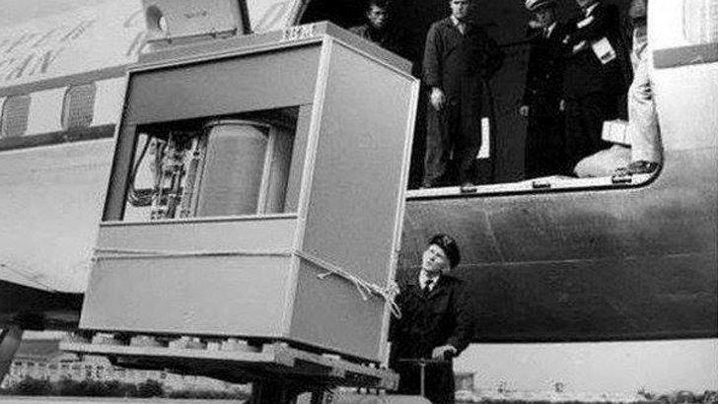
STORAGE
HARDDRIVES:
5MB hard drive in 1956 getting loaded onto a airplane.

Slide 4
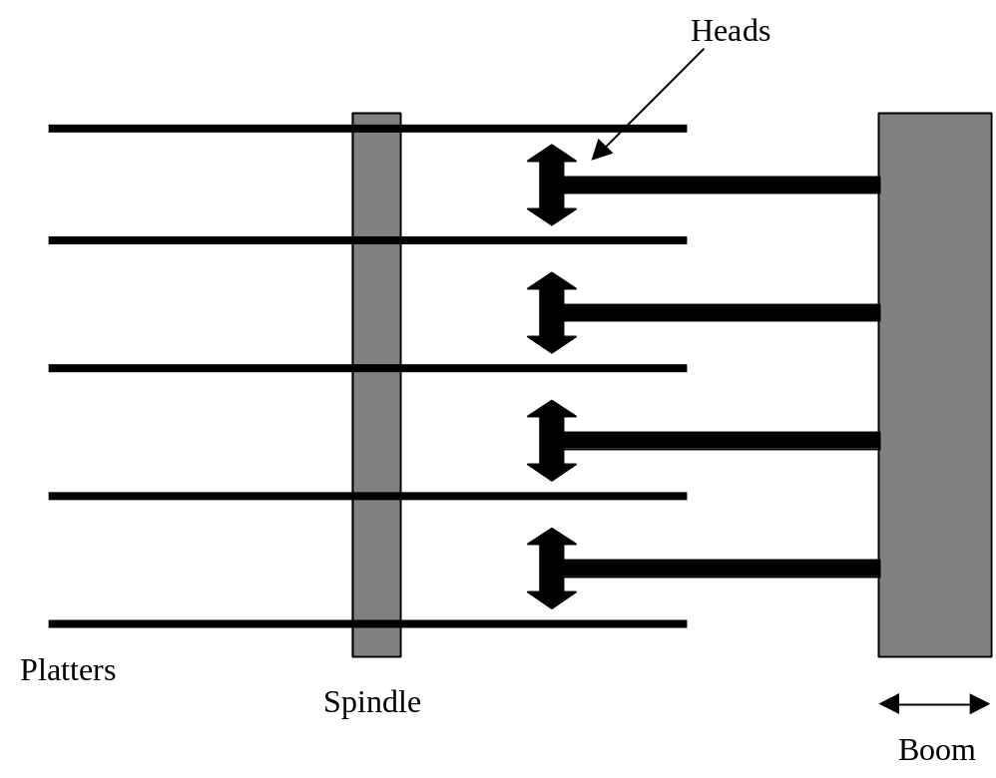
STORAGE
HARDDRIVES:
A moving head disk is shown below:
Most drives have several platters with spindle speeds approaching 15,000+ rpm.

Slide 5
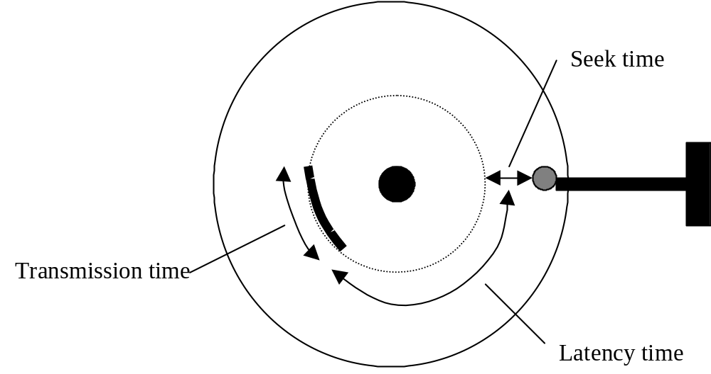
STORAGE
HARDDRIVES:
The time is takes to access information on a drive is driven by three factors: boom seek time, latency time (rotational delay), and transmission time.
Faster spindle speeds reduce latency.
Seek time is the major factor in drive performance.

Slide 6

STORAGE
HARDDRIVES:
In multi-programmed systems, many processes may be generating drive requests. Since these processes can generate requests faster than they can be serviced by the drive, a queue forms.
To further exasperate the problem, the intended disk locations will most likely be randomly spread about the disk.
If we use a First-Come-First-Serve approach to fulfilling the drive requests the heads are then forced to dance about the platters to meet the requests. A long, long queue becomes possible. Obviously, we need a disk scheduling method to combat this problem.

Slide 7
STORAGE
HEAD SCHEDULING:
Scheduling algorithms either attempt to reduce the seek time or the latency (rotational delay).
Scheduling algorithms should consider/optimize:
  Maximize drive throughput.
  Minimize mean response time.
  Minimize response time variance.
  Noise – Don’t shout at your disks! (http://queue.acm.org/blogposting.cfm?id=3477) (http://portal.acm.org/citation.cfm?doid2=1317394.1317403).
  But, you can play music with them.
  (http://www.youtube.com/watch?v=nOMX3deeW6Q#t=62)

Slide 8
STORAGE
SEEK TIME OPTIMIZATION:
First-Come-First-Served (FCFS) – Fair (first come first served) and acceptable on single user systems or lightly used systems. Variance in response times is small. However, as the load increases, the mean response time becomes unacceptably long. It has been said that the drive heads ramble about the platters in a “torrid dance” as the load becomes heavy. And, as can be expected, the throughput is low.
Shortest-Seek-Time-First (SSTF) – The drive requests are reordered such that the next shortest seek distance is always processed next. Throughput is high and mean response time is good. However, variance in response times is high. Especially for requests needing data on the inner or outer tracks. This method is acceptable with database systems, where the drive requests tend to be physically grouped in smaller regions of the drive.
SCAN – Similar to SSTF, except the heads have a preferred direction (in then out, in then out, …). If the head is working its way out, the next shortest seek distance towards the outside is processed next. The preferred direction is changed whenever the edge (inner or outer) of the drive is reached or no more requests in the preferred direction are waiting. SCAN has good throughput, low mean response times, and low variance in response times. SCAN is the method most commonly used with drives.

Slide 9
STORAGE
SEEK TIME OPTIMIZATION:
C-SCAN – Another modification to SCAN (Circular scan). The heads move from the outer tracks to the inner tracks, servicing the shortest seek distance requests along the way. When the head has completed its inward quest it jumps to the request nearest the outer track and starts back towards the inner track. C-SCAN has the lowest variance of all. Simulations have suggested that under lighter loads SCAN is best, but under heavy loads C-SCAN is best.
N-STEP SCAN – A modification to SCAN. N-STEP SCAN only services those requests that were already waiting when a particular sweep began. Requests than arrive during the sweep are queued up and forced to wait until the next sweep. N-STEP SCAN has even lower variance in response times then SCAN (with SCAN it is possible that requests may constantly arrive for a particular track – which would force SCAN to stay on that track).
Eschenback scheme – Similar to C-SCAN, except the head stays at each track long enough to read the entire track (whether it needs to be read or not). Requests are ordered track by track and sector by sector. Designed for an airline reservation system and is good under very heavy loads. But, for overall performance C-SCAN is better.

Slide 10
STORAGE
ROTATIONAL OPTIMIZATION:
Under very heavy loads, rotational optimization becomes a useful item to consider.
Shortest-Latency-Time-First – Once the head arrives at a track, the requests are ordered by the latency from the current head position. When rotational delay is the most important factor, this method has been shown to be near optimal.
http://pages.experts-exchange.com/processing-power-compared/

Slide 11



STORAGE
RAID:
Not this kind!

Slide 12
STORAGE
RAID:
Advancements in processor technology are far outpacing the efforts of drive manufacturers to make faster drives. The result: Hard drives are slowing down today's computer systems. Modern processors often operate at less than full capacity, even sitting idle while waiting for the disk to read or write data.
The problem is getting worse as the industry trend is toward more disk accessing with applications (such as graphics and imaging) placing heavier burdens on fixed disk drives. This creates a big need to bridge the gap between processor performance and disk I/O rates.
One solution is RAID (redundant array of inexpensive/independent drives). RAID technology turns several inexpensive/independent drives into one big drive with multiple actuators. The controller can manipulate these actuators either in parallel to share the work on reads or writes of large files or independently to perform multiple, simultaneous reads or writes of small files.

Slide 13
STORAGE
RAID:
Simply put, whenever the DODRaid (Data On Demand) RAID controller receives instructions from the host to write a block of data to the array, it "stripes" or breaks that block of data into smaller pieces and apportions the pieces among the drives in the array. This decreases the time needed to complete the write operation. Similarly, when the host asks to read a block of data from the array, the DODRaid determines which drives are involved and simultaneously fetches the data from each drive, again making use of the multiple actuators at its disposal.
There are several different methods of RAID in existence. The main differences between methods are in the way data is striped and if and how parity is implemented. The industry has agreed to call these different methods "RAID Levels”…

Slide 14
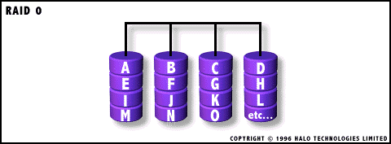
STORAGE
RAID LEVELS:
Raid 0 - Stripes data blocks across disks:
  Performance is improved by spreading the I/O load across many channels and drives.
RAID 0 was not one of the original RAID levels and provides no data redundancy.

Slide 15
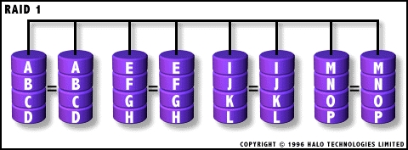
STORAGE
RAID LEVELS:
Raid 1 - creates an exact copy (or mirror) of a set of data on two or more disks:
  100% redundancy of data.
  Double cost w/o doubling capacity.

Slide 16
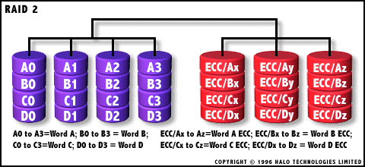
STORAGE
RAID LEVELS:
Raid 2 – stripes data at the bit (rather than block) level:
  Uses Hamming codes recorded on the ECC disks.
  Use of the Hamming code permits using 7 disks in RAID 2 (see figure).
  RAID 2 is the only standard RAID level which can automatically recover accurate data from single-bit corruption in data..

Slide 17
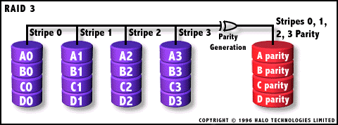
STORAGE
RAID LEVELS:
Raid 3 – uses byte-level striping with a dedicated parity disk.
  RAID 3 is very rare in practice.

Slide 18
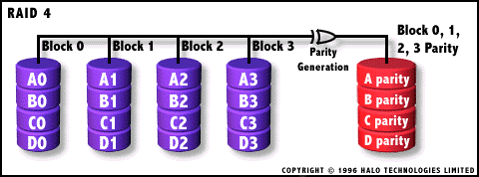
STORAGE
RAID LEVELS:
Raid 4 – uses block-level striping with a dedicated parity disk.
  RAID 4 looks similar to RAID 5 except that it does not use distributed parity, and similar to RAID 3 except that it stripes at the block level, rather than the byte level.

Slide 19
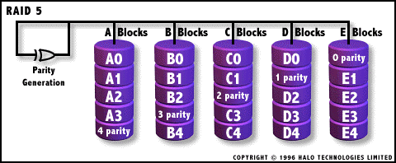
STORAGE
RAID LEVELS:
Raid 5 – uses block-level striping with parity data distributed across all member disks:
  Sometimes referred to as Raid S.
  A variation is known as ZFS Raid 5 which is similar to RAID-5 but uses variable stripe width to eliminate the RAID-5 write hole (stripe corruptions).

Slide 20
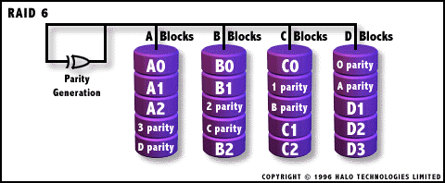
STORAGE
RAID LEVELS:
Raid 6 – Essentially an extension of RAID level 5 which allows for additional fault tolerance by using a second independent distributed parity scheme. Data is striped on a block level across a set of drives. Just like in RAID 5, a second set of parity is calculated and written across all the drives.

Slide 21
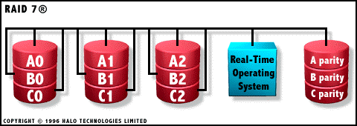
STORAGE
RAID LEVELS:
Raid 7 – All I/O transfers are asynchronous, independently controlled and cached via a high speed x-bus:
  Dedicated parity drive can be on any channel.
  Embedded RTOS controlled communications channel.
  Uses SCSI drives, standard PC buses, motherboards and memory.
  One vendor proprietary solution.
  Power supply must be UPS to prevent loss of cache data.

Slide 22
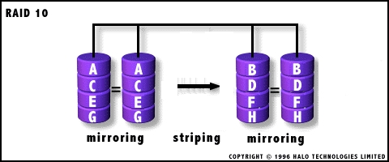
STORAGE
RAID LEVELS:
Raid 10 – Raid 1+0 - Implemented as a striped array whose segments are RAID 1 mirrored arrays.

Slide 23
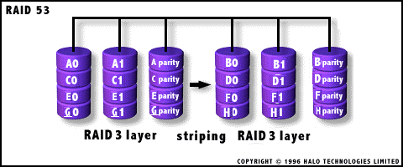
STORAGE
RAID LEVELS:
Raid 53 - Should really be called "RAID 03" because it's implemented as a striped (RAID level 0) array whose segments are RAID 3 arrays.

Slide 24
