Slide 1
Chapter 12

Slide 2
FILE SYSTEMS
FILE ALLOCATION METHODS:
We have 3 types of file allocations methods: contiguous, linked, and index.

Slide 3
FILE SYSTEMS
FILE ALLOCATION METHODS:
Contiguous allocation – Contiguous allocation requires that each file occupy a continuous set of blocks on the disk:
  Pros:
    For sequentially accessed files, performance is optimal.
  Cons:
    Finding enough free space for a file may be problematic.
    Requires an allocation algorithm to manage the method (just like contiguous memory allocation does).
    Can suffer from external fragmentation.
    How much space do we allocate for a file? What if the file grows? Do we copy it to a larger “disk hole”? What if we allocate too much space – then we have a lot of internal fragmentation.
    In some versions of contiguous allocation, it is possible to append (an extent) on additional contiguously allocated blocks via a pointer.
    It always possible to use a compaction (defragmentation) program to reorganize the blocks into contiguous chunks.

Slide 4
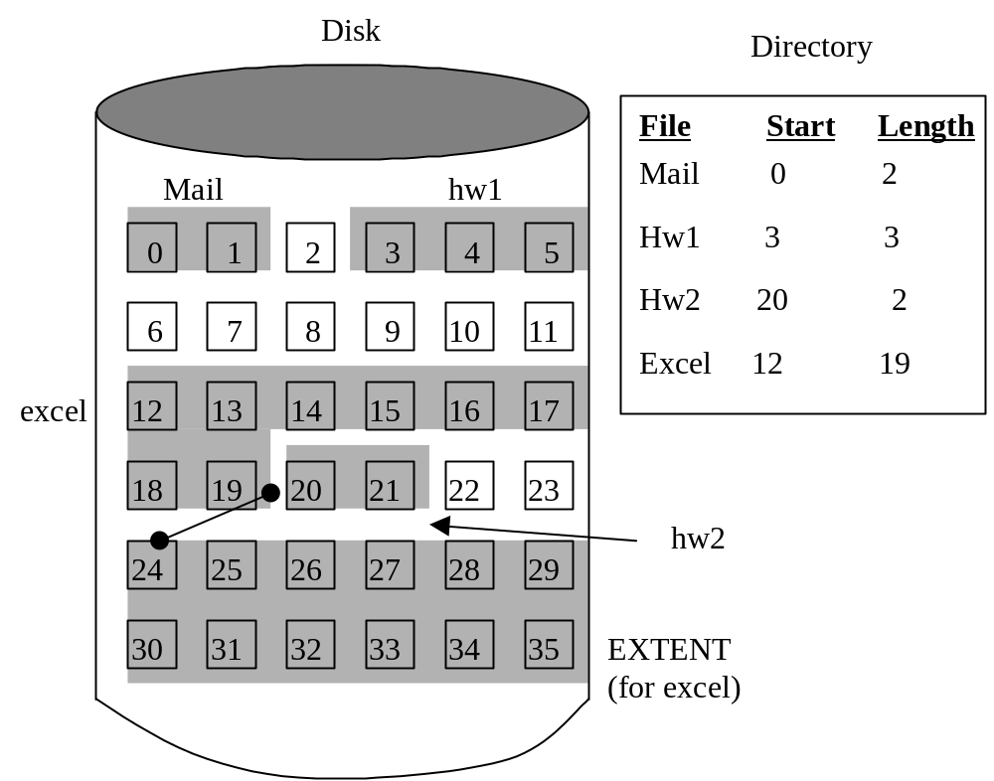
FILE SYSTEMS
FILE ALLOCATION METHODS:
Contiguous allocation example.

Slide 5
FILE SYSTEMS
FILE ALLOCATION METHODS:
Linked/Chained allocation – Linked allocation solves all of the problems of contiguous allocation. With linked allocation each file is a set of linked blocks. The directory contains the location of the first block for each file:
      Pros:
        No external fragmentation.
        No need to pre-specify file sizes.
        Never necessary to defragment disk.
      Cons:
        Can only be used effectively for sequentially accessed files.
        Requires an allocation algorithm to manage the method (just like contiguous memory allocation does).
        The pointers use additional disk space.
        Reliability. What if a pointer gets corrupted?
  To reduce the number of pointers, many clusters of contiguous blocks may be used.
  File-Allocation-Table (FAT) used by DOS and OS/2 is a variation on the linked list idea.

Slide 6
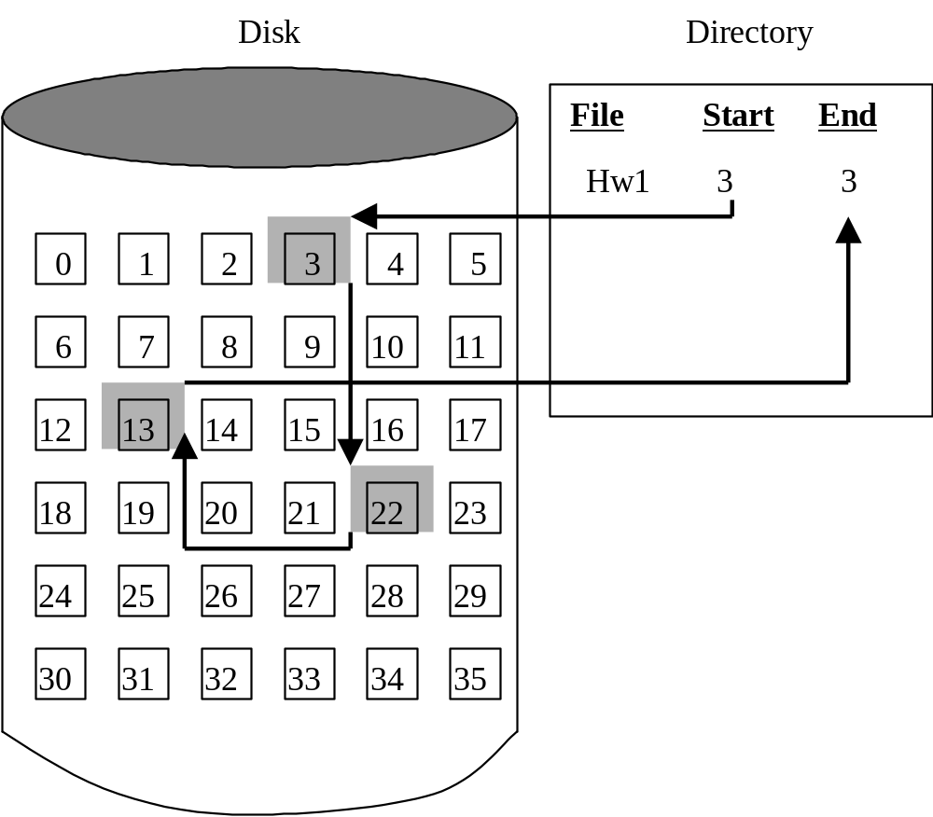
FILE SYSTEMS
FILE ALLOCATION METHODS:
Linked/Chained allocation example.

Slide 7
FILE SYSTEMS
FILE ALLOCATION METHODS:
Indexed allocation – Index allocation solves all of the problems of contiguous allocation. And, unlike linked allocation methods, it does support the random access of a file. With indexed allocation each file is like a set of linked blocks, except the pointers are all stored in an index. The directory contains the location of the index block for each file:
  Pros:
    No external fragmentation.
    No need to pre-specify file sizes.
    Never necessary to defragment disk.
  Cons:
    The pointers use an additional disk block.
  Since the index may become too large to fit in one disk block, we could link multiple blocks together, we could use a multilevel index.
  The Inode-Table used by UNIX is a combination linked-block / multilevel index method.

Slide 8
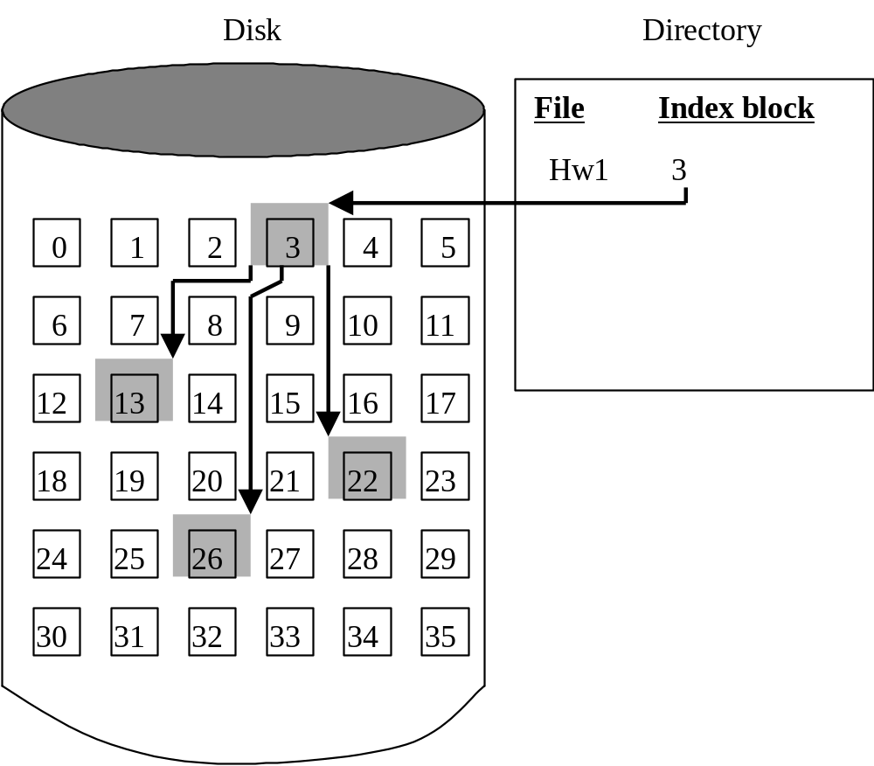
FILE SYSTEMS
FILE ALLOCATION METHODS:
Indexed allocation example.

Slide 9
FILE SYSTEMS
FREE SPACE:
Free space can be tracked using:
  Bit table – Each block is represented by a bit. 1 indicates the block is free. O indicates it is in use.
  Chained list – Free blocks are linked together.
  Chained free portions – The first free block contains the number of consecutive N free blocks. The Nth block contains a pointer to the next free segment.
  Indexing – Free blocks are treated as a single file and tracked by the allocation index.
  Free block list – The free list contains the address of a free blocks.
  FAT – DOS’s FAT tracks free blocks along with used blocks.

Slide 10
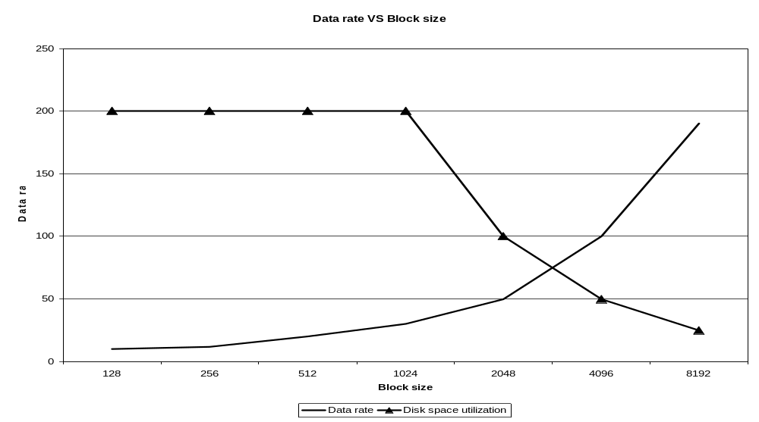
FILE SYSTEMS
PERFORMANCE:
Block size - By adjusting the block size, we can adapt the data transfer rate and regulate the amount of disk space lost to internal fragmentation.
For example, if you have a lot of very small files a small block size would reduce the internal fragmentation. However, small blocks reduce the data transfer rate. This is shown below:

Slide 11
FILE SYSTEMS
PERFORMANCE:
I-node placement – Keeping all of the I-nodes at the beginning of the file system creates inefficiency by forcing the head to move to the I-node region every time a file is accessed.
By placing I-nodes closer to where the actual file is located (preferably we would contiguously locate the file after the I-node) file access times are improved. Newer versions of UNIX do this (intelligently position the I-node).

Slide 12
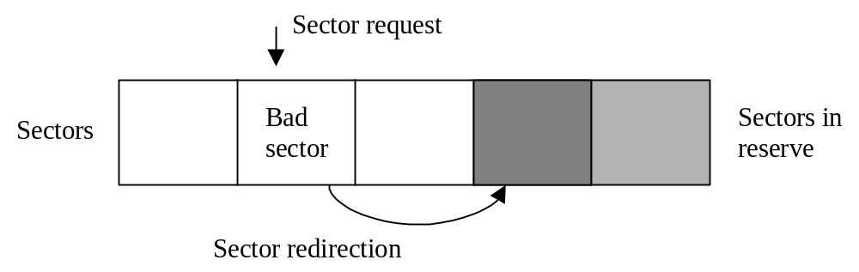
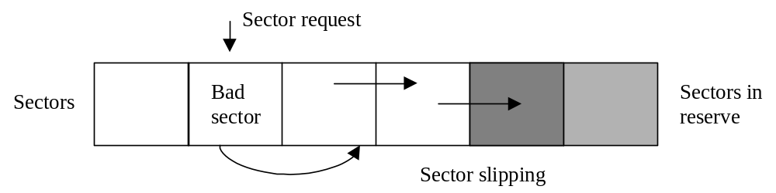
FILE SYSTEMS
BAD BLOCKS:
Sector sparing – When the controller redirects a (bad) block request to another good block (which was set in reserve during the low-level formatting).
Sector slipping – When the controller remaps a bad block by moving good sectors away by 1 block. One of the sectors held in reserve is used.

Slide 13


