Slide 1
Chapter 3: Lexical Analysis
UND School of Electrical Engineering and Computer Science
Dr. Hassan Reza
Copyright© 2020

Slide 2
Objectives
How to build Lexical analyzers
Lexical vs. parser
methods to recognize lexemes in a stream of characters
Input Buffering
Regular expression (token specifications)
State Transition Diagram (token recognizers)
Implementing a State Transition Diagram(STD)
Lexical analyzer tools (LEX)
Finite Automata (FA)
Conversion algorithms (e.g., from RE to DFA)

Slide 3
Lexical
Lex-i-cal: of or relating to words or the vocabulary of a language as distinguished from its grammar and construction
Webster’s Dictionary

Slide 4
Lexical analyzers features
Lexical analyzer (or lex)?
Reads characters from the input file
Reduces them to manageable tokens
Strips out comments/white space from input
Interacts with parser (consumer/producer relationship)
Generates error messages
Main features of Lex include
Efficiency
Correctness

Slide 5
Lexical Analysis vs. Syntax Analysis
Main reasons for separating the analysis phase
Simplicity of design (separation of concerns)
Efficiency (specialized buffering)
A large amount of time is dedicated for reading the source program and tokenization
Portability
Input peculiarities and device specific-anomalies can be limited to the lexical analyzers
Special symbols (e.g., ↑) can be isolated in the LA
Lexical analysis can be fully automated (e.g. LEX, FLEX)
Specialized tools have been implemented to automate the implementation of laxer and parser
Notes:
Parser is harder than lexical analysis because the size of parser grows as the grammar grows

Slide 6
Token, Pattern, Lexemes
Three closely related concepts used in the discussion of LA are:
Token (syntactic category)?
Terminal symbols in the grammar of the source languages
A pair: <token name, optional attribute value>
E.g., < ID, Mycounter>
Lexeme
An actual spelling or a sequence of characters in the source program
E.g., MyCounter
Pattern
possible forms that the lexemes of a token may take
E.g., an identifier can be specified as a regular expression: L⁺D*

Slide 7
Token classes
The following classes cover most or all of the tokens:
tokens for each keyword
IF, THEN. WHILE, FOR, etc.
tokens for operators
+, -, /, *
O tokens for identifier
Mycounter, Myclass, x, y, p234, etc.
Tokens for punctuation symbol
@, #, $, etc.
One or more tokens representing constants (numbers) and strings literals
“mybook”

Slide 8
Examples of tokens
Token | Description or pattern | Sample lexemes
If_symbol | Characters I follows by F | if
Else_symbol | e, l, s, e | else
Id | Letterer followed by letters or digits | D2, MyCounter
Number | Any numeric number | 377.1400, 1234
Relational _OP | <, <=, <>,… | <, <=, or <>,…

Slide 9
Examples of Non-Tokens
Examples of non-tokens
Comment: /* do not change */
Preprocessor directive
#include <stdio.h>
#define NUM 5
White space
blanks
tabs
newlines
Notes:
Preprocessor directives are lines included in a program that begin with the character #, which make them different from a typical source code text. They are invoked by the compiler to process some programs before compilation. Preprocessor directives change the text of the source code and the result is a new source code without these directives.

Slide 10
Attributes for Token
Attributes?
Additional information when one or more lexemes match a pattern
LA uses attributes to document the needed information because tokens influence parsing decisions
Attributes influence the translation of token

Slide 11
Example: tokens and related attributes
E = M * C ** 2
Written as
< ID, ptr to symbol-table for E>
< Assignsym>
< ID, ptr to symbol-table for M>
< Multsym>
< ID, ptr to symbol-table for C>

Slide 12
Lexical Analyzer (LA) and source code errors
LA cannot detect syntax or semantic errors
Leaves it up to parser or semantic analyzers
E.g., LA cannot detect the following error
fi (a == f(x))…
fi?
Could be undeclared function call
Could be misspelled keyword or ID
It will be treated it as a valid id by LA

Slide 13
LA: Error Recovery and Error handling
In case, no pattern matches the current input
Deleting successive characters from input till the LA finds the next well-formed token (panic mode)
Deleting an extraneous chars
Inserting a missing char
Replacing an incorrect char by corrected one
Transposing two adjacent char

Slide 14
Input Buffering
To find the end of token, LA may need to go one or more characters beyond the next lexeme
E.g., to find ID or =>, <=, ==, :=
Buffer Pairs?
Concerns with efficiency issues
Used with a lookahead on the input

Slide 15
Using a pair of input buffers
 |  |  | E |  | = |  | M | * | C | * | * | 2 | eof
N (4096 byte)
N (4096 byte)
lexemeBegin
Forward ptr

Slide 16
Using a pair of input buffers
 |  |  | E |  | = |  | M | * | C | * | * | 2 | eof
N (4096 byte)
N (4096 byte)
lexemeBegin
Forward ptr

Slide 17
Using a pair of input buffers
 |  |  | E |  | = |  | M | * | C | * | * | 2 | eof
N (4096 byte)
N (4096 byte)
lexemeBegin
Forward ptr

Slide 18
Using a pair of input buffers
 |  |  | E |  | = |  | M | * | C | * | * | 2 | eof
N (4096 byte)
N (4096 byte)
lexemeBegin
Forward ptr

Slide 19
Using a pair of input buffers
 |  |  | E |  | = |  | M | * | C | * | * | 2 | eof
N (4096 byte)
N (4096 byte)
lexemeBegin
Forward ptr

Slide 20
The Chomsky Hierarchy of languages

Slide 21
Regular expressions
Regular expressions arise from Chomsky type 3 grammars
A Chomsky type 3 grammar has production of the form:
A→⍺ or A→⍺B (A and B are non-terminals)
A regular expression is made up of symbols of the language being defined and some operators
The regular expression notation
Simple yet powerful
Compact and precise

Slide 22
Application of Regular Expressions to Specify Tokens
Regular Expression are used to specify forms or patterns of tokens
Each pattern matches a set of strings
Strings refers to finite sequence of symbols over alphabet denoted by Σ
ASCII and EBCDIC are two examples of Computer Alphabets
Language? Denotes any set of strings over some fixed alphabet
Alphabet denotes any finite set of symbols
E.g.1, BN = {0,1} represents the set of binary numbers
E.g.2, set of all well-formed C programs

Slide 23
Operations on Languages
Important operations that can be applied to languages are:
Union of R and S written as R∪S
R∪S = {x| x ∈ R ∨ x ∈ S} (i.e., Language L(R) ∪L(S))
Concatenation of RS
RS=R.S = {xy|x ∈ ∧ R y ∈S} (i.e. Language L(R)L(S))
Kleene Closure of R
R* = { } | R | RR | RRR|… (i.e., (L(R))*)
Positive closure of R written R⁺ (i.e., R⁺ = R | RR | RRR|…)
Notes:
Language = set of strings over some fixed alphabet

Slide 24
Some Examples of operations
Suppose: L = { A, B,…Z,a,b,…z} and D = {0,1,…,9}
New languages (sets of strings)) can be created from L and D by applying the operators
L∪D = the set of letters and digits
E.g., a, A, 1, b, …
LD is the set of strings consisting of a letter followed by a digit
E.g., a1, a2, a3, b9, etc.
L⁴ is the set of all four-letter strings
Aaaa, aadd, axcv,…

Slide 25
More examples
L* is a set of ALL strings of letters, including ∈ (
L(L∪D)* is a set of ALL stings of letters and digits beginning with a letter
E.g., a, aa, a1, …,a211111
Digits⁺ is a set of all strings of one or more digits

Slide 26
Regular Expression: Formal Definition
A regular expression is a formal expression that can be specified according to following rules:
if ∈ is a RE that denotes {∈ } (i.e., the set containing the empty string)
If “a” is a symbol in ∑, then a is a regular expression and L(a) = {a}
Induction: If r and s are REs denoting the language L(R) and L(s) then
(r)|(s) is RE denoting L(r)∪L(s)
(r)(s) is a RE denoting L(r)L(s)
(r)* is a RE denoting (L(r))*
(r) is a RE denoting L(r).
Notes:
A language denoted by a RE is said to be a regular set. If the meaning of a RE is the language L, then we say that a RE defines or describe L.

Slide 27
Precedence rules
Unnecessary parentheses can be avoided if we adopt the following precedence rules:
The unary operator * has the highest precedence and is left associate
Concatenation has second highest precedence and is left associative
Union has the lowest precedence and is left associative
Example, (a)|((b)*(c)) can be written as a|b*c
Notes:
Regular expressions often contain unnecessary pairs of parentheses. They can be dropped if we adopt the precedence rules.

Slide 28
Some examples
Example 3.4. Let Σ={a, b}
a|b denotes the set {a,b}
(a|b)(a|b) denotes {aa, ab, ba, bb} (i.e., the set of all strings of a’s and b’s of length two)
a* denotes the set of all strings of zero or more a’s{ε, a,aa,aaa,…}
(a|b)* denotes the set of all strings of zero or more instances of an a’s or b’s: {ε, a,aa,aa,b, bb, ab,ba,…}
a|a*b generates this set: {a,b,ab,aab,aaaaaab,…}

Slide 29
More examples of RE
we can specify the set of ASCII char
(b*(abb*)*(a|∈)
Any strings of a’s and b’s with no consecutive a’s
(a|b)*aa (a|b)*
Any strings of a’s and b’s having two consecutive a’s (aa)

Slide 30
More Examples
Examples
L(hello) = {hello}
L(hello | Bye)= { Hello, Bye}

Slide 31
Regular Language?
A language L is regular iff
there exists a regular expression that specifies the strings in L
If S and R regular expressions, then
R and S define the Regular Language L(R) and L(S)
A langue that can be defined by a RE is called a regular set

Slide 32
More on Regular Language
If two regular expressions r, and s denote the same regular set, we say they are equivalent and can be written as:
r = s
Example: (a|b) =(b|a)

Slide 33
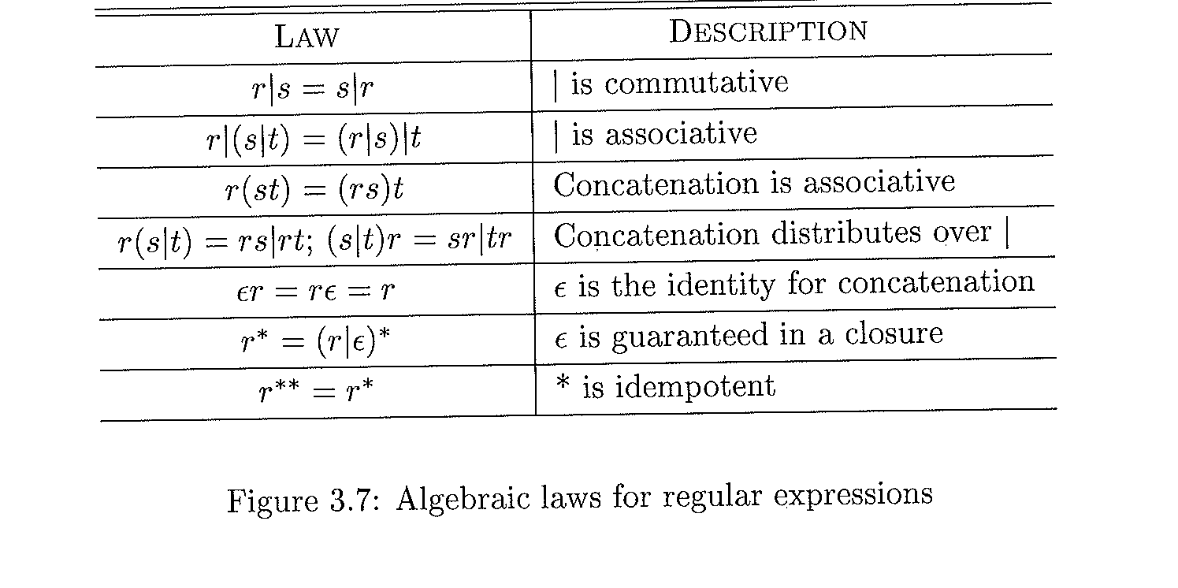
Algebraic laws used to show two REs are equivalent

Slide 34
Regular Definitions
For notational convenience, we may give names to RE and use those names in definition of subsequent rule using:
d_{i}→r_{i} Where
d_{i} = a unique symbol; it would be defined by r_{i,}
r_{i} = an RE; it can be member of
{ ∑ ∪ {d₁,…,d_{i-1}} }

Slide 35
Example: C identifier
C identifiers are strings of letters, digits, and underscores
They can be defined by following regular definitions:
letters → A|B|…|Z|a|b|…|z|_
digit →0|1|…|9
Id → letters_ (letters_ | digit)*

Slide 36
Example: Unsigned numbers in Pascal
Unsigned numbers in Pascal are strings such as
5280
78.90
6.336E4
1.89E-4
The following regular definitions is a precise SPEC for them
digit →0|1|…|9
digits →digitdigit*
optional_fractions →. digits |ε
optional_exp →(E(+|-| ε) digits| ε
number →digits optional_fraction optional_exp

Slide 37
Extension to RE
+: One or more instance using unary + operator
?: Zero or one instance using unary postfix ?
Shorthand: character classes using [abc] instead of a|b|c
Shorthand: [a-z] is shorthand for a|b|…|z

Slide 38
Simplified version of unsigned numbers using extended notations
The following Regular definitions is a precise SPEC of unsigned numbers using extensions of RE
digit →[0-9]
digits →digit⁺
number →digits (. digit)? (E[+-]? digits)?
Ex. 1.89E-4

Slide 39
RE & Tokens Specification
A Pattern represents an abstract description of the form that the lexemes of a token may take
A pattern could be simple or complex
simple patterns
E.g., keyword (IF, THEN, etc.),
Complex pattern
E.g., ID

Slide 40
Grammar for our running example
Consider the following grammar
Stmt→if exp then stmt
|if exp then stmt else stmt
|ε
exp →term relop term
| term
term →id
| num
Notes:
Our discussion is using BNF of statements.

Slide 41
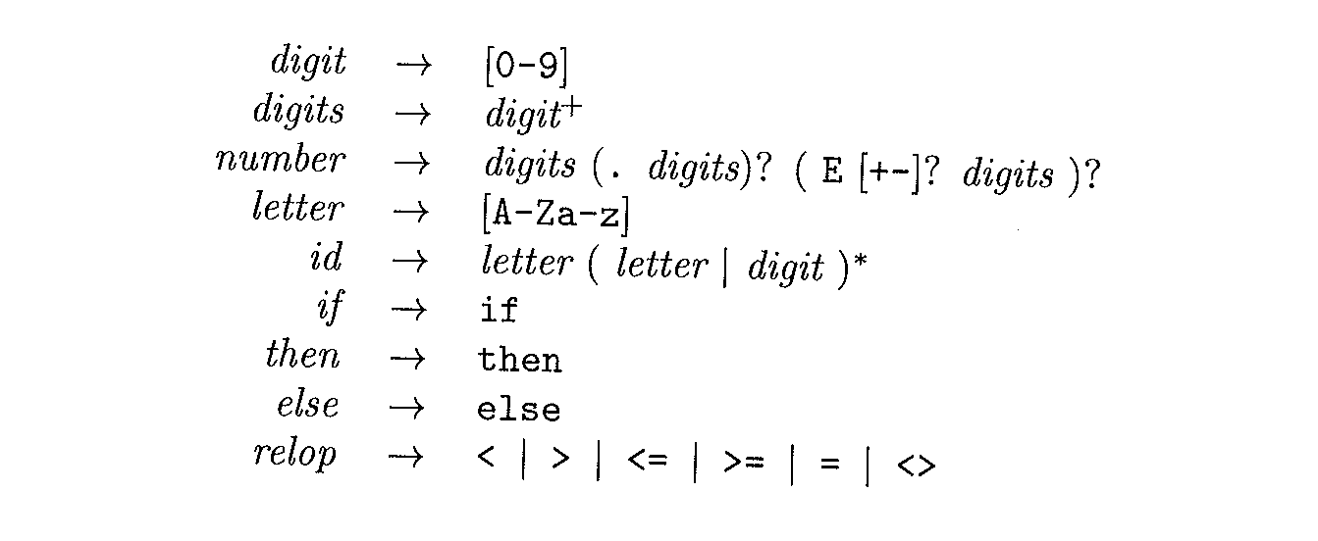
REs used to specify terminals (tokens) for our little grammar

Slide 42
LEXEMES, Token Names, attributes value
Notes:
ws→(blank|tab|newline)+

Slide 43
Recognizer of RE: State Transition Diagram
State Transition Diagram (STD)
Used as an intermediate step in implementing the lexical analyzer
Represents the actions that must take place when a Laxer is being called by the parser
Keeps track of information about characters as scanned by forward pointer AND beginning pointer
STD can be constructed from REs (discussed later)
Notes:
LA or LAX are the same (i.e., or Lexical Analyzer). LEX is a tool, which generates lexer.

Slide 44
Simple SDT to match “then”

Slide 45
Transition Diagram to recognize relational operators (relop)

Slide 46
Recognition of Reserved words and Identifies
Recognizing key words and IDs can be a problem
STD can be used to recognize both IDs and Keywords
To get token
To get attribute

Slide 47
Approaches to handle reserved words
A simple method to handle served words from IDs
Install the reserved words in the symbol table initially
A call to InstallID() insert the new ID into the table if it is not already there; returns ptr to the newly entry or existing one
A call to GetTtoken() consults the symbol table and returns TOKEN NAME for the lexeme (ID or Keyword)

Slide 48
STD for unsigned numbers
digit →0|1|…|9
digits →digitdigit*
optional_fractions →. digits |ε
optional_exp →(E(+|-| ε) digits| ε
number →digits optional_fraction optional_exp

Slide 49
Transition Diagram to handle Whitespace
delim = {blank, tab, newline}
Notes:
ws→(blank|tab|newline)+

Slide 50
Simulation of STD for relop in C++

Slide 51
Simulation of STD for relop in C++
Notes:
Fail() can be used to initiate an error correction (handling) to correct input.
Retract(): retract the input pointer one position (i.e., put char back on the input by moving the pointers in the buffer)

Slide 52
Lexical Analyzer: Implementation Approaches
General Approach to implement Lexical Analyzer (LA)
Tool such as Lex (easy)
Write the LA using Programming Language(moderate)
Write LA in assembly language (difficult)

Slide 53
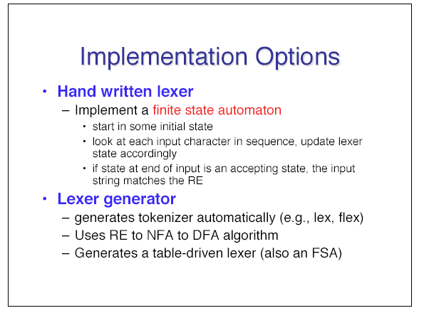
Main Approaches

Slide 54
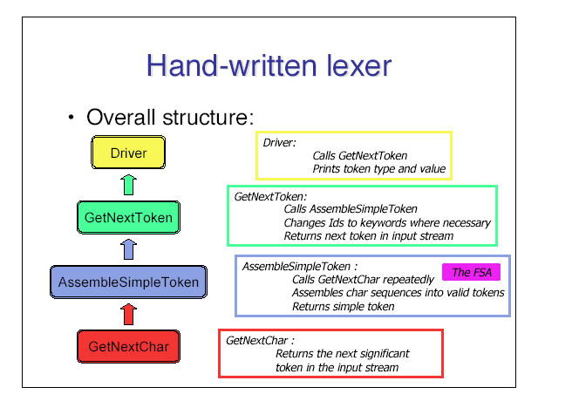
Hand-written approach

Slide 55
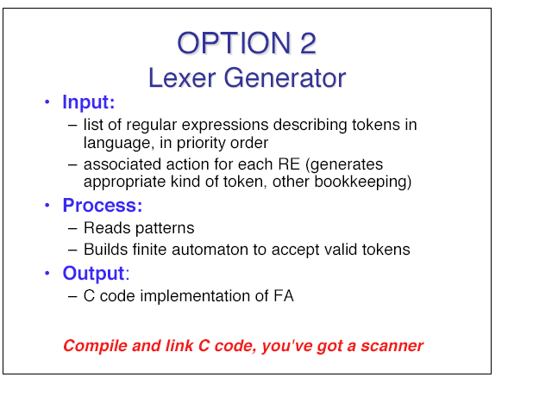
Option two: Using Tool to generate Lex

Slide 56
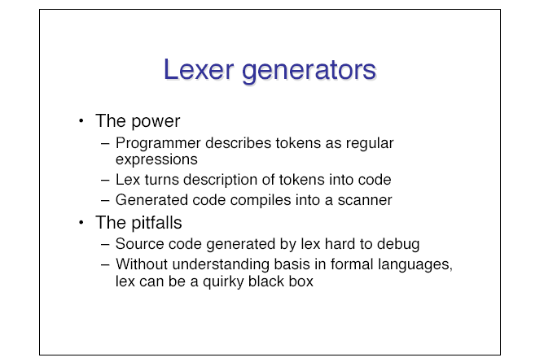
More on Lexar generators

Slide 57
Generating the Lexical Analyzer using LEX

Slide 58
The Lexical Analyzer LEX

Slide 60
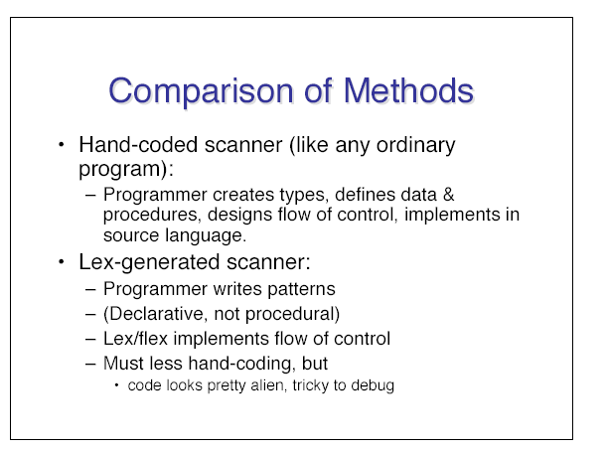
Some comparison

Slide 61
Part 2
Finite Automata: Recognizers

Slide 62
Finite Automata
LEX converts input program into a lexical analyzer using finite automata (FA)
FAs are recognizers
They ONLY say “yes” or “no” to each possible input string
FA comes in two flavors
Nondeterministic finite automata (NFA)
Deterministic finite automata (DFA)

Slide 63
Deterministic Finite Automata (DFA)
For every language defined by a RE, there exists a DFA to recognize the same language
DFA can be defined as M = (∑,Q,T,q₀, F), where
∑: alphabet
Q: a finite set of states
T: Q×∑→Q (i.e., a finite set of transition rule {partial function})
q₀: start state
F: final state(s)

Slide 64
Simple DFA
Input symbols
a d
a
A B
states
A
B
B B B
a
d

Slide 65
Simulating a DFA
INPUT:
An input string x terminated by eof character.
A DFA D with start state s₀, accepting F, and transition function move
OUTPUT:
Answer:
“yes” if D accepts string x;
“no” otherwise

Slide 66
Simulating a DFA: Apply algorithm

Slide 67
DFA accepting: (a|b)*abb
Input string: aaabb
Processing: the machine enters the sequences of states: 0,1,1,1,2,3.
Output: The answer is “yes”

Slide 68
Nondeterministic Finite Automata (NFA)
NFA differs from deterministic model in two ways:
For any given state and input symbol, there may exist more than one transition
State transition can occur without reading any input token; this is called empty transition

Slide 69
RE= (a|b)*abb
NFA
DFA

Slide 71
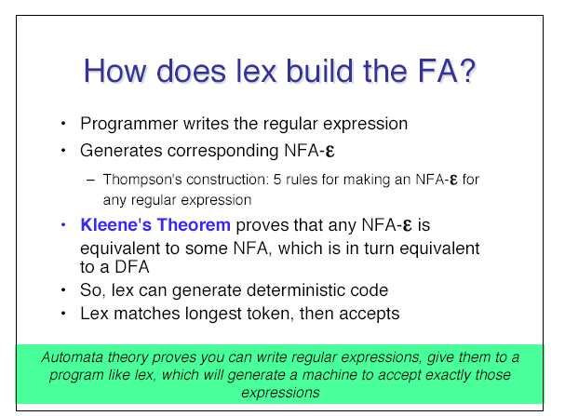
More

Slide 72
All kind of Transformation
There is all kind of transformation from
Automata to grammars
RE to grammars
RE to automata

Slide 73
The Cycle of construction

Slide 74
Converting RE to NFA using Thompson’s construction

Slide 75
Applying Thompson’s Construction to create NFA of a(b|c)*

Slide 76
Transforming Grammars to Automata and vis versus
We write scanner using regular grammars
An NFA can be generated directly from the grammar using the following steps
the alphabet is the same
each nonterminal in the grammar maps to a state in the NFA with same name
goal symbol maps to S
create a new state and make it the only final state

Slide 77
Some Examples: Converting Grammar to NFA
For each production of the form A→ xB
Generate a transition in the NFA: ϕ(A,x) =B
For each production in the grammar A→ x
Generate a transition in the NFA: ϕ(A,x) =F
The resulting automation could be NFA
it is possible to have two different productions in Regular grammar with same nonterminal on LHS

Slide 78
Transforming Regular Grammar to Regular expression
Grammar Productions | RE Productions
R.1: A→xB; B→ y | A→ xy
R.2: A→xA|y | A→x* y = L(x*y)={y, xy, xxxy,…}
R.3: A→x; A→y | A → x|y

Slide 79
More

Slide 80
Implementing FSA on a Computer
Compilers are implemented as programs
How to implement FSA as program? One Possible way
One variable of enumerated type to list all possible states
Use table representation of FSA
Store table as an array with state and symbol as indexes
Use a Boolean variable to signal termination of the FSA
Use Temporary variables to keep track of the current state and input

Slide 81
Limitation of RE
RE cannot be used to describe some programming constructs such as balanced parentheses or define/usage semantics
RE can be used for fixed or unspecified number of repetitions (arbitrary)
Repeating strings
L1= {wcw|w is a string of a’s and b’s(or (a|b)*)}
L1 consists of all words composed of a repeated strings of a’s and b’s separated by a “c”, such as aabcaab
The language abstracts the semantics of define/usage

Slide 82
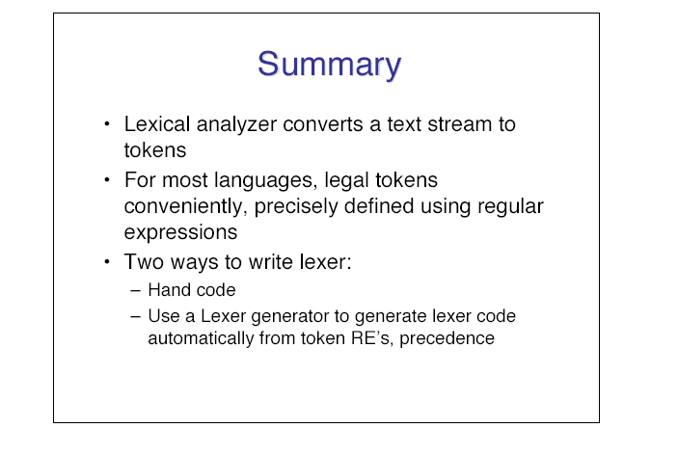
Summary

Slide 83
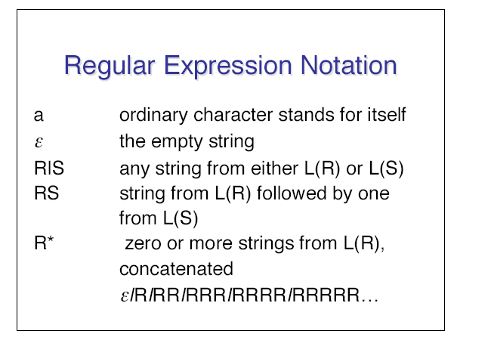
RE: Review

Slide 84
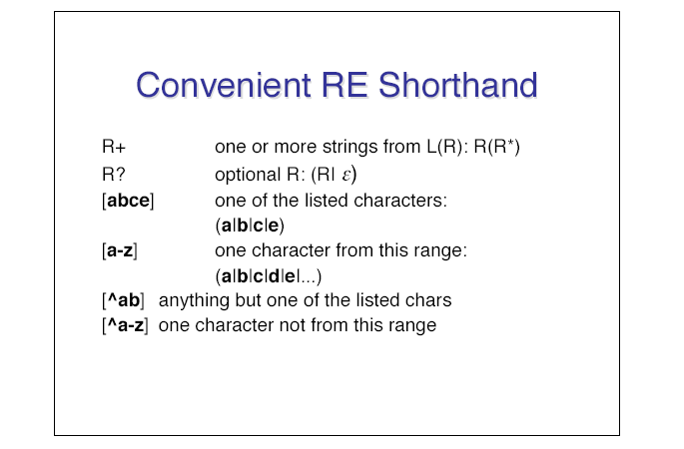
Shorthand notations

Slide 85
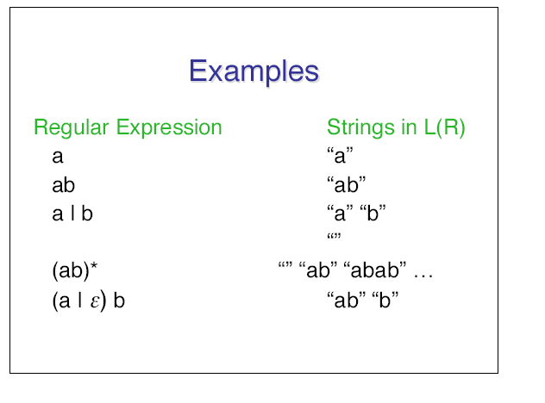
More Examples

