Slide 1
Csci465: Principals of Translations (Chapter 4)
Part 1: Top-Down parsing
UND School of Electrical Engineering and Computer Science
Dr. Hassan Reza

Slide 2
Objectives
Parser and its role in the design of compiler
Techniques used to build hand implementation parses
Top-down parsing
LL parser
CFG and Leftmost Derivations
First set
Follow set
Error Recovery Handling Techniques

Slide 3
Syntax Analysis
Every Programming Language (PL) has a set of rules prescribing the syntactic structure of the programs written in that language
E.g., Pascal Programming Language
Made out of Blocks
A block made out of statements
A statement is made out of expressions
An expression is made out of tokens
A token is made out of characters specified by REs

Slide 4
Grammar
Wikipedia definition
In linguistics, grammar is the set of structural rules governing composition of clauses, phrases, and words in any given natural language.
The Grammar also refers to the study of such rules:
Including syntax and phonology
Can be complemented by semantics, and pragmatics

Slide 5
Formal Grammars
Formal Grammars?
A set of production rules for composing strings (words) in a formal language.
Rules describe how to put the words together in a sense that the sentence meets the proper syntactical form

Slide 6
Significant of Grammars
Significant of Grammars
Provides a precise, easy-to-understand syntactic specifications
Automates the construction of an efficient parser
Supports maintainability of an existing language implementation by adding new programming constructs (rules)

Slide 7
Parser vs. Scanner
Lexical analyzer?
Recognizes token (i.e., terminal symbols) from the sequence of characters in an input string
Provide concise/simple notation to represent tokens
Efficient Lex can be built
Support separation of concerns and modularity
Syntax analyzer?
Recognizes a set of related words (or phrases)
How theses words are combined to form syntactically correct program

Slide 8
Limitation of Regular Expression (revisited)
Regular expressions and its recognizers are suitable for identifying error at word level
E.g., misspelling an identifier, keyword, or operator
RE cannot be used to handle nested or balanced parentheses
An arithmetic expression with unbalanced parentheses
If/Then/else

Slide 9
Role of parser
Token/getchar()
LA
Parser
Parse tree
code
Source
Pg
Rest of FE
Sym. Table

Slide 10
Types of Parser
Universal Parsing methods
Cocke-Younger_Kasami Algorithm
Parse any grammar
Not very efficient to use production compilers
Top-down
LL parsers (hand-written)
Bottom-up
LR parsers (automated parser)

Slide 11
Context-Free Grammars
Grammar can be used to describe syntax of PLs
PLs allow sentence construction with nested and matched parentheses
Some PLs constructs cannot be defined by Grammar
E.g., define/use
These languages are specified by CFG
Every language defined by CFG can be recognized by Push Down Automata (PDA)
Or, any language accepted by PDA is CFG

Slide 12
CFG and PDA
The focus here is on Context Free Language (CFL) that are accepted by PDAs
Context Free Language?
Languages defined by LL(K) is Context-Free Grammars

Slide 13
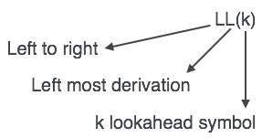
LL(K) Parser
Parsing methods that read the input from Left-to-Right, and constructs a Leftmost-derivation of the sentence and uses K-lookahead symbols

Slide 14
LL (K) Parsing
What is LL(K) grammar?
A grammar from which we can construct a deterministic, top-down PDA
Looks a head at most k-symbols on the input tape
What is LL(1) grammar?
The most common form of LL(K) grammar
Looks a head at most one symbol
The easiest one to convert into PDA

Slide 15
Derivations
There are several processes by which a grammar defines a languages:
Graphical view (parse tree)
Derivational views (a textual descriptions of top-down)

Slide 16
Derivations (Left Most)

Slide 17
Derivations: Notations

Slide 18
Push Down Automata (PDA): Implementation
PDA used to implement top-down parser
Starts with the goal symbol on the stack
Rewrites the leftmost non-terminal until the leftmost symbol is a terminal, which is the first token of the input string
Takes the transition that reads that token
Repeats the process until
Either the entire input has been read and no more input left
Or, PDA blocks (error!)

Slide 19
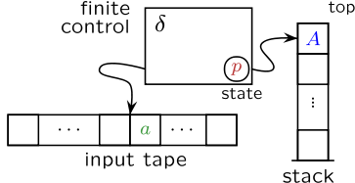
Model of PDA

Slide 20
Push-down automaton (PDA): 1
A push-down automaton is formally defined as a 7-tuple as follows:
P = (∑, Q, ▲, H, h₀, q₀, F)
∑: Alphabet
Q: states
▲: transition functions
H: finite stack alphabet
h_{0:} initial symbol in H (stack)
q_{0:} Initial state
F: finite set of final states

Slide 21
push-down automaton (PDA): 2
▲ has the following behavior (i.e., every transition is defined for a particular state)
T:Q×(∑∪∈)×H→Q×H*
READS one input token or nothing
POPS one symbol off the stack
MOVES to a new state
PUSHES a string of zero or more symbols back onto the stack

Slide 22
Example 1: PDA on input aacbb
Let P₀ = PDA and input be aacbb
∑={a, b, c}
Q={A,B,C}
▲ T:Q×(∑∪∈)×H→Q×H* ( 5 transitions)
T(A, a, i) = (B, h)
T(B, a, h) = (B, hh)
T(C, b, h) = (C,∈)
T(A, c, i) = (A, ∈)
T(B, c, h) = (C, h)
H={h,i}
h₀= i
q₀=A
F={ }
PDA RECONGNIZES ALL THE STRINGS GENERATED BY THE GRAMMAR: S→ aSb, S→c. (i.e., an equal number of a’s and b’s, separated by a single c.
Notes:
This PDA RECONGNIZES ALL THE STRINGS GENERATED BY THE GRAMMAR { S→ aSb, S→c} (i.e., an equal number of a’s and b’s, separated by a single c. It starts in State A with an ‘i’ on the top of the stack. PDA halts on an empty stacks.

Slide 23
Table: PDA on input aacbb
Configurations | Transitions | Actions
(A, aacbb, i) | T(A, a, i) = (B, h) | read a, pop i, push h, go to B
(B, acbb, h) | T(B, a, h) = (B, hh) | read a, pop h, push hh, go to B
(B, cbb, hh) | T(B, c, h) = (C, h) | read c, pop h, push h, go to C
(C, bb, hh) | T(C, b, h) = (C,∈) | read b, pop h, go to C
(C, b, h) | T(C, b, h) = (C,∈) | read b, pop h, go to C
(C,∈, ∈) | HALTS! | String is successfully parsed
Notes:
Note: the configuration of the machine (PDA) is a triple (q, string, stack).
When pushing symbol x, the configuration changes from (q, a.w, ε.t) to (qi, w, x.t).
• When popping symbol x, the configuration changes from(q, a.w, x.t) to (qi,w, t).
• When we don’t wish the stack to change at all in a computation step, the machine moves from a configuration (q, a·w, ε·t) to (qi,w, ε.t).
• Finally, on the occasion that we actually do wish to change the symbol c at the top of stack with symbol d, the configuration (q, a.w, c.t) changes to (qi,w, d.t).

Slide 24
Top-Down Parsing (revisited)
Top down parsing
Build a parse tree for input string
Start from the root
Create the nodes for the tree in preorder (depth first) fashion
Find a leftmost derivation for an input

Slide 25
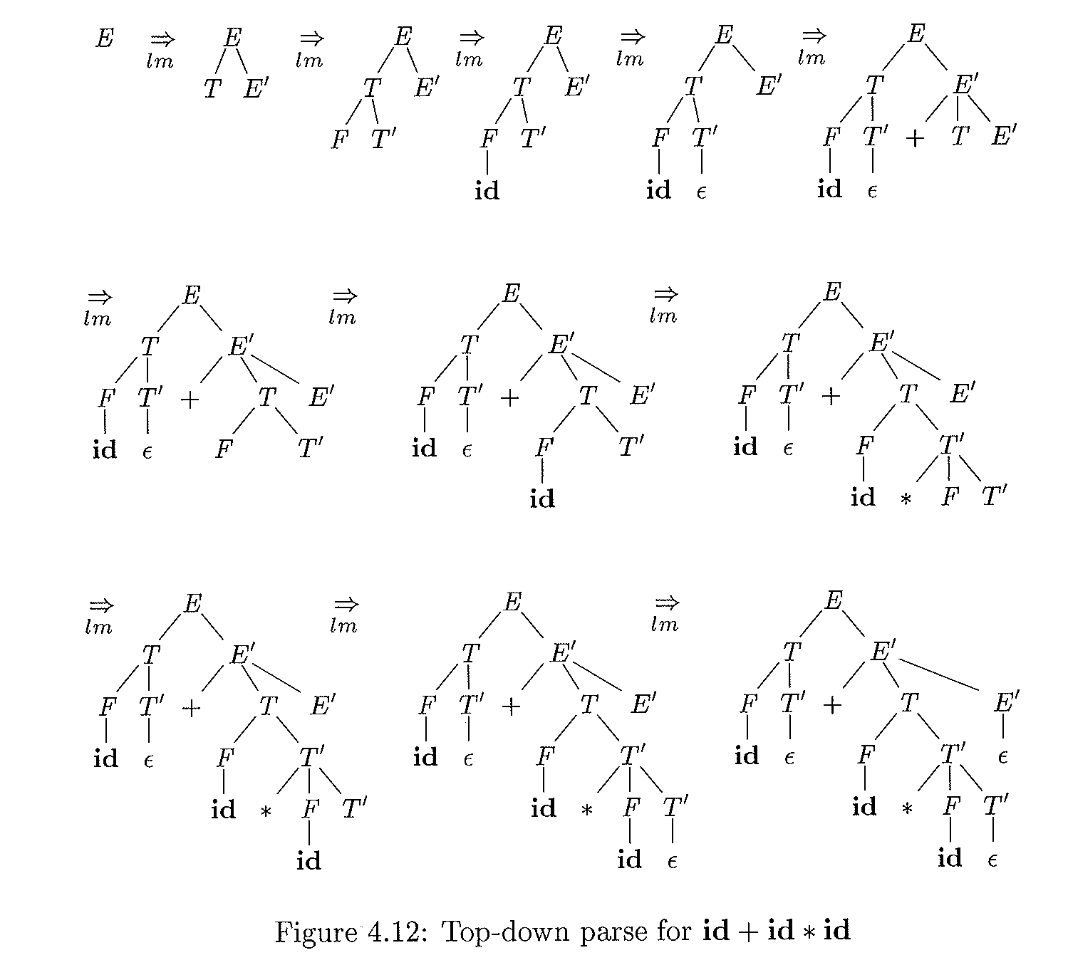

Slide 32
Recursive descent parsing
A parsing method consists of a set of procedures:
Defines one for each non-terminals
Executes the procedure implementing goal or start symbol
Halts and announces success if its procedure body scans the entire input string

Slide 33
Pseudocode for a typical nonterminal

Slide 34
FIRST () and FOLLOW() sets
The construction of both top-down and bottom-up parsers require two functions
FIRST()
FOLLOW()
These two functions help
to select the appropriate production rules for recursive parsing
To fill in the entries of a non-recursive predictive parsing using table (discussed later)

Slide 35
FIRST and Follow Sets
To show a grammar is LL(K), perform the following steps
Buid First_{k}(w) for all right-hand sides string w in the grammar’s production
Build Follow_{k}(N) for all non-terminals N in the grammar
First() and Follow() sets help to fill in the entries of the parsing table

Slide 36
FIRST_{k}(w)
The FIRST_{K} of any string w is the set of all terminal strings of K-tokens or fewer that can be derived from string w
First_{k}(uv) = First_{K}(First_{K}(u)First_{K}(v))
(i.e., first of u concatenated with first of v)
First_{k}(N) = ∪(First_{K}(w))
(i.e., the union of all first of N such that N→w is a production)
First_{k}(x) = {x}
(i.e., for any terminal x∈∑, then first of x is itself)
First_{k}(∈) = {∈}
(i.e., for empty string)
Notes:
Selection set? A set containing the prefixes of length K of strings that can be derived from a nonterminal A in Select_{k} (A → w).
Also called a look-ahead set.

Slide 37
Example 1: Compute the FIRST
First₂(uv) = First₂(First₂(u)First₂(v)) Where
First₂(u)={ab, cd, d, dd, ∈}
First₂(v)={cc, d, ∈}
therefore
First₂(uv) is formed by concatenating each of the First(u) with First (v )
{abcc, abd, ab, cdcc, cdd, cd, dcc, dd, d, ddcc, ddd, dd, cc, d, ∈}
Take the first two chars
{ab, ab, ab, cd, cd, cd, dc, dd, d, dd, dd, dd, cc, d, ∈}
The duplicates have been removed
First₂(uv)={ab,cd,dc,dd,d,cc, ∈}

Slide 38
Example 2
Consider the simple grammar G:
A→Ba
B→b
B→c
Where First(b)={b}, First(c)={c}, First(a)={a}
Find the First₁(A)?
=First₁(First₁(B)First₁(a))
=First((First(b)∪First(c))×First(a))
=First₁( {b, c}×{a} )
=First₁( {ba, ca} )
={b,c}

Slide 39
Follow_{k}(A)
Follow Set of a nonterminal A?
The set of terminals that can follow a nonterminal A in some sentential form
Follow(A) = {bϵ∑| S ==>⁺αAbβ}
Provides the proper context for nonterminal A

Slide 40
To Compute Follow set
For all production B→uAv, the Follow_{k}(A) can be built
Follow_{k}(A) = ∪(First_{k}(First_{k}(v)Follow_{k}(B))
To compute the Follow(A), look in the grammar for all productions in which A occurs in the Right-hand-side (RHS)
Apply the following rules:
the FIRST of everything to the right of the A, including the Follow(B), where B is the non-terminal on Left-Hand-Side (LHS): B→uAv
If A is the start symbol, then put $ in Follow (A)
If v is nonterminal, then everything in FIRST(v) except for empty (∈) is in Follow(A)
If v derives ∈ (i.e., v⇒* ∈), then Follow(A) = Follow(B)

Slide 41
Follow(): Example 1 (solution)
Consider the following grammar
S→Bx
A→aA
A→b
B→yAzA
Compute the Follow₁(A)?
Find All As on the R.H.S
there are 3 As
Find any terminal right after A
Add the terminal z, to the set = {z}
Find Follow of the non-terminal on L.H.S of A (i.e., A, and B)
Get Follow(B)=First(x)= {x}
Ignore the Follow(A) in L.H.S ? recursion
Follow (A)= {z} U{x} = {z, x}

Slide 42
Example 4.30: First and Follow
Consider the following the non-left-recursive grammar
E→TE’
E’→+TE’ |∈
T→FT’
T’→*FT’| ∈
F→(E)| id

Slide 43
Compute First and Follow
Consider the following grammar
E→TE’
E’→+TE’ |∈
T→FT’
T’→*FT’| ∈
F→(E)| id
Solution:
FIRST (E)=FISRT (T)=FIRST (F)={(,id}
FIRST(T)= FIRST(F)= {(,id}
FIRST(F)= {(,id}
FIRST(T’)= {*, ∈}
FIRST(E’)={+, ∈}

Slide 44
To compute Follow for the Grammar
Consider the following grammar
E→TE’
E’→+TE’ |∈
T→FT’
T’→*FT’| ∈
F→(E)| id
FOLLOW(E)= {), $} //applied rules 1, 2//
FOLLOW(E’)= {), $} //applied rules 1, 2//
FOLLOW(T)= First(E’) U Follow(E)= {+, ), $}
FOLLOW(T’)= FOLLOW(T)= {+, ), $} // applied rules 3, 4//
FOLLOW(F) = Follow (T’) U First (T’)= {*, +, ), $} // applied rules 3, 4//
Notes:
Apply the following rules to compute Follow set.
the FIRST of everything to the right of the A, including the Follow(B), where B is the non-terminal on L.H.S // B→uAv
If A is the start symbol, then put $ in Follow (A)
If v is nonterminal, then everything in FIRST(v) except for ∈ is in Follow(A)
If v derives ∈ (i.e., v⇒* ∈), then Follow(A) = Follow(B)

Slide 46
Selection Sets
The selection set of Select_{k} of a production is the set of lookahead strings of K-tokens
The set helps the selection of a production in a deterministic top-down parser

Slide 47
How to compute Selection Set?
For each production in a grammar of the form A→w
Select_{k}(A→w)=First_{k} (First_{k}(w) Follow_{k}(A))
A nonterminal A in a grammar is LL(K) iff
For any two selection sets S₁ and S₂ of the productions A the following condition holds
S₁∩S₂ = {}
A grammar is LL(K) if EVERY non-terminal in that grammar is LL(K) (i.e., S₁∩S₂ = {})

Slide 48
Example of Selection
Consider the simple grammar G
S→aSb
S→∈
1. S→aSb
Select₁(S→aSb ) = First₁ (First₁(aSb) Follow₁(S))
First₁({a} × {$,b}) // S is a goal symbol
First₁ ({a$, ab})
{a}

Slide 49
Example of Selection
Consider the simple grammar G
S→aSb
S→∈
2. S→∈
Select₁(S→∈) =First₁(First₁(∈)Follow₁(S))
=First₁({∈} Follow₁(S))
=First₁ ({∈} X{$,b})= {$,b}

Slide 50
Example of Selection
Consider the simple grammar G
S→aSb
S→∈
{$,b} ∩{a} = {} //i.e., means they have no elements in //common for two selections
//therefore, the G is LL(1)

Slide 51
Converting RE to FA to CFG

Slide 52
Converting CFG to PDA:1
PDA can be constructed from a CFG as follows:
PDA.∑ == CFG. ∑
PDA.H == ∑∪N //finite stack alphabet
PDA.h₀ == Goal of CFG
PDA.Q == One state; it halts on empty stack

Slide 53
Converting CFG to PDA: 2
Two Rules:
T(q, x, x) = (q, ∈) (i.e., for every terminal x)
T(q, ∈, A) = (q, ω) (i.e., replace A on LHS by RHS ω)

Slide 54
Example: From CFG to PDA
Consider the following Grammar G1 that generates all equal numbers of a’s followed by an equal number of b’s
L(G) ={aabb, aaabbb, …}
S→aSb |∈
First (S) = {a, ∈}
Follow (S) = {b}

Slide 55
Example 2: Transitions
Convert G1 to PDA
T(q,∈, S) = (q, aSb) < apply rule 2 for nonterminal>
T(q,∈, S) = (q, ∈) <apply rule 2 for nonterminal>
T(q, a, a) = (q, ∈) < apply rule 1 for terminal>
T(q, b, b) = (q, ∈) < apply rule 1 for terminal>

Slide 56
Example2: Parsing using follow and first sets
Apply 1 using First (S) = {a, ∈}
Step | Input | Stack | Transition
1 | .aabb | S
2 | .aabb | aSb | 1
3 | a.abb | Sb | 3
4 | a.abb | aSbb | 1
5 | aa.bb | Sbb | 3
Input string: aabb
Cnfg₀: (q, aabb,S)
Transitions:
T(q,∈, S) = (q, aSb)
T(q,∈, S) = (q, ∈)
T(q,a, a) = (q, ∈)
T(q,b, b) = (q, ∈)
Notes:
The grammar is LL(1) because a deterministic top-down PDA can be constructed using one lookahead symbol

Slide 57
Example2: Parsing
Apply 1 using First (S) = {a, ∈} won’t work!
Step | Input | Stack | Transition
1 | .aabb | S
2 | .aabb | aSb | 1
3 | a.abb | Sb | 3
4 | a.abb | aSbb | 1
5 | aa.bb | Sbb | 3
6 | aa.bb | aSbbb | 1 (No match!!!)
Input string: aabb
Cnfg₀: (q, aabb,S)
Transitions:
T(q,∈, S) = (q, aSb)
T(q,∈, S) = (q, ∈)
T(q,a, a) = (q, ∈)
T(q,b, b) = (q, ∈)
Notes:
The grammar is LL(1) because a deterministic top-down PDA can be constructed using one lookahead symbol

Slide 58
Example2: Parsing
Step | Input | Stack | Transition
1 | .aabb | S | No move
2 | .aabb | aSb | 1
3 | a.abb | Sb | 3
4 | a.abb | aSbb | 1
5 | aa.bb | Sbb | 3
6 | aa.bb | bb | 2
7 | aab.b | b | 4
8 | empty | empty | 4
Input string: aabb
Cnfg₀: (q, aabb,S)
Transitions:
T(q,∈, S) = (q, aSb)
T(q,∈, S) = (q, ∈)
T(q,a, a) = (q, ∈)
T(q,b, b) = (q, ∈)
Apply 2 using Follow (S) = {b}
Notes:
The grammar is LL(1) because a deterministic top-down PDA can be constructed using one lookahead symbol

Slide 59
Note on example
The grammar is LL(1) because non-determinism is resolved only by looking at one symbol
Applied 1 using FIRST() (i.e., S→ aSb)
the string is ‘abb’ and ‘a’ is the first token in S on R.H.S
Applied 2 using Follow() (i.e., S→∈ )
the current input string is a ‘b’, which matches the token that follows S in the S→aSb

Slide 60
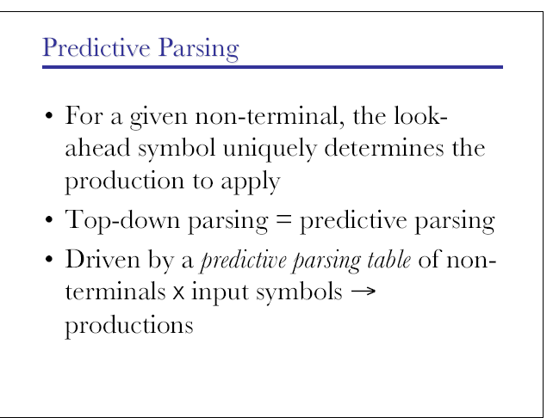
Predicative Parsing

Slide 61
Using First() and Follow() to build predictive parsing table
The information provided by First() and Follow() sets will be used to build a predictive parsing table (a 2-D array) where
Row represents non-terminals
Columns input symbols ({Σ∪$} )
Cells represnt applicable production rules or blanks

Slide 62
Parsing Table Algorithm
Algorithms
Grammar
Parsing Table

Slide 63
Algorithm 4.31 (pp 224)
INPUT: G (Grammar)
OUTPUT: Parsing table M
METHOD:
For each production A→α of G, do the following:
For each terminal a ɛ FIRST(A), add A→α to M[A, a]
If FIRST(α) = ε , then for each terminal b ∈ FOLLOW(A), add A→α to M[A,b]
If FIRST(α) = ε and $ ɛ FOLLOW(A), add A→α to M[A,$]
Otherwise set M[A,a] to error

Slide 64
Example: Table Driven
Consider the following grammar
E→TE’
E’→+TE’ |∈
T→FT’
T’→*FT’
F→(E)| id

Slide 65
Productions
Notes:
FIRST(E)= { (, id}

Slide 66
Productions
Notes:
FIRST(E)= { (, id}

Slide 67
Productions
Notes:
FIRST(E)= { (, id}

Slide 68
Productions
Notes:
FIRST(E)= { (, id}

Slide 69
Productions
Notes:
FIRST(E)= { (, id}

Slide 70
Implication of Algorithm 4.31
The algorithm can be applied to any grammar G to produce a parsing table
For any LL(1) grammar, each parsing table entry uniquely identifies a production or signals an error
Grammar G is not LL(1), when we have multiple entries!!!

Slide 71
Non-recursive Predictive Parsing: Table-driven approach
Table-driven approach parser
Input buffer
contains the string to be parsed
A stack (used stack instead of recursive calls)
Grammar symbols with $ at the bottom
A parsing table
Two-dimensional array M[A, a] indexed by non-terminal A and terminal a
Output
Desired code (or call to error recovery routine)

Slide 72
The semantics of parser
The behavior of the parser can be specified in terms of its configurations
Initial configuration consists of w$ in the input buffer
Where
w is the string of input symbol
$ (end of input marker)
S: Start symbol on top of the stack

Slide 73
Model of a table-driven predictive parser
Input
stack
PP-Program
output
Parsing Table M

Slide 74
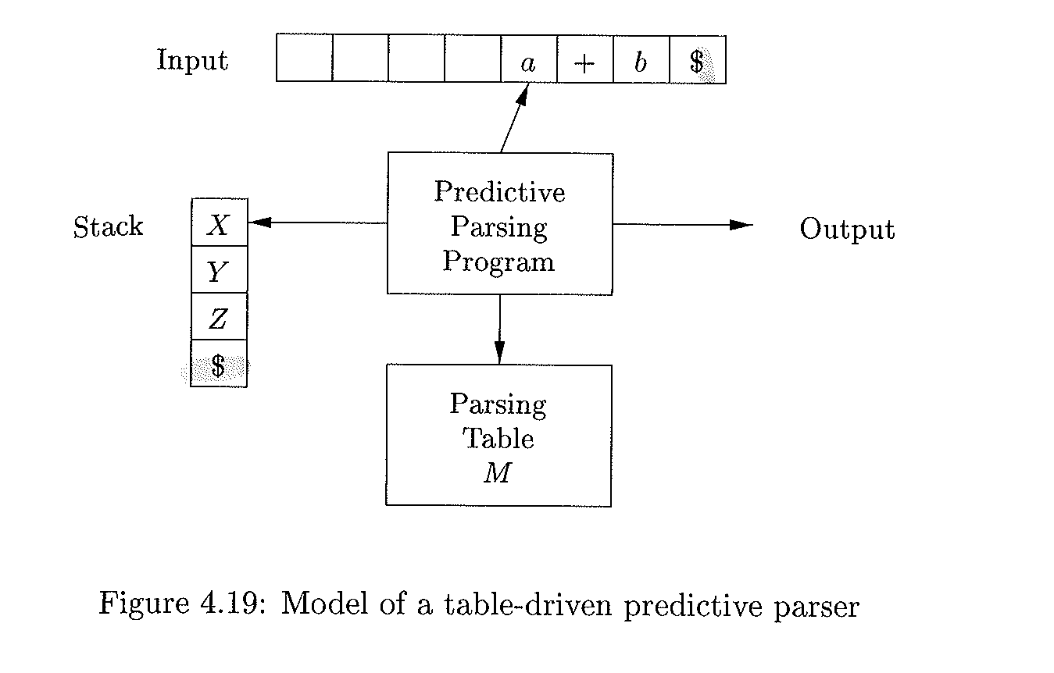
Model of a table-driven predictive parser using Stack (no recursion)
End of input marker
End of input marker

Slide 75
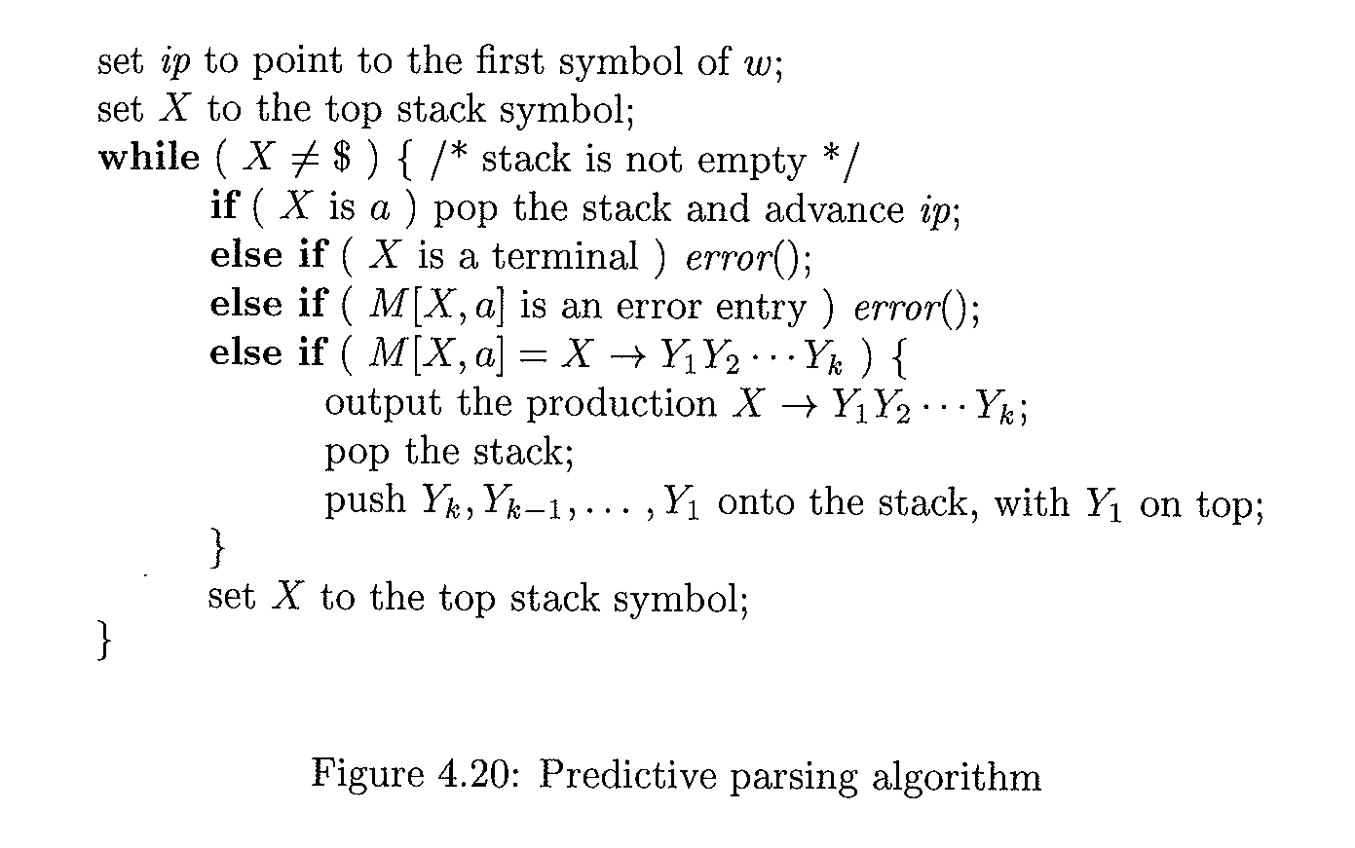
Program using parsing table (pg22 in ASU)
Algorithm: Non-Recursive Predictive Parser
Input: A string w and a Parsing table M for Grammar G
Output: if w is in L(G) a leftmost derivation of w; otherwise, an error indication
Method

Slide 76
Example : Table driven
Consider the following grammar
E→TE’
E’→+TE’ |∈
T→FT’
T’→*FT’
F→(E)| id

Slide 77
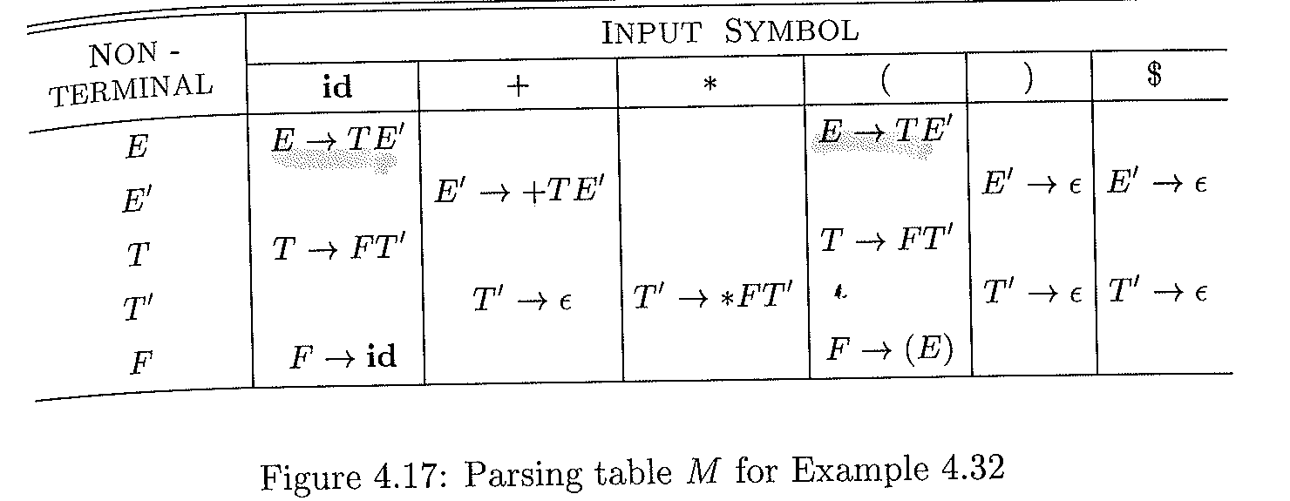
Parsing Table for the grammar 4.11

Slide 78
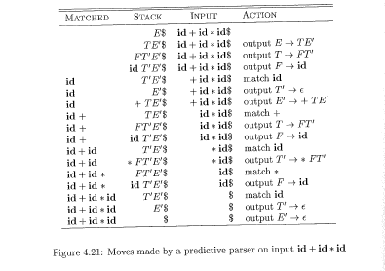
Figure 4.21

Slide 80
Syntax Errors
Program can contain errors at many different
Lexical
E.g., misspelling
Syntactic
E.g., arithmetic expression with unbalanced parentheses
Semantics
E.g., incompatible types
Logical
E.g., infinite loop

Slide 81
Parsing Error handler
The error handler in the parser should achieve proper reporting
The presence and the nature of errors explicitly
Recover from each error quickly

Slide 82
Issues
How should error handler report the presence of error?
Print the offending line
How should the parser recover?
quit
Quitting? Not an option because more errors in input is still possible

Slide 83
Error-Recovery Strategies
Panic mode
discards input symbol
Phrase level
perform local correction on the rest of input
Error production
Augment G with error productions
Global correction
find y; transfer y to x with minimal changes
Expensive (time/space)!!!

Slide 84
Error recovery in predictive parsing
An error is detected during the predictive parsing
when the terminal on top of the stack does not match the next input symbol
or when the nonterminal A on top of the stack, a is the next input symbol, and parsing table entry M[A,a] is empty/blank
Panic-mode error recovery?
based on the idea of skipping symbols on the input until a token in a selected set of synchronizing tokens.

Slide 85
Panic-mode error recovery
Works with synchronization token, which are tokens used in delimiters
E.g., semicolon, end, etc.
Error Recovery Panic-mode error?
Skips symbols on the input until a token is in Sync set
Sync set?
A set of words using FOLLOW function (e.g. Semicolon in C and Pascal)
Follow and First sets can be used in the sync set

Slide 86
Error Recovery Process using Sync Set
Using Sync set, the parsing table can be used :
If M[A, a] = sync, then pop non-terminal
If M[A, a] =“ ”, then skip the input symbol ‘a’
If input symbol ‘a‘ does NOT match terminal on the stack, then
pop the terminal on the top of stack
issue a message (e.g., token is inserted)
resume parsing

Slide 87
Solution for Follow()
Consider the following grammar
E→TE’
E’→+TE’ |∈
T→FT’
T’→*FT’| ∈
F→(E)| id
FOLLOW(E)={), $}
FOLLOW(T)= {+, ), $}
FOLLOW(F) = {*, +, ), $}
Synch-set= {*, +, ), $}

Slide 88
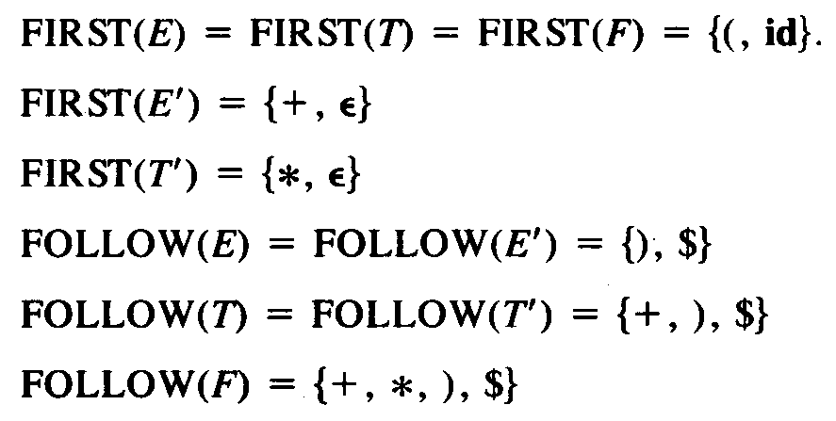
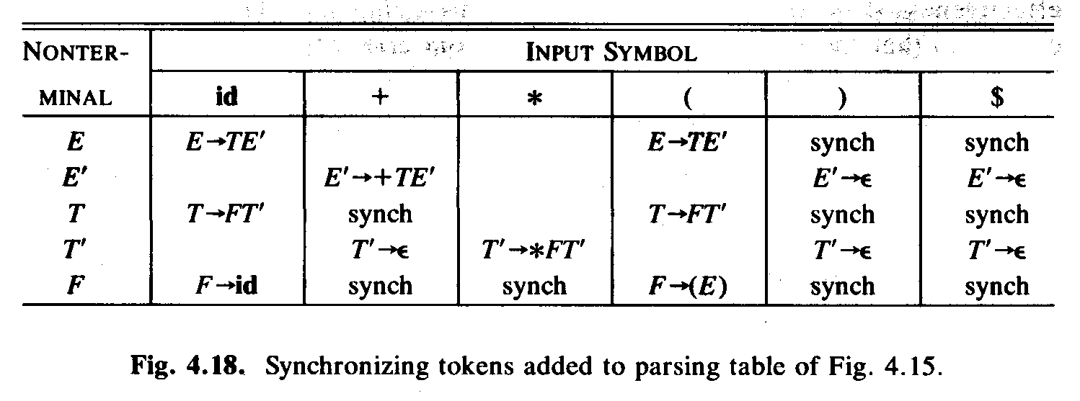
Example: error recovery
“synch” indicating synchronizing tokens obtained from FOLLOW set of the nonterminal in question.
If the parser looks up entry M[A, a] and finds that it is blank, it SKIPS the input symbol
If the entry is “synch”, or does match the input, POPS the nonterminal on top of the stack .

Slide 89
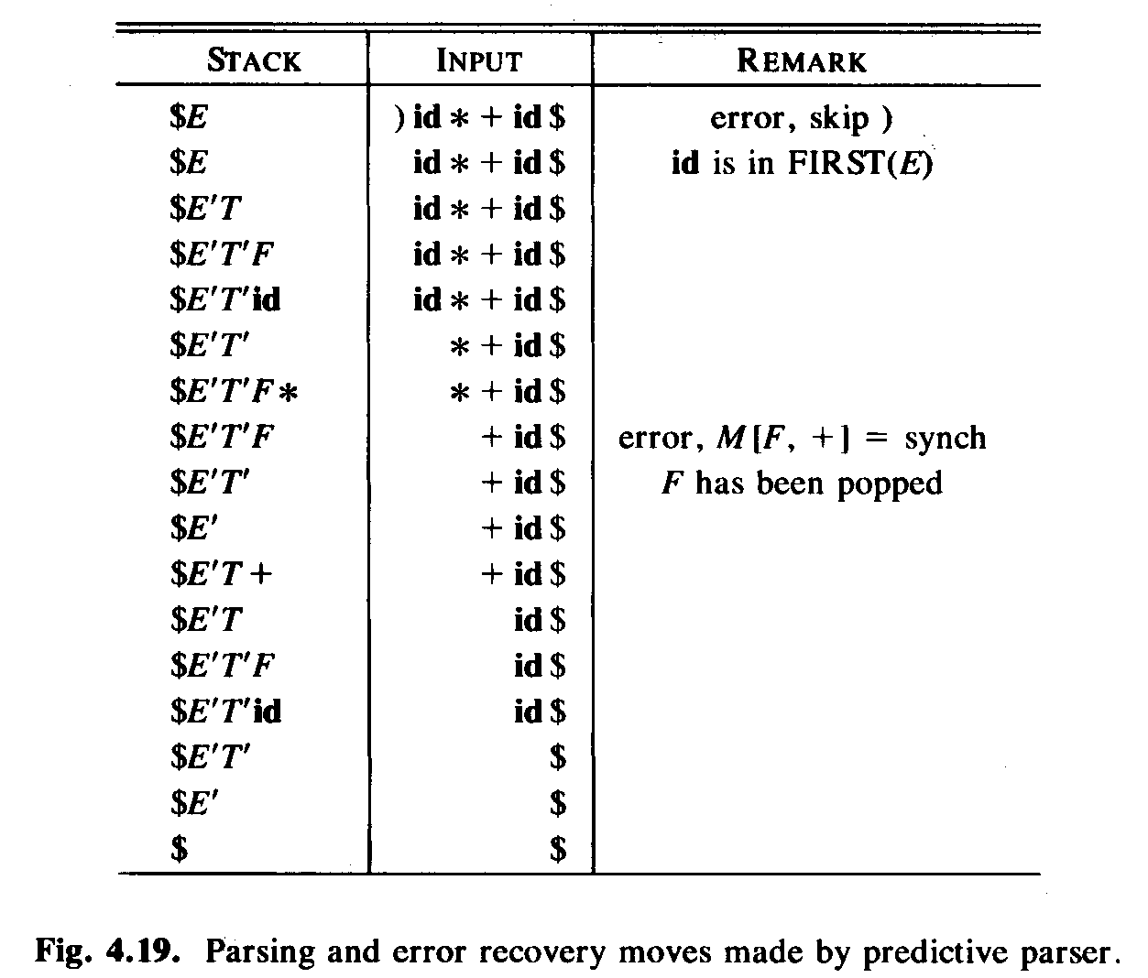
Example using: )id *+id$

Slide 90
How to handle ambiguous Grammar
Left recursion and left factoring eliminations

Slide 91
Left Recursion and Left Factoring
A grammar is a left recursive if it has a non-terminal A such that
A⁺⇒Aα
Left Recursion eliminations methods
Immediate left recursion
Non-immediate left recursion

Slide 92
Immediate left recursion
A→A α|β
Can be transformed to
A→βA’
A’→ αA’|ε
Elimination process
Group the offending production A
Introduce non-terminal A’
Create an empty production for A’
Append non-terminal A’ to the right of both type of productions (i.e., offending and non-offending)

Slide 93
Left Recursion elimination: General technique
A→A α₁| A α₂| A α₃| …|A α_{n}| β₁ | β₂ |…| β_{n}
where none of β_{I} begins with A
Can be transformed into
A→β₁ A’| β₂ A’|…| β_{n}A’
A’→ α₁ A’| α₂ A’| …| α_{m} A’| ε
where
None of α_{i} is empty

Slide 94
Non-immediate elimination
Consider the following grammar
S→Aa |b
A→ Ac|Sd| ε
S is left-recursive? why? S⇒Aa⇒Sda
First eliminate the derivation
S→Aa |b
A→ Ac|Aad|bd| ε //replace S by its r.h.s in A
Then apply immediate left recursion elimination methods
S→Aa |b
A→ bd A’| A’
A’→ cA’|adA’| ε

Slide 95
Left Factoring
When the selection between the alternatives of a production is NOT clear
Need to delay the selection until there is enough information

Slide 96
Left Factoring : Example
Suppose we have the following Grammar G
Stmt→if Exp Then Stmt
Stmt→if Exp Then Stmt else Stmt
G is NOT LL(1)
Why not?
Remove left-factored
Stmt →if Exp Then Stmt Rest
Rest→ else Stmt | ε

Slide 97
Summary of Non-Context Free Language Constructs
Programming constructs that cannot be specified using grammar
Define/USE
Counting number of formal parameters and actual parameters.

Slide 98
examples
Examples:
Define/Use: L1 = {wcw| w is in (a|b)*}
Where
the first w occurrence = declaration;
c: program;
the second w occurrence = usage
Checking the number of formal and actual parameters in procedure calls:
L2 = {Formal^{n} Actual^{m}| n≥1 and m≥1}
Possible Solution: Leave them up to semantic analyzers to handle them!!!

