Slide 1
Flight Pathfinding
Derek Trom
CSCI492

Slide 2
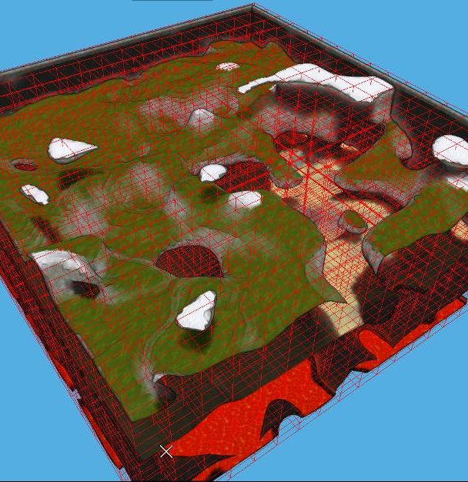
Summary of Goals
Design and implement an algorithm for pathfinding of a plane in a 3d space
Design for beyond line of sight flight (UAS) using the onboard radars and sensors as well as manned aircraft
Use data fusion of generated flight paths to find best route

Slide 3
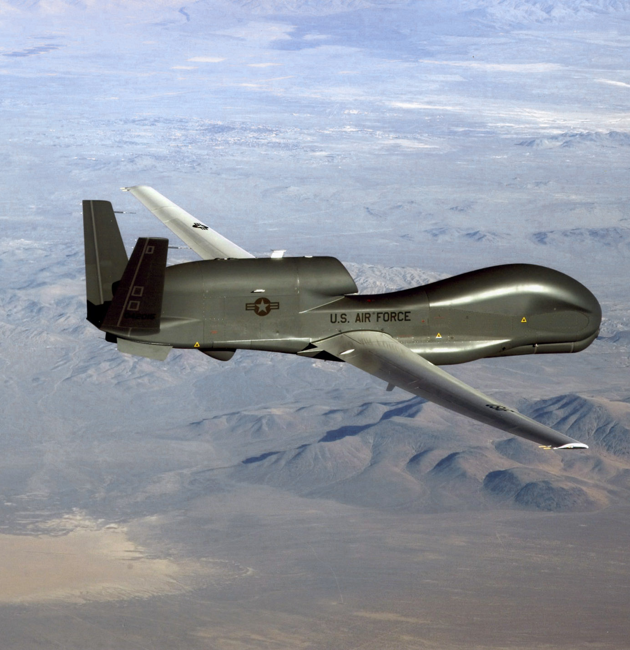
Background
Northrop Grumman Flight Simulation Lab
Some UAS are flown beyond line of sight
Mission optimization is the top priority of this project in order to accomplish as much of the mission plan as possible
Notes:
If adverse conditions occur, such as weather, planes will return to station or the pilot has to quickly come up with a new flight plan on the fly (pun intended). This new flight plan is sometimes not optimal.

Slide 4
Scientific Merit
The algorithms to be used in conjunction with this project are all public knowledge
The use of this project will be able to be modified for different software, mission needs, and aircraft
This could be applied to not only UAS but it could also be applied to land surveillance as well as disaster recovery situations where aerial coverage is needed
Nyquist-Shannon sampling theorem will be used along the flight path as the sampling rate to show viability of data

Slide 5
Strategy and Design
Algorithm Design
Implement Algorithm on Test Data using XPlane11
Integrate algorithm into Lab Simulation Software
Expansion

Slide 6
Algorithm Design
Greedy algorithm for scheduling and initial flight path creation
Use a* and other algorithms for determining a new flight path based on constraints
Current Restraints Identified:
Weather
Communication connections
Data Collection points
Restricted air space
Predetermined(restricted air space, altitude)
Undetermined(weather systems etc.)
Use data fusion to determine best path and give a confidence factor

Slide 7
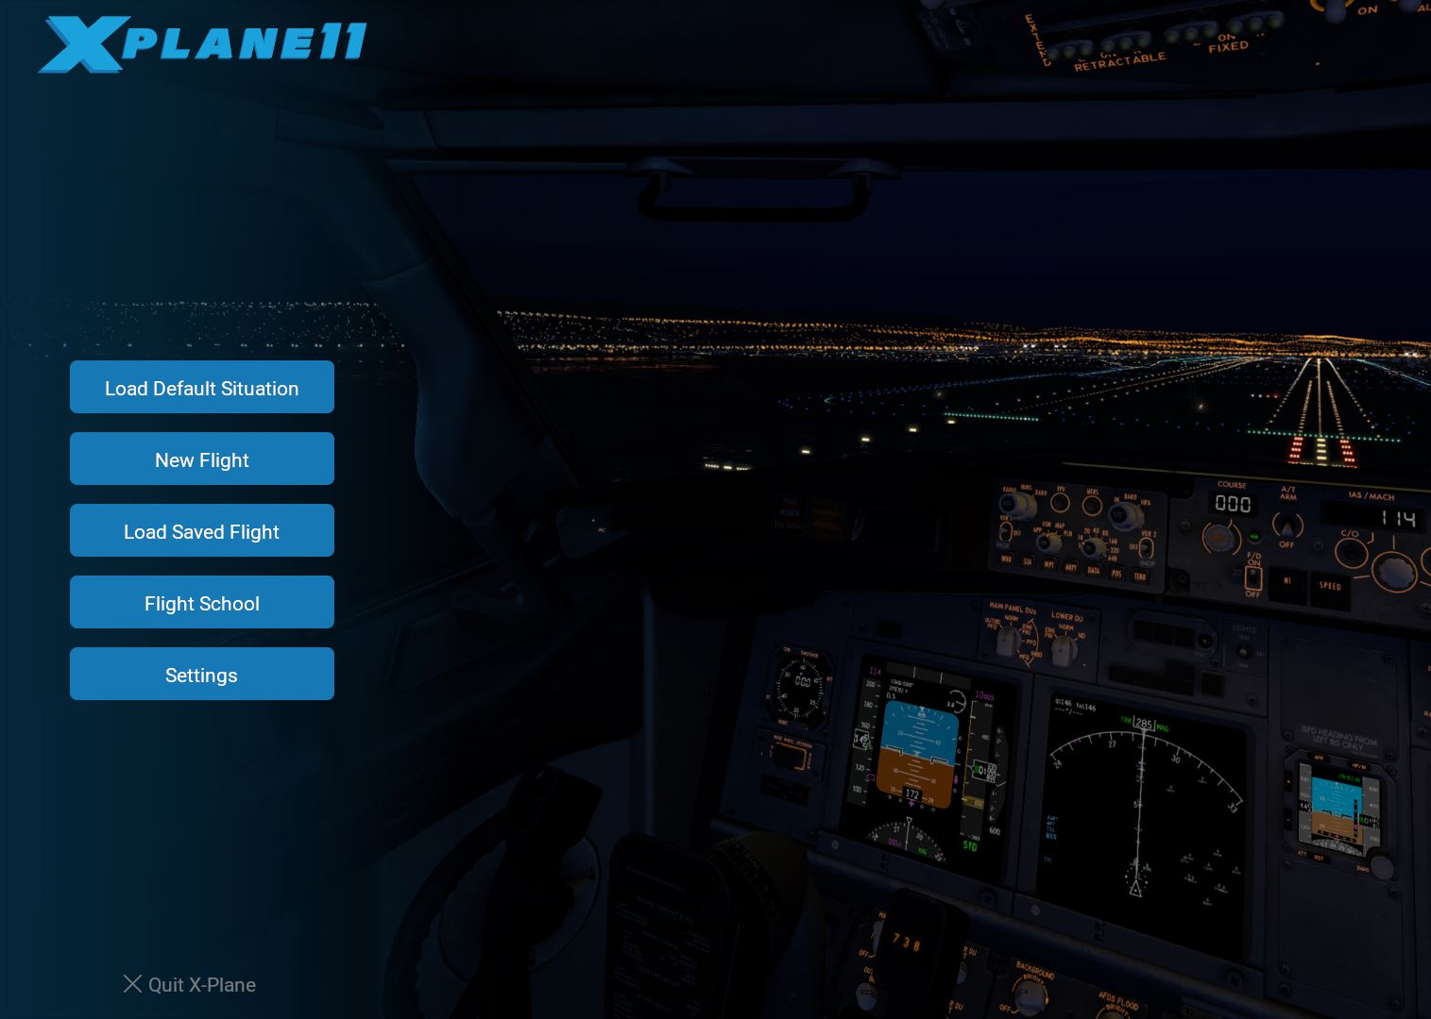
Implementation
Use premade flight paths to implement the algorithm
Using Xplane11 a flight simulation software show current flight path and the deviated flight path for proof of concept
Use current project plugin already implemented to fly the plane along the flight path.
Show the initial path and deviated path generated

Slide 8
Integrate Into Existing Simulation
Initial Release
Future Release
Based off of data files that will be predetermined to test the algorithm
Most likely in the form of a csv
Will be gathered by flying in XPlane11 and outputting at least two times the sampling rate from existing flight path
Change from predetermined data that will be fed into XPlane11
Modify to read in packet data from simulation environment as well as output packet data

Slide 9
Future Goals
Create UI for Pilots to Interact with
Expand to closed loop simulations so that data for the environment and the algorithm are separated.
Read in real time weather data from radars in the simulation
Implement in live aircraft scenarios
Notes:
Use to create initial flight plan based on mission plan
If conditions appear to pilot or onboard sensors such as the weather radar, pilot can click a button and calculate new route.

Slide 10
QUESTIONS?

