Slide 1
CS Capstone presentation
Flight Pathfinding
Derek Trom, Spencer Bretz(Northrop Grumman), Kent Ridl(Northrop Grumman Project Manager)

Slide 2
Related works
Cruise Missile Pathfinding (Dr. Ronald Marsh)
Autonomous Pathfinding in a Simulated 3D Environment (S. Raja, T. Bhatia, A. Mishra, S. Kashyap and O. Verma)
GPU Accelerated Pathfinding (A. Bleiweiss)

Slide 3
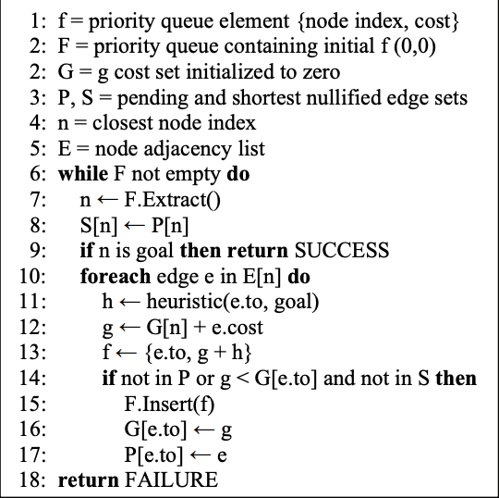
Cruise Missile Pathfinding (Dr. Ronald Marsh)
Navy funded project
Before this project it took personnel 12-15 hours to calculate paths the cruise missiles would take to target
Using multiple graphics algorithms this was reduced to about 2 hours
The main algorithm used for the pathfinding was the A* pathfinding algorithm

Slide 4
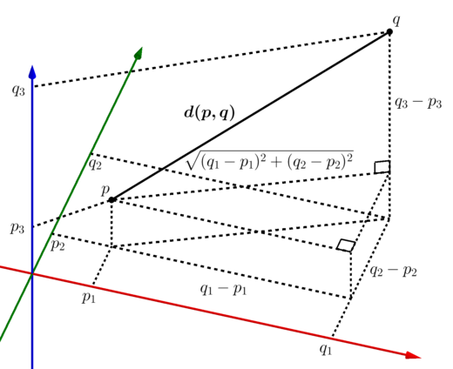
Autonomous Pathfinding in a Simulated 3D Environment
The research that is described in this section presents an approach for navigating an autonomous agent in a simulated room environment with multiple obstacles.
divided the entire 3D environment into unit volume cubes centered at integer coordinates
Heuristic aided search using heuristics
Heuristics used were Manhattan Distance as well as Euclidean Distance
Found some success using neural network as well

Slide 5
GPU Accelerated Pathfinding
Avi Bleiweiss explored some of the techniques for optimizing pathfinding on GPUs
He compared the a* algorithm to the breadth first search algorithm and Dijkstra’s algorithm and showed that it is fast and optimal compared to the latter two algorithms
I will be attempting to also optimize the a* using GPU calculations in order to speed up the pathfinding even further
Search | Start | Goal | Heuristic | Optimal | Speed
BFS | no | yes | yes | no | fair
Dijkstra | yes | no | no | yes | slow
A* | yes | yes | yes | yes° | fast

Slide 6
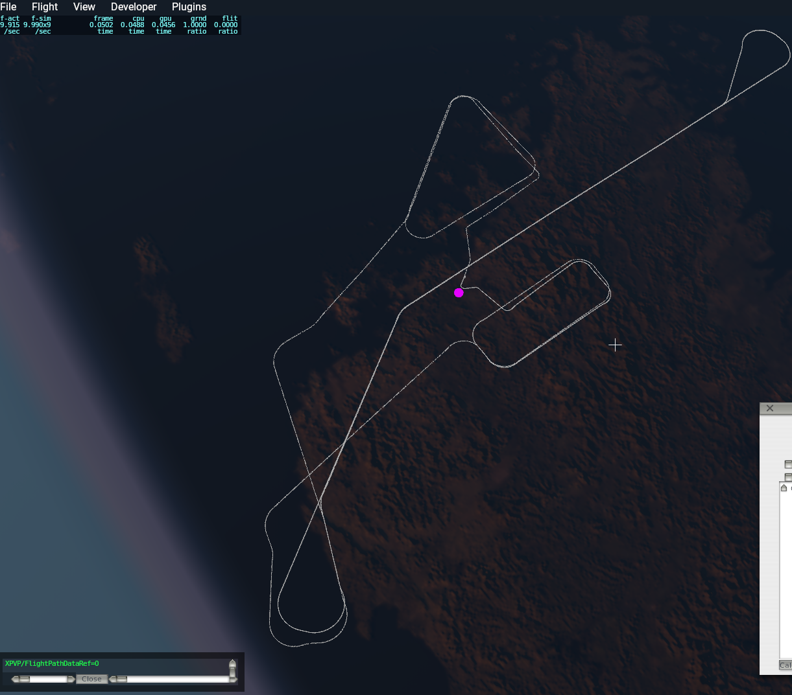
Current state of the project
At the moment we have narrowed down to using the a* algorithm as the main pathfinder
Have a remote repository in BitBucket for code sharing as well as using Jira for issue tracking
Have a base of code (C++ and Python) that is able to draw the flight paths that we have data for in XPlane11
This base of code is also able to fly the plane in xplane based off the data points we have
Have begun building the base of our pathfinding plugin for xplane which will have a user interface within xplane to control the algorithm

Slide 7
Strategy and design
Algorithm Design
Implement Algorithm on Test Data using XPlane11
Integrate algorithm into Lab Simulation Software
Expansion

Slide 8
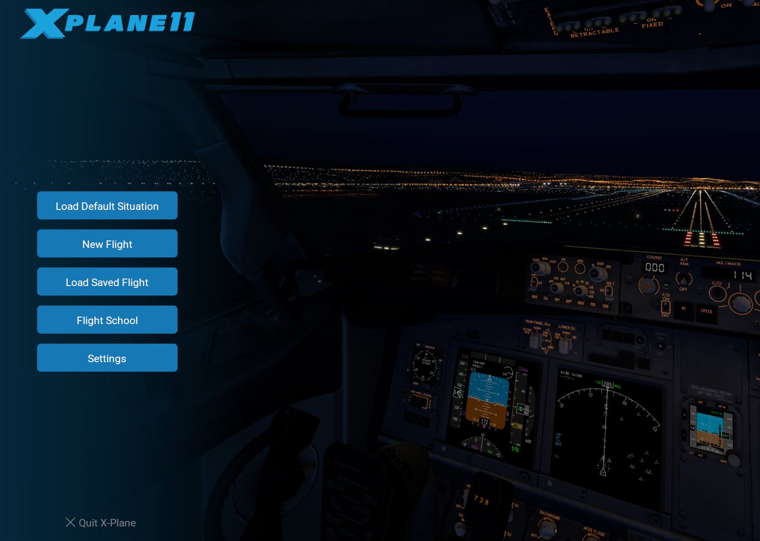
Work Remaining
Algorithm Design
Narrow down our heuristics and make sure they are admissible
Data fusion method needs to be identified if we end up using it to optimize the path
Implementation in Xplane
Plugin should be able to read environmental data within xplane and react accordingly to calculate new path and fly the plane along the new path

Slide 9
Summary
Some related research was found and examined which solidified which algorithm base we want to use
A* and some GPU Optimization
Current state
We have a good code base to work from which handles visualization of flight path as well as autonomously flying the plane in xplane

Slide 10
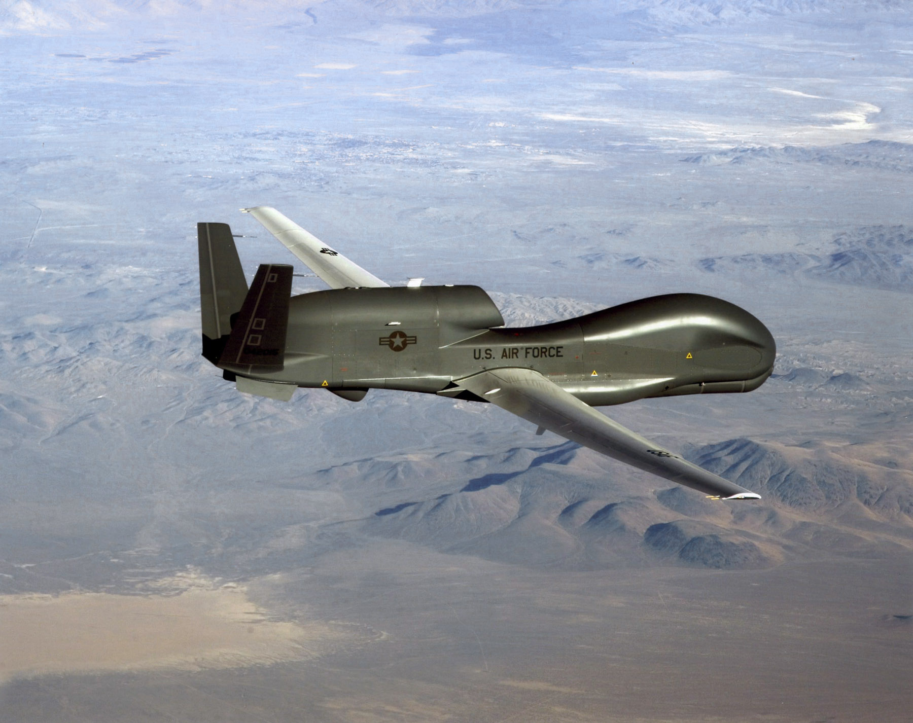
Questions??

