Slide 1
Intro to Node.js + NW.js

Slide 2
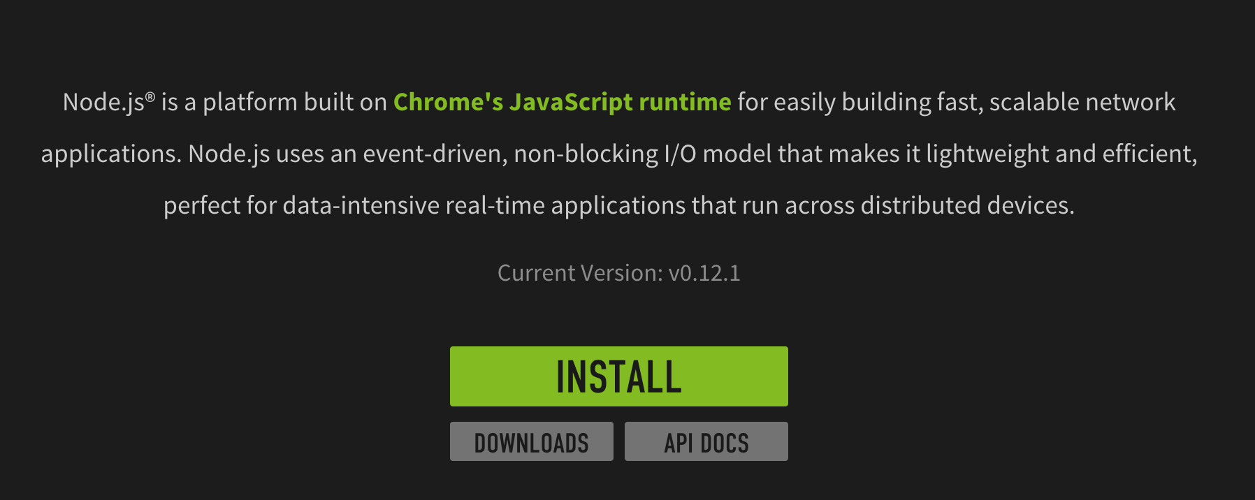
What is Node.js

Slide 3
How to install Node.js
Click INSTALL and run installer
C> node -v

Slide 4
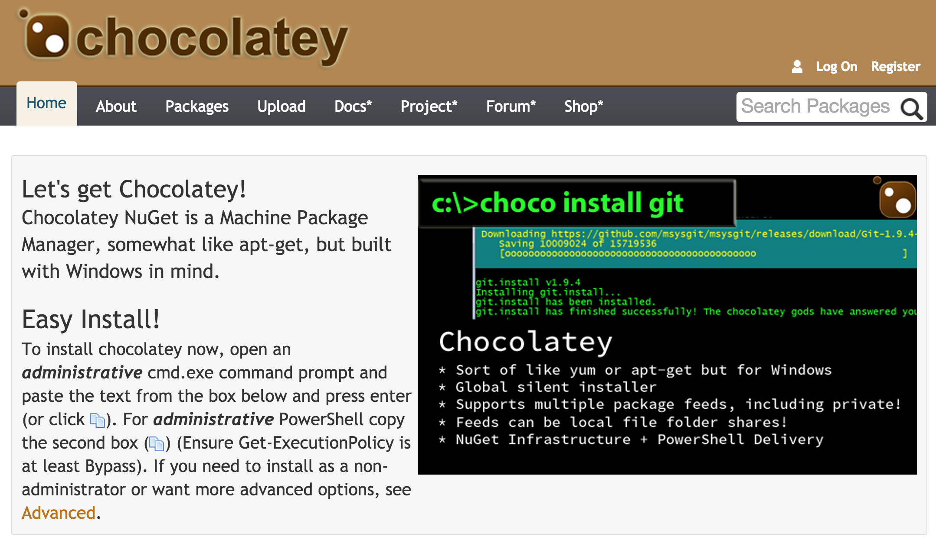
How to install Node.js (via Chocolatery)

Slide 5
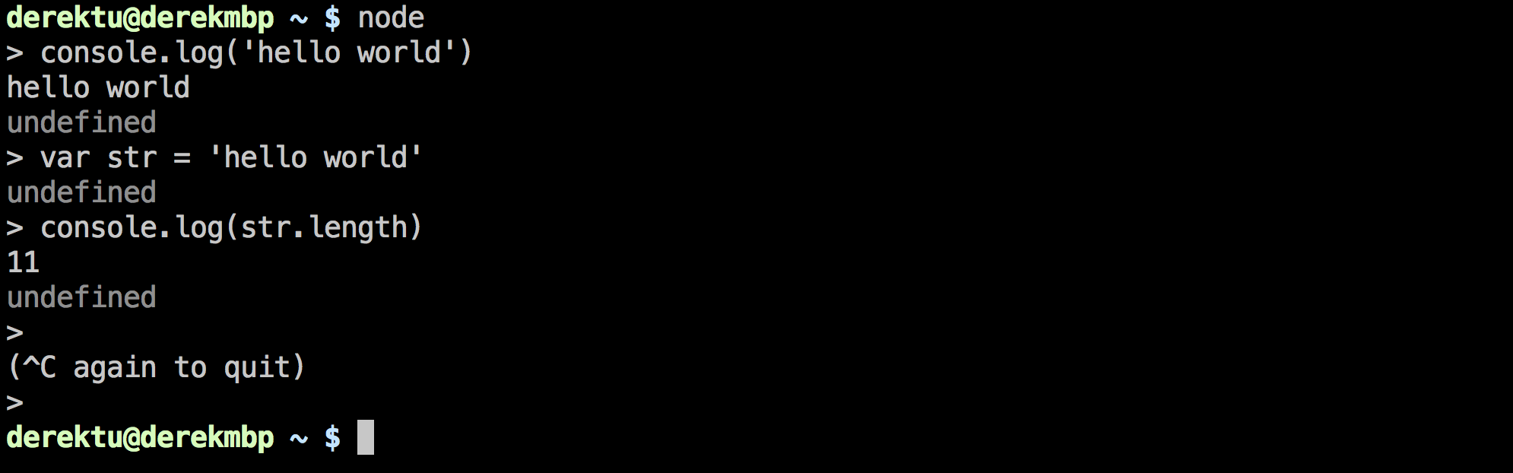
How to run Node.js

Slide 6
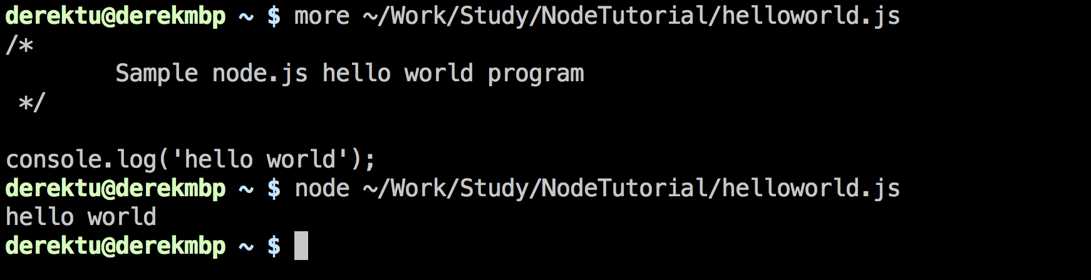
How to run Node.js

Slide 7
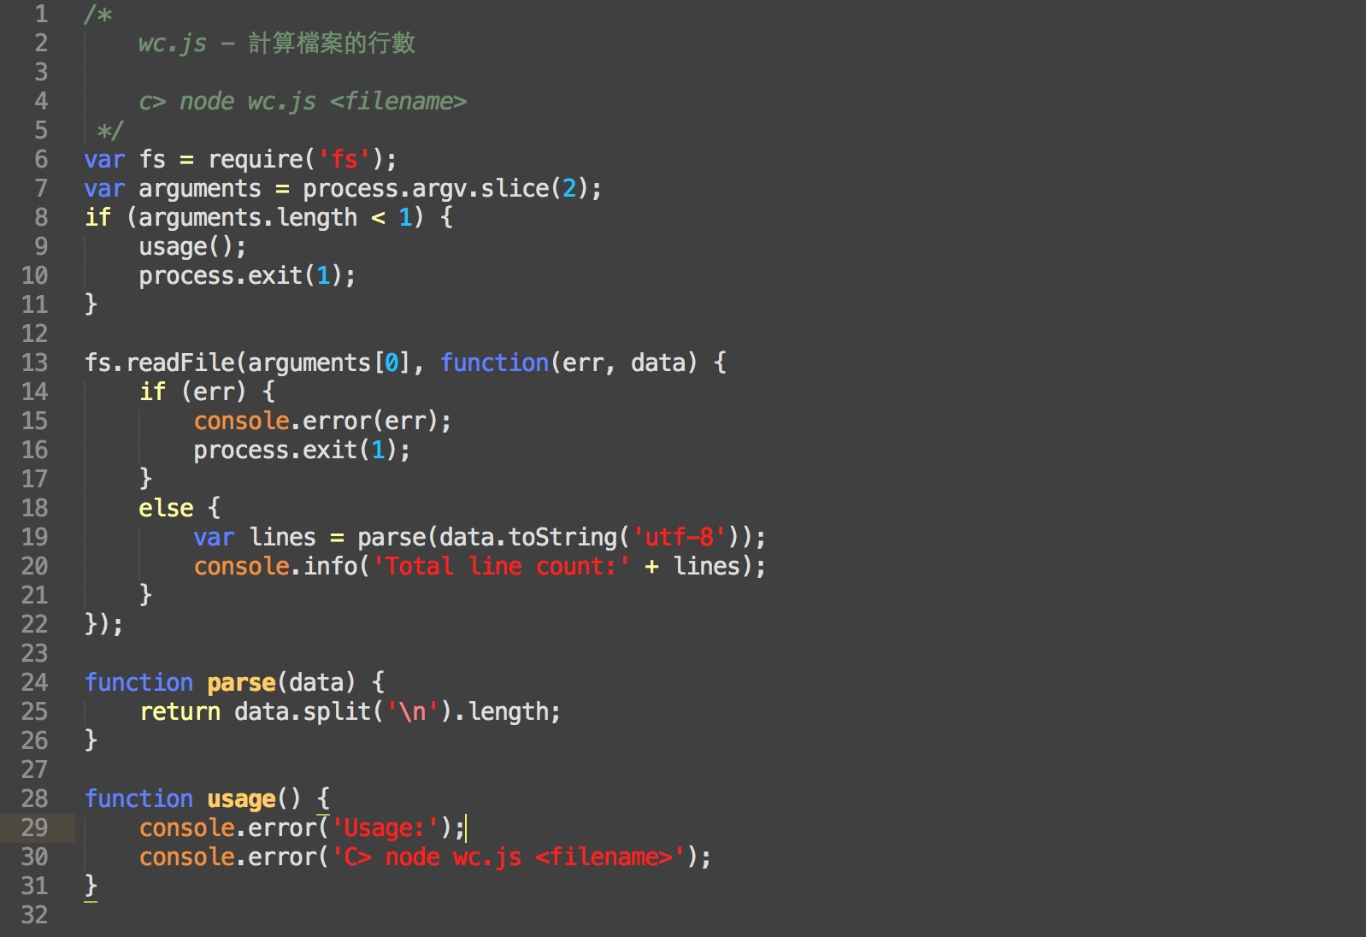

Slide 8
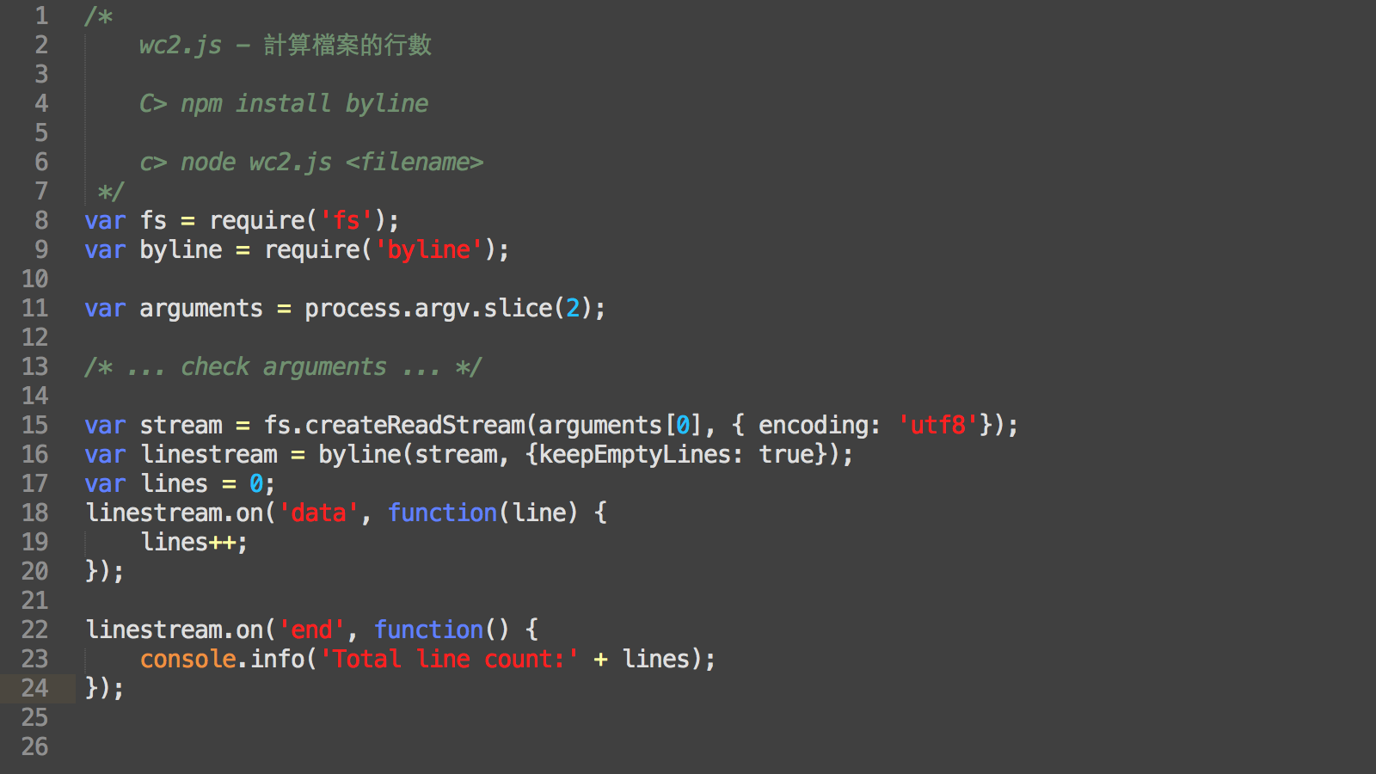

Slide 9
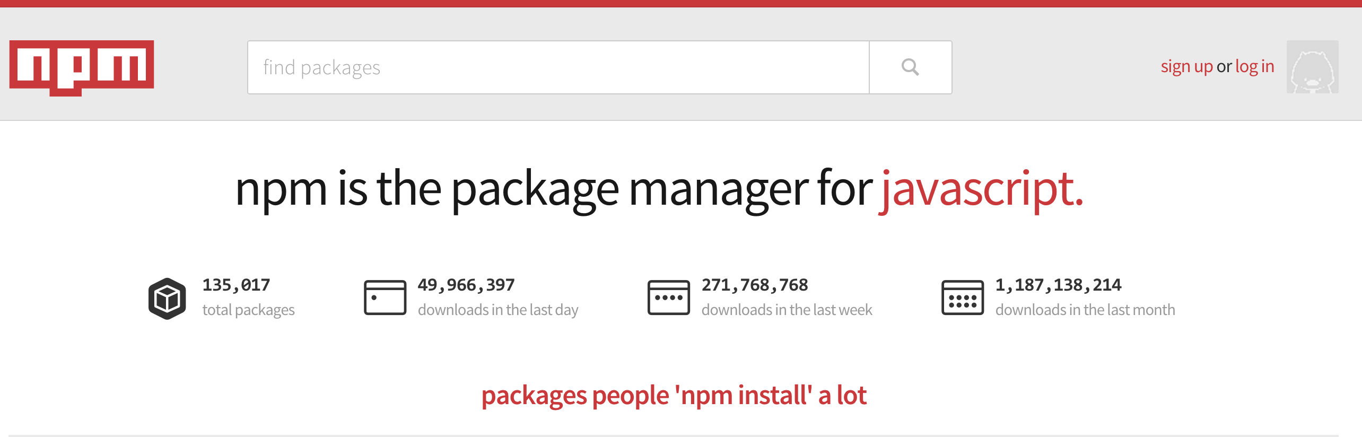

Slide 10
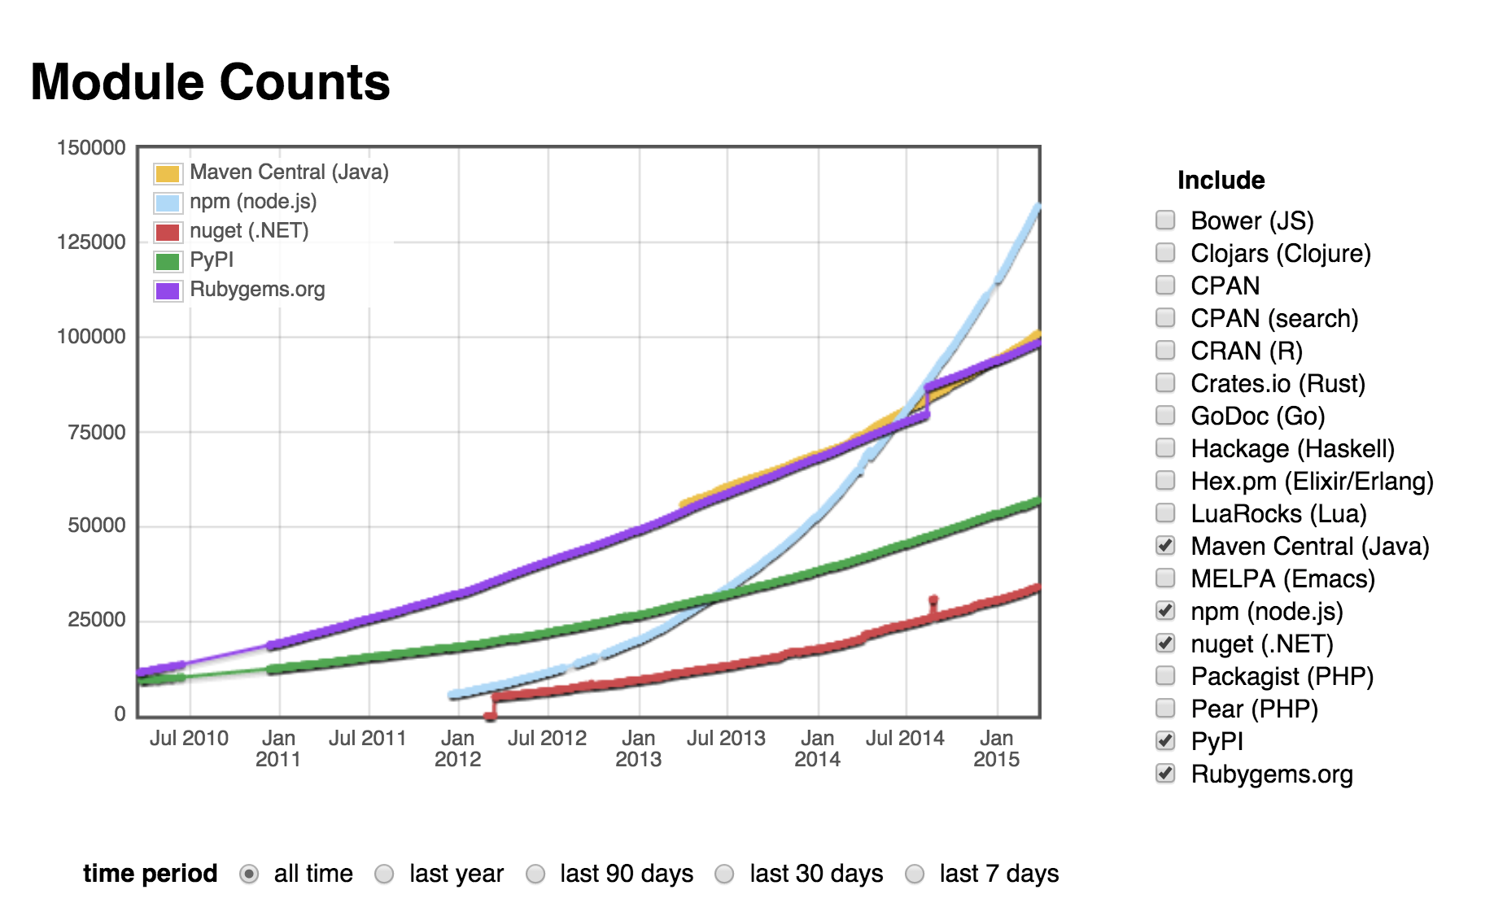
http://www.modulecounts.com

Slide 11
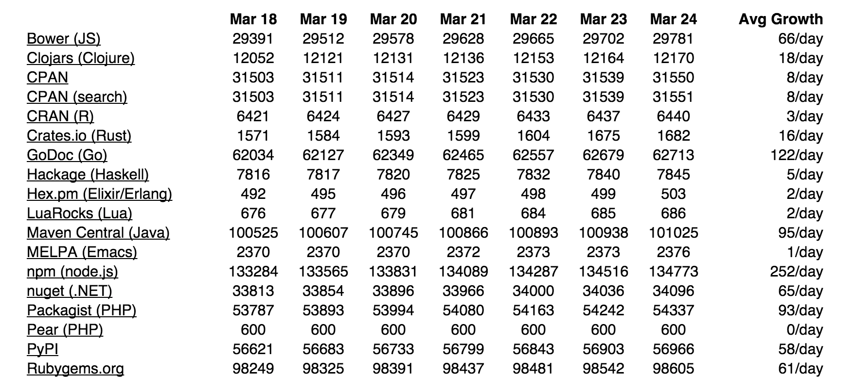

Slide 12
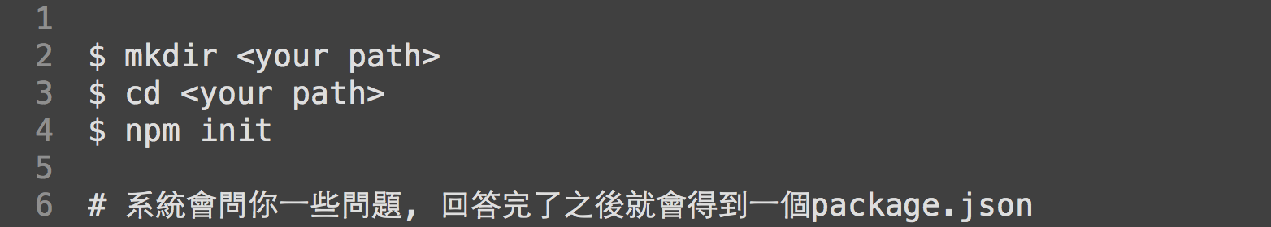
npm & package.json

Slide 13
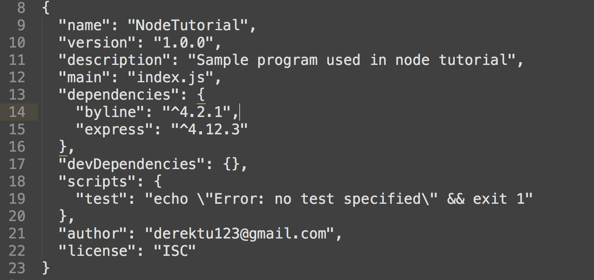
package.json

Slide 14
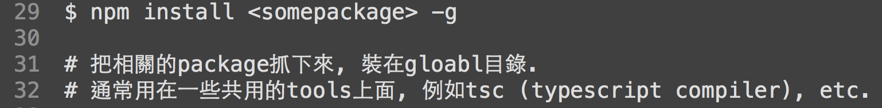
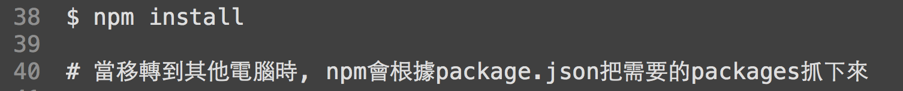

Slide 15
How to write our own modules ?

Slide 16
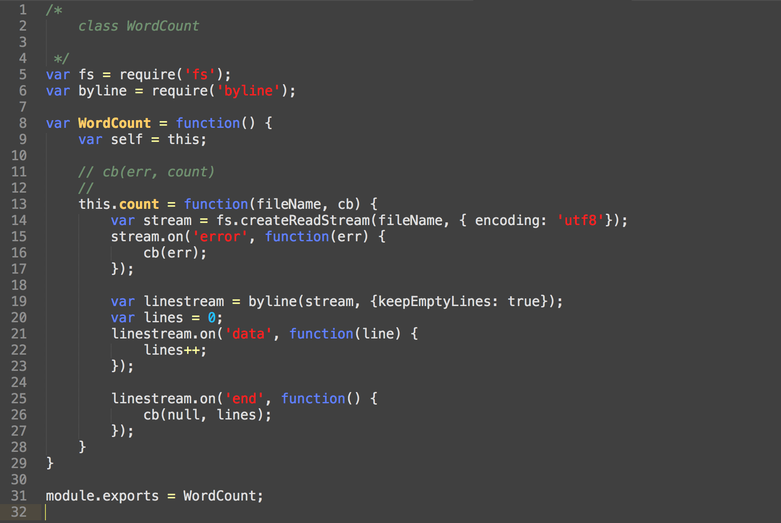
wordcount.js

Slide 17
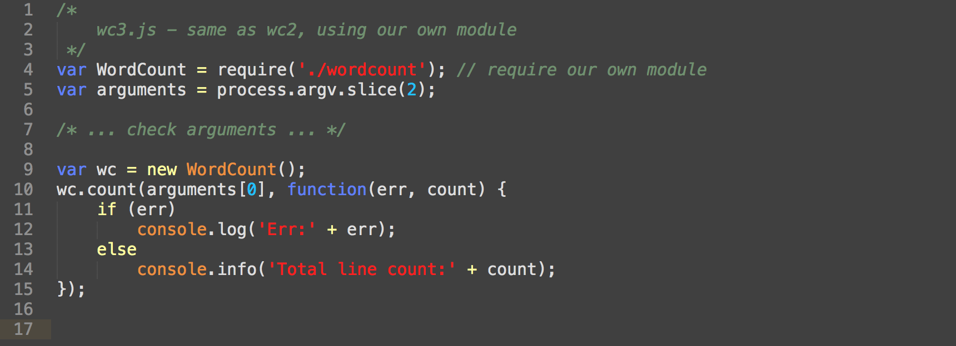

Slide 18
WebServer Example (ca 1990)

Slide 19
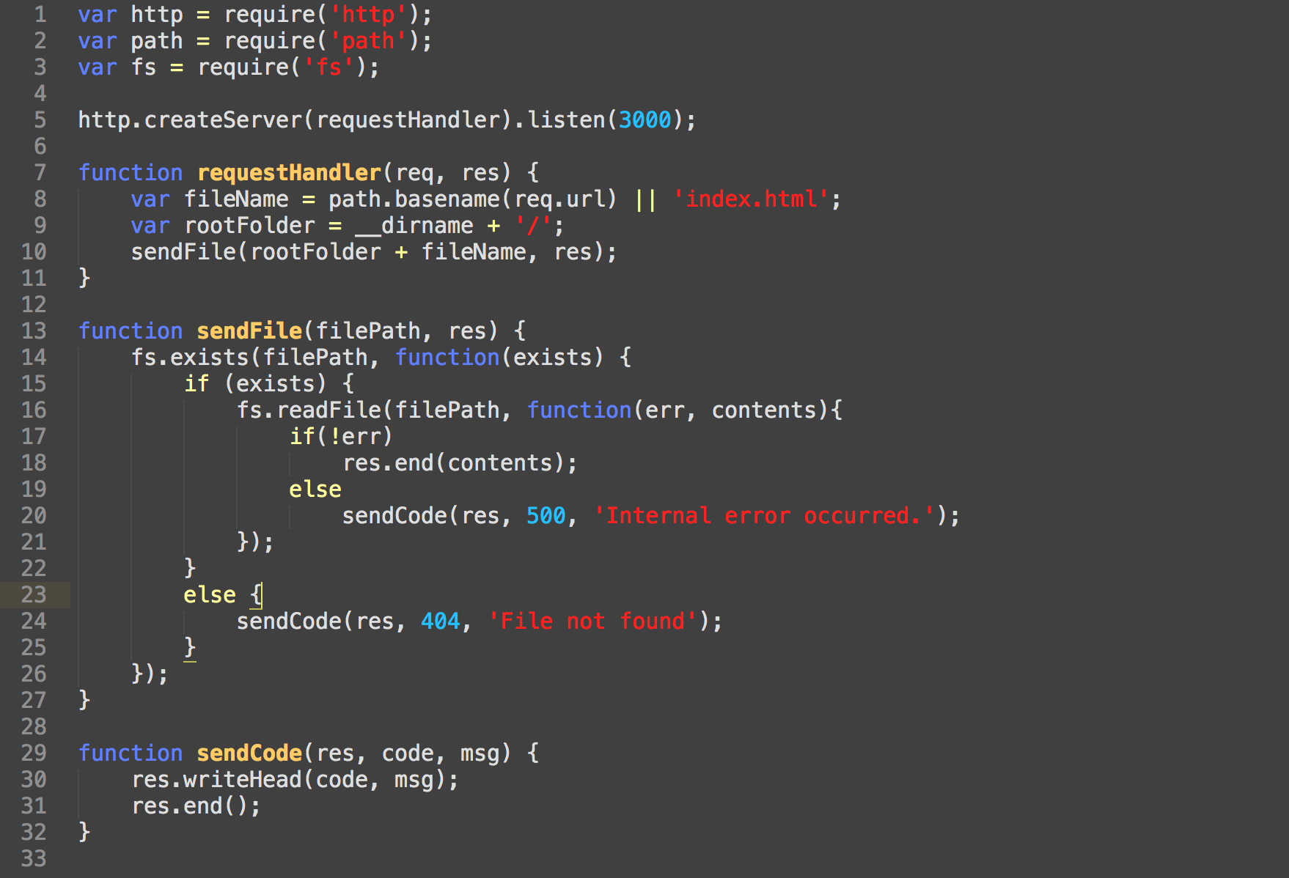

Slide 20
WebServer Example (using express framework)

Slide 21
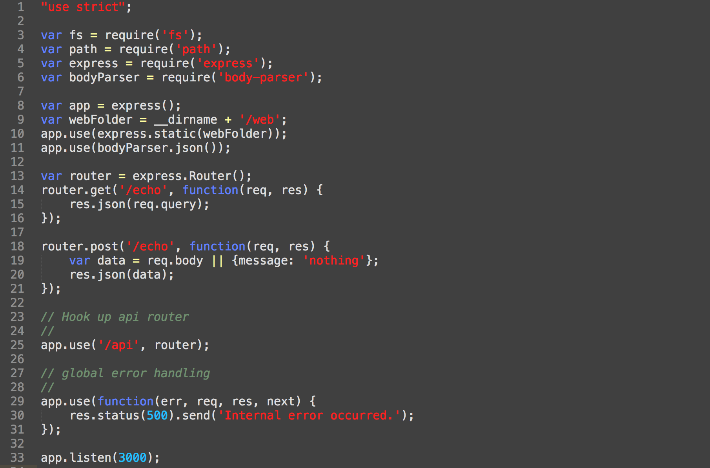

Slide 22
NW.JS (was node-webkit)

Slide 23
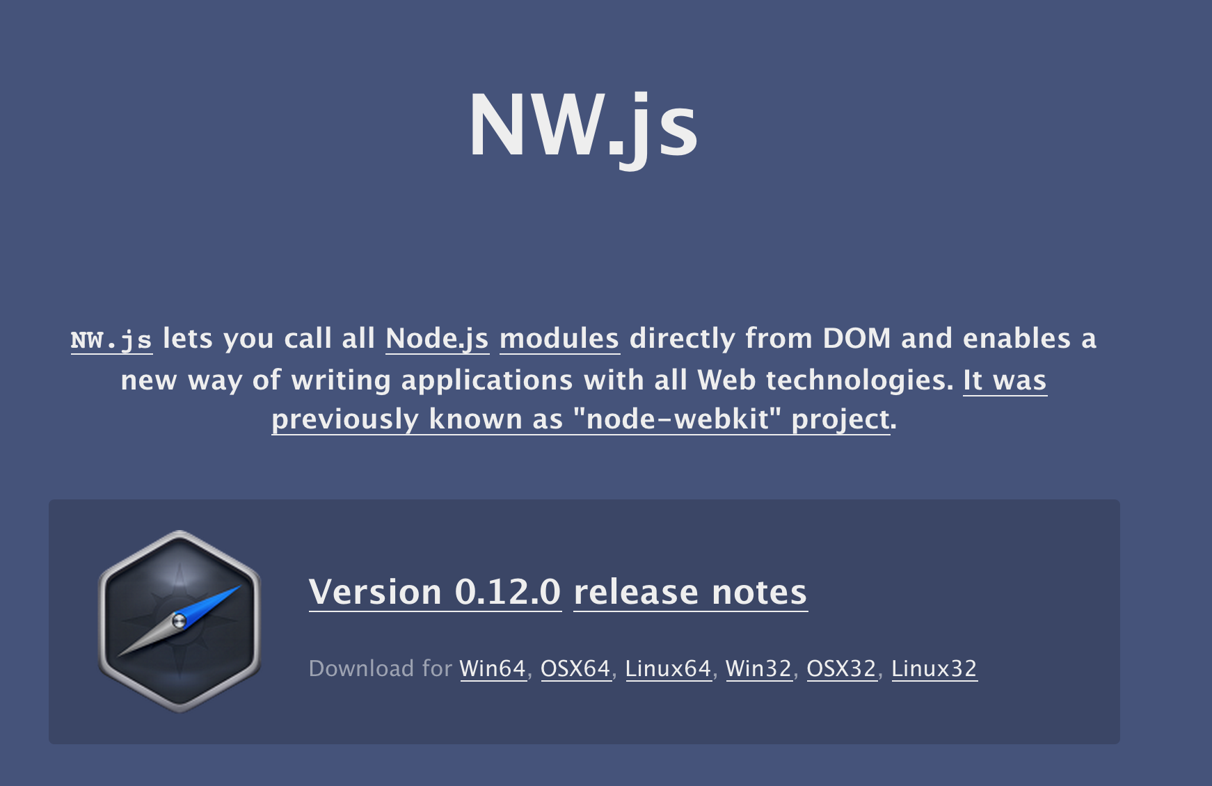

Slide 24
一個可以用node.js + html5來撰寫 desktop程式的平台

Slide 25
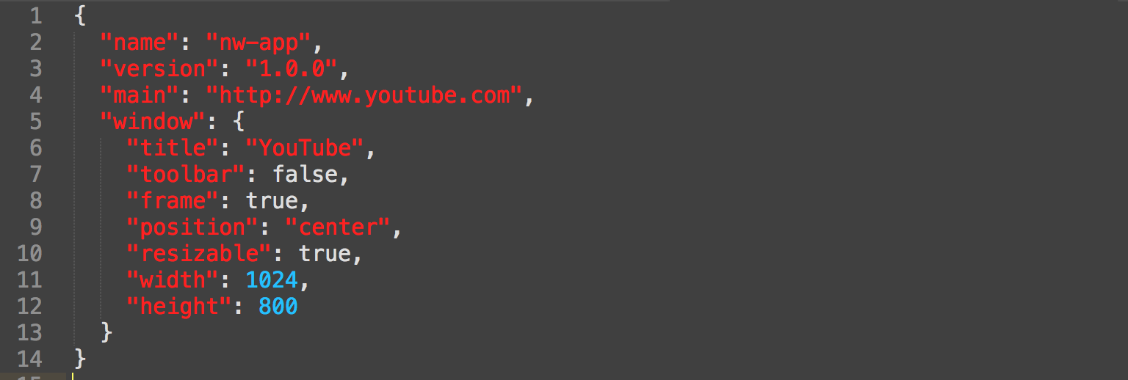
Simple way to run nw.js
nw-app/package.json
C> nw.exe nw-app

Slide 26
nw-app/package.json
C> nw.exe nw-app

Slide 27
NW.JS with Client & Server DEMO
https://github.com/derektu/ExtWebNW

