Slide 1
Intro to Node.js + NW.js

Slide 2
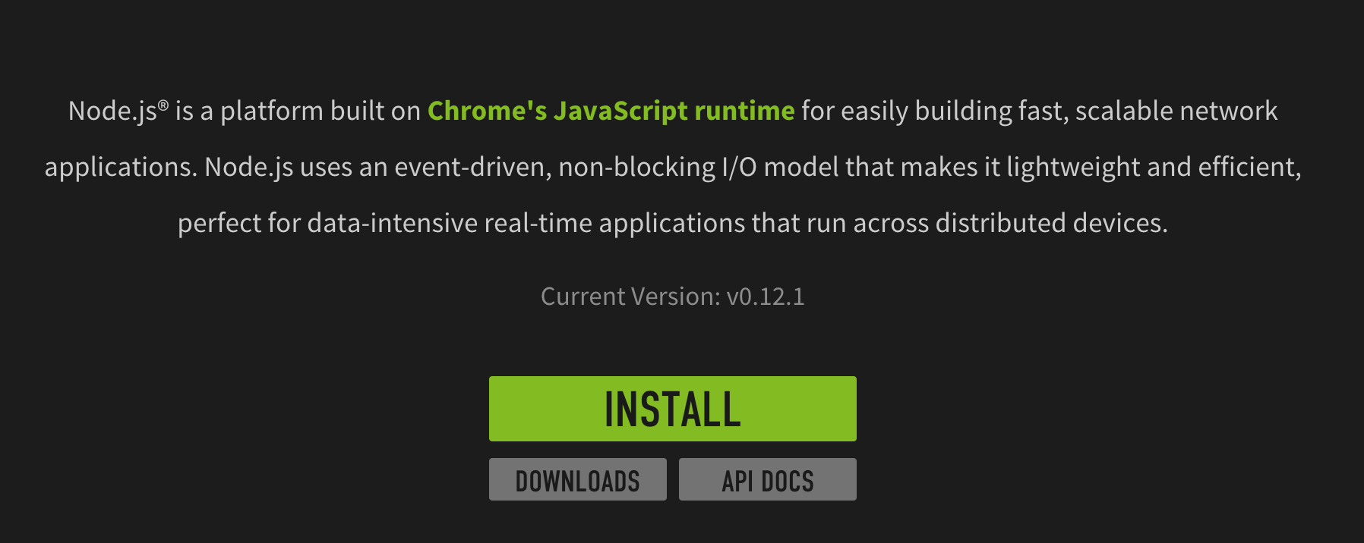
What is Node.js

Slide 3
How to install Node.js
Click INSTALL and run installer
C> node -v

Slide 4
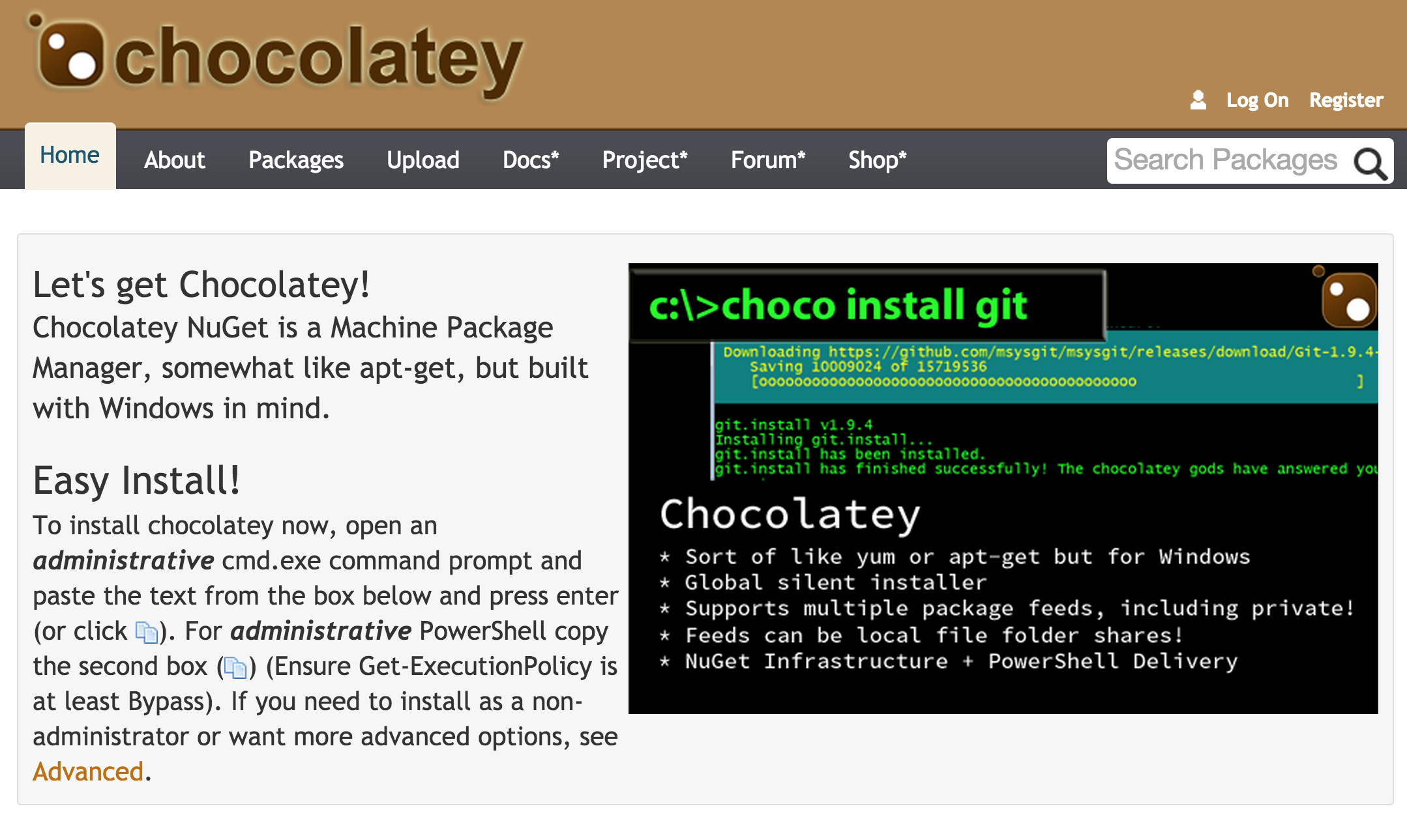
How to install Node.js (via Chocolatery)

Slide 5
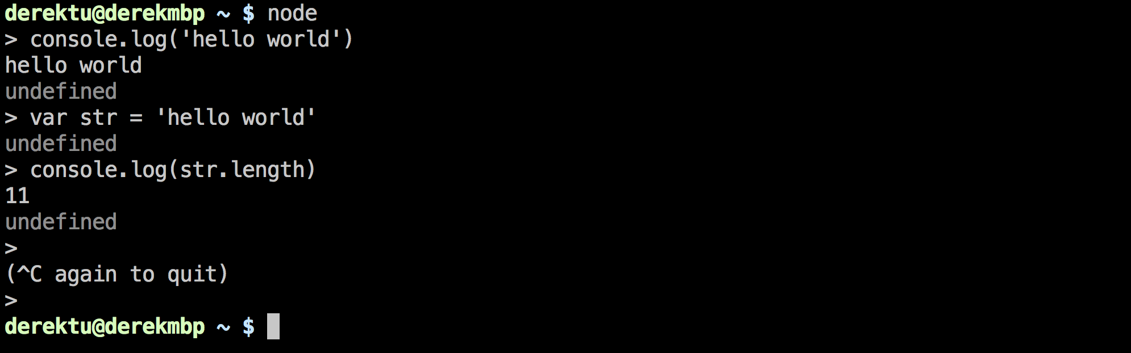
Node.js - HelloWorld

Slide 6
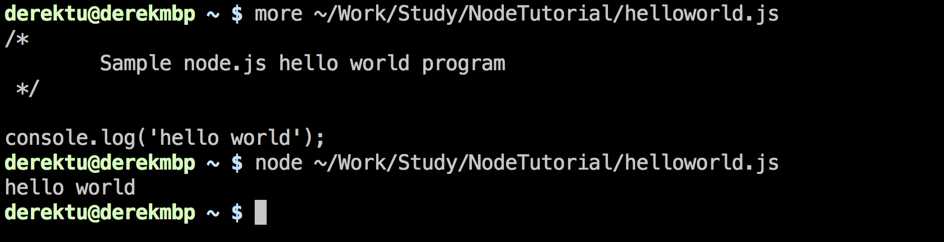
Node.js - HelloWorld

Slide 7
A more useful example Let’s count the lines of a given file

Slide 8
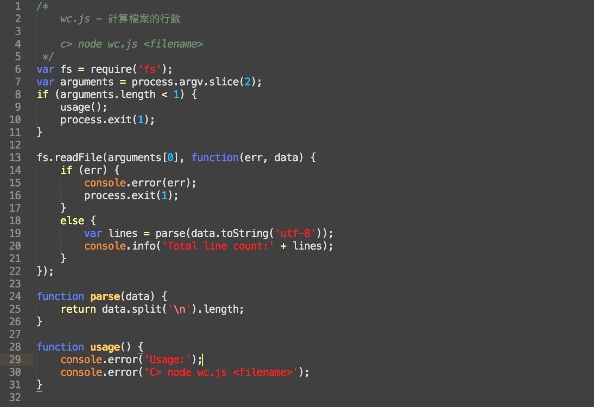

Slide 9
Node.js is single threaded So most of the APIs are ‘async’ And we must use callback to handle IO and other time consuming tasks

Slide 10
Is there any problem with this program ?
What if the file is very HUGE ?

Slide 11
解決之道 把檔案切成一塊一塊分開處理

Slide 12
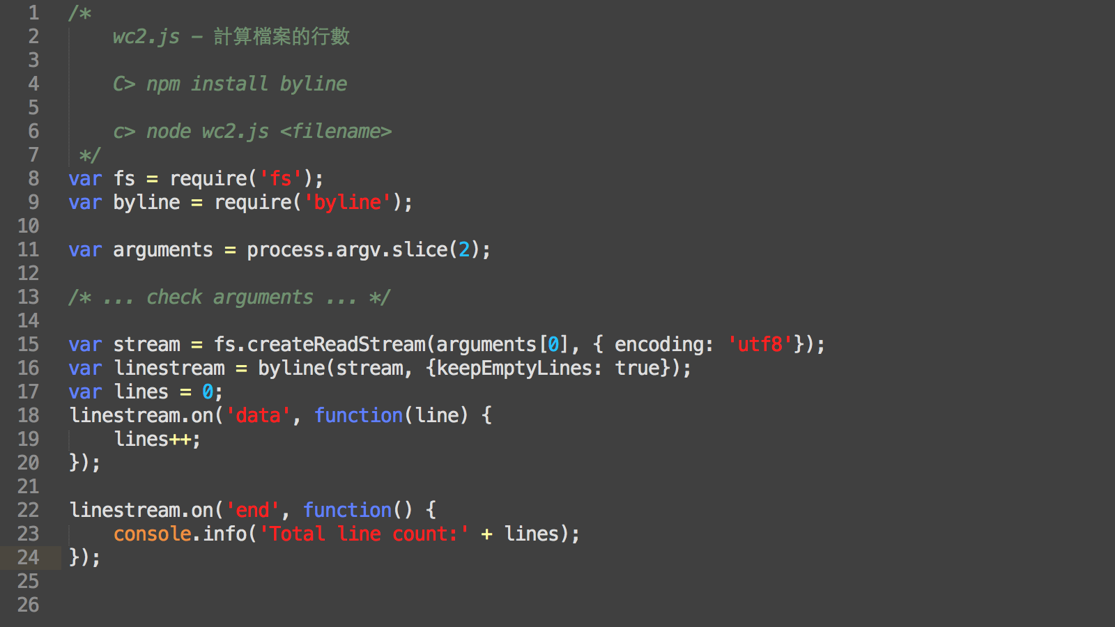

Slide 13
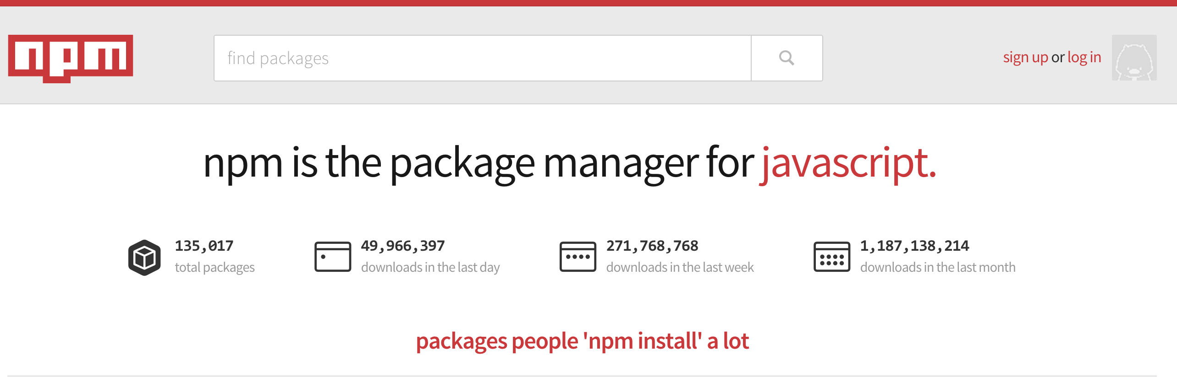
NPM – Node Package Manager Leverage open source community

Slide 14
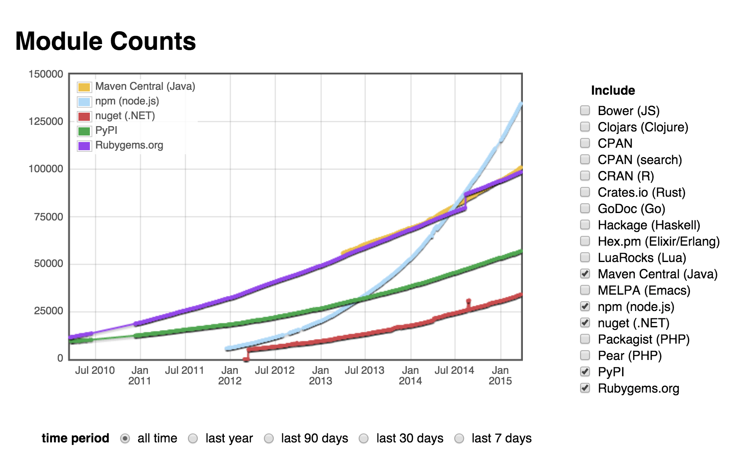
http://www.modulecounts.com

Slide 15
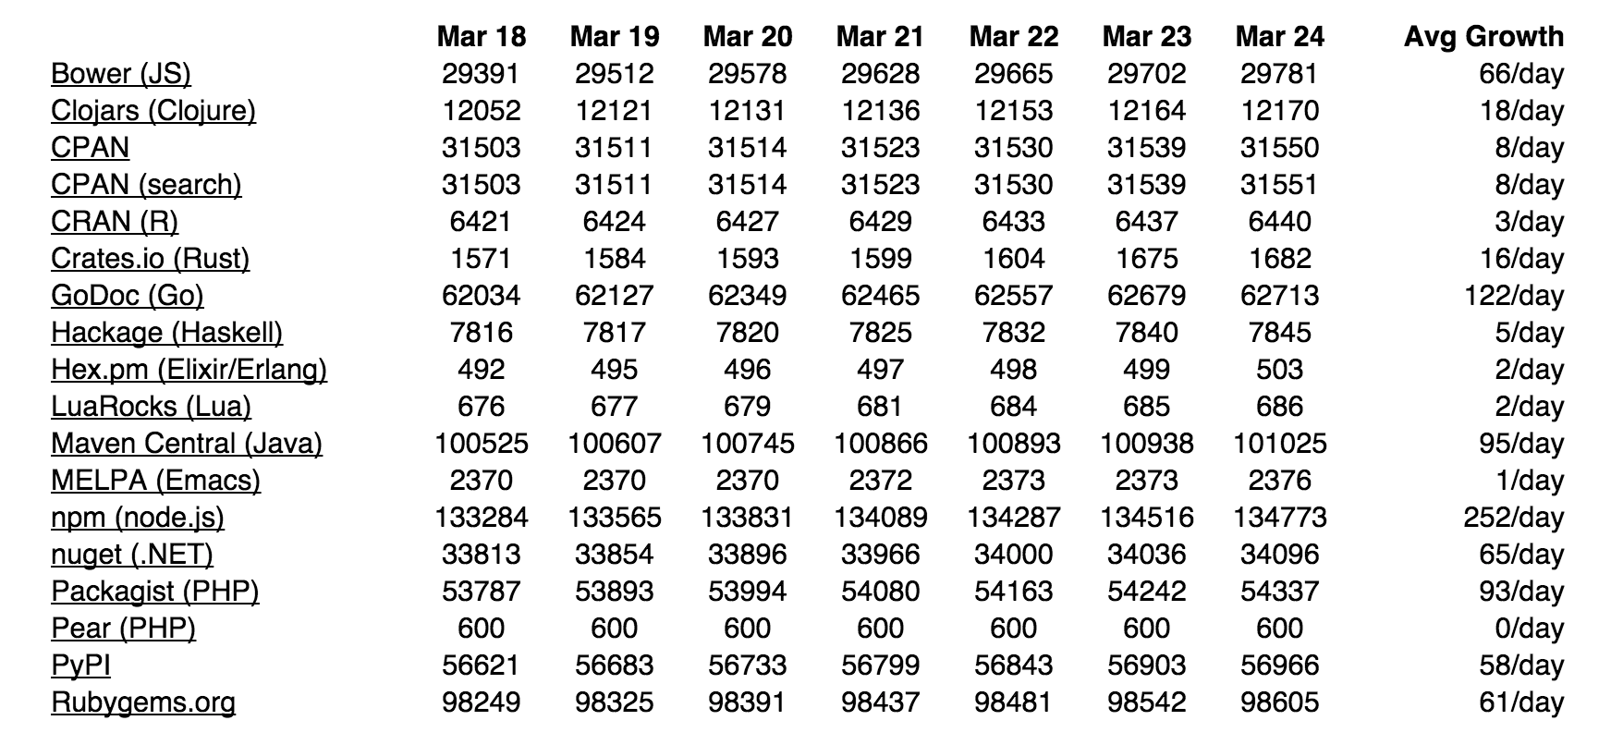

Slide 16
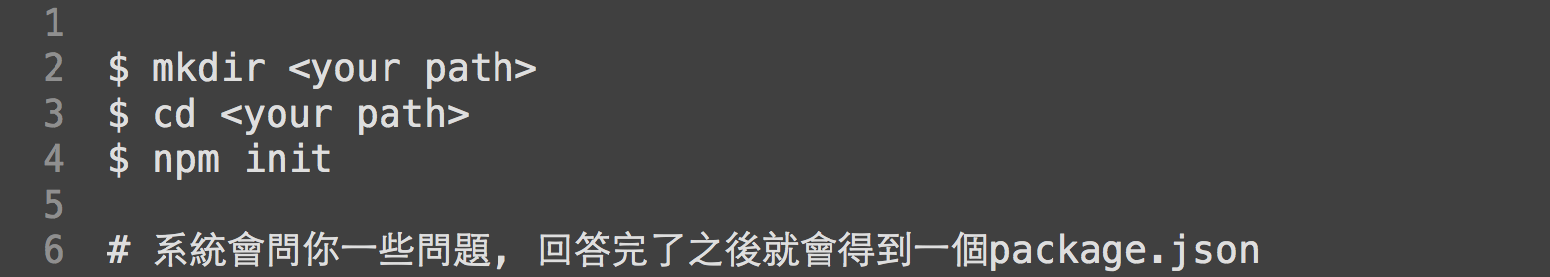
npm & package.json

Slide 17
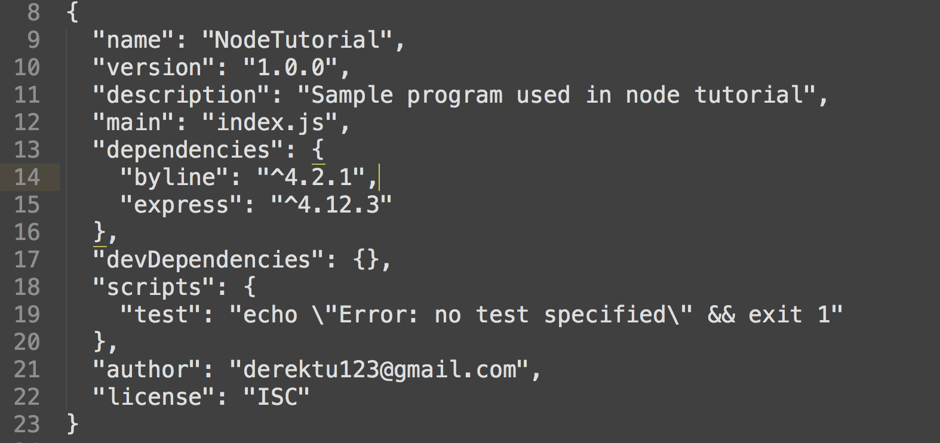
package.json

Slide 18
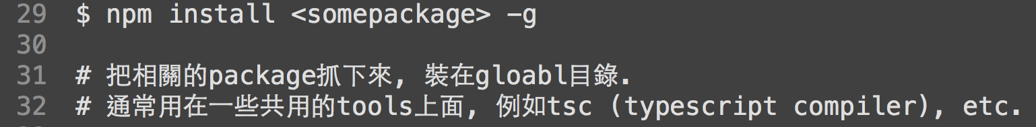
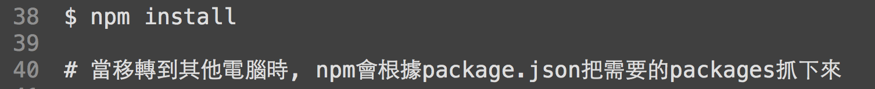
npm 常用指令

Slide 19
How to write our own modules ?

Slide 20
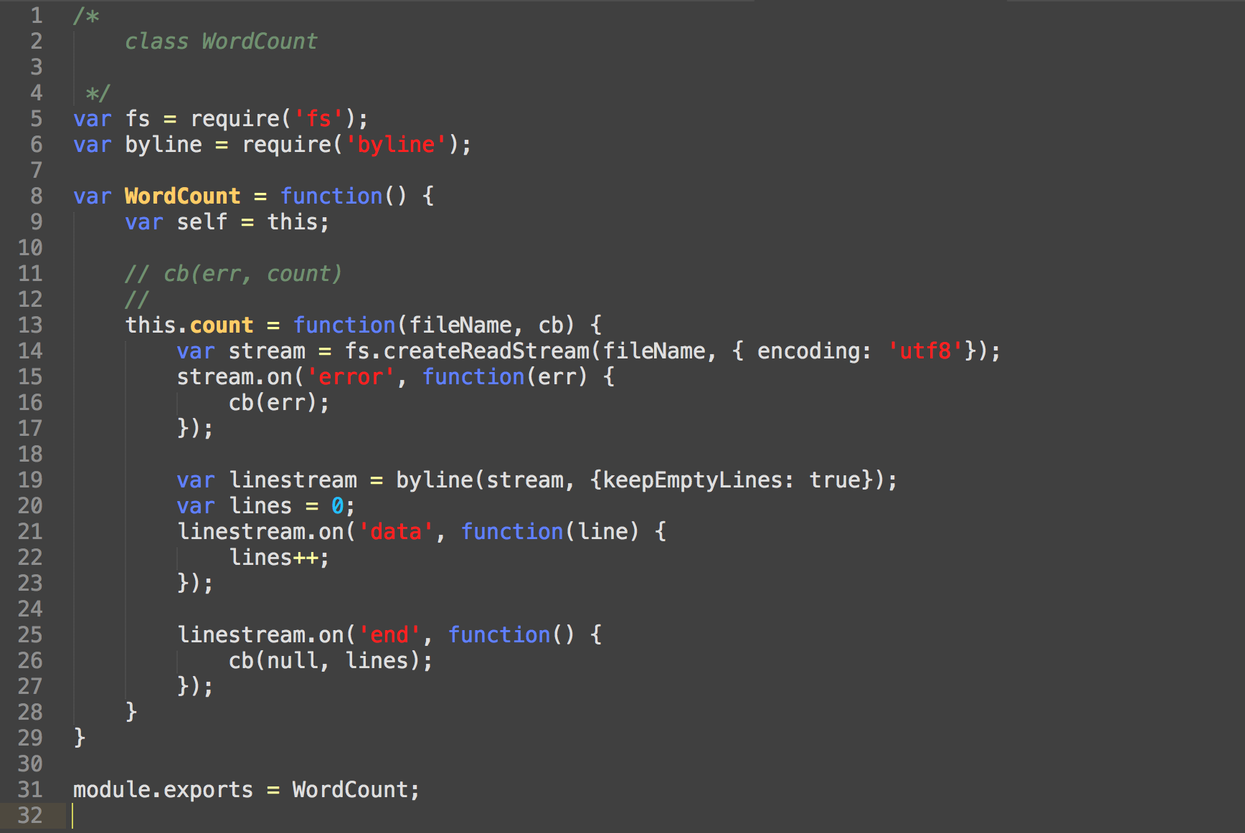
wordcount.js

Slide 21
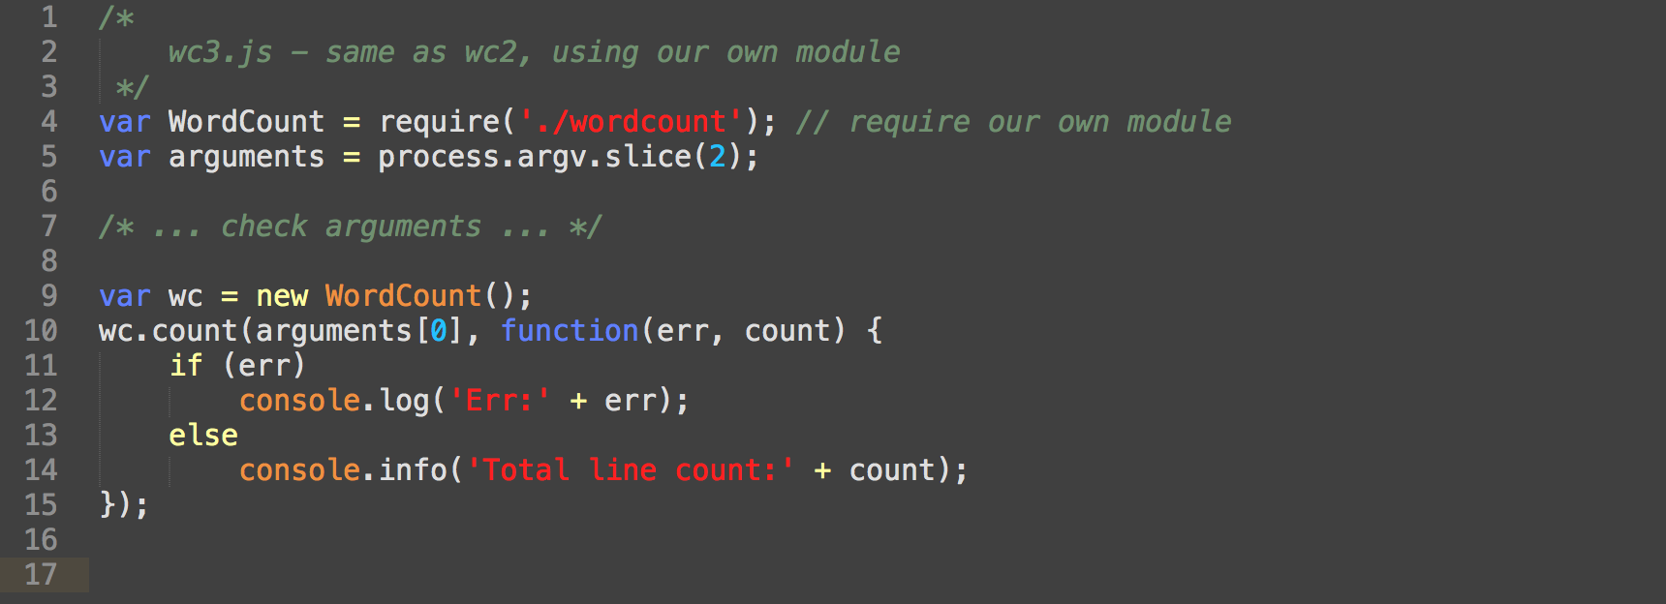

Slide 22
Node.js內建HTTP/NET模組 WebServer Example (ca 1990)

Slide 23
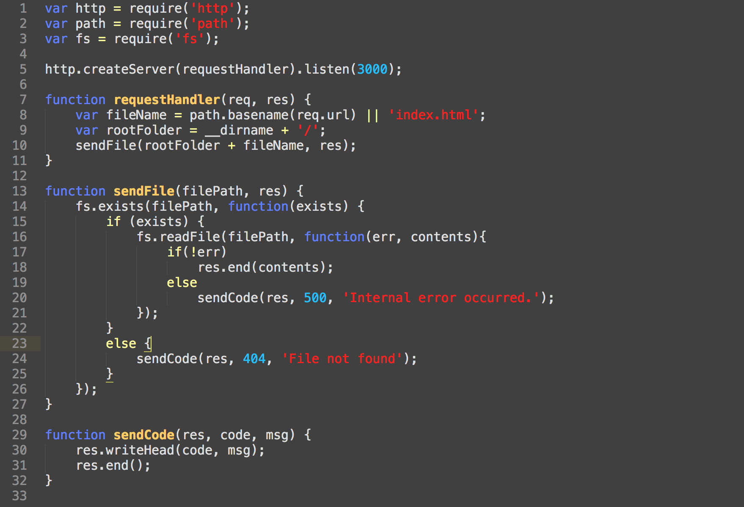

Slide 24
WebServer Example (using express framework)

Slide 25
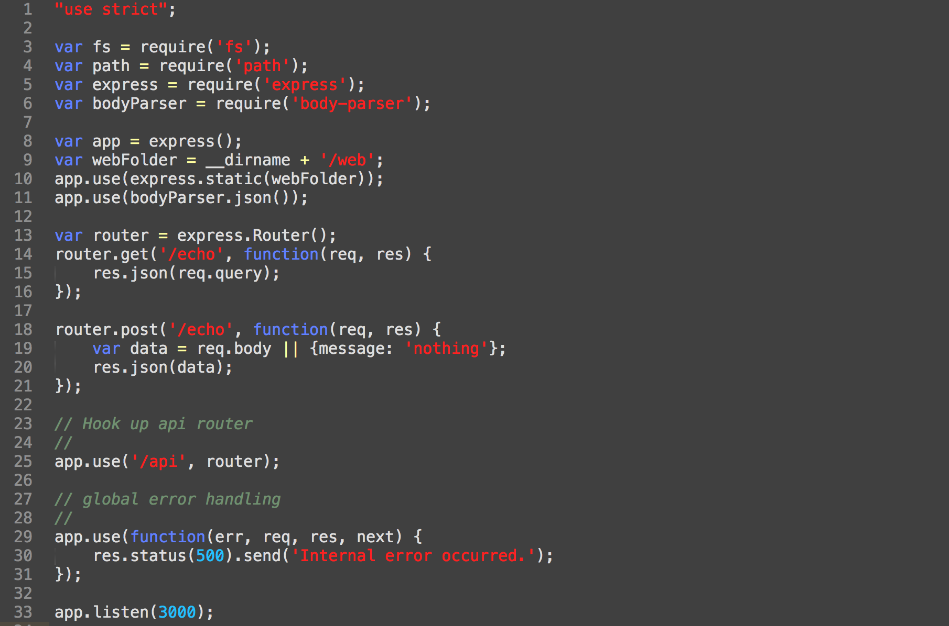

Slide 26
NW.JS (was node-webkit)

Slide 27
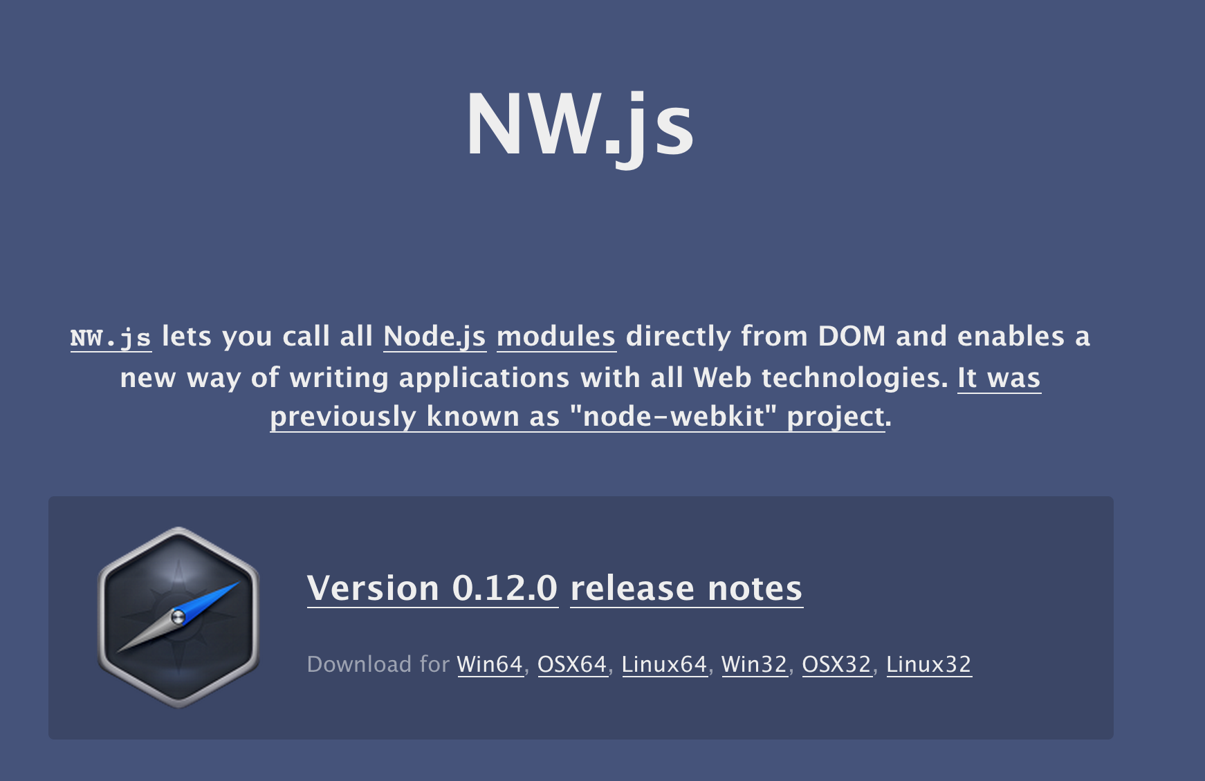

Slide 28
一個可以用node.js + html5來撰寫 desktop程式的平台

Slide 29
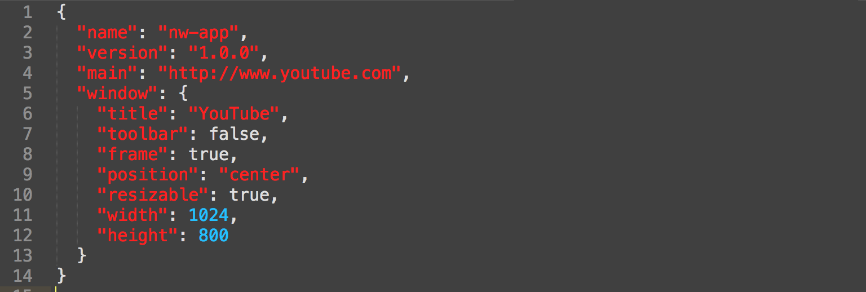
Simple way to run nw.js
nw-app/package.json
C> nw.exe nw-app

Slide 30
NW.JS with Client & Server DEMO
https://github.com/derektu/ExtWebNW

Slide 31
Q & A

