Slide 1
Intro to Node.js + NW.js

Slide 2
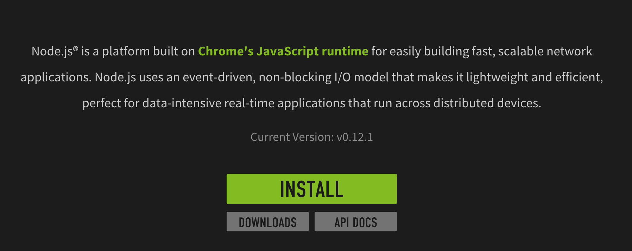
What is Node.js

Slide 3
How to install Node.js
Click INSTALL and run installer
C> node -v

Slide 4
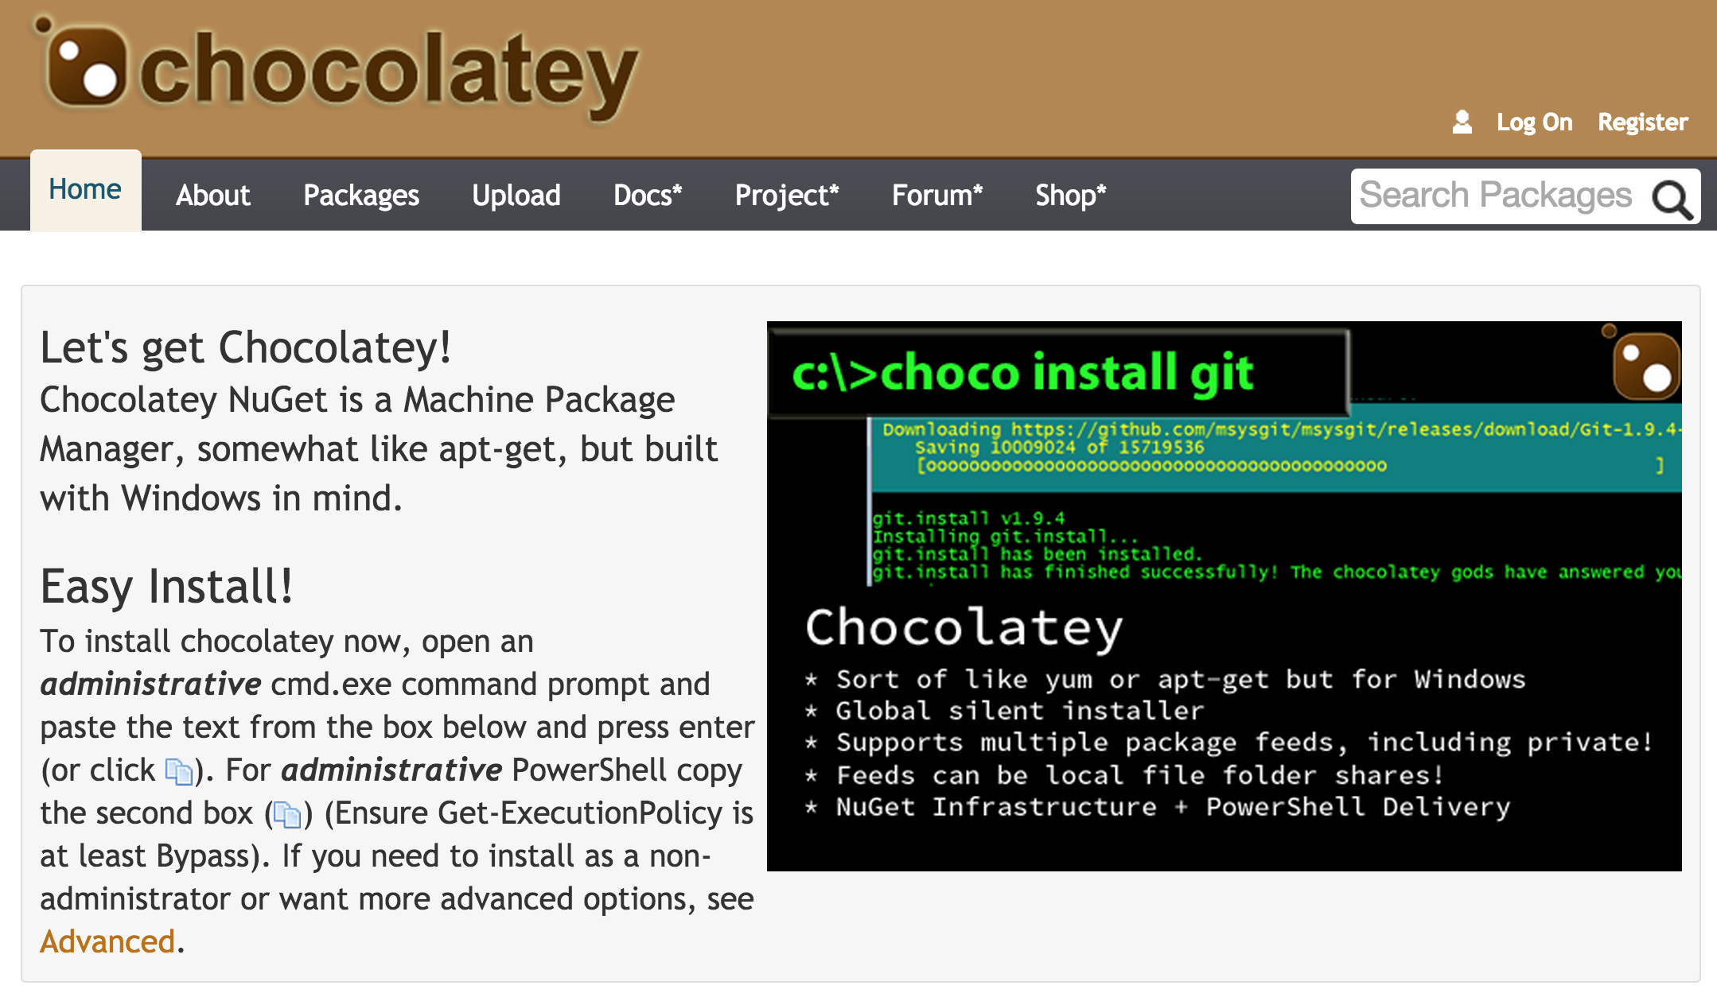
How to install Node.js (via Chocolatery)

Slide 5
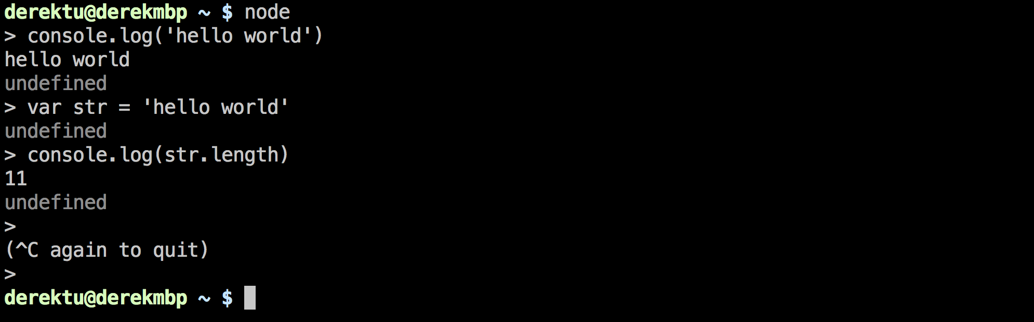
Node.js - HelloWorld

Slide 6
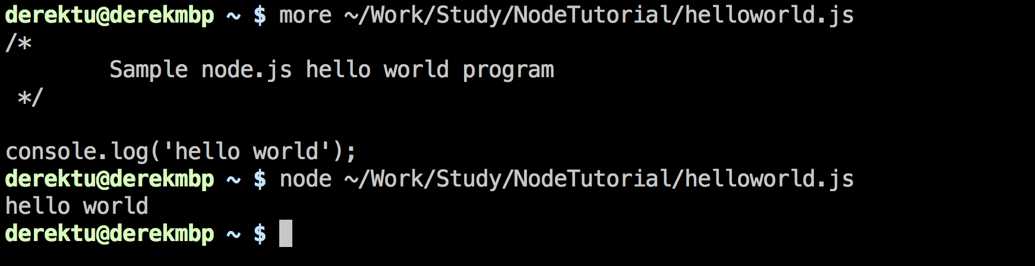
Node.js - HelloWorld

Slide 7
A more useful example Let’s count the lines of a given file

Slide 8
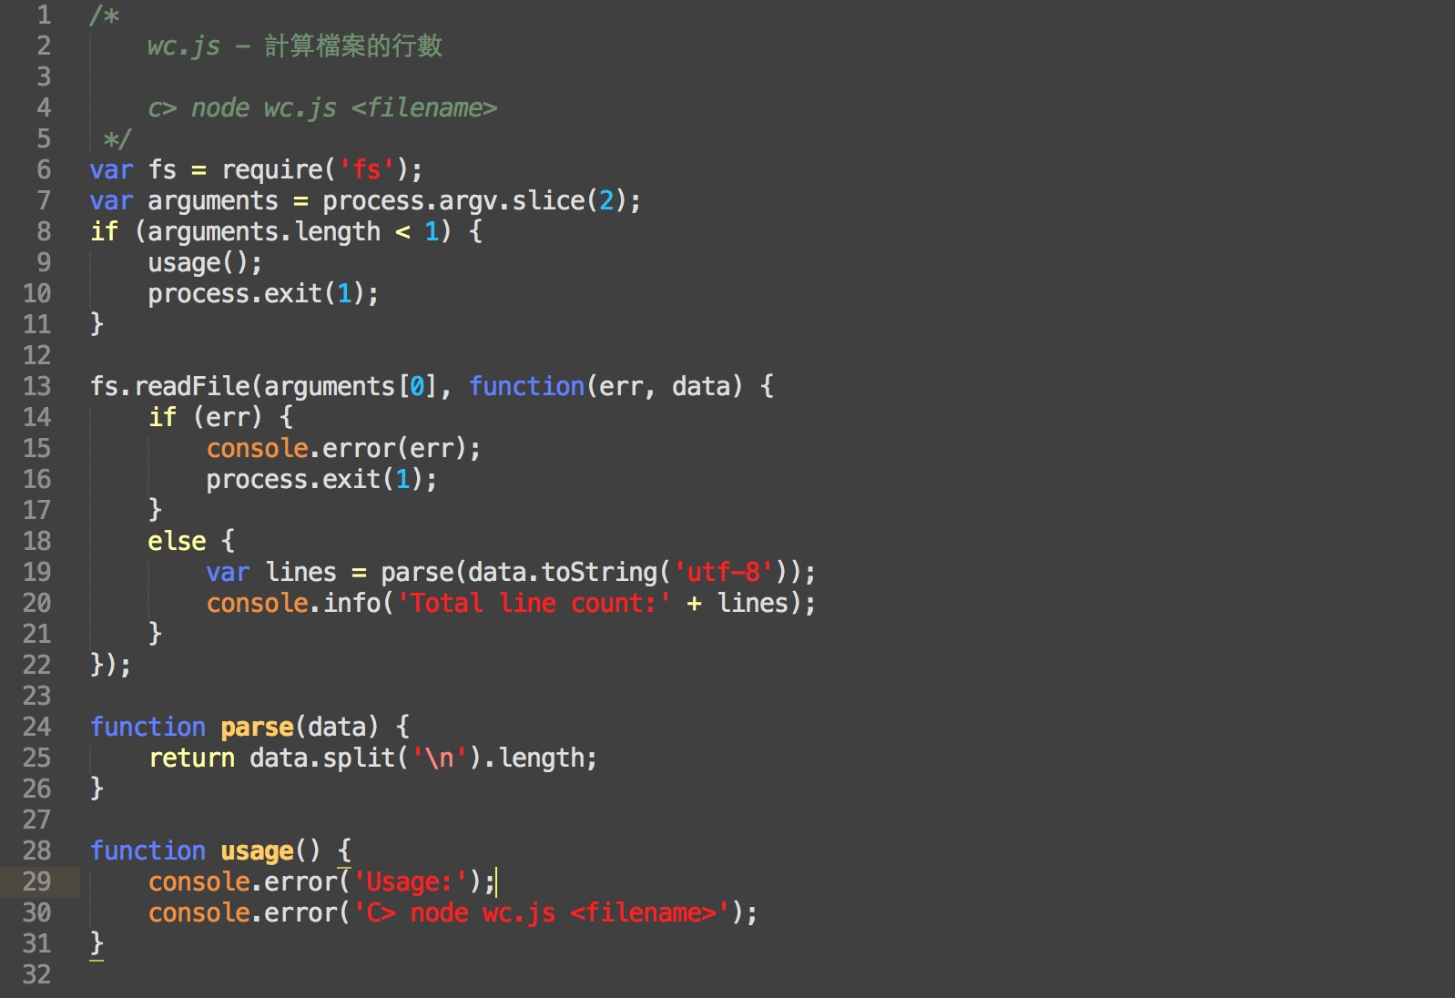

Slide 9
Node.js is single threaded So most of the APIs are ‘async’ And we must use callback to handle IO and other time consuming tasks

Slide 10
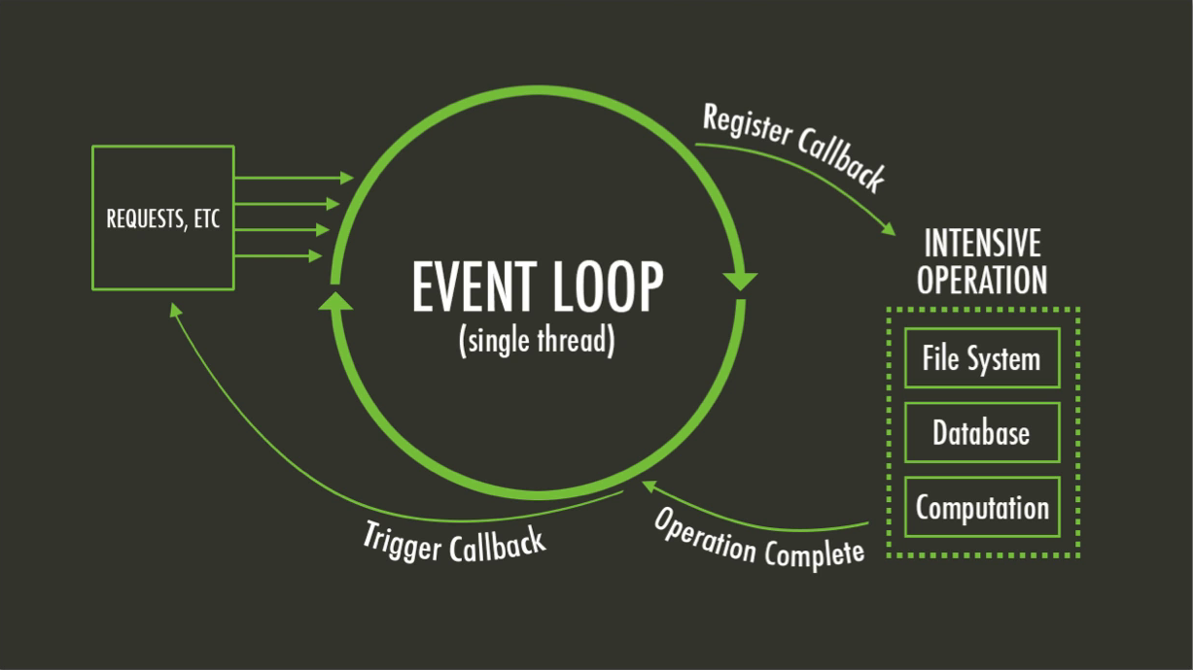

Slide 11
Everything run in parallel Except your code

Slide 12
Is there any problem with this program ?
What if the file is very HUGE ?

Slide 13
解決之道 把檔案切成一塊一塊分開處理

Slide 14
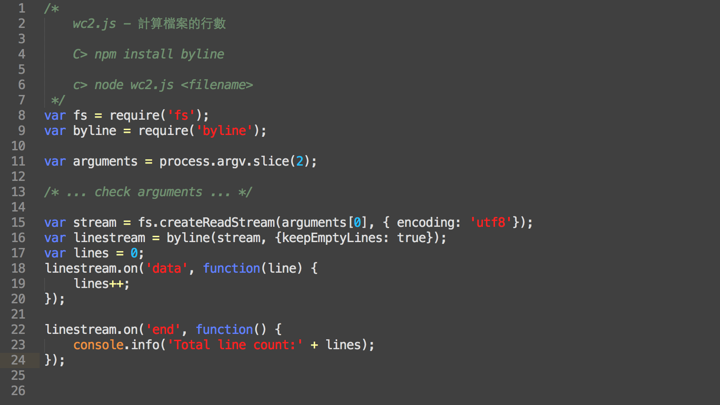

Slide 15
Tools for high concurrency
Nested callback is hard to manage ?
use Promise, Async, etc.
CPU intensive or want to use all cores ?
use cluster, pm2, etc.

Slide 16
Why Node ? 好像也沒有很好寫耶
Javascript is a mainstream language: it is the only language that all browsers speak
One language to get you from backend to frontend: share code and style
Development speed is super FAST
NPM: leverage open source community !!

Slide 17
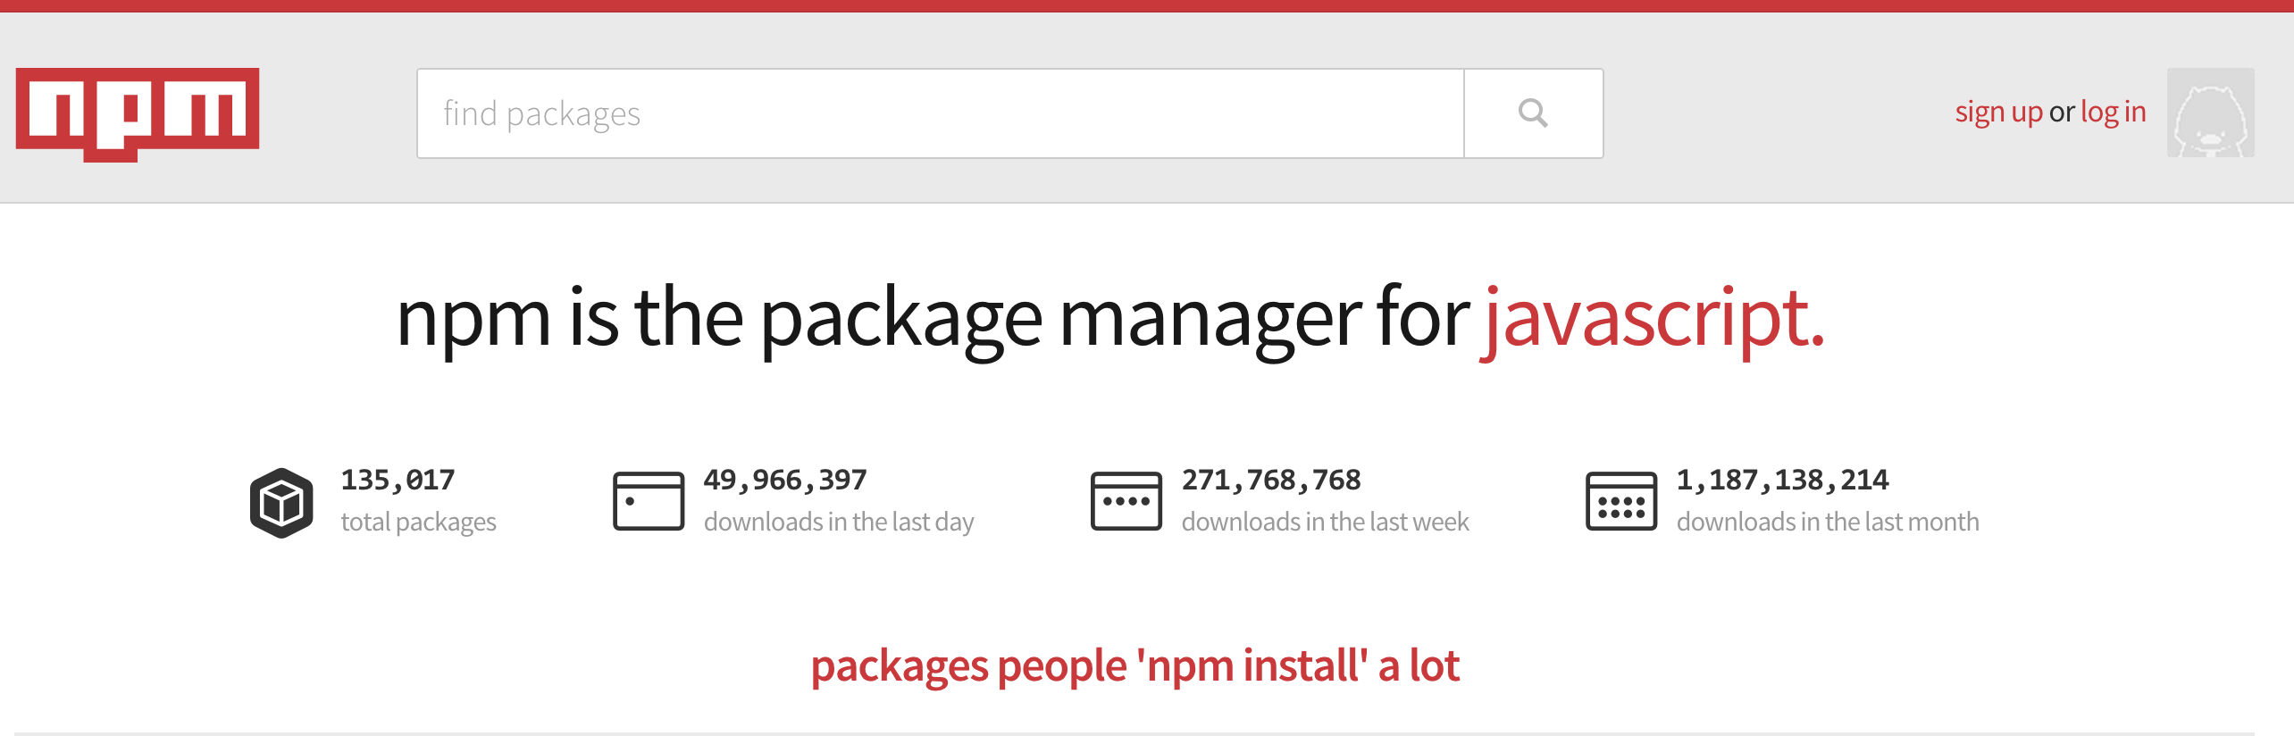
NPM – Node Package Manager

Slide 18
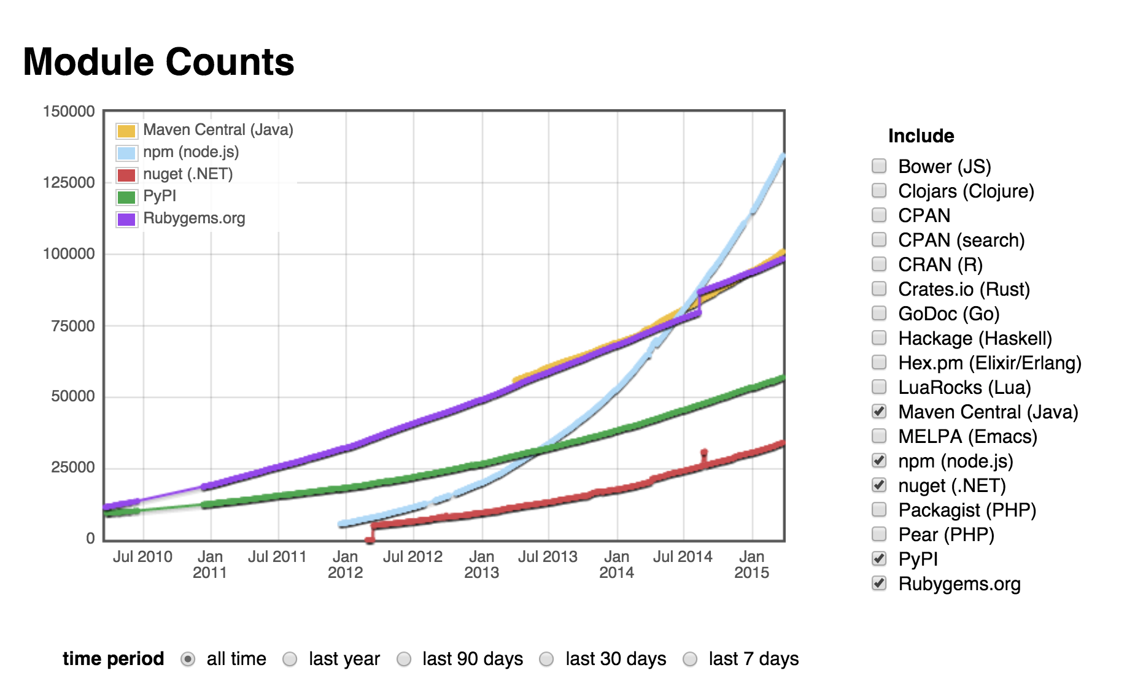
http://www.modulecounts.com

Slide 19
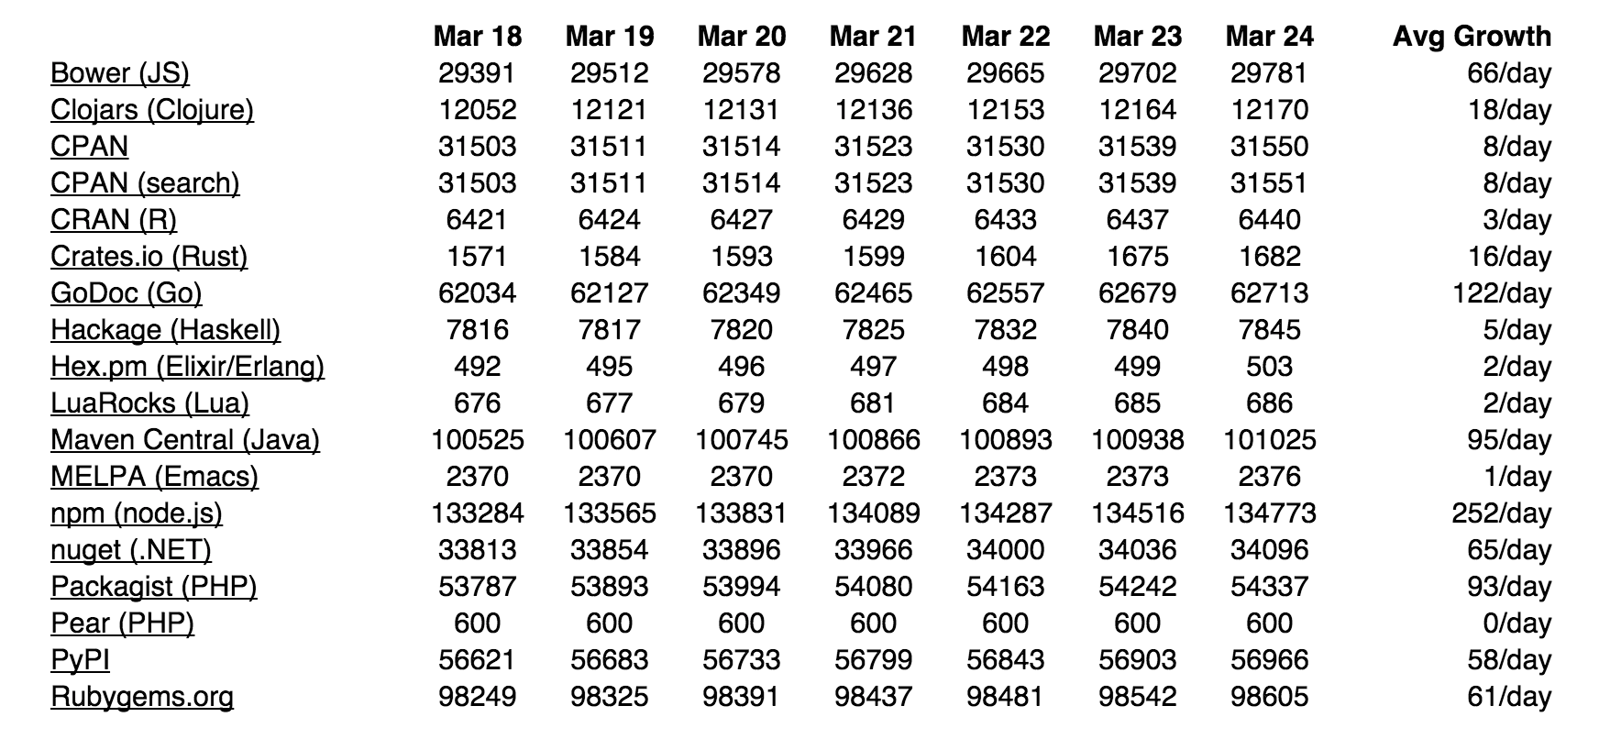

Slide 20
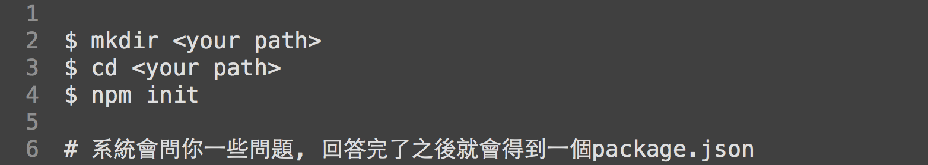
npm & package.json

Slide 21
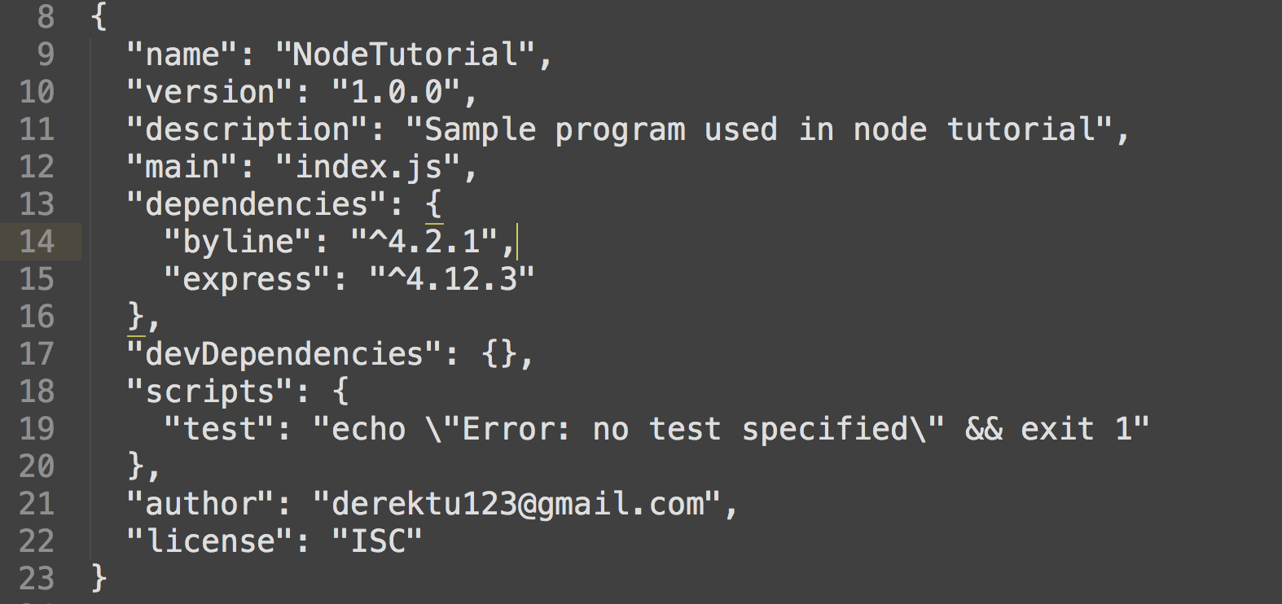
package.json

Slide 22
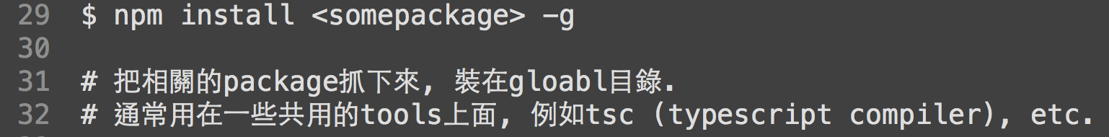
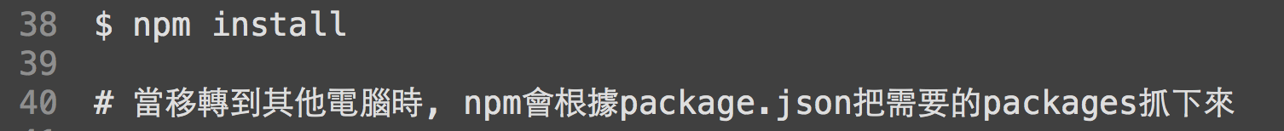
npm 常用指令

Slide 23
How to write our own modules ?

Slide 24
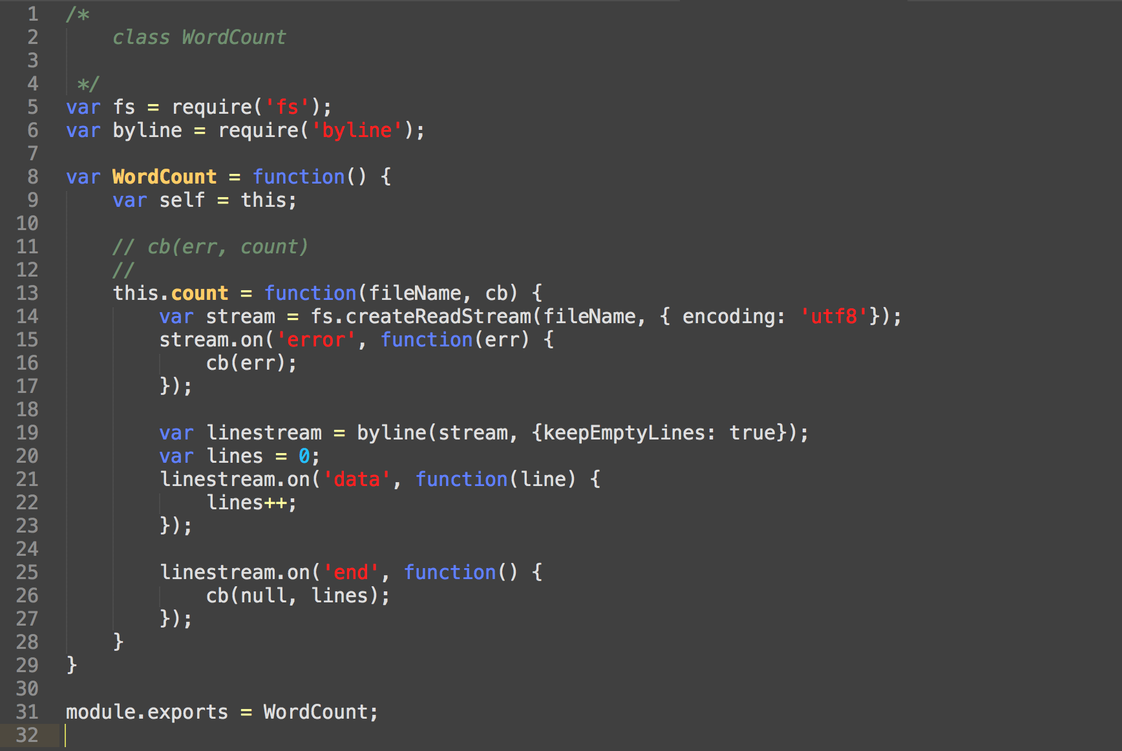
wordcount.js

Slide 25
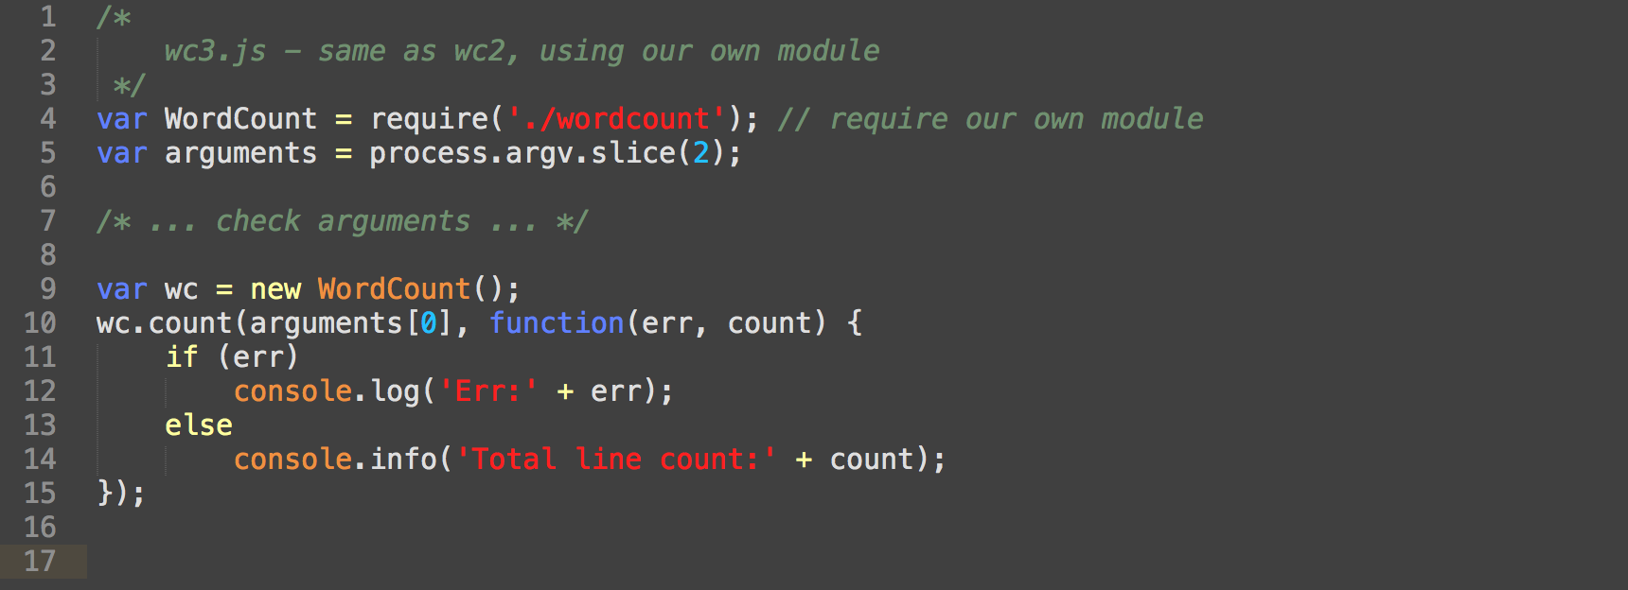

Slide 26
Node.js內建HTTP/NET模組 WebServer Example (ca 1990)

Slide 27
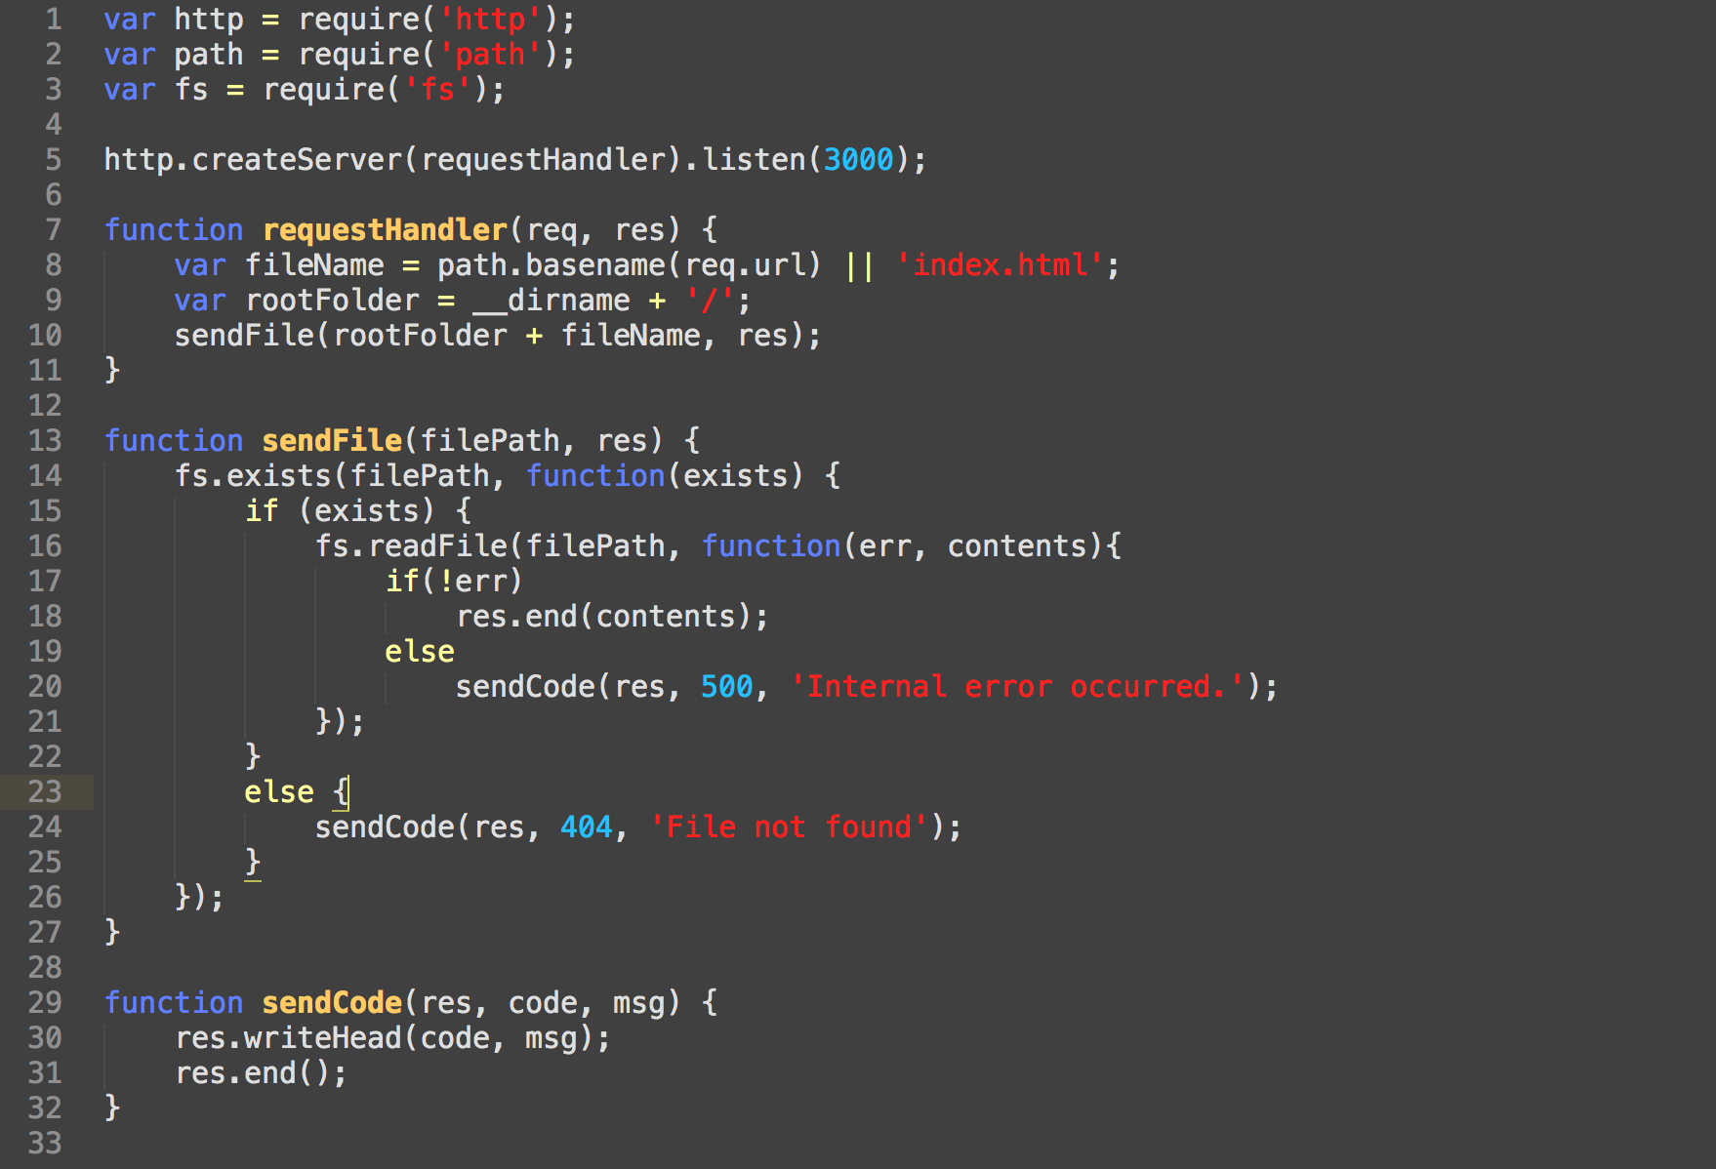

Slide 28
WebServer Example (using express framework)

Slide 29
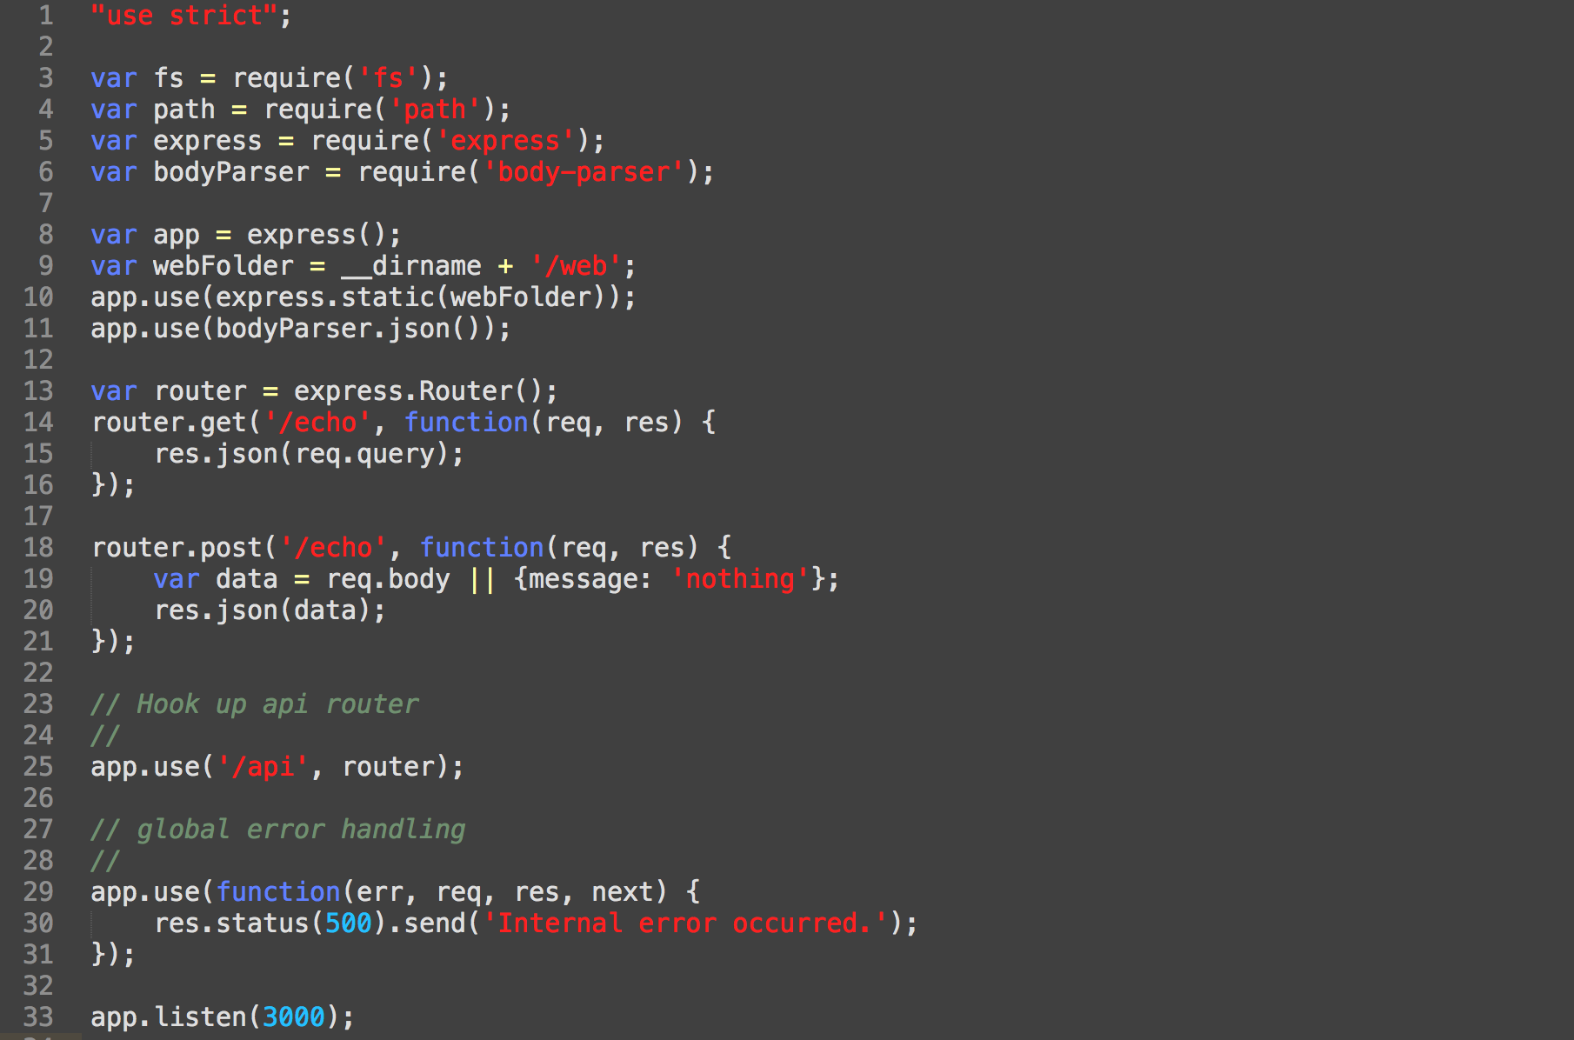

Slide 30
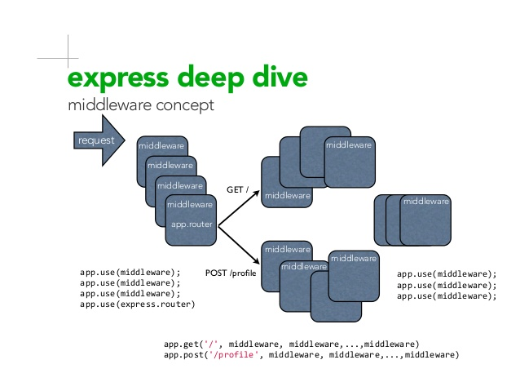

Slide 31
NW.JS (was node-webkit)

Slide 32
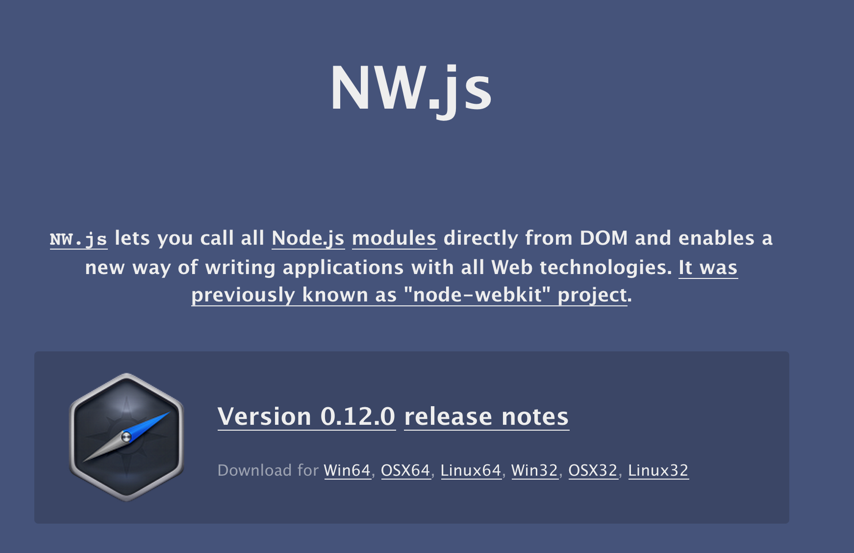

Slide 33
一個可以用node.js + html5來撰寫 desktop程式的平台

Slide 34
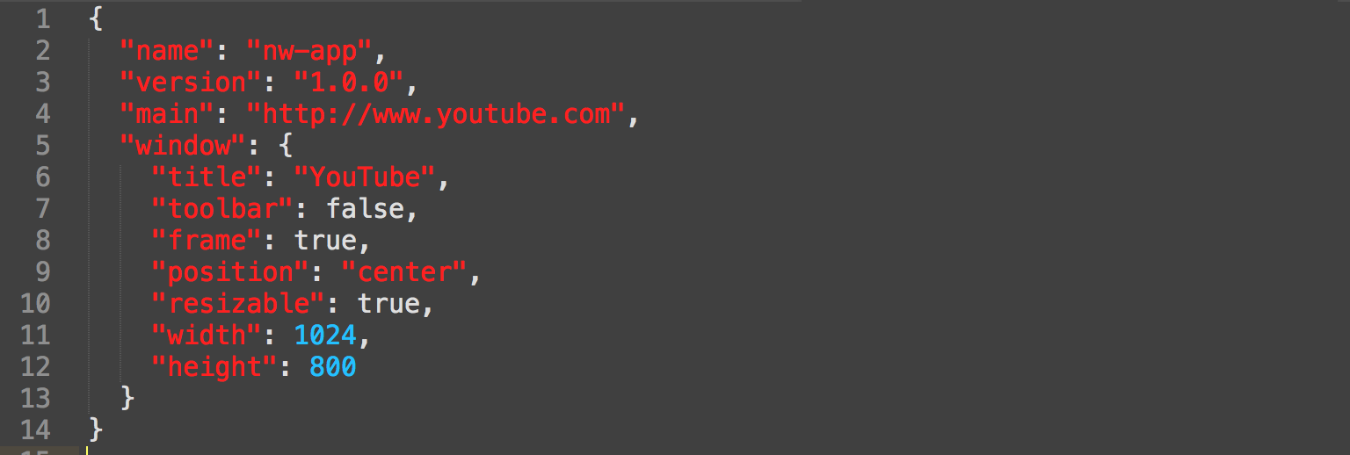
Simple way to run nw.js
nw-app/package.json
C> nw.exe nw-app

Slide 35
NW.JS with Client & Server DEMO
https://github.com/derektu/ExtWebNW

Slide 36
ExtWebNW 操作流程
C> git clone https://github.com/derektu/ExtWebNW
C> cd ExtWebNW
C> npm install
C> nw.exe ExtWebNW
//Windows Task manager: look for nw.exe process
//Browser: http://localhost:3000/api/hello
//Browser: http://localhost:3000/api/list
//Browser: http://localhost:3000/api/quit
C> choco install curl
C> curl -H "Content-Type: application/json" -X POST -d "{\"id\":\"1\",\"title\":\"Google\",\"url\":\"http://www.google.com\"}" http://localhost:3000/api/launch
//minimize or close, and run the post again
//Browser: http://localhost:3000/api/list
C> curl -H "Content-Type: application/json" -X POST -d "{\"id\":\”2\",\"title\":\”YouTube\",\"url\":\"http://www.youtube.com\"}" http://localhost:3000/api/launch

Slide 37
Q & A

