Slide 1
Big Mountain Ski Resort
daily ticket pricing model

Slide 2
Problem ID and Business Context
Big Mountain recently added a new chair lift which will increase operational costs by $1.5million annually
Daily ticket prices have historically been set using a simple industry average.
Explore options for creating a more sophisticated pricing model
Benchmark Big Mountain features against the industry

Slide 3
Price Increase and Key Findings
Recommended price increase of $8 – 10 per day
Increase would grow annual revenue by $15million+
Big Mountain ranks high amongst US resorts in key feature categories
Big Mountain has a modest ticket price compared to the national average

Slide 4
Assumptions
350,000 visitors per annum
Each visitor skis 5 days per year
Other resorts included in the dataset are not over or undervaluing their ticket prices

Slide 5
Key Features
Feautures with strongest positive correlation to ticket price are:
Number of Fast Quad Chairlifts
Total Number of Runs
Area Covered by Snowmakers
Vertical Drop

Slide 6
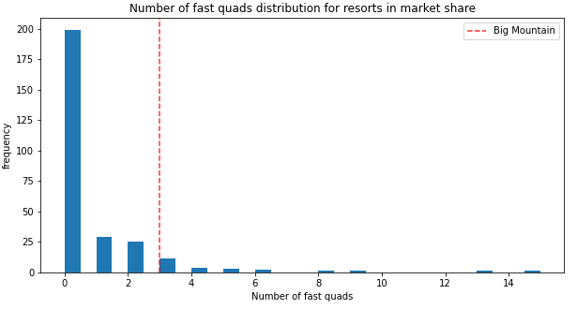
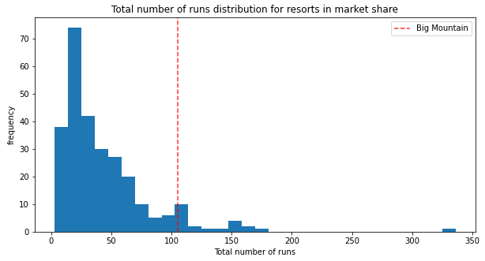
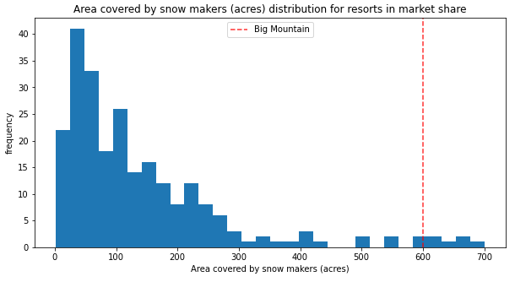
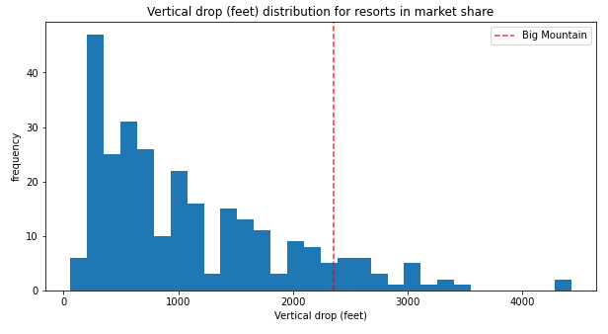

Slide 7
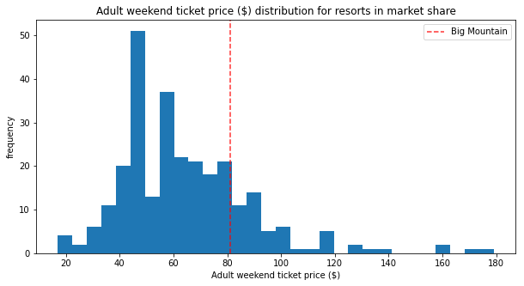
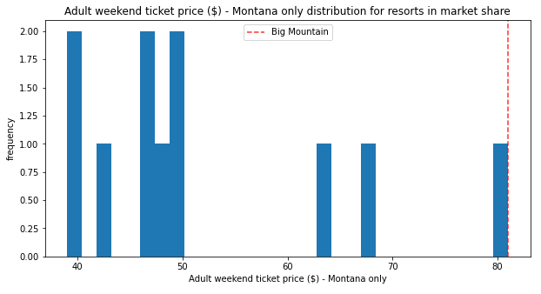
Big Mountain ranks relatively low on a national level considering how high the resort ranks in key feature categories
Big Mountain already has the highest price in Montana – what share of visitors come from out of state?

Slide 8
Conclusion
There is strong evidence the market could bear a price increase, but proceed with caution
Additional analysis of visitor data is recommended
Which resorts have highest visitor counts?
What proportion of Big Mountain visitors come from out of state?
Can Big Mountain attract more visitors from out of state?
Canadian resorts should be included in the model

