Slide 1
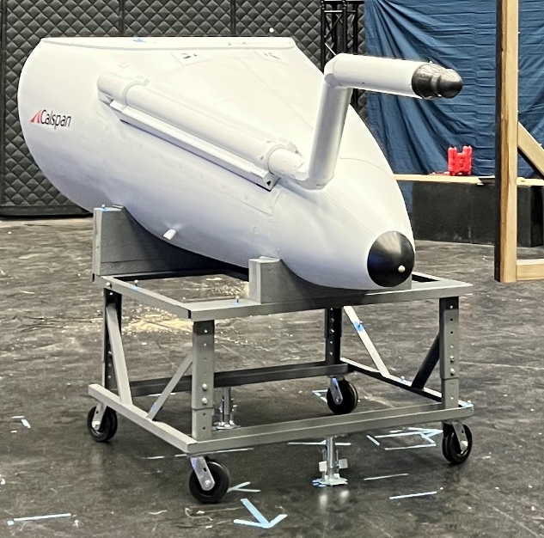
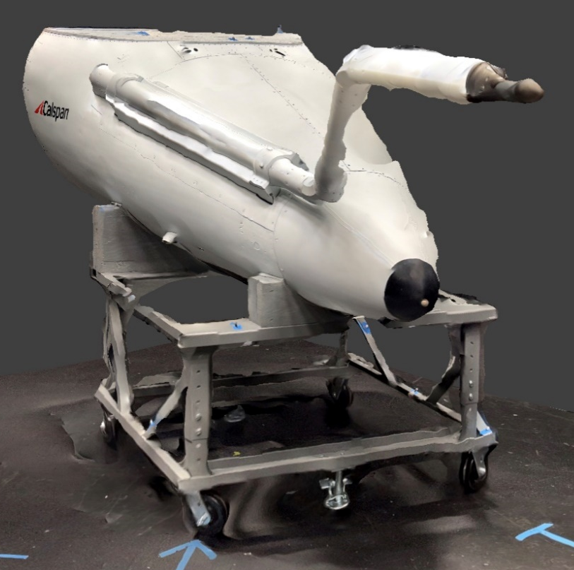
Machine Transfer Learning
Scene Augmentation
Background
Lighting
Perspective
Orientation
Cameras:
Alvium G5 811c
Insta360 Link
Hybrid
(AR)
Virtual
world
Real
world
3D
Scans
MoCap Image
Re-projection
Label Generation
Relative Vectoring
Using predictions on real imagery
Optimize:
Bounding box corrections
Feature selection
Optimize:
Model size
Image input size
Model Training

Slide 2
Scene Augmentation
Background
Lighting
Perspective
Orientation
3D
Scans
MoCap Image
Reprojections
Hybrid
(AR)
Virtual
imagery
Real
imagery
Generate Labels
Camera:
Alvium G5 811c
Hyperparameters:
Feature selection
Bounding box corrections
Hyperparameters:
YOLOv5 model size
Image input size
Data augmentation
Train Models
Perform Inference
Using predictions on real imagery

