Slide 1
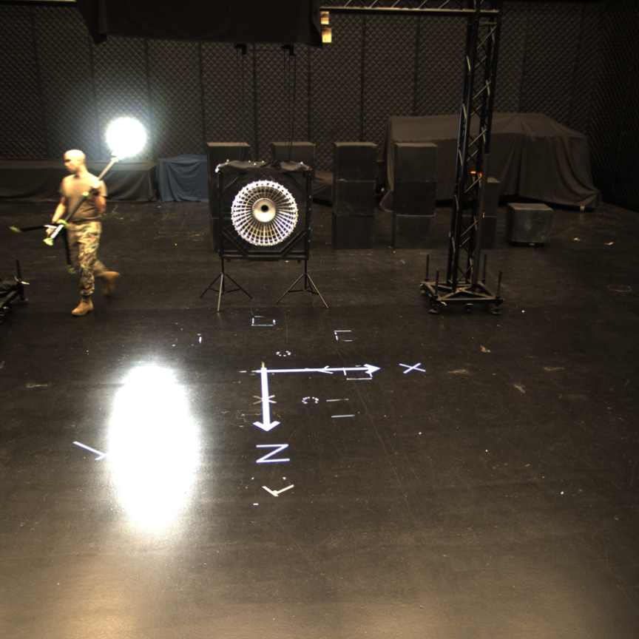

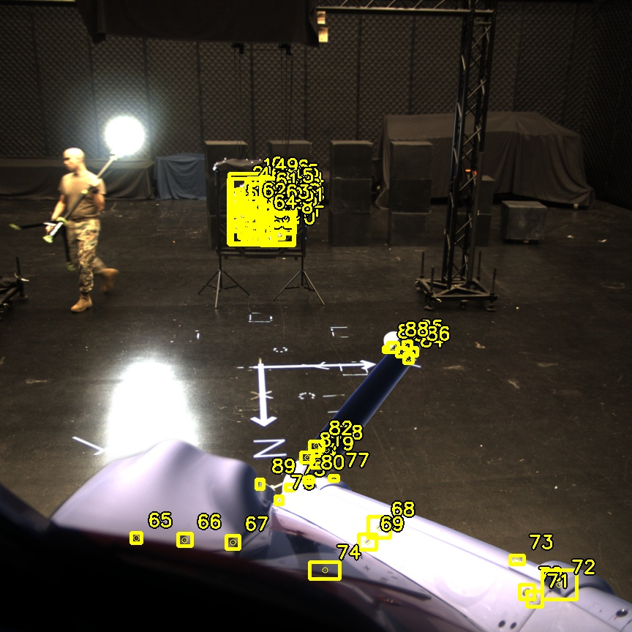

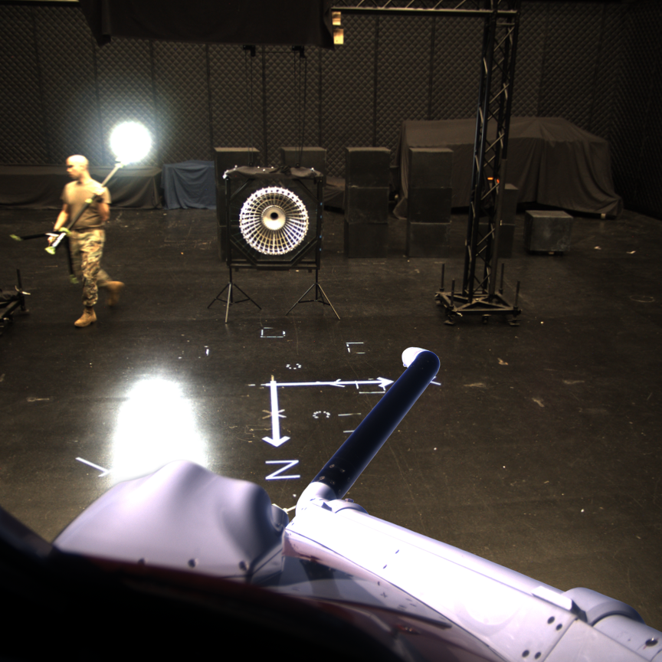

Slide 2
probe
drogue
mask
merged
labeled

Slide 3
probe
drogue
mask
merged
labeled

