Slide 1
Course Outline
Introduction and Algorithm Analysis (Ch. 2)
Hash Tables: dictionary data structure (Ch. 5)
Heaps: priority queue data structures (Ch. 6)
Balanced Search Trees: Splay Trees (Ch. 4.5)
Union-Find data structure (Ch. 8.1–8.5)
Graphs: Representations and basic algorithms
Topological Sort (Ch. 9.1-9.2)
Minimum spanning trees (Ch. 9.5)
Shortest-path algorithms (Ch. 9.3.2)
B-Trees: External-Memory data structures (Ch. 4.7)
kD-Trees: Multi-Dimensional data structures (Ch. 12.6)
Misc.: Streaming data, randomization

Slide 2
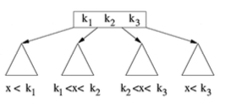
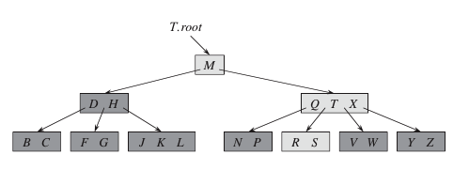
B-Trees
B-Trees are designed to minimize I/O operations
Large database stored in secondary memory (disks, cloud)
Too large for main memory
Non-uniform data access cost: memory vs. disk
Similar considerations for cache vs. main memory

Slide 3
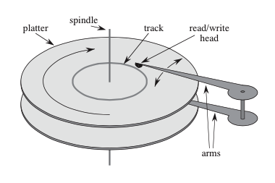
B-Trees
Data access costs vary significantly
Disk access 10³ --10⁵ times slower than silicon memory.
Somewhat outdated numbers, but illustrative:
Disks rotate at about 7200 RPM; typical range 5K-15K.
One rotation takes 8.33 ms, which is about 5 orders slower than a 50 nsec access for current silicon memory.

Slide 4
B-Trees
To amortize huge disk access cost, data transferred in large chunks.
Information (e.g. set of key values) chunked into large "pages” laid out consecutively within each disk cylinder
Typical page size: 2¹¹ to 2¹⁴ bytes (2K-16K)
Think of B-Tree as a BST with very fat nodes
Processing an entire page takes less time than to fetch it
So, in disk-bound data structures, we consider two factors separately:
number of disk accesses,
the CPU time.

Slide 5
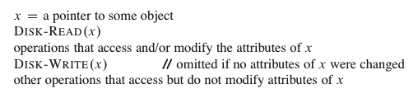
B-Trees
B-Tree algorithms operate at the granularity of pages. I.e., the unit operations READ or WRITE a page
The main memory can accommodate only so many pages, so older pages will be flushed out as new ones are fetched.

Slide 6
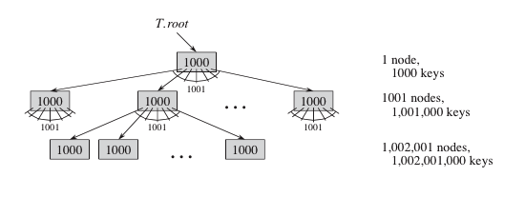
B-Trees
To optimize the number of page accesses, we choose the size of the B-Tree node to match the page size.
That is, each node will store keys for about 50-2000 items, and will have the similar branching factor
With a branching factor of 1001 (1000 keys per node), 1 billion keys can be accessed by a tree of height 2.
Just 2 disk accesses!

Slide 7
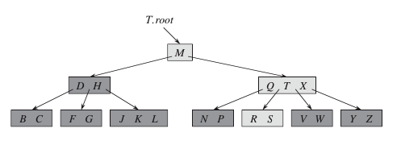
B-Trees: an example

Slide 8
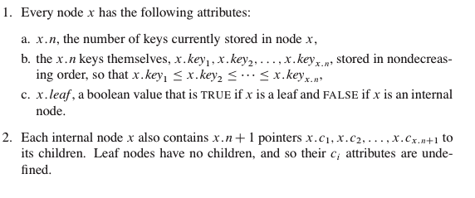
B-Tree: Structural Details

Slide 9

B-Tree: Formal Definitions

Slide 10
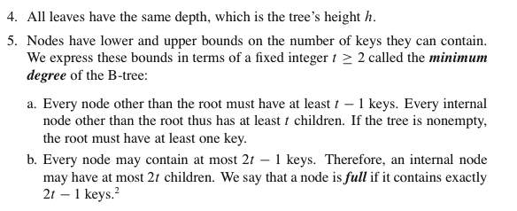
B-Tree: Formal Definitions

Slide 11
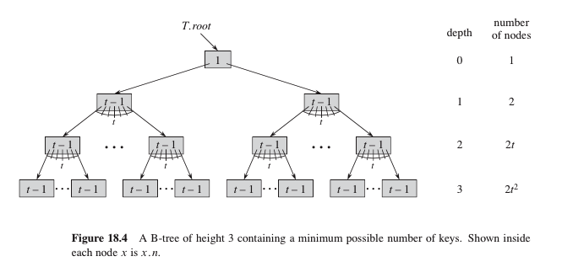
B-Tree: Properties
Simplest B-tree when t=2 (also called 2-3-4 trees)
Height of a B-tree: h <= log_{t} (n + 1)/2

Slide 12
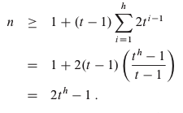
B-Tree: Height Bound

Slide 13
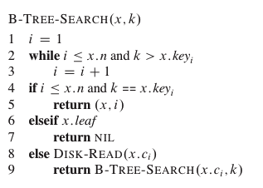
B-Tree: Searching for a Key
Root node always in main memory, so no disk-access required there.
But access to any other node requires disk-read.

Slide 14
B-Tree: Inserting a key k
Search for the leaf node to insert k.
What happens if that node is full (2t-1 keys)
All B-Tree nodes must be at same depth and have between t-1 and 2t-1 keys.
For instance, insert key I into the leaf [J, K, L]

Slide 15
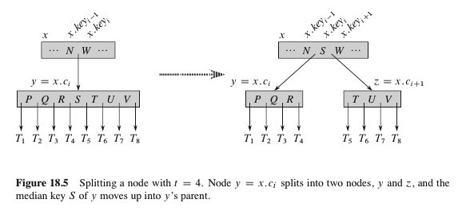
B-Tree: Splitting a node
If insert leaf is full, we split it around its middle t^{th} key.
Median key moves to the parent, and
Two new children, each with t-1 keys formed.
If parent becomes full, recursively split upwards

Slide 16
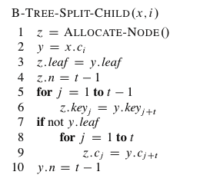
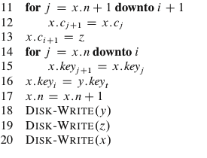
B-Tree-Split-Child
y is the i^{th} child of x, and is the node being split.
y originally has 2t children, and is reduced to t (and t-1 keys) by this operation.
z adopts the t largest children of y, and z becomes a new child of x, positioned just after y in x's table.
The median key of y moves up to x, separating y and z.

Slide 17
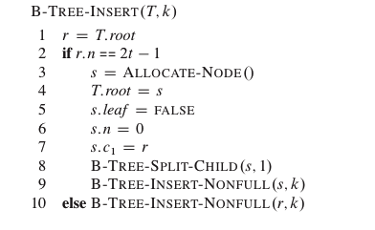
B-Tree-Insert

Slide 18
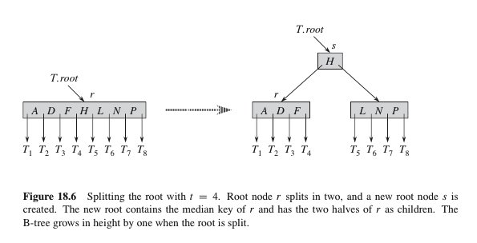
B-Tree: Splitting a Node

Slide 19
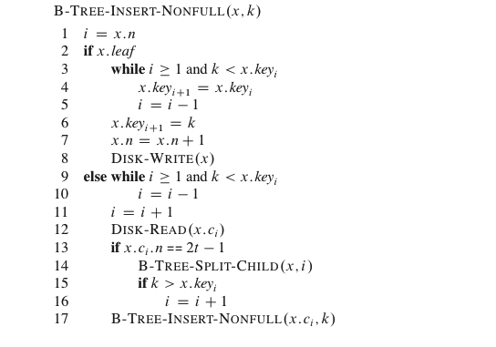
B-Tree-Insert: main routine
1st while loop = x is a leaf.
When x non-leaf, insert into appropriate leaf in the sub-tree rooted at x.
2nd while loop determines the child of x to descend to.
The if condition checks if that child is a full node.
If full, B_TREE_SPLIT splits it into two non-full nodes, and the next if determines which of the children to descend to.

Slide 20
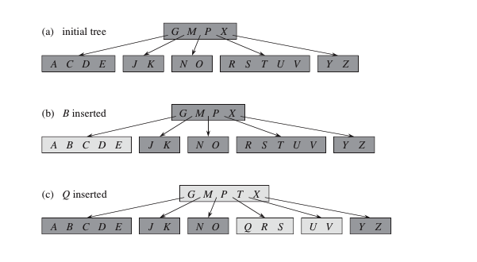
B-Tree-Insert: Illustration

Slide 21
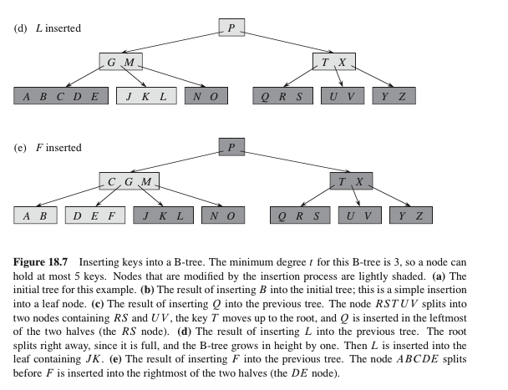
B-Tree-Insert: Illustration

Slide 22
B-Trees: Insert Complexity
The number of disk accesses by B-TREE-INSERT is O(h): only O(1) disk read or writes between calls to B-TREE-NONFULL.
The total CPU time is O(t h) = O(t log_{t} n).

Slide 23
B-Trees: Deleting a key
Deleted key may be in a non-leaf node.
If the size of a node drops below t-1 after deletion, fix it.
Suppose we from sub-tree rooted at x.
We ensure that when B-TREE-DELETE is called on a node x, the number of keys in x is at least t.
This allows us to perform deletion in one pass, without backing up.

Slide 24
B-Trees: Deleting a key (Complicated!)
If k is in leaf-node x, delete k from x.
If k is in non-leaf node x, do:
if the child y that precedes k in node x has t or more keys, then find predecessor k' of k in sub-tree rooted at y. Recursively delete k', and replace k with k' in x.
Symmetrically, if child z that follows k in node x has >= t keys, find the successor k' of k in sub-tree rooted at z. Recursively delete k', and replace k with k' in x.
Otherwise, if both y and z have only t-1 keys, merge k and all of z into y so that x loses both k and the pointer to z, and y now has 2t-1 keys. Free z and recursively delete k from y.

Slide 25
B-Trees: Deleting a key (Complicated!)
If the key k is not present in node x,
determine the root c_{i}(x) of the appropriate sub-tree containing k.
If c_{i}(x) has only t-1 keys, execute steps (3a) or (3b) to guarantee we descend to a node with >= t keys.
Then finish by recursive call on appropriate child of x.
3a. If c_{i}(x) has only t-1 keys but has an immediate sibling with t or more keys, give c_{i}(x) an extra key by moving a key from x down to c_{i}(x), moving a key from c_{i}(x)'s immediate left or right sibling up into x, and moving the appropriate child pointer from the sibling into c_{i}(x).
3b. If c_{i}(x) and both of c_{i}(x)'s immediate siblings have t-1 keys, merge c_{i}(x) with one sibling, which involves moving a key from x down into the new merged node to become the median key for that node.

Slide 26
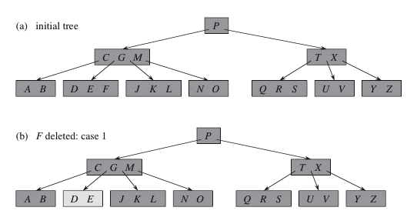
B-Tree Deletion: Illustration

Slide 27
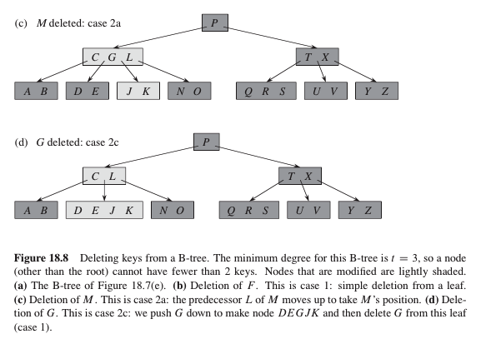
B-Tree Deletion: Illustration

Slide 28
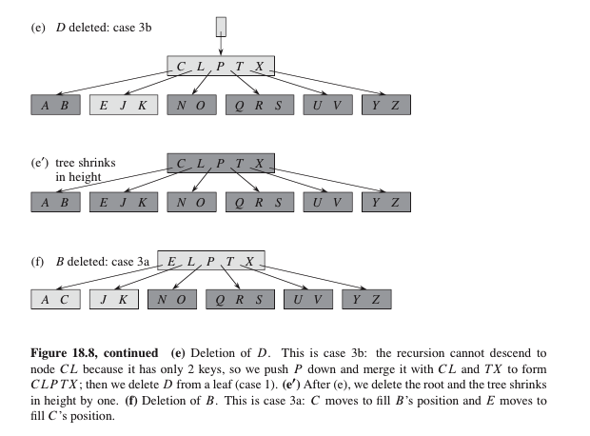
B-Tree Deletion: Illustration

Slide 29
B-Tree: Deletion Complexity
Also O(h) disk accesses and O(t log_{t} n) CPU.

