Slide 1
Course Outline
Introduction and Algorithm Analysis (Ch. 2)
Hash Tables: dictionary data structure (Ch. 5)
Heaps: priority queue data structures (Ch. 6)
Balanced Search Trees: general search structures (Ch. 4.1-4.5)
Union-Find data structure (Ch. 8.1–8.5)
Graphs: Representations and basic algorithms
  Topological Sort (Ch. 9.1-9.2)
  Minimum spanning trees (Ch. 9.5)
  Shortest-path algorithms (Ch. 9.3.2)
B-Trees: External-Memory data structures (Ch. 4.7)
kD-Trees: Multi-Dimensional data structures (Ch. 12.6)
Misc.: Streaming data, randomization

Slide 2
Data Structures for Sets
Many applications deal with sets.
  Compilers have symbol tables (set of vars, classes)
  IP routers have IP addresses, packet forwarding rules
  Web servers have set of clients, etc.
  Dictionary is a set of words.
A set is a collection of members
  No repetition of members
  Members themselves can be sets
Examples
  {x | x is a positive integer and x < 100}
  {x | x is a CA driver with > 10 years of driving experience and 0 accidents in the last 3 years}
  All webpages containing the word Algorithms

Slide 3
Abstract Data Types
Set + Operations define an ADT.
  A set + insert, delete, find
  A set + ordering
  Multiple sets + union, insert, delete
  Multiple sets + merge
  Etc.
Depending on type of members and choice of operations, different implementations can have different asymptotic complexity.

Slide 4
Dictionary ADTs
Data structure with just 3 basic operations:
  find (i): find item with key (identifier) i
  insert (i): insert i into the dictionary
  remove (i): delete i
  Just like words in a Dictionary
Where do we use them:
  Symbol tables for compiler
  Customer records (access by name)
  Games (positions, configurations)
  Spell checkers
  P2P systems (access songs by name), etc.

Slide 5
Naïve Method 1: Linked List
Keep a linked list of the keys
  insert (i): add to the head of list. Easy and fast O(1)
  find (i): worst-case, search the whole list (linear)
  remove (i): also linear in worst-case

Slide 6
Naïve Method 2: Direct Mapping
Perm #
An array (bit vector) for all possible keys
Map key i to location i
  insert (i): set A[i] = 1
  find (i): return A[i]
  remove (i): set A[i] = 0
1
2
3
8
9
13
14
Student Records
Graduates

Slide 7
Naïve Method 2: Direct Mapping
Maintain an array (bit vector) for all possible keys
  insert (i): set A[i] = 1
  find (i): return A[i]
  remove (i): set A[i] = 0
All operations easy and fast O(1)
What’s the drawback?
Too much memory/space, and wasteful!
The space of all possible IP addresses, variable names in a compiler is enormous!

Slide 8
Shortcomings of Naïve Implementations
Linked list space-efficient, but search-inefficient.
  Insert is O(1) but find and delete are O(n).
  A sorted search structure (array) also no good. The search becomes fast, but insert/delete take O(n).
Bit Vector search-efficient but space-inefficient.
Balanced search trees (Chap. 4) work but take O(log n) time per operation, and complicated.

Slide 9
Towards an Efficient Data Structure: Hash Table
Formal Setup
Assume keys are integers {0, 1, …, |U|}
  Non-numeric keys (strings, webpages) converted to numbers: Sum of ASCII values, first three characters
  The keys come from a known but very large set, called universe U (e.g. IP addresses, program states)
The set of keys to be managed is S is a subset of U.
  The size of S is much smaller than U, namely, |S| << |U|
  We use n for |S|.

Slide 10
Hash Table
Key idea is that instead of direct mapping, Hash Tables use a Hash Function h to map each input key to a unique location in table of size M
  h : U -> {0, 1, …, M-1}
  hash function determines the hash table size.
Desiderata:
  M should be small, O(n)
  h should be easy to compute
  Typical example: h(i) = i mod M

Slide 11
Hashing : the basic idea
9
10
20
39
4
14
8
Student Records
Perm # (mod 9)
Graduates

Slide 12
Hash Tables: Intuition
Hash function lets us find an item in O(1) time.
  Each item is uniquely identified by a key
  Just check the location h(key) to find the item
Suppose we expect to have at most 100 keys in S
  91, 2048, 329, 17, 689345, ….
We create a table of size 100 and use the hash function h(key) = key mod 100
It is both fast and uses the ideal size table.
What can go wrong?

Slide 13
Hashing:
But what if all keys end with 00?
  All keys will map to the same location
  This is called a Collision in Hashing
This motivates the 3rd important property of hashing
  A good hash function should evenly spread the keys to foil any special structure of input
  Hashing with mod 100 works fine if keys random
  Most data (e.g. program variables) are not random

Slide 14
Hashing:
A good hash function should evenly spread the keys to foil any special structure of input
Key idea behind hashing is to “simulate” the randomness through the hash function
A good choice is h(x) = x mod p, for prime p
h(x) = (ax + b) mod p called pseudo-random hash functions

Slide 15
Hashing: The Basic Setup
Choose a pseudo-random hash function h
  this automatically determines the hash table size.
An item with key k is put at location h(k).
To find an item with key k, check location h(k).
What to do if more than one keys hash to the same value. This is called collision.
We will discuss two methods to handle collision:
  Separate chaining
  Open addressing

Slide 16
Separate chaining
0
1
2
3
4
5
6
7
8
9
10
23
1
56
Maintain a list of all elements that hash to the same value
Search using the hash function to determine which list to traverse
Insert/deletion–once the “bucket” is found through Hash, insert and delete are list operations
24
36
14
16
17
7
29
find(k,e)
HashVal = Hash(k,Hsize);
if (TheList[HashVal].Search(k,e))
then return true;
else return false;
31
20
42
class HashTable {
……
private:
unsigned int Hsize;
List<E,K> *TheList;
……
Notes:
Hash function is x mod 11

Slide 17
Insertion: insert 53
53 = 4 x 11 + 9
53 mod 11 = 9
0
1
2
3
4
5
6
7
8
9
10
0
1
2
3
4
5
6
7
8
9
10
23
1
56
23
1
56
24
24
36
14
36
14
16
16
17
17
7
29
7
29
31
20
42
53
20
42
31

Slide 18
Analysis of Hashing with Chaining
Worst case
  All keys hash into the same bucket
  a single linked list.
  insert, delete, find take O(n) time.
  A worst-case Theorem later
Average case
  Keys are uniformly distributed into buckets
  Load Factor L = InputSize/HashTableSize
  In a failed search, avg cost is L
  In a successful search, avg cost is 1 + L/2

Slide 19
Open addressing
0
1
2
3
4
5
6
7
8
9
10
42
If collision happens, alternative cells are tried until an empty cell is found.
Different probing strategies
  Linear
  Quadratic
  Double Hashing
1
24
14
16
28
7
31
9

Slide 20
Linear Probing (insert 12)
12 = 1 x 11 + 1
12 mod 11 = 1
0
1
2
3
4
5
6
7
8
9
10
42
0
1
2
3
4
5
6
7
8
9
10
42
1
1
24
24
14
14
12
16
16
28
28
7
7
31
31
9
9

Slide 21
Search with linear probing (Search 15)
15 = 1 x 11 + 4
15 mod 11 = 4
0
1
2
3
4
5
6
7
8
9
10
42
1
24
14
12
16
28
7
NOT FOUND !
31
9

Slide 22
Search with linear probing
// find the slot where searched item should be in
int HashTable<E,K>::hSearch(const K& k) const
{
int HashVal = k % D;
int j = HashVal;
do {// don’t search past the first empty slot (insert should put it there)
if (empty[j] || ht[j] == k) return j;
j = (j + 1) % D;
} while (j != HashVal);
return j; // no empty slot and no match either, give up
}
bool HashTable<E,K>::find(const K& k, E& e) const
{
int b = hSearch(k);
if (empty[b] || ht[b] != k) return false;
e = ht[b];
return true;
}

Slide 23
Deletion in Hashing with Linear Probing
Since empty buckets are used to terminate search, standard deletion does not work.
One simple idea is to not delete, but mark.
  Insert: put item in first empty or marked bucket.
  Search: Continue past marked buckets.
  Delete: just mark the bucket as deleted.

Slide 24
Deletion with linear probing: LAZY (Delete 9)
9 = 0 x 11 + 9
9 mod 11 = 9
0
1
2
3
4
5
6
7
8
9
10
42
0
1
2
3
4
5
6
7
8
9
10
42
1
1
24
24
14
14
12
12
16
16
28
28
7
7
31
31
FOUND !
D
9

Slide 25
Eager Deletion: fill holes
Remove and find replacement:
  Fill in the hole for later searches
remove(j)
{ i = j;
empty[i] = true;
i = (i + 1) % D; // candidate for swapping
while ((not empty[i]) and i!=j) {
r = Hash(ht[i]); // where should it go without collision?
// can we still find it based on the rehashing strategy?
if not ((j<r<=i) or (i<j<r) or (r<=i<j))
then break; // yes find it from rehashing, swap
i = (i + 1) % D; // no, cannot find it from rehashing
}
if (i!=j and not empty[i])
then {
ht[j] = ht[i];
remove(i);
}
}

Slide 26
Eager Deletion Analysis (cont.)
  If not full
    After deletion, there will be at least two holes
    Elements that are affected by the new hole are
      Initial hashed location is cyclically before the new hole
      Location after linear probing is in between the new hole and the next hole in the search order
      Elements are movable to fill the hole
Initial
hashed location
Location after
linear probing
Initial
hashed location
New hole
Next hole in the search order
Next hole in the search order

Slide 27
Eager Deletion Analysis (cont.)
The important thing is to make sure that if a replacement (i) is swapped into deleted (j), we can still find that element. How can we not find it?
  If the original hashed position (r) is circularly in between deleted and the replacement
j
r
i
i
r
j
Will not find i past the empty green slot!
i
r
r
i
j
Will find i
j
i
r
i
r

Slide 28
Hashing with Linear Probing
Avg. cost for successful searches ½ (1 + 1/(1 – L))
Failed search avg. cost more ½ (1 + 1/(1 – L)²)

Slide 29
Quadratic Probing
Solves the clustering problem in Linear Probing
  Check H(x)
  If collision occurs check H(x) + 1
  If collision occurs check H(x) + 4
  If collision occurs check H(x) + 9
  If collision occurs check H(x) + 16
  ...
  H(x) + i²

Slide 30
Quadratic Probing (insert 12)
12 = 1 x 11 + 1
12 mod 11 = 1
0
1
2
3
4
5
6
7
8
9
10
42
0
1
2
3
4
5
6
7
8
9
10
42
1
1
24
24
14
14
12
16
16
28
28
7
7
31
31
9
9

Slide 31
Double Hashing
When collision occurs use a second hash function
  Hash₂ (x) = R – (x mod R)
  R: greatest prime number smaller than table-size
Inserting 12
  H₂(x) = 7 – (x mod 7) = 7 – (12 mod 7) = 2
  Check H(x)
  If collision occurs check H(x) + 2
  If collision occurs check H(x) + 4
  If collision occurs check H(x) + 6
  If collision occurs check H(x) + 8
  H(x) + i * H₂(x)

Slide 32
Double Hashing (insert 12)
12 = 1 x 11 + 1
12 mod 11 = 1
7 –12 mod 7 = 2
0
1
2
3
4
5
6
7
8
9
10
42
0
1
2
3
4
5
6
7
8
9
10
42
1
1
24
24
14
14
12
16
16
28
28
7
7
31
31
9
9

Slide 33
Rehashing
If table gets too full, operations will take too long.
Build another table, twice as big (and prime).
  Next prime number after 11 x 2 is 23
Insert every element again to this table
Rehash after a percentage of the table becomes full (70% for example)

Slide 34
Collision Functions
H_{i}(x)= (H(x)+i) mod B
  Linear pobing
H_{i}(x)= (H(x)+c*i) mod B (c > 1)
  Linear probing with step-size = c
H_{i}(x)= (H(x)+i²) mod B
  Quadratic probing
H_{i}(x)= (H(x)+ i * H₂(x)) mod B

Slide 35
Analysis of Open Hashing
Effort of one Insert?
  Intuitively – that depends on how full the hash is
Effort of an average Insert?
Effort to fill the Bucket to a certain capacity?
  Intuitively – accumulated efforts in inserts
Effort to search an item (both successful and unsuccessful)?
Effort to delete an item (both successful and unsuccessful)?
  Same effort for successful search and delete?
  Same effort for unsuccessful search and delete?

Slide 36
Issues:
What do we lose?
  Operations that require ordering are inefficient
  FindMax: O(n) O(log n) Balanced binary tree
  FindMin: O(n) O(log n) Balanced binary tree
  PrintSorted: O(n log n) O(n) Balanced binary tree
What do we gain?
  Insert: O(1) O(log n) Balanced binary tree
  Delete: O(1) O(log n) Balanced binary tree
  Find: O(1) O(log n) Balanced binary tree
How to handle Collision?
  Separate chaining
  Open addressing

Slide 37
Theory of Hashing
First the bad news.
Theorem: For any hash function h: U -> {0, 1, …, M}, there exists a set S of n keys that all map to the same location, assuming |U| > nM.
  So, in the worst-case no hash function can avoid linear search complexity!
Proof.
  Take any hash function h you wish to consider
  Map all the keys of U using h to the table of size M
  By the pigeon-hole principle, at least one table entry will have n keys.
  Choose those n keys as input set S.
  Now h will maps the entire set S to a single location, for worst-case example of hashing.

Slide 38
Theory of Hashing
The negative result says that given a fixed hash function h, one can always construct a set S that is bad for h.
However, what we desire is something different:
  We are not choosing S; it is our (given) input.
  Can we find a good h for this particular S?
  Theory shows that a random choice of h works.

Slide 39
Theory of Hashing: Birthday Paradox
To appreciate the subtlety of hashing, first consider a puzzle: the birthday paradox.
Suppose birth days are chance events:
  date of birth is purely random
  any day of the year just as likely as another

Slide 40
Theory of Hashing: Birthday Paradox
What are the chances that in a group of 30 people, at least two have the same birthday?
How many people will be needed to have at least 50% chance of same birthday?
It’s called a paradox because the answer appears to be counter-intuitive.
There are 365 different birthdays, so for 50% chance, you expect at least 182 people.

Slide 41
Birthday Paradox: the math
Suppose 2 people in the room.
What is the prob. that they have the same birthday?
Answer is 1/365.
  All birthdays are equally likely, so B’s birthday falls on A’s birthday 1 in 365 times.
Now suppose there are k people in the room.
It’s more convenient to calculate the prob. X that no two have the same birthday.
Our answer will be the (1 – X)

Slide 42
Birthday Paradox
Define P_{i} = prob. that first i all have distinct birthdays
For convenience, define p = 1/365
  P₁ = 1.
  P₂ = (1 – p)
  P₃ = (1 – p) * (1 – 2p)
  P_{k} = (1 – p) * (1 – 2p) * …. * (1 – (k-1)p)
You can now verify that for k=23, P_{k} <= 0.4999
That is, with just 23 people in the room, there is more than 50% chance that two have the same birthday

Slide 43
Birthday Paradox: derivation
Use 1 – x <= e^{-x}, for all x
Therefore, 1 – j*p <= e^{-jp}
Also, e^{x} + e^{y} = e^{x+y}
Therefore, P_{k} <= e^{(-p -2p -3p … -(k-1)p)}
P_{k} <= e^{-k(k-1)p/2}
For k = 23, we have k(k-1)/2*365 = 0.69
e^{-0.69} <= 0.4999
Connection to Hashing:
  Suppose n = 23, and hash table has size M = 365.
  50% chance that 2 keys will land in the same bucket.

Slide 44
Theory of Hashing: Universal Hash Functions
A set of hash functions H is called universal if for any hash function h chosen randomly from it
  Prob[h(x) = h(y)] <= 1/M, for any x, y in U
Theorem. Suppose H is universal, S is an n-element subset of U, and h a random hash function from H.
  The expected number of collisions is at most (n-1)/M for any x in S.

Slide 45
Theory of Hashing: Universal Hash Functions
Theorem. Suppose H is universal, S is an n-element subset of U, and h a random hash function from H.
  The expected number of collisions is at most (n-1)/M for any x in S.
Proof.
  Consider any x in S. For any other y, the prob. that h(y) = h(x) is at most 1/M (by universal hashing)
  By linearity of expectation, the number of keys mapping to h(x) is at most (n-1)/M.
Corollary. By using a random hash function (from a universal family), we get expected search time O(1 + n/M).
Universal hash functions exists. Modulo prime is an example, but not proved here.

Slide 46
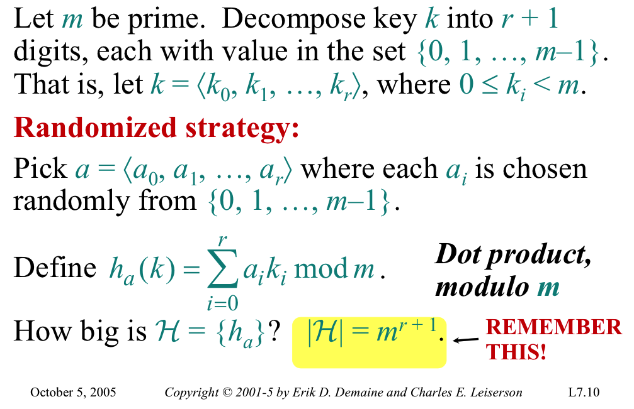
Constructing Universal Hash Functions

Slide 47
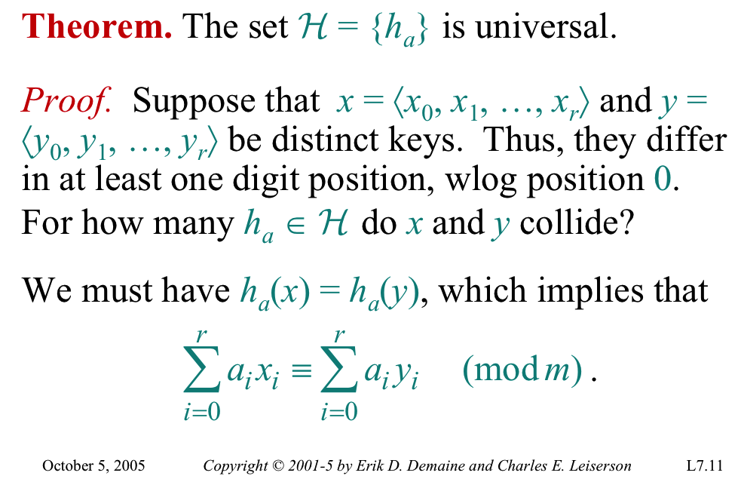
Universal Hash Functions by Dot Products

Slide 48
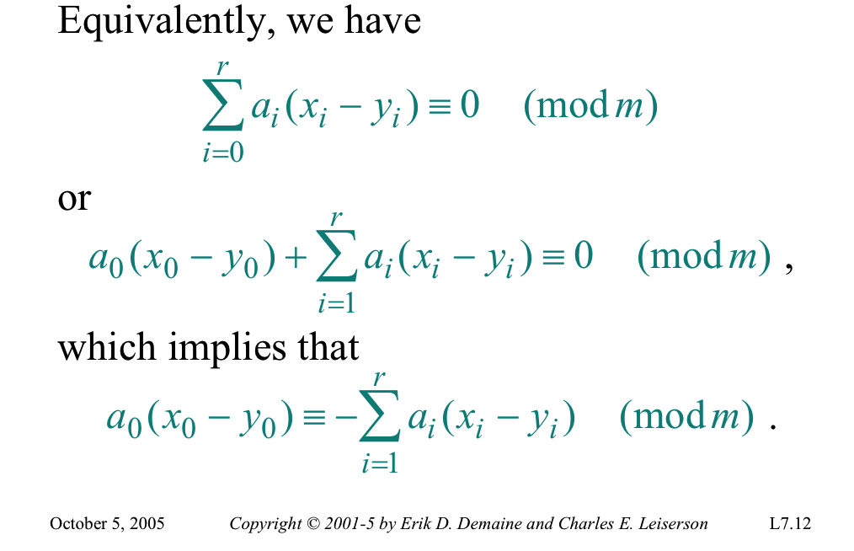
Proof

Slide 49
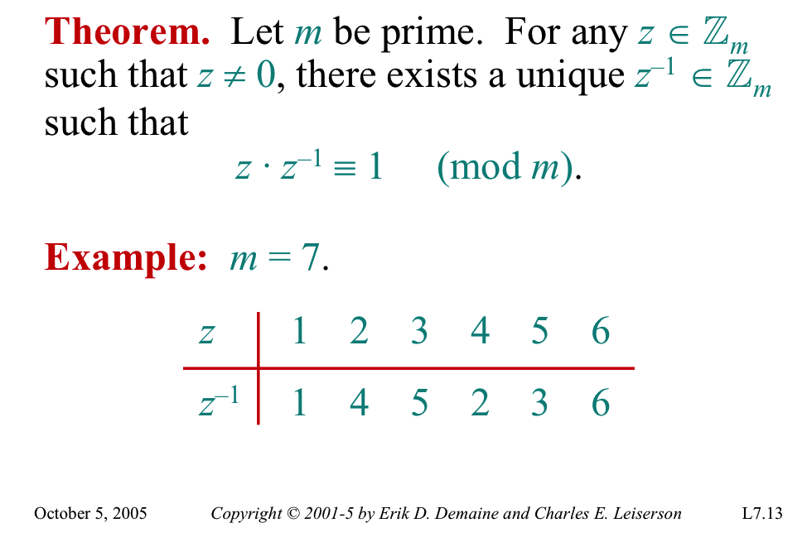
A Fact from Number Theory

Slide 50
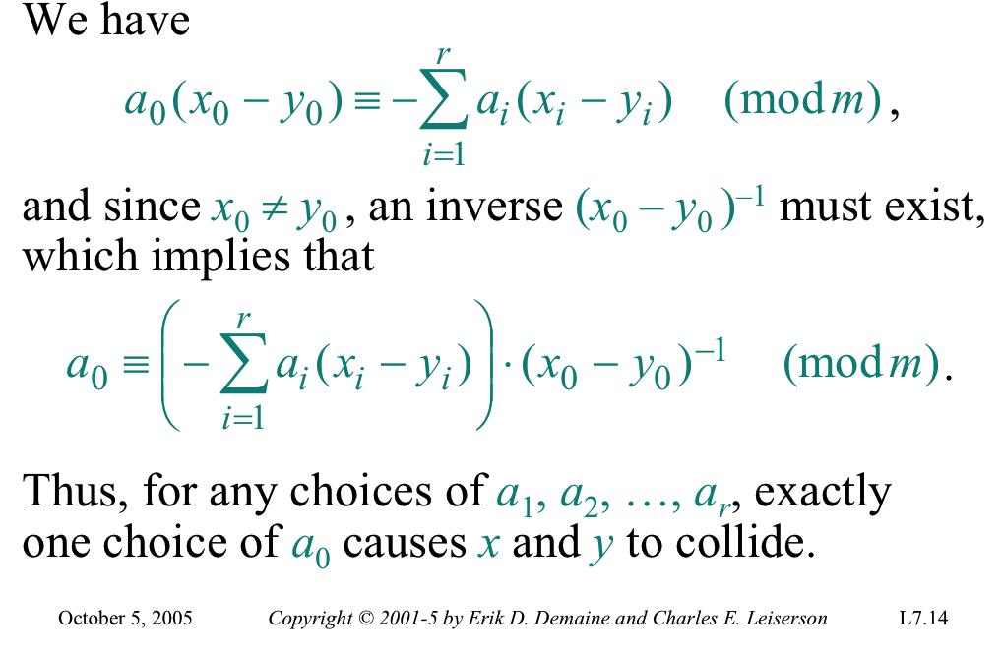
Proof (cont.)

Slide 51
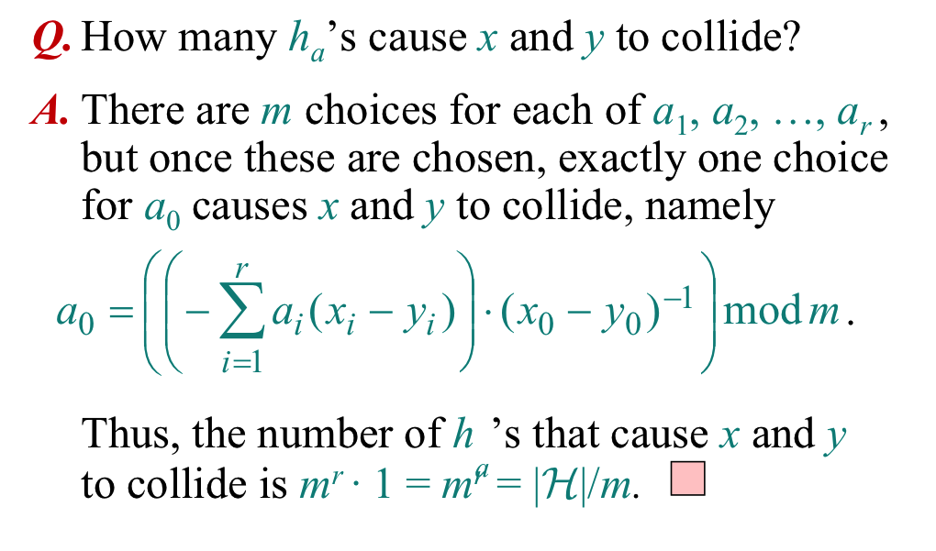
Proof (cont.)

Slide 52
Perfect Hashing: Worst-Case O(1) Lookup
Universal hashing assures us that hashing has expected O(1) search time, assuming n/M is at most a constant.
But what about worst case?
There remains a small, but non-zero, prob. of unlucky random draw.
A more sophisticated theory of Perfect Hashing shows that one can even achieve O(1) worst-case result, using a 2-level hashing table.
  Fredman-Komlos-Szemeredi [JACM 1984]

Slide 53
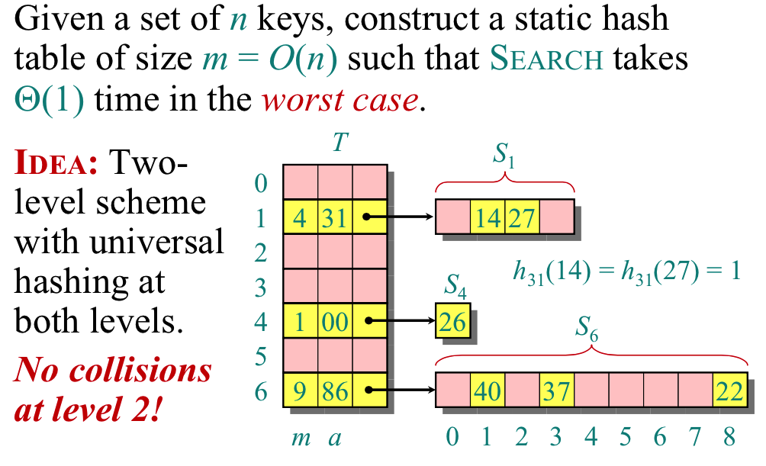
Perfect Hashing: Worst-Case O(1) Lookup

Slide 54
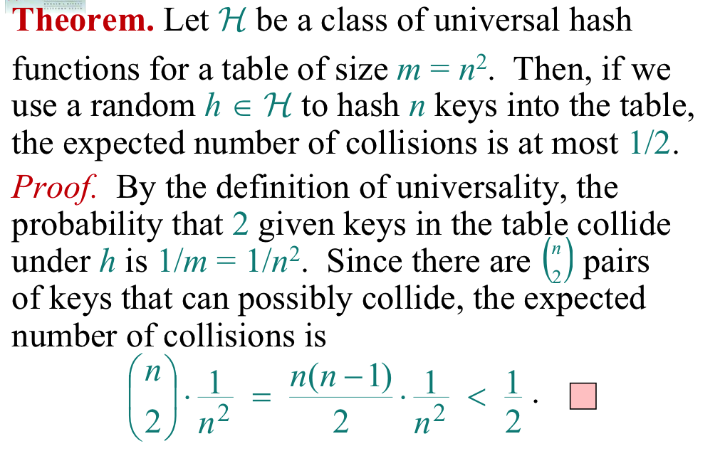
Collisions at Level 2

Slide 55
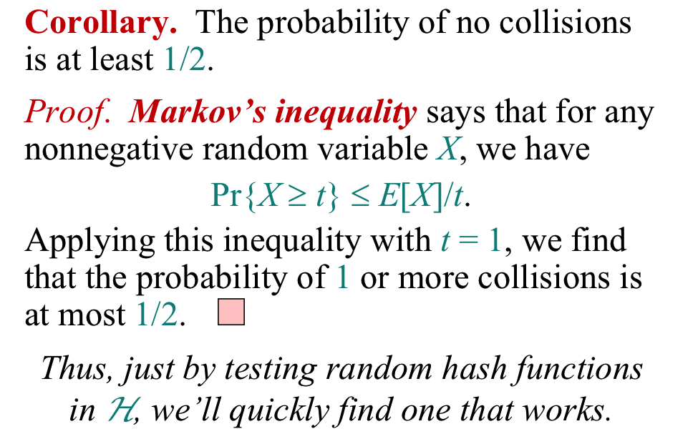
Achieving Zero Collisions at Level 2

Slide 56
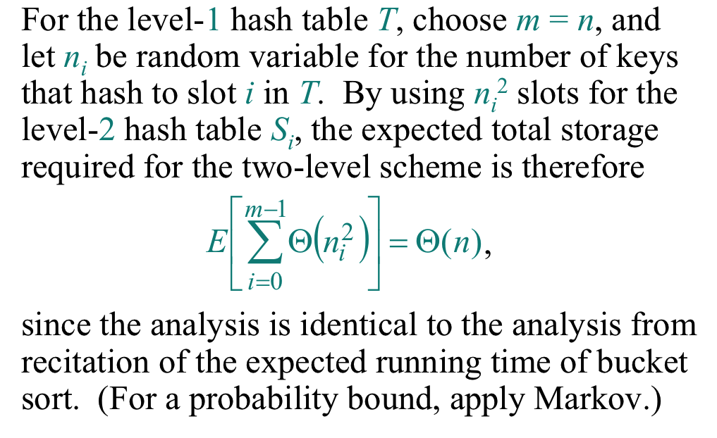
Analysis of Space Complexity

Slide 57
Bloom Filters
In some applications, we need very compact data structure for quick membership test: weak passwords, malicious websites, etc.
Hash tables provide a compact data structure by storing only hashed values. However, a non-malicious site may be mistakenly flagged malicious due to hash collision.
Bloom filters provide tradeoff where the false-positive rate can be reduced by using multiple hash functions.
Abstractly, our problem is this: how compact a table will suffice if we just want a quick test for “Is x in S?”

Slide 58
A Motivating Application
Web Caching
  An ISP keeps several levels of caches for fast access
  Upon a client’s request for data (image, movie etc)
    Check if data in local cache. If so, serve from cache
    Otherwise, fetch data from remote serve
    Remote server access is several orders of magnitude slower
    Local access is therefore hugely preferable
    As long as false positive rate is low, this is clear win.

Slide 59
Bloom Filters vs. Hashing
Bloom Filters sacrifice correctness for space efficiency:
  If key present, always find it
  But may say Yes when in fact key is not present
    The false positives problem.
They can also be thought of as an extension of hashing with an interesting space-error-rate tradeoff
  Universal hashing gets its power from choosing the hash function at random. However, if we don’t store keys explicitly, the collisions create false positive.
  Perfect Hash functions shows this can be achieved even in worst-case, but at the expense of added complexity.
  An alternative: multiple hash functions to each key.
    This allows the use of simple hash functions
    But minimizes the risk of a single hash function

Slide 60
Bloom Filter: formal setup
Store an n-element set S from a large universe U
  n = |S| << |U|
  Think of U as all possible web pages, and S as the set maintained in cache.
We want to support “membership queries”
  Is a given element x currently in the set S?
  If data structure returns No, then x definitely not in S
  But the data structure can say Yes, even if x not in S, but only with small probability.
  Membership and Insert operations should take O(1) time.
    Delete can be handled as well.

Slide 61
Bloom Filters; Details
A bloom filter is a bit vector B of m bits
Each key is mapped to B using k independent hash functions
The number of hash functions k is an optimization parameter
To insert x into S
  Compute h₁(x), h₂(x), …, h_{k}(x)
  Set B[h_{i}(x) = 1], for i=1,2,…, k.
To check for membership:
  Compute h₁(x), h₂(x), …, h_{k}(x)
  Answer Yes if B[h_{i}(x) = 1], for all i=1,2,…, k.
  Otherwise answer No.

Slide 62
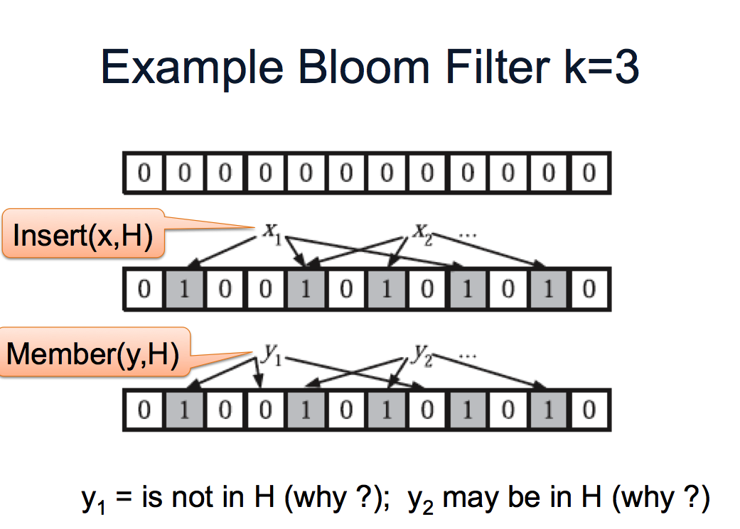
Bloom Filters: an example

Slide 63
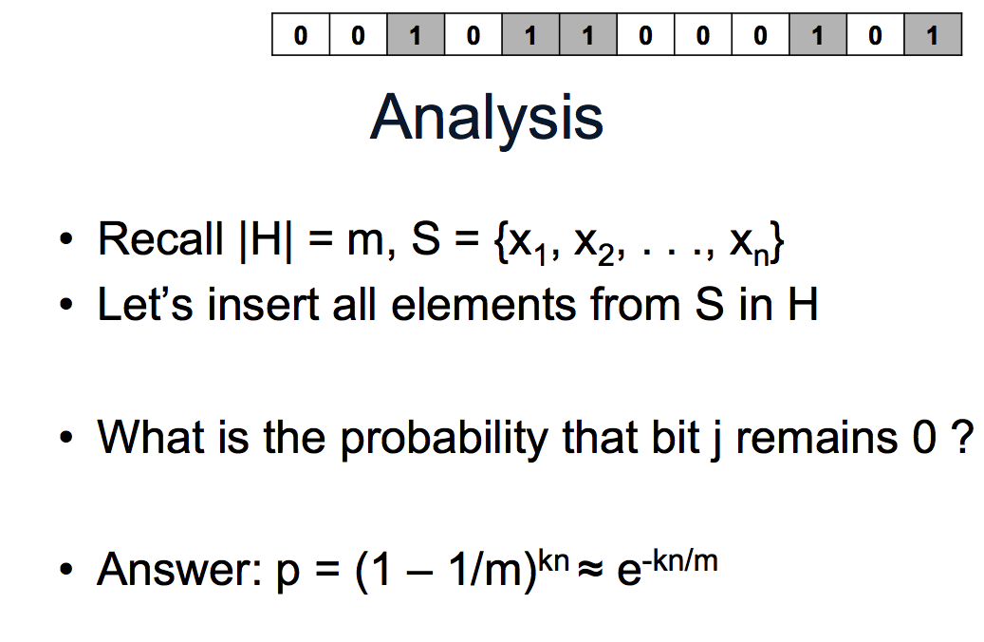
Bloom Filters: analysis

Slide 64
Bloom Filters: analysis
  Prob. of 1 unset (0) bit is p
  Prob. that some non-member y gets flagged as present
    When all k hash entries for y are set to 1
    (1 – p)^{k}
    ( 1 – e^{-kn/m})^{k}

Slide 65
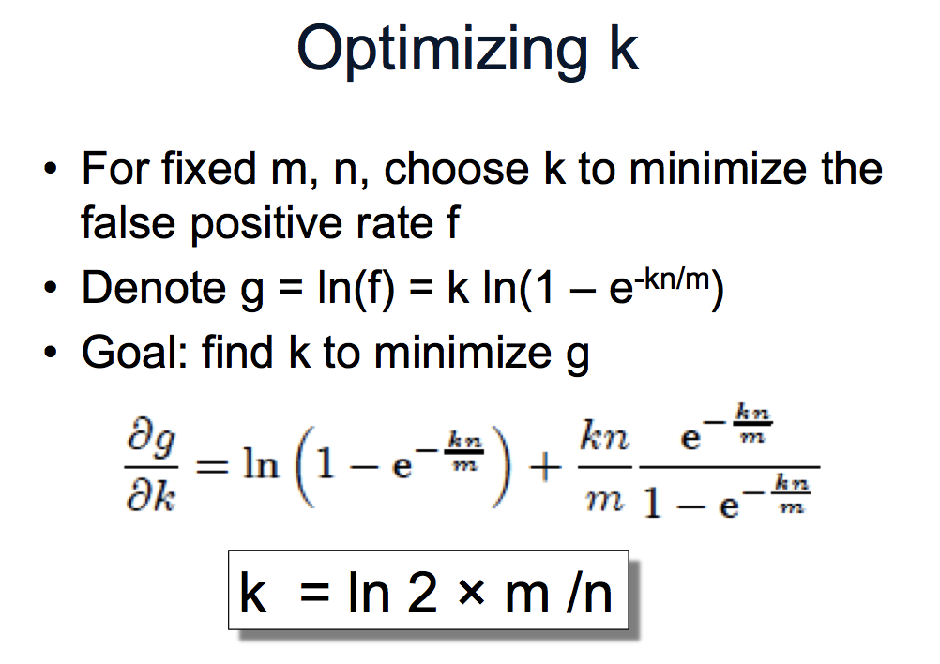
Bloom Filters: analysis

Slide 66
Bloom Filters vs. Hashing
  Bloom Filters use multiple hash functions, and create a k-bit finger-print for each input key.
  If we store a n-key set in table of size m, BF tells the optimal choice of k, and the resulting error rate.
  Why is this better than a simple hash table of size m?
  Let’s compare.
    Hash table gives a false positive when a collision occurs
    The prob. of collision = 1 - (1 – 1/m)^{n} which is approx. 1 – e^{-n/m}

Slide 67
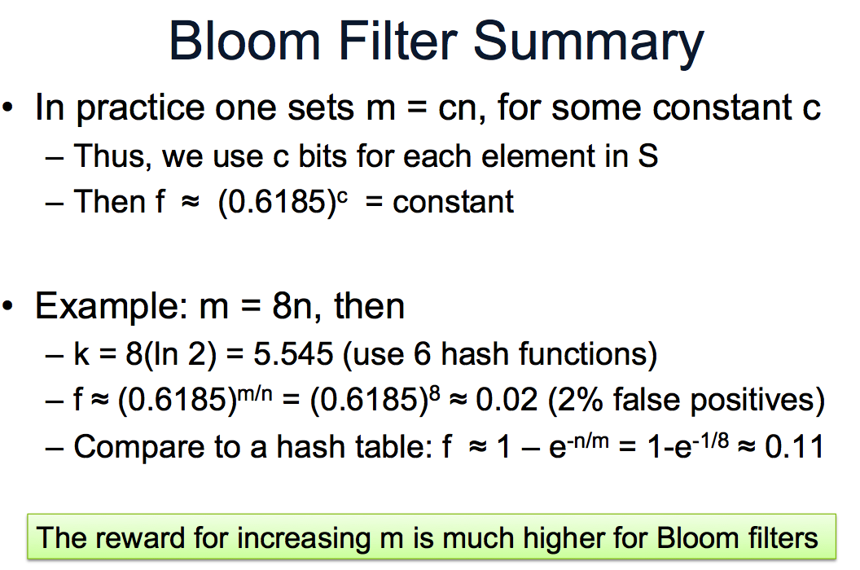
Bloom Filter vs. Hash Tables

Slide 68
END

Slide 69
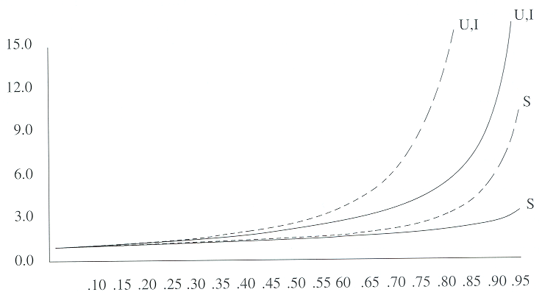
Comparison of linear and random probing

Slide 70
Set ADT: Union, Intersection, Difference
AbstractDataType SetUID
instance
multiple sets
operations
union (s₁,s₂): {x | x in s₁ or x in s₂}
intersection (s₁,s₂): {x | x in s₁ and x in s₂}
difference (s₁,s₂): {x | x in s₁ and x not in s₂}

Slide 71
Examples
Sets: Articles in Yahoo Science (A), Technology (B), and Sports (C)
  Find all articles on Wright brothers.
  Find all articles dealing with sports medicine
Sets: Students in CS10 (A), CS20 (B), and CS40 (C)
  Find all students enrolled in these courses
  Find students registered for CS10 only
  Find students registered for both CS10 and CS20
  Etc.

Slide 72
Set UID Implementation: Bit Vector
Set members known and finite (e.g., search keywords)
Operations
  Union: u[k]= x[k] | y[k];
  Intersection: u[k] = x[k] & y[k];
  Difference: u[k] = x[k] & ~y[k];
Complexity: O(n): n size of the set
Key words
1
0
1
1
documents
1
0
0
1
1
0
1
A set
1

Slide 73
Set UID Implementation: linked lists
Bit vectors great when
  Small sets
  Known membership
Linked lists
  Unknown size and members
  Two kinds: Sorted and Unsorted

Slide 74
Set UID Complexity: Unsorted Linked List
Intersection
  For k=1 to n do
    Advance set_{A} one step to find kth element;
    Follow set_{B} to find that element in B;
    If found then
      Append element k to set_{AB}
  End
Searching for each element can take n steps.
Intersection worst-case time O(n²).

Slide 75
Set UID Complexity: Sorted Lists
The list is sorted; larger elements are to the right
Each list needs to be scanned only once.
At each element: increment and possibly insert into A&B, constant time operation
Hence, sorted list set-set ADT has O(n) complexity
A simple example of how even trivial algorithms can make a big difference in runtime complexity.

Slide 76
Set UID: Sorted List Intersection
Case A *set_{A}=*set_{B}
    Include *set_{A} (or *set_{B} ) in *set_{AB}
    Increment set_{A}
    Increment set_{B}
Case B *set_{A}<*set_{B}
    Increment set_{A} Until
    *set_{A}=*set_{B} (A)
    *set_{A}>*set_{B} (C)
    *set_{A}==null
Case C *set_{A}>*set_{B}
    Increment set_{B} Until
    *set_{A}=*set_{B} (A)
    *set_{A}<*set_{B} (B)
    *set_{B}==null
Case D *set_{A}==null or *set_{B}==null
    terminate

