Slide 1
Course Outline
Introduction and Algorithm Analysis (Ch. 2)
Hash Tables: dictionary data structure (Ch. 5)
Heaps: priority queue data structures (Ch. 6)
Balanced Search Trees: Splay Trees (Ch. 4.5)
Union-Find data structure (Ch. 8.1–8.5)
Graphs: Representations and basic algorithms
Topological Sort (Ch. 9.1-9.2)
Minimum spanning trees (Ch. 9.5)
Shortest-path algorithms (Ch. 9.3.2)
B-Trees: External-Memory data structures (Ch. 4.7)
kD-Trees: Multi-Dimensional data structures (Ch. 12.6)
Misc.: Streaming data, randomization

Slide 2
Splay trees
Invented by Sleator and Tarjan.
Self-adjusting Binary Search Trees. JACM, pp. 652-686, 1985.
BSTs (AVL, weight balanced, B-Trees) have
O(log n) worst case search
but are complicated to implement and/or require extra space for balance
No explicit balance condition in Splay Trees
Instead apply a simple restructuring heuristic, called splaying every time the tree is accessed.

Slide 3
Splay trees: Intuition
For search cost to be small in a BST, the item must be close to the root.
Many tree-restructuring rules try to move the accessed item closer to the root.
Same idea behind caching---keep recently accessed data in fast memory.

Slide 4
Splay trees: Intuition
Two classical heuristics are:
Single rotation: after accessing item i at a node x, rotate the edge joining x to its parent; unless x is the root.
Move to Root: after accessing i at a node x, rotate edges joining x and p(x), and repeat until x becomes the root.
Unfortunately, neither heuristic has O(log n) search cost:
Show arbitrarily long access sequences where time per access is O(n).

Slide 5
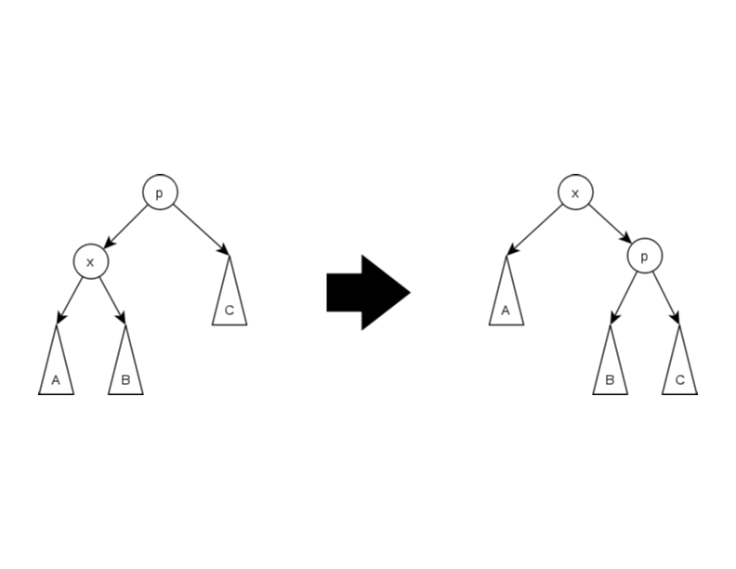
Splay trees: Intuition
Sleator-Tarjan's heuristic similar to move-to-front, but its swaps depend on the structure of the tree.
The basic operation is rotation.

Slide 6
Splay trees: Advantages
Simplicity and uniformity
Elegant theory and amortized analysis
average over a Worst-case sequence
useful metric for data structure performance
Besides access, insert, delete, many other useful ops
Access always brings node to the root
Join
Split

Slide 7
Splaying at a Node
To splay at a node x, repeat the following step until x becomes the root:
Case 1 (Zig): [terminating single rotation]
if p(x) is the root, rotate the edge between x and p(x);
and terminate.

Slide 8
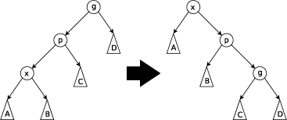
Splaying at a Node
Case 2 (zig-zig): [two single rotations]
if (p(x) not root) and (x and p(x) both left or both right children)
first rotate the edge from p(x) to its grandparent g(x), and then rotate the edge from x to p(x).

Slide 9
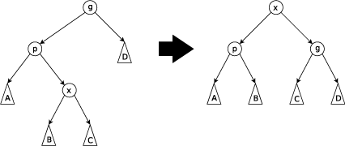
Splaying at a Node
Case 2 (zig-zag): [double rotation]
if (p(x) not root) and (x is left child and p(x) right child)
first rotate the edge from from x to p(x), and
then rotate the edge from x to its new p(x).

Slide 10
Splay trees
Splay at a node: rotate the node up to the root
Basic operations (repeat until node X is at root):
zig-zag:
zig-zig:
G
X
P
D
P
G
A
X
A
B
C
D
B
C
G
X
P
A
P
D
X
C
B
G
A
B
C
D

Slide 11
Splay Tree Properties
Fact 1. Splaying at a node x of depth d takes O(d) time.
Fact 2. Splaying moves x to the root, and roughly halves the depth of every node on the access path.

Slide 12
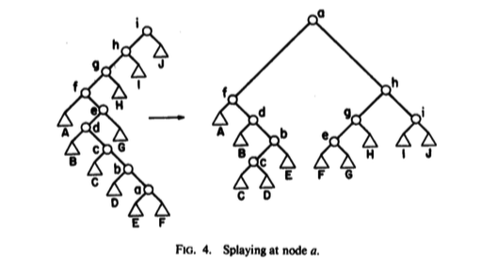
Splaying at a node

Slide 13
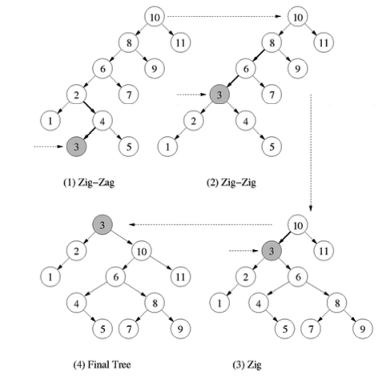
Splaying at a node

Slide 14
Splay Tree Operations
access (i,t): return a pointer to location of item i, if present; otherwise, return a null pointer.
insert (i,t): insert item i in tree t, if it is not there already;
delete (i,t): delete i from t, assuming it is present.
join (t₁, t₂): combines t₁ and t₂ into a single tree and returns the resulting tree; assume all items in t₁ smaller than t₂
split (i,t): return two trees: t₁, containing all items less than or equal to i, and t₂, containing items greater than i. This operation destroys t.

Slide 15
Splay Tree: Implementing the Operations
access (i,t)
Search down from the root, looking for i.
If search reaches a node x containing i, we splay at x and return the pointer to x.
If search reaches a null node, we splay the last non-null node, and return a null pointer.

Slide 16
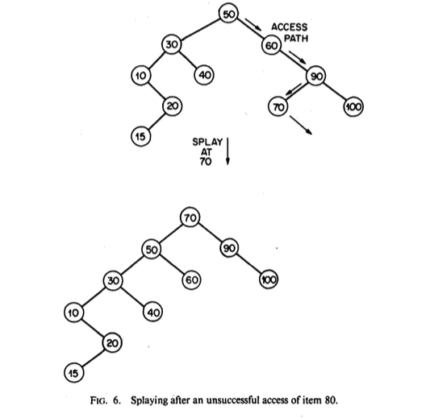
Illustration: Access 80

Slide 17
Insert and Delete in Splay Trees
Insert, delete easily implemented using join and split.
because access(x) moves x to the root.
For join(t₁, t₂), first access the largest item in t₁.
Suppose this item is x. After the access, x is at the root of t₁.
Because x is the largest item in t₁, the root must have a null right child. Simply make t₂'s root to be the right child of t₁.
Return the resulting tree.
For split(x,t), first do access(x,t).
If root > x, then break the left child link from the root, and return the two subtrees.
Otherwise, break the right child link from the root, and return the two subtrees.
In all cases, special care if one of subtrees is empty.

Slide 18
Insert in Splay Trees
To do insert(x,t), perform split(x,t).
Replace t with a new tree consisting of a new root node containing x, whose left and right subtrees are t₁ and t₂ returned by the split.

Slide 19
Illustration

Slide 20
Delete in Splay Trees
To do delete(x,t), perform access(x,t), and then replace t by the join of its left and right subtrees.

Slide 21
Splay trees: the main theorem
Starting with an empty tree, any m operations (find, insert, delete) take O(m log n) time, where n is the maximum # of items ever in the tree
Lemma: Any sequence of m operations requires at most 4 m log n + 2 splay steps.
(The theorem follows immediately from the lemma.)

Slide 22
Splay trees: Main Theorem
Starting with an empty tree, any m operations (find, insert, delete) take O(m log n) time, where n is the maximum # of items ever in the tree
Proof: “credit accounting”
just count the cost of splaying
each operation gets 3 lg n + 1 coins
one coin pays for one splay step
each node holds floor(lg(size of subtree)) coins

Slide 23
Splay trees: proving the lemma
Each operation gets 4 log n + 2 coins (3 log n + 1 is enough for all but insert )
One splay step costs one coin, from somewhere
Some of the leftover coins are left “on the tree” to pay for later operations
Credit invariant: Every tree node holds log(subtree size) coins (rounded down to an integer)

Slide 24
Splay trees: maintaining the credit invariant
G
X
P
D
P
G
A
X
A
B
C
D
B
C
lss(x) = log(subtree size) before step; lss’ after step
zig-zag step costs 1 coin (to do the step) plus lss’(x) – lss(x) + lss’(p) – lss(p) + lss’(g) – lss(g) (to maintain the invariant)
this is always <= 3(lss’(x) – lss(x)) [complex argument]
similarly for zig-zig; 1 more for last half step
total cost of splay is <= 3(lss(root))+1 = 3 log n + 1

Slide 25
Splay trees: end of the main proof
maintaining invariant during splay costs <= 3 log n + 1 coins
maintaining invariant during insert may cost an extra log n + 1 coins (because lss goes up)
maintaining credit invariant never costs more than 4 log n + 2 coins
Lemma: Any sequence of m operations requires at most 4 m log n + 2 splay steps.
Theorem: Starting with an empty tree, any m operations (find, insert, delete) take O(m log n) time

