Slide 1
Course Outline
Introduction and Algorithm Analysis (Ch. 2)
Hash Tables: dictionary data structure (Ch. 5, CLRS)
Heaps: priority queue data structures (Ch. 6)
Balanced Search Trees: general search structures (Ch. 4.1-4.5)
Union-Find data structure (Ch. 8.1–8.5, Notes)
Graphs: Representations and basic algorithms
  Topological Sort (Ch. 9.1-9.2)
  Minimum spanning trees (Ch. 9.5)
  Shortest-path algorithms (Ch. 9.3.2)
B-Trees: External-Memory data structures (CLRS, Ch. 4.7)
kD-Trees: Multi-Dimensional data structures (Notes, Ch. 12.6)
Misc.: Streaming data, randomization (Notes)

Slide 2
Introduction: 2 Motivating Applications
Imagine you are in charge of maintaining a corporate network (or a major website such as Amazon)
  High speed, high traffic volume, lots of users.
Expected to perform with near perfect reliability, but is also under constant attack from malicious hackers
Monitoring what is going through the network is complex:
  Why is it slow?
  Which machines have become compromised?
  Which applications are eating up too much bandwidth etc.

Slide 3
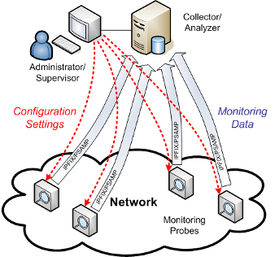
IP Network Monitoring
Any monitoring software/engine must be extremely light weight and not add to the network load
  These algorithms need smart data structures to track important statistics in real time

Slide 4
IP Network Monitoring
Consider a simple (toy) example
Is some IP address sending a lot of data to my network?
  Which IP address sent the most data in last 1 minute?
  How many different IP addresses in last 5 minutes?
  Have I seen this IP address in the last 5 minutes?
IP address format: 192.168.0.0 (10001011001…0010)
IPv4 has 32 bits, IPv6 has 128 bits
Cannot afford to maintain a table of all possible IP addresses to see how much traffic each is sending.
These are data structure problems, where obvious/naïve solutions are no good, and require creative/clever ideas.

Slide 5
Microprocessor Profiling
Modern microprocessors run at GHz or higher speeds
Yet they do an incredible amount of optimization for instruction scheduling, branch prediction etc
Profiling or monitoring code tracks performance bottlenecks, and looks for anomalies.
  Compute memory access statistics
  Correlations across resources etc
Toy examples:
  Which memory locations used the most in the last 1 sec?
  Usage map over sliding time window
Need for highly efficient dynamic data structures

Slide 6
A Puzzle
An abstraction: Most Frequent Item
You are shown a sequence of N positive integers
Identify the one that occurs most frequently
Example: 4, 1, 3, 3, 2, 6, 3, 9, 3, 4, 1, 12, 19, 3, 1, 9
However, your algorithm has access to only O(1) memory
  “Streaming data”
  Not stored, just seen once in the order it arrives
  The order of arrival is arbitrary, with no pattern
  What data structure will solve this problem?

Slide 7
A Puzzle: Most Frequent Item
Items can be source IP addresses at a router
The most frequent IP address can be useful to monitor suspicious traffic source
More generally, find the top K frequent items
  Targeted advertising
  Amazon, Google, eBay, Alibaba may track items bought most frequently by various demographics

Slide 8
Another Puzzle
The Majority Item
You are shown a sequence of N positive integers
Identify the one that occurs at least N/2 times
A: 4, 1, 3, 3, 2, 6, 3, 9, 3, 4, 1, 12, 19, 3, 1, 9, 1
B: 4, 1, 3, 3, 2, 3, 3, 9, 3, 4, 1, 3, 19, 3, 3, 9, 3
Sequence A has no majority, but B has one (item 3)
Can a sequence have more than one majority?
Again, your algorithm has access to only O(1) memory
  What data structure will solve this problem?

Slide 9
Solving the Majority Puzzle
Use two variables M (majority) and C (count).
When next item, say, X arrives
  if C = 0, put M = X and C = 1;
  else if M equals X, set C = C+1;
  else set C = C-1;
Claim: At the end of sequence, M is the only possible candidate for majority.
  Note that sequence may not have any majority.
  But if there is a majority, M must be it.

Slide 10
Examples
Try the algorithm on following data streams:
1, 2, 1, 1, 2, 3, 2, 2, 2, 2, 3, 2, 1
1, 2, 1, 2, 1, 2, 1, 2, 3, 3, 1

Slide 11
Proof of Correctness
  Suppose item Z is the majority item.
  Z must become majority candidate M at some point (why?)
  While M = Z, only non-Z items cause counter to decrement
  “Charge” this decrement to that non-Z item
  Each non-Z item can only cancel one occurrence of Z
  But in total we have fewer than N/2 non-Z items; they cannot cancel all occurrences of Z.
  So, in the end, Z must be stored as M, with a non-zero count C.

Slide 12
Solving the Majority Puzzle
False Positives in Majority Puzzle.
  What happens if the sequence does not have a majority?
  M may contain a random item, with non-zero C.
  Strictly, a second pass through the sequence is necessary to “confirm” that M is in fact the majority.
But in our application, it suffices to just “tag” a malicious IP address, and to monitor it for next few minutes.

Slide 13
Generalizing the Majority Problem
Identify k items, each appearing more than N/(k+1) times.
Note that simple majority is the case of k = 1.

Slide 14
Generalizing the Majority Problem
Find k items, each appearing more than N/(k+1) times.
Use k (majority, count) tuples (M₁, C₁), …, (M_{k}, C_{k}).
When next item, say, X arrives
  if X = M_{j} for some j, set C_{j} = C_{j}+1
  elseif some counter i zero, set M_{i} = X and C_{i} = 1
  else decrement all counters C_{j} = C_{j}-1;
Verify for yourselves this algorithm is correct.

Slide 15
Back to the Most Frequent Item Puzzle
You are shown a sequence of N positive integers
Identify most frequently occurring item
Example: 4, 1, 3, 3, 2, 6, 3, 9, 3, 4, 1, 12, 19, 3, 1, 9
Streaming model (constant amount of memory)
What clever idea will solve this problem?

Slide 16
An Impossibility Result
Cannot be done!
Computing the MFI requires storing Θ(N) space.
An adversary based argument:
  The first half of the sequence has all distinct items
  At least one item, say, X is not remembered by algorithm.
  In the second half, all items will be distinct, except X will occur twice, becoming the MFI.

Slide 17
Lessons for Data Structure Design
Puzzles such as Majority and Most Frequent Items teach us important lessons:
  Elegant interplay of data structure and algorithm
  To solve a problem, we should understand its structure
  Correctness is intertwined with design/efficiency
  Problems with superficial resemblance can have very different complexity
  Do not blindly apply a data structure or algorithm without understanding the nature of the problem

Slide 18
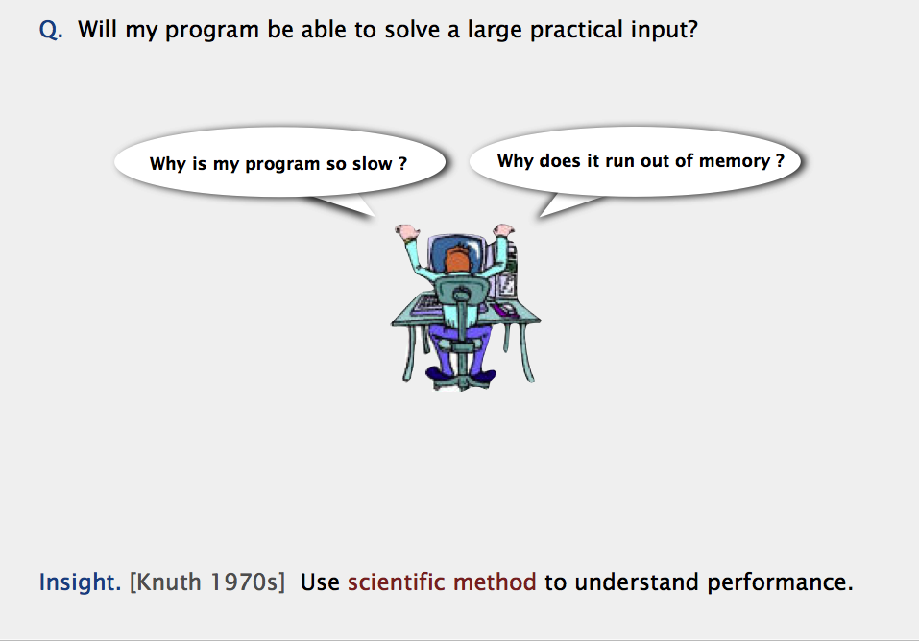
Performance Bottleneck: algorithm or data structure?

Slide 19
Data Structures & Algorithms vs. Programming
All of you have programmed; thus have already been exposed to algorithms and data structure.
Perhaps you didn't see them as separate entities
Perhaps you saw data structures as simple programming constructs (provided by STL--standard template library).
However, data structures are quite distinct from algorithms, and very important in their own right.

Slide 20
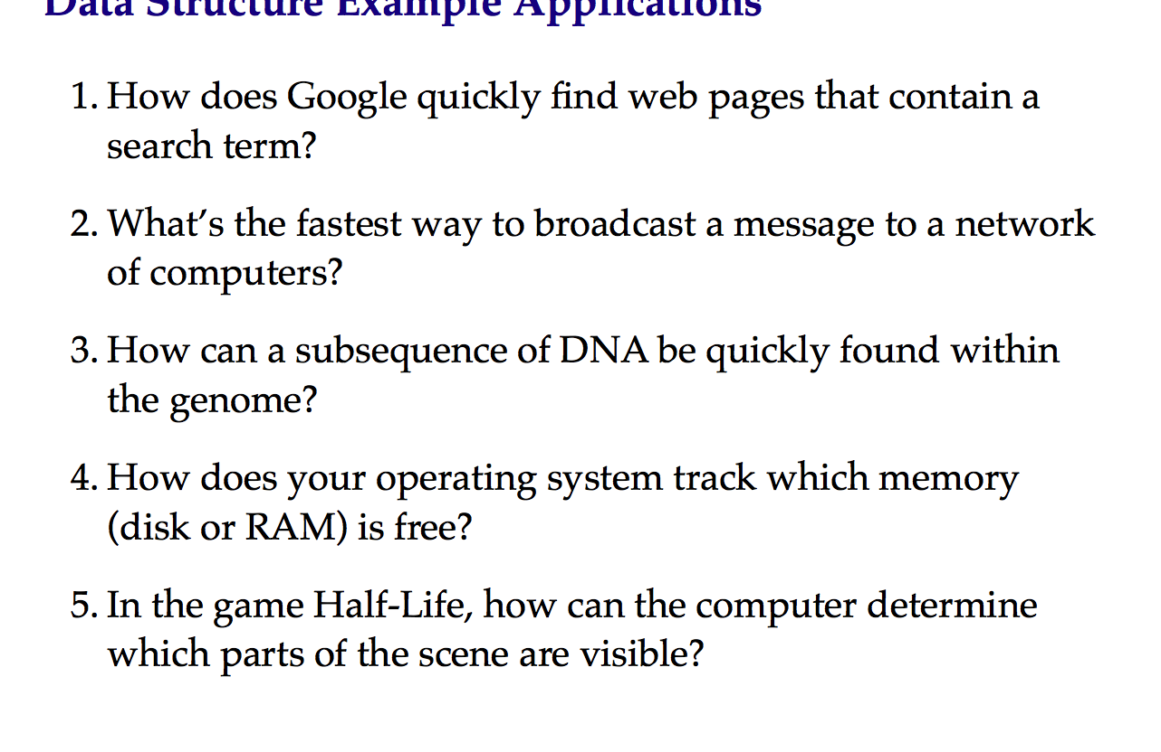
Interplay of Data Structures and Algorithms

Slide 21
Some Famous Algorithms
Constructions of Euclid
Newton's root finding
Fast Fourier Transform
Compression (Huffman, Lempel-Ziv, GIF, MPEG)
DES, RSA encryption
Simplex algorithm for linear programming
Shortest Path Algorithms (Dijkstra, Bellman-Ford)
Error correcting codes (CDs, DVDs)
TCP congestion control, IP routing
Pattern matching (Genomics)
Page Rank

Slide 22
130a: Design and Analysis
Foundations of Algorithm Analysis and Data Structures.
Data Structures
  How to efficiently store, access, manage data
  Data structures effect algorithm’s performance
Algorithm Design and Analysis:
  How to predict an algorithm’s performance
  How well an algorithm scales up
  How to compare different algorithms for a problem

Slide 23
Course Objectives
Focus: systematic design and analysis of data structures (and some algorithms)
  Algorithm: method for solving a problem.
  Data structure: method to store information.
Guiding principles: abstraction and formal analysis
Abstraction: Formulate fundamental problem in a general form so it applies to a variety of applications
Analysis: A (mathematically) rigorous methodology to compare two objects (data structures or algorithms)
In particular, we will worry about "always correct"-ness, and worst-case bounds on time and memory (space).

Slide 24
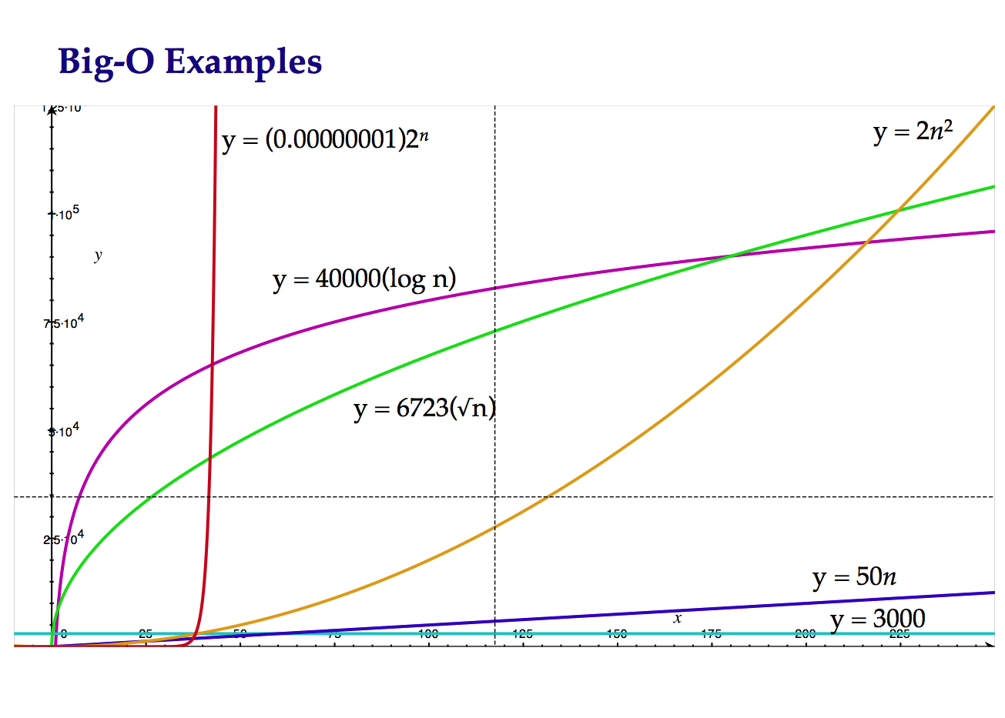
Asymptotic Complexity Analysis

Slide 25
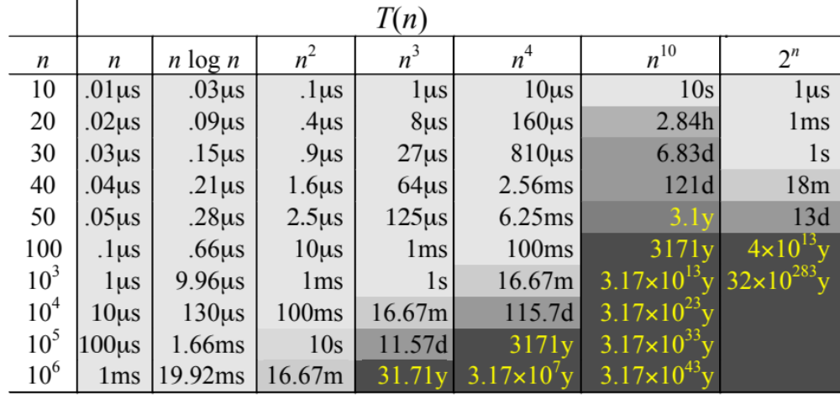
Complexity and Tractability
Assume the computer does 1 billion ops per sec.

Slide 26
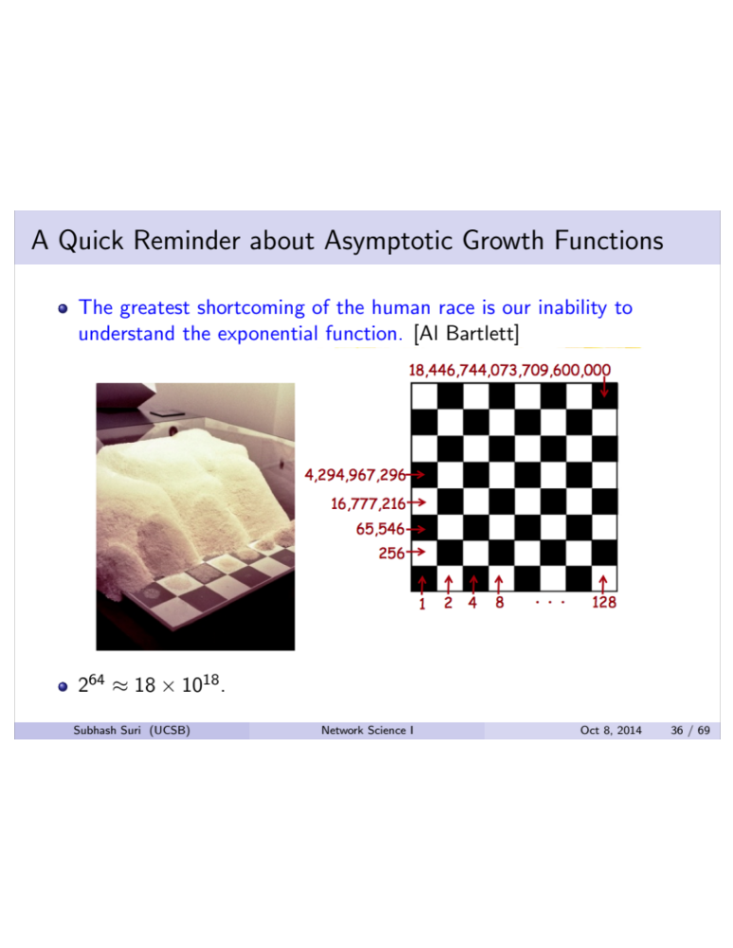
N² is bad, Exponential is horrible

Slide 27
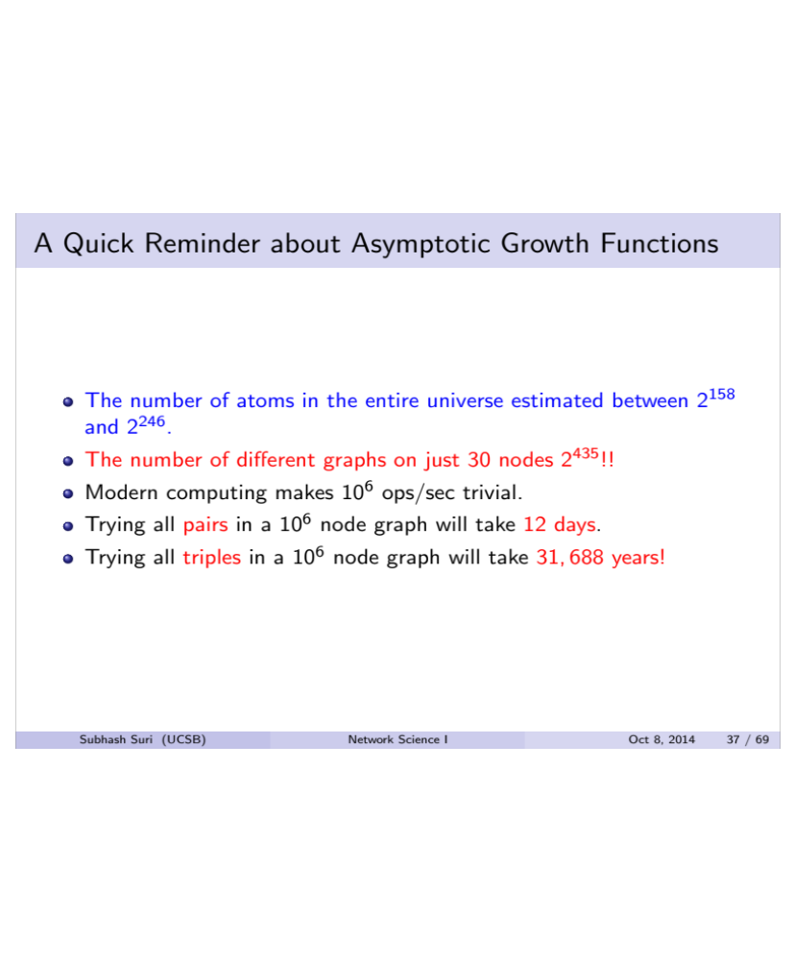
Graph Problems Often face Combinatorial Explosion

Slide 28
Quick Review of Algorithm Analysis
Two algorithms for computing the Factorial
Which one is better?
int factorial (int n) {
if (n <= 1) return 1;
else return n * factorial(n-1);
}
int factorial (int n) {
if (n<=1) return 1;
else {
fact = 1;
for (k=2; k<=n; k++)
fact *= k;
return fact;
}
}

Slide 29
A More Challenging Algorithm to Analyze
main ()
{
int x = 3;
for ( ; ; ) {
for (int a = 1; a <= x; a++)
for (int b = 1; b <= x; b++)
for (int c = 1; c <= x; c++)
for (int i = 3; i <= x; i++)
if(pow(a,i) + pow(b,i) == pow(c,i))
exit;
x++;
}
}

Slide 30
Max Subsequence Problem
Given a sequence of integers A1, A2, …, An, find the maximum possible value of a subsequence Ai, …, Aj.
Numbers can be negative.
You want a contiguous chunk with largest sum.
Example: 4, 3, -8, 2, 6, -4, 2, 8, 6, -5, 8, -2, 7, -9, 4, -1, 5
While not a data structure problems, it is an excellent pedagogical exercise for design, correctness proof, and runtime analysis of algorithms

Slide 31
Max Subsequence Problem
Given a sequence of integers A1, A2, …, An, find the maximum possible value of a subsequence Ai, …, Aj.
Example: 4, 3, -8, 2, 6, -4, 2, 8, 6, -5, 8, -2, 7, -9, 4, -1, 5
We will discuss 4 different algorithms, of time complexity
O(n³), O(n²), O(n log n), and O(n).
With n = 10⁶, Algorithm 1 may take > 10 years; Algorithm 4 will take a fraction of a second!

Slide 32
Algorithm 1 for Max Subsequence Sum
Given A₁,…,A_{n} , find the maximum value of A_{i}+A_{i+1}+···+A_{j}
Return 0 if the max value is negative

Slide 33

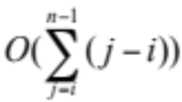
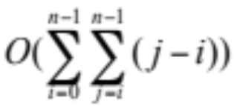

Algorithm 1 for Max Subsequence Sum
Given A₁,…,A_{n} , find the maximum value of A_{i}+A_{i+1}+···+A_{j}
0 if the max value is negative
int maxSum = 0;
for( int i = 0; i < a.size( ); i++ )
for( int j = i; j < a.size( ); j++ )
{
int thisSum = 0;
for( int k = i; k <= j; k++ )
thisSum += a[ k ];
if( thisSum > maxSum )
maxSum = thisSum;
}
return maxSum;
Time complexity: O(n³)

Slide 34
Algorithm 2
Idea: Given sum from i to j-1, we can compute the sum from i to j in constant time.
This eliminates one nested loop, and reduces the running time to O(n²).
into maxSum = 0;
for( int i = 0; i < a.size( ); i++ )
int thisSum = 0;
for( int j = i; j < a.size( ); j++ )
{
thisSum += a[ j ];
if( thisSum > maxSum )
maxSum = thisSum;
}
return maxSum;

Slide 35
Algorithm 3
This algorithm uses divide-and-conquer paradigm.
Suppose we split the input sequence at midpoint.
The max subsequence is
  entirely in the left half,
  entirely in the right half,
  or it straddles the midpoint.
Example:
left half | right half
4 -3 5 -2 | -1 2 6 -2
Max in left is 6 (A1-A3); max in right is 8 (A6-A7).
But straddling max is 11 (A1-A7).

Slide 36
Algorithm 3 (cont.)
Example:
left half | right half
4 -3 5 -2 | -1 2 6 -2
Max subsequences in each half found by recursion.
How do we find the straddling max subsequence?
Key Observation:
  Left half of the straddling sequence is the max subsequence ending with -2.
  Right half is the max subsequence beginning with -1.
A linear scan lets us compute these in O(n) time.

Slide 37
Algorithm 3: Analysis
The divide and conquer is best analyzed through recurrence:
T(1) = 1
T(n) = 2T(n/2) + O(n)
This recurrence solves to T(n) = O(n log n).

Slide 38

Algorithm 4
2, 3, -2, 1, -5, 4, 1, -3, 4, -1, 2

Slide 39
Algorithm 4
2, 3, -2, 1, -5, 4, 1, -3, 4, -1, 2
int maxSum = 0, thisSum = 0;
for( int j = 0; j < a.size( ); j++ )
{
thisSum += a[ j ];
if ( thisSum > maxSum )
maxSum = thisSum;
else if ( thisSum < 0 )
thisSum = 0;
}
return maxSum;
}
Time complexity clearly O(n)
But why does it work? I.e. proof of correctness.

Slide 40
Proof of Correctness
Max subsequence cannot start or end at a negative A_{i}.
More generally, the max subsequence cannot have a prefix with a negative sum.
Ex: -2 11 -4 13 -5 -2
Thus, if we ever find that A_{i} through A_{j} sums to < 0, then we can advance i to j+1
  Proof. Suppose j is the first index after i when the sum becomes < 0
  Max subsequence cannot start at any p between i and j. Because A_{i} through A_{p-1} is positive, so starting at i would have been even better.

Slide 41
Algorithm 4
int maxSum = 0, thisSum = 0;
for( int j = 0; j < a.size( ); j++ )
{
thisSum += a[ j ];
if ( thisSum > maxSum )
maxSum = thisSum;
else if ( thisSum < 0 )
thisSum = 0;
}
return maxSum
The algorithm resets whenever prefix is < 0. Otherwise, it forms new sums and updates maxSum in one pass.

Slide 42
Why Efficient Algorithms Matter
Suppose N = 10⁶
A PC can read/process N records in 1 sec.
But if some algorithm does N*N computation, then it takes 1M seconds = 11 days!!!
100 City Traveling Salesman Problem.
  A supercomputer checking 100 billion tours/sec still requires 10¹⁰⁰ years!
Fast factoring algorithms can break encryption schemes. Algorithms research determines what is safe code length. (> 100 digits)

Slide 43
How to Measure Algorithm Performance
What metric should be used to judge algorithms?
  Length of the program (lines of code)
  Ease of programming (bugs, maintenance)
  Memory required
  Running time
Running time is the dominant standard.
  Quantifiable and easy to compare
  Often the critical bottleneck

Slide 44
Abstraction
An algorithm may run differently depending on:
  the hardware platform (PC, Cray, Sun)
  the programming language (C, Java, C++)
  the programmer (you, me, Bill Joy)
While different in detail, all hardware and prog models are equivalent in some sense: Turing machines.
It suffices to count basic operations.
Crude but valuable measure of algorithm’s performance as a function of input size.

Slide 45
Average, Best, and Worst-Case
On which input instances should the algorithm’s performance be judged?
Average case:
  Real world distributions difficult to predict
Best case:
  Seems unrealistic
Worst case:
  Gives an absolute guarantee
  We will use the worst-case measure.

Slide 46
Asymptotic Notation Review
Big-O, “bounded above by”: T(n) = O(f(n))
  For some c and N, T(n) ≤ c·f(n) whenever n > N.
Big-Omega, “bounded below by”: T(n) = Ω(f(n))
  For some c>0 and N, T(n) ≥ c·f(n) whenever n > N.
  Same as f(n) = O(T(n)).
Big-Theta, “bounded above and below”: T(n) = Θ(f(n))
  T(n) = O(f(n)) and also T(n) = Ω(f(n))
Little-o, “strictly bounded above”: T(n) = o(f(n))
  T(n)/f(n) → 0 as n → ∞

Slide 47

By Pictures
Big-Oh (most commonly used)
  bounded above
Big-Omega
  bounded below
Big-Theta
  exactly
Small-o
  not as expensive as ...

Slide 48
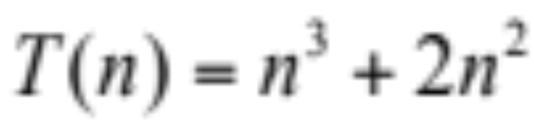
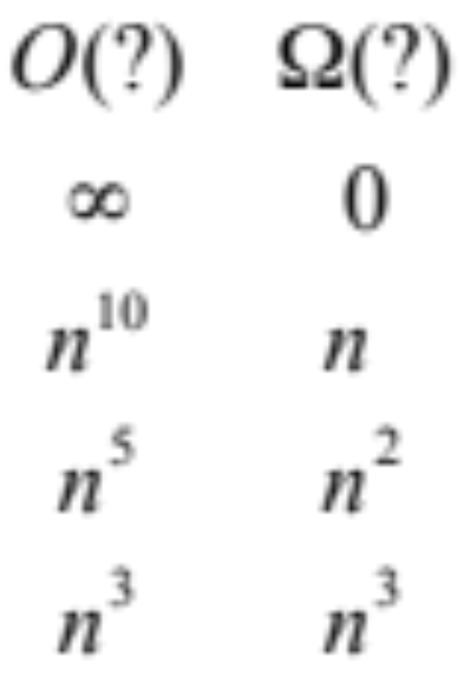
Example

Slide 49
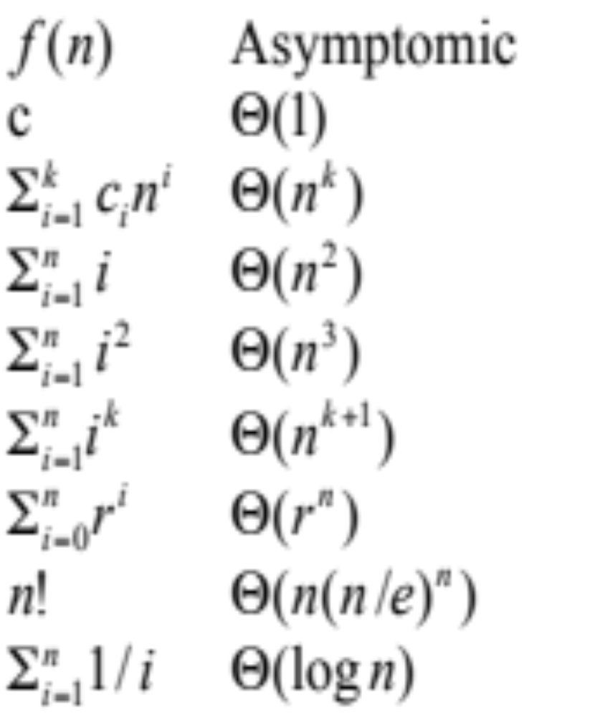
Examples

Slide 50
End of Introduction and Analysis
  Next Topic: Hash Tables

Slide 51
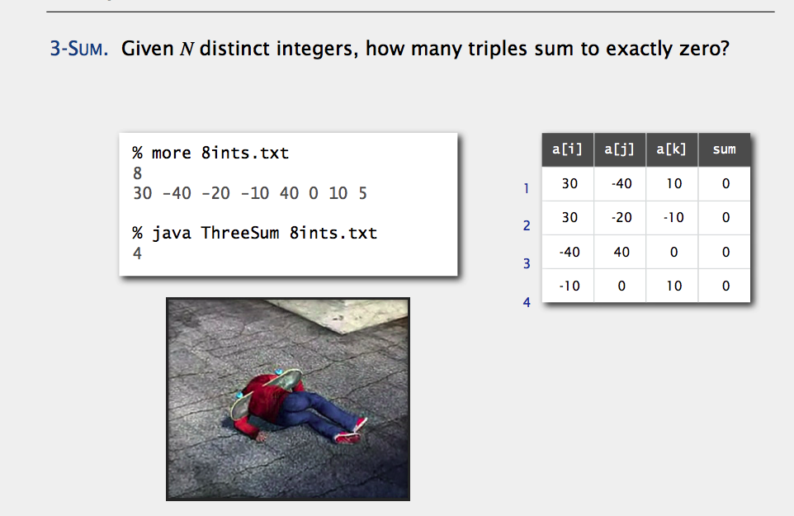
A Challenging Problem

Slide 52
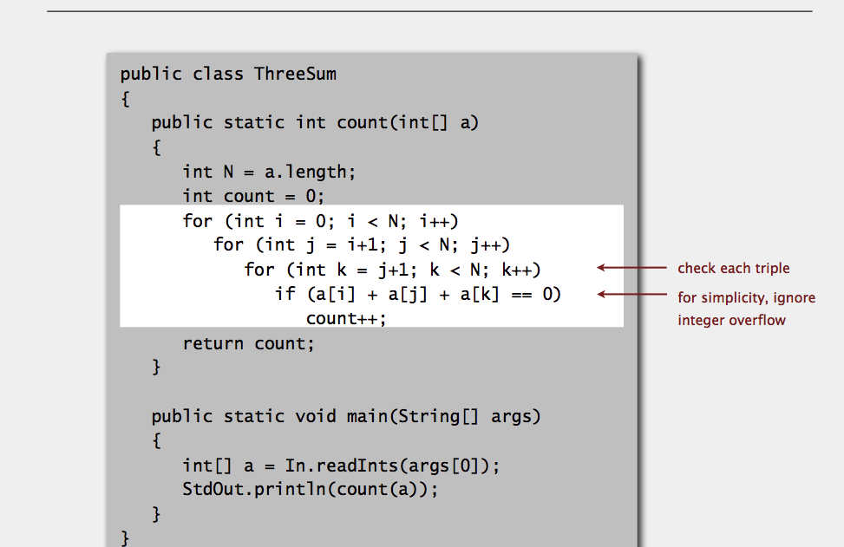

Slide 53
Can one solve it faster?
A simpler version
  Input: a set S of n integers (positive or negative)
  Question: Are there 3 that sum to 0
  That is, does (a + b + c) = 0, for some a, b, c in S?
  An O(n² log n) time solution relatively easy.
  Beating n² open research problem.

Slide 54
Summary (Why O(n)?)
T(n) = c_{k} n^{k} + c_{k-1} n^{k-1} + c_{k-2} n^{k-2} + … + c₁ n + c_{o}
Too complicated
O(n^{k} )
  a single term with constant coefficient dropped
Much simpler, extra terms and coefficients do not matter asymptotically
Other criteria hard to quantify

Slide 55
Runtime Analysis
Useful rules
  simple statements (read, write, assign)
    O(1) (constant)
  simple operations (+ - * / == > >= < <=
    O(1)
  sequence of simple statements/operations
    rule of sums
  for, do, while loops
    rules of products

Slide 56
Runtime Analysis (cont.)
Two important rules
  Rule of sums
    if you do a number of operations in sequence, the runtime is dominated by the most expensive operation
  Rule of products
    if you repeat an operation a number of times, the total runtime is the runtime of the operation multiplied by the iteration count

Slide 57
Runtime Analysis (cont.)
if (cond) then O(1)
  body₁ T₁(n)
else
  body₂ T₂(n)
endif
T(n) = O(max (T₁(n), T₂(n))

Slide 58
Runtime Analysis (cont.)
Method calls
  A calls B
  B calls C
  etc.
A sequence of operations when call sequences are flattened
  T(n) = max(T_{A}(n), T_{B}(n), T_{C}(n))

Slide 59
Example
  for (i=1; i<n; i++)
    if A(i) > maxVal then
      maxVal= A(i);
      maxPos= i;
Asymptotic Complexity: O(n)

Slide 60
Example
  for (i=1; i<n-1; i++)
    for (j=n; j>= i+1; j--)
      if (A(j-1) > A(j)) then
        temp = A(j-1);
        A(j-1) = A(j);
        A(j) = tmp;
      endif
    endfor
  endfor
Asymptotic Complexity is O(n²)

Slide 61
Run Time for Recursive Programs
T(n) is defined recursively in terms of T(k), k<n
The recurrence relations allow T(n) to be “unwound” recursively into some base cases (e.g., T(0) or T(1)).
Examples:
  Factorial
  Hanoi towers

Slide 62
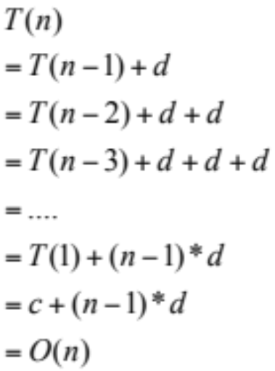
Example: Factorial
int factorial (int n) {
if (n<=1) return 1;
else return n * factorial(n-1);
}
factorial (n) = n*n-1*n-2* … *1
n * factorial(n-1)
n-1 * factorial(n-2)
n-2 * factorial(n-3)
…
2 *factorial(1)
T(n)
T(n-1)
T(n-2)
T(1)

Slide 63

Example: Factorial (cont.)
int factorial1(int n) {
if (n<=1) return 1;
else {
fact = 1;
for (k=2;k<=n;k++)
fact *= k;
return fact;
}
}
Both algorithms are O(n).

Slide 64
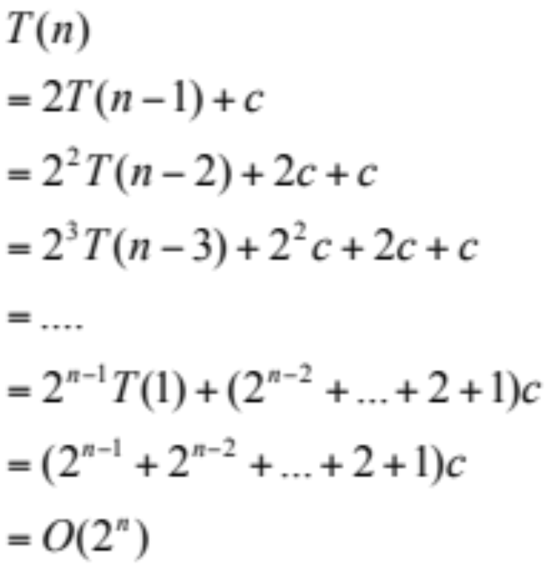
Example: Hanoi Towers
Hanoi(n,A,B,C) =
Hanoi(n-1,A,C,B)+Hanoi(1,A,B,C)+Hanoi(n-1,C,B,A)

Slide 65
Worst Case, Best Case, and Average Case
template<class T>
void SelectionSort(T a[], int n)
{
for (int size=n; (size>1); size--) {
int pos = 0;
// find largest
for (int i = 1; i < size; i++)
if (a[pos] <= a[i]) pos = i;
Swap(a[pos], a[size - 1]);
}
}
// Early-terminating version of selection sort
bool sorted = false;
!sorted &&
sorted = true;
else sorted = false; // out of order
Worst Case
Best Case

Slide 66
c f(N)
T(N)
n₀
f(N)
T(N)=O(f(N))
T(N)=6N+4 : n0=4 and c=7, f(N)=N
T(N)=6N+4 <= c f(N) = 7N for N>=4
7N+4 = O(N)
15N+20 = O(N)
N²=O(N)?
N log N = O(N)?
N log N = O(N²)?
N² = O(N log N)?
N¹⁰ = O(2^{N})?
6N + 4 = W(N) ? 7N? N+4 ? N²? N log N?
N log N = W(N²)?
3 = O(1)
1000000=O(1)
Sum i = O(N)?

Slide 67
An Analogy: Cooking Recipes
Algorithms are detailed and precise instructions.
Example: bake a chocolate mousse cake.
  Convert raw ingredients into processed output.
  Hardware (PC, supercomputer vs. oven, stove)
  Pots, pans, pantry are data structures.
Interplay of hardware and algorithms
  Different recipes for oven, stove, microwave etc.
New advances.
  New models: clusters, Internet, workstations
  Microwave cooking, 5-minute recipes, refrigeration

Slide 68
A real-world Problem
Communication in the Internet
Message (email, ftp) broken down into IP packets.
Sender/receiver identified by IP address.
The packets are routed through the Internet by special computers called Routers.
Each packet is stamped with its destination address, but not the route.
Because the Internet topology and network load is constantly changing, routers must discover routes dynamically.
What should the Routing Table look like?

Slide 69
IP Prefixes and Routing
Each router is really a switch: it receives packets at several input ports, and appropriately sends them out to output ports.
Thus, for each packet, the router needs to transfer the packet to that output port that gets it closer to its destination.
Should each router keep a table: IP address x Output Port?
How big is this table?
When a link or router fails, how much information would need to be modified?
A router typically forwards several million packets/sec!

Slide 70
Data Structures
The IP packet forwarding is a Data Structure problem!
Efficiency, scalability is very important.
Similarly, how does Google find the documents matching your query so fast?
Uses sophisticated algorithms to create index structures, which are just data structures.
Algorithms and data structures are ubiquitous.
With the data glut created by the new technologies, the need to organize, search, and update MASSIVE amounts of information FAST is more severe than ever before.

Slide 71
Algorithms to Process these Data
Which are the top K sellers?
Correlation between time spent at a web site and purchase amount?
Which flows at a router account for > 1% traffic?
Did source S send a packet in last s seconds?
Send an alarm if any international arrival matches a profile in the database
Similarity matches against genome databases
Etc.

Slide 72
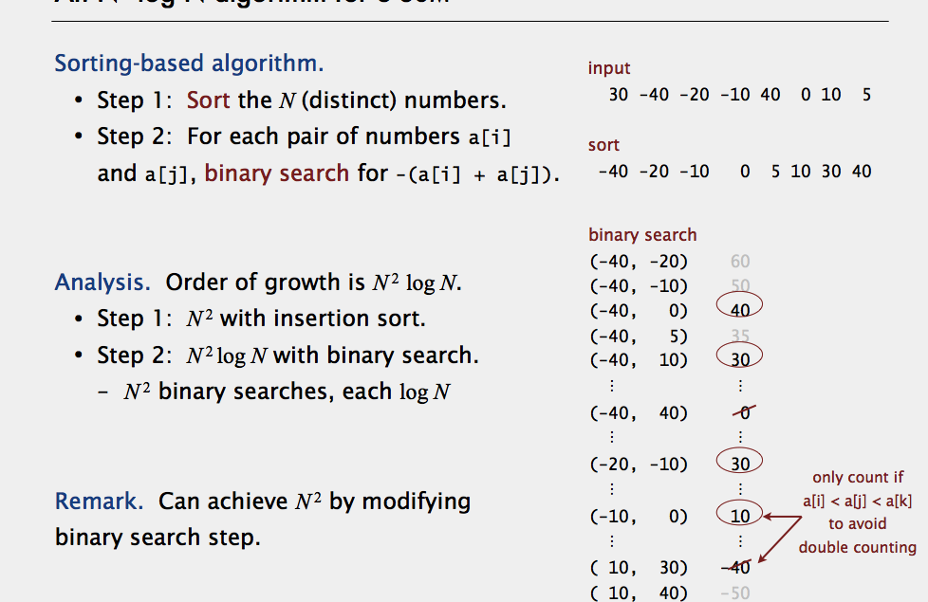

Slide 73
Administrative Details
Grade Composition
  30%: Written homework assignments:
  30%: Programming assignments
  40%: In-class exams
Discussion Sections
Policies:
  Late assignments not allowed.
  Cheating and plagiarism: F grade and disciplinary actions

Slide 74
Special Announcements
Each CS student should fill out this survey by Tuesday COB at the latest:
https://www.surveymonkey.com/s/UCSBCSAdvisingSurvey
If they do not fill it out and have not turned in their form, we will place a HOLD on their registration for next quarter.
We are using this process to ensure that all upper division students receive advising and complete their senior elective form (required for graduation and also for our ABET review).
Students should see Benji or Sheryl in the CS office to have the hold removed.

Slide 75
ABET Visit, Nov 3

Slide 76
Examples
Vector addition Z = A+B
  for (int i=0; i<n; i++)
    Z[i] = A[i] + B[i];
  T(n) = c n
Vector (inner) multiplication z =A*B
  z = 0;
  for (int i=0; i<n; i++)
    z = z + A[i]*B[i];
  T(n) = c’ + c₁ n

Slide 77
Examples
Vector (outer) multiplication Z = A*B^{T}
  for (int i=0; i<n; i++)
  for (int j=0; j<n; j++)
  Z[i,j] = A[i] * B[j];
  T(n) = c₂ n²;
A program does all the above
  T(n) = c₀ + c₁ n + c₂ n²;

Slide 78
Simplifying the Bound
T(n) = c_{k} n^{k} + c_{k-1} n^{k-1} + c_{k-2} n^{k-2} + … + c₁ n + c_{o}
  too complicated
  too many terms
  Difficult to compare two expressions, each with 10 or 20 terms
Do we really need that many terms?

Slide 79
Simplifications
Keep just one term!
  the fastest growing term (dominates the runtime)
No constant coefficients are kept
  Constant coefficients affected by machines, languages, etc.
Asymtotic behavior (as n gets large) is determined entirely by the leading term.
  Example. T(n) = 10 n³ + n² + 40n + 800
    If n = 1,000, then T(n) = 10,001,040,800
    error is 0.01% if we drop all but the n³ term
  In an assembly line the slowest worker determines the throughput rate

Slide 80
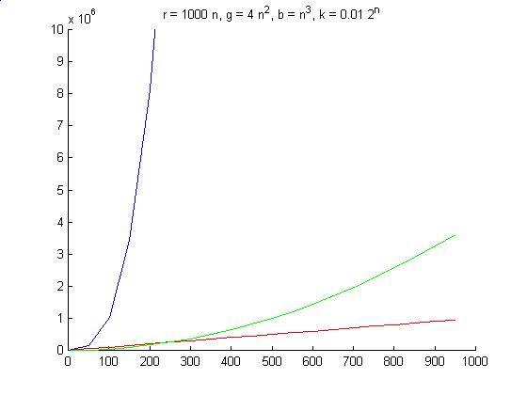
Simplification
Drop the constant coefficient
  Does not effect the relative order

Slide 81
Simplification
The faster growing term (such as 2^{n}) eventually will outgrow the slower growing terms (e.g., 1000 n) no matter what their coefficients!
Put another way, given a certain increase in allocated time, a higher order algorithm will not reap the benefit by solving much larger problem

Slide 82
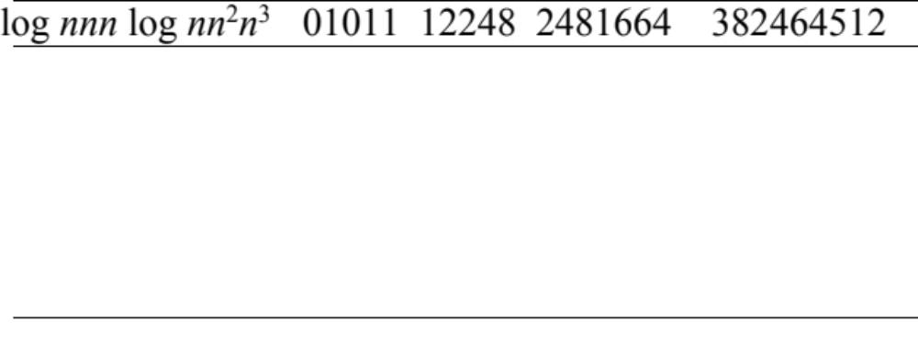
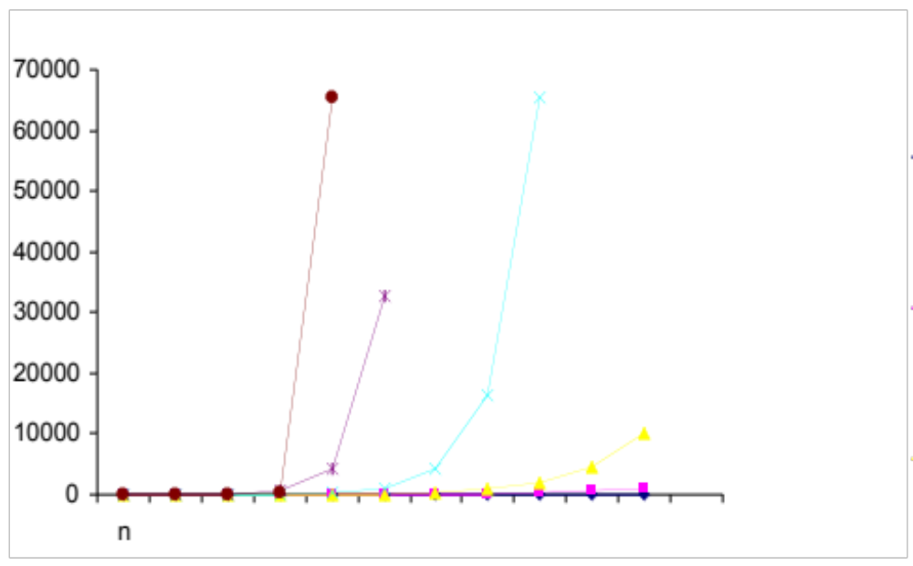
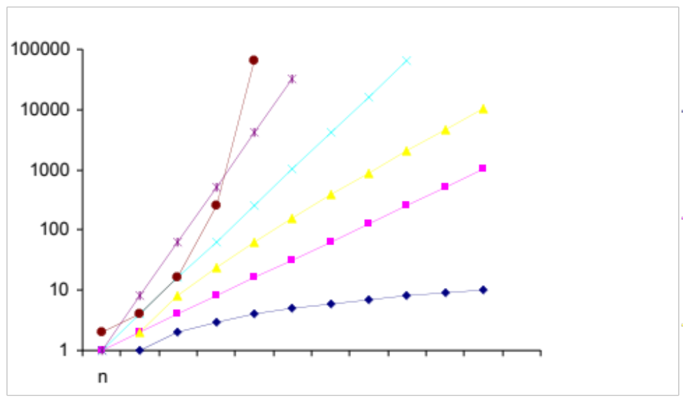
2^{n}
n²
2^{n}
n³
n²
n log n
n³
n
n log n
log n
n
log n

Slide 83
Another View
More resources (time and/or processing power) translate into large problems solved if complexity is low
T(n) | Problem size solved in 10³ sec | Problem size solved in 10⁴ sec | Increase in Problem size
100n | 10 | 100 | 10
1000n | 1 | 10 | 10
5n² | 14 | 45 | 3.2
N³ | 10 | 22 | 2.2
2^{n} | 10 | 13 | 1.3

Slide 84
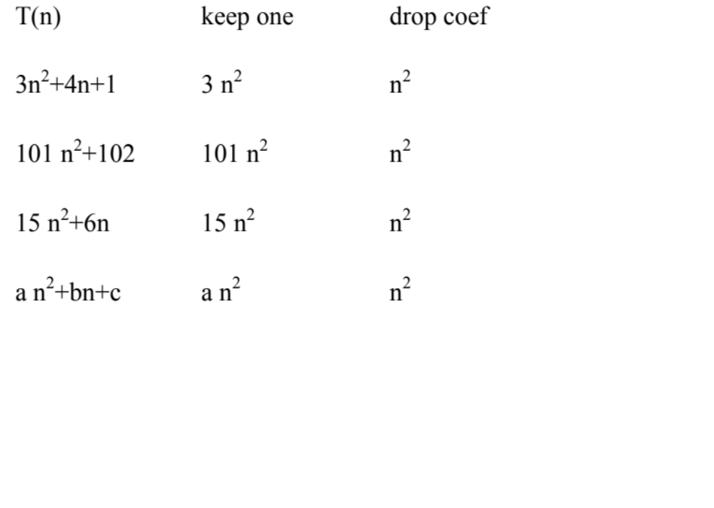
Asympotics
They all have the same “growth” rate

Slide 85
Caveats
Follow the spirit, not the letter
  a 100n algorithm is more expensive than n² algorithm when n < 100
Other considerations:
  a program used only a few times
  a program run on small data sets
  ease of coding, porting, maintenance
  memory requirements

