Slide 1
Kernel-Heap

Slide 2
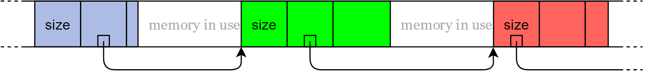
Verkettete Liste

Slide 3
Implementierung
linked_list_allocator
Windows
GlobalAlloc
LocalAlloc
HeapAlloc
VirtualAlloc
Linux
MMAP
SLAB
.Net
Large Object Heap
Small Object heap
BSD
uma
C
Malloc
Unix
sbreak

Slide 4
Strategien
Probleme:
Laufzeit
Fragmentierung
Overhead
Eigener Allocator
HeartBleed Bug
Strategien
Best Fit
Worst Fit
First Fit
Implementierungen
Linked List
B-Tree
Region Maps
Darwin
Frame Bitmap

Slide 5
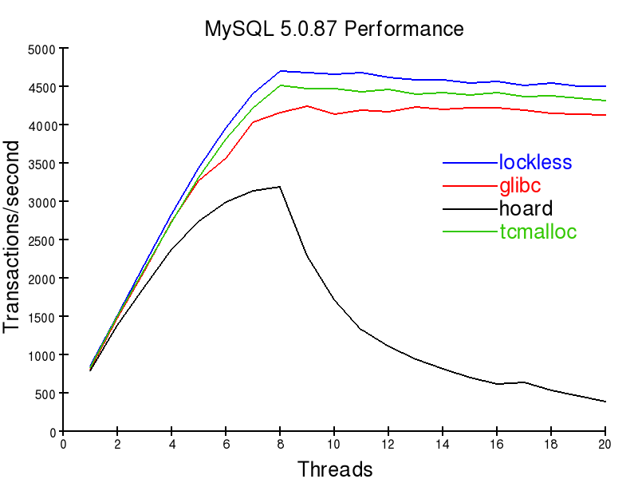

(Heap)Allocator -> Eigenes Forschungsthema

