Slide 1
NSG Pilkington Consultancy Project
Dr Peter L Green
Senior Lecturer
School of Engineering
p.l.green@Liverpool.ac.uk
13/05/2020

Slide 2
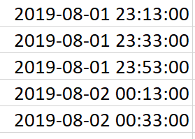
Fault Scanner Data
Used data from MK4 Fault Scanner
ISRA 5D Fault Scanner Data was empty so was unable to use this data in the current project.
No missing data from the MK4 Fault Scanner
Date format for MK4 Fault Scanner:
year / month / day / hour / minute / seconds:

Slide 3
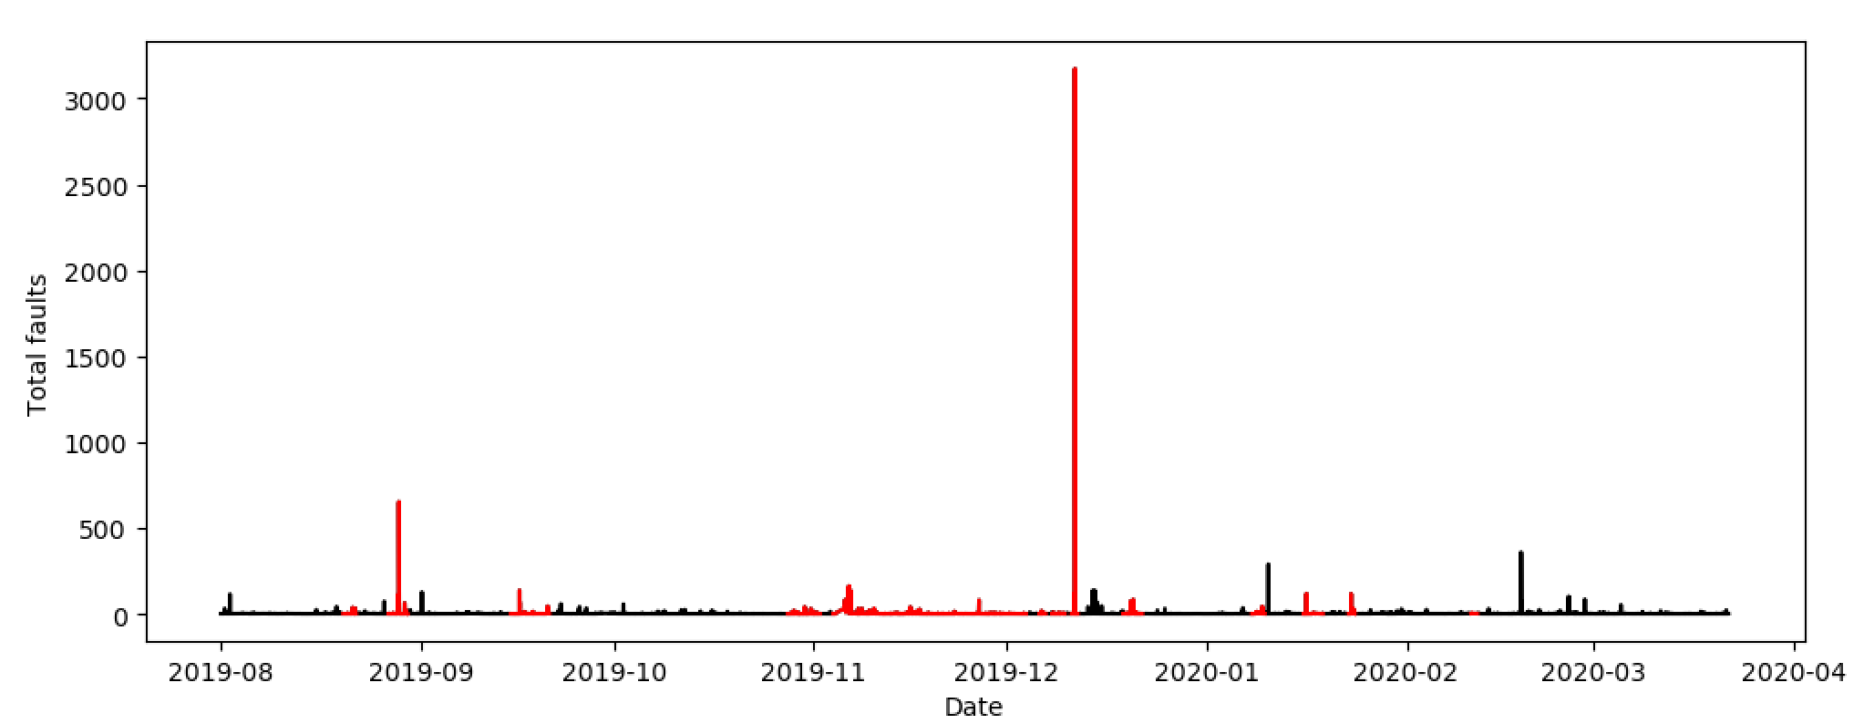
Fault Scanner Data
Here we try to predict ‘total faults’ (from MK4 Fault scanner).
Red regions indicate exclusion periods, where data is unreliable.

Slide 4
Fault Scanner Data
Initial analysis focused on this region (21/09/19 – 25/10/19)

Slide 5
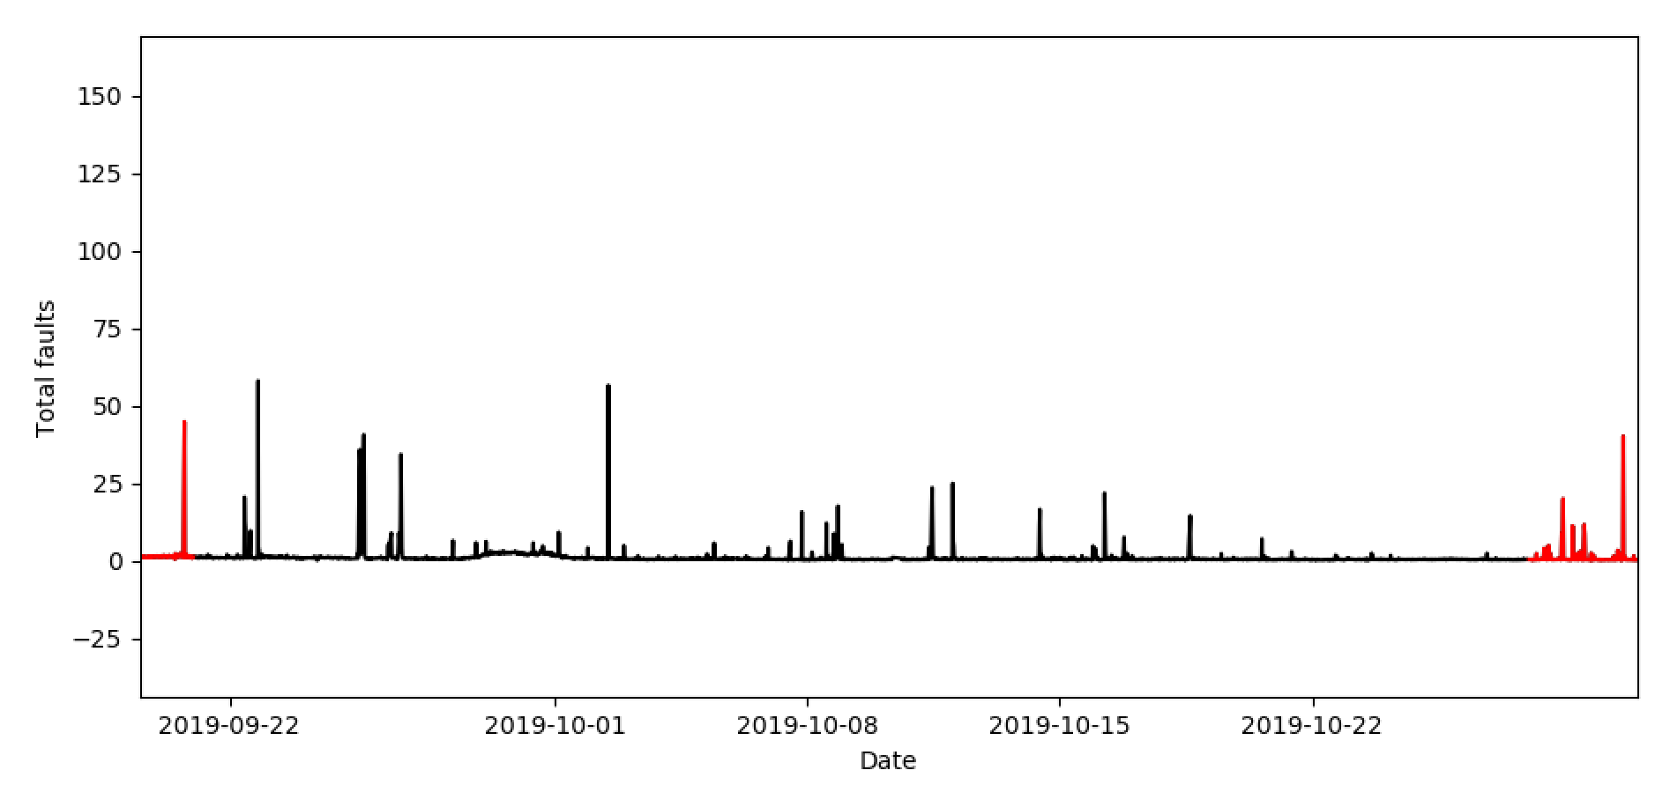
Fault Scanner Data
Initial analysis focused on this region (21/09/19 – 25/10/19)

Slide 6
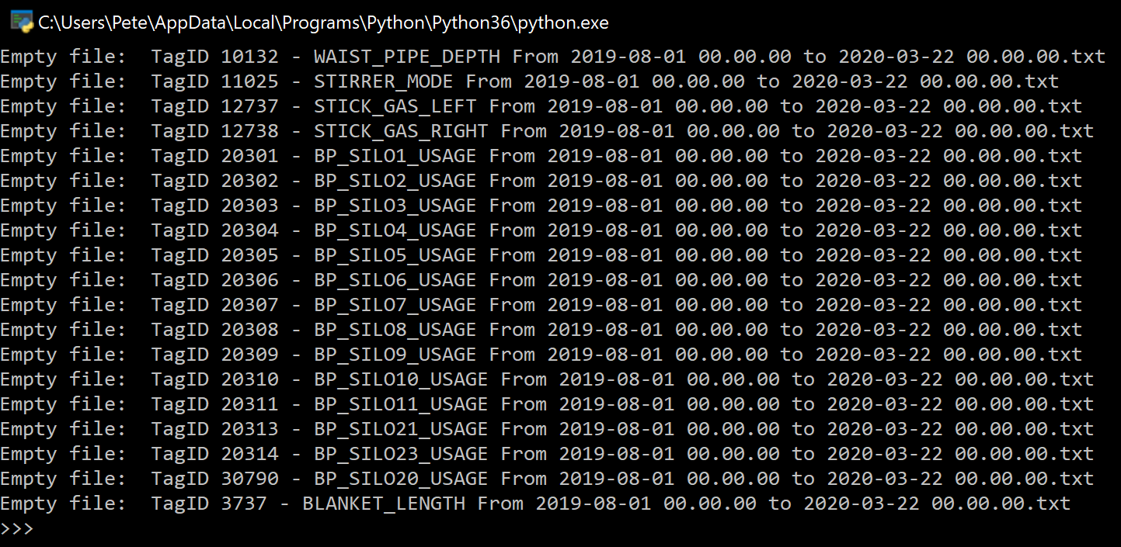
Tag Data
The following files were found to be empty:

Slide 7
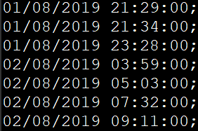
Tag Data
All had time stamps in the format:
Day-Month-Year-Hour-Minute-Seconds
We go down to second-by-second resolution, otherwise multiple readings get assigned to the same timestamp.

Slide 8
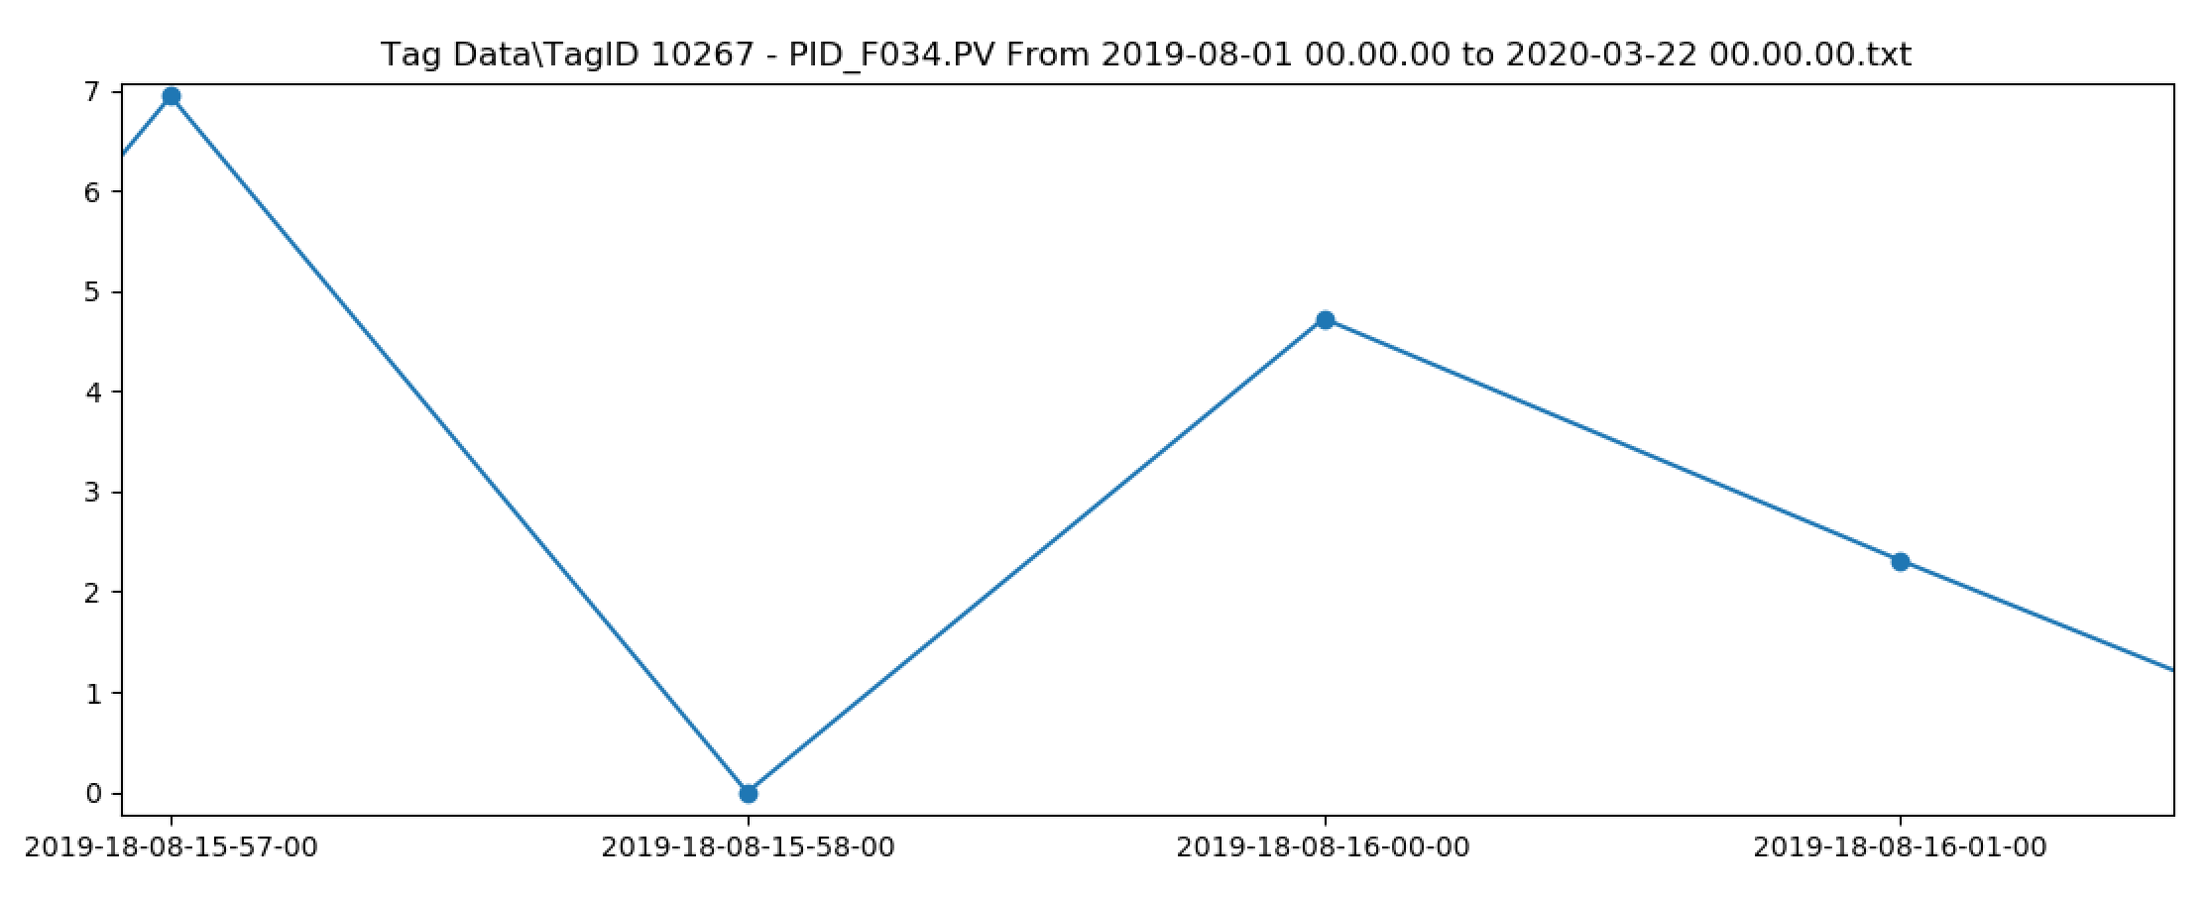
Tag Data
Example Tag Data:

Slide 9
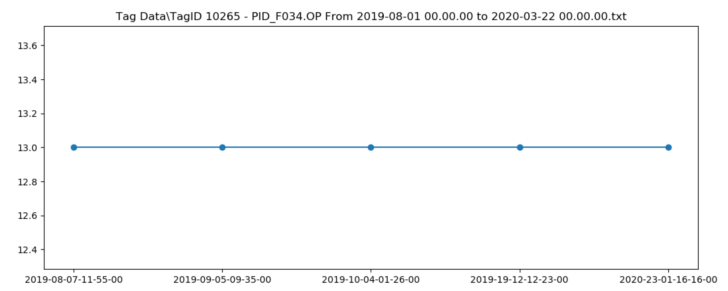
Tag Data
In some files, nothing is happening.

Slide 10
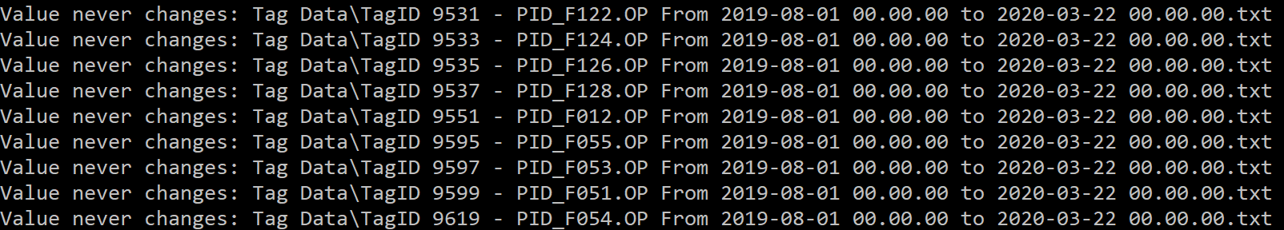
Tag Data
In some files, a lot is happening:
In the pre-processing we:
Include any files that are over 1KB (because something must be happening)
Remove files under 1KB, where the sensor reading never changes. These won’t give us any predictive capability.
Remove highly correlated inputs data.

Slide 11
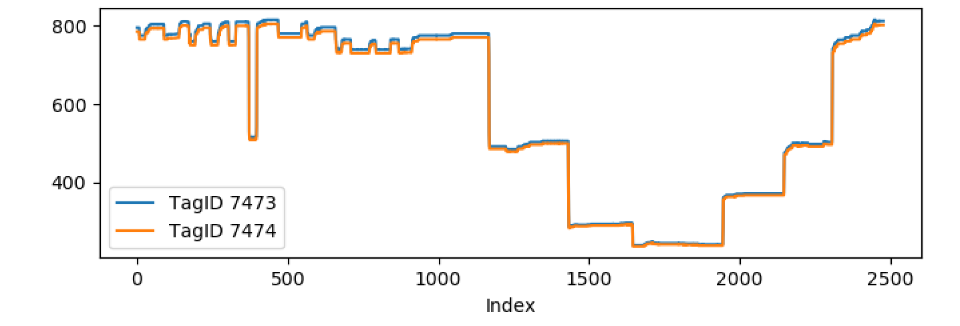
Tag Data
An example of some highly correlated ‘tag data’:
These correspond to ‘Lehr Drive 1 Speed’ and ‘Lehr Drive Line Shaft Speed’.
In this case, for example, we only need to retain data from one of these sensors.

Slide 12
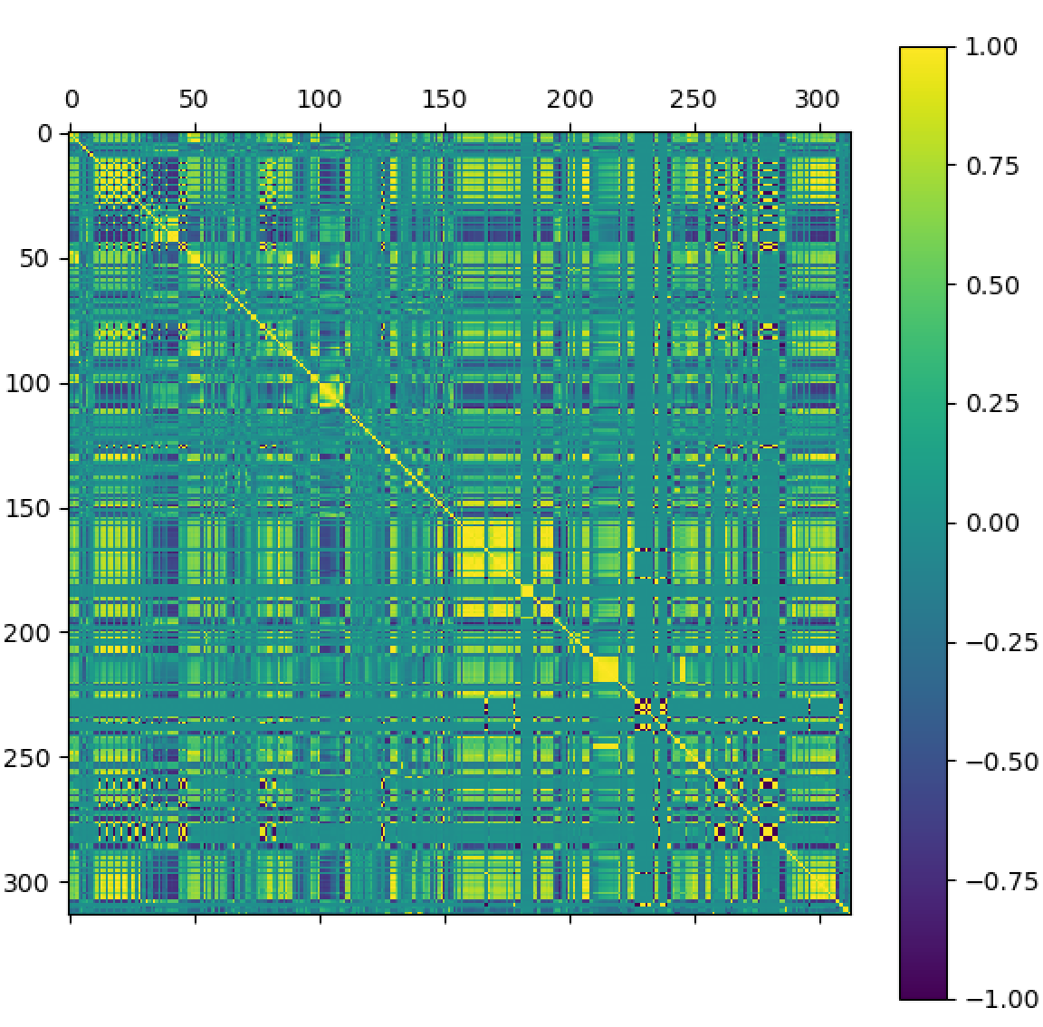
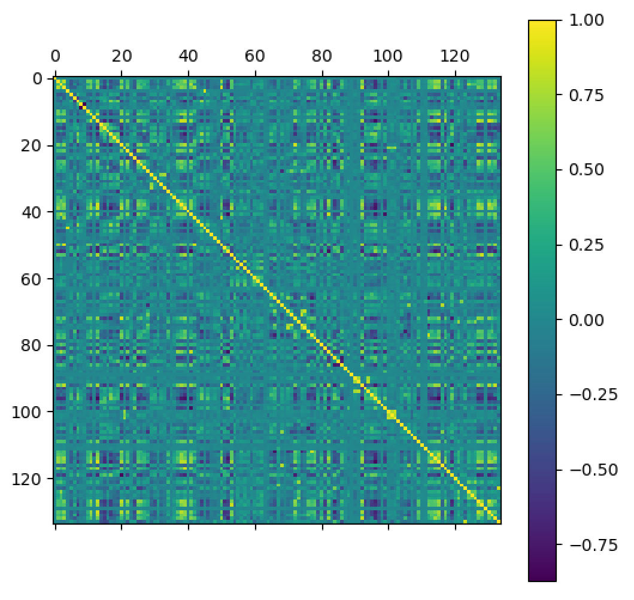
Tag Data
Correlation matrix before correlated data was removed.

Slide 13
Tag Data
Correlation matrix after correlated data was removed.
Data from 134 sensors used as predictors.

Slide 14
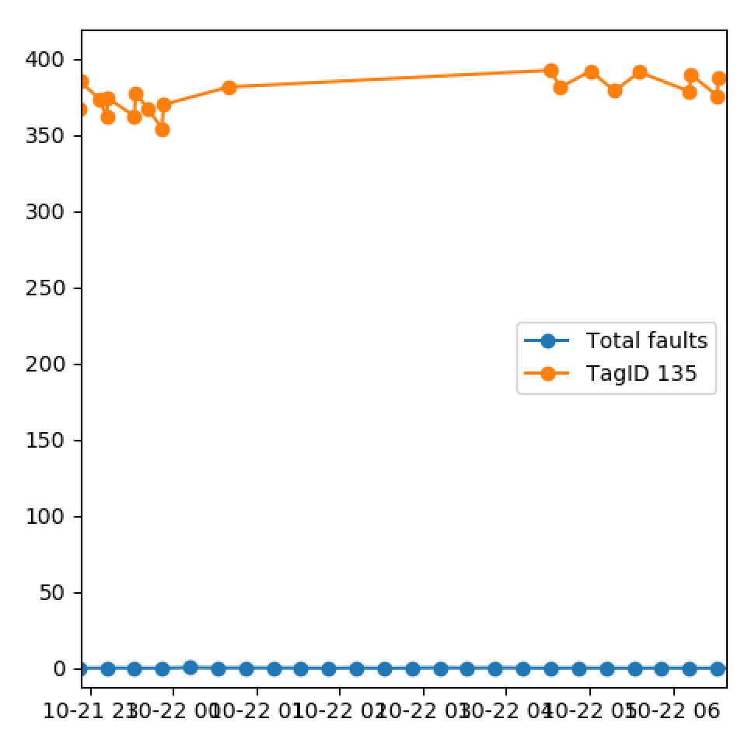
Combining Tag and Fault Data
Tag data only recorded if there’s a change (mostly!)
Need to set Tag data at specific time equal to closest previous fault reading.

Slide 15
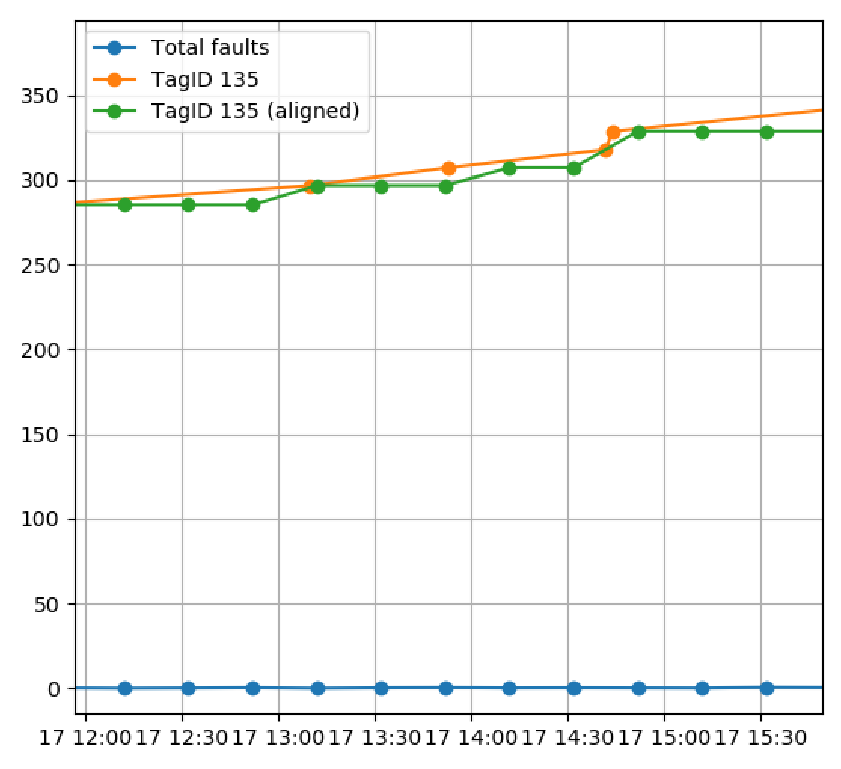
Combining Tag and Fault Data
Tag data only recorded if there’s a change (mostly!)
Need to set Tag data at specific time equal to closest previous reading.
Note we could also try linear interpolation at a later stage.

Slide 16
Combining Tag and Fault Data
This ‘pre-processing step was conducted for all of the remaining Tag data.
Results combined into a single .csv file.
Took a relatively long time to process (a few hours)
This could definitely be sped up in the future (but is a secondary issue).
The approach taken here was ‘programmer friendly’ but not necessarily ‘computer friendly’.

Slide 17
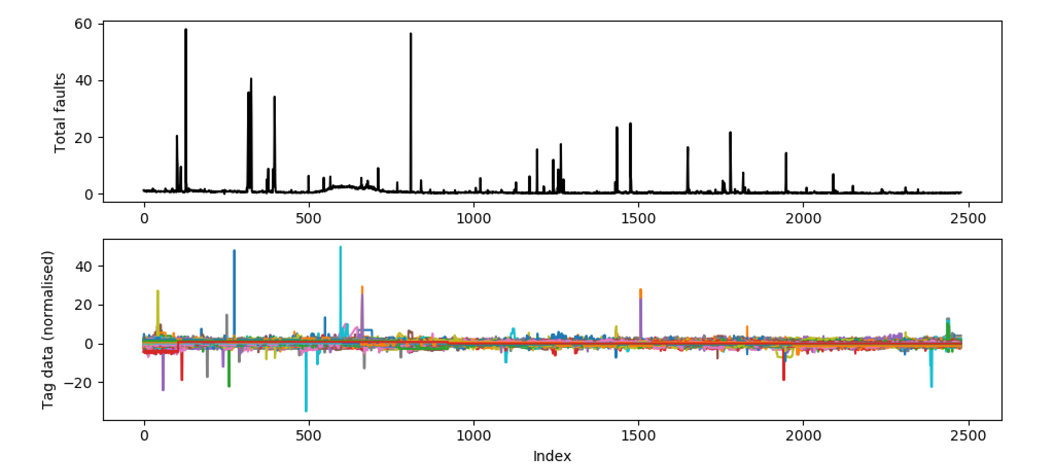
Combining Tag and Fault Data

Slide 18
Combining Tag and Fault Data
Why the large spikes? Compressed air injected into the coating beam (for cleaning)?
Note that the tag data was normalised

Slide 19

Linear Regression
Always start with something simple:
$$y_{t}=θ_{1}x_{1,t}+θ_{2}x_{2,t}+…+θ_{N}x_{N,t}$$

Slide 20

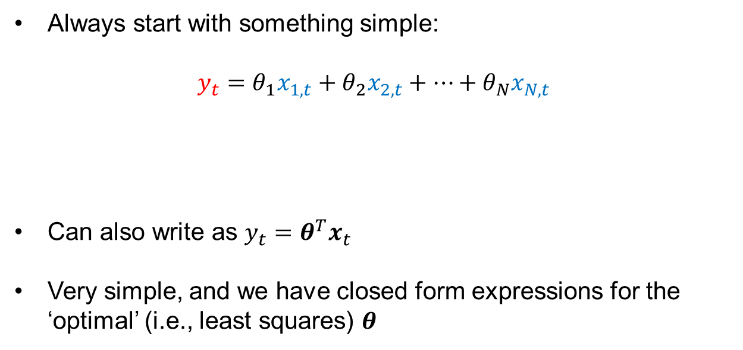

Linear Regression
Always start with something simple:
$$y_{t}=θ_{1}x_{1,t}+θ_{2}x_{2,t}+…+θ_{N}x_{N,t}$$
Can also write as $y_{t}=θ^{T}x_{t}$
Very simple, and we have closed form expressions for the ‘optimal’ (i.e., least squares) $θ$
Total faults at time $t$
Tag data at time $t$

Slide 21
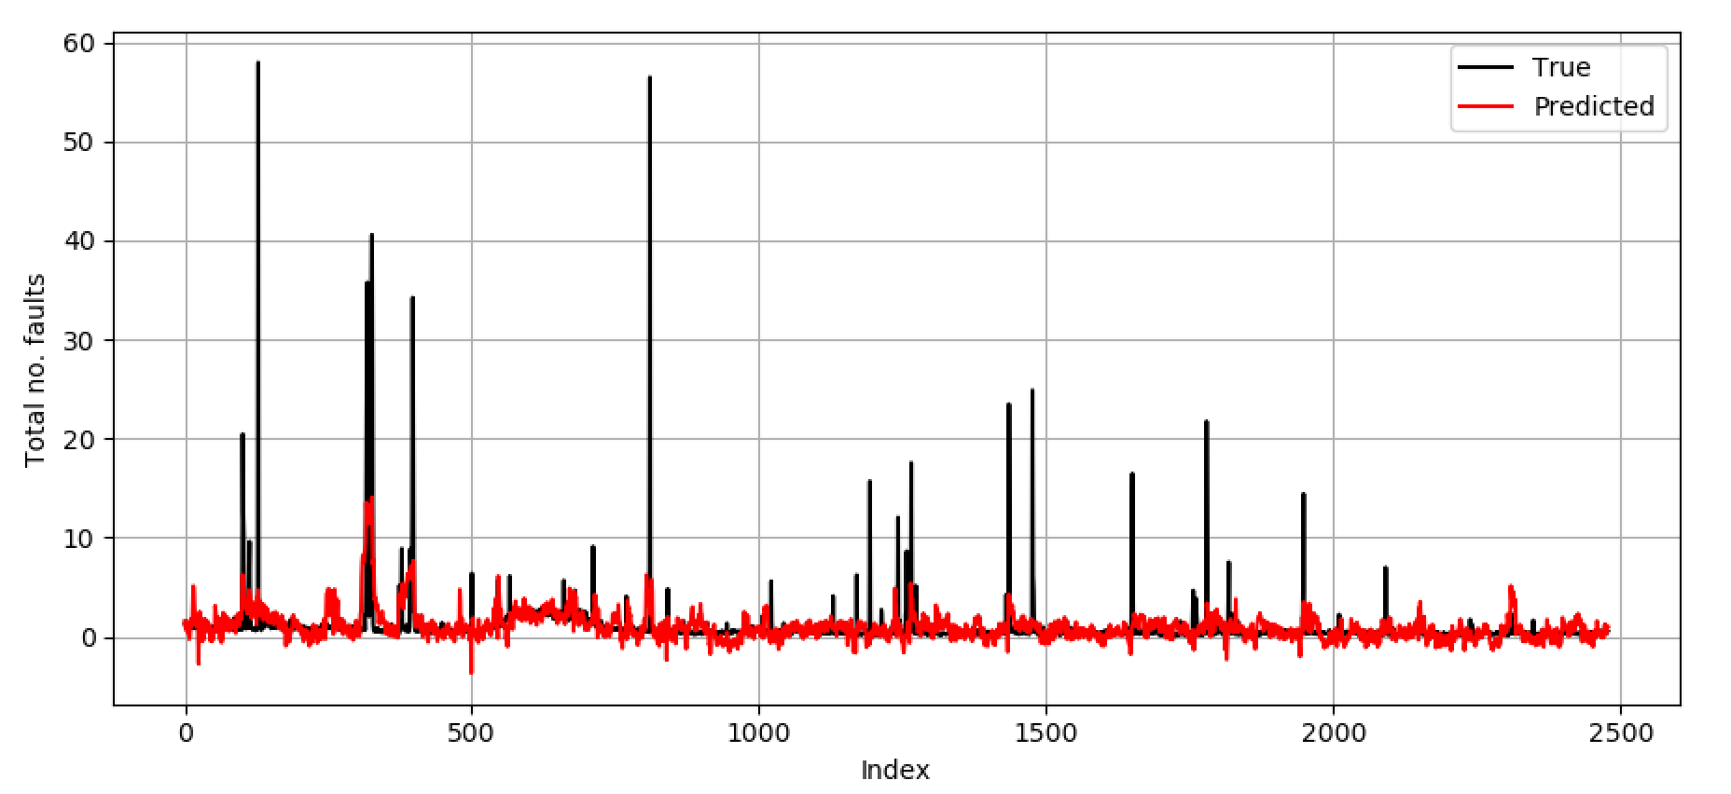
Linear Regression

Slide 22
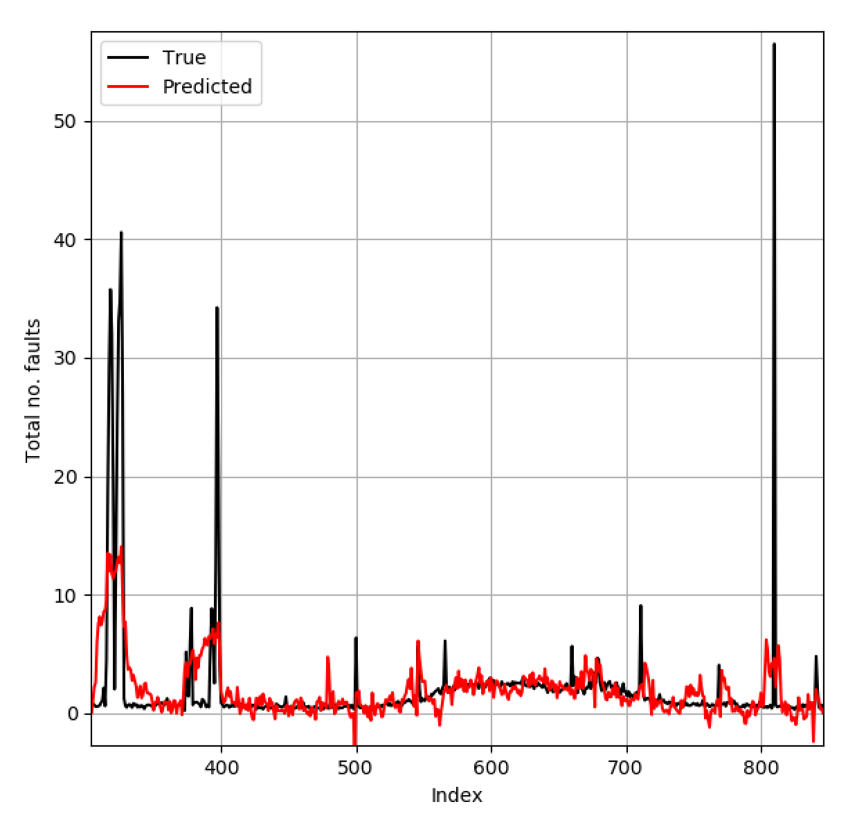
Linear Regression
Seems to capture main trends, large spikes are not captured.

Slide 23
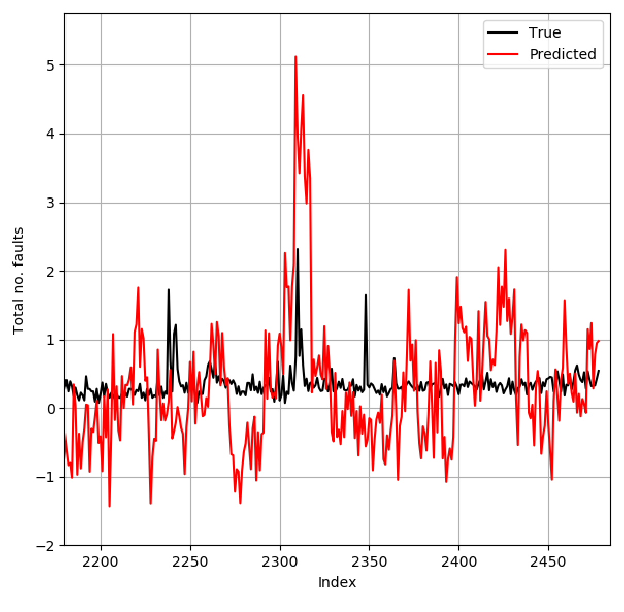
Linear Regression
Very noisy… tag data needs filtering?

Slide 24
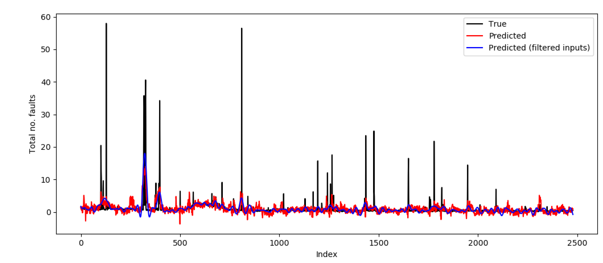
Linear Regression
Tag data was passed through a low-pass filter (twice,so no phase difference) and linear regression was performed again.

Slide 25
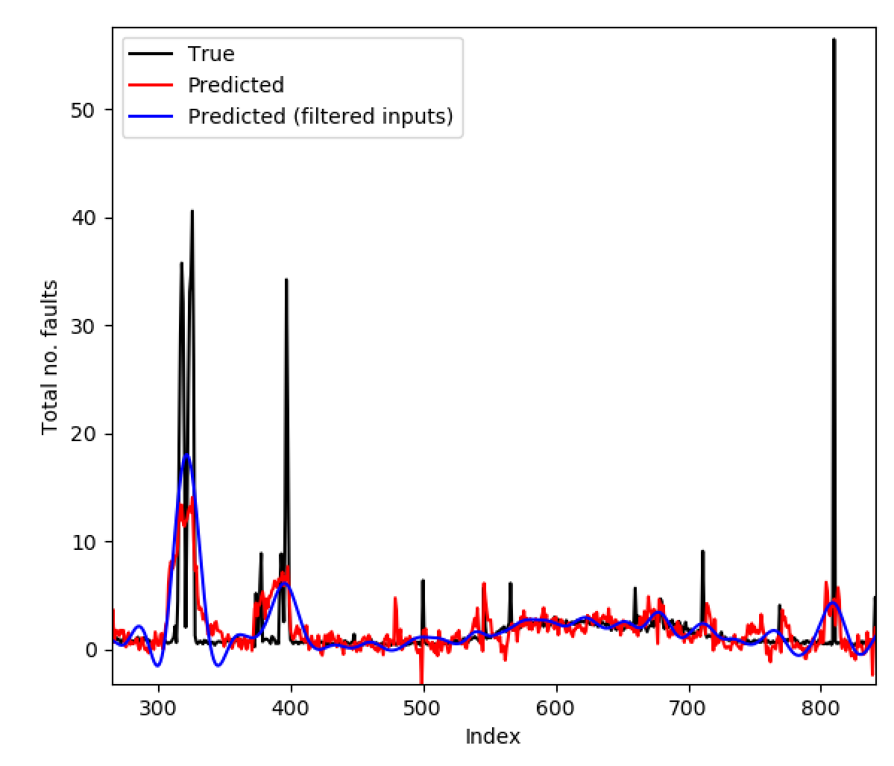
Linear Regression
Predictions are much less noisy, but still cannot capture ‘spikes’ in total fault data.

Slide 26
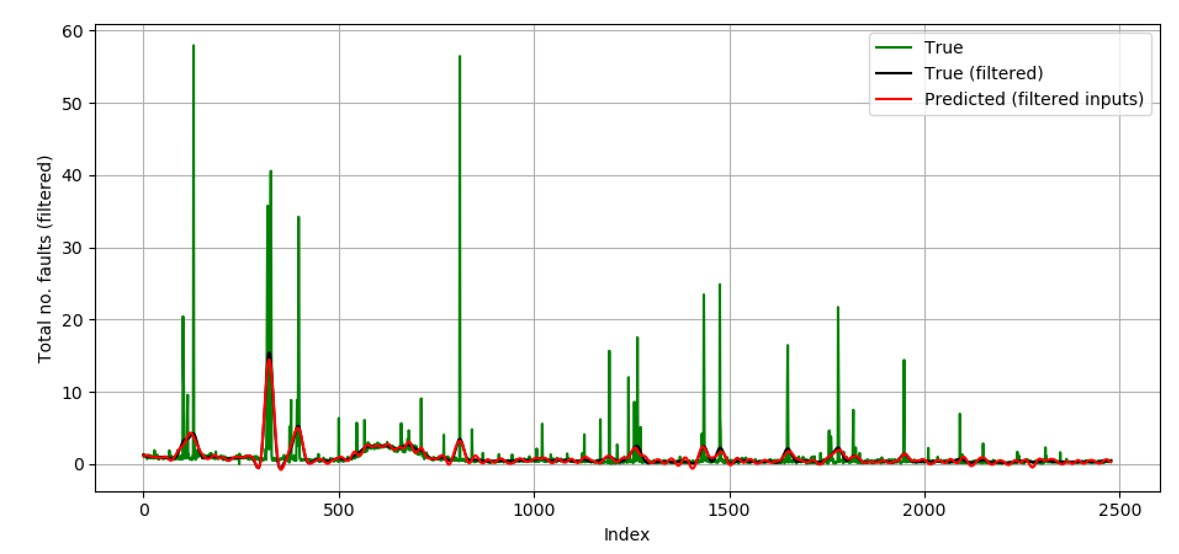
Linear Regression
Tried passing fault data through the same filter.
So, now, both inputs and outputs are filtered.

Slide 27
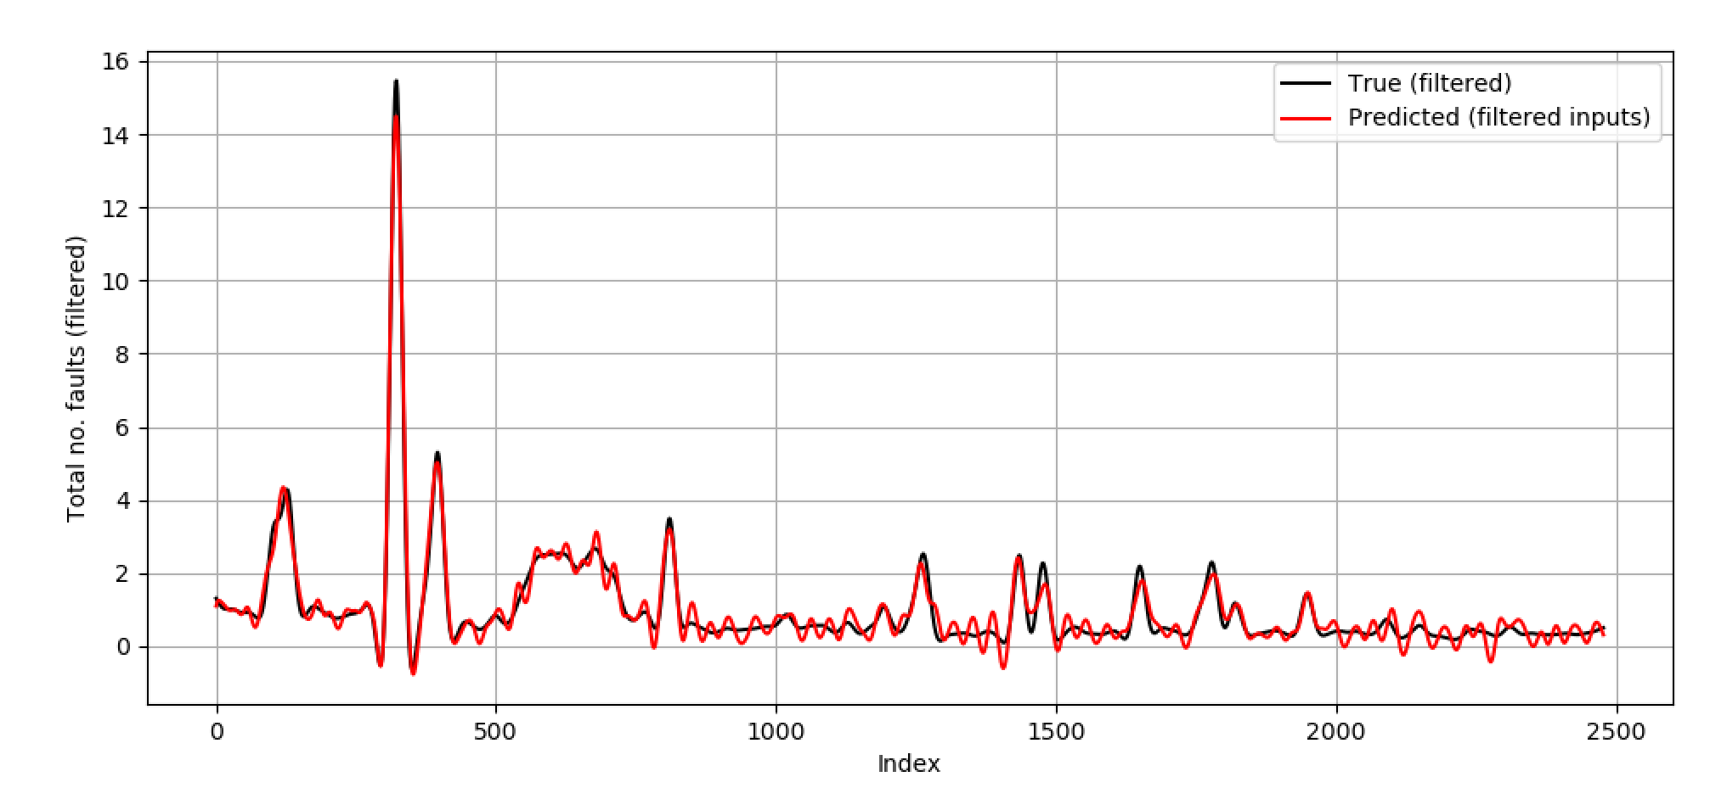
Linear Regression
Predictions are now excellent.
There is a linear relationship between the low frequency components of the tag data and the fault data.

Slide 28
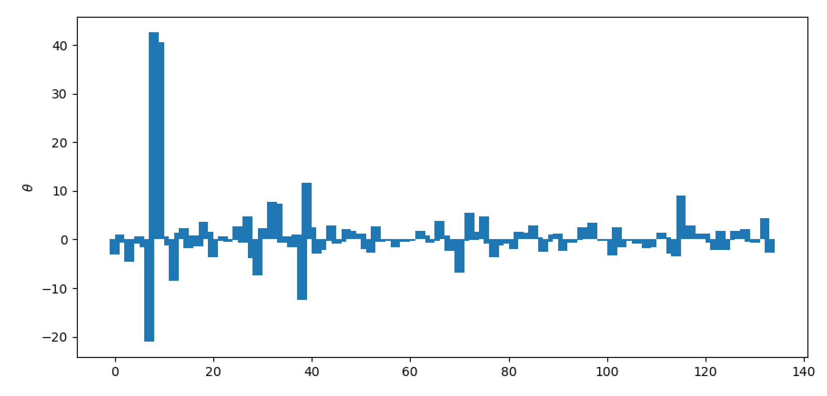

Linear Regression
The optimal parameters, $θ$
Already an interpretable approach – could also try removing some of these inputs in the future and seeing if predictive performance changes.
Can quantify uncertainties over $θ$, but decided that was a secondary goal at this point.

Slide 29
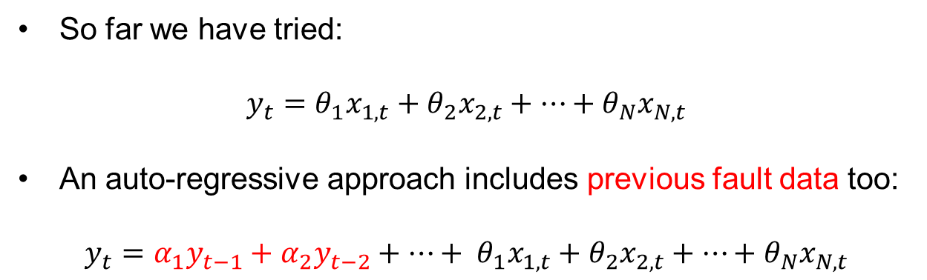
Linear Regression (auto-regressive)
So far we have tried:
$$y_{t}=θ_{1}x_{1,t}+θ_{2}x_{2,t}+…+θ_{N}x_{N,t}$$
An auto-regressive approach includes previous fault data too:
$$y_{t}={{α_{1}y}_{t−1}+α_{2}y_{t−2}+…+ θ}_{1}x_{1,t}+θ_{2}x_{2,t}+…+θ_{N}x_{N,t}$$

Slide 30
Linear Regression (auto-regressive)
So far we have tried:
$$y_{t}=θ_{1}x_{1,t}+θ_{2}x_{2,t}+…+θ_{N}x_{N,t}$$
An auto-regressive approach includes previous fault data too:
$$y_{t}={{α_{1}y}_{t−1}+α_{2}y_{t−2}+…+ θ}_{1}x_{1,t}+θ_{2}x_{2,t}+…+θ_{N}x_{N,t}$$
When predicting more than one step into the future, the inputs to the model become its own previous predictions. Potentially allows for predictions further into the future.

Slide 31
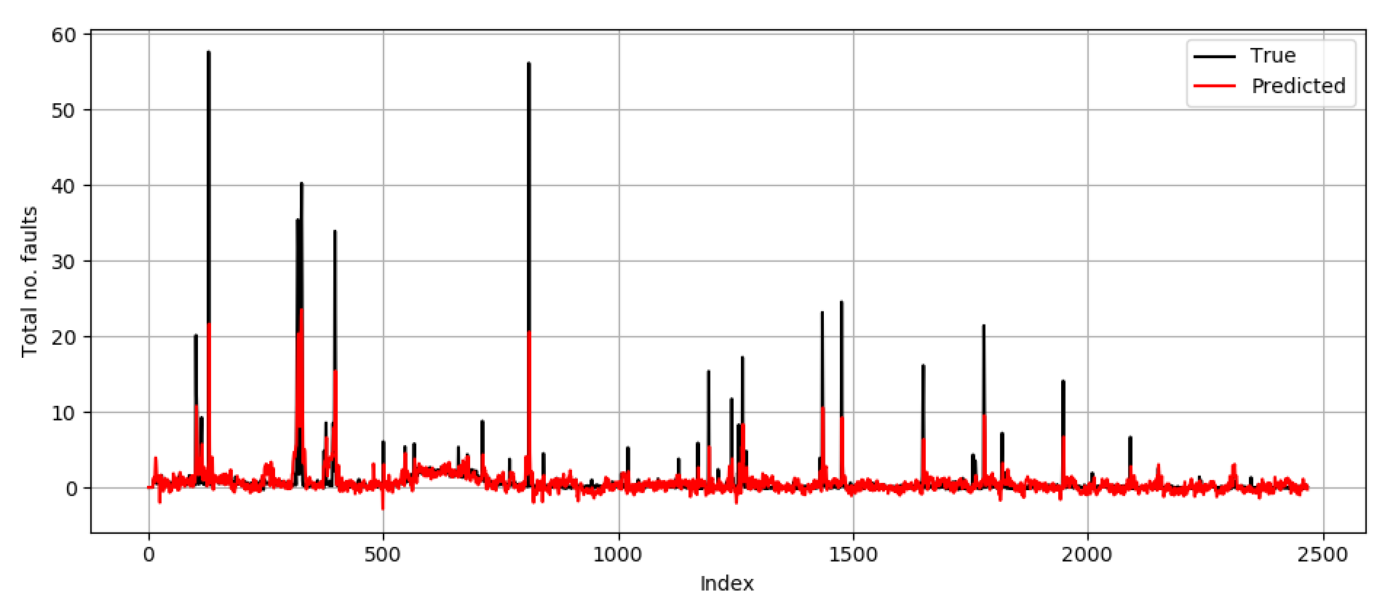
Linear Regression (auto-regressive)
Auto-regressive model applied to (unfiltered) data.
Initial results look promising, but …

Slide 32
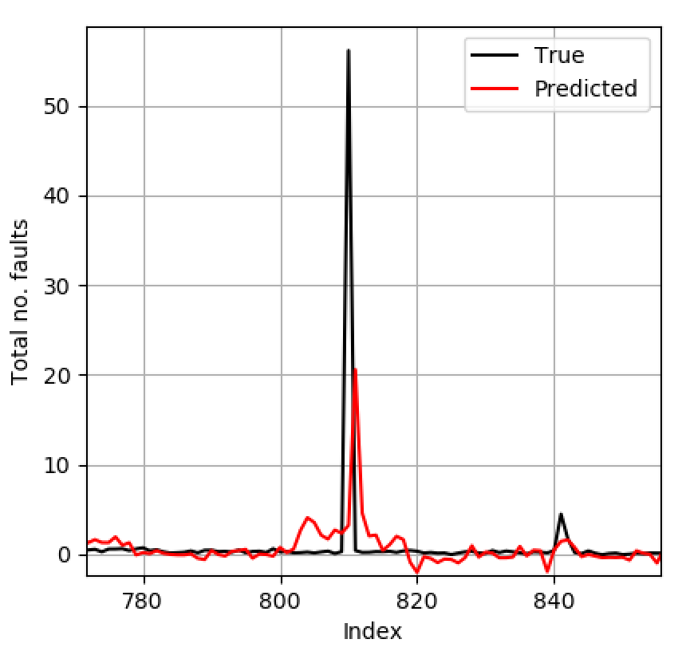
Linear Regression (auto-regressive)
Predictions of ‘spikes’ always lag behind them actually occurring.

Slide 33
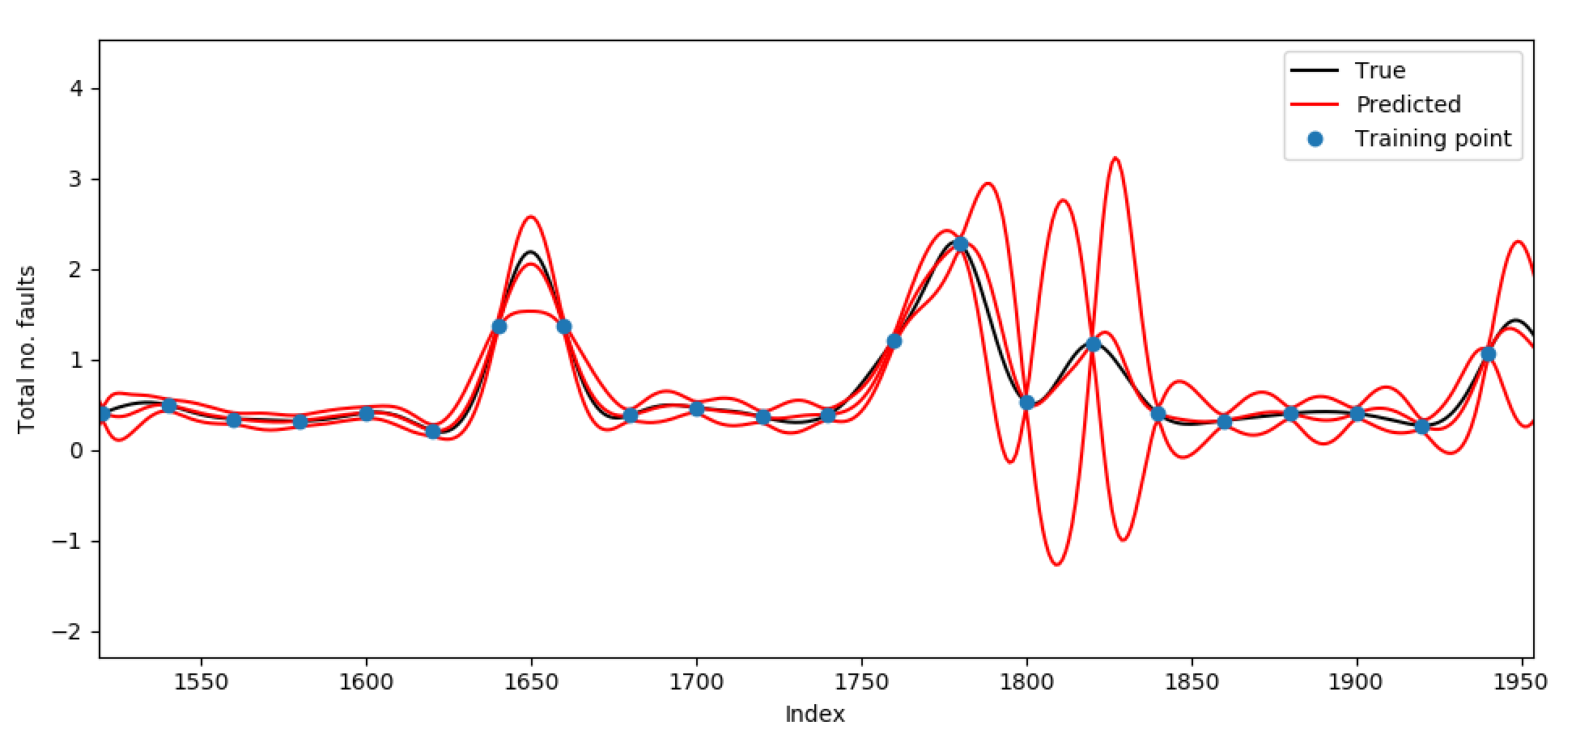
Gaussian Process Regression
An example of a much more ‘advanced’ approach.
Automatically outputs confidence bounds based on whether the tag data it is presented with, is similar to tag data it has seen before.

Slide 34
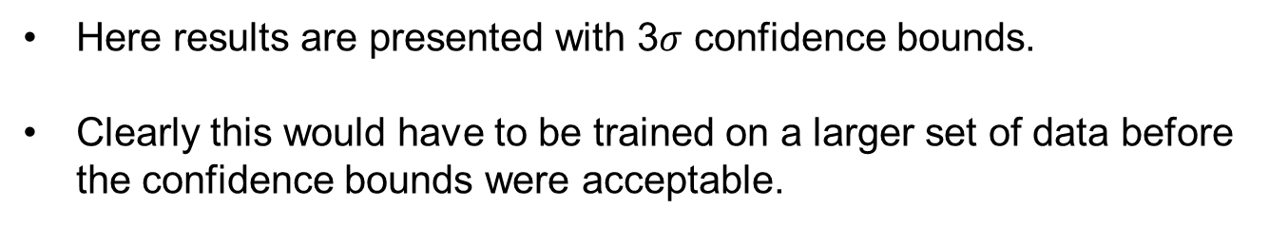
Gaussian Process Regression
Here results are presented with 3$σ$ confidence bounds.
Clearly this would have to be trained on a larger set of data before the confidence bounds were acceptable.

Slide 35
Questions and Next Steps
Was filtering the right thing to do? Certainly uncovered an interesting relationship between the low frequency components of the data.
We can used methods much more advanced than linear regression (GP, for example) – do we need to?
Autoregressive model applied to filtered data?
We can also try using ‘lagged’ tag data to aid predictions.
Alternatively, we can simply investigate mapping directly to future fault data.

Slide 36
Questions and Next Steps
So far our models have fixed parameters. We can try having time-varying parameters – applicable if furnace conditions are fundamentally changing over time.
Linear regression is very interpretable – can think about the best way to present how this model is realising predictions.
Uncertainty quantification can be ‘folded’ into all of these approaches.

Slide 37
Thank you for your attention. ANY QUESTIONS?
Dr Peter L Green
p.l.green@liverpool.ac.uk

