Slide 1

NSG Pilkington – University of Liverpool Machine Learning Project
Dr. Peter Green
Diego Echeverria
Risk Institute,
School of Engineering
07/07/2020

Slide 2
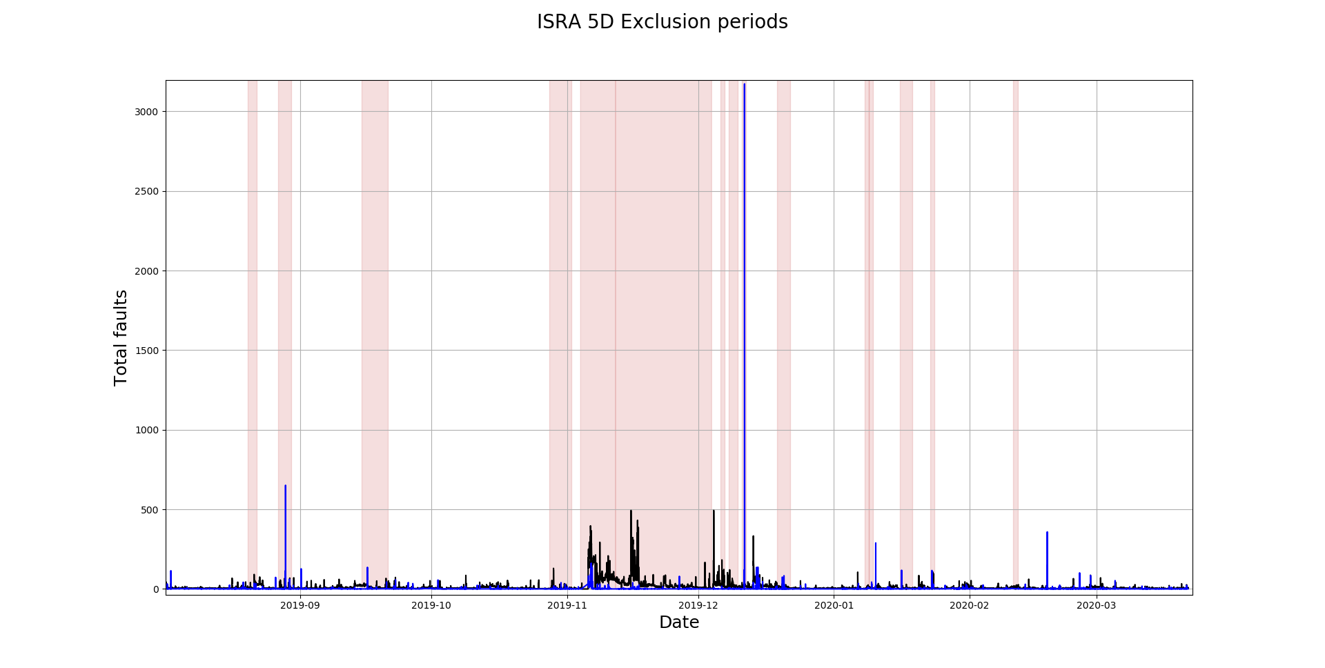
Exclusion Periods: ISRA 5D and MK4 data
Exclusion Periods
ISRA 5D
MK4

Slide 3
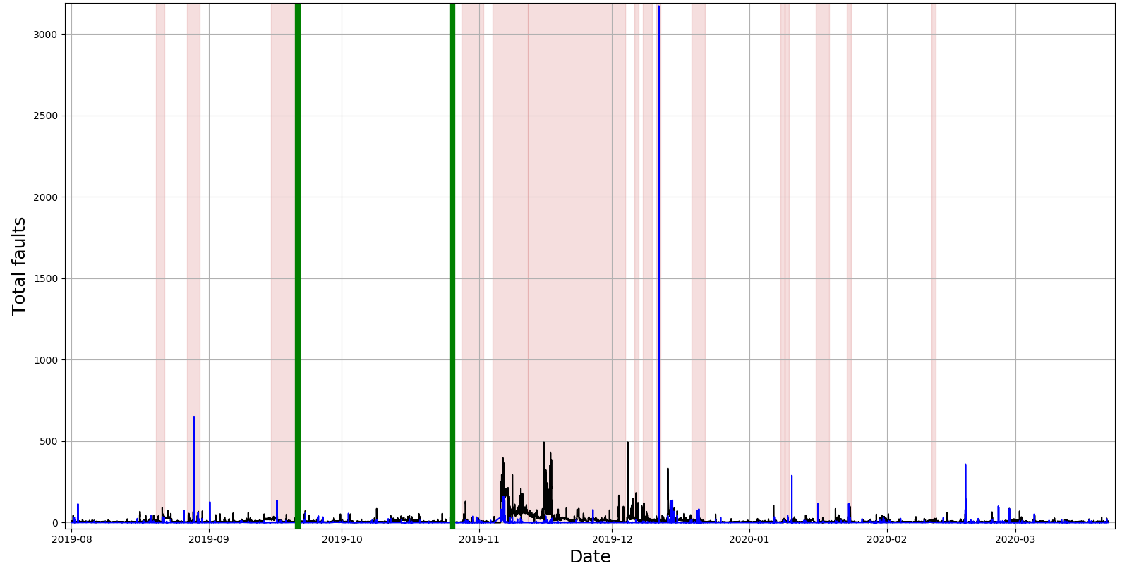
Exclusion Periods: ISRA 5D and MK4 data
Exclusion Periods
ISRA 5D
MK4
Initial analysis: region (21/09/19 – 25/10/19)

Slide 4
MK4 data
Excel file: UK5 Data Set Definitions and Data Sets
2019-10-03 05:10:00
2019-10-03 05:30:00
2019-10-03 05:50:00
2019-10-03 06:10:00
2019-10-03 06:32:00
2019-10-03 06:52:00
2019-10-03 07:12:00
2019-10-03 07:32:00
2019-10-03 07:52:00
Steps of 20 minutes:
Starts at:
hh:10:00
Steps of 20 minutes:
Starts at:
hh:12:00
The delay occurred in the time region: 21/09/19 – 25/10/19
Notes:
Indices of the mentioned dates starts at 4525

Slide 5
ISRA 5D data
Excel file: UK5 Data Set Definitions and Data Sets
2019-10-03 05:00:00
2019-10-03 05:20:00
2019-10-03 05:40:00
2019-10-03 06:00:00
2019-10-03 06:20:00
2019-10-03 06:40:00
2019-10-03 07:00:00
2019-10-03 07:20:00
2019-10-03 07:40:00
Steps of 20 minutes:
Starts at:
hh:00:00
Steps of 20 minutes:
Starts at:
hh:00:00
The readings did not show any delays along the specified time region: 21/09/19 – 25/10/19

Slide 6
Time periods showing irregularities: MK4
Missing Scan values
DateTime | Area | TotalFaults | FaultsPerArea | Class1Faults | Class2Faults
2019-09-24 09:10:00 | 870.91 | 0.827 | 0.00094958 | 0.253 | 0.126
2019-09-24 09:30:00 | 851.4 | 0.869 | 0.00102067 | 0.141 | 0.2
2019-09-24 09:50:00 | 866.88 | 1.234 | 0.0014235 | 0.369 | 0.242
2019-09-24 10:10:00 | 857.92 | 0.012 | 1.3987E-05 | 0.012 | 0
2019-09-24 12:10:00 | 839.16 | 1.442 | 0.00171839 | 0.369 | 0.298
2019-09-24 12:30:00 | 839.16 | 1.144 | 0.00136327 | 0.381 | 0.358
2019-09-24 12:50:00 | 839.16 | 1.073 | 0.00127866 | 0.179 | 0.262

Slide 7
Time period showing irregularities: ISRA 5D
Zero values
DateTime | Area | TotalFaults | FaultsPerArea | Class1Fault | Class2Fault
2019-09-24 09:00:00 | 868.8 | 6.23 | 0.00717 | 4.28 | 0.03
2019-09-24 09:20:00 | 850.94 | 6.9 | 0.00811 | 4.56 | 0.06
2019-09-24 09:40:00 | 848.71 | 7.03 | 0.00828 | 4.63 | 0.11
2019-09-24 10:00:00 | 0 | 0 | 0 | 0 | 0
2019-09-24 10:20:00 | 0 | 0 | 0 | 0 | 0
2019-09-24 10:40:00 | 0 | 0 | 0 | 0 | 0
2019-09-24 11:00:00 | 0 | 0 | 0 | 0 | 0
2019-09-24 11:20:00 | 0 | 0 | 0 | 0 | 0
2019-09-24 11:40:00 | 0 | 0 | 0 | 0 | 0
2019-09-24 12:00:00 | 721.91 | 11.72 | 0.01623 | 8.12 | 0.01
2019-09-24 12:20:00 | 837.19 | 6.49 | 0.00775 | 4.17 | 0.02
2019-09-24 12:40:00 | 837.42 | 11.32 | 0.01352 | 8.42 | 0.07
2019-09-24 13:00:00 | 840.69 | 9.69 | 0.01153 | 7.39 | 0.06

Slide 8
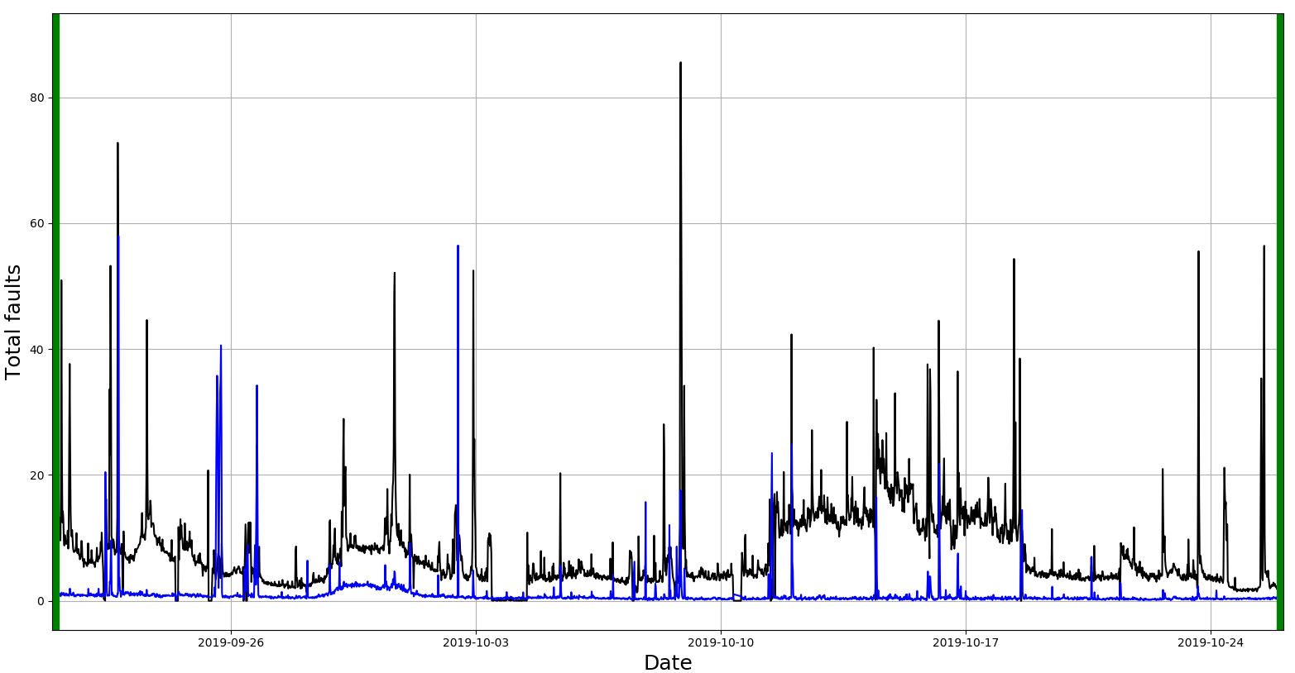
Exclusion Periods: ISRA 5D and MK4 data
Exclusion Periods
ISRA 5D
MK4

Slide 9
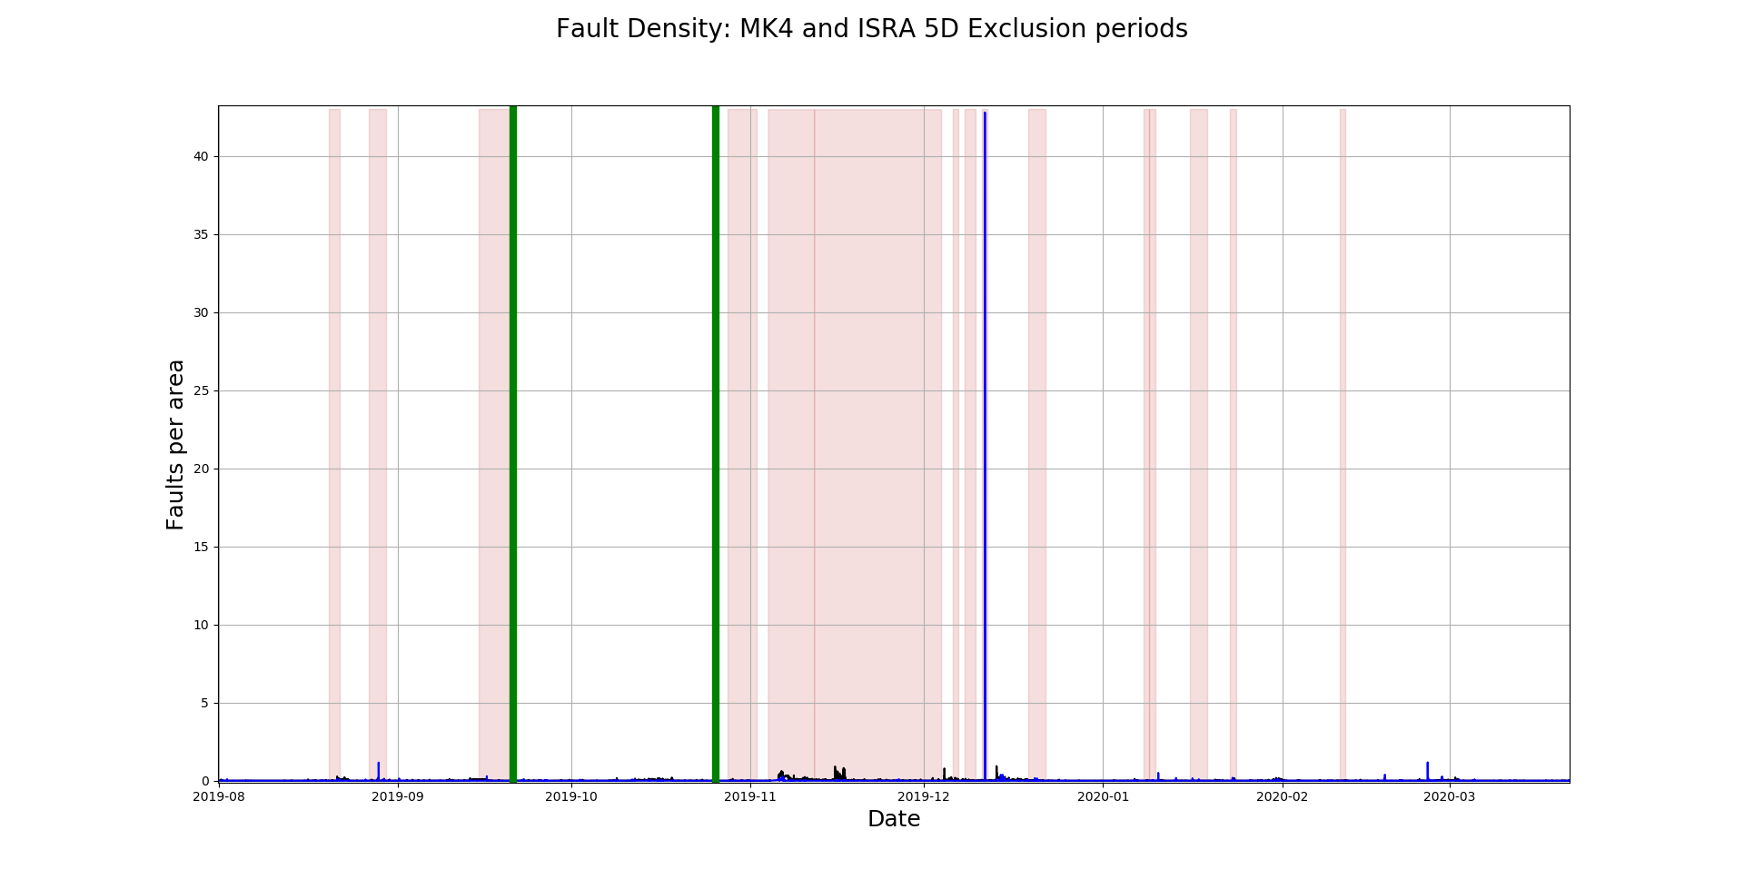
Exclusion Periods: ISRA 5D and MK4 data
Exclusion Periods
ISRA 5D
MK4

Slide 10
Exclusion Periods: ISRA 5D and MK4 data
Exclusion Periods
ISRA 5D
MK4
Initial analysis: region (21/09/19 – 25/10/19)

Slide 11
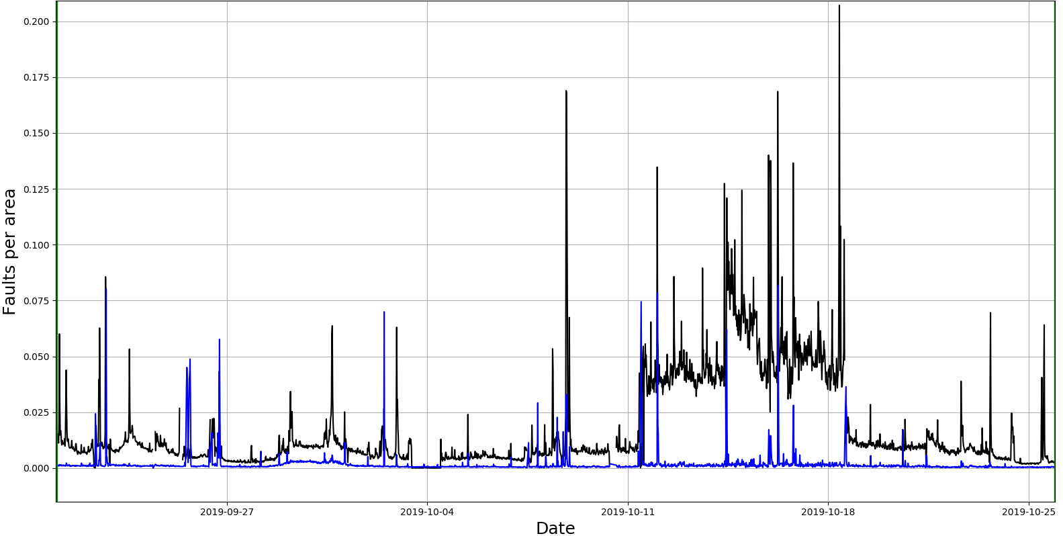
Exclusion Periods: ISRA 5D and MK4 data
Exclusion Periods
ISRA 5D
MK4

Slide 12
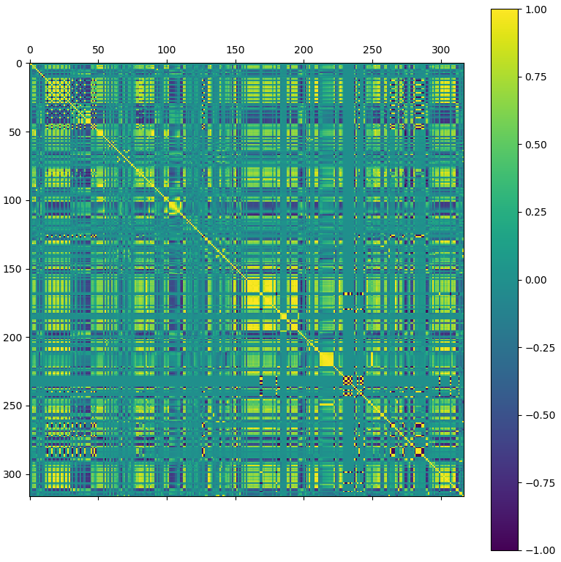
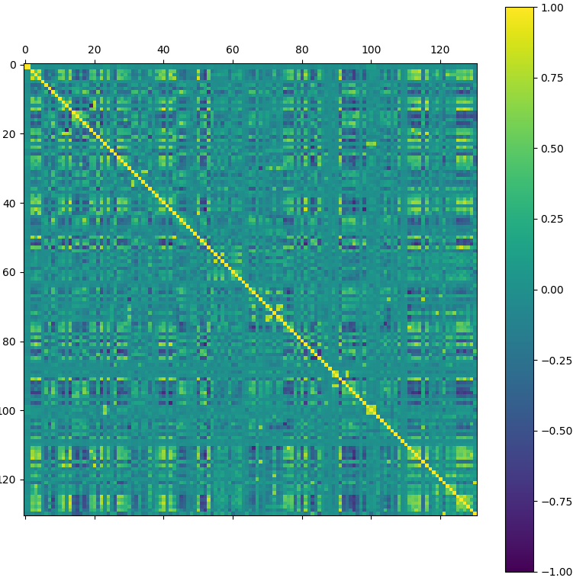
Pre-process data: Correlation analysis:
Tag data
Correlation matrix before correlated data was removed.
Correlation matrix after correlated data was removed.

Slide 13
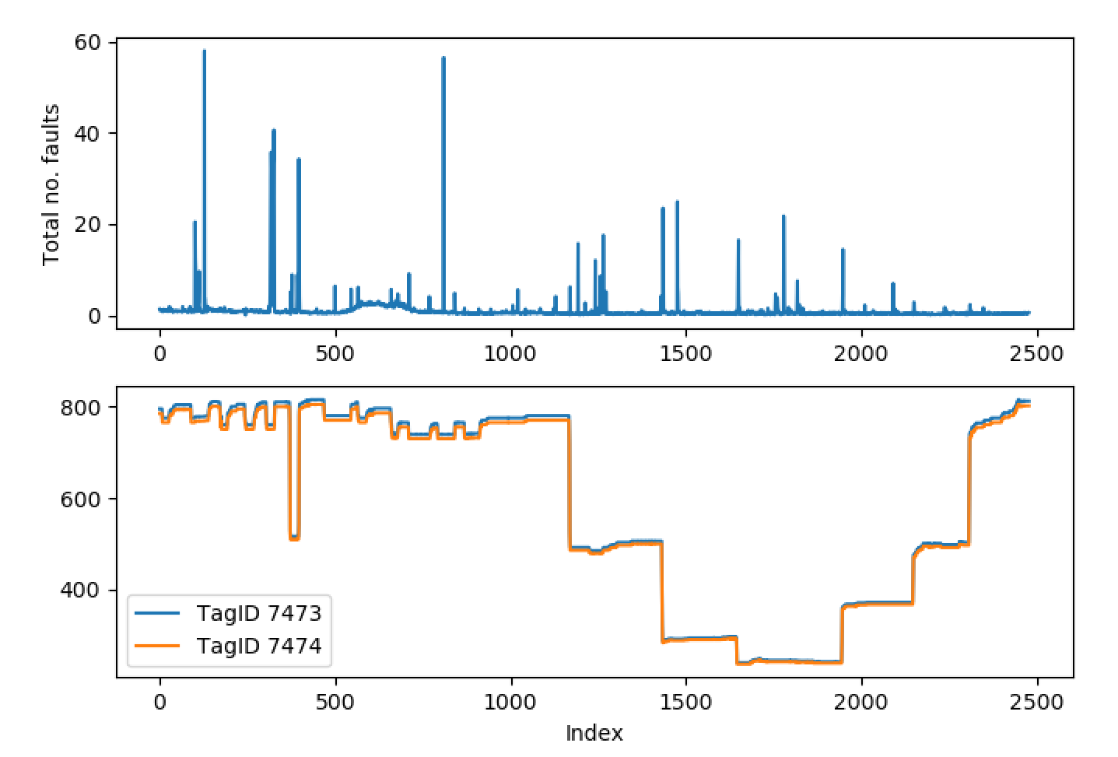
Pre-process data: Correlation analysis:
An example of some highly correlated ‘tag data’:
These correspond to ‘Lehr Drive 1 Speed’ and ‘Lehr Drive Line Shaft Speed’.
In this case, for example, we only need to retain data from one of these sensors.

Slide 14
Post-process data:
Tag data files (.txt): Analysed: 452 From which 112 were eliminated
Post-processed Tag data (correlation and information):
Analysed: 1535 From which 131 were eliminated
Correlation matrix after correlated data was removed.

Slide 15
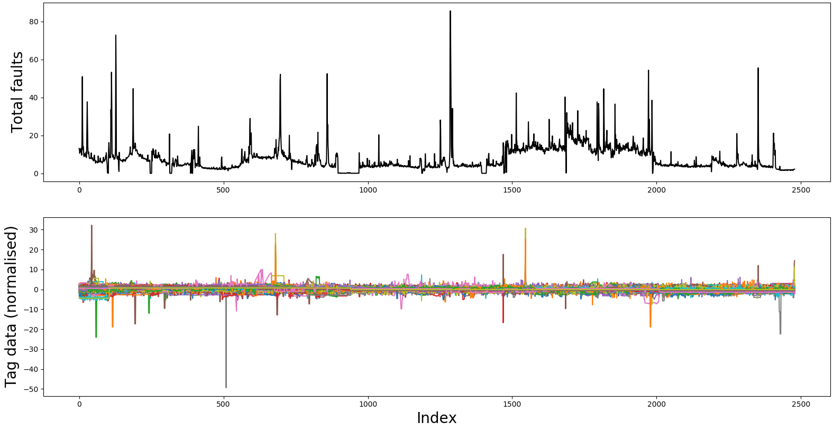
Defining the training dataset: Total faults
Total Faults as outputs
Tag data as inputs

Slide 16
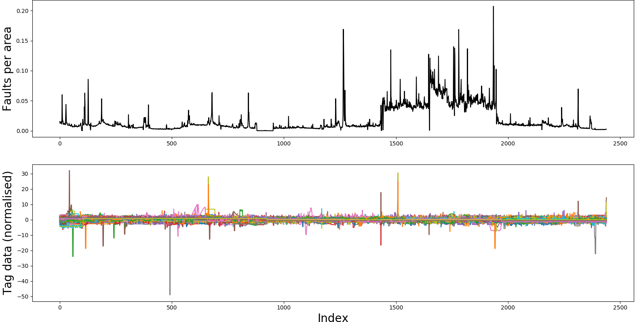
Defining the training dataset: Faults per area
Faults per area as outputs
Tag data as inputs

Slide 17

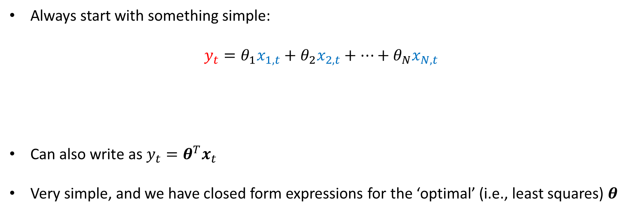

Linear Regression
Always start with something simple:
$$y_{t}=θ_{1}x_{1,t}+θ_{2}x_{2,t}+…+θ_{N}x_{N,t}$$
Can also write as $y_{t}=θ^{T}x_{t}$
Very simple, and we have closed form expressions for the ‘optimal’ (i.e., least squares) $θ$
Total faults at time $t$
Tag data at time $t$

Slide 18
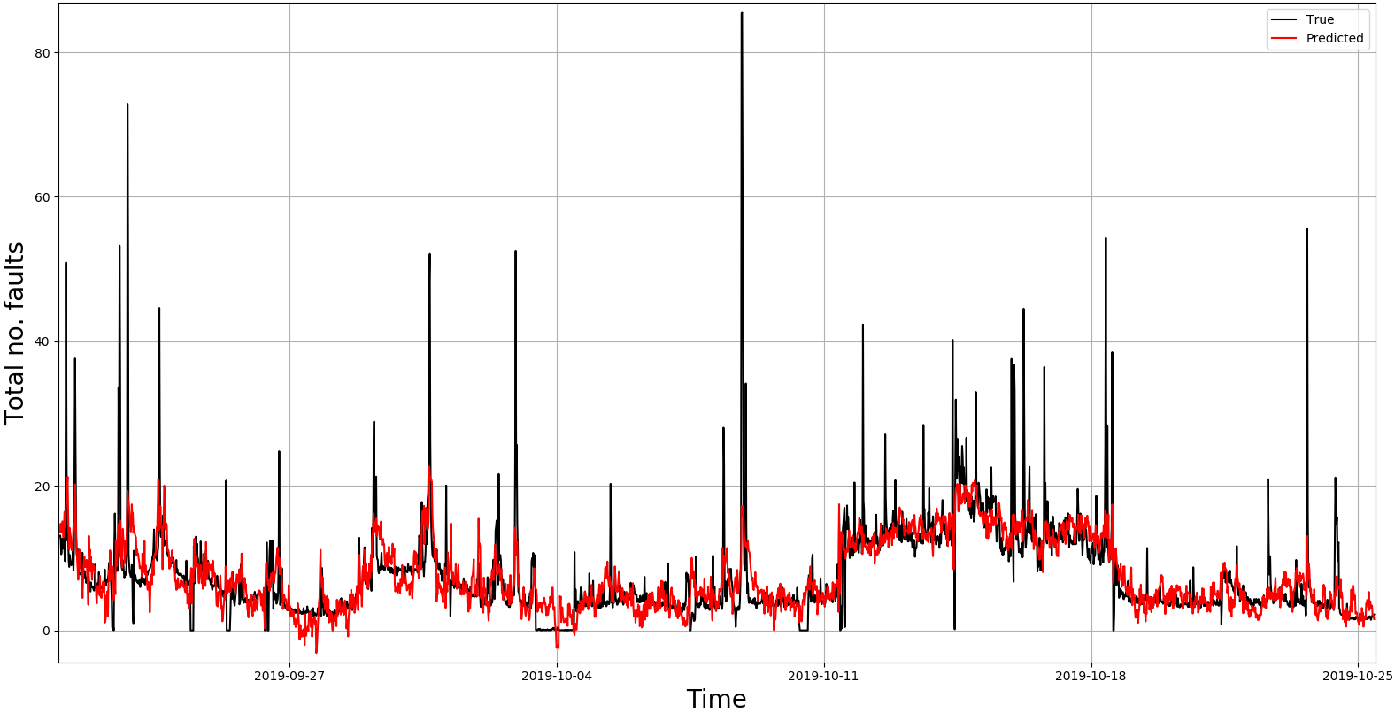
Linear Regression: Total faults analysis

Slide 19
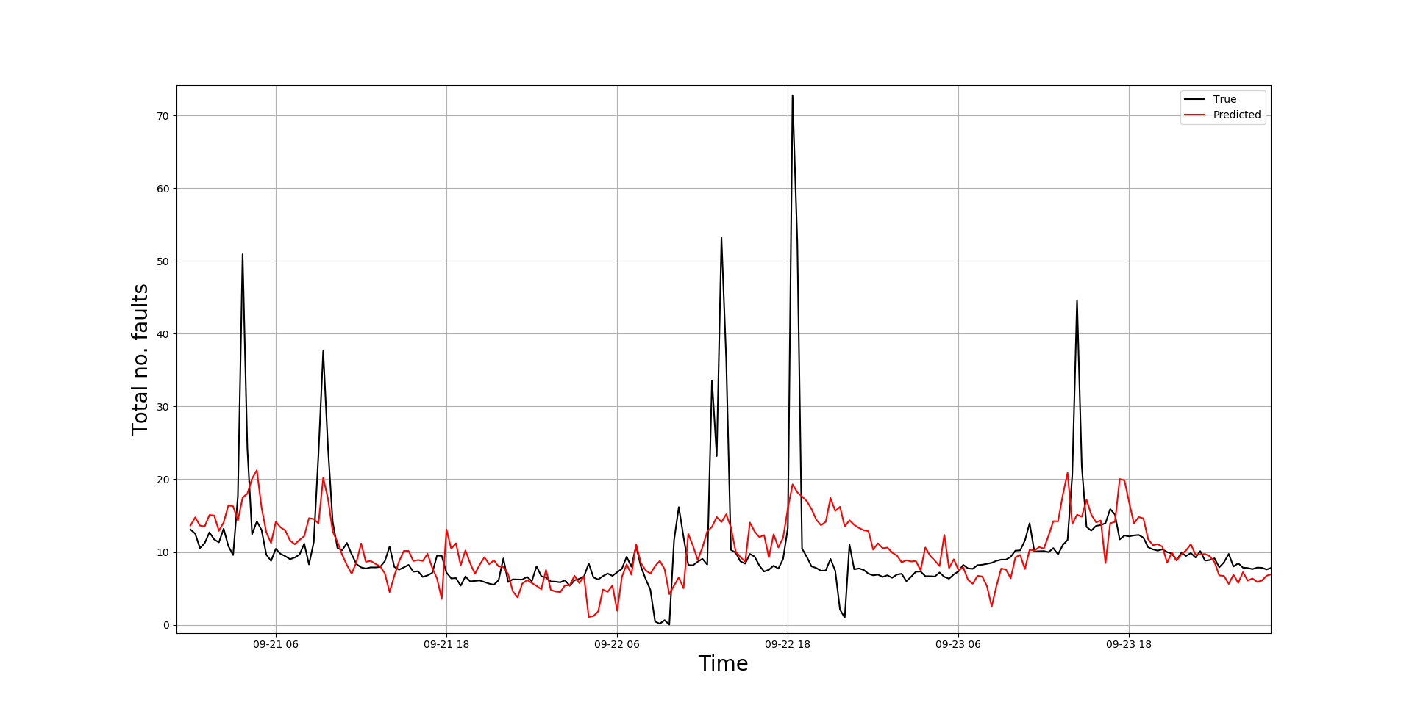
Linear Regression: Total faults analysis

Slide 20
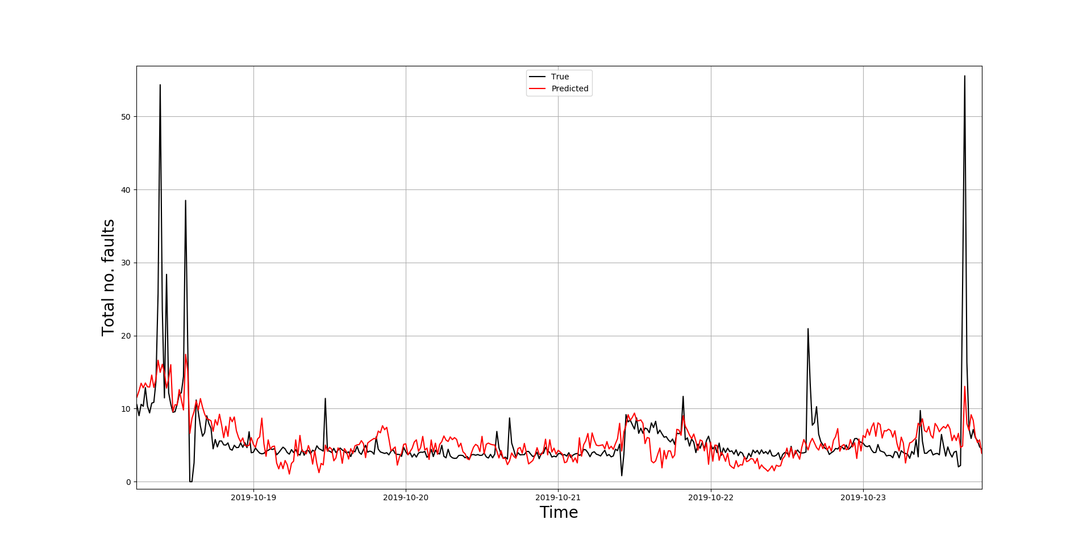
Linear Regression: Total faults analysis

Slide 21
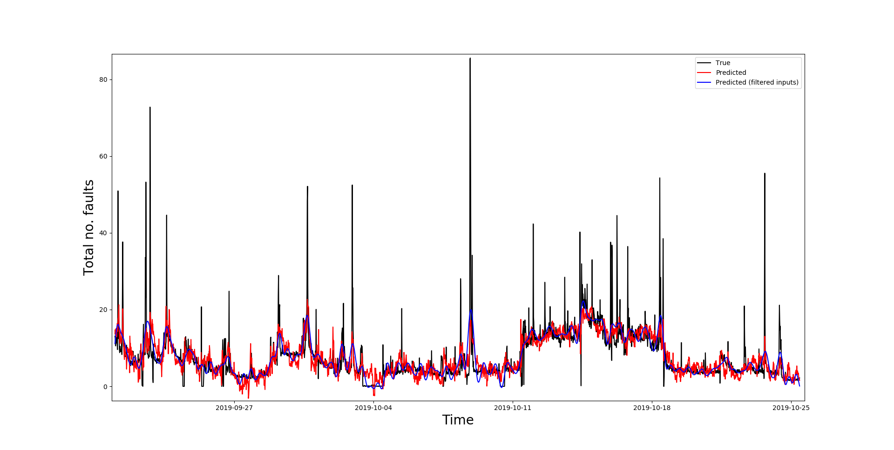
Linear Regression: Total faults analysis
Tag data was passed through a low-pass filter twice (no phase difference).

Slide 22
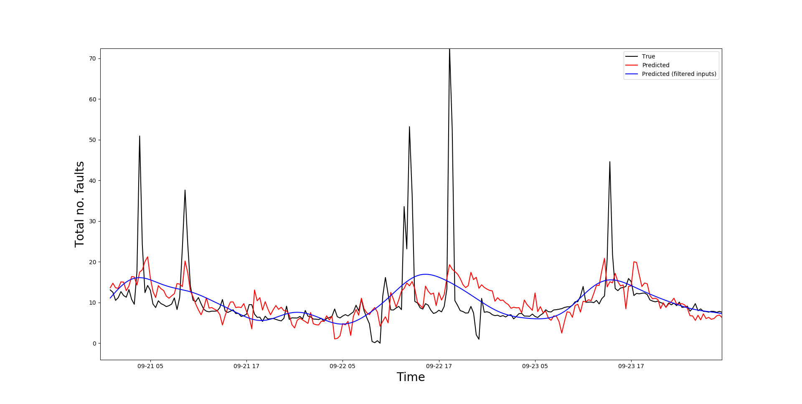
Linear Regression: Total faults analysis

Slide 23
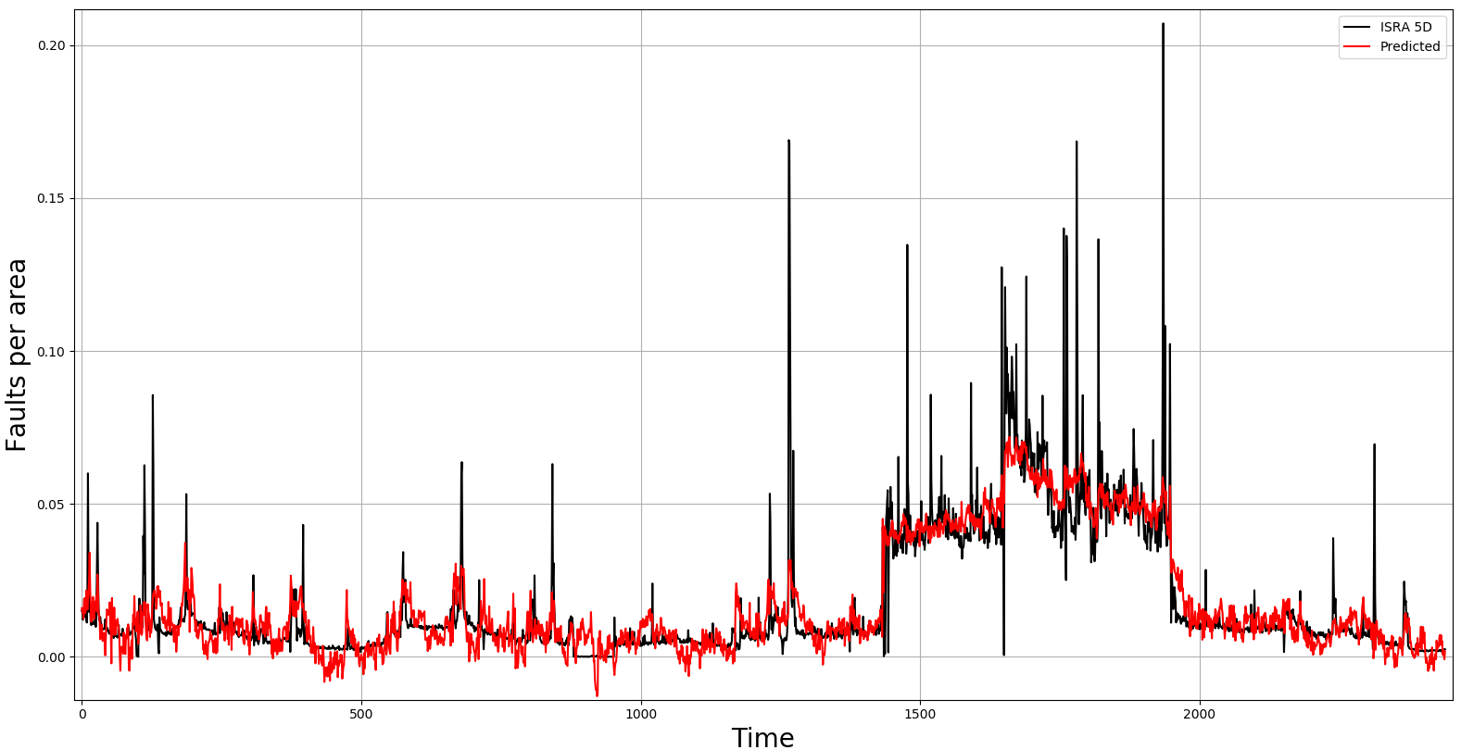
Linear Regression: Faults per area analysis

Slide 24
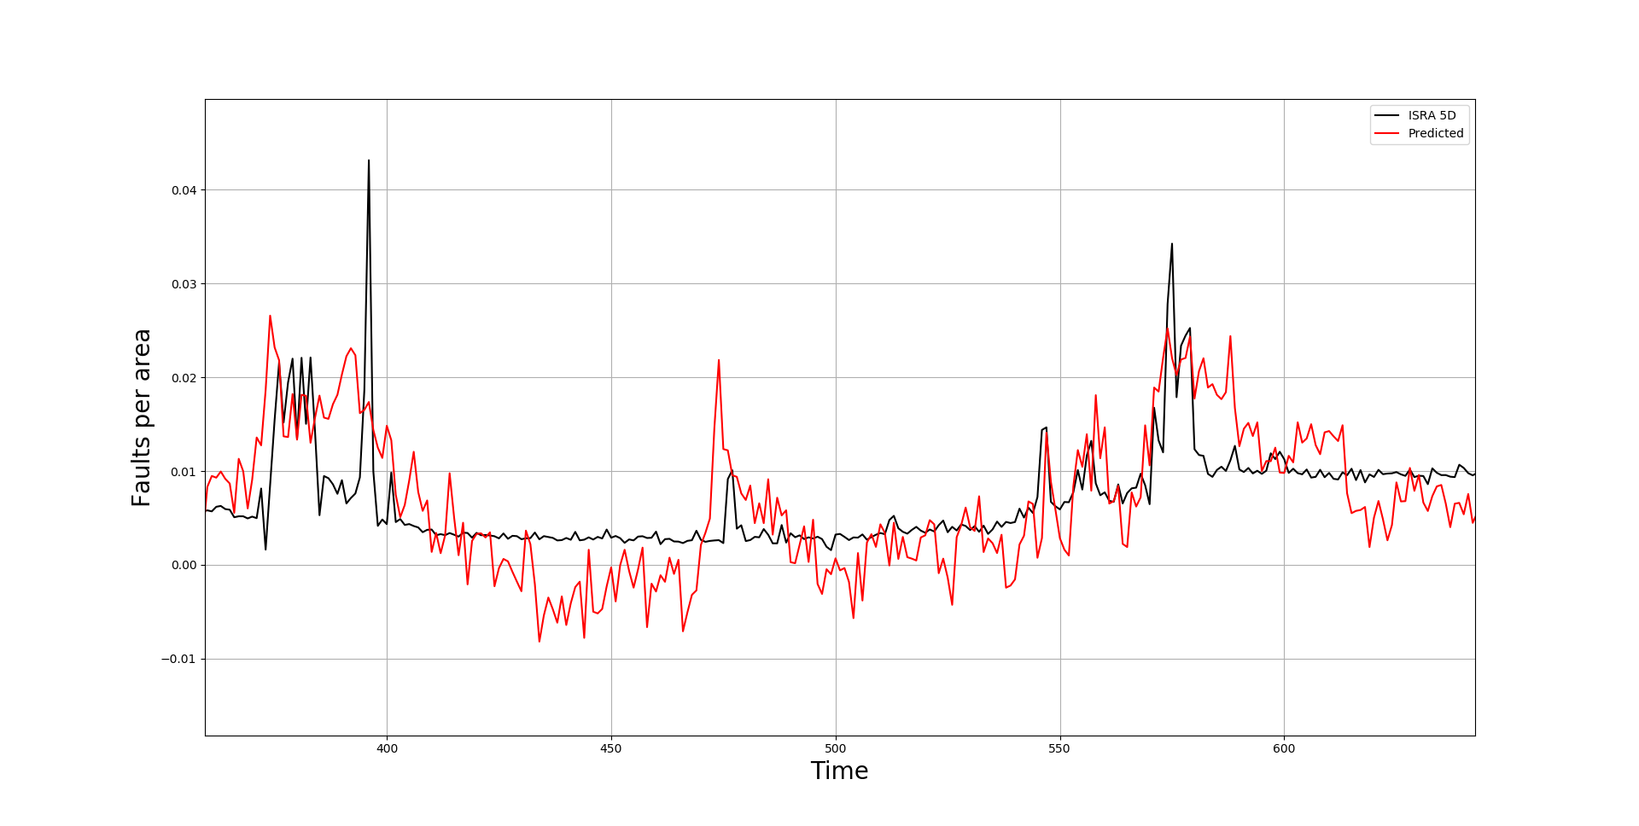
Linear Regression: Faults per area analysis

Slide 25
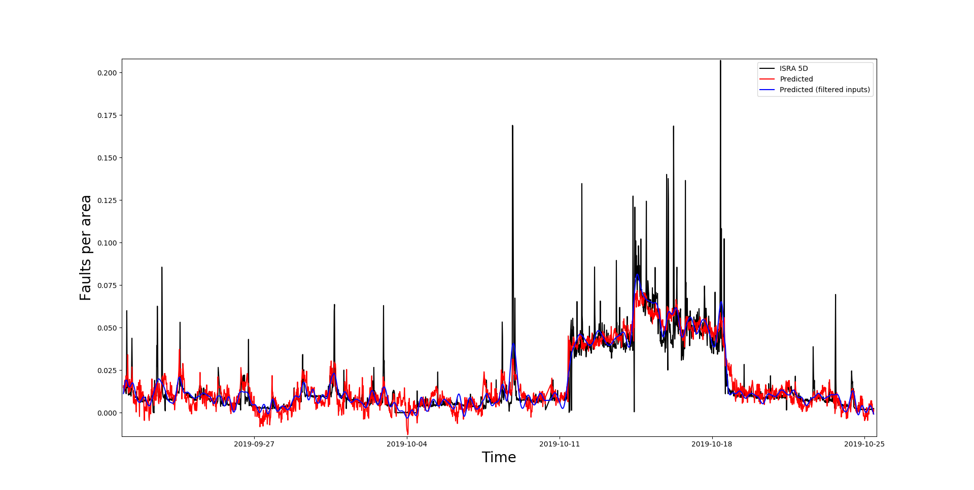
Linear Regression: Faults per area analysis
Tag data was passed through a low-pass filter twice (no phase difference).

Slide 26
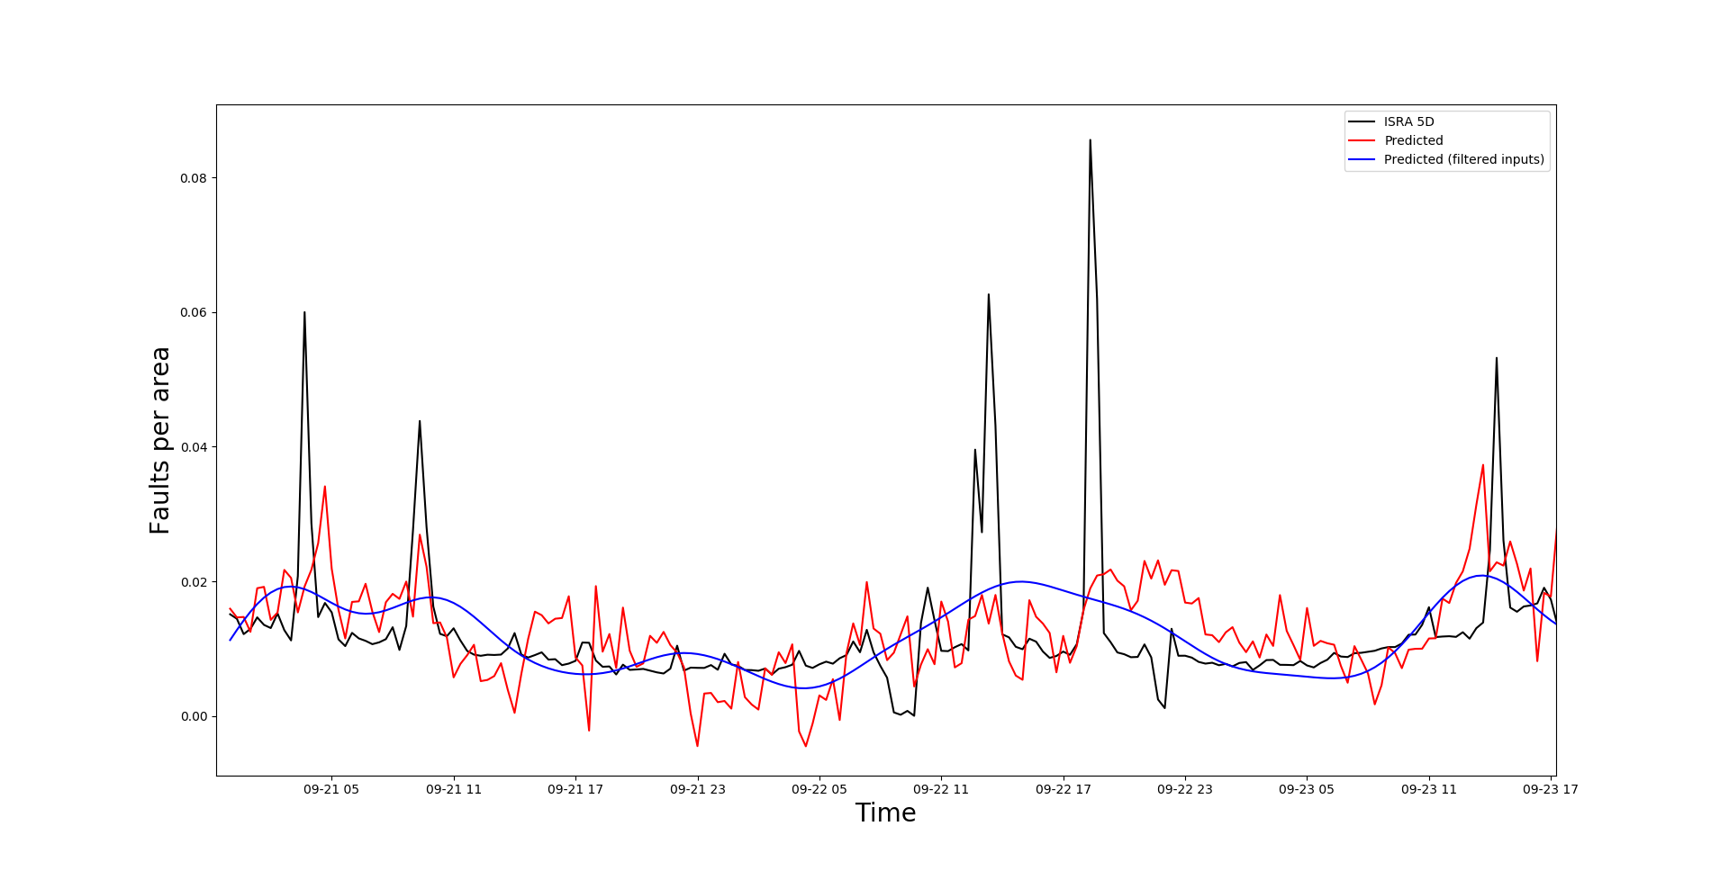
Linear Regression: Faults per area analysis
Predictions with filtered inputs: Very general relationship captured between the Tag data and the ISRA 5D data.

Slide 27
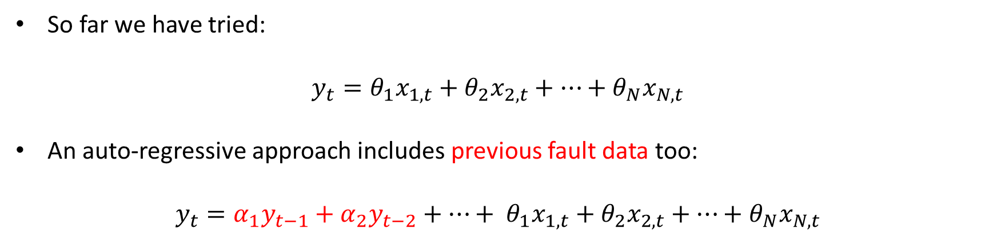
Linear Regression: Auto-regressive analysis
So far we have tried:
$$y_{t}=θ_{1}x_{1,t}+θ_{2}x_{2,t}+…+θ_{N}x_{N,t}$$
An auto-regressive approach includes previous fault data too:
$$y_{t}={{α_{1}y}_{t−1}+α_{2}y_{t−2}+…+ θ}_{1}x_{1,t}+θ_{2}x_{2,t}+…+θ_{N}x_{N,t}$$

Slide 28
Linear Regression: Auto-regressive analysis
So far we have tried:
$$y_{t}=θ_{1}x_{1,t}+θ_{2}x_{2,t}+…+θ_{N}x_{N,t}$$
An auto-regressive approach includes previous fault data too:
$$y_{t}={{α_{1}y}_{t−1}+α_{2}y_{t−2}+…+ θ}_{1}x_{1,t}+θ_{2}x_{2,t}+…+θ_{N}x_{N,t}$$
When predicting more than one step into the future, the inputs to the model become its own previous predictions. Potentially allows for predictions further into the future.

Slide 29
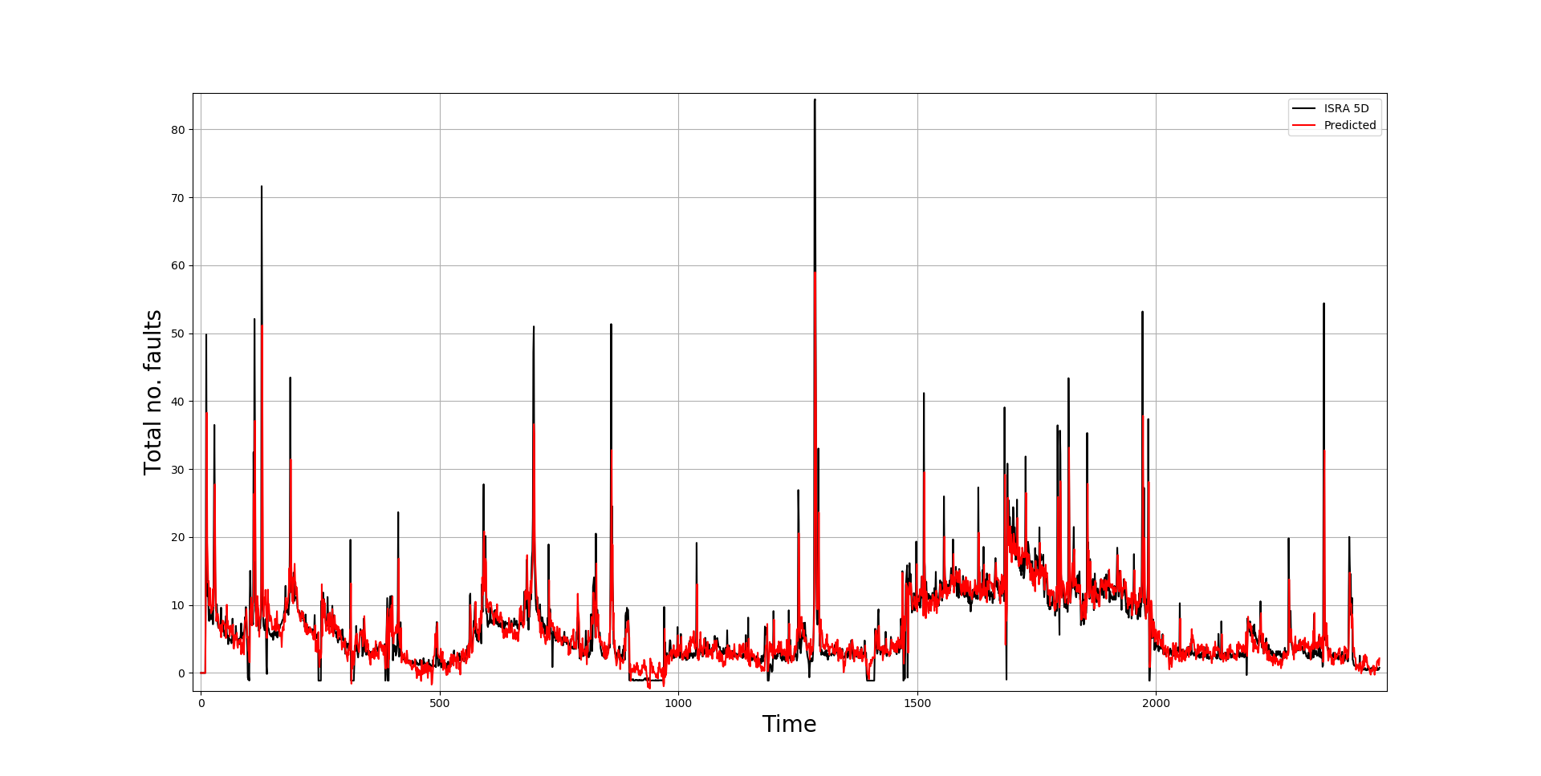
Linear Regression: Auto-regressive analysis
Inputs not filtered

Slide 30
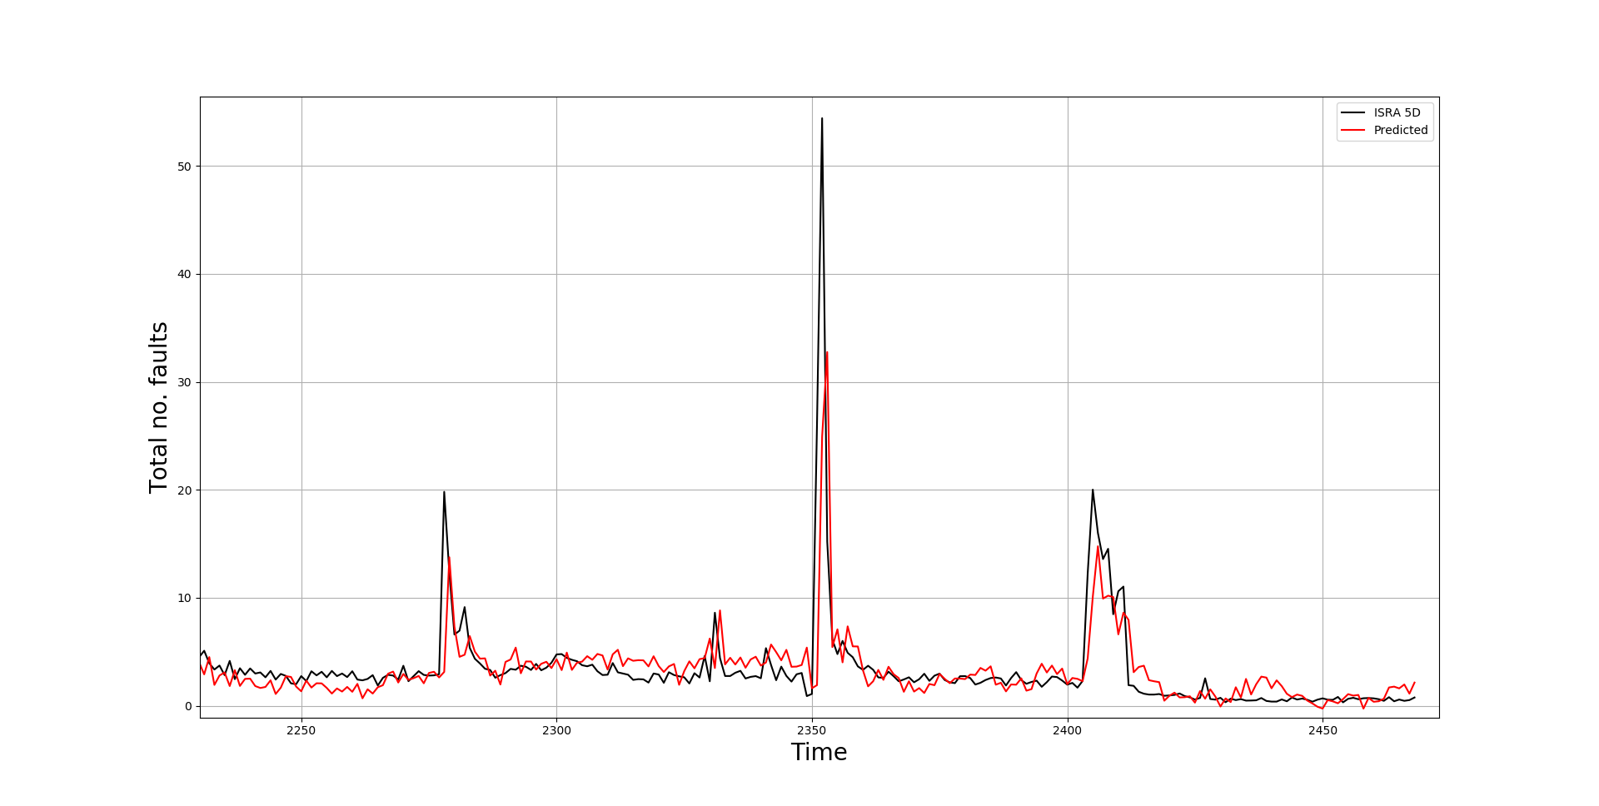
Linear Regression: Auto-regressive analysis

Slide 31
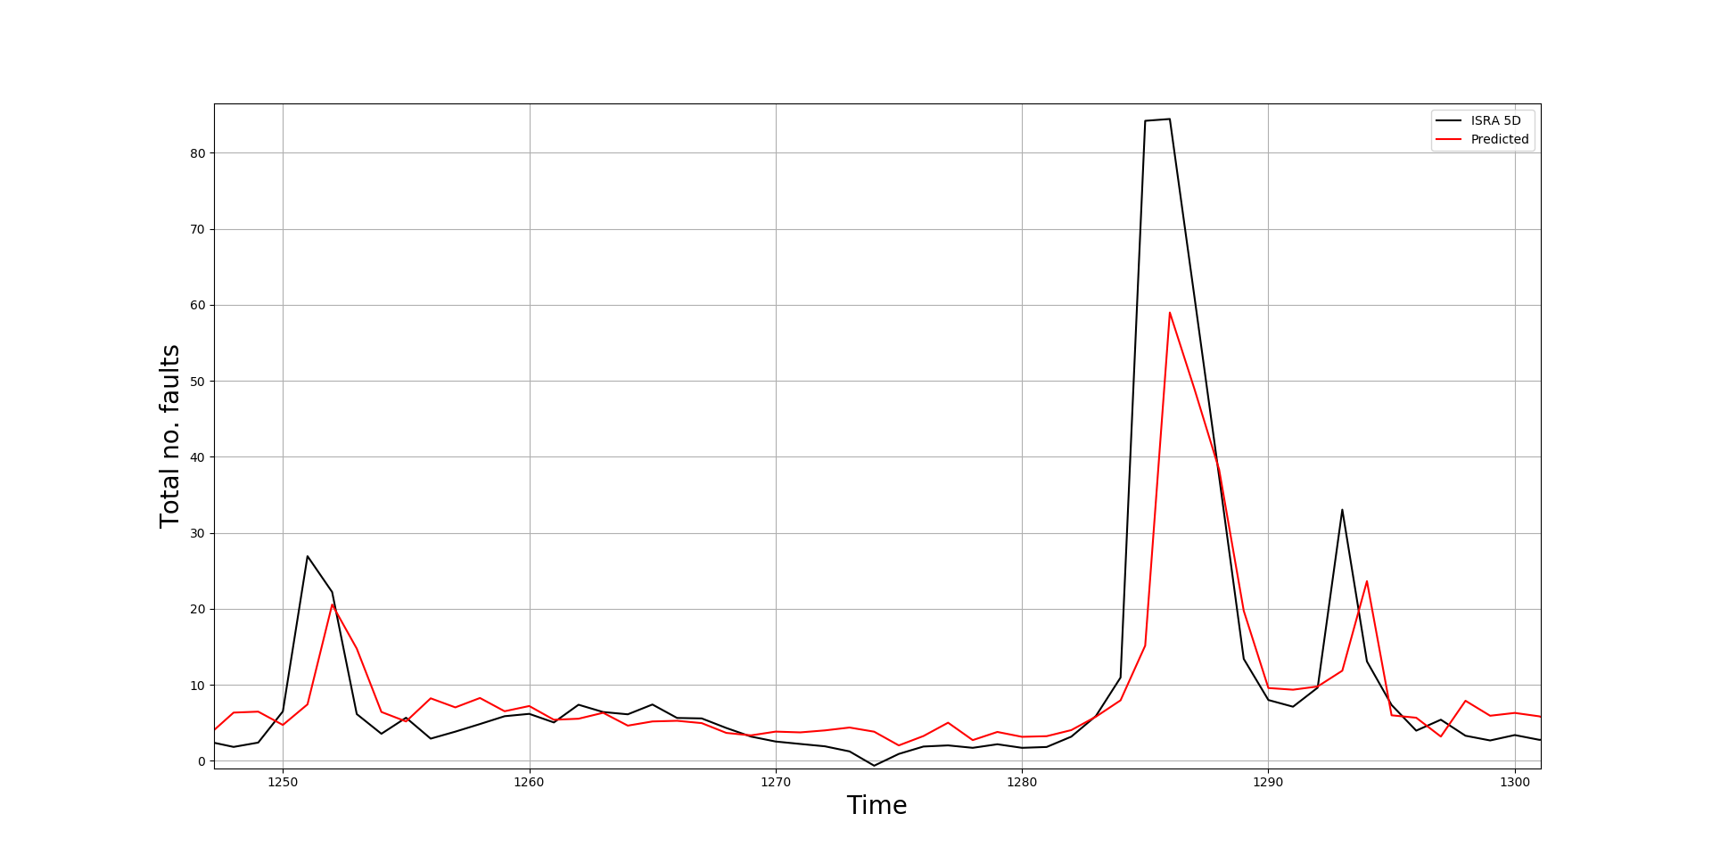
Linear Regression: Auto-regressive analysis

Slide 32
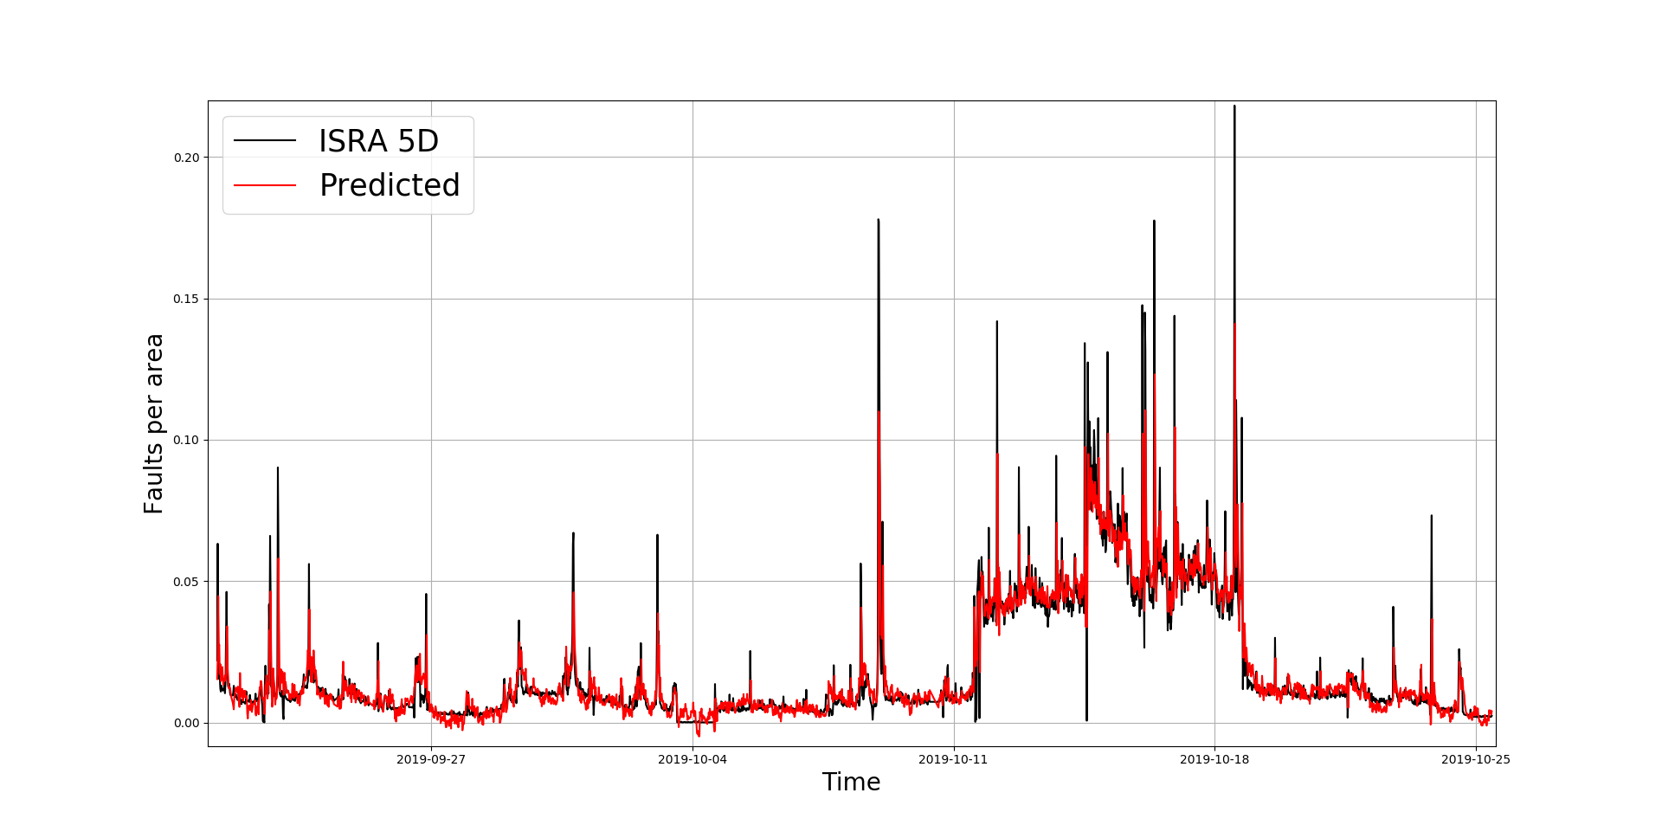
Linear Regression: Auto-regressive analysis
Inputs not filtered

Slide 33
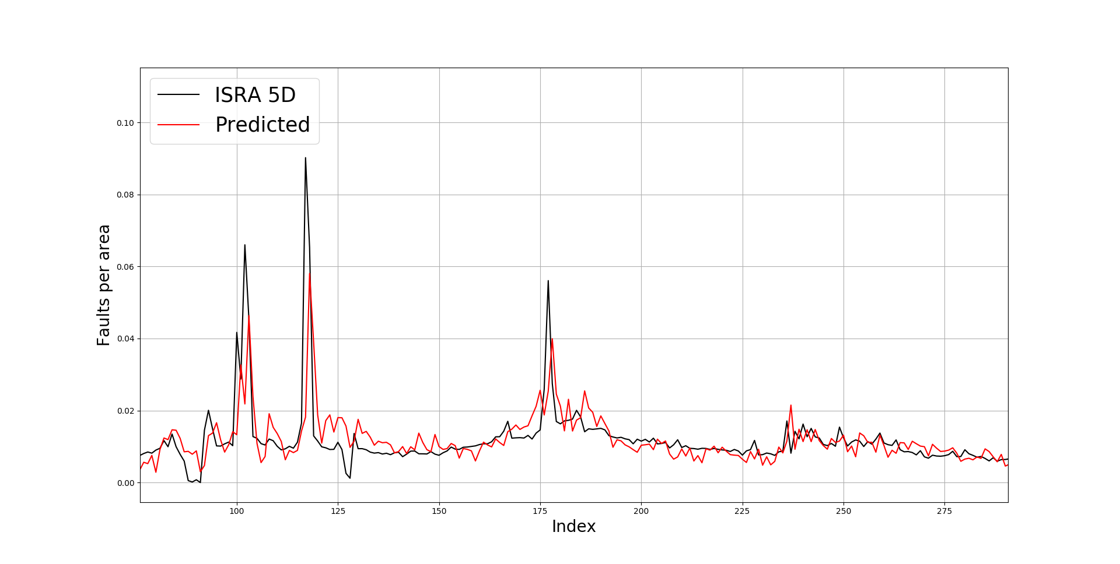
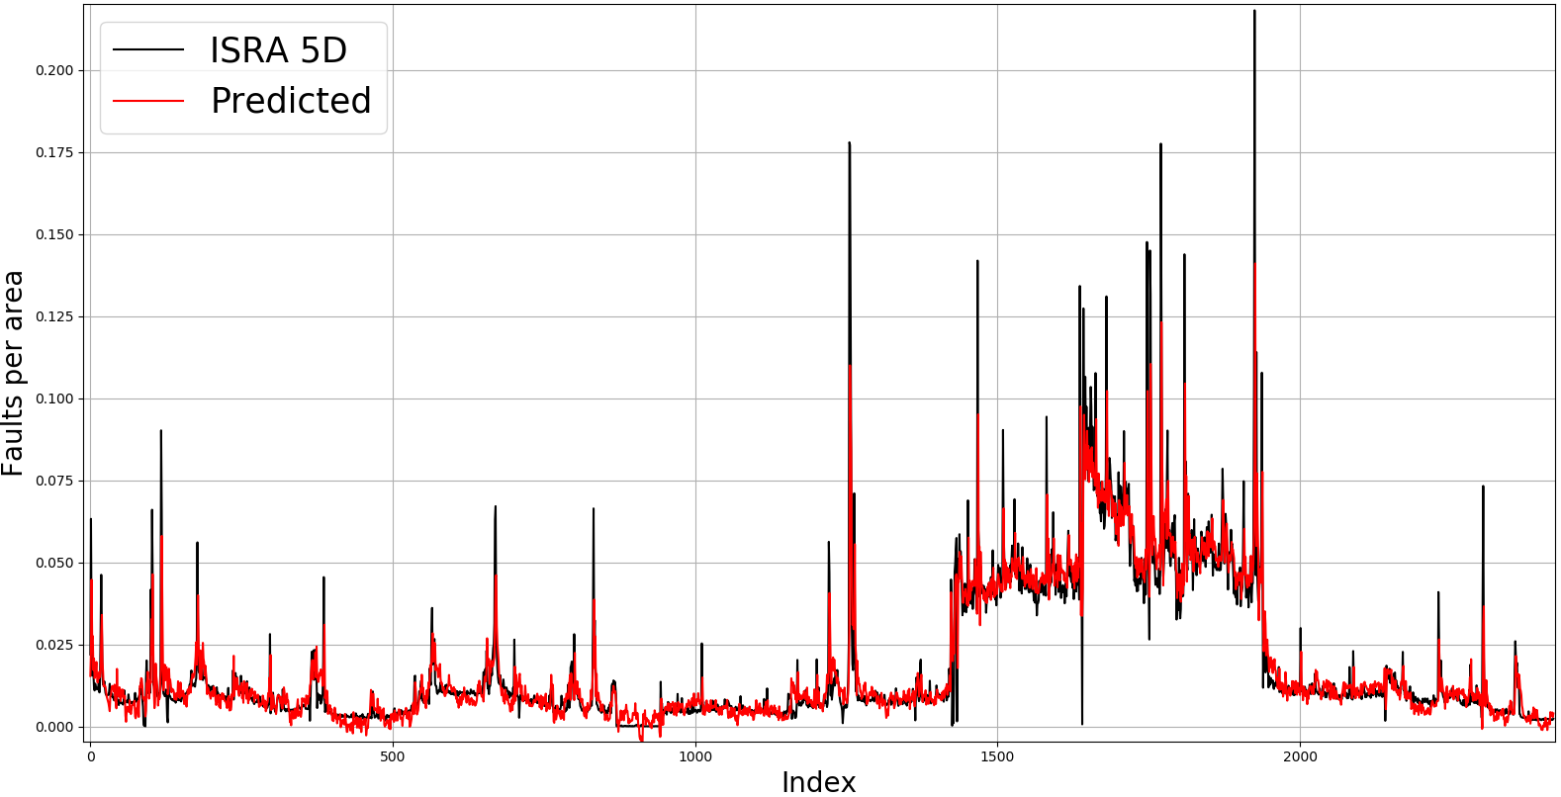
Linear Regression: Auto-regressive analysis
Zoom-in

Slide 34
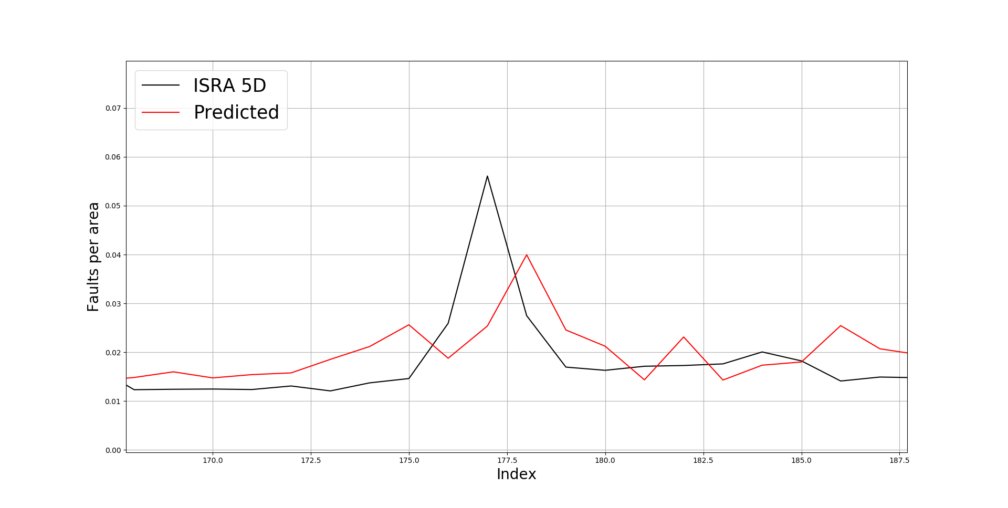
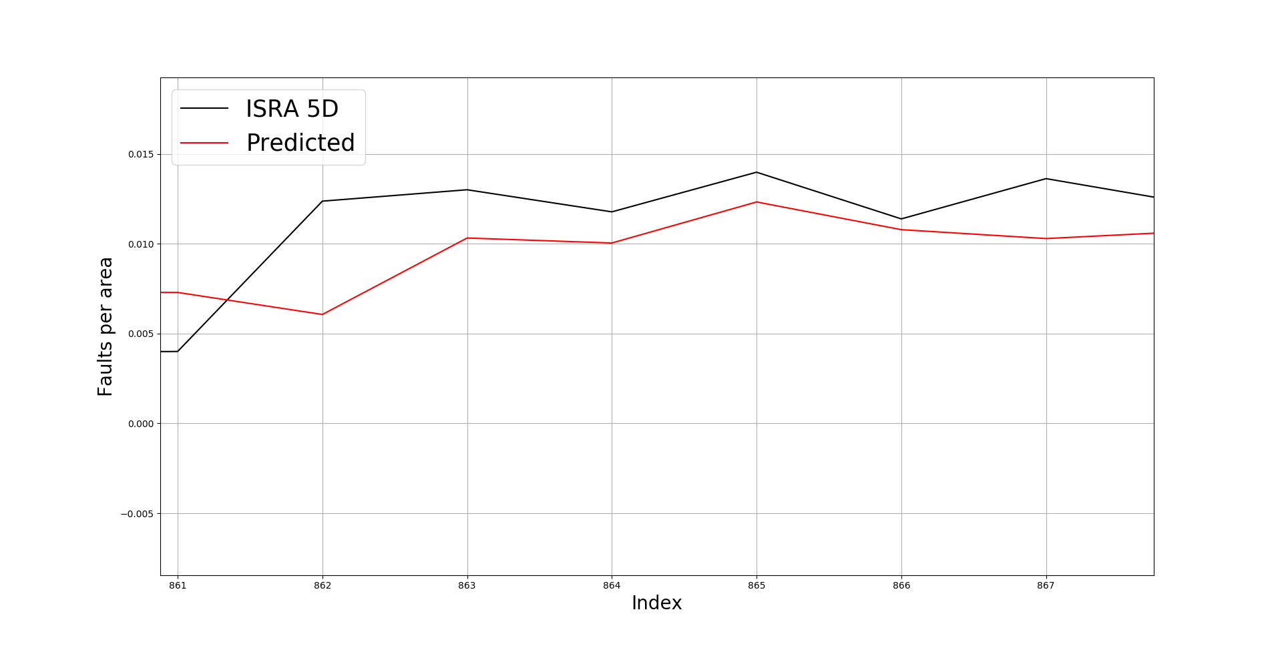
Linear Regression: Auto-regressive analysis
The approximation is excellent but if we zoom-in even more, we can identify the lagging.
Some regions does not experienced the lagging,

Slide 35
Conclusions:
Linear Regression:
The Linear Regression model was able to capture a close relationship between the Tag data and the ISRA 5D scanner data (inputs and outputs not filtered).
Outputs seems less noisy compared to the ones obtained in the linear regression analysis using the MK4 data.
Better performance compared with the MK4 regression analysis (Total Faults).
Did not capture the full length of the spikes
Filtered inputs only captured a very general trend of the outputs
Try changing the threshold of the filters.

Slide 36
Conclusions:
Auto-regressive analysis (Total Faults and Faults per area):
Very good Predictions: ARX model was able to capture a close relationship between the Tag data and the ISRA 5D scanner data (inputs and outputs not filtered).
Better performance compared to standard linear regression model (using the ISRA 5D data).
Lagging introduced in the predictions, however not in all regions.

Slide 37
To consider in future regression analyses:
Try changing the threshold of the filters.
Interpolate the inputs and see if the lagging in the auto-regressive linear regression outcomes change.
Non-linear regression models might reduce the lagging in the auto-regressive analysis.
Determine the structure of the ’Faults per area’ function and try predicting to the future without the auto-regressive approach (non-linear regression).

Slide 38
Thank you for your attention. ANY QUESTIONS?

Slide 39
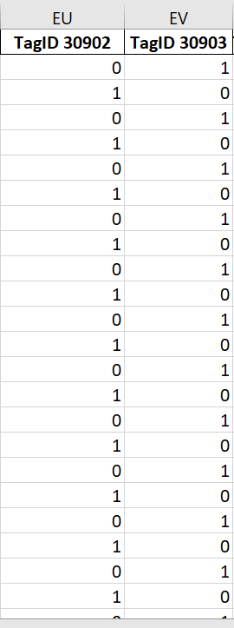
Tag data
Boolean sensors
Boolean sensors are not considered in the analysis. Should we consider them to capture the spikes?

Slide 40
Questions from the consultancy project:
Was filtering the right thing to do? Certainly uncovered an interesting relationship between the low frequency components of the data.
We can used methods much more advanced than linear regression (GP, for example) – do we need to?
Autoregressive model applied to filtered data?
We can also try using ‘lagged’ tag data to aid predictions.
Alternatively, we can simply investigate mapping directly to future fault data.
So far our models have fixed parameters. We can try having time-varying parameters – applicable if furnace conditions are fundamentally changing over time.
Linear regression is very interpretable – can think about the best way to present how this model is realising predictions.
Uncertainty quantification can be ‘folded’ into all of these approaches.

