Slide 1

NSG Pilkington – University of Liverpool Machine Learning Project: Furnace faults analysis
Dr. Peter Green
Diego Echeverria
Risk Institute,
School of Engineering
11/08/2020

Slide 2
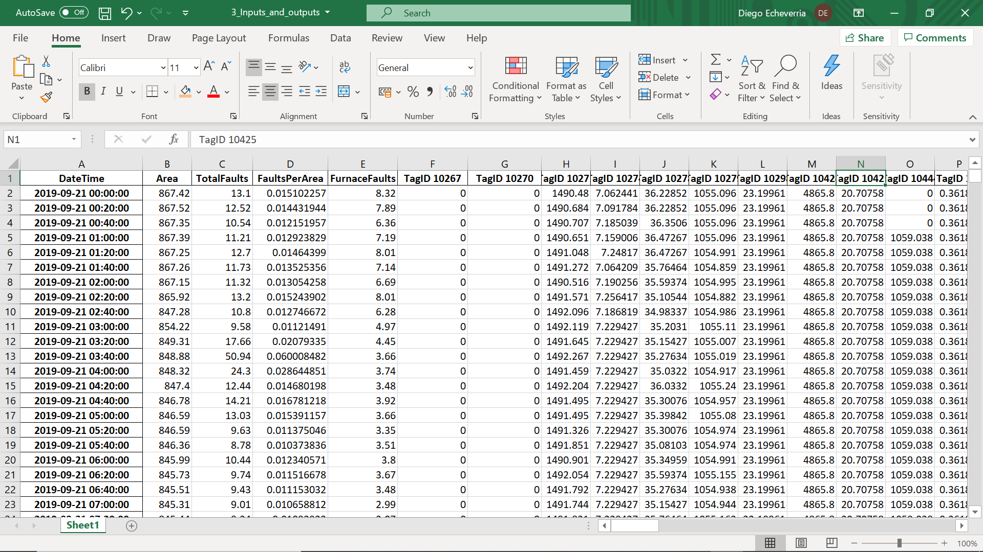
Sensors that passed the “Data Processing” tasks

Slide 3
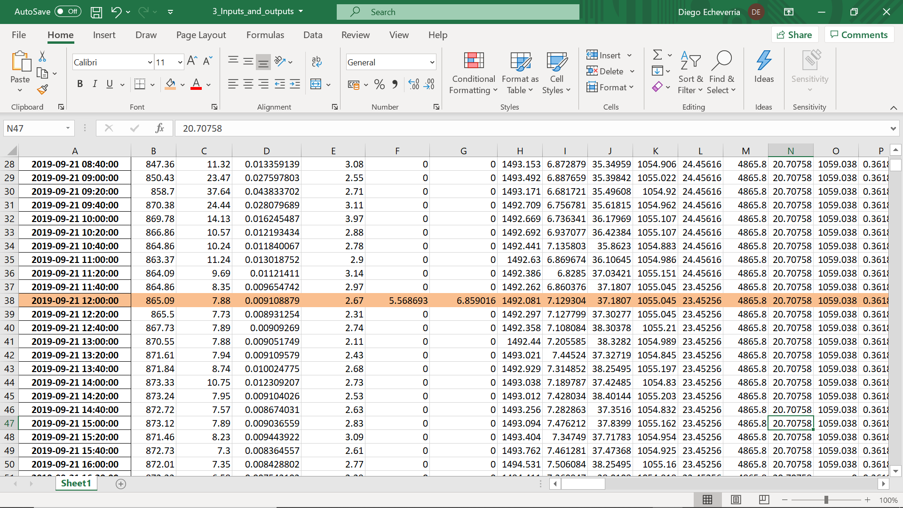
Sensors that passed the “Data Processing” task
.
.
.
Are these part of the furnace process?

Slide 4
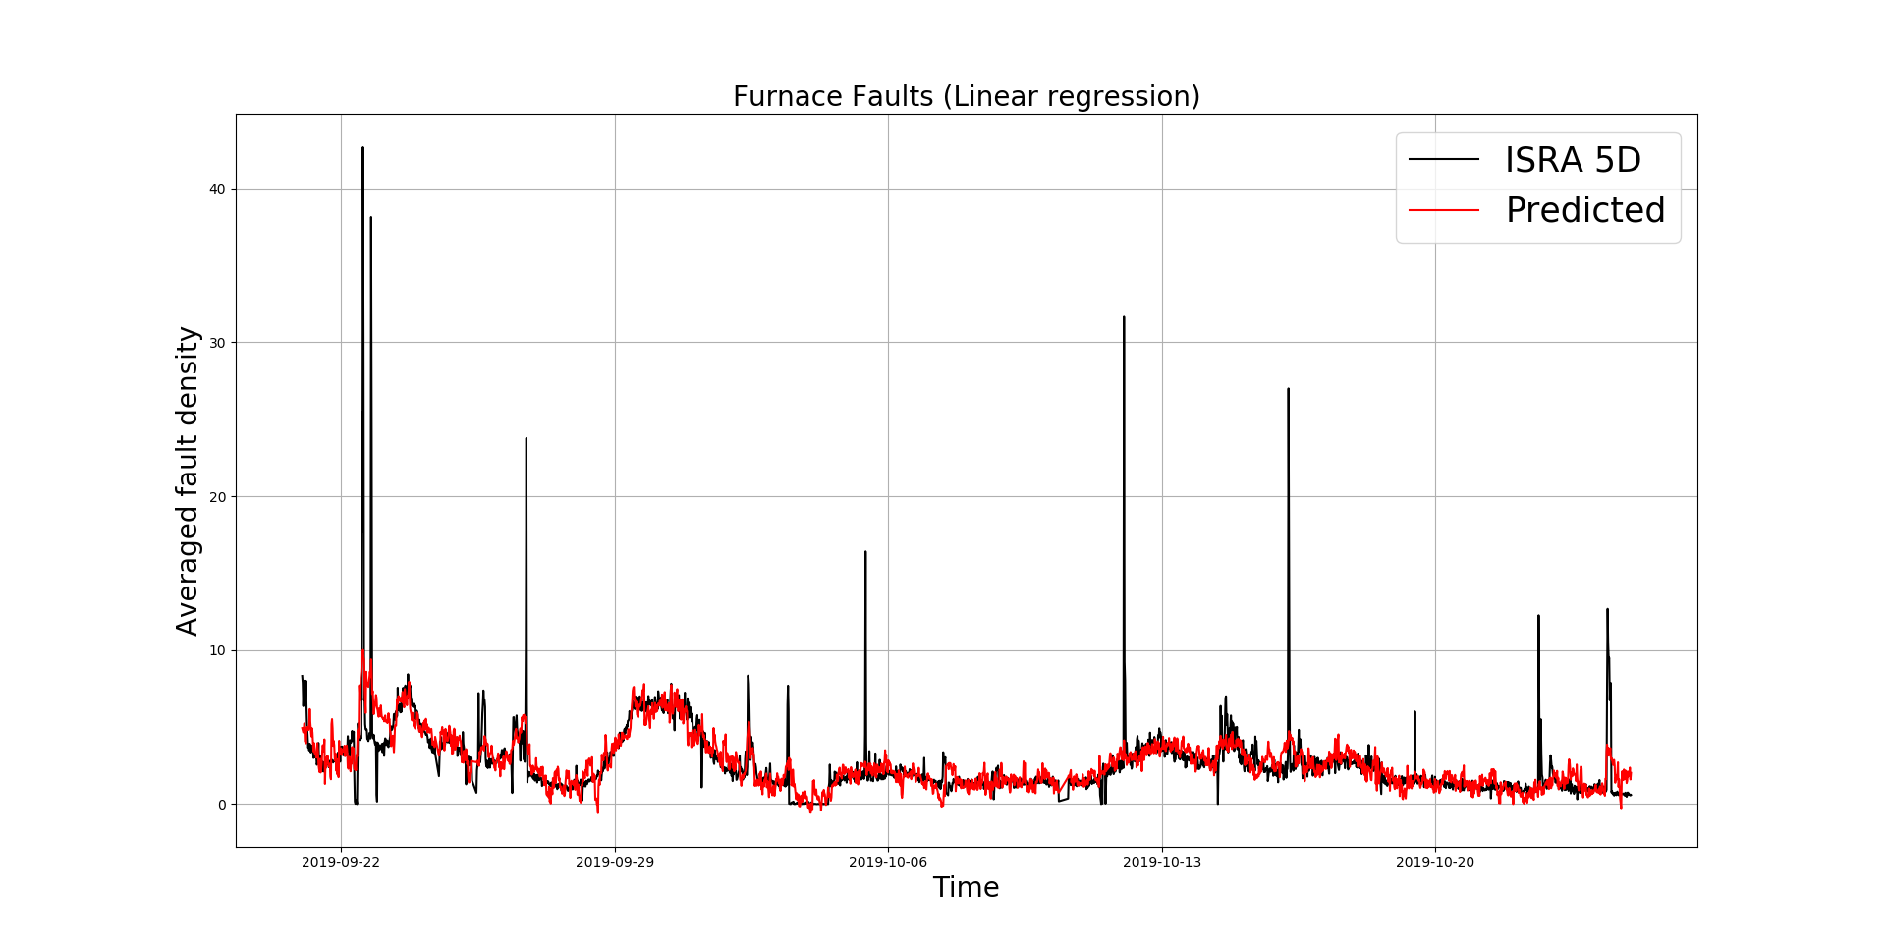
Furnace Faults Analysis

Slide 5
Furnace Faults Analysis
Seems like outliers

Slide 6
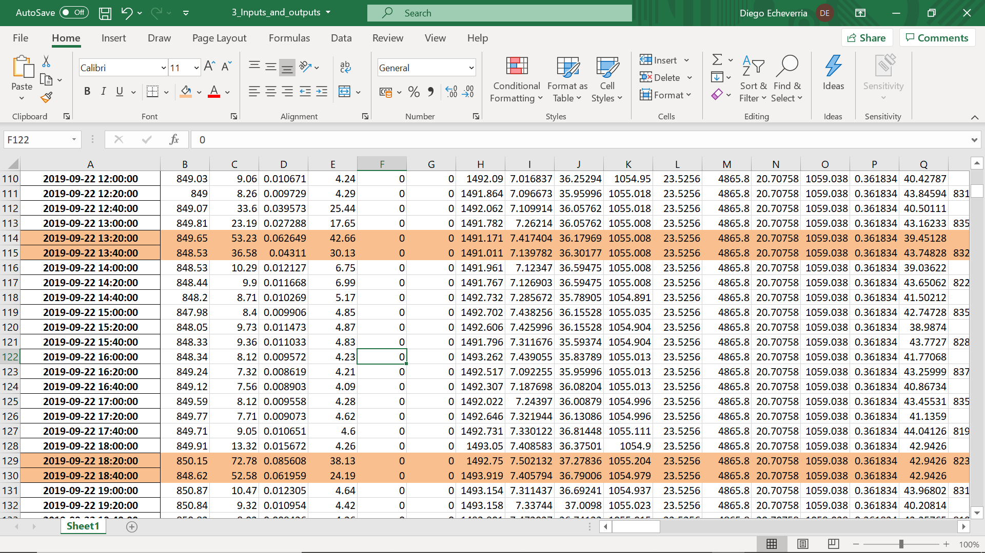
Location of the identified spikes
Furnace Faults

Slide 7
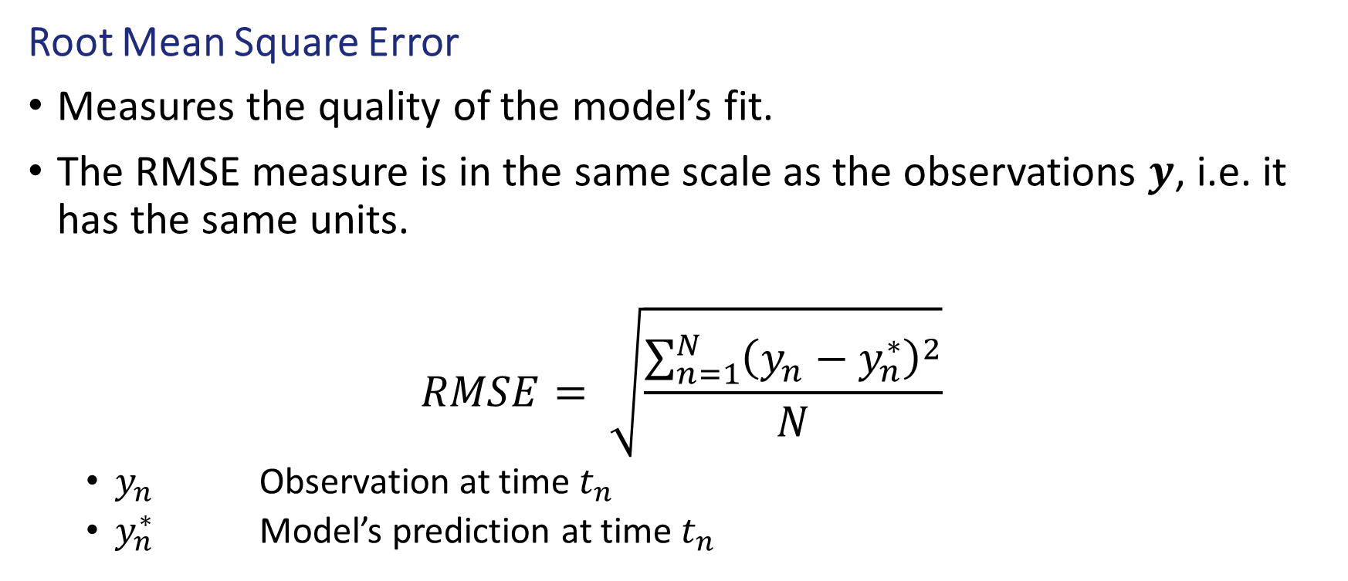
Normalised Root Mean Square Error
Root Mean Square Error
Measures the quality of the model’s fit.
The RMSE measure is in the same scale as the observations 𝒚, i.e. it has the same units.
$$RMSE= \sqrt{\frac{\sum_{n=1}^{N}{{\left(y_{n}−y_{n}^{∗}\right)}^{2}}}{N}}$$
$y_{n}$ Observation at time $t_{n}$
$y_{n}^{∗}$ Model’s prediction at time $t_{n}$

Slide 8
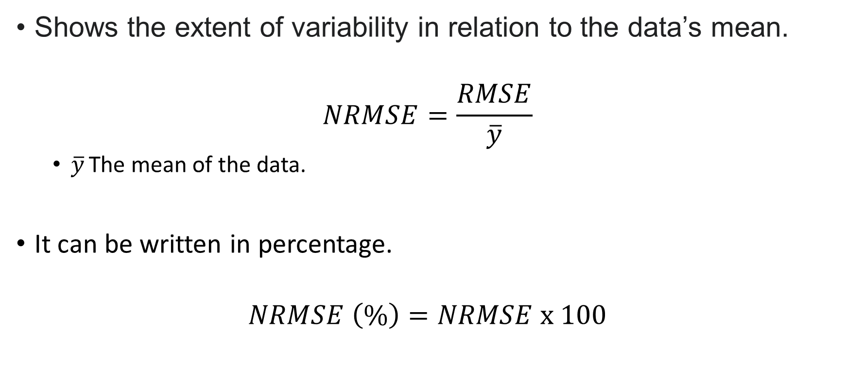
Normalised Root Mean Square Error
Shows the extent of variability in relation to the data’s mean.
$$NRMSE=\frac{RMSE}{\overline{y}}$$
$\overline{y}$ The mean of the data.
It can be written in percentage.
$$NRMSE \left(\%\right)=NRMSE x 100$$

Slide 9
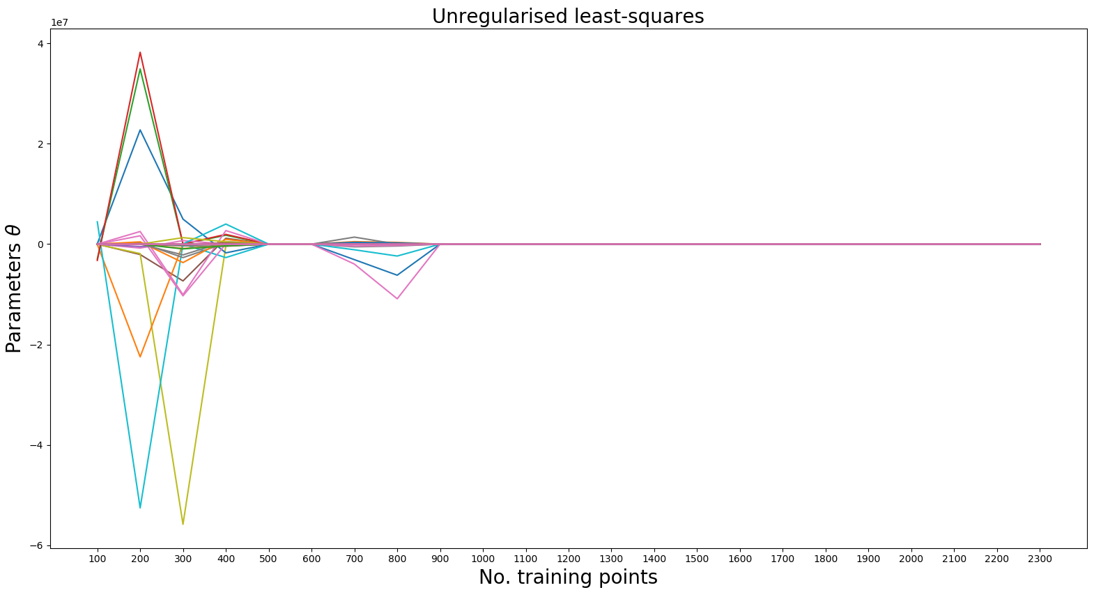
Least Squares Parameters (time-lag analysis)

Slide 10
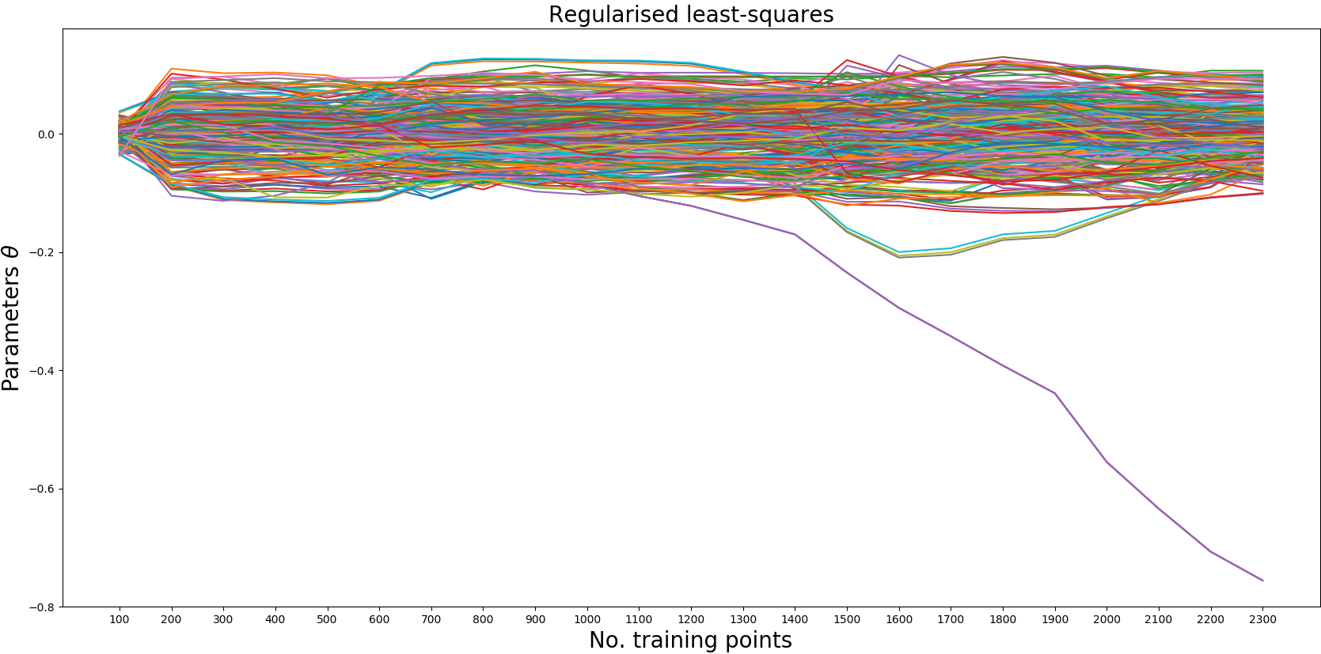
Regularised Least Squares Parameters (time-lag analysis)

Slide 11
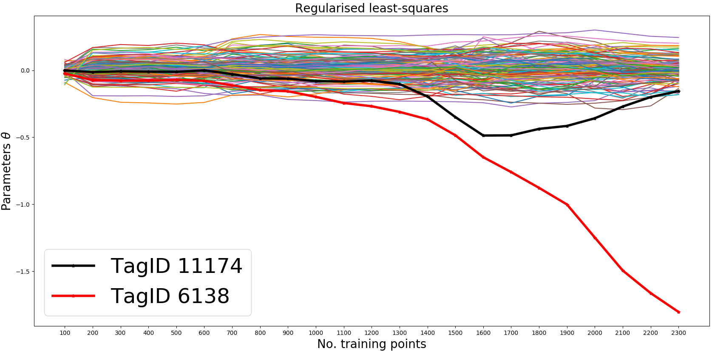
Regularised Least Squares Parameters

Slide 12
Conclusions
If the Regularised Least Squares parameters does not converge when increasing the training data, then we might be facing a regression problem with dynamic inputs.
Online Least Squares can update its parameters and thus capturing the dynamic behaviour of the inputs.

Slide 13
Thank you for your attention. ANY QUESTIONS?

