Slide 1

NSG Pilkington – University of Liverpool Machine Learning Project: Work Package II
Dr. Peter Green
Diego Echeverria
Risk Institute,
School of Engineering
07/07/2020

Slide 2
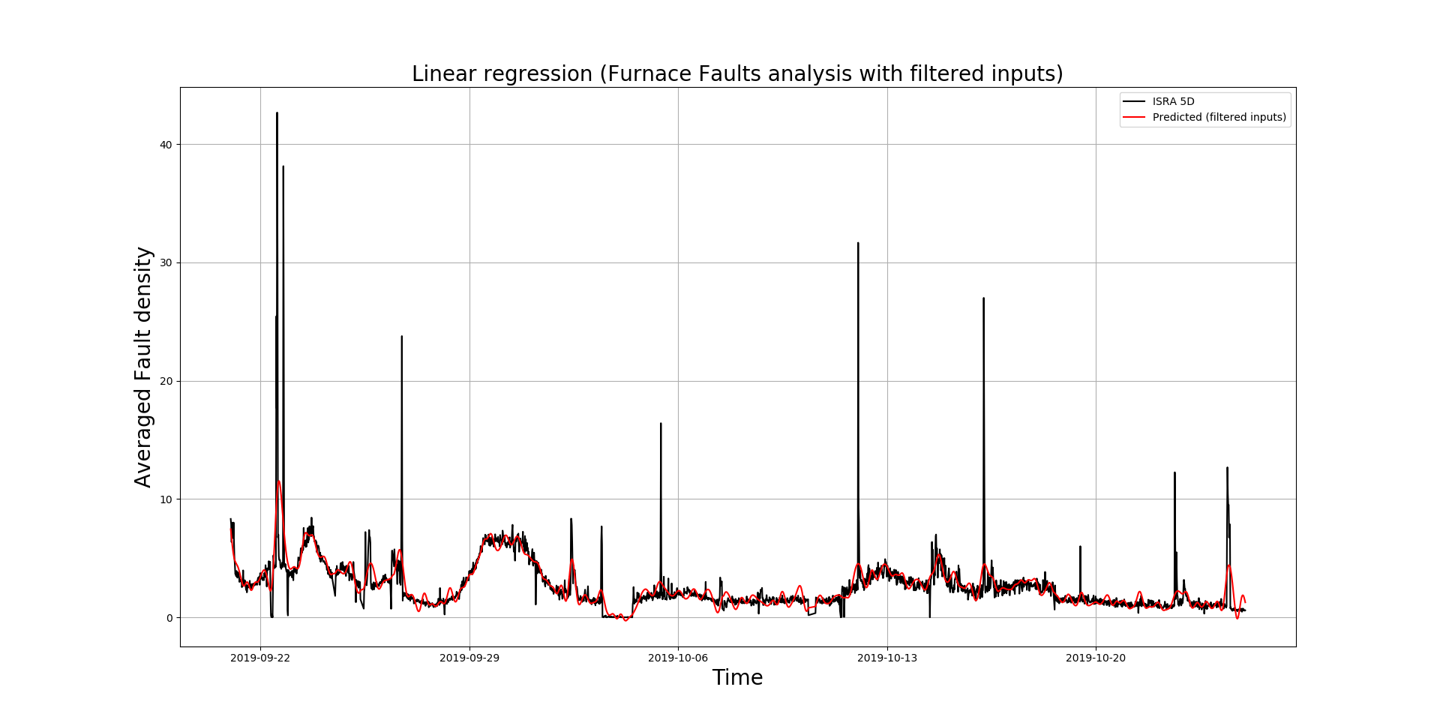
Furnace Faults Analysis

Slide 3
Normalised Root Mean Square Error
NRMSE (%)
 | Total Fault Density | Furnace Fault Density
Linear Regression: | 0.6284 | 116.85
LR Filtered Inputs: | 0.5749 | 108.81
ARX: | 0.0111 | 147.92
ARX Filtered Inputs | 0.0097 | 141.83
LR - Time-lag analysis (Filtered Inputs) | 0.1753 | 25.999

Slide 4
Thank you for your attention. ANY QUESTIONS?

Slide 5
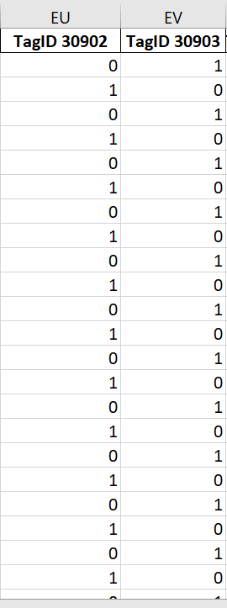
Tag data
Boolean sensors
Boolean sensors are not considered in the analysis. Should we consider them to capture the spikes?

Slide 6
Questions from the consultancy project:
Was filtering the right thing to do? Certainly uncovered an interesting relationship between the low frequency components of the data.
We can used methods much more advanced than linear regression (GP, for example) – do we need to?
Autoregressive model applied to filtered data?
We can also try using ‘lagged’ tag data to aid predictions.
Alternatively, we can simply investigate mapping directly to future fault data.
So far our models have fixed parameters. We can try having time-varying parameters – applicable if furnace conditions are fundamentally changing over time.
Linear regression is very interpretable – can think about the best way to present how this model is realising predictions.
Uncertainty quantification can be ‘folded’ into all of these approaches.

