Slide 1


Slide 2
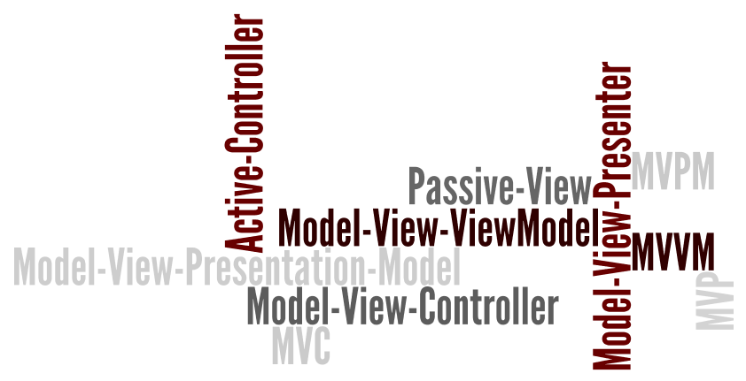
MV* Family

Slide 3
Components
Events
HTML Templates
Collections
Views
Page / DOM
Models
Routers
URL / Hash
Change (Route)
Models
Models

Slide 4


Prerequisites
required
Underscore.js
or

Slide 5
Views
Collections
HTML / Templates
MyView = Backbone.View.extend({
el: “#someElement”,
events: { … },
render: function(){
this.model;
this.collection;
}
});
Models
Page / DOM

Slide 6
View Events
MyView = Backbone.View.extend({
events: {
“click #save”: “saveClicked”,
“click #cancel”: “cancelClicked”,
“change :text”: “nameChanged”
},
saveClicked: function(e){
// …
},
cancelClicked: function(e){
// …
}
});
First Name:
Last Name:
cancel
Save

Slide 7
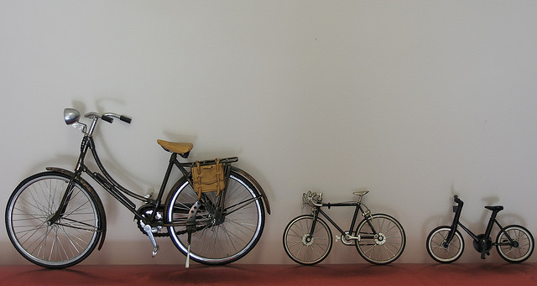
Models & Collections
Image From: http://www.flickr.com/photos/macinate/2056496970/sizes/z/in/photostream/

Slide 8
Routing & History
MyRouter = Backbone.Router.extend({
routes: {
“inbox”: “showInbox”,
“inbox/:id”: showEmail”
},
showInbox: function() { … },
showEmail: function(id) { … }
})
My Inbox
Content For Email 13339d0a…

Slide 9

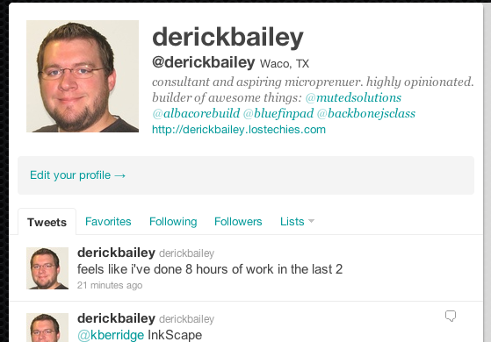
#! Routes

Slide 10


Pushstate / History API
http://diveintohtml5.info/history.html
Backbone.history.start({pushState: true});
Notes:
Kyle Simpson’s discussion from earlier today
Backbone has a fallback to use hash routes for browsers that don’t support the history api

Slide 11
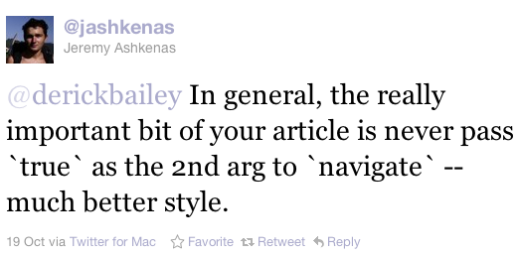
Routing & Code
https://twitter.com/#!/jashkenas/status/126768987936784384

Slide 12
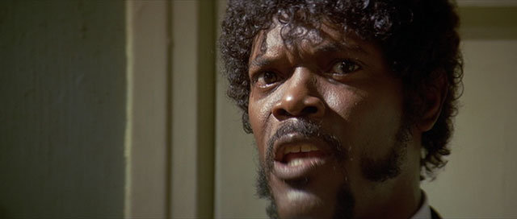
STATE! Do you speak it?!

Slide 13
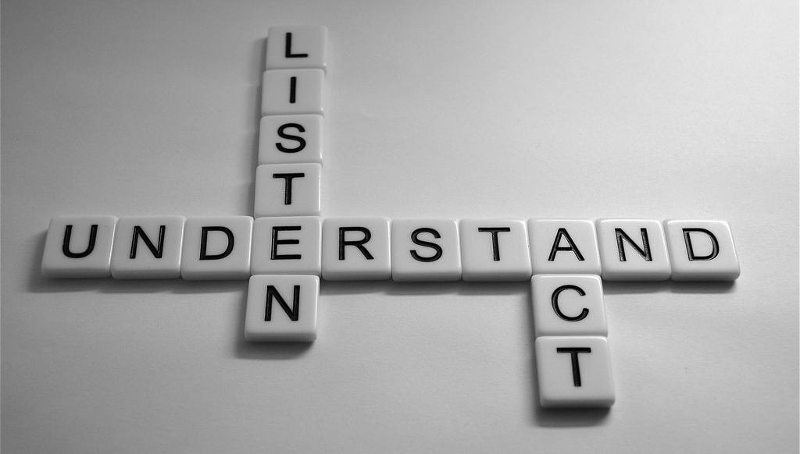
Events
Image From: http://www.flickr.com/photos/highersights/6231641551/sizes/l/in/photostream/

Slide 14
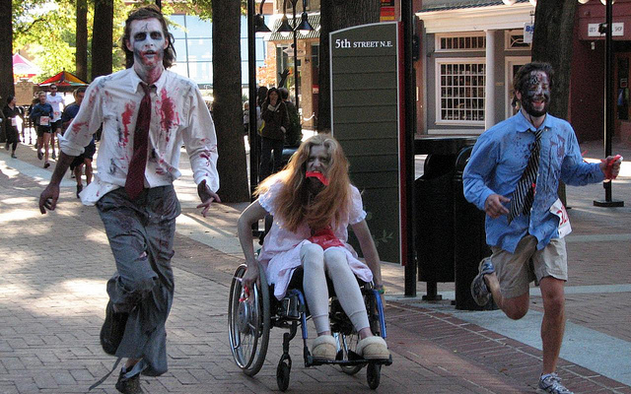
ZOMBIES! RUN!
Image From http://www.flickr.com/photos/reabhecc/5090344285/sizes/z/in/photostream/

Slide 15
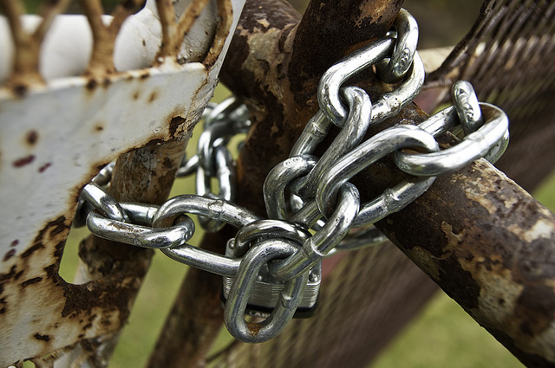
Unbind
Image From: http://www.flickr.com/photos/trekmtber/4054110301/sizes/z/in/photostream/

Slide 16
Resources
DocumentCloud.github.com/backbone
BackboneScreencasts.com
Workshops.Thoughtbot.com/backbone-js-on-rails
RecipesWithBackbone.com
BackboneTraining.net/resources ( <---- my site )
About Me
Independent consultant, contractor, author, trainer, code slinger
Twitter: @derickbailey Email: derickbailey@gmail.com
Blog: DerickBailey.LosTechies.com Web: MutedSolutions.com

