Slide 1
An Improved Genetic Algorithm With A Local Optimization Strategy And An Extra Mutation Level For Solving Traveling Salesman Problem
Derick Hansraj
Queens College
Professor Goldberg

Slide 2
Abstract
The use of a genetic algorithm is the best approach when it comes to solving the Traveling salesman problem(TSP). The TSP itself is for the most part NP complete so therefore it cannot be solved efficiently. This paper utilizes two different approaches which are thoroughly discussed. The first approach is the conventional Genetic algorithm while the second approach is a hybrid Genetic algorithm. The results of the computation show that the hybrid approach results in better paths in efficient and acceptable computation time.

Slide 3
Introduction
The basic genetic algorithm randomly generates chromosomes called population. Each chromosome represents an individual solution.
The algorithm then map elements into a new set of the population.
The algorithm finds an approximate solution over a series of iterations, called generations.
Then during each generation each element is given a fitness value and those with greater value are chosen to be included in the the upcoming generation.
The algorithm runs in a sort of loop until a max generation is reached or when an acceptable limit such as fitness level has been reached.
Due to how inefficient it is to find exact answers to some problems, genetic algorithms are used to find a steady mix between the best and most approximate answers.
Genetic algorithms can be combined with other intelligent algorithms for better performance as seen here in the text.

Slide 4
Background
The TSP was developed in 1930 and remains heavily studied due to its impact on benchmarking and optimization.
The TSP has many real world applications such as planning, logistics, and the manufacturing of microchips.
The goal of the TSP is to find the shortest distance through each city given different distances between each city on a map.
There are no polynomial time algorithms for it.

Slide 5
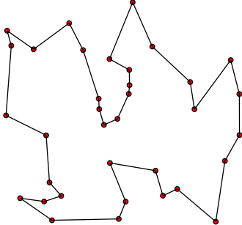
Defining the problem
The problem can be worded by the following, "Given a list of cities and the distances between each pair of cities, what is the shortest possible route that visits each city exactly once and returns to the origin city?"
The salesperson has to start from one city.
Then he has to go all of the provided cities.
After visiting all cities the salesperson has to return to the origin city
TSP is all about finding the path with the least cost (distance).

Slide 6
Literature Review
Genetic Algorithm for Traveling Salesman Problem with Modified Cycle Crossover Operator, Hussain, Muhammad, Sajid, Hussain, Shoukry, Gani, 2017
In this text path representation techniques are used, particularly partially mapped, ordered, and cycle crossover. They are compared to the proposed crossover(CX2). The proposed crossover is referred to as CX2 as it shares many similarities to CX.
The difference between the steps of CX and CX2 differ as described below:
Step 1. Choose two parents for mating.
Step 2. Select 1st bit from second parent as a 1st bit of first offspring.
Step 3. The selected bit from Step 2 would be found in first parent and pick the exact same position bit which is in second parent and that bit would be found again in the first parent and, finally, the exact same position bit which is in second parent will be selected for 1st bit of second offspring.
Step 4. The selected bit from Step 3 would be found in first parent and pick the exact same position bit which is in second parent as the next bit for first offspring. (Note: for the first offspring, we choose bits only with one move and two moves for second offspring’s bits.)
Step 5. Repeat Steps 3 and 4 till 1st bit of first parent will not come in second offspring (complete a cycle) and process may be terminated.
Step 6. If some bits are left, then the same bits in first parent and in second offspring till now and vice versa are left out from both parents. For remaining bits repeat Steps 2, 3, and 4 to complete the process.
MATLAB code is used for comparison and the results are listed in a table.
The CX2 method along with the other crossovers are used with ft53, dantzig42, and ftv170 problems and perform exceptionally well compared to the others.

Slide 7
Experimentation
PMX (Partially Matched Crossover)
OX (Order Crossover)-
CX (Cycle Crossover)
Mutation strategy
First local optimization strategy
Second local optimization strategy

Slide 8
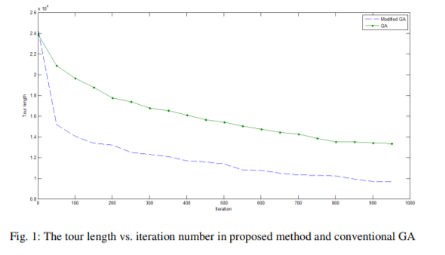
Experimental Results

Slide 9
Discussion of the results
The results obtained from the experiment show how much of an improvement the hybrid GA was compared to the conventional GA.
The difference in length was consistent as the number of iterations increased.

Slide 10
Conclusion
This paper has many clever and interesting uses of genetic algorithms.
An improved hybrid GA by way of conventional GA and local optimization techniques are used to achieve a much faster method of solving the TSP.

Slide 11
Future Research
The author has future plan to use other meta-heuristic algorithms instead of GA and apply this hybrid algorithm developed here.
It would be a great advantage to the field of genetic algorithms.
The methods developed in this paper perform better than the average conventional genetic algorithm.
There can be further optimizations for specific types of problems which can benefit from algorithms that are specific to the problem.
If I were the author I would work on implementing specific hybrid GA’s for other Np complete problems that are similar to TSP. The experiment and research provided could also enable others to continue this trend and possibly develop these algorithms as well.

Slide 12
Acknowledgement
Franck Dernoncourt
Research Scientist at Adobe Research, Quora
Sushant Sharma
Software Engineer at Microsoft, Quora

Slide 13
Bibliography
Borna, K., & Hashemi, V. H. (2014, August). AN IMPROVED GENETIC ALGORITHM WITH A LOCAL OPTIMIZATION STRATEGY AND AN EXTRA MUTATION LEVEL FOR SOLVING TRAVELING SALESMAN PROBLEM [PDF]. Tehran: International Journal of Computer Science, Engineering and Information Technology (IJCSEIT).
Abid Hussain, Yousaf Shad Muhammad, M. Nauman Sajid, Ijaz Hussain, Alaa Mohamd Shoukry, Showkat Gani, "Genetic Algorithm for Traveling Salesman Problem with Modified Cycle Crossover Operator", Computational Intelligence and Neuroscience, vol. 2017, Article ID 7430125, 7 pages, 2017. https://doi.org/10.1155/2017/7430125

