Slide 1


IIT Challenge logo
Desa Marga Mulya
Village Services, Open Data & Local Trade in One Website
EcoQuest Web Application | IIT Challenge 2026
Member 1
Member 2
Member 3
Notes:
Good morning. We are presenting the official website for Desa Marga Mulya in Mauk, Tangerang: village services, open data, and a local marketplace in one place, all managed through a CMS.

Slide 2

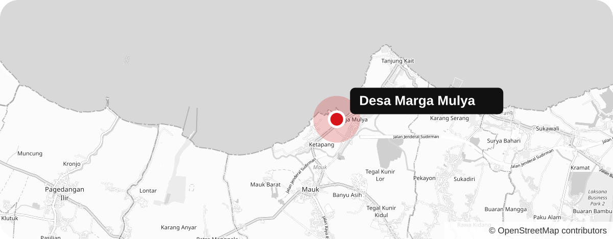
Village
Problem
Solution
Demo
Impact
A COASTAL FARMING VILLAGE
“Rice fields, milkfish ponds, and the Java Sea”
RESIDENTS
RICE FIELDS & FISH PONDS
FARMING & FISHING JOBS
7,842
55%
41%
2,318 households
228 of 412 ha of land
1,638 of 4,035 workers
Notes:
Marga Mulya sits on the north coast of Tangerang. More than half of its land is rice fields and fish ponds, and about four in ten workers farm or fish. Village figures follow the competition's data structure and can be replaced with official data in the CMS.

Slide 3


Village
Problem
Solution
Demo
Impact
Connected, But Not Informed
Search “Desa Marga Mulya Mauk”: 0 official websites found
Rural Reach
The Analog Trap
The Nation’s Engine
74%
of rural residents are online
6 of 10 MSMEs are still offline
61%
97%
of GDP
of jobs
yet rural areas make up only 30.5% of national internet use
27M of ~65M MSMEs are digital
MSMEs carry the economy, but most still sell offline
source: APJII Internet Survey, 2024
source: Statista 2023; GoodStats 2023
source: Kemenkeu, via ITEJ journal
Notes:
80 percent of Indonesians are online, and 74 percent of rural residents too, yet rural areas generate only 30 percent of internet use. When we searched for Desa Marga Mulya we found no official website. Six in ten small businesses are still offline, even though they generate 61 percent of GDP and 97 percent of jobs.

Slide 4




Village
Problem
Solution
Demo
Impact
Our Unfair Advantage
Village information and local trade, in one place
Rich village info
LIVE OFFICE STATUS
7
Desa Marga Mulya
service checklists
Village info systems
OPEN VILLAGE DATA
42
tables, CSV export
No local trade
Local trade built in
PASAR DESA
0%
seller commission
Village social media
Big marketplaces
TANYA DESA AI
24/7
answers from CMS data
Little village info
Indicative positioning by team
Notes:
Village information systems give data but no trade. Marketplaces give trade but take fees and know nothing about the village. Our website does both: live office status with service checklists, 42 open data tables, a commission-free village market, and an AI assistant that answers from the village's own data.

Slide 5

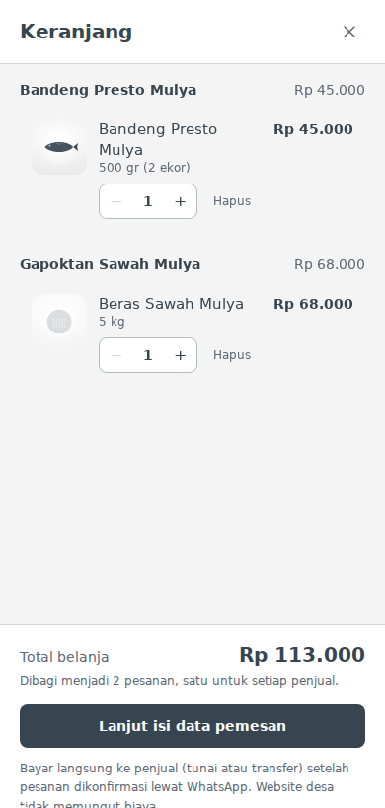
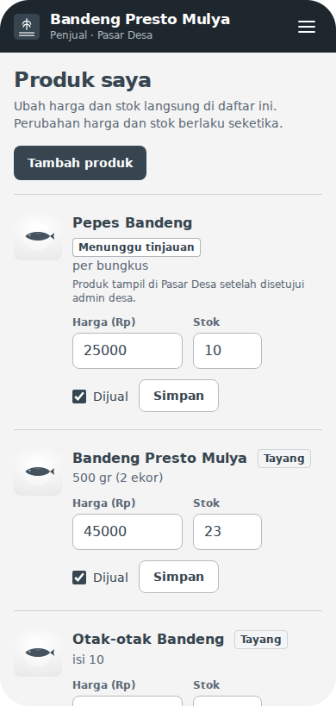










Village
Problem
Solution
Demo
Impact
Built and Live
Live demo: desa-marga-mulya.vercel.app
Home: live office status
Cart split per seller
Seller portal
Tech Stack
Next.js
React
TypeScript
Tailwind
PostgreSQL
Vercel
Gemini AI
Leaflet
CI tests
Notes:
This is the live site. Residents see whether the office is open right now. In the Pasar Desa, one cart can hold products from several sellers and becomes one WhatsApp order per seller. Sellers manage price and stock from their phone, and new products are reviewed by the admin first.

Slide 6
Village
Problem
Solution
Demo
Impact
A True Win-Win-Win
Impact & feasibility
Residents
Village Office
Sellers
7
services with checklists
Rp 0
monthly hosting
0%
commission
24/7
AI answers
11
CMS collections
3
steps to WhatsApp order
0
trips just to ask
109
automated checks
16
products online
SDG 8 Decent work
SDG 9 Innovation
SDG 11 Communities
SDG 16 Institutions
Notes:
Residents get answers without a trip to the office. The village office pays nothing per month on free tiers and updates everything through the CMS, backed by 109 automated checks. Sellers keep all their income and take orders in three steps. This supports SDGs 8, 9, 11, and 16.

Slide 7


IIT Challenge logo
THANK YOU
Village information, one tap away.
10
42
16
public pages
data tables
local products
Scan to try the live demo
desa-marga-mulya.vercel.app
Notes:
To sum up: residents get answers without a trip, local businesses get a commission-free market, and the village gets a website its own staff can run. Scan the code to try it. Thank you.

