Slide 1
Genomecomb tutorial
Peter De Rijk

Slide 2
Very Basic Bash
    Bash
      The command line shell you will be in
      Tab completion
    File system commands
      pwd: display the present working directory
      ls: list files in the current directory
      ls path: lists the files in the directory given by “path”
      cd pathname: changes the present working directory
      cp: copy files, e.g. cp file1 file2
      ln -s: like cp, but makes a soft (or symbolic) link
      mv: rename (move) files (e.g. mv test.tsv good.tsv)
      rm: remove files (e.g. rm temp.tsv) (no undo!)
      mkdir: make a new directory (e.g. mkdir testdir)

Slide 3
Very Basic Bash
    Basic usefull commands
      Display
        cat: show contents of file(s) (e.g. cat projectinfo.tsv)
        less: show contents of file, page by page (e.g. less info.txt)
        head (tail): show first (last) lines of file
      Help
        man: display manual of a command (e.g. man cp)
        cg help | less -r
        cg select -h | less -r
      Other
        wc: word count (also counts lines)
        grep: search for a pattern

Slide 4
Very Basic Bash
    Wildcards
      e.g. ls *.tsv: shows only files that end with .tsv
    Input/output redirection (pipes)
      Most programs send output to stdout (the standard output), usually the screen
        Use > to write output of a (any) command to a file instead of to the screen
        e.g. “ls > filelist.tsv” writes the names of files in the curent directory to the file filelist.tsv
        Use >> to append output to a file
      Most programs can accept input from stdin
        Stdin can be redirected using < (e.g. less < info.txt)
      |: the “pipe” symbol is used to send output of one command as input of another
        e.g. “ls | wc” counts how many files are present in dir

Slide 5
Analysis pipelines
 | mastr | exome | CG genome
Adaptor clipping | fastq-mcf | fastq-mcf | CG
alignment | bwa | bwa
Duplicate removal | - | picard
realignment | gatk | gatk
Variant calls | gatk,samtools | gatk,samtools
Conversion | vcf2tsv | vcf2tsv | process_sample
Comparison | multicompar | multicompar | multicompar
Annotation | annotate | annotate | annotate

Slide 6
Sample directory: Region files
  Sequenced region file
      Tab-separated file
        fields chromosome, begin, end
        Each line is a genomic region
        Sorted
      Genomic regions that can be considered sequenced
      given the coverage and quality cutoffs used in the corresponding variant file
      File name sreg-varcaller-mapper-sample.tsv
        e.g. sreg-gatk-rsbwa-NA19240.tsv
          region file for sample NA19240
          alignment using bwa after duplicate removal and realignment (rdsbwa)
          variants called using gatk

Slide 7
Sample directory: Region files
  Many calculations with regions
      cg covered: number of bases in regions
      cg regsubtract: subtract regions
      cg regcommon: common regions
      cg regjoin: join regions
      … (cg help for list)
    Examples
      How large (bases) is the region covered by sreg.tsv
        cg covered sreg.tsv
      find which targetted regions were not sequenced:
        cg regsubtract targetreg.tsv sreg.tsv > missing.tsv
      How large is the region of the sequenced genome are we missing
cg regsubtract /complgen/refseq/hg19/extra/reg_hg19_sequencedgenome.tsv sreg.tsv | cg covered

Slide 8
Sample directory:
Variant files
  Variant list file
      Variant list with snps+small indels in sample
      Tab-separated, one variant per line, sorted
      File name var-varcaller-mapper-sample.tsv
        e.g. var-gatk-rdsbwa-NA19240.tsv
        for CG → link to fannotvar-sample.tsv
  Variant list basic fields
      chromosome, begin,end (genomic location)
      type: snp, del, ins, sub
      ref: reference sequence
        number if large
      alt: alternative allele
        Comma separated lists if multiple
        Split mode: if multiple alt alleles → each on separate line

Slide 9
Sample directory:
Variant files
  Variant list genotype data fields
      alleleSeq1, alleleSeq2
        Genotype, Empty for deletion
      zyg
        m (homozygous), t (heterozygous), c (compound)
        o (other, only for split mode)
        r (reference)
        u (unsequenced)
      (phased: 0 if no phase)
      genotype (from GT in vcf)
        List of genotype numbers
          0 for ref, 1 for first alt, ...
          Comma (,) separated for phased genotypes (| in vcf)
          ; separated for unphased (/ in vcf)
        Allows other ploidies than 2

Slide 10
Sample directory:
Variant files
  Variant lists quality fields
      Variant callers determine a variant based on
        number of alt and ref alleles (fw and reverse)
        qualities for all these alleles, mapping qualities
        Priors, neighborhood quality, …
        → combined in a call and quality score(s)
      CG
        totalscore1,totalscore2 (CG): confidence for each allele
          Likelihood ratio in dB → 10log10(L call/L next best call)
        refscore (CG): likelihood ratio for reference call
      gatk, samtools (Illumina)
        quality (QUAL field in vcf)
          Phred-scaled quality score for the assertion made in ALT
          −10log10 prob(call in alt is wrong)
          e.g. quality 20 → 1/100 probability of error

Slide 11
Sample directory:
Variant files
  Variant lists other fields
    coverage
      From genotype DP in vcf, or coverage in CG
      Number of reads covering the variant position
      Should be high enough for good quality calls
      better to also keep a minimum coverage cutof
        Variant callers sometimes tend to make (usually low quality) calls even on very low coverage (e.g. 3 reads)
      Can differ from depth seen in mapping file
        badly mapping or low quality reads could be filtered
        CG uses 2 passes, adding reads in potential variant areas found in first pass
    totalcoverage
      variant DP, converted from vcf info field

Slide 12
Sample directory:
Variant files
  Variant lists other fields converted from vcf
      frequency (AF)
      alleledepth (AD)
      allelecount (AC), totalallecount (AN)
      filter (FT)
      loglikelihood (GL, list genotype likelihoods)
      ancestralallele (AA)
      dbsnp (DN), hapmap2 (H2)
      genoqual (GQ), haploqual (HQ)

Slide 13
Sample directory:
Variant files
  Variant lists other fields direct from vcf
      Other vcf data are converted to columns where the column name is the same as the vcf code, e.g.
        PL (phred scaled GL), HQ (haplotype qualities),
        PS (phase set), PQ (phasing quality)
        MQ (RMS mapping quality)
        ...
      More information on these fields (from the vcf header) is in the comments of the tsv file
      http://samtools.github.io/hts-specs/VCFv4.2.pdf
  Variant list annotation fields
    Variant impact (CG), ...
    cluster

Slide 14
Sample directory:
Variant info completion
  Info on reference positions
      Needed later in comparisons
    varall-varcaller-mapper-sample.tsv.gz (illu)
      reference+snps in sample for all (callable) positions
      Sequenced regions (sreg) are extracted from this file
        currently: $quality >= 30 and $totalcoverage >= 5x
    coverage-cg-samplename (CG)
      Information on coverage, refscore for all positions
      Info comes from ASM/REF/coverageRefScore-* files
      directory containing many bcol files
        Each contains info on one field for one chromosome
        Filename: field-chromosome-sample.bcol
        Actual data in compressed binary file .bcol.bin.rz

Slide 15
Sample directory:
Structural variants
  Structural variants (CG)
      Detected by discordant mate pairs
        Insert size or orientation different from expected
      insertions, deletions, inversions, translocations
  cgsv-sample.tsv
        Basic fields
          Variant: Chromosome, begin, end, type, id, type
          type: ins, del, inv, trans
        Other
          Mapping positions of discordant reads: strand1, start1, end1, size, strand2, chr2, start2, end2
          Quality: (score, scoretype,) DiscordantMatePairAlignments,
          Info: transitionLength, StrandConsistent, ….
          Annotation: LeftGenes, RightGenes, Xref, ...

Slide 16
Sample directory:
CNV files
  CNV calls (CG)
      Based on coverage vs reference baseline
      del ~ del in sv
      amp (Amplification) very different from sv calls
  cgcnv-sample.tsv
      Fields
        Variant: chromosome, begin, end, type, calledPloidy
        Quality: ploidyScore, CNVTypeScore
        Source: AvgNormalizedCvg, relativeCvg
        Annotation: overlappingGene, knownCNV, repeats

Slide 17
Compar directory
Variant comparison
  Multicompar variant file
      Filename compar-projectname.tsv
      Tab-separated variant file
      Each line contains one variant for multiple samples
      Variant fields: chromosome,begin,end,type,ref,alt, ...
      Sample specific fields
        Value can differ for each sample → separate columns
        Column names: fieldname-samplename
          e.g. zyg-sample1
        Multiple dashes in case of multiple methods
          e.g. zyg-gatk-rsbwa-sample1

Slide 18
Compar directory
Variant comparison
  Multicompar variant file creation
      Add variant files
        cg multicompar comparfile varfile1 varfile2 ...
        Lines of same variant are merged
          alt in non-split mode may gain new alleles in list
        Variants that are new in comparfile or varfile
          → columns are filled with ? (for unkown)
      Complete data in reannot step
        cg multicompar_reannot comparfile
        Fill in data for variants that were not in varfile (?)
          From files in sampledir (found based on name and location)
          sreg files → reference (r) or unsequenced (u)
          additional sample data from varall or coverage dir: coverage, quality, …

Slide 19
Compar directory
Region comparison
  Multireg file
      Filename reg-projectname.tsv
        Combines info on multiple region files
        Tab-separated region file (chromosome,begin,end)
        One field added for each regfile
          Name field = base name of the original regfile
          Value field = 1 if region is present, 0 if not
      cg multireg multiregfile regfile1 regfile2 ...
        Used to create multireg
        One region in one regfile may be split up in multiple adjoining regions
      Can be queried, …

Slide 20
Compar directory
Other variants
  Multicompar files for other variants
    structural variants (CG)
      cgsv-project.tsv
      Made using cg svmulticompar
        approximate matching, allows doubles
    cnv variants (CG)
      cgcnv-project.tsv
      Made using cg svmulticompar
    Structural variants (in house)
      sv-project.tsv
      Made using cg svmulticompar

Slide 21
Compar directory
Annotation
  Annotated variant comparison files
    Compar files with added fields with all kinds of information about the variants
      e.g. impact, conservation, repeats, …
      All available annotation files in reference data directories (dbdir)
        /complgen/refseq/hg18
        /complgen/refseq/hg19
    Annotated files in compar
      annot_compar-project.tsv
      annot_cgsv-project.tsv
      annot_cgcnv-project.tsv

Slide 22
Compar directory
Annotation
  Annotation files
    Files with name type_build_name.tsv
      Tab separated file
      3 types: region, gene, var
      Build: hg18, hg19
      Name: base for names of fields added as annotation
        Default fields used for annotation are (depending on type): name, name2, freq, score
        e.g. fields added from var_hg19_snp135.tsv
          snp135_name, snp135_freq
    Info file: type_build_name.info
      Information on annotation file
    Annotation option file (.opt)
        Change base name (name), fields

Slide 23
Compar directory
Region Annotation
  Region annotation files
      Region file: chromosome,start,end
      Variants are annotated if region overlaps
      Annotation files in reference dirs
        Repeats: microsat, rmsk, simpleRepeat, chainSelf, genomicSuperDups, homopolymer
        Info: cytoBand
        Conserved: phastConsElements46, evofold
        Regulatory: oreganno, tfbsConsSites, vistaEnhancers
        nc genes: tRNAs, mirbase, targetScanS, wgRna
        dgvMerged: sv regions
        gad: Genetic Association Database
        Encode (wgEncode*): CaltechRnaSeq, H3k27ac, H3k4me1, H3k4me3, RegDnaseClusteredV2, RegTfbsClusteredV3

Slide 24
Compar directory
Gene Annotation
  Gene annotation files
      genepred-like format
        Tab-separated files, one transcript per line
        Fields:
          chromosome, begin, end, name, strand, cdsStart, cdsEnd
          lists: exonCount, exonStarts, exonEnds
      Annotation
        effects of variant on the transcripts/genes
          Comma separated list for multiple alt alleles
          ; separated for different transcripts
        Adds fields
          name_impact: impact
          name_gene: affected gene(s)
          name_descr: standard variant effect notation

Slide 25
Compar directory
Gene Annotation
    Impact:
        downstream, upstream, annot, intron
        reg, prom (promotor), splice (splice region)
        RNA, RNASPLICE (splice site deleted)
        UTR3, UTR3SPLICE, RNAEND (transcription_end),
        ESPLICE (essentialsplice)
        UTR5, UTR5SPLICE, RNASTART (transcription_start),
        CDSsilent, CDSMIS, CDSDEL, CDSINS ,CDSSPLICE
        CDSNONSENSE, CDSDELSPLICE, CDSSTOP, CDSFRAME, CDSSTART, CDSDELSTART
        GENEDEL
    descr example:
      +NM_001005484:exon1:310:c.C311T:p.E104V

Slide 26
Compar directory
Gene Annotation
    Gene annotation files in refseq
      refGene: RefSeq Genes
      KnownGene: UCSC Genes track
      ensGene: from Ensembl
      gencode: encode subproject
      acembly: predictions based on cDNA mapping
      Genscan: “ab initio”: much more, much less reliable

Slide 27
Compar directory
Variant Annotation
  Variant annotation files
    var_build_name.tsv
      Tab-separated variant list
      Non-split format!
    Annotation
      Adds name, freq of variant in annotation file
      Only if it completely matches, also alt allele!
      “-” for not present in annotation file
      For non-split format files: can be list
    In reference dbdir
      snp138 (dbsnp), snp138Common (dbsnp > 1%)
      1000gCEU, 1000gCHBxJPT, 1000gYRI, 1000glow

Slide 28
Annotation: extra
  Reference data directories (dbdir)
    /complgen/refseq/build
      Contains default annotation files
      Also genome sequence, …
    Subdirectory extra
      Interesting ref data, not used by default for annotation
      Reg (info) files
        reg_hg19_fullgenome.tsv
        reg_hg19_sequencedgenome.tsv, ...
      Conservation
        reg_hg19_GERP.tsv (huge file)

Slide 29
Annotation: dbnsfp
    dbnsfp in extra: var_hg19_dbnsfp.tsv
      info only for coding regions
      Functional predictions
        sift, polyphen, LRT, MutationTaster, FATHMM
      Conservation
        PhyloP, GERP++, SiPhy
      Variant
        Exome variant server
          ESP_AA_AF: Alternative allele frequency in Afrian American samples
          ESP_EA_AF: Alternative allele frequency in European American samples

Slide 30
Annotation: annotate
  Annotation using cg annotate
    cg annotate variantfile resultfile annotfile1 …
      If annotfile is a directory, all available files in this dir are used, e.g. default annotation:
          cg annotate variantfile resultfile /complgen/refseq/hg19
      Option -near allows annotation of features near variant
      You can also annotate your own variant files
      You can also use your own annotation files

Slide 31
Querying
Need to select/prioritize variants
    Balance sensitivity vs specificity
      Depends on project/question
      Practical issues: how much is actionable
        Technical validation
        Follow-up in other patients/family/controls
    Multicompar files give broad information
      Sensitivity: includes low quality (even “unsequenced”) variants
      Not filtered: annotated with information that can be used to query/filter adaptively
    Tools to do this querying
      cg select, cg viz

Slide 32
Selection/filtering
  Quality (see paper)
    Based on sequencing quality data (coverage, ...)
    Based on regions (repeats, ...)
    Based on method: consensus calling
  Functional
    Impact (coding, regulatory, ...)
    Novelty (1000genomes, dbSNP, ...)
    Comparison (shared or linked regions, mendelian errors, …)
    Some functional filters have effect on quality
      e.g. presence in multiple genomes

Slide 33
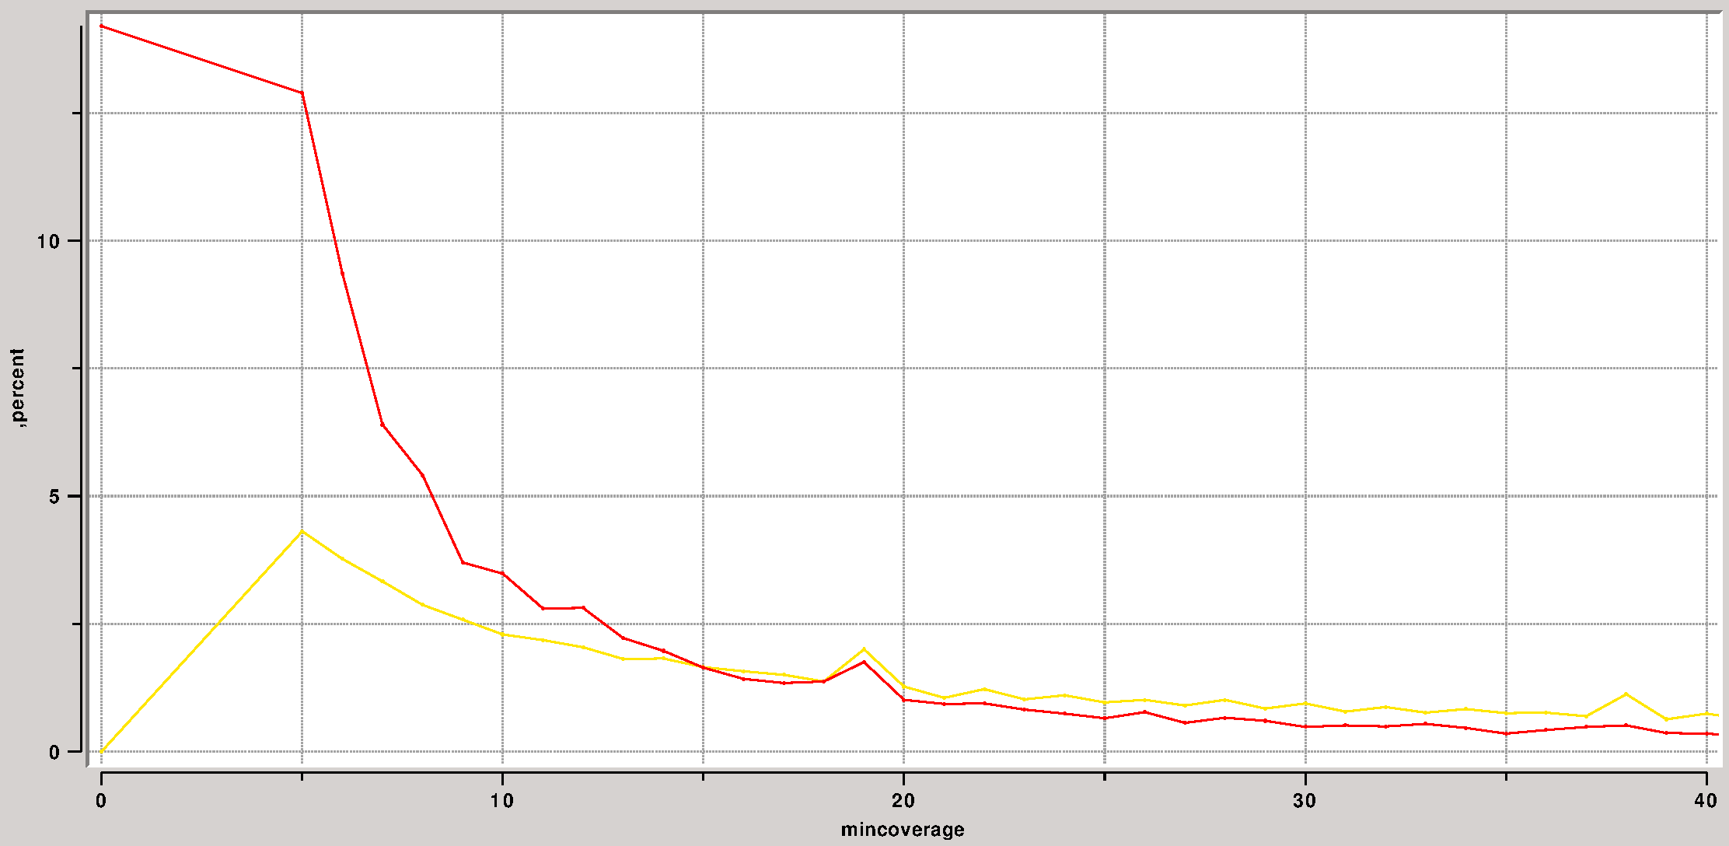

Twin exomes: coverage
Twin exomes
    Diff = differences (mostly errors in one)
    Same = same variant called (mostly correct)

Slide 34
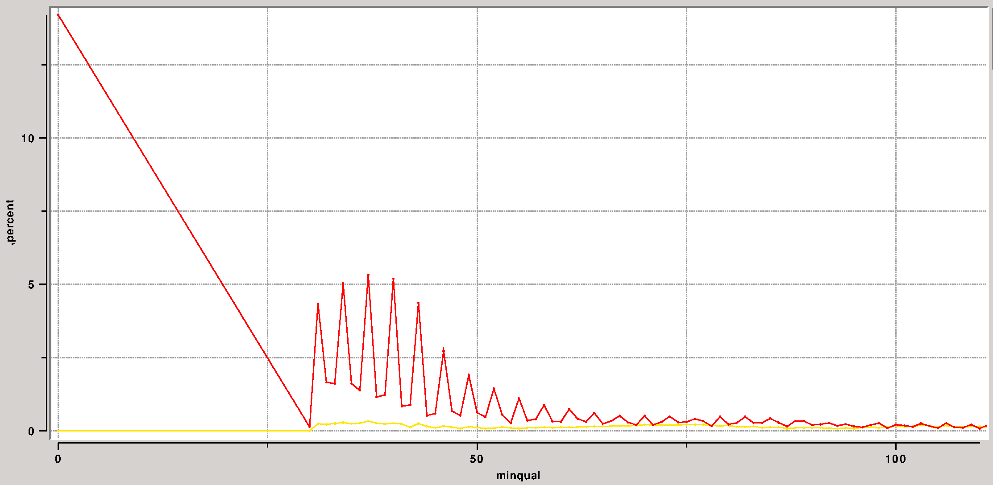
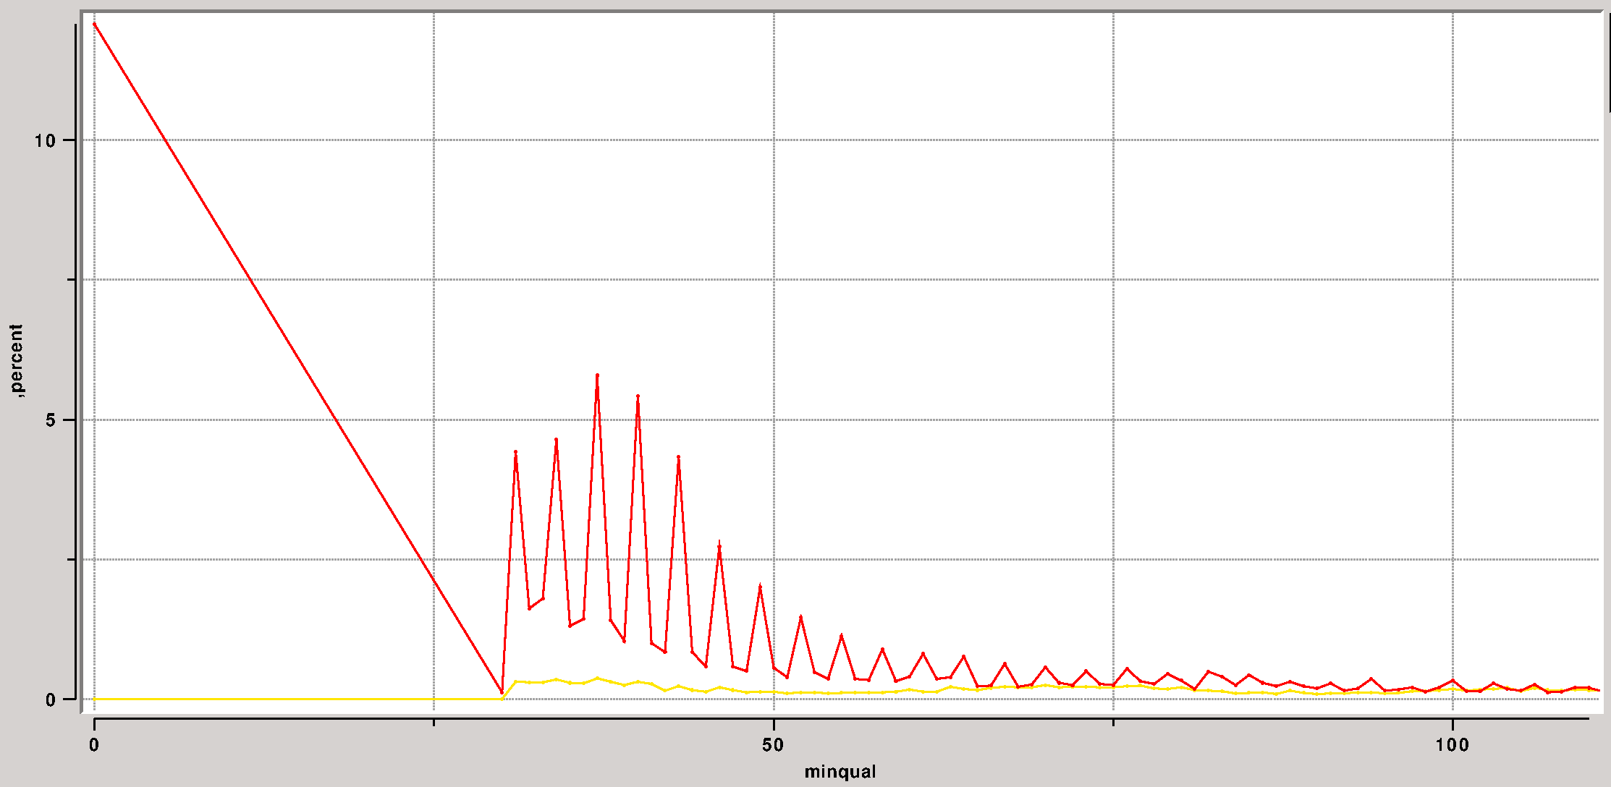
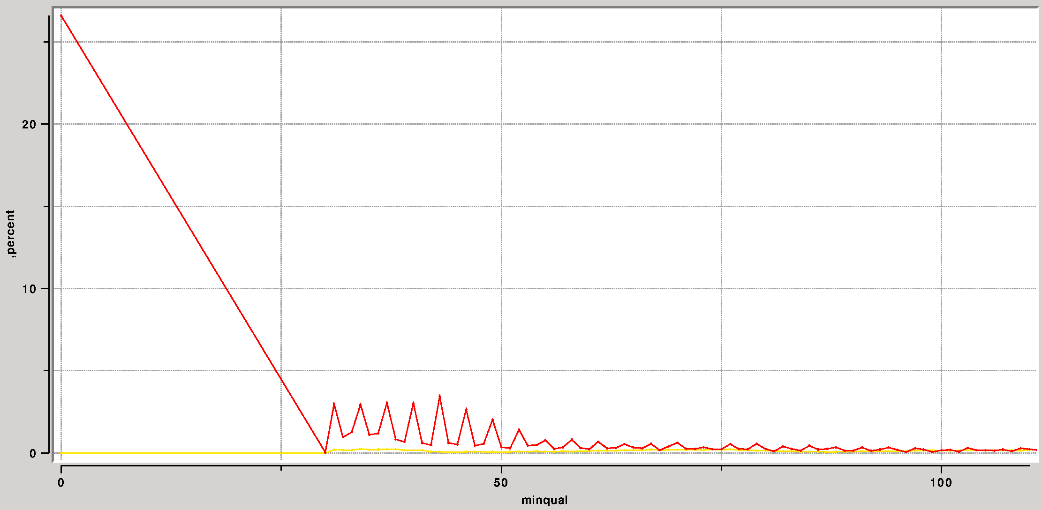
Twin exomes: quality

Slide 35
Twin exomes: filters
filter | ratio
minqual | 10.45
simple | 5.12
microsat | 5.07
consensus | 4.79
cluster | 4.04
genomicSuperDups | 2.77
mincoverage | 2.33
homopolymers | 0.9

Slide 36
Query: cg select
  cg select
    Command for querying tsv files
      Help: cg select -h | less -r
      cg select ?options? ?tsvfile? ?outfile?
      Slices and dices tsv tables
      Can handle huge files
    Info options
      Header data: -h
      Names of samples: -n
    Sort (-s) option
      Sort on given fields
      natural sort
        e.g. 'chr1 chr2 chr10' will be sorted correctly

Slide 37
Query: cg select
    Query (-q) option
      Output only lines for which query expression (see further) is true
    Field (-f) option
      Only fields in given list will be in output
      Wildcards can be used
        e.g. zyg-* will include all fields starting with zyg-*
        * will add all fields (that are not in the list yet)
      Calculated fields
        fieldname=expression
        If expression contains spaces, enclose with {}
          cg select -f '{size=$end - $begin}' reg.tsv

Slide 38
Query: cg select
    Expressions in queries and calculated fields
      Variables
        $fieldname returns the value for the field
          e.g. $coverage > 15
        $ROW returns the current row number
      Operators: many are supported
        Calc (+,-,…), comparison (==,<, …), boolean (and, or)
          e.g. $coverage > 15 and $type == “snp”
      Functions: many functions supported
        Including bio (range), logical (if), vector, string
        Multifield functions
          e.g. count($field1, $field2, ..., test) → number of fields that fullfill the test
          Wildcards can be used e.g. Count($zyg-*, == “m”) counts the number of homozygous samples

Slide 39
Query: cg select
    Expressions in queries and calculated fields
      Functions: handling of numbers and lists
        Queries will give an error if you have non number values in a “number operator”
          e.g. $freq < 0.05 gives error if $freq == “-”
        Some fields contain lists (comma separated).
          Several functions (lmin,lmax, ...) and operators (contains, ...) specifically for lists
          A list of numbers is not a number! e.g. $freq == “0.1,0.05”
        Needs to be explicitly solved, e.g. lmind($freq,0) < 0.05
          lmind: take minimum in list, use default (0) for elements in the list that are not numbers

Slide 40
Query: cg select
    Expressions in queries and calculated fields
      Sample aggregates
        Aggregate (summary) info over all samples, e.g.
          scount(condition): number of samples for which condition is true
          slist(?condition?,value): values for each sample for which (if given) condition is true
          sdistinct(?condition?,value): non-redundant list
          smin, smax, ssum, savg, sstdev, smedian, smode
          spercent(condition1,condition2): returns 100.0*(number of samples for which condition1 and condition2 are true)/(number of samples for which condition1 is true)
        Condition and value can use sample specific fields without the -sample suffix
        $sample returns current sample name
        e.g. more than 5 samples have a coverage > 60
          cg select -q 'scount($coverage > 60) > 5' var.tsv

Slide 41
Query: cg select
    Groupfields: -g 'field1 filter1 …'
      A summary table will be returned
        Fields in summary table: field1,...,count
        One line for each unique combination of field1,...
        count contains number of lines in original with this combination
          e.g. number of each type of variant: cg select -g type var.tsv
        Limited by memory (of result)
      Field
        If field is not a field in tsv file → value “field” for all lines
          e.g. to count number of (data) lines: cg select -g all var.tsv
        field “sample”
          separate row will be made for each sample
          Other fields (without -sample suffix) can be used
          e.g.: cg select -g 'sample {} sequenced v' var.tsv

Slide 42
Query: cg select
    Groupfields
      Filter
        Space separated list of values
        Only lines where one these values is found are counted
        Can use a wildcard (*)
        Empty for all possible values

Slide 43
Query: cg select
    Groupcols: -gc 'field1 filter1 … functions'
      Changes summary table
        Instead of the default count
        new column for each unique combination of values in field1,field2,...,function
        Values can be filtered as in the -g option
        functions determines type of summary data
          Can be a comma separated list → one column for each function (and unique combination of field values)
          e.g. count, avg(coverage)
        e.g. average coverage of variants for each gatk sample
          cg select -g 'sample {gatk-*}' -gc 'avg(coverage)' var.tsv

Slide 44
Query: cg select
      Groupcol functions
        count:number of lines
        percent: count as percent versus total count in given column
        gpercent: count as percent versus total count in given group (row)
        min(field): minimum of all values in the field (for the given group and column)
        max(field): maximum
        avg(field): average
        stdev(field): standard deviation
        distinct(field): lists (comma separated) all distinct values found in the field
        list(field): lists (comma separated) all values found in the field (the same one can occur multiple times)

Slide 45
Query: cg viz
  cg viz
    Graphical user interface for querying
      Shows table
      Functionality (~ cg select)
        Query builder
        Field selection, calculated field builder
        Summary (group) data
        Graphs (summary)
      Can handle huge files
        Indexes file when first opening (faster display)

Slide 46
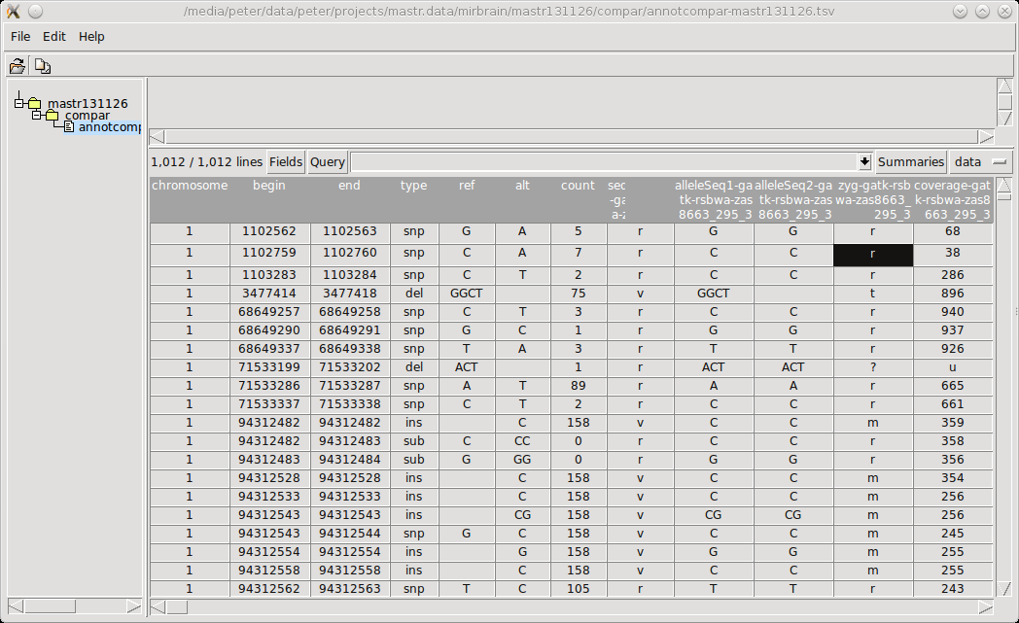
Query: cg viz

Slide 47
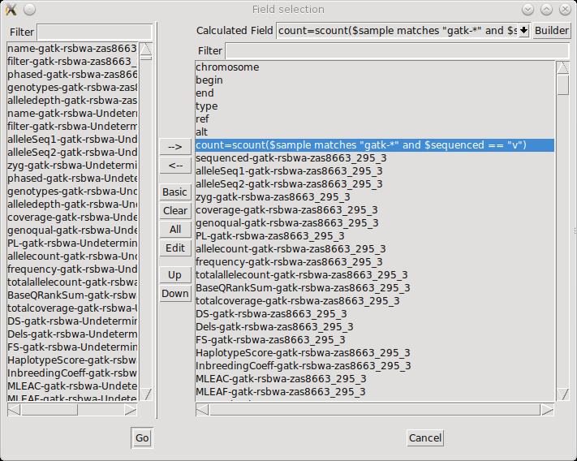
Query: cg viz

Slide 48
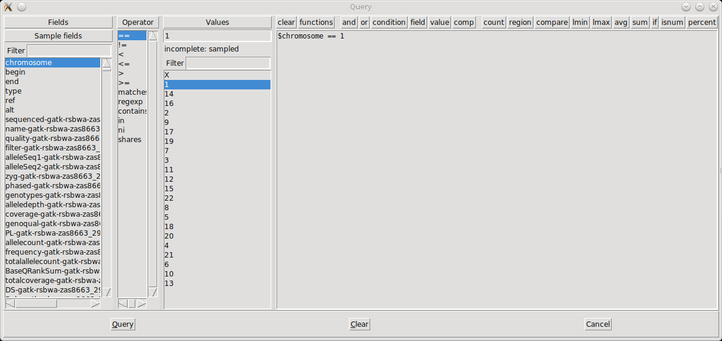
Query: cg viz

Slide 49
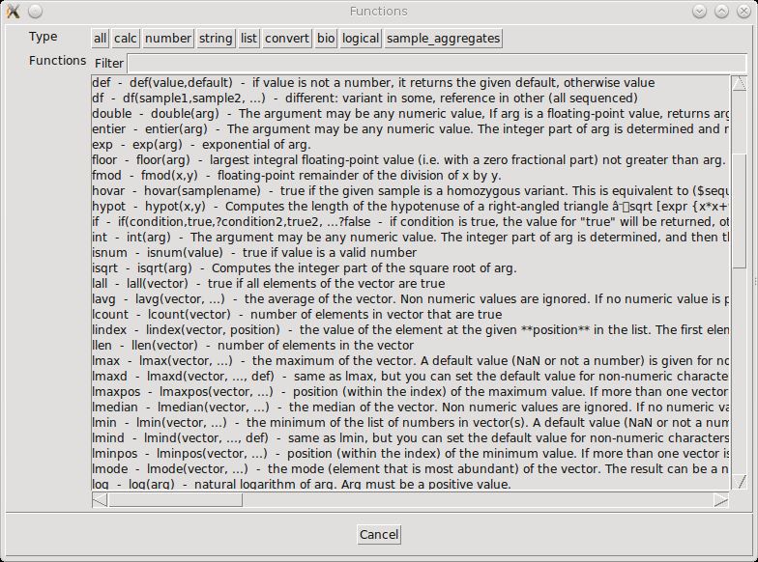
Query: cg viz

Slide 50
Validation: Sanger
Sanger sequencing
    cg makeregions
      Take closeby variants together in one target region
    cg makeprimers
      Automatic design primer pairs
        to sequence the target region
        Given size, standard primer conditions
      Tries to avoid:
        Multiple mapping positions (internal ePCR)
        Primers in repeats, primers on variants
        If these cannot be avoided → indicated in remark field
    cg primercheck
      Given set of primers → amplicons, same annotation

Slide 51
Validation: Sequenom
Sequenom validation
    cg makesequenom
      Given a variant file
      Creates input file for sequenom design
      Masking options
        -n : freq cutoff for masking dbsnp variants
        -f : freq cutoff for softmasking
        -r : how deal with repeatmasker repeats

Slide 52
More tools
genome_seq
    sequences for given regions in the genome
    Fasta file
    Masking (and other) options
Exportplink
    create files for genetic analysis (plink)
liftover: convert data to another build
updatevarfile: correct variation files vs reference genome
razip, cat, ...

Slide 53
Practical demo
cg help | less -r
cg select -h | less -r
Examples in docs/query.txt

