Slide 1
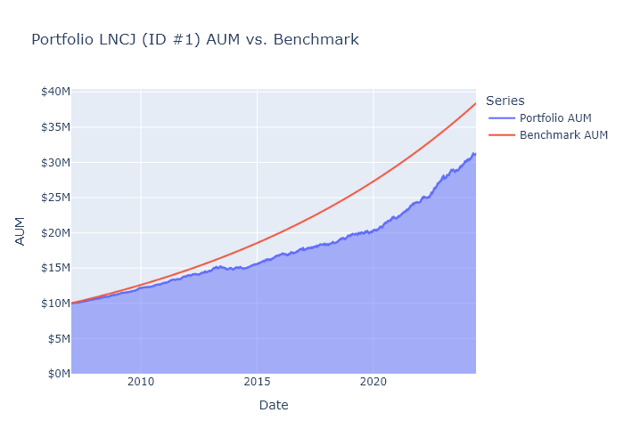

Portfolio LNCJ Performance

Slide 2
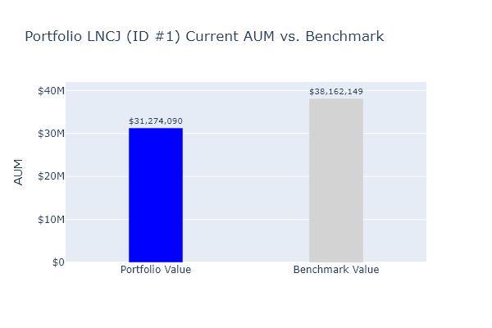
Portfolio LNCJ Performance
Benchmark return: 8.0% Annualized portfolio return: 6.77% Year established: 2007 Stocks currently held: 15 Starting capital: $10,000,000

Slide 3
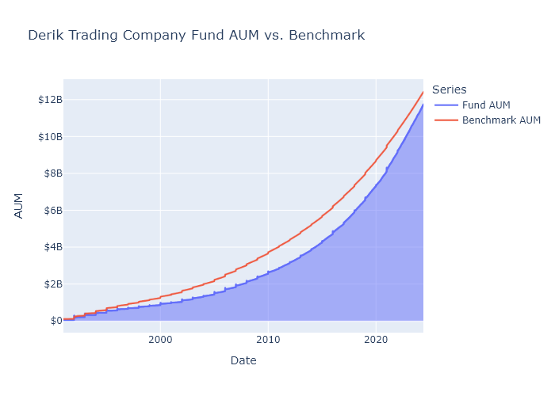
Derik Trading Company AUM vs. Benchmark

Slide 4
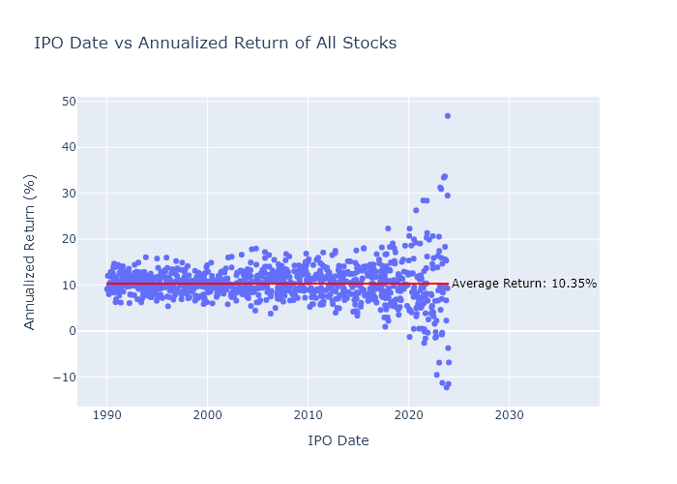
Performance of All Portfolio Stocks from IPO Dates

Slide 5
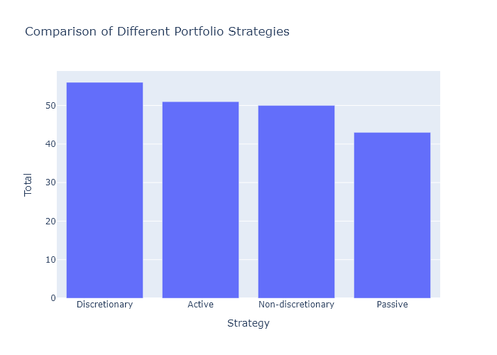
Portfolio Strategy Comparison

