Slide 1
Immersive Windows 8 Applications
Derik Whittaker
http://www.devlicio.us
@DerikWhittaker
C# MVP / ASP Insider / Pluralsight
derik@graudo.com

Slide 2
What is on tap?
What are Contracts?
How does Windows 8 allow Immersion
How do I?
Implement Integrated Search
Implement Sharing of data
Implement Receiving Shared data
Implement Integrated Settings
Agenda

Slide 3
What is on tap?
Learn what contracts are
Learn how they allow your application to stand out
Deep dive into each contract
Notes:
Ask people who has used web api
Who has used mvc
Who has used wcf
Not fair to be mean to wcf

Slide 4
What is on tap?
What are Contracts?
How does Windows 8 allow Immersion
How do I?
Implement Integrated Search
Implement Sharing of data
Implement Receiving Shared data
Implement Integrated Settings
Agenda

Slide 5
What Are Contracts
System integration points
Consistent ways to provide system functionality.
Allows uses to feel comfortable with your app even if they are new to it
Available Contracts:
Search
Share (Source and Target)
Settings
Notes:
Ask people who has used web api
Who has used mvc
Who has used wcf
Not fair to be mean to wcf

Slide 6
What is on tap?
What are Contracts?
How does Windows 8 allow Immersion
How do I?
Implement Integrated Search
Implement Sharing of data
Implement Receiving Shared data
Implement Integrated Settings
Agenda

Slide 7
How does it Allow Immersion?
By giving the appea
X
Y
z
Notes:
Ask people who has used web api
Who has used mvc
Who has used wcf
Not fair to be mean to wcf

Slide 8
What is on tap?
What are Contracts?
How does Windows 8 allow Immersion
How do I?
Implement Integrated Search
Implement Sharing of data
Implement Receiving Shared data
Implement Integrated Settings
Agenda

Slide 9
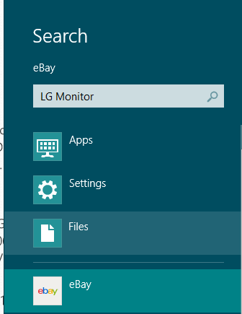

Using the Search Contract
Enables your application to become searchable via the search charm.
You can allow:
External Searches
Internal Searches
Search Suggestions
Demo Time
How Do I?

Slide 10
What is on tap?
What are Contracts?
How does Windows 8 allow Immersion
How do I?
Implement Integrated Search
Implement Sharing of data
Implement Receiving Shared data
Implement Integrated Settings
Agenda

Slide 11
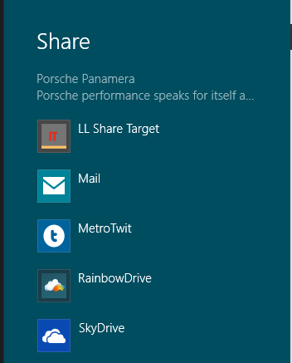

Using the Share Source Contract
Enables your application to share data with other applications.
You can share:
Text
Images
Custom Complex Types
Demo Time
How Do I?

Slide 12
What is on tap?
What are Contracts?
How does Windows 8 allow Immersion
How do I?
Implement Integrated Search
Implement Sharing of data
Implement Receiving Shared data
Implement Integrated Settings
Agenda

Slide 13
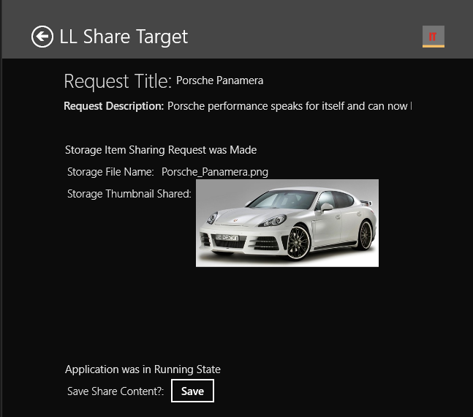
Using the Share Target Contract
Enables your application to receive and process data from other applications
You can:
Limit data to accept
Reject data
Store and use the as your own
Demo Time
How Do I?

Slide 14
What is on tap?
What are Contracts?
How does Windows 8 allow Immersion
How do I?
Implement Integrated Search
Implement Sharing of data
Implement Receiving Shared data
Implement Integrated Settings
Agenda

Slide 15
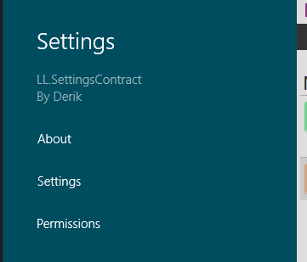

Using the Settings Contract
Enables your application to integrate and provide settings via the Settings Charm
You can:
Integrates w/ any page in your app
Have as many ‘settings’ as needed
Demo Time
How Do I?

