Slide 1
TypeScript:
The Gateway Drug
Dealer: Derik Whitaker
Notes:
Before we get started ask some questions
Who in here is a javascript developer?
if not why? Are you afraid of the tooling? Afraid of the leaning curve
if yes, my goal is to convert you to a TypeScript developer and show you why your life will get better
Has anyone used typescript in the past
Give them my back story
I understand that javascript is not OO like C# is OO but I could leverage my knowledge all the same
My goal tonight is to educate you on typescript and for you to have an understanding on the power behind the language

Slide 2
Why it’s a Gateway Drug
Notes:
The title of my talk is ‘typescript the gateway drug’ but what is a gate way drug

Slide 3
Definition:
a habit-forming drug that, while not itself addictive, may lead to the use of other addictive drugs.
Notes:
As I stated, my hope is that when you see the power of typescript you will want to use it, thus getting you addicted to not just TYpeScript but also to Javascript

Slide 4
Makes JavaScript less Scary

Slide 5
Will help you see the Scary which lies within JavaScript

Slide 6
May lead to writing ‘Pure’ JavaScript

Slide 7
What is TypeScript?
Notes:
TypeScript can be boiled down to this, it is a new language which is designed to make enterprise javascript development more scaleable
Tell the story about being in a session w/ Anders at the MVP summit
- Question was asked about how or what Microsoft was going to do to counter javascript and its growing popularity. I am pretty sure the question was asked because the person was thinking MS was going to create a NEW non-javascript language which ran in the browser
- Anders response was that javascript was a great language, but the tooling and support was lacking. And that better tooling would lead to better enterprise development w/ javascript.

Slide 8
A JavaScript SuperSet
* Compiles down to pure JavaScript
Notes:
TypeScript is a javaScript super set
** has animation **

Slide 9
All JavaScript is valid TypeScript
Notes:
This means that in theory you could simply rename your .js files to .ts files and everything will work. In practice this is not 100% true as we need add in our type definition files for 3rd party source libries

Slide 10
Not another Language like CoffeeScript || Dart
Notes:
TypeScript adds syntactical suger ontop of pure javascript
Microsoft said why should developers have to learn a NEW language when we could simply extend javascript to meet our needs

Slide 11
“What TypeScript does is, it basically formalizes a static type system that describes JavaScripts dynamic types. But it describes them at development time, not compile time”
⁻⁻ Anders Hejsberg
Notes:
What TypeScript does is, it basically formalizes a static type system that describes JavaScripts dynamic types. But it describes them at development time, not compile time. – Anders Hejlsberg

Slide 12
Ecma 4 & 6 Compliant*
* Based on current proposals
Notes:
I mentioned that TypeScript for the most part add syntactical suger to JavaScript, and this is true. What it also does is it implements many of the proposed Ecma Script 6 proposals TODAY.
We all know how long open source standards propoals can take to get ratified… can we say HTML5

Slide 13
Why use TypeScript?
Notes:
If TypeScript is simply some sugar on top of JavaScript why not just use JavaScript?

Slide 14
Simpler Syntax
** Removes some fuggly from JavaScript **
Notes:
** has animation **
I am not saying that javascript is as ugly as pearl, but I don’t feel it is near as elegant as say C#
** You might be thinking. If TypeScript is a SUPER set of JavaScript how can the syntax be any cleaner?
-- creating classes
-- creating modules
-- creating enums
-- function signatures

Slide 15
Compile time Type Checking *
* Type checking can be turned off

Slide 16
Compiles to compliant JavaScript

Slide 17
Improved Tooling inside VisualStudio

Slide 18
How to get TypeScript?

Slide 19
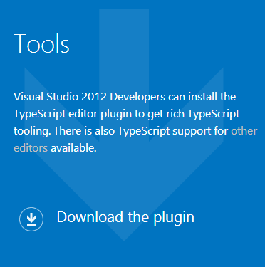
Install the Visual Studio plugin
* Available at http://typescriptlang.org

Slide 20
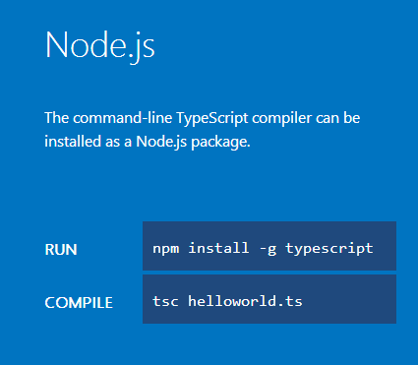
Install the Node.js compiler
* Available at http://typescriptlang.org

Slide 21
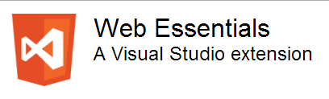
Install Web Essentials Plugin
* Available at http://vswebessentials.com

Slide 22
Target Audience
Notes:
We now know what typescript is as well as why to use it so lets dive a bit deeper to undertand who Microsoft was targeting when the set out to build TypeSript

Slide 23
Non-Traditional JavaScript Developers

Slide 24
Enterprise Scale Applications

Slide 25
Software Simplest

Slide 26
Language Features

Slide 27
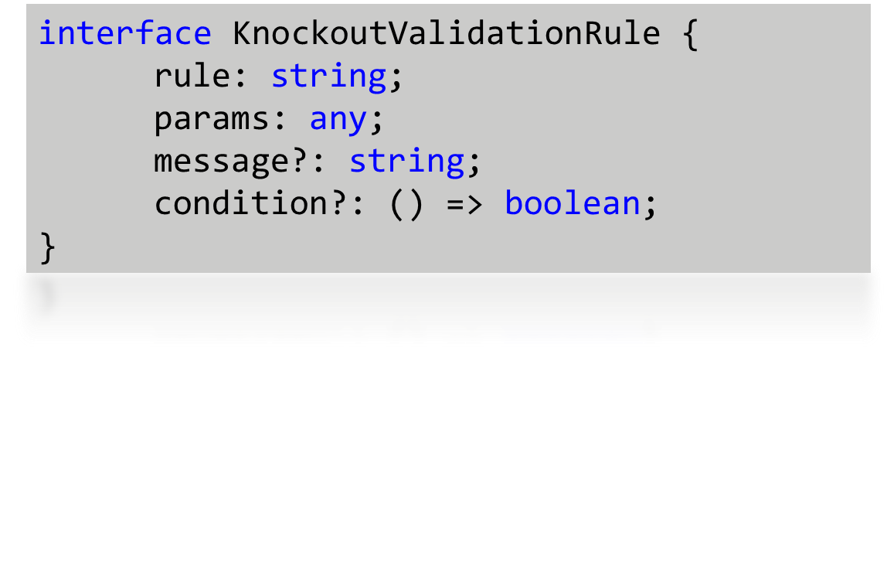
Type Definition Files
* Similar to C++ header files
Notes:
Because typescript is a typed ‘developer experience’ the compiler needs to be aware of the libraries you are using and their types

Slide 28
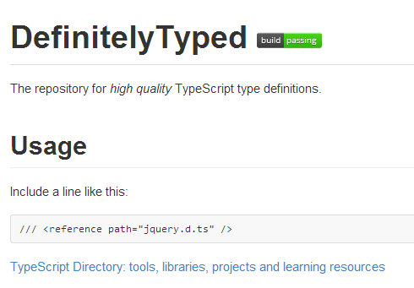
Github
Repository of Type Definitions
* Available at http://github.com/borisyankov/DefinitelyTyped

Slide 29
Source Dependencies
/// <reference path="../Models/CurrentUserModel.ts" />
/// <reference path="../Scripts/typings/References.ts" />
Notes:
This is a compile time only feature.
You still have to reference the underlying .js files and have them sent ot the client or you will get runtime exceptions

Slide 30
Type Checking
filtered = _.filter(filtered, (item: Models.UpcomingReminderModel) => {
var forcastMatch = _.any(item.ForcastTypes(), (type: number) => {
var typeMatch = type == rangeFilterKey;
return typeMatch;
});
return forcastMatch;
});
private pageSize: number = 8;
private activePage: number = 1;

Slide 31
Lambda Syntax
$.get(route)
.done((results) => {
var convertedResults = [];
});
* Also called Arrow Syntax

Slide 32
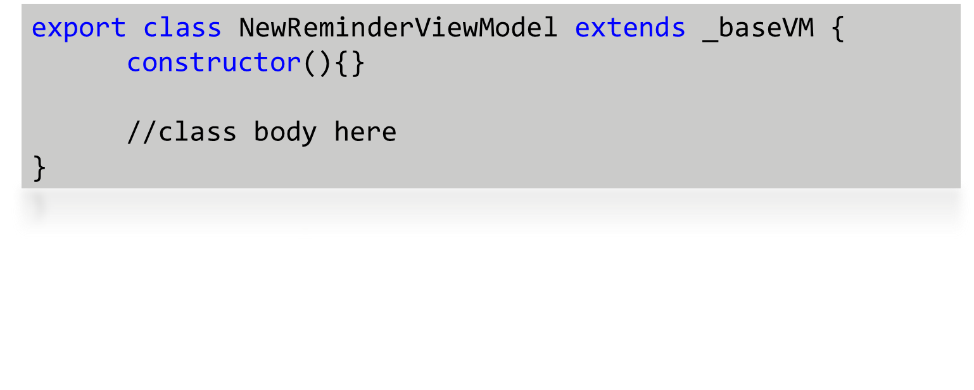
Inheritance
Notes:
Not outputted to compiled javascript → Tooling support only
Can be declared across multiple files → allows for extensions
Supports multiple interface inheritance

Slide 33
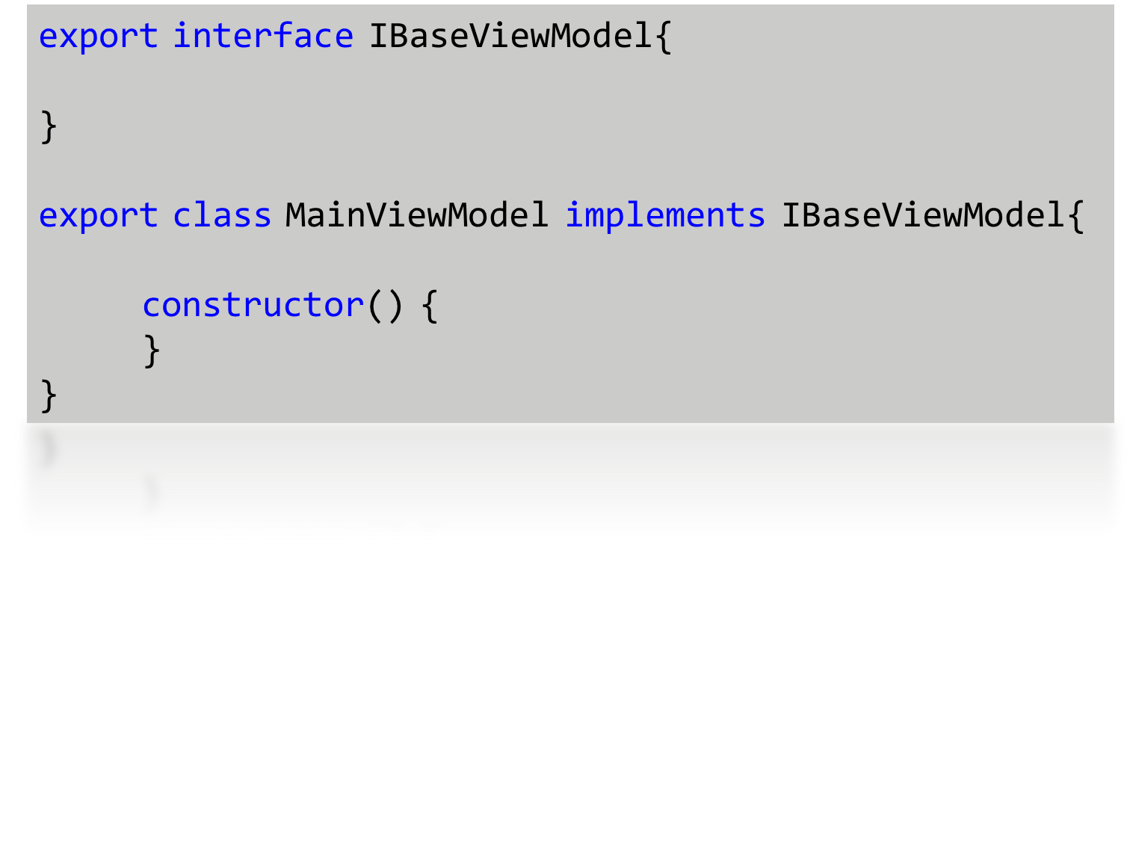
Interfaces
* Design time only constructs
Notes:
Not outputted to compiled javascript → Tooling support only
Can be declared across multiple files → allows for extensions
Supports multiple interface inheritance

Slide 34
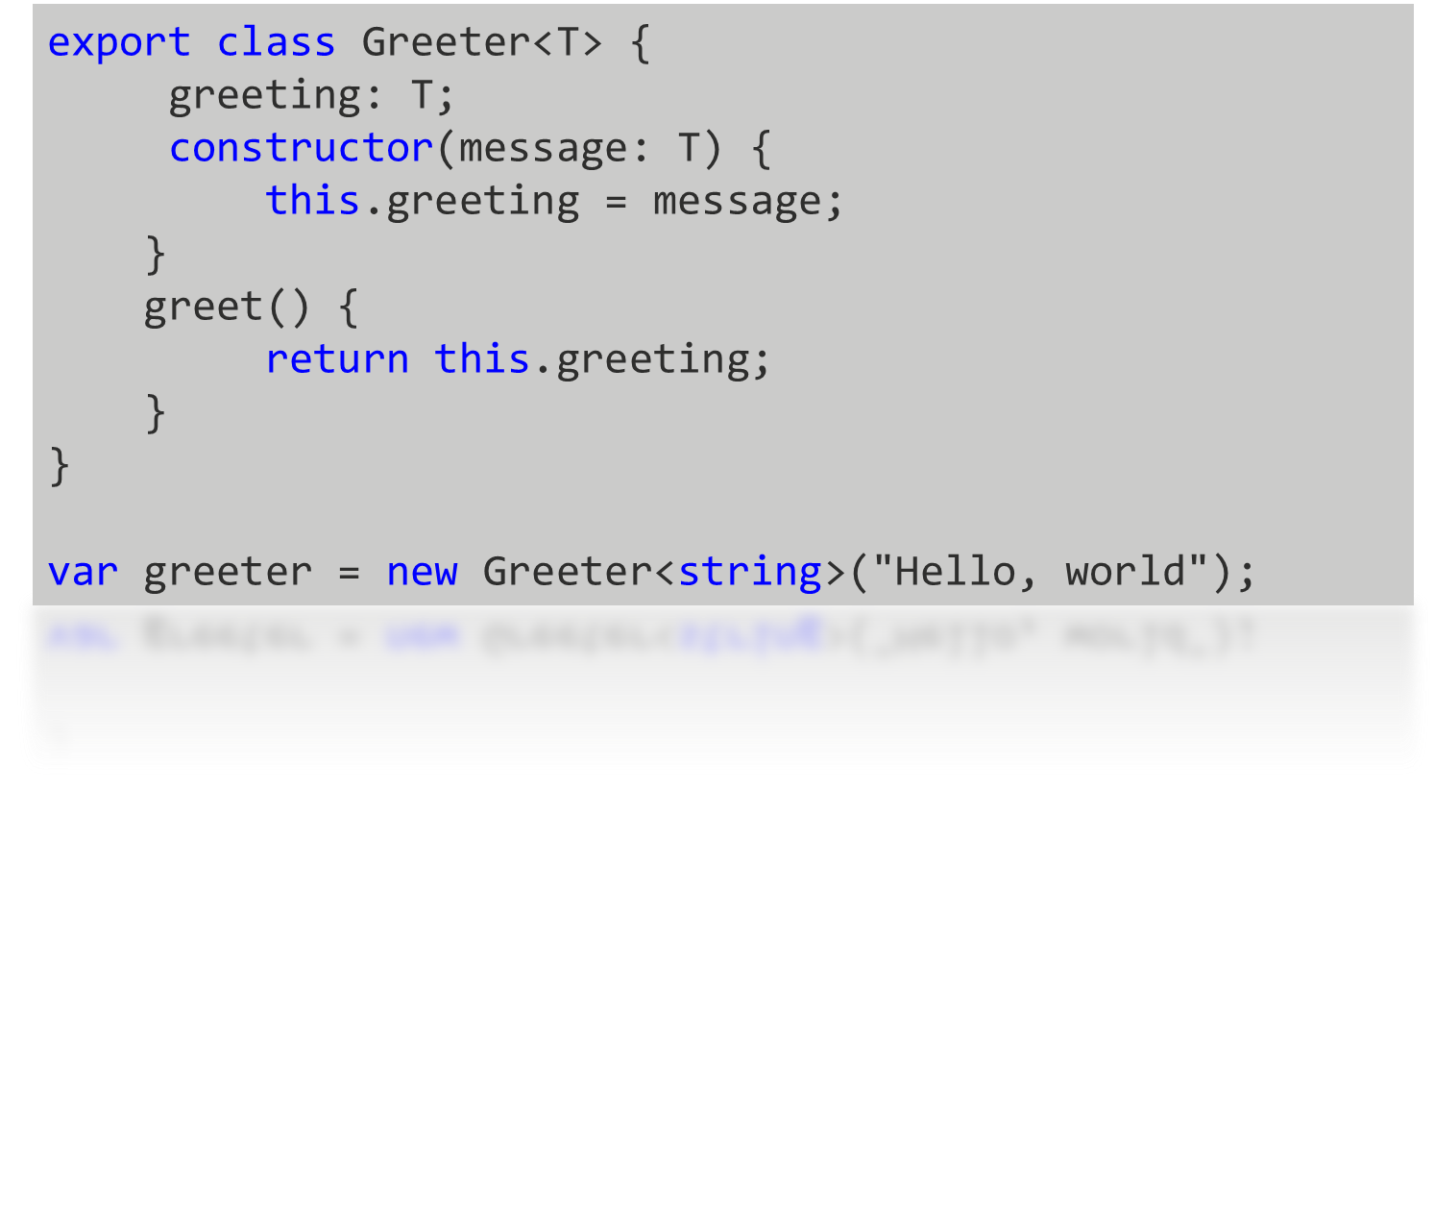
Generics
* Design time only constructs

Slide 35
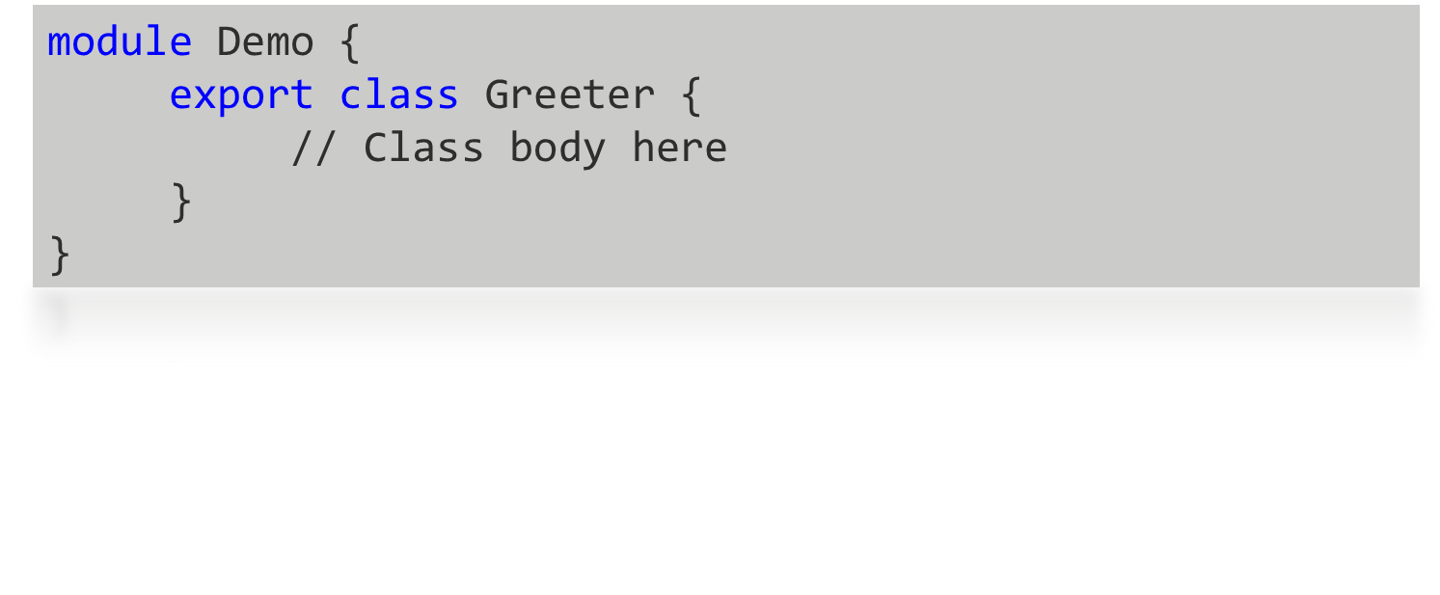
Modules and Classes
Notes:
Modules:
Analagous to namespaces in .net or java
Prevents global variabels w/ the same name from colliding
Allows easy segmentation of code
Classes
Provides simplier syntax for building objects or classes in javascript
Aligns w/ the Ecma Script 6 proposal
Allows for inheritance

Slide 36
Demo Time
Notes:
Modules:
Analagous to namespaces in .net or java
Prevents global variabels w/ the same name from colliding
Allows easy segmentation of code
Classes
Provides simplier syntax for building objects or classes in javascript
Aligns w/ the Ecma Script 6 proposal
Allows for inheritance

Slide 37
Hope you enjoyed the session!

