Slide 1
Knockout for the XAML developer
Derik Whittaker
@DerikWhittaker
Notes:
Hello and welcome to module 3 of knockout for the xaml developer, I am your host Derik Whittaker.
In the previous module our focus was on learning how to display data to the user which was critical in order to set our foundation for using knockout. However, this is only part of the story when working with input controls. The focus of this module is going to be learning how to handle user interaction within our application via knockout, which involves things like click events, focus events and general event handling.

Slide 2
Agenda
Handling Click Bindings
Basic Bindings
Bindings with Parameters
Non-Button Click Bindings
Setting Control Focus
Basic Bindings
Workflow based Bindings
Event Bindings
Subscription Bindings
Notes:
The first item we are going to learn in this module is how to work with click events in knockout. In html pretty much every UI element can handle the click event and knockout facilitates this beautifully.
We will start off by looking at how to handle basic click bindings for button controls. Once we know the basics of this we will move on to learn how we can provide parameters to our binding in order to provide context to our underlying click method. Finally we will wrap up by taking a look at how we can use knockout to handle click events to non-input elements such as the span or paragraph elements
[show animation]
The next thing we are going to learn is how to set focus to our input fields via knockout. Having the ability to set our focus via our view model will allow our applications to better guide a user through a data entry process which leads to a better user experience.
[show animation]
Finally we will wrap up this module by learning how we can use knockout to setup DOM event bindings on elements in order to dynamically change the interaction of your application.

Slide 3
END OF Overview Slides

Slide 4
Agenda
Input Click Bindings
Input Click Bindings with Parameters
Input Click Bindings with Enabled/Disabled State
Field Focus Bindings
Event Bindings
Notes:
When we talk about handling user interaction we must start with capturing their request to save any manipulated data. Typically this will be done via capturing some sort of click event. When working with HTML and knockout capturing the click event and then processing it, is simple and the syntax needed to accomplish this will be familiar to XAML developers.

Slide 5
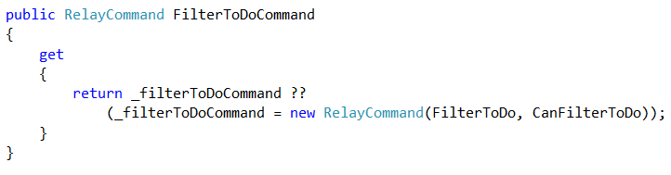

Handling Click Binding
Using XAML
Bound property implements ICommand
Relay Command
Provide methods to handle click action
Command Binding
Bind to our ICommand in the View Model
Notes:
When you need to capture the click event in XAML using MVVM you would first start off by creating a property in your view model as you see here
[show animation]
This property implements the ICommand interface which is required to enable commanding to work successfully in XAML.
[show animation]
When implementing the ICommand, which in our case is being done via the RelayCommand class, you must provide it the method to execute when the user clicks the command. When you have set this up successfully the underlying method will be executed when the user executes our command.
[show animation]
Once you have your backing field setup correct you will need to bind this to your button in xaml as you see here
[show animation]
As you can see our backing field is being bound to our Command on our button using standard binding syntax.

Slide 6



Handling Click Binding
Using Knockout
Create a normal method in your view model
Method to handle Click
Can provide parameters with no effort
Binding to Input Control
Bind via the Click Binding to our method
Notes:
When needing to capture the click even in knockout things are similar to xaml but require considerably less ceremony.
[show animation]
In fact, in our knockout view model all you need to do is create a standard method and bind this method to the HTML element and knockout will take care of the rest
[show animation]
Here is another example of our save method but this time we are going to pass it in some data. You can see there is no special syntax needed in order for this to work
[show animation]
We have setup our method in our view model and binding it to our HTML element is as simple as you see here on the screen.
[show animation]
You just need to use the standard data-bind syntax with the click binder and bind to the underlying method.

Slide 7
END OF Overview Slides

Slide 8
Agenda
Input Click Bindings
Input Click Bindings with Parameters
Input Click Bindings with Enabled/Disabled State
Field Focus Bindings
Event Bindings
Notes:
Previously we took a look at how to capture the click events using the Click Binder, but we only examined the basic scenario, which is how to bind to a method without provide any parameters to the method. This works great, but many times you are going to need to provide parameter information to your bound method in order for your use case to work correctly. The good news is that knockout makes passing parameters to a bound method simple and pain free.

Slide 9
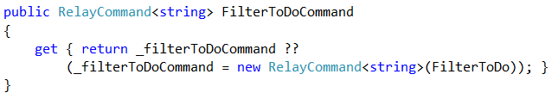


Handling Click Binding w/ Parameters
Using XAML
Relay Command
ICommand with parameter
Parameter passed into the bound method
Command Binding
Bind to our ICommand
Provide our Parameter via Binding
Notes:
In XAML setting up the ability to accept a parameter is not too different from not accepting a parameter, but it does require a bit more setup in both the view and the view model
[show animation]
The first thing we need to do is modify our Icommand implementation. The modification we make is to provided a parameter type via generics as seen here.
[show animation]
Once we have our command updated, of course we are going to need to update the signature of our bound method in order to accept our new parameter. You can see here I have accomplished this by adding a filterText parameter to our method which is a string. I now have my command setup correctly, but I need to update my xaml bindings in order for this to work as expected.
[show animation]
When working with our xaml I can leave my configuration for our command as is because I am still binding to the same method, in our case it is the FilterToDoCommand.
[show animation]
However, I still need to pass the parameter to our method and I accomplish this by using the command parameter binder and binding to the correct property which contains the value we are going pass into our method. Once I have my parameter binding setup correct the underlying ICOmmand implementation will be setup correctly and we will be able to pass a value via binding to our method in the view model.

Slide 10


Handling Click Binding w/ Parameters
Using Knockout
Method to handle Click
Method w/ Parameters
Binding to Input Control
Use Bind to attach
to our method
Setting the ‘this’ reference to our current model
Providing our parameters
Notes:
When working with knockout and needing to pass parameters to the bound click event the frist thing we need to do is update the signature of the bound method
[show animation]
You can see here I have simply added 2 parameters, team1Score and team2Score. Now that my parameters have been added, I am all set w/ the changes in our view model, but what about the changes needed in our view
[show animation]
IN our view we will need to change the setup for our click binder to be as shown here. As you can see this setup is a bit different from our previous setup and does require a bit of explanation.
[show animation]
The first thing to point out is the use of .bind. This is a javascript feature which allows us to bind methods to the function reference. Basically it is what allows us to push in values to our method
[show animation]
The next thing we need to provide is the this reference. In our case here we are going to use the $data value, which is a feature of knockout that specifies we are going to be using the current VM pointer as our reference.
[show animation]
Finally we can provide our parameters to the method. In our case we are going to be using 2 values from our view model, but if you wanted to hard code a value or use any other value this is allowed as well

Slide 11
END OF Overview Slides

Slide 12
Agenda
Input Click Bindings
Input Click Bindings with Parameters
Input Click Bindings with Enabled/Disabled State
Field Focus Bindings
Event Bindings
Notes:
The last feature of click binding we need to explore is the ability to enable or disable the bound UI element based on a condition. This feature can be easily accomplished in both XAML as well as knockout but their implementations are a bit different.

Slide 13
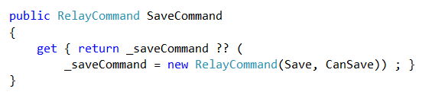
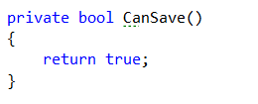

Handling Click Binding w/ State
Using XAML
Relay Command
ICommand w/ CanExecute
CanExecute method implemented
Command Binding
No changes needed to the Command
Notes:
When using XAML and binding to an input button of course we need to have our Icommand setup as seen here.
[show animation]
We have seen this setup many times already in this course, but this time I want to explicitly call out the need to provide a ‘can execute’ method to our command. This canExecute will be the magic which allows our input button to be either disabled or enabled.
[show animation]
After I have my command setup I do need to create our canExecute implementation. In our case I have a simple CanSave method which simply returns true to illustrate our point.
[show animation]
Once we have our command setup correctly we are all set as there are no changes needed to command binding in XAML

Slide 14



Handling Click Binding w/ State
Using Knockout
Enabling State
Create our Computed
Implement our Computed
Binding to Input Control
Bind to computed
Use Enable
Binder
Notes:
There are multiple ways we can handle the need to change the state of an input control in knockout. I have chosen a way which uses a computed observable to determine if the control should be enabled or disabled.
[show animation]
You can see here that I have declared a IsValid computed observable.
[show animation]
After we declare our IsValid of course we need to implement it in order for our state to change
[show animation]
After we have our underlying computed set up we need to make a smple change to our html bindings
[show animation]
The change we need to make is to add the use of the enable binder as see here
[show animation]
After we setup our enable binder we need to bind it to our IsValid computed. Now our input button will either be enabled or disabled based on the value o our computed observable.

Slide 15
END OF Overview Slides

Slide 16
Agenda
Input Click Bindings
Input Click Bindings with Parameters
Input Click Bindings with Enabled/Disabled State
Field Focus Bindings
Event Bindings
Notes:
When building applications which require some sort of data input it is very common to want to default a specific field to having focus. By being able to set the focus to a given field you are able to help guide your user down the correct pathways in your application.
Unfortunately when working with xaml applications there are many different ways to set focus to a field. These ways range from using the code behind (boo) to creating custom event handlers for xaml. None of the options, IMO, are elegant or simple. However, Knockout does have a very elegant way to accomplish this.

Slide 17
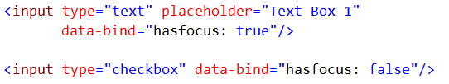

Handling Setting Focus
Using Knockout
Basic Usage
hasFocus binder
With Observables
Bound to an observable
Basic Boolean Observable
Notes:
When needing to set focus to an HTML element via knockout we are going to follow the same implementation pattern as before by using our data-bind attribute on the html element
[show animation]
However, this time we are going to use the hasFocus binder and provide it a true or false Boolean value. When the value is set to true the control will have focus and you are good to go.
[show animation]
Above we set our focus with a hard coded true or false value. Of course this works but in the real world we are going to liky want to use observables to set or value. The good news is this can be accomplished as expected by simply binding to an observable attached to our view model. Once we have our observable bound the control will either gain focus or lose focus based on our observable.

Slide 18
END OF Overview Slides

Slide 19
Agenda
Input Click Bindings
Input Click Bindings with Parameters
Input Click Bindings with Enabled/Disabled State
Field Focus Bindings
Event Bindings
Notes:
The last item we are going to explore in this module is going to be how to listen to DOM events in our application. Being able to listen to DOM events means that we can have our application react to various actions our user may be taking such as pressing or releasing the mouse button, giving a UI element focus and many many more.

Slide 20
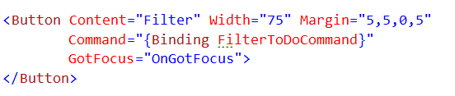
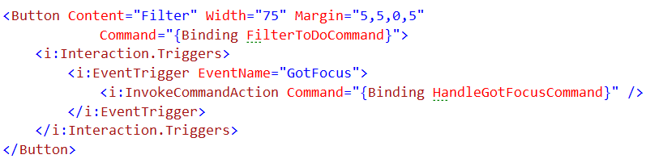
Handling Event Bindings
Using XAML
Non-MVVM way
Hook to the event on the UI Element
MVVM Way
Specify the event to bind to
Bind to an ICommand
Notes:
When working in XAML there are multiple ways we can listen to and react to events.
[show animation]
The frist way, which is a NON mvvm way, is to wire up a listener to the event and handle everything inside our code behind. This works well, but is anti-mvvm and leads to more coupled code which is harder to maintain in the long run.
[show animation]
Another way to accomplish this is to use a more MVVM approach and wire everything up via XAML to hit commands in your view model
[show animation]
You can see here we have 5 lines of XAML code which accomplishes this for us.
[show animation]
The first thing we need to do is create an even trigger and tell it which event we want to listen to. IN our example we are going to listen to the gotfocus event.
[show animation]
After we defined which event to listen to we need to specify which command to execute when the event is raised. In our case we are going to use command binding and bind to the HandleGotFocusCommand in our view model.

Slide 21
Handling Event Bindings
Using Knockout
Simple Binding
Provide any DOM event
Multiple Bindings
Can provide multiple events
Notes:
When working in HTML and knockout the ability to listen for and react to DOM events is very simple.
[show animation]
In fact if you look at the code here you can see we are using the standard data-bind attribute in conjuction with the event binder.
[show animation]
Along w/ the event binder we need to specify which event we want to listen to, in our case we are going to listen for the mouse down event. Once we setup our event next we simply need to provide the methond in our VM to respond to the event.
[show animation]
In the code above we are only listening to 1 event, but of course there are going to be times where you want to listen to multiple events and knockout supports this out of the box.
[show animation]
To listen to multiple events all you need to do is comma separate each declaration and provide the correct event name and its underlying method.

Slide 22
END OF Overview Slides

Slide 23
Summary
Learned about Input Click Bindings
Learned about Input Click Bindings with Parameters
Learned about Input Click Bindings with Enabled/Disabled State
Learned about Field Focus Bindings
Learned about Event Bindings
Notes:
This module was dedicated to working with and handling user interaction inside of your application.
We started off by taking a look at how to handle click events in knockout via the click binder and how this compared to handling click events in XAML. Our first example taught us that we could accomplish this by using the click binder and providing a method to bind to.
We then realized that there were many more options available to us when working with the click binder, such as how to pass values into our bound method. We learned that passing values into out method was easy but it did require some additional configuration inside of our binder.
We then realized that having the ability to handle the click event is nice, but we wanted to also be able to enable or disable the ui element based on some business logic, which in xaml can be easily accomplished via the CanExecute property on the Icommand interface. We learned that knockout easily supports this concept but in a slightly different manor.
The next thing we learned is how to set focus to our input fields via knockout. We learned that this can be accomplished via the hasFocus binder.
[show animation]
Finally we wrapped up this module by learning how we can use knockout to setup DOM event bindings on UI elements in order to dynamically change the interaction of your application.

