Slide 1
Knockout for the XAML developer
Derik Whittaker
@DerikWhittaker
Notes:
Hello and welcome to module 4 of knockout for the xaml developer, I am your host Derik Whittaker.
IN our previous modules we have focused on learning the basics of using knockout such as how to bind ui elements as well as how handle user interaction such as click events.
In this module we are going to focus our efforts on learning about binding contexts and control flow. We will explore how we can use build in facilities in knockout to change our context in our markup as well as how to control the way we display data to our users.
In keeping w/ the other modules, before we learn how to do anything in knockout we will review how to accomplish the same task in a xaml environment.

Slide 2
Agenda
Handling Binding Context
Changing Context via the ‘with’ binder
Working with Binding Hierarchies
Learning to use $root
Learning to use $parent
Working with Collections
Iterating over collections via the ‘foreach’ binder
Conditionally showing elements
Showing or Hiding data via the ‘if’ & ‘ifnot’ binder
Notes:
The first thing we are gong to learn about in this module is how to work with binding contexts in knockout. A binding context is a pointer to a bound object in our view model and when working with complex object graphs you will find yourself needing to understand how to change the binding context in your markup.
[show animation]
The next thing we will look at is how to traverse our binding hierarchies via the $root and $parent properties in knockout. The $root property is a easy way to change our context pointer to the root of the bound view module. The $parent property will allow us to easly change our context to point to the immediate parent context in our markup.
[show animation]
Next we will learn how to work with collections via the ‘foreach’ binder. We will learn how the foreach binder can provide an elegant way to repeat any UI lement with no effort.
[show animation]
Finally we will wrap up this module by learning how to use the if and ifnot binders. These binders can be used to conditionally show or hide UI elements based on a value in your view model.

Slide 3
END OF Overview Slides

Slide 4
Agenda
Changing Binding Context using ‘with’
Binding Hierarchy using ‘$root’ and ‘$parent’
Working with collections using ‘foreach’
Conditional Statements using ‘if’ and ‘ifnot’
Notes:
When working with models and binding engines, the complexity of your markup can largely be determined by how you setup your binding context. Both XAML and knockout will allow you to keep things simple and have a single context or break things apart and have multiple contexts. The decision and the approach you take is largely up to personal preference, the good news is that like XAML, knockout will support either a single context or setting up multiple context’s

Slide 5

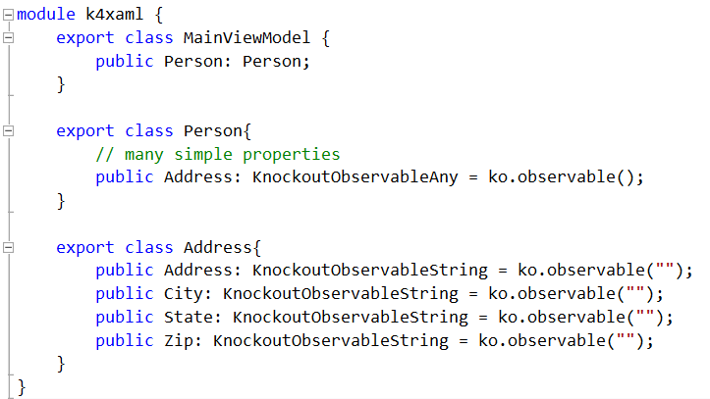
Changing Binding Context
Deep Object Hierarchy
Notes:
When working with any type of object graph it is very common for its hierarchy to get deep. Take for example the code you see here.
[show animation]
We have our main object, which is represented by the ‘this’ keyword, it has a reference to an secondary object. This secondary object is an instance of a person and it to has reference to another object which in our case is our Address object.
[show animation]
Here is our implementation code for this graph for bit more clarity
Any time we are working with a binding engine, such as the one in XAML and knockout, deep object graphs can make binding this type of code overly verbose and cumbersome. It is exactly for this reason why both frameworks have facilities which support changing object contexts inside their markup.

Slide 6
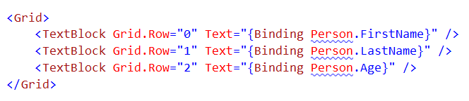
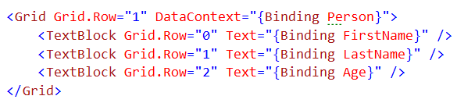
Changing Binding Context
Using XAML
Simple Binding Context
Chaining to get to deep objects
Changing Binding Context
Change the Grid’s Data Context
No Chaining of objects
Notes:
When working with deep object graphs in XAML you do have some options available to you if you which to simplify your markup.
[show animation]
For this code Assume that our view is bound to a view model at its root. In the code you see here we have a secondary object called Person which is in the root view model and we want to display various properties from person in our UI. We can accomplish this by chaining our binding calls in order to reach our nested objects.
This works well and can be useful but you can see how this would start to get ugly if you have a lot of chaining to do
[show animation]
Fortunattly for XAML developers there is an option which allows you to simplify your markup
[show animation]
As you can see here we are going to set the data context on the grid to point to the person object and we can accomplish this with standard binding syntax
[show animation]
Once we have our grid context set we now can change the rest of our properties in our child elements there is no longer need to chain off of person, which in turn simplflies our markup.

Slide 7
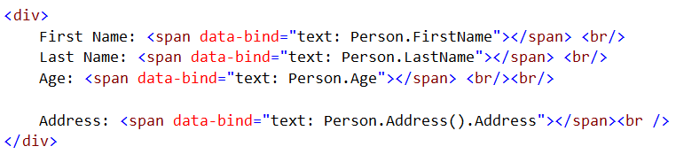
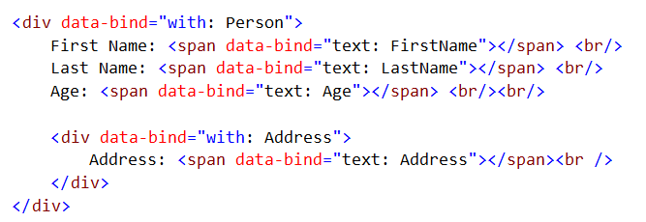
Changing Binding Context
Using Knockout
Simple Binding Context
Chaining context’s together
Changing Binding Context
Change context using the ‘with’ Binder
Remove reference to Person
Next N Deep
Notes:
When working in knockout we will run into the same issue when dealing with deep object graphs.
[show animation]
If you take a look at the code on screen you can see that I have 4 properties and each of these are attempting to bind to a property which is not part of our main context. As with xaml this is an ok solution but again this can get very verbose
[show animation]x x2
When using knockout and wanting to simplify your binding you can use the ‘with’ binder. Using the ‘with’ binder allows you to specify the new context at a given UI element and all child elements will be based off of that context
[show animation]
As you can see, when we change context using the with binder I am able to remove the reference to person in my property binding.
[sjow animation]
As expected I am able to nest the user of with as deep as I in order to simplify my bindings

Slide 8
END OF Overview Slides

Slide 9
Agenda
Changing Binding Context using ‘with’
Binding Hierarchy using ‘$root’ and ‘$parent’
Working with collections using ‘foreach’
Conditional Statements using ‘if’ and ‘ifnot’
Notes:
Previously learned how we can use the ‘with’ binder in knockout to set the data context of a given element to be something other than the root context. Now what we want to look at is the ability to change our context pointer in order to point upwards in our hierarchy to be able to find items such as the root context of the view model or our immediate parent context. Having this ability is useful in scenarios where you have used the ‘with’ to change your context.

Slide 10
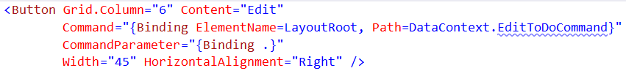
Binding Hierarchy
Using XAML
Binding to the Parent Context
Change the context to the parent
Bind to the command
Notes:
When working with deep object graphs and multiple binding levels in xaml you will often find yourself needing to bind to something that is above the current binding context
Taking a look at the xaml on the screen you should notice that my binding syntax is not the typical syntax. This is because the command on this button is being bound to something which is not part of our current context.
In order to allow this button to bind correctly I need to do 2 things
[show animation]
First thing I need to do is specify which element in our xaml contains the right binding context, in our case we are pointing to the LayoutRoot element which is the outermost element in our xaml and contains the method I wish to bind to
[show animation]
Next you will notice I am changing my binding path to point to DataContext.EditToDoCommand. This command is part of the root context and this is the needed syntax in order to make this binding work correctly.
The net effect of this non-typical syntax is to allow me to bind correctly to something which is not part of the current context but rather is on one of our parent context.

Slide 11
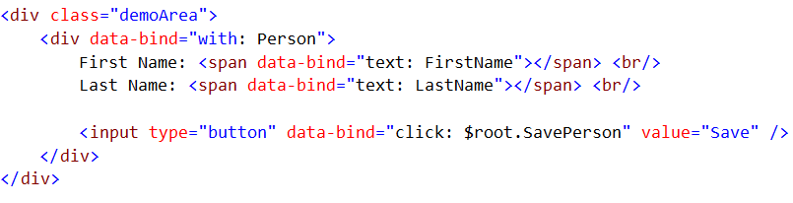
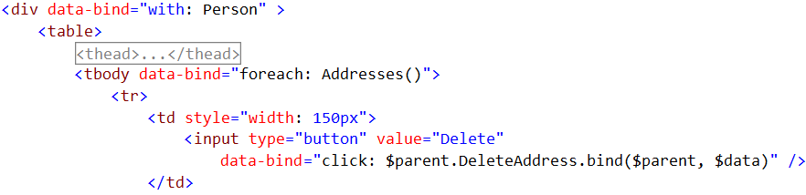
Binding Hierarchy
Using Knockout
Binding to the $root
Bound to the root context
Change context to Person
Changing binding to point to the $root context
Binding to the $parent
Bound to Person context
Change context to Address collection
Changing binding to point to the $parent context
Notes:
When working in knockout the ability to change binding context could not be simpler as it has built in facilities which allow you to reference both the root context or a parent context.
[show animation]
Looking at the HTML on the screen here our outer Div is bound to our root vm or context.
[show animation]
Our inner div changes our context to point to the Person object. This means that we currently have 2 different context levels we can work with
[show animation]
When working with our person context I want to wire up the save method, but this method is NOT attached to our current context but rather it is on the root context. In order to bind to this method correctly I need to use a special knockout property $root. This property is the way in knockout that you can change your context pointer inline to the root context in the view. Using this will allow me to change binding context with little effort.
[show animation]
Here is another example of nested contexts.
[show animation]
Our div is bound to our person context, which is a descendant of our root context.
[show animation]
Next you see we are binding to our Addresses collection which again changes our context. We now have 3 levels of context in this view.
[show animation]
For each address I want to provide the ability to delete this item, but he delete logic is NOT in the address context but rather the person one.
In order to point to the correct context in this case I canot use $root but rather I need to ue the $parent property. Unlike $root which changes the pointer to the root of the view, the $parent will change the pointer to point up ONE level in the hierarchy. By using $parent we can now correctly bind to the Delete method.

Slide 12
END OF Overview Slides

Slide 13
Agenda
Changing Binding Context using ‘with’
Binding Hierarchy using ‘$root’ and ‘$parent’
Working with collections using ‘foreach’
Conditional Statements using ‘if’ and ‘ifnot’
Notes:
When building applications it is very common for you to need iterate over a collection of data and show it to the user. Both xaml and knockout have facilities which support the ability to display collections of data to the users. In fact both of them even implement this ability in very similar fashions. However, knockout does offer a richer set of features for working with collections than xaml does and we will illustrate this shortly.

Slide 14
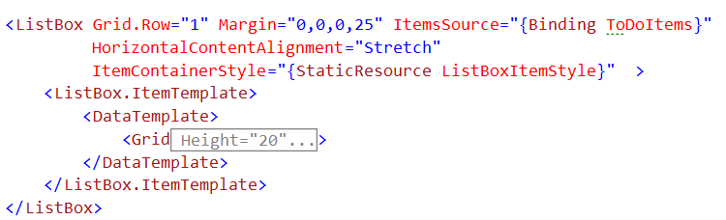
Working with Collections
Using XAML
Binding to collections
Create our observable collection
Bind to our collection
Notes:
Working with collections in xaml is very straight forward
[show animation]
The first thing we need to do is create a backing property for our collection which typically will be of type Observable collection
[show animation]
Once we have our collection created we can create our xaml. In xaml you are pretty limited to the types of controls which allow collections to be bound to them, in our example we are using a list box.
[show animation]
You can see that I am binding our collection to the ItemsSoruce property on the list box. Binding in this manor will enable the runtime engine to create a row for each item in the collection based off of our associated DataTemplate.

Slide 15
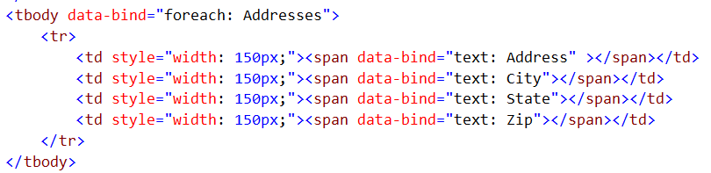
Working with collections
Using Knockout
Binding with foreach
Use the ‘foreach’ binder
Use the ‘foreach’ binder
Some Features
Can be given an alias
Allows access to
$index
$data
Notes:
Working with collections within knockout could not be easier.
[show animation]
The first thing we need to do is to create an observable array in our view model
[show animation]
Now that we have our array created we can use the ‘foreach’ binder on any UI element to iterate over the collection. This is a great enhancement over the way XAML handles collections because if you remember in XAML you can only iterate over things like grids or list boxes.
[show animation]
One thing to understand is that EVERY child ui ELEMENT below the foreach binder will be duplicated for every item in the collection.
[show animation]
When using the foreach binder there are a couple of hidden features which are great to know about
[show animation]
The first one is that I can give the collection an alias if I want, this allows me to change the way I reference the collection in my markup.
[show animation]
Another feature is the ability to access the index and data property of each item collection.
To learn more about these features please see the knockoutjs website.

Slide 16
END OF Overview Slides

Slide 17
Agenda
Changing Binding Context using ‘with’
Binding Hierarchy using ‘$root’ and ‘$parent’
Working with collections using ‘foreach’
Conditional Statements using ‘if’ and ‘ifnot’
Notes:
When building applications it is very common to need to be able to include or exclude portions of your UI based on some business logic. Both xaml and knockout have facilities to support this. However, in xaml there is no direct equivalent to the if and ifnot binders which knockout supports. This is because the if/ifnot binders will not simply mark your markup as hidden or collapsed but rather it will remove the ui elements all together from the view. The closest we have in xaml to this is the typical Boolean to visibility converter, but again this will simply hide the markup rather than remove it from the DOM.

Slide 18
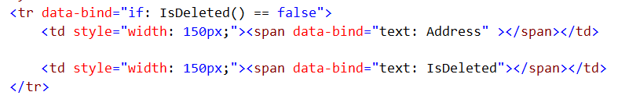
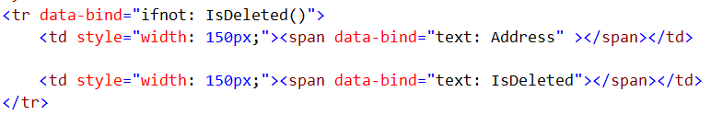

Conditional Statements
Using Knockout
Binding with if and ifnot
Use ‘if’ to evaluate expression
Use ‘ifnot’ to evaluate expression
No child HTML elements generated
Notes:
Using the if and ifnot binders in knockout follows the exact same pattern as all of our other binders.
[show animation]
We use the data-bind attribute in our ui element along with the correct binder, in our case here we are using the if binder. Along with the binder we can provide some sort of expression such as the one here which is checking to see if an observable is equal to false. If our expression passes knockout will remove all the child UI elements from the dome leaving only the tr tag.
[show animation]
Above we used the if binder to check our expression and here we are using the ifnot. Both these binders work in the same way the only difference is how you want to state yor expression.
[show animation]
If you look at this html you should notice that 2 of the tr elements have no child elemetns. You can tell this because there is no expansion icon to the left of the elements. This illustrates the way that knockout will remove all child dom elements if the if or ifnot expression proves true.

Slide 19
END OF Overview Slides

Slide 20
Summary
Learned about Binding Context
Learned about working with Binding Hierarchies
Learned about showing Collections of data via ‘foreach’ Binder
Learned about conditionally showing elements via ‘if’ & ‘ifnot’ Binder
Notes:
This module was dedicated to learning how to work with the Knockout binding context and controlling information flow
We started off by taking a look at how knockout handles the binding context. We learned that we can change our context and simplify our markup by using the ‘with’ binder
We then learned how to use the $root and $parent properties in order to reference items that are outside of our current context. We learned that the $root property will always reference the base context for our view and that the $parent property will point one level up from our current context.
We then learned how to use the foreach binder to show collections of data. We leared that the foreach binder can be used to duplicate html markeup from any UI element, not just grids and list boxes as in XAML
Finally we wrapped up this module by learning how to use the ‘if’ and ‘ifnot’ binders to conditionally show or hide elements based on data in our view model. We learned that these binders allow for you UI to adapt or change based on business work flows.

