Slide 1
Knockout for the XAML developer
Derik Whittaker
@DerikWhittaker
Notes:
Hello and welcome to module 5 of knockout for the xaml developer, I am your host Derik Whittaker.
In this module we are going to learn how to use knockout to control the appearance of our user interface. We will explore the many ways we can conditionally show or hide elements by using the visible binder. We will also learn how we can use the css and style binders to be able to dynamically change the look and feel of our application at run time.
In keeping w/ the other modules, before we learn how to do anything in knockout we will review how to accomplish the same task in a xaml environment.

Slide 2
Agenda
Conditionally showing or hiding elements
Using the Visible Binder
Changing the appearance of your elements
Learning to use css binder
Learning to use style binder
Notes:
The first thing we are going to learn about in this module is how to conditionally show or hide ui elements by using the visible binder. The visible binder in knockout works in a similar manor as the if binder with one big difference. The ‘if’ binder will actually remove all elements form the underlying DOM where the visibile binder will simply toggle the display style.
[show animation]
Next we will take a look at how we can use 2 knockout binders to dynamically change the appearance of your user interface.
These 2 binders are the css binder and the style binder. We will learn how we can use the css binder to dynamically add or remove css classes to an element based on our bound values.
After learning about the css binder we will learn about the style binder. The style binder is different from the css binder as it does not work with an entire css class but rather individual inline styles such as font-size or width.

Slide 3
END OF Overview Slides

Slide 4
Agenda
Togging Visibility using ‘visible’
Applying Styles
Using ‘css’
Using ‘style’
Notes:
When building line of business applications it is very common to need to be able to show or hide user interface elements based on different data values. When working with a xaml application this can be accomplished with a converter which binds to a value in your view model and will either show or hide the UI element based on the bound value. This approach works well but you must create a custom converter which simply increases developer over head. Fortunately for us knockout has a solution for this in the form of the visible binder.

Slide 5
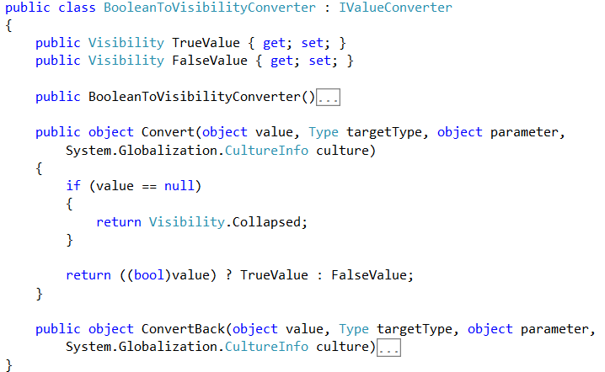
Toggling Visibility
Using XAML
Boolean to Visibility Converter
Typical Boolean to visibility converter
Notes:
As I mentioned, when working with xaml applications you typically will create a converter which implements the IValueCOnverter interface like the one shown here.
[show animation]
The converter you see here will accept a value which can be provided via a bound property. The provided value will be evaluated and the correct visibility status will be returned based on the evaluation.

Slide 6
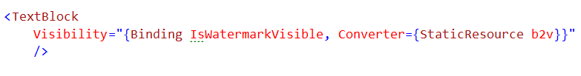
Toggling Visibility
Using XAML
Setting Visibility
Bind to your property
Use the Converter
Notes:
The xaml you see here implements our boolean2visibility converter we saw in the prior slide.
[show animation]
The first thing you would do is bind a Boolean property to the visibility attribute on UI element.
[show animation]
Next you would use the specify that our boolean2visibility converter should be used when evaluating our binding.
After the binding Is complete our UI element will either be shown or hidden based on our bound value.

Slide 7


Toggling Visibility
Using Knockout
Using the ‘visible’ binder
Visible Binder
Notes:
To accomplish the same result in knockout you would create html like you see here on screen
Knockout has a visible binding which will toggle the associated html DOM element to either be visible or hidden
[show animation]
When using visible binding, you need to provide a statement to be evaluated. In our example we are going to evaluate a text property to see if it matches a predetermined value. There is one special thing should understand about the way this evaluates and that is this does not follow strict true/false lines. This follows the javascript truthly falsly concept which basically means that if it appears true by either having a true Boolean, a true string or a non 0 value it will evaluate as true. However, if it appears false, by either being false, 0, null or undefined value it will resolve to false.

Slide 8
END OF Overview Slides

Slide 9
Agenda
Togging Visibility using‘visible’
Applying Styles
Using ‘css’
Using ‘style’
Notes:
When building applications it is pretty much a given that you are going to want to be able to change the appearance of your UI based on business rules. When working with a xaml application you can accomplish this by using style converters or binding to specific style elements.
When building an HTML and application w/ knockout you can accomplish this same goal in 2 different ways. The first is by using the css binder to swap entire css clases or you can use the style binder to change a single inline style.

Slide 10
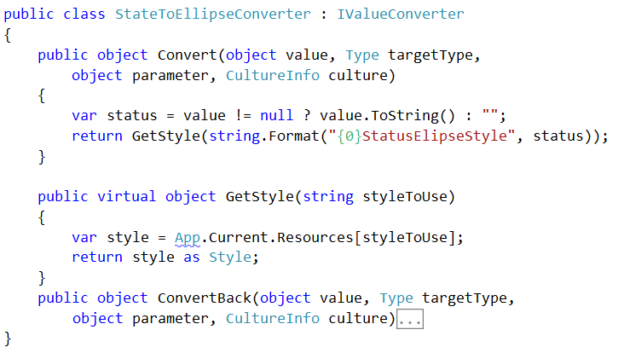
Applying Styles
Using XAML
Typical Style Converter
Style Converter
Notes:
As I mentioned, when working with xaml applications you typically will create a converter which implements the IValueCOnverter interface like the one shown here.
[show animation]
The converter you see here will accept a value which can be provided via a bound property. The provided value will be evaluated and the correct style will be returned based on the evaluation.

Slide 11

Applying Styles
Using XAML
Binding to the Style Converter
Bind to your property
Using the Converter
Notes:
The xaml you see here implements our style converter we saw in the prior slide.
[show animation]
The first thing you would do is bind a Boolean property to the style attribute on UI element.
[show animation]
Next you would use the specify that our style converter should be used when evaluating our binding.
After the binding Is complete our UI element will have the correct style applied to it based on the converter.

Slide 12
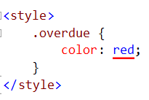
Applying Styles
Using Knockout
Using the CSS binder
Reference the style
Using multiple CSS binders
Separate by , (comma)
Notes:
When needing to swap out css classes in knockout you would want to create html like you see here on the screen.
[show animation]
In order to swap out css classes you would want to use the css binder
[show animation]
Next you will provide the name of the class to be added or removed followed by some sort of statement to evaluate. Once you have this setup your css class will be added or removed from the UI element based on the result of the evaluated expression.
[show animation]
Above I showed how to swap out one css class, but knockout will allow you to preform this action on as many classes as needed.
[show animation]
All you would need to do is comma separate your class declarations and you can chain as many together as you need.

Slide 13

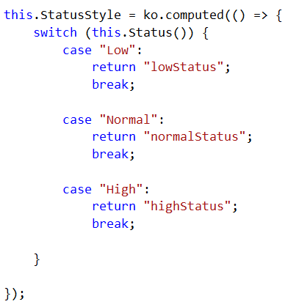
Applying Styles
Using Knockout
Using the CSS binder with expressions
Bind to method
Name of css styles
Method to determine which styles to apply
Notes:
Another way to

Slide 14
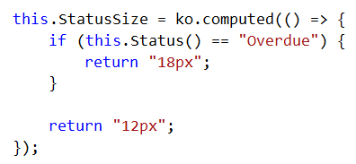
Applying Styles
Using Knockout
Using the Style binder
Setting the Display style
Using Methods to set the style
Notes:
I mentioned that when working with knockout there were 2 ways to apply styling to our UI. The first being by using the css binder and the other is by using the style binder. The style binder will allow you to set specify styles on an element.
[show animation]
To use the style binder you would use the standard data-bind syntax in conjuction w/ the ‘style’ binder.
[show animation]
You would then provide the name of the style you wish to apply along with the expression to set the value.
[show animation]
When using the style binder you can also use the results of an evaluated method to set the style.
[show animation]
You can see that I am attempting to set the fontWeight style by binding to the StatusWeight method
[show animation]
Here is the StatusWeight method and as you can see this method will return a specified font sized based on the value in the Status property. This font size will then be applied to the Font-weight style and the UI will be updated.

Slide 15
END OF Overview Slides

Slide 16
Summary
Learned about conditionally showing elements via ‘visible’ Binder
Learned about styling applications via the ‘css’ and ‘style’ Binder
Notes:
This module was dedicated to learning how to use knockout to control the appearance of our user interface.
We started off by taking a look at how to use the visible binder in knockout and comparing this to the concept of visibility converters in xaml. We learned that the visible binder was similar to the ‘if’ binder in that it can be used to show or hide UI elements. But we also learned that unlike the ‘if’ binder the visible binder does not remove the UI elements from the underlying DOM but rather it just changes their display state.
Next we wrapped up this module by learning how to dynamically change the appearance of our UI by using the ‘css’ and the ‘style’ binders. We learned that the css binder can be used to dynamically add or remove css classes from an element. We then learned that the style binder can be used to dynamically adjust inline styles for a given element.

