Slide 1

Code Automation via Grunt.js

Slide 2
Who Am I?
@DerikWhittaker
Derik@graudo.com
http://devlicio.us/blogs/derik_whittaker
Microsoft C# MVP
Asp.Net Insider
Pluralsight Author

Slide 3
What is Grunt.js
A “task-based command line build tool for JavaScript projects which makes performing repetitive, but necessary, task trivial”

Slide 4
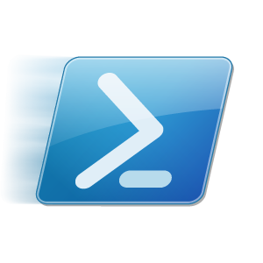



History Lesson
Before there was Grunt there was…
MSBuild
~ 2000
Make
1977
PSake
Grunt
Rake
< 2005
2008
~ 2000

Slide 5


Why So Many Tools?
Language Preferences Change
C++
Java / .Net
Ruby
JavaScript

Slide 6
Why So Many Tools?
Syntax Structure Changes
C
XML
Json

Slide 7
Why Grunt vs Alternatives?

Slide 8
Grunt Features

Slide 9
Installing Grunt

Slide 10
Install Node.js – http://nodejs.org
Install Node Package Manager – http://npmjs.org
Install Grunt Cli – npm –install –g grunt-cli
Start Rocking w/ Grunt

Slide 11
Quick Introduction
(a.k.a. key concepts to understand)

