Slide 1
Windows 8 Live Tiles
Derik Whittaker
http://www.devlicio.us
@DerikWhittaker
C# MVP / ASP Insider
Derik@Graudo.com
Notes:
This template can be used as a starter file for a photo album.

Slide 2
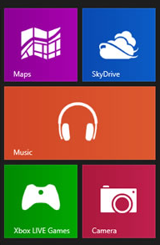
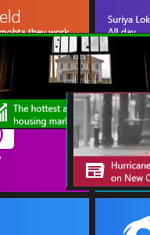
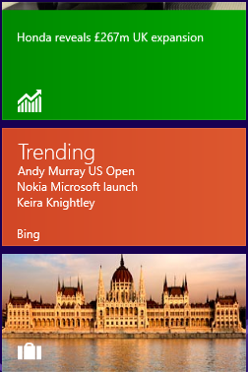
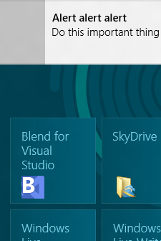
Agenda
Live Tiles
Tile Notifications
Secondary Tiles
Toast Notifications

Slide 3

What Makes Live Tiles Special?

Slide 4

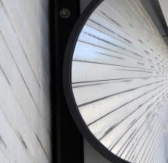




Engaging
Sexy
Difference Maker
Live
Deep Linking
Informative

Slide 5


Types of Live Tiles
Small Square Tiles (30x30px)
Logo Square Tiles (150x150px)
Wide Square Tiles (310x150px)

Slide 6

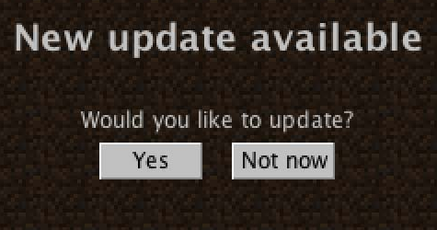
What are Secondary Tiles
Secondary Tiles are tiles which can be used to ‘deep link’ into your application.
Secondary Tiles are tiles are able to be ‘Live’, they can be updated in the same manor as primary tiles

Slide 7
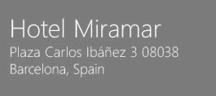

What are Scheduled Notifications
Scheduled Notifications allow for you to push content to your tile at a predetermined time
Scheduled Notifications are able to be queued to allow multiple updates over the course of time
Scheduled Notifications are able to be removed if their content is no longer important

Slide 8

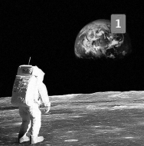
What are Toast Notifications
Toast Notifications are a way to notify the user of a long running process has completed
Scheduled Notifications are able to be scheduled for a future time
Scheduled Notifications are able to be pushed remotely from the cloud (we will not demo this today)

Slide 9

Lets Code

