Slide 1
Typescript The Gateway Drug
Derik Whittaker
@Derik Whittaker
PluralSight Author
Notes:
Gateway Drug Definition -- A habit-forming substance whose use may lead to the use or abuse of drugs that are more addictive or more dangerous.

Slide 2
First a quick History Lesson

Slide 3
There are 3 Types of Developers

Slide 4

‘Cool Kids’ aka - Innovators

Slide 5
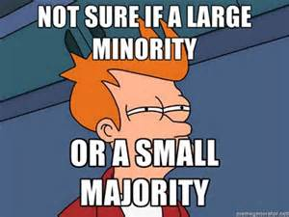
‘Normal People’ aka - Majority

Slide 6

‘Morts’ aka - Laggards

Slide 7
But I think we are missing One

Slide 8

‘Ostrich’

Slide 9
Why are people Ostrich’s?

Slide 10
Afraid of Tooling?

Slide 11
Afraid of Syntax?

Slide 12
Afraid of Getting Started?

Slide 13
Afraid of Libraries?

Slide 14
If your afraid…. GET OVER IT

Slide 15
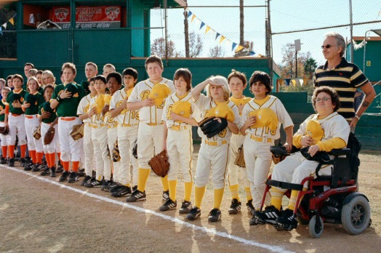
I got bad news for you

Slide 16

JavaScript Won the Language War

Slide 17
What does this Mean?

Slide 18
Must I find a new Job?
NO!

Slide 19
Must I learn JavaScript?
YES!

Slide 20
Why learn JavaScript?

Slide 21
It solved THE unsolvable

Slide 22
It can run EVERWHERE

Slide 23
But there is a Problem!

Slide 24
JavaScript is Different!

Slide 25
JavaScript is Hard!

Slide 26
JavaScript is Scary!

Slide 27
Enter TypeScript

Slide 28
TypeScript is Similar!

Slide 29
TypeScript is Simpler!

Slide 30
TypeScript is Familiar!

Slide 31
What is TypeScript?

Slide 32
It is a:
JavaScript Superset

Slide 33
It makes the Dynamic:
Static (ish)

Slide 34
It is:
Pure Awesomeness

Slide 35
Lets learn how

Slide 36
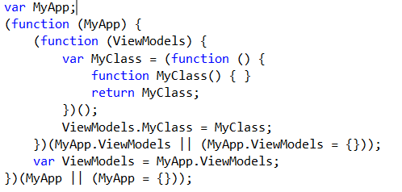
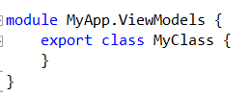
Creating Classes:
JavaScript way
TypeScript way

Slide 37
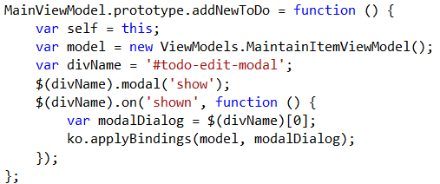
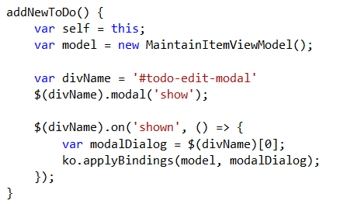

Creating Methods:
JavaScript way
TypeScript way

Slide 38
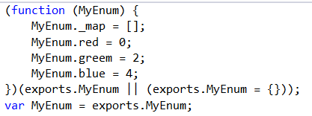
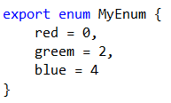
Creating Enumerations:
JavaScript way
TypeScript way

Slide 39
Time to Code

Slide 40
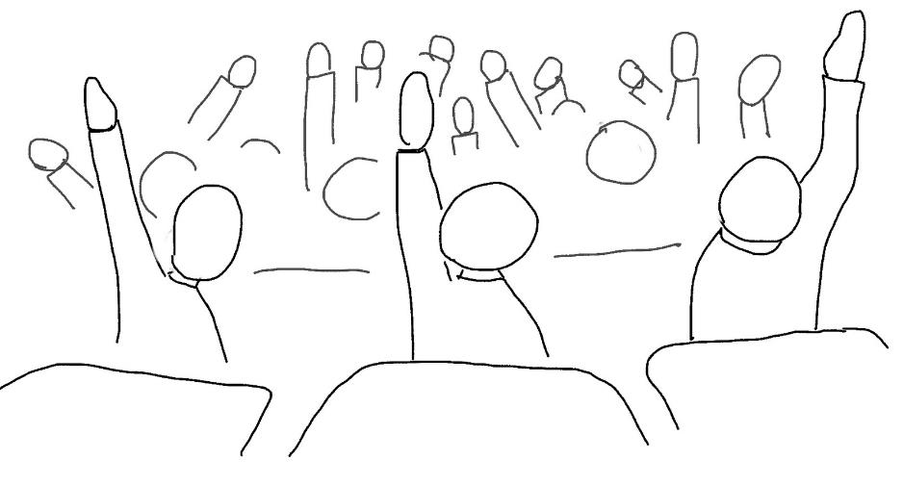
Questions

