Slide 1
Typescript,
Gateway Drug to Javascript
Derik Whittaker
http://www.devlicio.us
@DerikWhittaker
C# MVP / ASP Insider / Pluralsight
derik@graudo.com

Slide 2
Laying the Foundation
What is this Typescript thing
Agenda

Slide 3

Did you know
The Language War has been won?
Notes:
http://robertnyman.com/2008/10/09/explaining-javascript-scope-and-closures/

Slide 4
What does this mean?
Does it mean I have to find a new Job?
NO
Does it mean I should learn JavaScript?
YES
The War has been won
Notes:
http://robertnyman.com/2008/10/09/explaining-javascript-scope-and-closures/

Slide 5
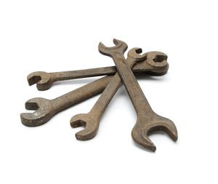


Why Did it Win?
Better Tooling?
Mega-Corp Backing?
Easy to Master?
The War has been won
Notes:
http://robertnyman.com/2008/10/09/explaining-javascript-scope-and-closures/

Slide 6




Then Why?
It solved THE problem?
Write Once, Run anywhere
The War has been won
Notes:
http://robertnyman.com/2008/10/09/explaining-javascript-scope-and-closures/

Slide 7
Who are the losers?
C++
Java
.Net
Silverlight (Kinda)
Flash (Kinda)
The War has been won
Notes:
http://robertnyman.com/2008/10/09/explaining-javascript-scope-and-closures/

Slide 8

So given this……
Language Primer
Notes:
http://robertnyman.com/2008/10/09/explaining-javascript-scope-and-closures/

Slide 9

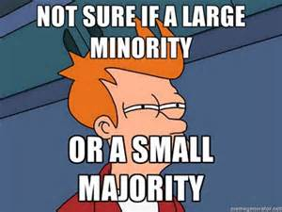

Types of Adopters
Innovators
Majority
Laggards
Notes:
http://robertnyman.com/2008/10/09/explaining-javascript-scope-and-closures/

Slide 10

Additional Type of Adopter
Ostrich
Notes:
http://robertnyman.com/2008/10/09/explaining-javascript-scope-and-closures/

Slide 11
Why are people afraid?
Tooling
Fuggly Syntax
Implementation Patterns
Libraries
Not sure where to start
The Ostrich Adopter
Notes:
http://robertnyman.com/2008/10/09/explaining-javascript-scope-and-closures/

Slide 12
Language Primer

Slide 13
Scope
Language Primer
Notes:
http://robertnyman.com/2008/10/09/explaining-javascript-scope-and-closures/

Slide 14
Closure
Language Primer
Notes:
http://robertnyman.com/2008/10/09/explaining-javascript-scope-and-closures/

Slide 15
Language Typing
Language Primer
Notes:
http://robertnyman.com/2008/10/09/explaining-javascript-scope-and-closures/

Slide 16
Implementation Patterns
Language Primer
Notes:
http://robertnyman.com/2008/10/09/explaining-javascript-scope-and-closures/

Slide 18
So what exactly is TypeScript?
A JavaScript Superset
Is NOT another language like CoffeeScript/Dart
All JavaScript is TypeScript
Implements proposed ECMAScript 6 features
Current targets ECMAScript 3 by default
Attempts to add Static typing to Javascript
The What
Notes:
http://robertnyman.com/2008/10/09/explaining-javascript-scope-and-closures/

Slide 19
Why not just use JavaScript
Attempts to add Static typing to JavaScript
Cleaner, more meaningful syntax
Removes much of the fuggly
Improved Tooling
Why use it
Notes:
http://robertnyman.com/2008/10/09/explaining-javascript-scope-and-closures/

Slide 20
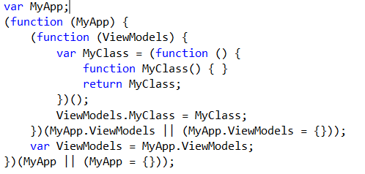
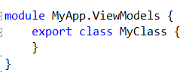
Creating Classes/Namespaces
JavaScript Way:
Syntax Examples
TypeScript Way:
Notes:
http://robertnyman.com/2008/10/09/explaining-javascript-scope-and-closures/

Slide 21
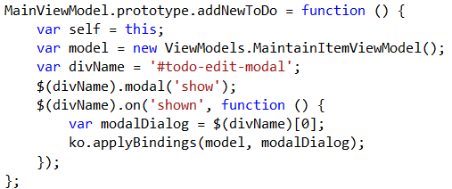
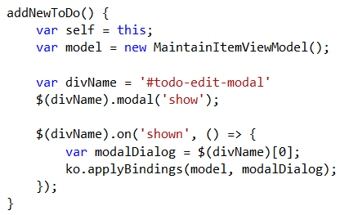

Creating a Methods
JavaScript Way:
Syntax Examples
TypeScript Way:
Notes:
http://robertnyman.com/2008/10/09/explaining-javascript-scope-and-closures/

Slide 22
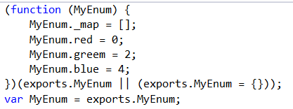
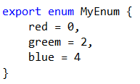
Creating a Enumerations
JavaScript Way:
Syntax Examples
TypeScript Way:
Notes:
http://robertnyman.com/2008/10/09/explaining-javascript-scope-and-closures/

Slide 25
Typing
JavaScript == Dynamic Typed
C#/VB == Static Typed
What is a Static Typed Language
What is a Dynamically Typed Language
Understanding the Basics
Notes:
http://robertnyman.com/2008/10/09/explaining-javascript-scope-and-closures/

Slide 26
What does Dynamic mean?
Not Precompiled (typically)
Ability to extend object definitions
Add Methods
Add Properties
Change Meaning of existing items
Can be difficult to track down bugs
Understanding the Basics
Notes:
http://robertnyman.com/2008/10/09/explaining-javascript-scope-and-closures/

Slide 27
Scope
Global
Items are accessible from anyplace in your code
Kinda like static’s in C#
Local
Accessible only within their closures
Kinda like class scope in C#
Wait, not public vs private?
Understanding the Basics
Notes:
http://robertnyman.com/2008/10/09/explaining-javascript-scope-and-closures/

Slide 28
Closure
Global vs Local
Wait, not public vs private?
Understanding the Basics
Notes:
http://robertnyman.com/2008/10/09/explaining-javascript-scope-and-closures/

Slide 29
Implementation Patterns
Prototype vs Module
Understanding the Basics

Slide 30
What is Typescript
JavaScript Superset Language
Attempts to add order to chaos
Adds Static typing to a dynamic language...
Typescript What?
Notes:
http://robertnyman.com/2008/10/09/explaining-javascript-scope-and-closures/

Slide 31
What is Typescript
JavaScript Superset Language
Attempts to add order to chaos
Typescript What?
Notes:
http://robertnyman.com/2008/10/09/explaining-javascript-scope-and-closures/

Slide 32
Get up and running w/ Typescript
Blah blah blah
How Do I?

Slide 33
Blah blah blah
How Do I?

