Slide 1
Typescript The Gateway Drug
Derik Whittaker
@Derik Whittaker

Slide 2
First a quick History Lesson

Slide 3
There are 3 Types of Developers

Slide 4

‘Cool Kids’ aka - Innovators

Slide 5
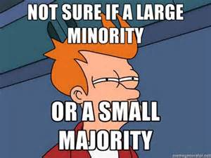
‘Normal People’ aka - Majority

Slide 6

‘Morts’ aka - Laggards

Slide 7
But I think we are missing One

Slide 8

‘Ostrich’

Slide 9
Why are people Ostrich’s?

Slide 10
Afraid of Tooling?

Slide 11
Afraid of Syntax?

Slide 12
Afraid of Getting Started?

Slide 13
Afraid of Libraries?

Slide 14
If your afraid…. GET OVER IT

Slide 15
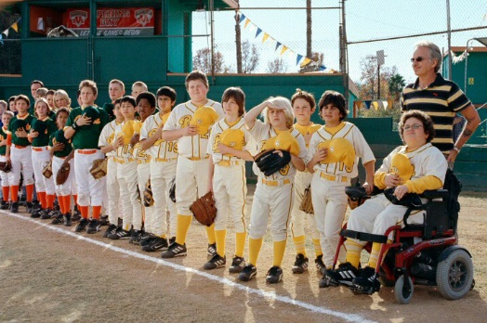
I got bad news for you

Slide 16

JavaScript Won the Language War

Slide 17
What does this Mean?

