Slide 1
Typescript,
Gateway Drug to Javascript
Derik Whittaker
http://www.devlicio.us
@DerikWhittaker
C# MVP / ASP Insider / Pluralsight
derik@graudo.com

Slide 2
Laying the Foundation
What is this Typescript thing
Agenda

Slide 3

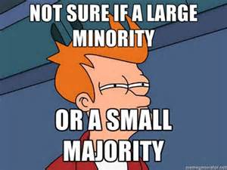

Types of Adopters
Innovators
Majority
Laggards
Notes:
http://robertnyman.com/2008/10/09/explaining-javascript-scope-and-closures/

Slide 4

Additional Type of Adopter
Ostrich
Adopters
Notes:
http://robertnyman.com/2008/10/09/explaining-javascript-scope-and-closures/

Slide 5
Why are people afraid?
Tooling
Fuggly Syntax
Implementation Patterns
Libraries
Not sure where to start
The Ostrich Adopter
Notes:
http://robertnyman.com/2008/10/09/explaining-javascript-scope-and-closures/

Slide 6

Did you know
Notes:
http://robertnyman.com/2008/10/09/explaining-javascript-scope-and-closures/

Slide 7
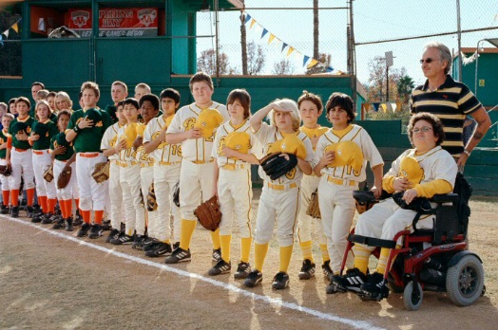
Bad News!
Notes:
http://robertnyman.com/2008/10/09/explaining-javascript-scope-and-closures/

Slide 8

Did you know
The War has been won?
Notes:
http://robertnyman.com/2008/10/09/explaining-javascript-scope-and-closures/

Slide 9
What does this mean?
Does it mean I have to find a new Job?
NO
Does it mean I should learn JavaScript?
YES
The War has been won
Notes:
http://robertnyman.com/2008/10/09/explaining-javascript-scope-and-closures/

Slide 10
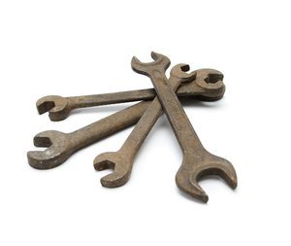
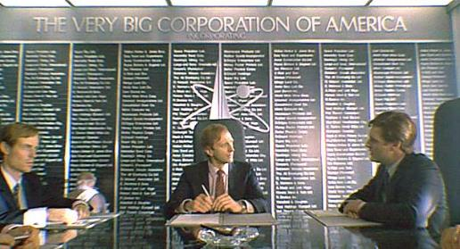
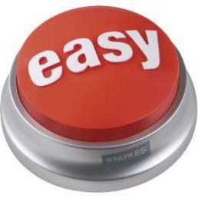
Why Did it Win?
Better Tooling?
Mega-Corp Backing?
Easy to Master?
The War has been won
Notes:
http://robertnyman.com/2008/10/09/explaining-javascript-scope-and-closures/

Slide 11




Then Why?
It solved THE problem?
Write Once, Run anywhere
The War has been won
Notes:
http://robertnyman.com/2008/10/09/explaining-javascript-scope-and-closures/

Slide 12
Who are the losers?
C++
Java
.Net
Silverlight (Kinda)
Flash (Kinda)
The War has been won
Notes:
http://robertnyman.com/2008/10/09/explaining-javascript-scope-and-closures/

Slide 13
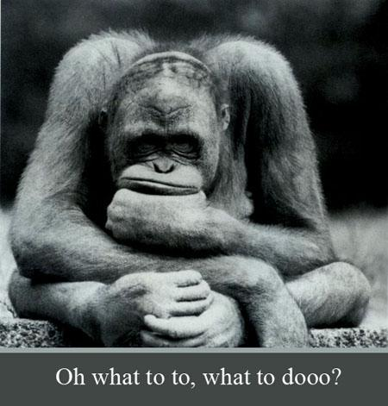
So given this……
The War has been won
Notes:
http://robertnyman.com/2008/10/09/explaining-javascript-scope-and-closures/

Slide 14
Wake up
&
Learn Something New
Notes:
http://robertnyman.com/2008/10/09/explaining-javascript-scope-and-closures/

Slide 15

Notes:
So on that note…. Lets take a look at some things we need to know about javascript

Slide 16

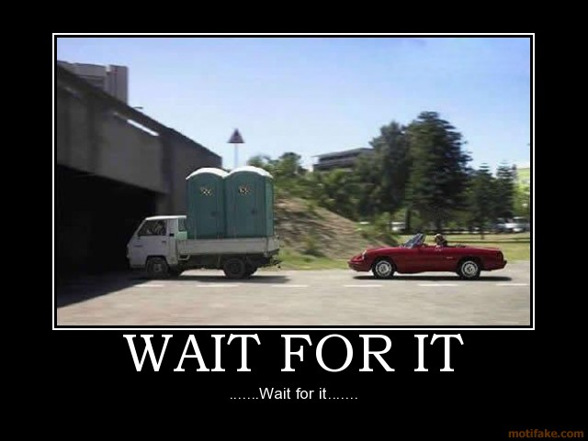
Notes:
http://robertnyman.com/2008/10/09/explaining-javascript-scope-and-closures/

Slide 17

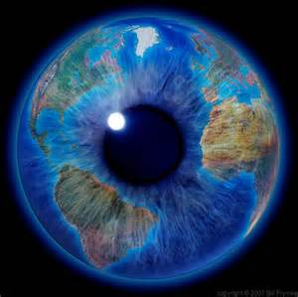
Scope
Global
Local
Demo Time
Language Primer
Notes:
http://robertnyman.com/2008/10/09/explaining-javascript-scope-and-closures/
http://javascriptplayground.com/blog/2012/04/javascript-variable-scope-this

Slide 18
Scope
Demo Time
Language Primer
Notes:
http://robertnyman.com/2008/10/09/explaining-javascript-scope-and-closures/
http://javascriptplayground.com/blog/2012/04/javascript-variable-scope-this

Slide 19
Closure
Expressions which hide variables/functions
When local variables are kept alive after a function is returned.
Allow you to control scope
Demo Time
Language Primer

Slide 20
Closure
Demo Time
Language Primer
Notes:
http://robertnyman.com/2008/10/09/explaining-javascript-scope-and-closures/
http://javascriptplayground.com/blog/2012/04/javascript-variable-scope-this

Slide 21
Language Typing
Is Dynamic
‘the meaning’ of items can change
Can make debugging harder than static languages
Demo Time
Language Primer
Notes:
http://robertnyman.com/2008/10/09/explaining-javascript-scope-and-closures/

Slide 22
Language Typing
Demo Time
Language Primer
Notes:
http://robertnyman.com/2008/10/09/explaining-javascript-scope-and-closures/
http://javascriptplayground.com/blog/2012/04/javascript-variable-scope-this

Slide 23
Implementation Patterns
Prototype
Leverages JavaScript’s built in features
Loads functions into memory one time, perf gain
Allows overriding functions
Module
Removes variables/functions from global scope
Only exposed public members.
Loads functions into memory for each instance of an object
Demo Time
Language Primer
Notes:
http://robertnyman.com/2008/10/09/explaining-javascript-scope-and-closures/

Slide 24
Implementation Patterns
Demo Time
Language Primer
Notes:
http://robertnyman.com/2008/10/09/explaining-javascript-scope-and-closures/
http://javascriptplayground.com/blog/2012/04/javascript-variable-scope-this

Slide 25

Notes:
So on that note…. Lets take a look at some things we need to know about javascript

Slide 26
So what exactly is TypeScript?
A JavaScript Superset
Is NOT another language like CoffeeScript/Dart
All JavaScript is TypeScript
Implements proposed ECMAScript 6 features
Current targets ECMAScript 3 by default
Attempts to add Static typing to Javascript
Pure Awesomeness
The What
Notes:
http://robertnyman.com/2008/10/09/explaining-javascript-scope-and-closures/

Slide 27
Why not just use JavaScript
Cleaner, more meaningful syntax
Removes much of the fuggly
Removes much of ceremony of JavaScript
Improved Tooling
‘Compile time checking’
Feels more natural to OO developers
Why use it
Notes:
http://robertnyman.com/2008/10/09/explaining-javascript-scope-and-closures/

Slide 28

Before we get started
Notes:
http://robertnyman.com/2008/10/09/explaining-javascript-scope-and-closures/

Slide 29
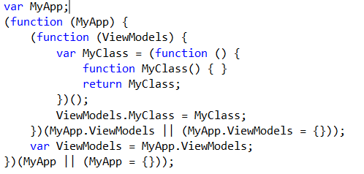
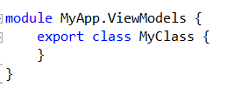
Creating Classes/Namespaces
JavaScript Way:
Syntax Examples
TypeScript Way:
Notes:
http://robertnyman.com/2008/10/09/explaining-javascript-scope-and-closures/

Slide 30
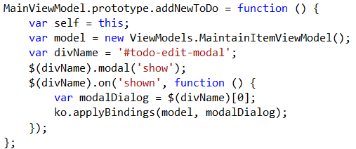
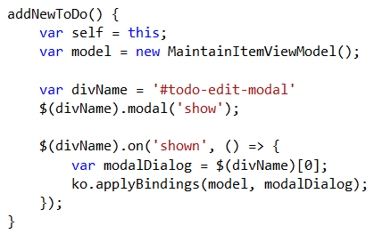

Creating a Methods
JavaScript Way:
Syntax Examples
TypeScript Way:
Notes:
http://robertnyman.com/2008/10/09/explaining-javascript-scope-and-closures/

Slide 31
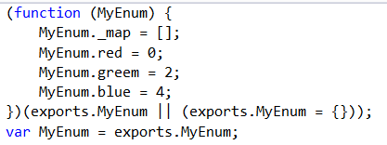
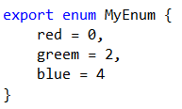
Creating a Enumerations
JavaScript Way:
Syntax Examples
TypeScript Way:
Notes:
http://robertnyman.com/2008/10/09/explaining-javascript-scope-and-closures/

Slide 32

Typescript Demo Time
Get our Learn On!

Slide 33
Typescript Demo Time
We are going to:
Review how to install Typescript
How to use

Slide 34
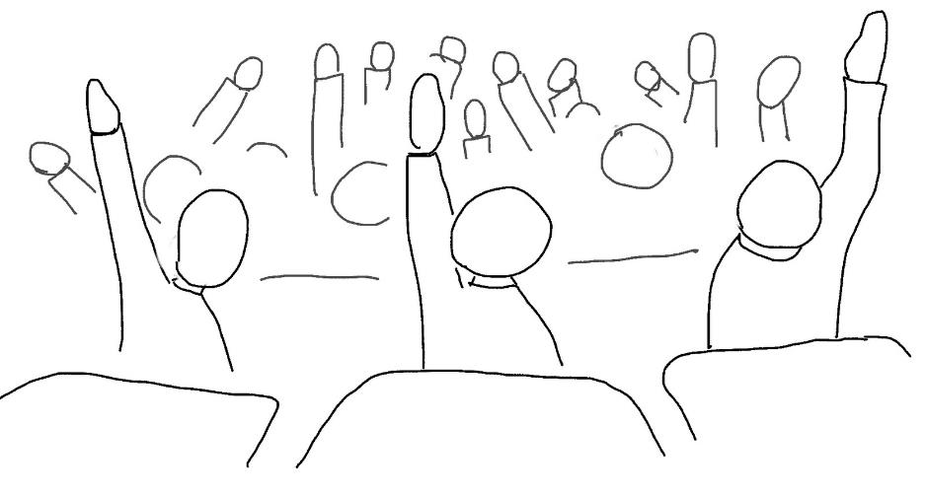
Question
Notes:
Ask the user if they have learned javascript

